Slide 1
FFE+CDR

Slide 2
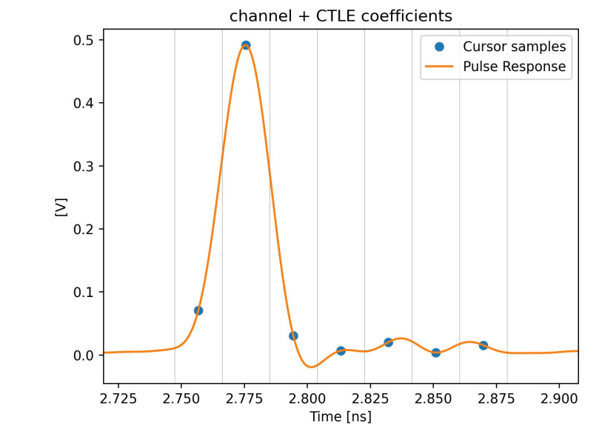
Impulse Response

Slide 3
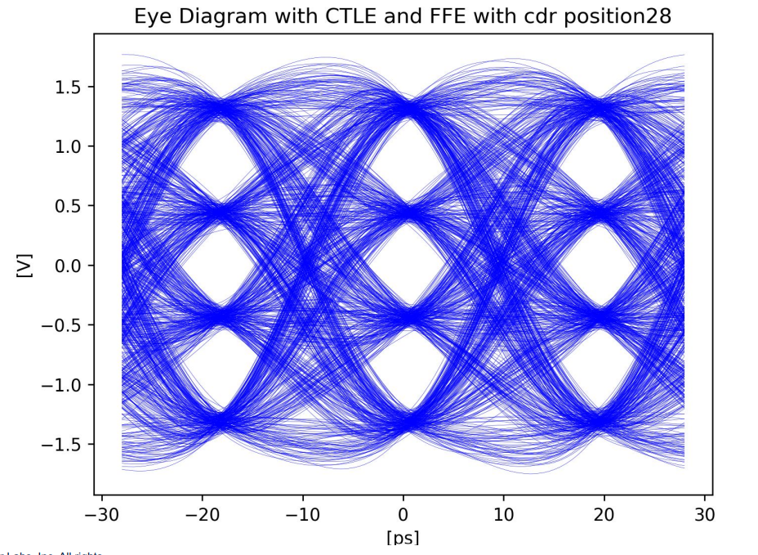
CTLE FFE+CDR

Slide 4
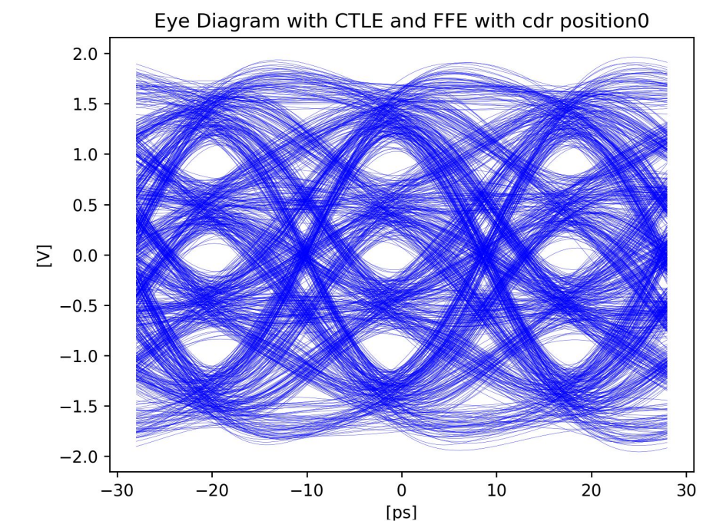
CTLE FFE+CDR

Slide 5
e[n]
dLev
X[n+1]
d[n]
C-1
Z⁻¹
Z⁻¹
X[n]
C0
H1
Z⁻¹
X[n-1]
C1
C₋₁[n+1]=C₋₁[n]-u*e[n]*x[n+1]
C₀[n+1]=C₀[n]-u*e[n]*x[n]
Same as dLev?
Z⁻¹
C₁[n+1]=C₁[n]-u*e[n]*x[n-1]
X[n-2]
C2
C₂[n+1]=C₂[n]-u*e[n]*x[n-2]
H₁[n+1]=H₁[n]+u*e[n]*d[n-1]

