Slide 1
Parkinson’s Disease Prediction with Supervised Machine learning
Omer Kurban
Osama Ben Ismaeil

Slide 2
Project Tasks
Inspecting Parkinson’s Disease Telemonitoring System
Exploratory Data Analysis (EDA)
Univariate Analysis
Multivariate Analysis
Handling with the missing values
Preprocessing the data
Splitting the dataset into train and test sets
Fitting model to the train set
Making predictions and evaluating performance
Finding the best performing model

Slide 3
Parkinson’s Disease Telemonitoring System
Parkinson’s disease is the second most common neurodegenerative disorder after Alzheimer’s
Estimated that more than one million people in North America alone are affected,
A further estimated 20% of people with Parkinson’s are never diagnosed ,
Parkinson’s disease increases steeply after age fifty,
Medication and surgical intervention can hold back the progression of the disease,
So, early diagnosis is critical in order to improve the patient’s quality of life and to prolong it .

Slide 4
Tracking Parkinson's disease symptom progression often uses the Unified Parkinson’s Disease Rating Scale, which requires the patient's presence in clinic, and time-consuming physical examinations by trained medical staff.
Symptom monitoring is costly and logistically inconvenient for patient and clinical staff alike, also hindering recruitment for future large-scale clinical trials.

Slide 5
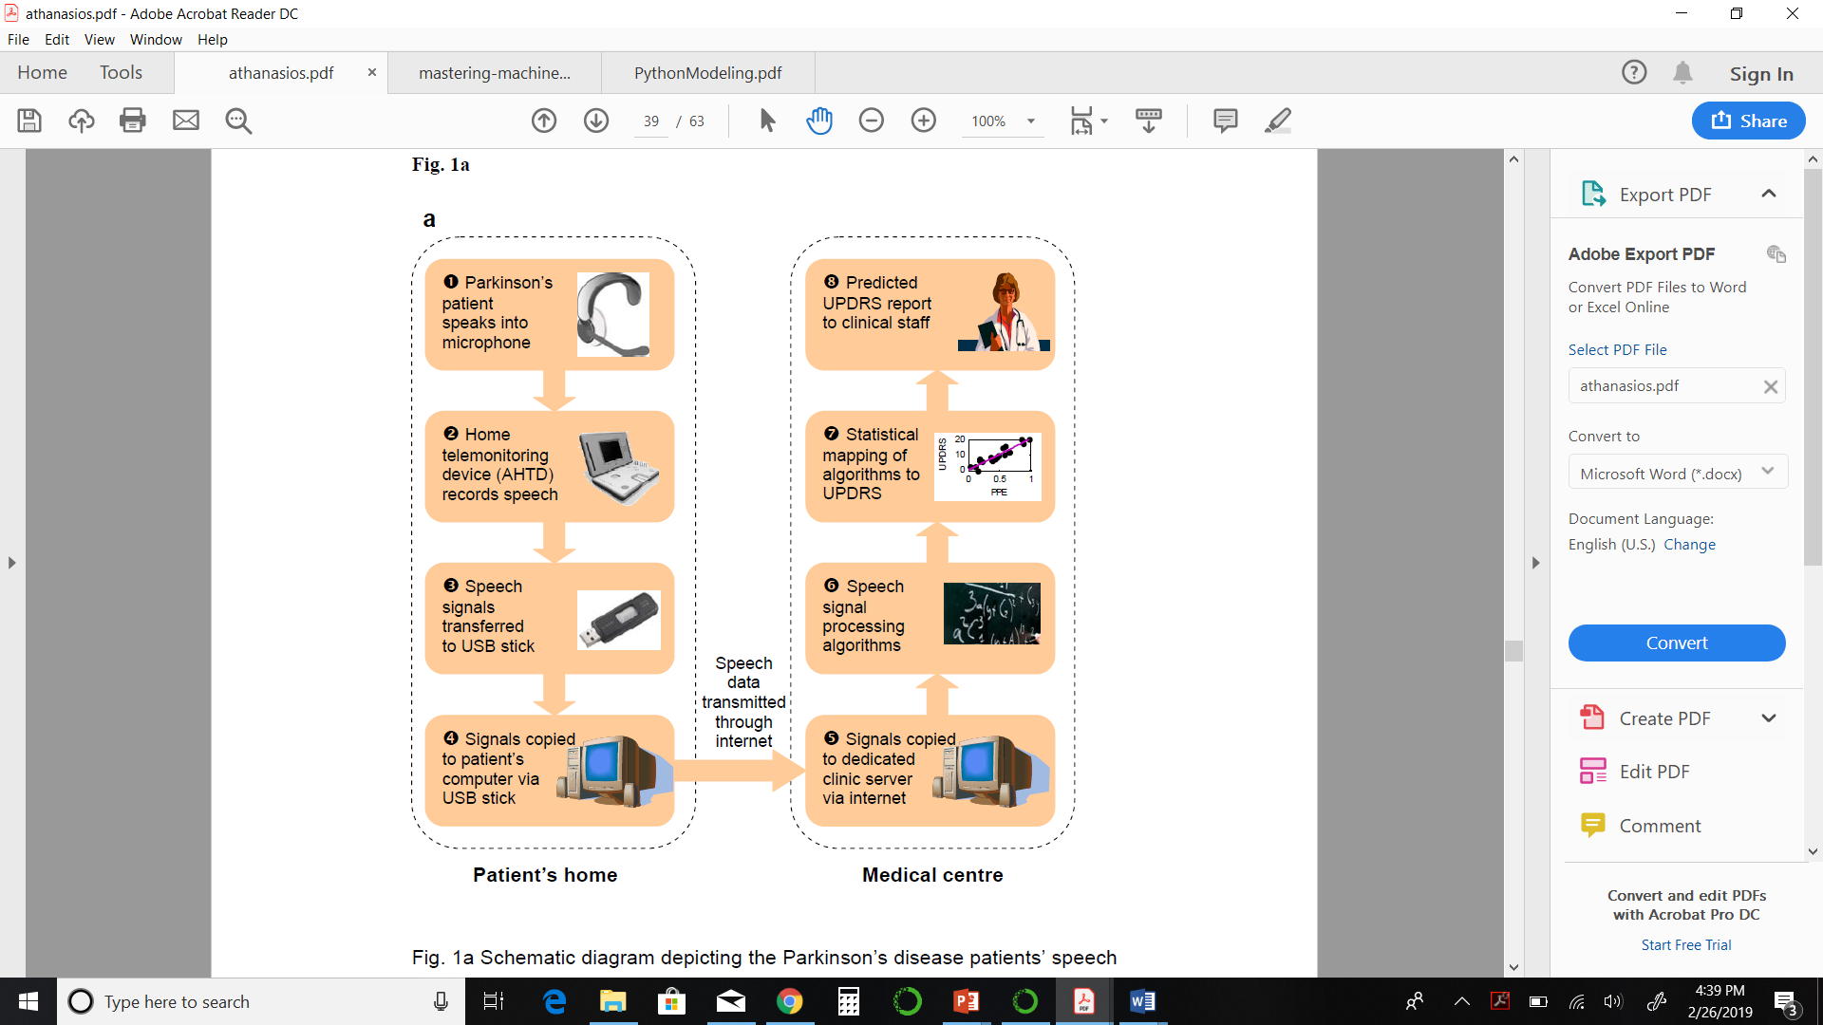
Patients’ speech signal recorded on the telemonitoring At-Home-Testing-Device,
Transmitted to a dedicated server at the clinic through the internet,
Calculation of the speech signal processing measures,
Regression method that predicts the symptom score on the Unified Parkinson's Disease Rating Scale.

Slide 6
Exploratory Data Analysis
The dataset is composed of a range of biomedical voice measurements from 42 people with early-stage Parkinson's disease recruited to a six-month trial ,captured in the patient's homes.
Subject number, subject age, subject gender, time interval from baseline recruitment date, motor UPDRS, total UPDRS, and 16 biomedical voice measures.
Each row corresponds to one of 5,875 voice recording from these individuals.
The main aim of the data is to predict the total UPDRS scores from the 16 voice measures.

Slide 7
Exploratory Data Analysis
Attribute Information:
Subject# - Integer that uniquely identifies each subject Age - Subject age Sex - Subject gender '0' - male, '1' - female Test_time - Time since recruitment into the trial. The integer part is the number of days since recruitment. Motor_UPDRS - Clinician's motor UPDRS score, linearly interpolated Total_UPDRS - Clinician's total UPDRS score, linearly interpolated Jitter(%),Jitter(Abs),Jitter:RAP,Jitter:PPQ5,Jitter:DDP - Several measures of variation in fundamental frequency Shimmer,-Shimmer(dB),Shimmer:APQ3,Shimmer:APQ5,Shimmer:APQ11,Shimmer:DDA - Several measures of variation in amplitude NHR,HNR - Two measures of ratio of noise to tonal components in the voice RPDE - A nonlinear dynamical complexity measure DFA - Signal fractal scaling exponent PPE - A nonlinear measure of fundamental frequency variation

Slide 8
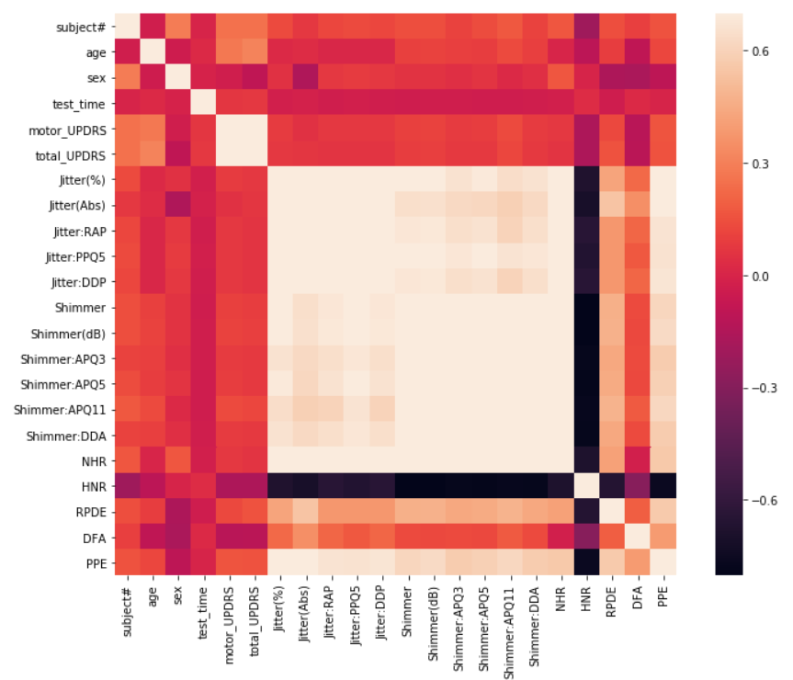

Slide 9
Multivariate Analysis
The dysphonia measures are weakly correlated to UPDRS.
To find relationship, statistical regression techniques have been proposed
We used linear regression and Random Forest regressor methods to map the dysphonia measures to interpolated UPDRS values, and compared their predictive performance

Slide 10
Making predictions and evaluating performance
Regression analysis we fit a line to the data points, in such a manner that the error between the value of fitted regression model at each point and the actual value are minimized .

Slide 11
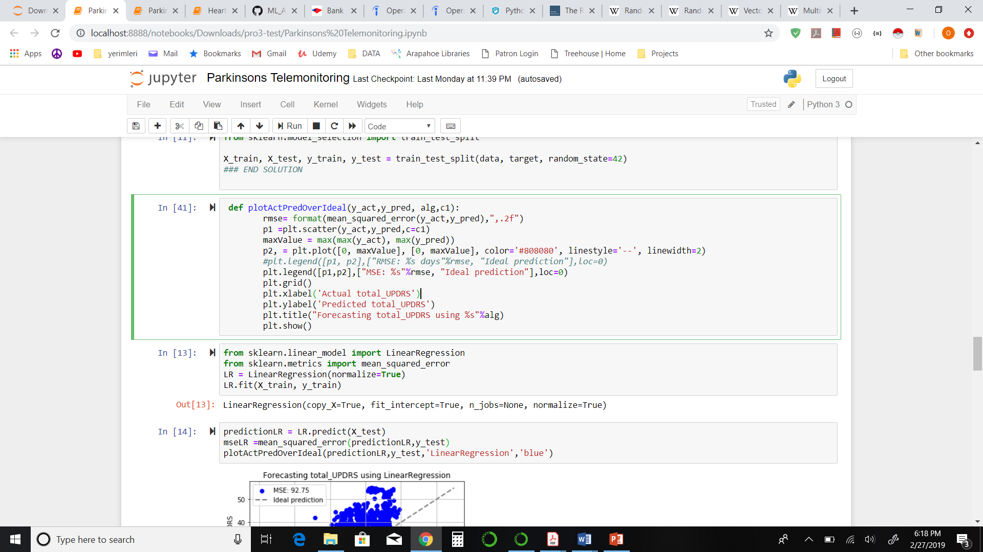
Generate function to plot the predictions

Slide 12
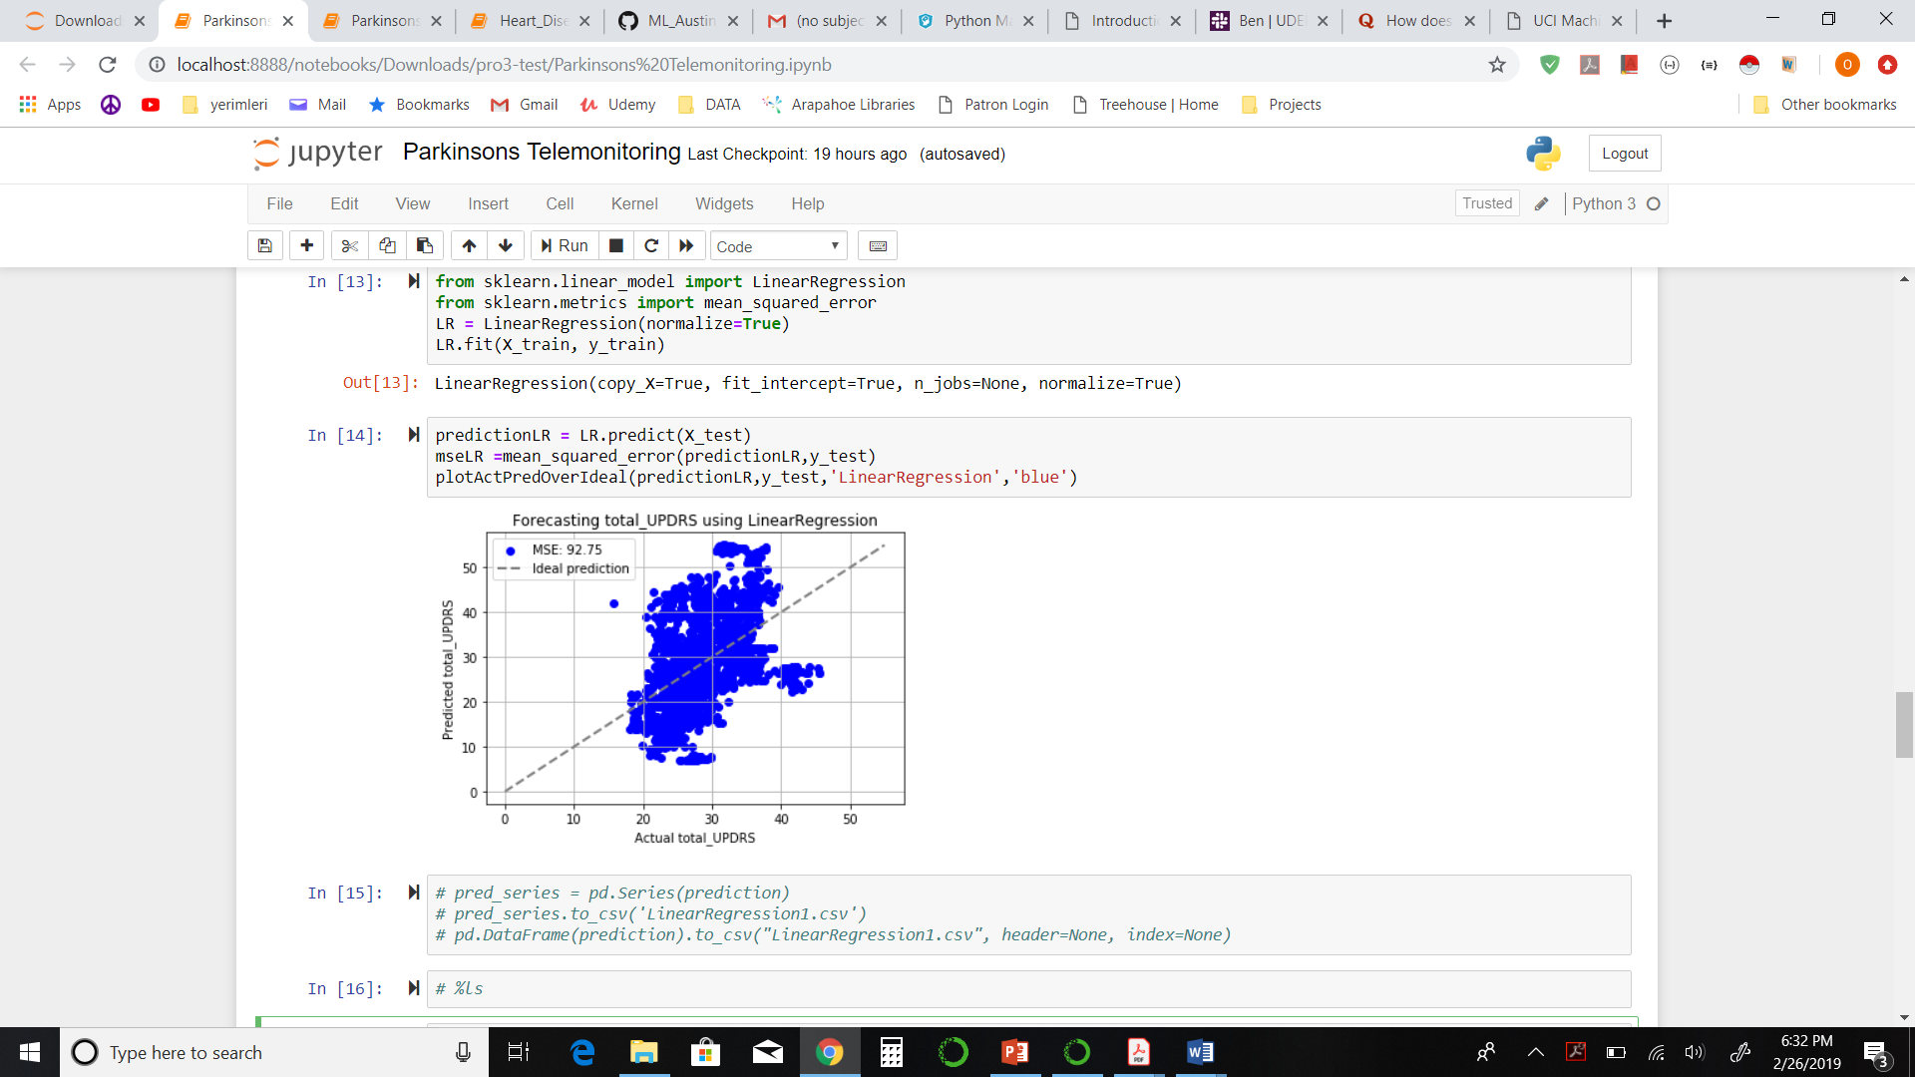
Root Mean Squared Error
0.20067541710582776

Slide 13
Random Forest is a supervised learning algorithm. it creates a forest and makes it somehow random.
Random forest builds multiple decision trees and merges them together to get a more accurate and stable prediction.

Slide 14
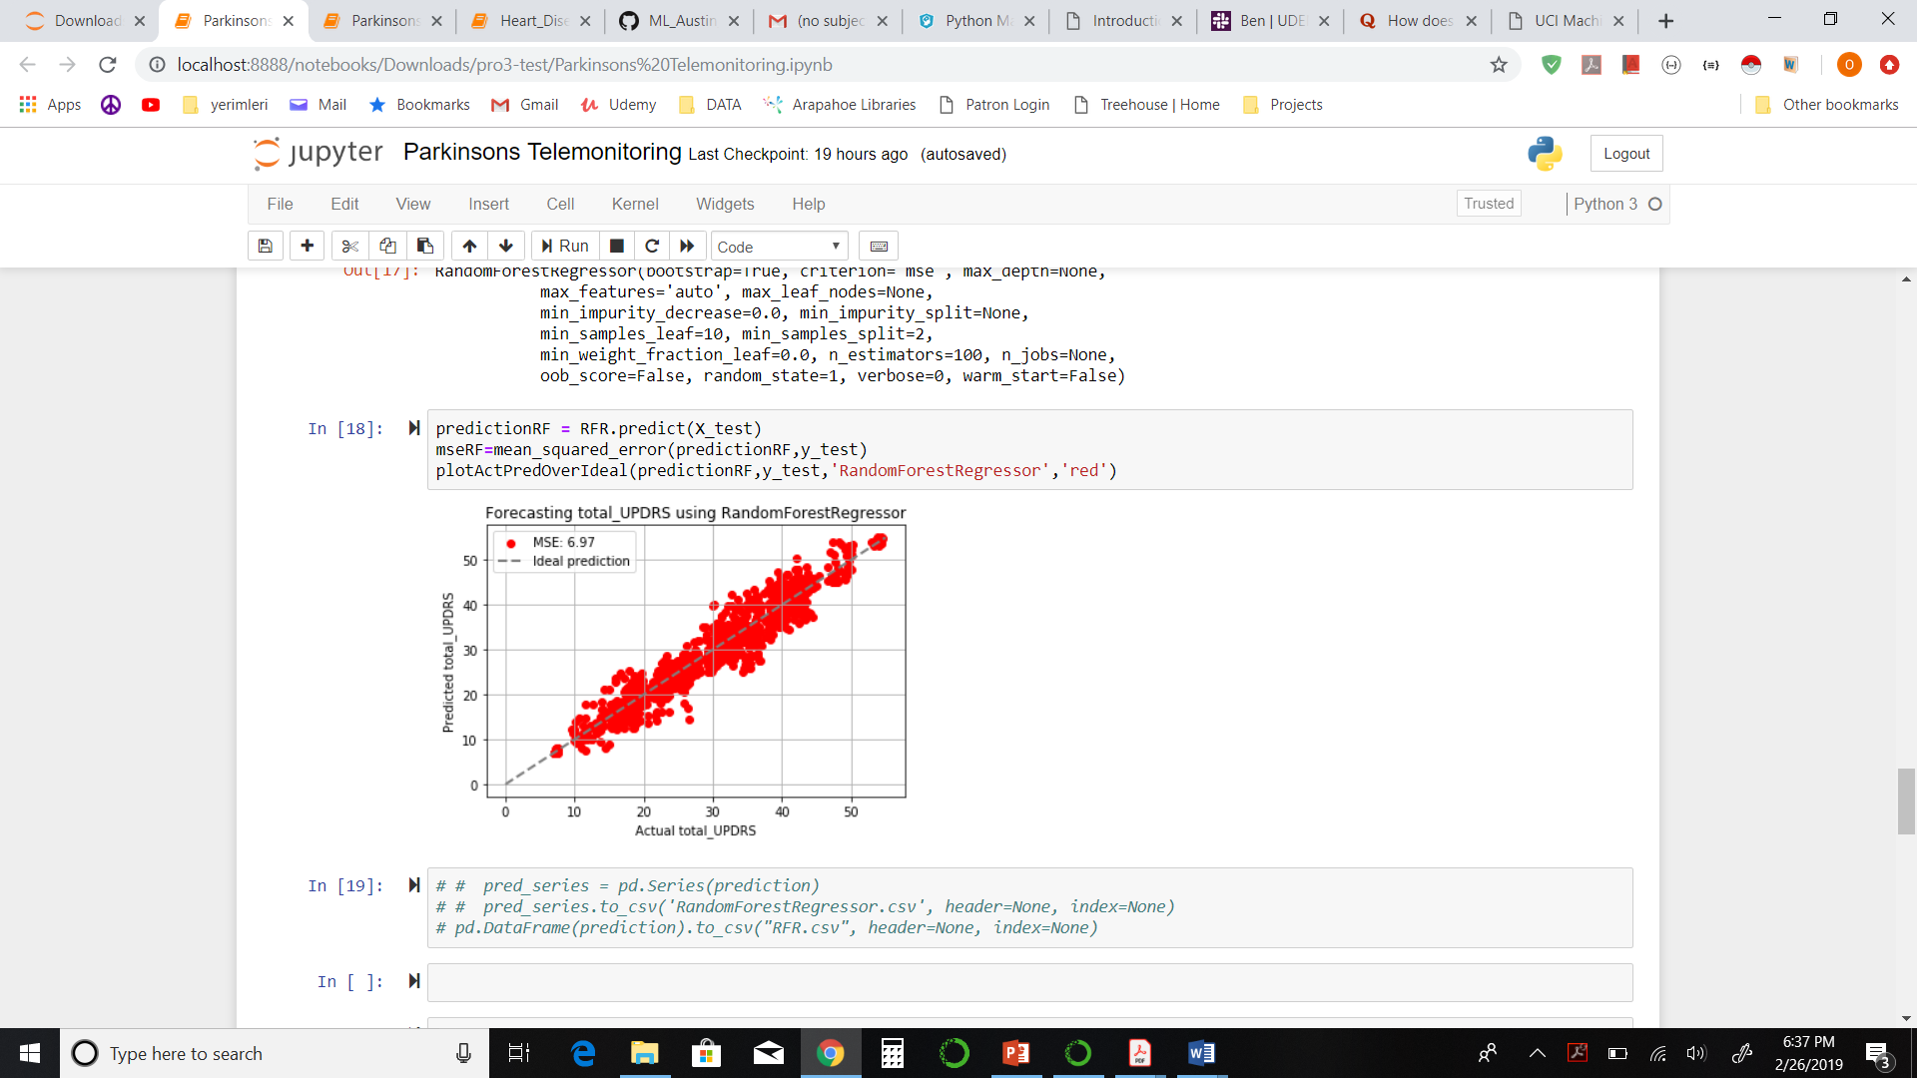
Root Mean Squared Error
0.05501096278077054

Slide 15
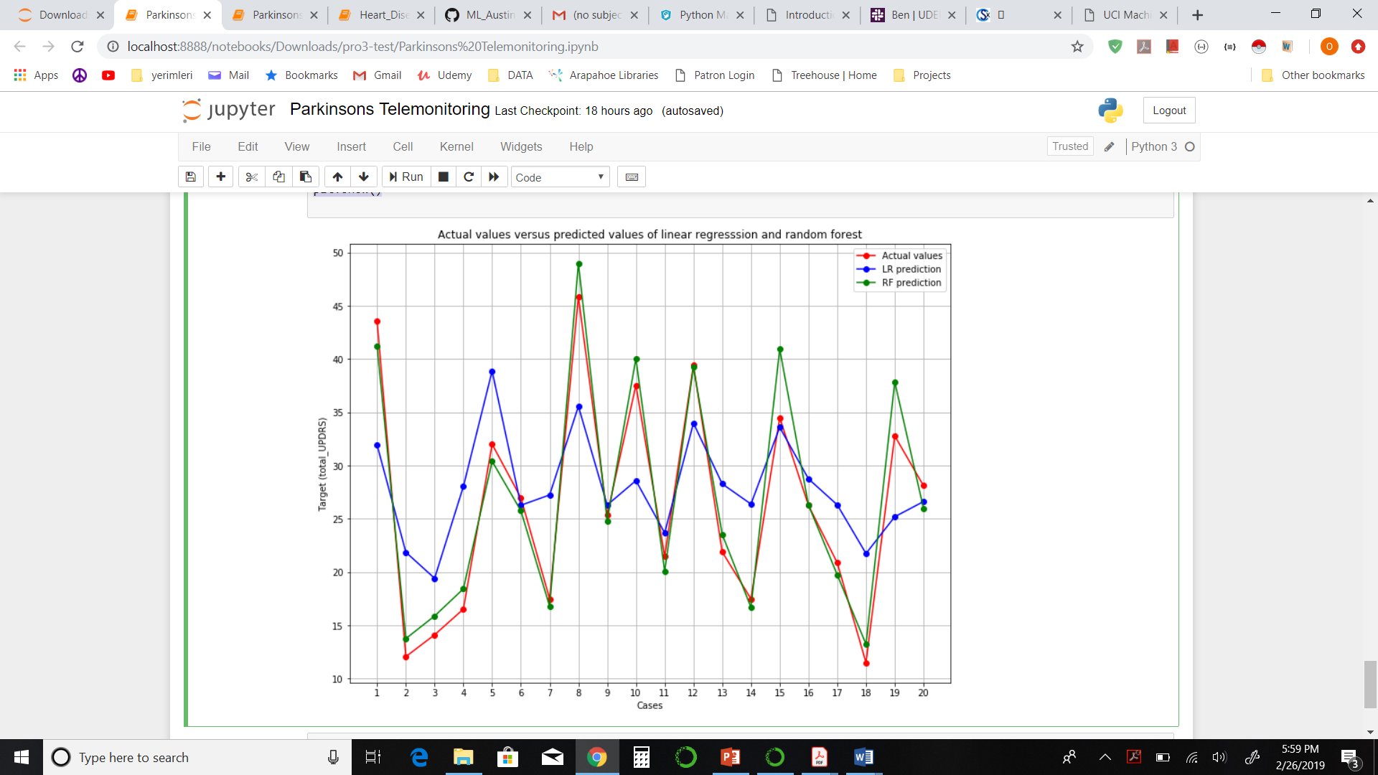

Slide 16


