Slide 1
Java Lecture #3 IO/NIO
Saint Petersburg, 2014

Slide 2
The simplest questions are often the best (с)

Slide 3
IO Basics
Source
Program
Destination

Slide 4
Source / Destination
Files
Network Connections
In-memory Buffers (e.g. arrays)
thousands of them…

Slide 5
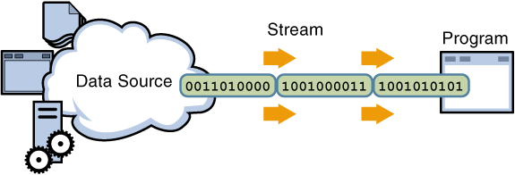
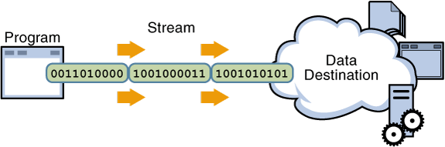
Streams
Root of java IO hierarchy
InputStream represents source
OutputStream represents destination

Slide 6
InputStream
InputStream
File*
ByteArray*
Object*
Filter*
Buffered*
Data*
* is an abbreviation for InputStream

Slide 7
OutputStream
OutputStream
File*
ByteArray*
Object*
Filter*
Buffered*
Data*
Print*
* is an abbreviation for OutputStream

Slide 8
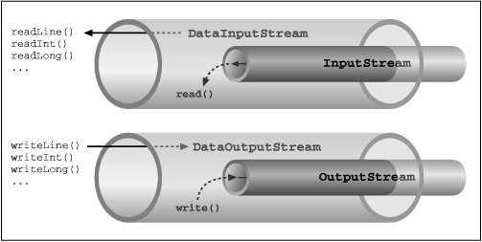
FilterStream
* Read about:
Composition
Delegation
Decorator pattern

Slide 9
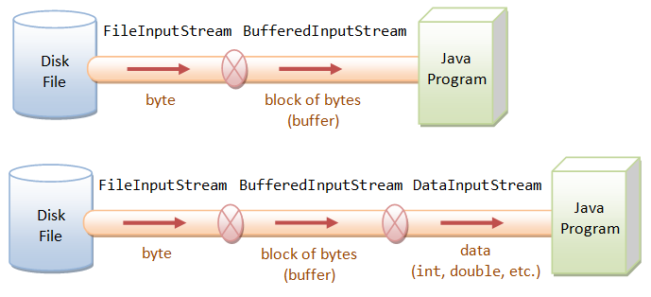
Buffering

Slide 10
Outside of streams API
File
Existence
Access rights
Length
Creating/Deleting
So on
RandomAccessFile
Random access instead of sequential

Slide 11
Reader/Writer
Same as Input/Output streams but for characters, not bytes
Work with characters encodings

Slide 12
Serialization
Serializable
ObjectInputStream / ObjectOutputStream
Serial UUID
Joshua Bloch, Effective Java (2nd Edition)

Slide 13
Example 1
IntegerInputStream
IntegerOutputStream

Slide 14
Sockets

Slide 15
Basics
Communications protocol
TCP/IP stack
TCP vs UDP
Socket
University course: “Computer networks”

Slide 16
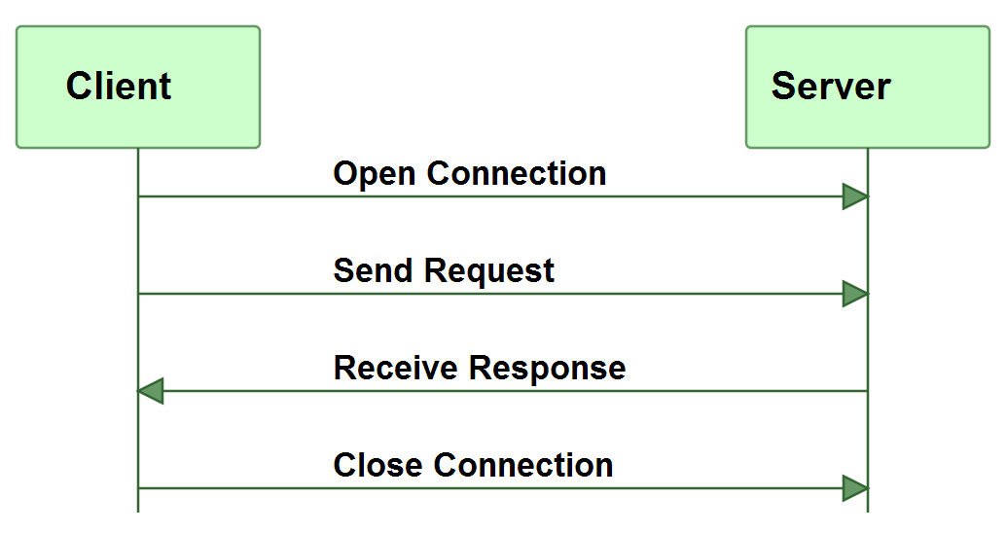
Client/Server

Slide 17
java.net.*
Socket
ServerSocket
DatagramSocket

Slide 18
ClientSocket
Open connection
Send request
Receive response
Close connection

Slide 19
ServerSocket
Listen on port
Accept connection
Receive request
Send response
Close connection

Slide 20
Protocol design
Client - Server Roundtrips
Demarcating the End of Requests and Responses
Always send equal portions of data
Send the length in bytes of the request in the beginning of the request
Send an end-of-request marker after the request data
Solve the problem in the lower level protocol, see HTTP Chunked encoding

Slide 21
Multithreaded servers
Thread per connection
Non-blocking I/O

Slide 22
Example 2
Client-server hello-world
Client-server custom message
Thread per connection server

Slide 23
NIO

Slide 24
NIO
Channels
Buffers
Selectors

Slide 25
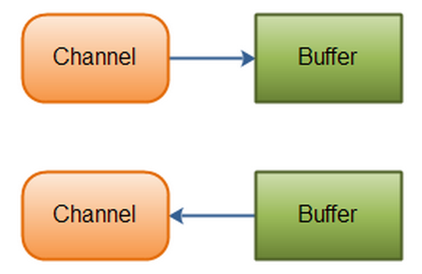
Channels and Buffers

Slide 26
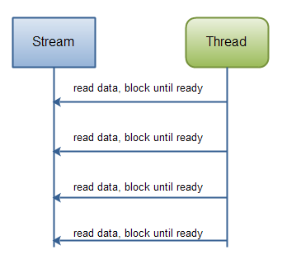
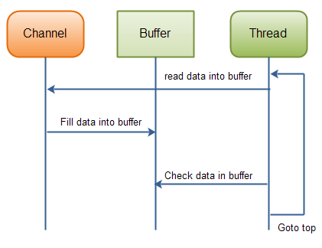
Channels and Buffers

Slide 27
Channels and Buffers
Channels
FileChannel
DatagramChannel
SocketChannel
ServerSocketChannel
Buffers
ByteBuffer
CharBuffer
DoubleBuffer
FloatBuffer
IntBuffer
LongBuffer
ShortBuffer
MappedByteBuffer

Slide 28
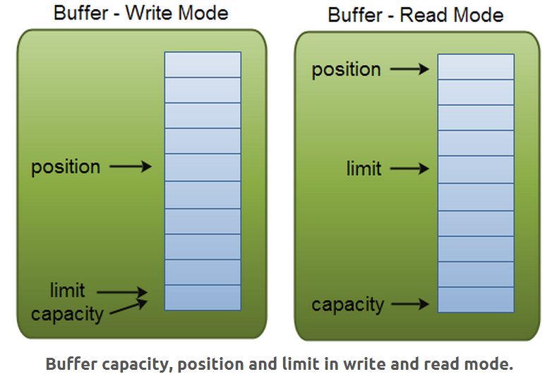
Buffers

Slide 29
Features
Direct transfer
For exchanging data bypassing CPU
Memory mapped files
For very large files
Linear performance boost in case of frequent usage

Slide 30
Example 3
Read/write buffer structure
Memory mapped file

Slide 31
Non-blocking Sockets

Slide 32
SocketChannels
SocketChannel / ServerSocketChannel
Logically identical to sockets
Main feature is the non-blocking mode

Slide 33
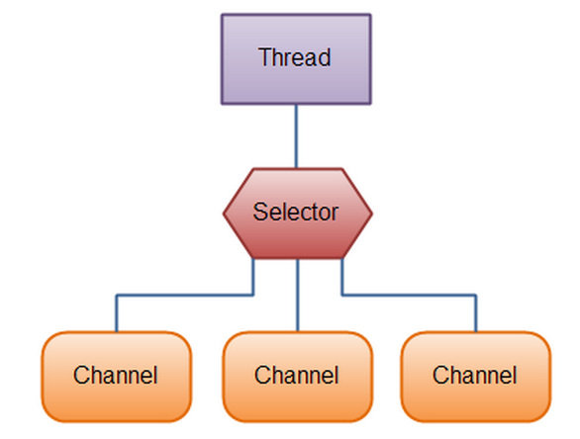
Selector

Slide 34
Interest set
Connect
Accept
Read
Write

Slide 35
SelectionKey
The interest set
The ready set
The Channel
The Selector
An attached object (optional)

Slide 36
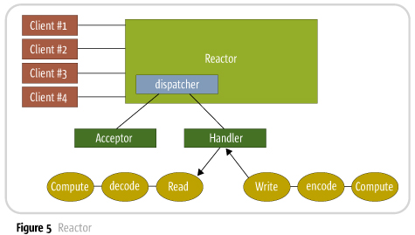
Reactor Pattern

Slide 37
Example 4
NIO client-server
Non-blocking server

Slide 38
Resources
http://tutorials.jenkov.com/
http://www.amazon.com/Effective-Java-Edition-Joshua-Bloch
http://www.amazon.com/First-Design-Patterns-Elisabeth-Freeman
ruslan.sverchkov@t-systems.com, ruslan.sverchkov@gmail.com
pavel.dyadych@t-systems.com, revenforv@gmail.com

