Slide 1
Java Lecture #13 Enterprise Java Beans 3.1
Saint Petersburg, 2012

Slide 2
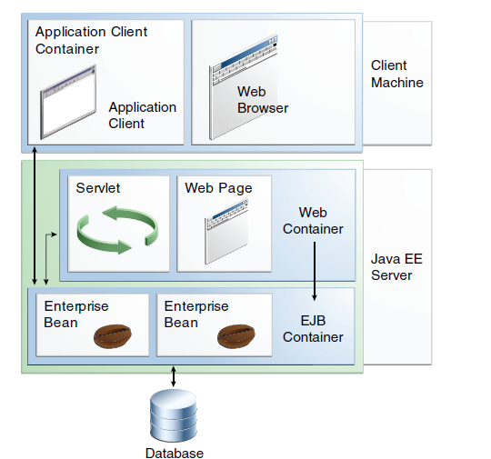
Container Types

Slide 3
When to Use EnterpriseBeans
Written in the Java programming language, an enterprise bean is a server-side component that encapsulates the business logic of an application.
■ The application must be scalable. To accommodate a growing number of users, you may
need to distribute an application’s components across multiple machines. Not only can the
enterprise beans of an application run on different machines, but also their location will
remain transparent to the clients.
■ Transactions must ensure data integrity. Enterprise beans support transactions, the
mechanisms that manage the concurrent access of shared objects.
■ The application will have a variety of clients. With only a few lines of code, remote clients
can easily locate enterprise beans. These clients can be thin, various, and numerous.

Slide 4
Types of EnterpriseBeans
1. Session. Performs a task for a client; optionally, may implement a web service
2. Message-driven. Acts as a listener for a particular messaging type, such as the JavaMessage ServiceAP
Types of SessionBeans:
1) Stateful SessionBeans. In a stateful session bean, the
instance variables represent the state of a unique client/bean session. Because the client
interacts (“talks”) with its bean, this state is often called the conversational state.
2) Stateless SessionBeans. A stateless session bean does not maintain a conversational state with the client.
3) SingletonSessionBeans. A singleton session bean is instantiated once per application and exists for the lifecycle of the application.

Slide 5
Stateful SessionBeans
Stateful session beans are appropriate if any of the following conditions are true:
■ The bean’s state represents the interaction between the bean and a specific client.
■ The bean needs to hold information about the client acros smethod invocations.
■ The bean mediates between the client and the other components of the application,
presenting a simplified view to the client.
■ Behind the scenes, the bean manages the work flow of several enterprise beans.
As its name suggests, a session bean is similar to an interactive session. A session bean is not shared; it can have only one client, in the same way that an interactive session can have only one user. When the client terminates, its session bean appears to terminate and is no longer associated with the client.
The state is retained for the duration of the client/bean session. If the client removes the bean, the session ends and the state disappears.

Slide 6
Stateless SessionBeans
When a client invokes the methods of a stateless bean, the bean’s instance variables may contain a state specific to that client but only for the duration of the invocation. When the method is finished, the client-specific state should not be retained.
Because they can support multiple clients, stateless session beans can offer better scalability for applications that require large numbers of clients. Typically, an application requires fewer stateless session beans than stateful session beans to support the same number of clients.
You might choose a stateless session:
■ The bean’s state has no data for a specific client.
■ In a single method invocation, the bean performs a generic task for all clients. For example, you might use a stateless session bean to send an email that confirms an online order.
■ The bean implements a web service.

Slide 7
Singleton SessionBeans
Singleton session beans are designed for circumstances in which a single enterprise
bean instance is shared across and concurrently accessed by clients.
Singleton session beans offer similar functionality to stateless session beans but differ from them in that there is only one singleton session bean per application, as opposed to a pool of stateless session beans, any of which may respond to a client request. Like stateless session beans, singleton session beans can implement web service endpoints.
Singleton session beans maintain their state between client invocations but are not required to maintain their state across server crashes or shutdowns.

Slide 8
What Is a Message-DrivenBean?
A message-driven bean is an enterprise bean that allows Java EE applications to process messages asynchronously. This type of bean normally acts as a JMS message listener, which is similar to an event listener but receives JMS messages instead of events.
Message-driven beans have the following characteristics.
■ They execute upon receipt of a single client message.
■ They are invoked asynchronously.
■ They are relatively short-lived.
■ They do not represent directly shared data in the database, but they can access and update this data.
■ They can be transaction-aware.
■ They are stateless.

Slide 9
Accessing EnterpriseBeans
A client can access a session bean only through the methods defined in the bean’s business interface or through the public methods of an enterprise bean that has a no-interface view.
The client of an enterprise bean obtains a reference to an instance of an enterprise bean through either dependency injection, using Java programming language annotations, or JNDI lookup, using the Java Naming and Directory Interface syntax to find the enterprise bean instance.
When you design a Java EE application, one of the first decisions you make is the type of client access allowed by the enterprise beans: remote, local, or web service.
@Stateless
public class ExampleBean { ... }
@EJB
private ExampleBean exampleBean;
ExampleBean exampleBean = (ExampleBean)InitialContext.lookup("java:module/ExampleBean");

Slide 10
Accessing EnterpriseBeans
@Local
public interface InterfaceName { ... }
@Local(InterfaceName.class)
public class BeanName implements InterfaceName
@Remote
public interface InterfaceName { ... }
@Remote(InterfaceName.class)
public class BeanName implements InterfaceName { ... }

Slide 11
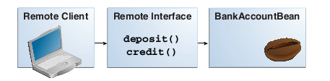
Remote Clients
A remote client of an enterprise bean has the following traits.
■ It can run on a different machine and a different JVM from the enterprise bean it accesses.
(It is not required to run on a different JVM.)
■ It can be a web component, an application client, or another enterprise bean.
■ To a remote client, the location of the enterprise bean is transparent.
■ The enterprise bean must implement a business interface. That is, remote clients may not
access an enterprise bean through a no-interface view.

Slide 12
Local Clients
A local client has these characteristics.
■ It must run in the same application as the enterprise bean it accesses.
■ It can be a web component or another enterprise bean.
■ To the local client, the location of the enterprise bean it accesses is not transparent.

Slide 13
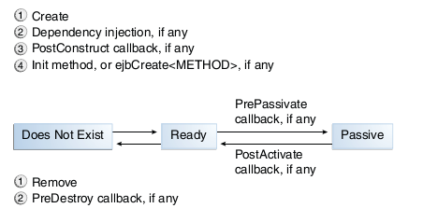
TheLifecycleof aStateful SessionBean

Slide 14
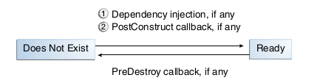
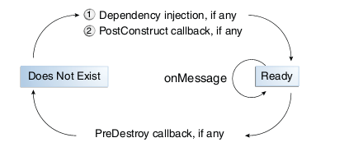
Lifecycleof a Stateless SessionBean , Singleton, MDB

Slide 15
Lifecycle Callback Methods
A method in the bean class may be declared as a lifecycle callback method by annotating the method with the following annotations:
■ javax.annotation.PostConstruct:Methods annotated with @PostConstructare invoked
by the container on newly constructed bean instances after all dependency injection has
completed and before the first business method is invoked on the enterprise bean.
■ javax.annotation.PreDestroy:Methods annotated with @PreDestroyare invoked after
any method annotated @Removehas completed and before the container removes the
enterprise bean instance.
■ javax.ejb.PostActivate:Methods annotated with @PostActivateare invoked by the
container after the container moves the bean from secondary storage to active status.
■ javax.ejb.PrePassivate:Methods annotated with @PrePassivateare invoked by the
container before it passivates the enterprise bean, meaning that the container temporarily
removes the bean from the environment and saves it to secondary storage.

Slide 16
Stateless and Stateful Session Bean by Example
@Remote
public interface Cart {…}
@Stateful
public class CartBean implements Cart {…}
@Stateless
public class BookStatelessBean {…}

Slide 17
Singleton Session Bean by Example
Singleton session beans are designed for concurrent access, situations in which many clients need to access a single instance of a session bean at the same time.
Container-Managed Concurrency
@ConcurrencyManagement(ConcurrencyManagementType.CONTAINER)
@Lock(LockType.READ)
@Lock(LockType.WRITE
@AccessTimeout(value=120000)
Bean-ManagedConcurrency
@ConcurrencyManagement(ConcurrencyManagementType.BEAN)
@DependsOn("DependsSingletonBean")

Slide 18
Timer Service by Example
Programmatic Timers
Automatic Timers
Canceling and Saving Timers
Getting Timer Information

Slide 19
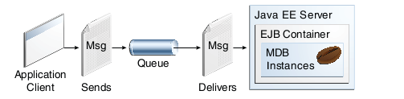
Message-Driven Bean
@Resource(mappedName="jms/ConnectionFactory")
private static ConnectionFactory connectionFactory;
@Resource(mappedName="jms/Queue")
private static Queue queue;
@MessageDriven(mappedName="jms/Queue", activationConfig

Slide 20
Transaction
To emulate a business transaction, a program may need to perform several steps:
begin transaction
debit checking account
credit savings account
update history log
commit transaction
A transaction can end in twoways: with a commit or with a rollback.

Slide 21
Container-Managed Transactions
In an enterprise bean with container-managed transaction demarcation, the EJB container sets the boundaries of the transactions.
Typically, the container begins a transaction immediately before an enterprise bean method starts and commits the transaction just before the method exits.
Container-managed transactions do not require all methods to be associated with transactions.
Enterprise beans that use container-managed transaction demarcation must not use any transaction-management methods: commit, setAutoCommit, and rollback methods
of java.sql.Connectionor the commit and rollback methods of javax.jms.Session
Enterprise beans that use container-managed transaction demarcation also must not use the javax.transaction.UserTransaction interface.

Slide 22
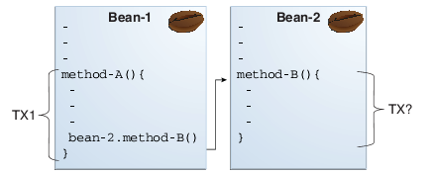
Transaction Attributes
A transaction attribute controls the scope of a transaction.
A transaction attribute can have one of the following values:
■ Required
■ RequiresNew
■ Mandatory
■ NotSupported
■ Supports
■ Never ansaction

Slide 23
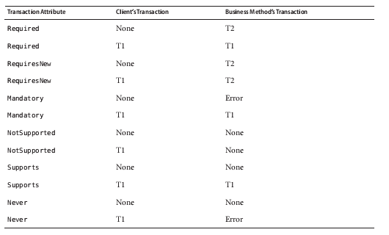
Transaction Attributes

Slide 24
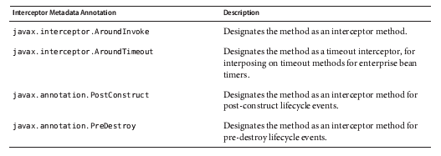
Interceptors
Interceptors are used in conjunction with Java EE managed classes to allow developers to
invoke interceptor methods in conjunction with method invocations or lifecycle events on an
associated target class. Common uses of interceptors are logging, auditing, or profiling.

