Slide 1
Welcome to CS312
Benjamin Brewster

Slide 2
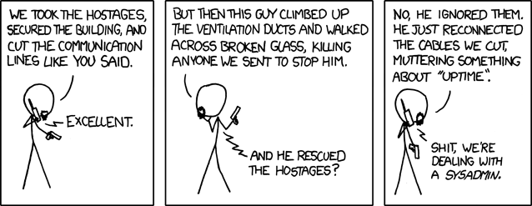

Who You Are
Done with CS344
Done with CS372
(or concurrent)
Interested in CS, EE, and Engineering
Engineering is applying science within temporal and budgetary constraints
You're already the go-to person amongst your friends for IT help, aren't you? Or you want to be that person?
Who is a sysadmin? Who thrives in chaos, constant change, being the doctor, the hero, the jack-of-all-trades, the irreplaceable?

Slide 3

Who Ben Brewster Is
I've been taking things apart my entire life
Worked for IT groups as an undergrad
Started CT as a grad student
Grew it to largest IT company in the mid-Willamette valley
Sold CT to teach at OSU
Convinced OSU to let me rebrand Linux System Administration as just System Administration
He’s very excited

Slide 4
What We Will Learn - the Art of IT
The Art of IT: Design, Deployment, Maintenance
System Administration is an art
There are problem-solving and observational skills we can't teach, but they involve divide and conquer, perception, inquisitional precision, and experience
All good art is bound by rules
Jackson Pollock just stuck to lines, splotches, and dots
Experts break the rules
Sometimes you've seen enough to cut through all the clutter
Mavericks break the rules, get fired, sued, write a book, then get hired back for 3 times their salary

Slide 5
What We Will Learn - Course Subjects
Hardware
Storage
Operating Systems
Virtualization
Containerization
Automation
Server Tech
Active Directory
Network Deployment
Kali & Hacking Tools
Squishy Stuff: Management, SLA, etc.
How to Start an IT Company

Slide 6
How We’re Going to Learn
Lectures, 75% of which are Hands-On: our focus is on the practical usage, experience, and differentiation of application:
We’ll sometimes go into design and science
Rarely get into history, even though I'd like to do more
Homework
Your source for much of the info in this course must necessarily be from the internet.
This isn’t because of laziness on my part, but because no book is current on these topics
Get used to discerning between lies, damn lies, statistics, advertisements, and truth
Labs
Experience the joys of cutting your fingers, lithium poisoning, and fscking disks
Discussion: Piazza & Slack

Slide 7
What We're Going to Do For the Rest of Today
Intro (these slides)
Canvas:
Syllabus
Home Page
Syllabus Quiz
Final

Slide 8
Key Points to Take Away
You cannot save money on IT
You cannot save time in IT
It is incredibly lucrative
For somebody
We have lots of fun toys

