Slide 1
Windows 10 and macOS Architecture
Benjamin Brewster

Slide 2

Why You Need to Care
Because someday you’ll have to:
Reinstall Windows for the umpteenth time
Do something about that old Mac your grandma has
Know where to go to fix Windows printer issues
Examine the running processes and learn how to kill exactly the right one
Get under the hood with these OSs and configure them

Slide 3
Windows 10 Overview
Editions you can buy: Home, Pro
Prices: $80-200 depending on Home versus Pro, OEM, retail versus download, and the market
Editions you can’t buy: Enterprise, Education, Mobile, at least 7 more
Prices: LOL
Brief history/notes:
Released on July 29, 2015
Features Universal Apps that run on PCs, tablets, smartphones, embedded systems, Xbox One, Surface Hub and AR devices
Windows Updates cannot be disabled
Twice-yearly (Spring, Fall) updates that add major new features; think SaaS

Slide 4
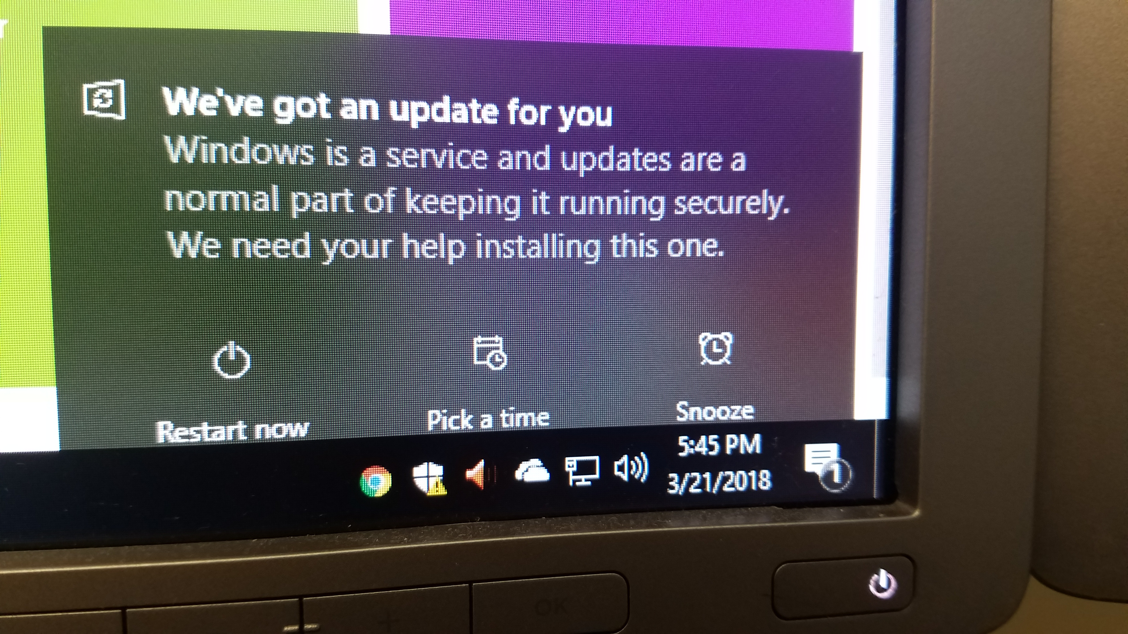
Windows 10 Overview
Editions you can buy: Home, Pro
Prices: $80-200 depending on Home versus Pro, OEM, retail versus download, and the market
Editions you can’t buy: Enterprise, Education, Mobile, at least 7 more
Prices: LOL
Brief history/notes:
Released on July 29, 2015
Features Universal Apps that run on PCs, tablets, smartphones, embedded systems, Xbox One, Surface Hub and AR devices
Windows Updates cannot be disabled
Twice-yearly (Spring, Fall) updates that add major new features; think SaaS

Slide 5
Windows 10 Architecture Overview and Detail

Slide 6
Important Programs in Windows 10
We can gain information about what Windows is doing by examining what is running
Task Manager can view all kinds of things, but limits our ability to see the actual underlying processes
Way better is Process Explorer:
https://docs.microsoft.com/en-us/sysinternals/downloads/process-explorer

Slide 7

Important Programs in Windows 10
Say
Demonstrate
Lack of specificity, though breadth is nice
The rest of these are shown in Process Explorer
The kernel
Handles shutdown, consoles, and other Win32 tasks
First process started by kernel, manages environment variables, starts Win32 subsystem, starts virtual memory, starts winlogon.exe
Runs processes at system boot for all logons
The login process
Manages all services
Holds a particular service process
Renders the visual UI
Manages user-started programs and file browser(s)
Task Manager tabs
Process Explorer: File->Show Processes for All Users
System
Client Runtime Subsystem: csrss.exe (x2)
Session Manager Subsystem: System -> smss.exe
Wininit: wininit.exe
Winlogon: winlogon.exe
Service Control Manager: wininit.exe->services.exe
Service Host: winint.exe->services.exe->svchost.exe
Desktop Window Manager (DWM): winlogon.exe->dwm.exe
Windows Explorer: explorer.exe

Slide 8
Important Services in Windows 10
Say
Demonstrate
The paths in Process Explorer aren’t all that useful: use Task Manager instead to see what’s running
Process Explorer Service command line entries
Show Service entries in Task Manager on Processes tab
On Services tab, stop and start "Spooler", the print spooler

Slide 9
The Windows SysAdmin Shortcut Menu
Say
Demonstrate
Shows the basic hardware installed, System Type (32 or 64 bit), NETBIOS name, and installed OS version
Quick access to the most important Windows sysadmin tools!
Task Scheduler (more on this another day)
Event Viewer (automated processing demo another day)
Shared Folders
Performance
Device Manager
Disk Management
Services
WIN+X
->System
->Computer Management
Briefly show each component
Tour of Disk Management layout

Slide 10
Installing Software on Windows 10
Say
Demonstrate
The Program Files themselves are written to either “Program Files” for 64-bit software, or “Program Files (x86)” for 32-bit software. These are protected folders, so normally software doesn’t write settings or other data frequently to them after installation
Used for non-user-specific application data
User-specific application data that follows the user on a domain
User & machine-specific application data
Stores machine-specific settings and config data for the software
Some games like to write data to the users documents folder to make it easy to find and backup
Program Files & Program Files (x86)
ProgramData
C:\Users\<USER>\AppData\Roaming
C:\Users\<USER>\AppData\Local & …\LocalLow
Registry (via regedit)
The users Documents folder

Slide 11
Installing Software on Windows 10
Say
Demonstrate
Programs are typically installed as either:
.EXE executables that manually copy files to the appropriate places, write registry values, and configure shortcuts and environment variables to enable starting the program
.MSI files, which are packaged programs that use the Windows Installer APIs to do the same installation tasks
Programs can be removed from the "Apps & features" area in Settings
The Uninstall and other management features in here use the Windows Installer tool to do their work
WIN+X -> Settings -> Apps (Loads Apps & Features)

Slide 12
Important Folders and Files in Windows
Say
Demonstrate
Main storage location for Windows, mostly contains other folders and a few key apps (regedit.exe, etc.)
Used in old 16-bit Windows editions, empty now
Most of 64-bit Windows itself
32-bit Windows files
Non-user-specific temporary files
Location of system-specific Registry files
User-specific portion of Registry
Where print jobs sit until finished - delete this to free stuck print jobs!
Virtual Memory page file
System Restore points, search index databases, Volume Shadow Copy entries
C:\Windows
C:\Windows\System
C:\Windows\System32
C:\Windows\SysWOW64
C:\Windows\Temp
C:\Windows\System32\Config
C:\Users\<USER>NTUSER.DAT
C:\Windows\System32\spool\PRINTERS & ..\SERVERS
C:\pagefile.sys
<DRIVE>:\System Volume Information

Slide 13
Installing Windows on a New VM
Broad strokes (this is a homework assignment to go play with):
Create VM in VirtualBox
For Windows 10 64-bit, I recommend assigning two CPUs, 2 GB RAM, all the video RAM, and a fixed disk size of at least 16GB
Insert the Windows 10 .ISO into the VM so that the VM boots off of it
Settings -> Storage -> Select the CD drive -> click the little CD icon on the far right
Start the VM
You’ll want to create a “New” partition when Windows asks you to
You’ll probably need to Eject the .ISO after Windows does the initial install, or it’ll just boot off of it again when it reboots (don’t “Remove Attachment” - that removes the actual/virtual CD drive)
It’s very easy, plus the correct drivers are all pre-loaded for the VM

Slide 14
Driver Installation Order
If you were installing Windows yourself, on bare hardware, you’d install the drivers in this order:
MOBO, sometimes called Firmware; includes CPU
BIOS, if needed
Storage controllers and/or management software for RAID arrays, SANs, etc.
GPU, if not built-in to the MOBO
Network, if needed (this is often part of the MOBO drivers these days)
Audio, if needed (this is often part of the MOBO drivers these days)
Optical disk drives, if needed
Input, like special gaming mice and keyboards, if needed
External, like printers, webcams, other external USB devices

Slide 15
Critical Things to Configure in Windows
Say
Demonstrate
This is how your PC is found on the network locally
Make these changes from the common defaults
Assign new NETBIOS name, reboot
WINX -> System -> Rename…
View -> Options -> Folder Options -> View tab
Check “Always show menus”
Check “Show hidden files…”
Uncheck “Hide extensions for known file types”
Uncheck “Hide protected operating system files…”
Uncheck “Use Sharing Wizard”

Slide 16
Windows Updates
Say
Demonstrate
Windows isn’t as buggy as you might think: the problem is normally one that exists with buggy third-party software
New bugs that affect usability and security are constantly discovered
System Updates fix these bugs, though knowledge of the existence of the bugs can cause "zero-day" viruses that exploit the bug until the patch hits all systems
In the past, Windows updates could be disabled, but not anymore
Yeah people are mad, but this is better than botnets
WIN+X -> Settings -> Update & Security
Explore "Change active hours", "Restart options", and "Advanced options"
Note how there is no "disable" button!

Slide 17
macOS Architecture Overview
Mach kernel
A microkernel
BSD subsystems
BSD is a fork of UNIX; includes basic binaries like ls, cat, etc.
Together, the core of macOS is called Darwin, which is shared with iOS, tvOS, and watchOS
Apple GUIs (Aqua) and APIs (Cocoa, etc.)

Slide 18
Installing macOS
This isn’t NEAR as common as it is in Windows
Normally, you’d just do one of the following:
Stick in the DVD and reformat (harder to do these days since there’s no ODD)
Apply the update from the App Store to upgrade
Hold Command+R to boot into a “macOS Utilities” menu where the OS can be reinstalled and the partitions formatted
But if you’re doing it on a VM:
https://www.howtogeek.com/289594/how-to-install-macos-sierra-in-virtualbox-on-windows-10/
iTunes, Facetime, other Apple-authored software won’t work
Since Apple builds the hardware (is this good or bad?), there aren’t separate drivers to install

Slide 19
macOS Disk Management
Say
Demonstrate
Like in Windows, the general, easy to find System Preferences is not where administration really happens
System Information gives you specifics about your hardware
The Built-in Disk Utility won’t show you all the partitions in the system
Fire up the terminal to see all the disk partitions
You can do all the normal commands from here or Disk Utility
Apple -> System Preferences
Finder -> Go -> Utilities
->System Information
->Disk Utility
->Terminal
$ diskutil list
$ diskutil reformat

Slide 20
Installing Software onto macOS
Say
Demonstrate
Typically downloads are .dmg files, which are Apple Disk Image files that contain compressed data which is mounted as a new volume
Once mounted, the data can be copied off of it
When these folders contain programs to install, you simply drag them to the Applications folder
Uninstallation is just dragging them from Applications to Trash
Some Applications come as .pkg files, which use the Apple installer in the same way that the Windows Installer works
Double click .dmg on desktop
Show in Disk Utility the mounted image
Eject by moving to trash
Finder -> Go -> Applications

Slide 21
Other macOS Folders
Say
Demonstrate
In general, this is simpler than Windows and Linux
Where these personal folders are actually located
You can see the Applications folder here
/Volumes has the mount drives
~/System/Library and /Library and ~/Library has base settings, computer-wide mods to those settings, and user-specific mods to those settings
/System and /Network are for admins to play in
The rest of the lower-case folders we’ll see in the Linux overview
Finder -> Go -> Terminal
$ ls -pla (from ~)
$ cd /
$ ls -pla
$ ls -pla /Users/macuser
$ ls -pla /Applications
$ ls -pla /Volumes

Slide 22
macOS Updates
Say
Demonstrate
You can see what updates are automatically being applied in the standard App Store
Disable updates in the preferences
I’ve done that in our VM so that it doesn’t spend its limited CPU time trying to download a bunch of updates
Note that in a VM, several patches will fail to install, like iTunes, Facetime, etc.
Apple -> About This Mac -> Software Update
App Store -> Preferences

Slide 23
Command Line Interface
Both Windows and Apple have extensive CLIs with a long history behind them.
Windows 10’s DOS is supplemented now with PowerShell and bash
macOS uses bash on BSD
Important, powerful, dangerous, yet infrequently used tools and options are only available in the CLI on both OSs

Slide 24
Conclusion
All Operating Systems consist of collections of files
Messing with those files causes things to stop working
If you know what you’re doing, you might be able to fix certain things
But in bad events, you have to recover from a known good system (recovery partitions, OS repair from DVD, etc.)
In really bad events, the OS can “simply” be reinstalled, often with the loss of all of your kid’s baby pictures

