Slide 1
GNU/Linux Architecture
Benjamin Brewster & Erich Kramer
Please boot up the "CentOS_Reference" VM in VirtualBox now

Slide 2

Why You Need to Care
Because someday you’ll have to:
Find a particular system file in Linux
Install Linux programs without fear
Manage packages like a boss
Understand the difference between /bin and /usr
Know how to pronounce GNU (guh-NEW)

Slide 3
Linux Overview
Let’s say that an Operating System consists of two parts:
Programs that talk to other programs
GNU is a UNIX-like OS consisting of applications, libraries, dev tools, etc.
Programs that talk to the hardware
Linux is a kernel that handles machine resource allocation and communication with the hardware
First thing loaded into memory, stays resident while system runs
Together, this is GNU/Linux
We mostly just call it Linux, though it makes the GNU people mad

Slide 4
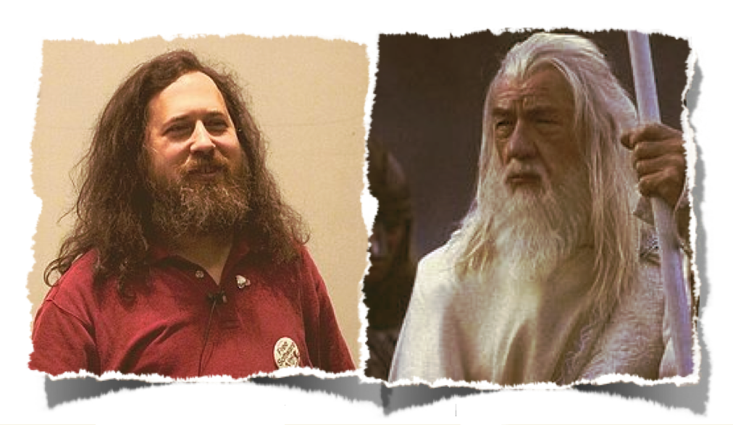
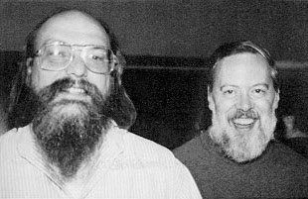
Other than beards, GNU is Richard Stallman's pet project
Ken Thompson – Unrestrained, yet directed
Bonus Dennis! Does this guy know how to party!
Gandalf the White
Richard Stallman
http://book.roomofthings.com/2012/05/15/enchanted_objects_IoT_for_humans

Slide 5
Family Trees
Most modern GNU/Linux Operating System Distributions are children of Debian, Redhat, and Slackware
We’ll be studying and using CentOS, a descendent of Redhat
CentOS is very stable, and is widely used for running servers
Most OSU servers use CentOS
Making your own distribution is as easy as swapping out the GNU “ls” utility for your own, and then giving it a snazzy name
Distro name ideas from students:
Dolfins, JustABunchOfIllegalEmulators, etc.

Slide 6

Important Programs in Linux
Say
Demonstrate
Before we get into the contents of the Linux file system, let’s talk about important processes
The vmlinuz.* files are the Linux executable, stored in compressed form
The VM stands for Virtual Memory, as in, Linux supports it
The “z” means that it’s compressed with gzip; it’s not just compressed, though: the gzip decompressor is built into the front of the binary so that it can be decompressed by the bootloader!
Why compressed? Because it’s slow to copy from external storage, but fast to work in RAM: make the copy be small
This is made from a complied kernel called “vmlinux”, which is the uncompressed, unbootable image (the bootloader expects the compressed form)
All the versions of the Linux kernel will be listed in this directory
The kernel is loaded by the bootloader
The kernel’s first job is to start up systemd
$ cd /boot
$ ls -pla

Slide 7
Important Programs and Services in Linux
Say
Demonstrate
PID 0 is the scheduler and memory pages; part of the kernel (not a user-mode process)
PID 1 is systemd (or init), which starts up Linux, once it’s been loaded by the bootloader, and then runs the system
PID 2 is (usually) kthreadd, which spawns kernel threads as needed
See how many other daemons are started up by PID 2?
syslogd, in charge of logging everything Linux does
crond, in charge of running scheduled tasks
cupsd, in charge of printer
Lots of network ones like httpd, ftpd, sshd, dhcpd, etc.
$ ps -elf | sort -nr -k 4
$ ps -elf | grep syslogd
$ ps -elf | grep crond
$ ps -elf | grep cupsd

Slide 8
Packages and Managers
Say
Demonstrate
While software can be compiled on any OS, and the files copied manually wherever you choose, modern Linux distros use the concept of Packages and Managers
A Package is usually a collection of files and metadata related to a particular application, like apache or Docker
The metadata tracks the particular version of the software, among other things
Package Managers know how to:
Download and install new packages
Follow instructions in the packages to install the executables, and save instructions on later how to uninstall them
Update packages to a newer (or target) version
$ yum list installed
$ yum list installed | grep "grep"

Slide 9
Packages and Managers Around the World
Say
Demonstrate
Debian-based distros, like Debian, Ubuntu, etc., use packages stored as "dpkg" files
The dpkg manager is apt
Arch-based distros, like Arch, Manjaro, etc., use packages stored as "libalpm" files
The libalpm manager is pacman
RedHat-based distros, like RedHat, Fedora, CentOS, etc., use packages stored as "rpm" files
The rpm manager is yum
Valid and useful commands are install, update, and erase, which we'll talk about
$ apt
$ pacman
$ yum

Slide 10
Finding Packages
Say
Demonstrate
Packages are stored in online repositories, but not all repositories have the same packages
Sometimes, you won't know what a package is called, and you aren't looking in the right repo
Use an online page to find stubborn ones
Typically we'd install a repo with this command
But EPEL has you install a package that includes the repo set up, so do it like this:
$ sudo yum install cowsay
Show https://pkgs.org, search for cowsay in CentOS 7
This says that the pkg is in EPEL x86_64
$ sudo yum-config-manager --add-repo ???
$ sudo yum install epel-release

Slide 11
Installing, Updating, and Removing
Say
Demonstrate
Now, we can install our program
Do updates for cowsay
See if there are any updates for anything
Remove cowsay - 'tis a silly thing
Put it back in, see how fast it installs since the dependencies are still there!
$ sudo yum -y install cowsay
This installs a lot of dependencies!
$ cowsay hi
$ echo "HELLO WORLD" | cowsay
$ sudo yum update cowsay
$ yum check-update
$ sudo yum erase cowsay
$ sudo yum install cowsay

Slide 12
What Dependencies?
Say
Demonstrate
Install some tools that will let us play with yum
What are all those dependencies for cowsay?!
That's a ridiculous amount of dependency
$ sudo yup -y install yum-utils
$ repoquery --tree-requires cowsay

Slide 13
Something a Little More Useful: Lynx
Say
Demonstrate
Let's install a text-based web browser. That's right.
You'll need to reject a ton of cookies unless you push V for "neVer"
Up and Down move the cursor between links, while Left and Right move forward and back between pages in your history
$ sudo yum install lynx
$ lynx www.google.com
elephant

Slide 14
The UNIX File Hierarchy
IN THE BEGINNING, there was only /
In the past, no actual standard for file locations
In 1994, the File System Standard (FSSTND), adapted into the Filesystem Hierarchy Standard (FHS), was adopted by the majority of distros
Files have a few interesting characteristics and intentions:
Shareable or not: should these files be accessible to other hosts?
Should the files be read-only or are the modifiable?
Are the files physically stored on the disk, or are they virtual?

Slide 15
/usr
As an example, consider /usr :: UNIX Systems Resource
Contains binaries, docs, libraries, header files, and programs installed by users
Has by far the largest share of data on the system
These are intended to be shareable: people should see and use this data, but it should not be modified
/usr/bin General purpose binaries
/usr/local Locally (user) compiled binaries
/usr/src Linux kernel source code
Visit these as we go!

Slide 16
/bin
Let's talk about binaries…
/bin Binaries that are essential and must be available cd, kill, ping, mount, passwd, systemctl, vi
/sbin System binaries essential for booting, restoring, etc. On CentOS, simply a symbolic link to /usr/sbin
/usr/bin Contains most of the binaries for a system, very diverse yum, chown, chmod, curl, dd, grep, ls, make
/usr/sbin Typically programs to be ran by root, sysadmin purposes chroot, fdisk, fsck, parted, shutdown, useradd
/usr/local/bin Self-compiled binaries, typically
/usr/local/sbin Self-compiled system binaries, typically

Slide 17
/proc
This is a virtual file system! These files are created and destroyed when the system boots and shuts down
Each process has a set of virtual files stored here, like stdin, stdout, stderr
Lots of the data is hard to interpret, so other utilities do it for us:
top, ps, etc.
/proc/sys Contains a lot of kernel settings you can examine
/proc/1/stat Contains the state of process 1, which is systemd

Slide 18
/etc
A critical location to know about: it's where most system config files are stored
/etc/X11 Where graphics settings are kept
/etc/shells Allowed shells
/etc/os-release What OS is installed
/etc/fstab File system mapping table: where, what disks are
/etc/sudoers Who can use sudo
/etc/hosts Maps hostnames to IP addresses
/etc/yum.repos.d/ Stores all configured repos for packages

Slide 19
/dev
Where physical devices are connected: hard drives, optical drives, GPUs, removable flash drives, mice, keyboards, and a few special ones:
/dev/sda b… Hard drives
/dev/random Generates random numbers
/dev/zero Your source for all your null terminator needs
/dev/null Throws away everything sent to it
/dev/tty Your current terminal - try echo to it! $ echo "YO" > /dev/tty

Slide 20
/boot
Where everything needed to boot your system lives
/boot/vmlinuz* Actual Linux kernel binaries
/boot/initramfs Default RAM-based file system for early boot
/boot/efi Holds EFI variables for UEFI systems

Slide 21
Summary: Important Folders and Files in Linux
/ The beginning of everything, all files exist underneath root
/boot Everything required for boot process; things needed before user-mode; may contain Linux exe itself
/bin Essential binaries for configuring and using the OS
/dev Device files; everything is a file: HDD partitions, mouse connections, etc.
/etc Contains many critical config files; contains /etc/X11 and xorg configs
/home Home file storage for users; contains user level configs
/root Home file storage for root user
/lib Application libraries and kernel modules
/media Removable flash drives are usually mounted here, not cat pictures
/opt Software and add-on packages provided by a third party
/proc Process virtual filesystem
/sbin System binaries for booting, restoring, and repairing the system; super admin stuff
/usr Unix systems resource: installed programs, source code, etc.
/var Variable data like logging, email, temp files, etc.

Slide 22
Conclusion
Linux has a defined hierarchy of files
Programs are easily installable and removable as separate packages, maintained by a package manager
A key feature of package managers is to track the dependencies of a package: what it needs to be installed before it will function
The Linux kernel is an executable itself!

