Slide 1

Server Technology
Benjamin Brewster
Except where noted, content, art, and pictures are by the author

Slide 2
Why You Need to Care
Because someday you’ll have to:
Recover from a business-ending, lawsuit-inducing virus
Set up hard drives in a redundant manner
Plan for interrupting notifications
Handle power outages, earthquakes, and floods

Slide 3
Essential Technologies
Backups
RAID
UPS
Notifications
Logs
Environmental concerns

Slide 4
Backups
Practically speaking, no technology, no system, no policy, and no methodology is more important than having a backup that is:
Frequent
Must occur often enough to catch changes
Comprehensive
Has to cover everything
Accessible
The best backup in the world is useless if it takes too long to download or mail
Verifiable
It needs to be tested and report its success or failure loudly
Secured
If the backup is used for any kind of work, it's not a backup
Needs to be stored off-site, away from bad guys, safe from the environment

Slide 5
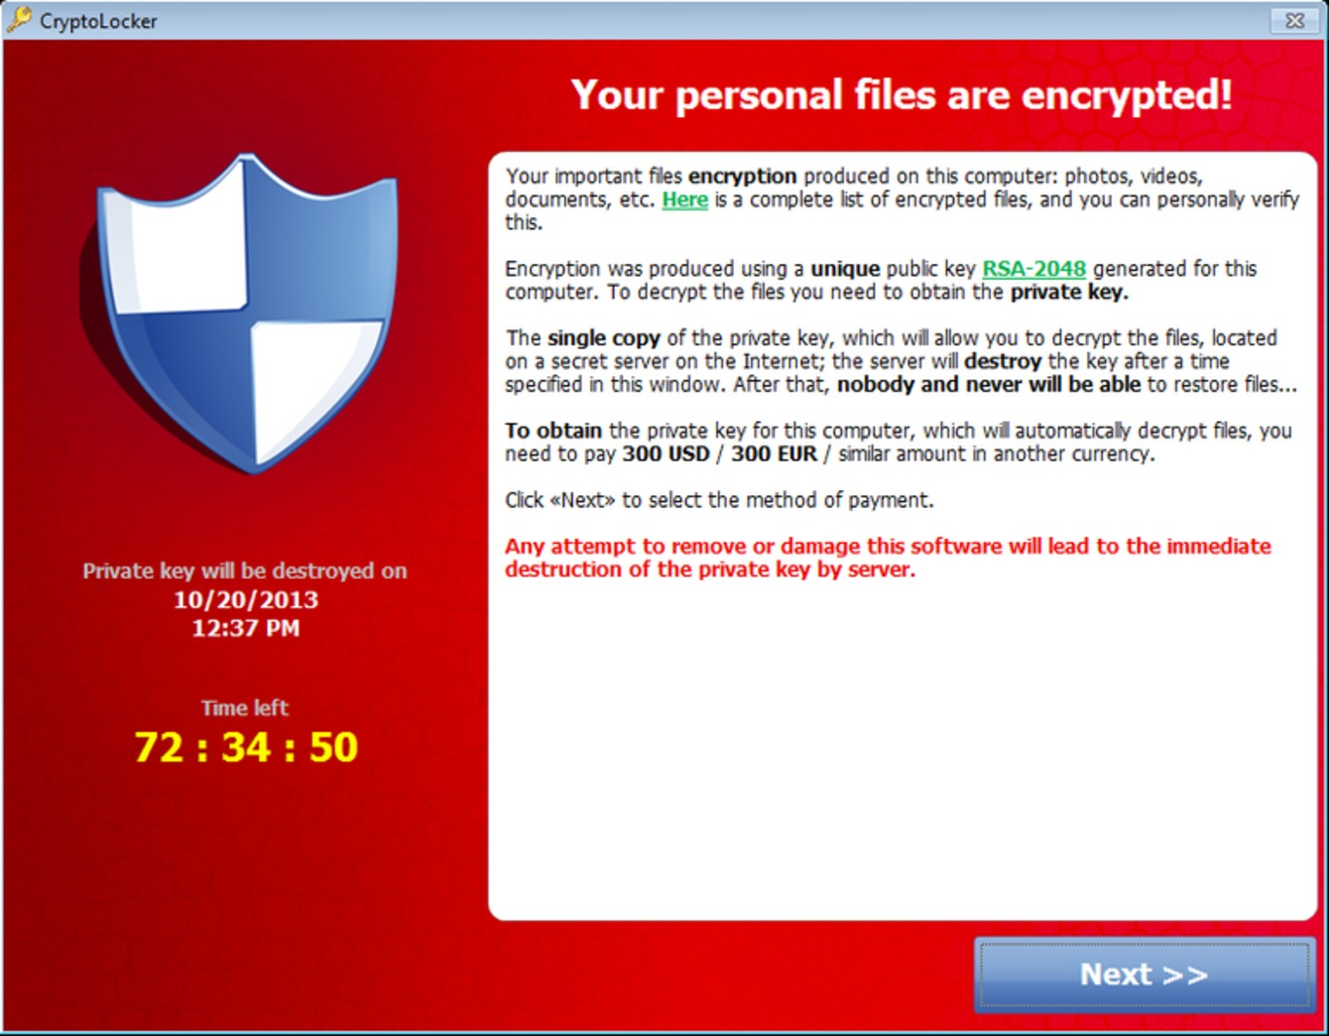
Backups - a Case Study
BAD
A large tax prep firm client of mine once had a lower-level employee browse Facebook on a company computer...
...who clicked a bad link...
...and got a cryptographic ransomware (cryptoware) on her PC...
...which encrypted all named/lettered drives on her PC: C:, D:, etc...
... including the company network share, which was mapped as Z:
WORSE

Slide 6
Backups - a Case Study - to the Rescue
The cryptography was not beatable, and the process ran as fast as it could on the server - we were able to observe it's presence before we killed it
The only reason they are still in business is because we had nightly backups of the company server, where all data was stored
We sure as heck weren't going to pay some jerk ransom money
FYI, nearly all of the cryptoware authors remain uncaught

Slide 7
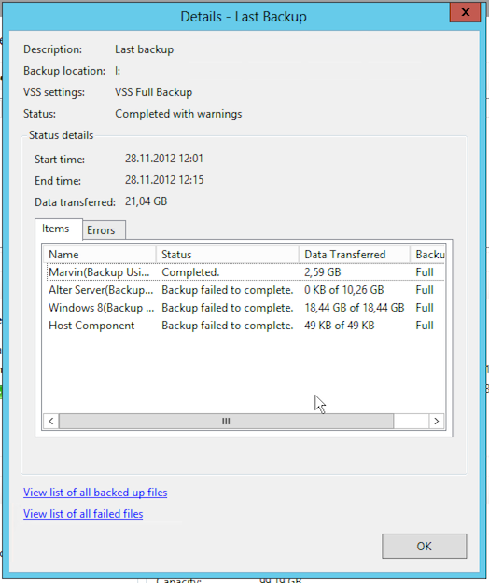

Windows Backup
Windows Server has a great backup tool built in!
Other backup tools include Acronis, Veeam, ShadowProtect, and a ton of others
Windows PC has a built-in backup client called File History
Fundamental issue is: if a USB or network drive is connected to your PC, you could lose it too, to a virus, flood, power surge, etc.; thus, that's not a valid backup
I have tested lots of them: Carbonite, Dropbox, iDrive, Shadow Protect PC, Google Drive, Box
My favorite is Dropbox

Slide 8
Backup System Classification
Dropbox, Box, etc. are not actually backup clients, but they are close
They're file versioning and sharing systems: previous versions of files often are only available for a month, so you better hope you notice a virus before then!
git is not a backup client, though it has similarities
It's a version control system
Long-term storage is properly called an archive: these should be periodically transferred off-site

Slide 9
Linux, Mac Backup, and Images
Linux backup is not built in, but there are lots of clients
Old-school techniques include rsync that are still widely used
Easy to set up in a cron job:
$ rsync -avzh /root/mycoolfiles /fileserver/mount/mycoolfiles5-5-2018
macOS uses Time Machine, a backup utility that keeps snapshots of your files and system state
Not designed to keep these as long-term, off-line archives
Images are a way to restore the entire computer back to an earlier state, just like restoring to a particular snapshot in VirtualBox
Famous applications include Ghost, Acronis, ShadowProtect, and Paragon
Images are normally kept as differentials: one master image is taken, and then "deltas" are taken that only record what has changed

Slide 10
Why Spend Time Talking About Backups?
Because above all else, your primary task is business continuity
If you fail at this, you will have failed at your entire job

Slide 11
RAID
Redundant Array of Independent Disks combines multiple drives into one (or more) big ones for performance improvement or redundancy
Difficult to simulate in a VM
Designed to provide fault tolerance with inexpensive disks
To the OS, these arrays appear as single disks (or multiple partitions), not as the component hard drives

Slide 12
Standard RAID Levels
RAID Level 0: Striping - Each file is distributed across multiple disks. Throughput is multiplied by number of disks at the cost of 100% vulnerability to any lost drive: if a drive drops, the whole array is lost.
RAID Level 1: Mirroring - Each file is written to two drives, not just one. Reading is done from whichever drive responds fastest. Large reads can be streamed from multiple drives, approaching RAID 1 speeds, but still limited to fastest drive. Writing speed is limited to slowest drive, as all have to be updated. Works as long as any drive still functions.

Slide 13
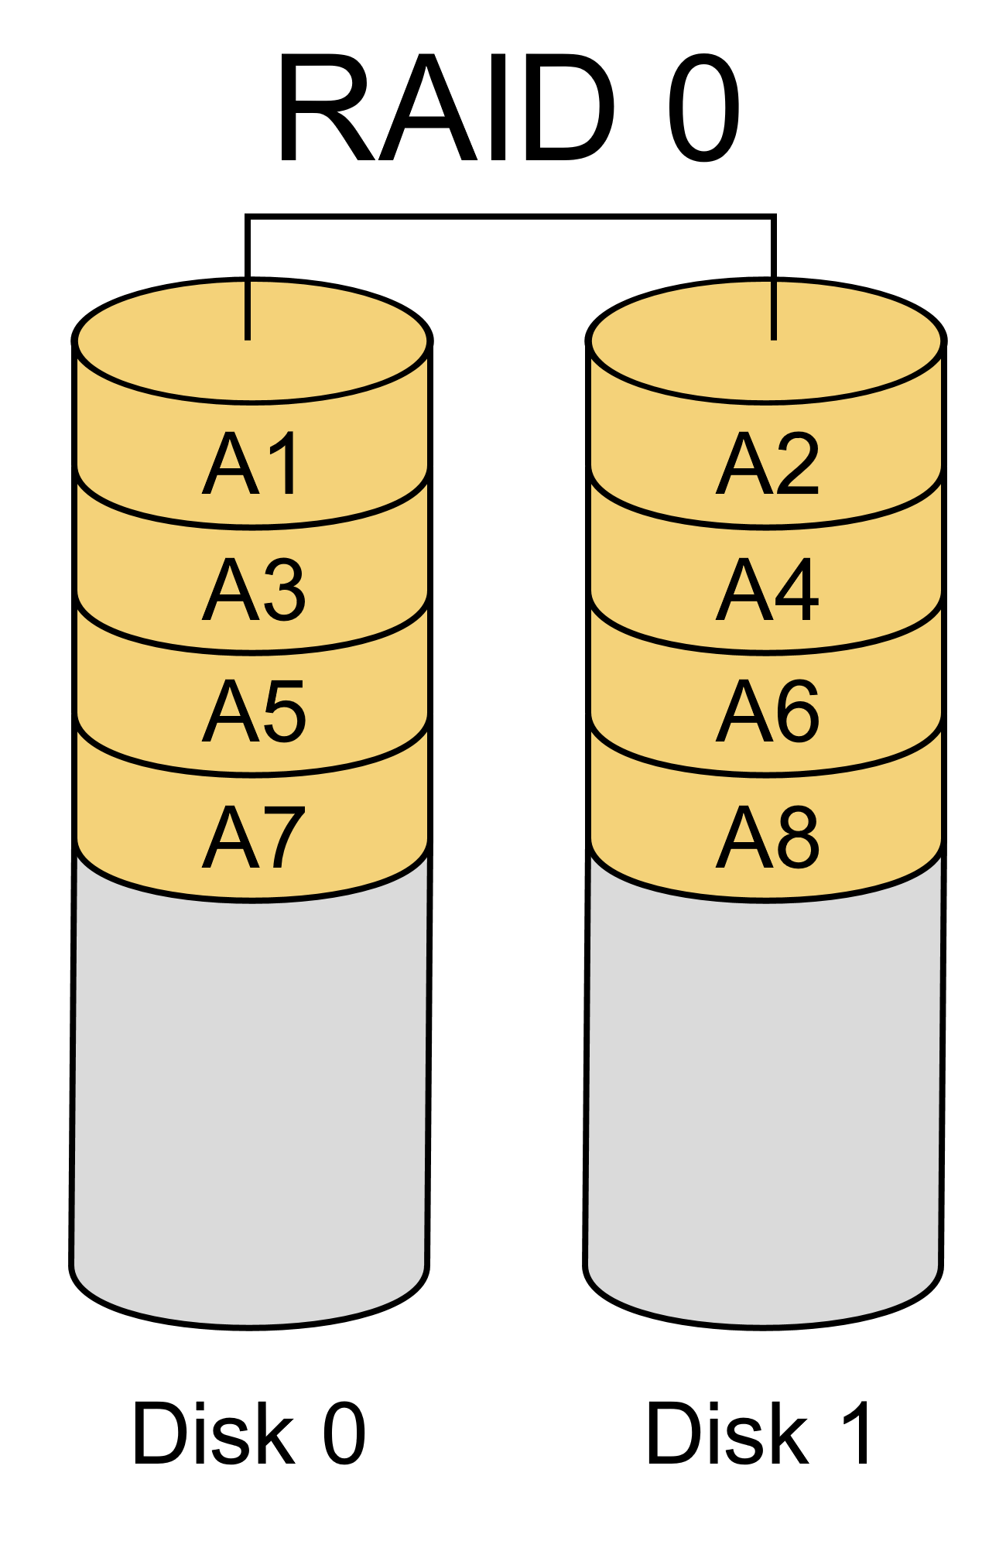
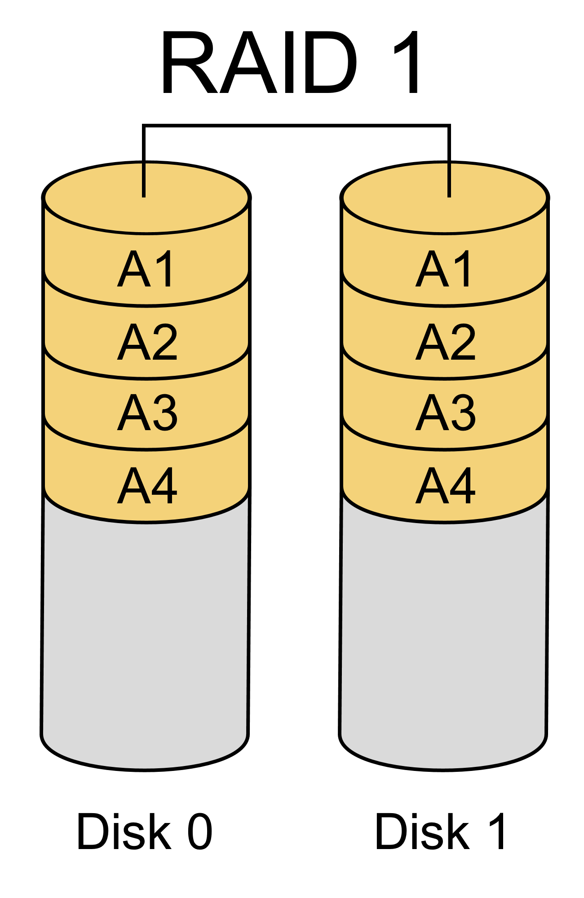
Standard RAID Levels
File
File
Copy
File
Copy
Base images by Wikipedia user Cburnett, CC BY-SA 3.0

Slide 14
Standard RAID Levels
RAID Level 5: Block striping, distributed parity - A block of data is distributed across multiple disks, but an extra parity drive is added. If any disk drops, it can be rebuilt by calculating the missing drive's contents from the others. Array rebuild thus requires reading all data from all drives, which causes stress: if they're all from the same manufacturer, another could fail at about the same time!
RAID Level 6: Block striping, double distributed parity - The same as RAID 5, but there are two parity drives, meaning that two can drop and the array can still be rebuilt (and function).

Slide 15
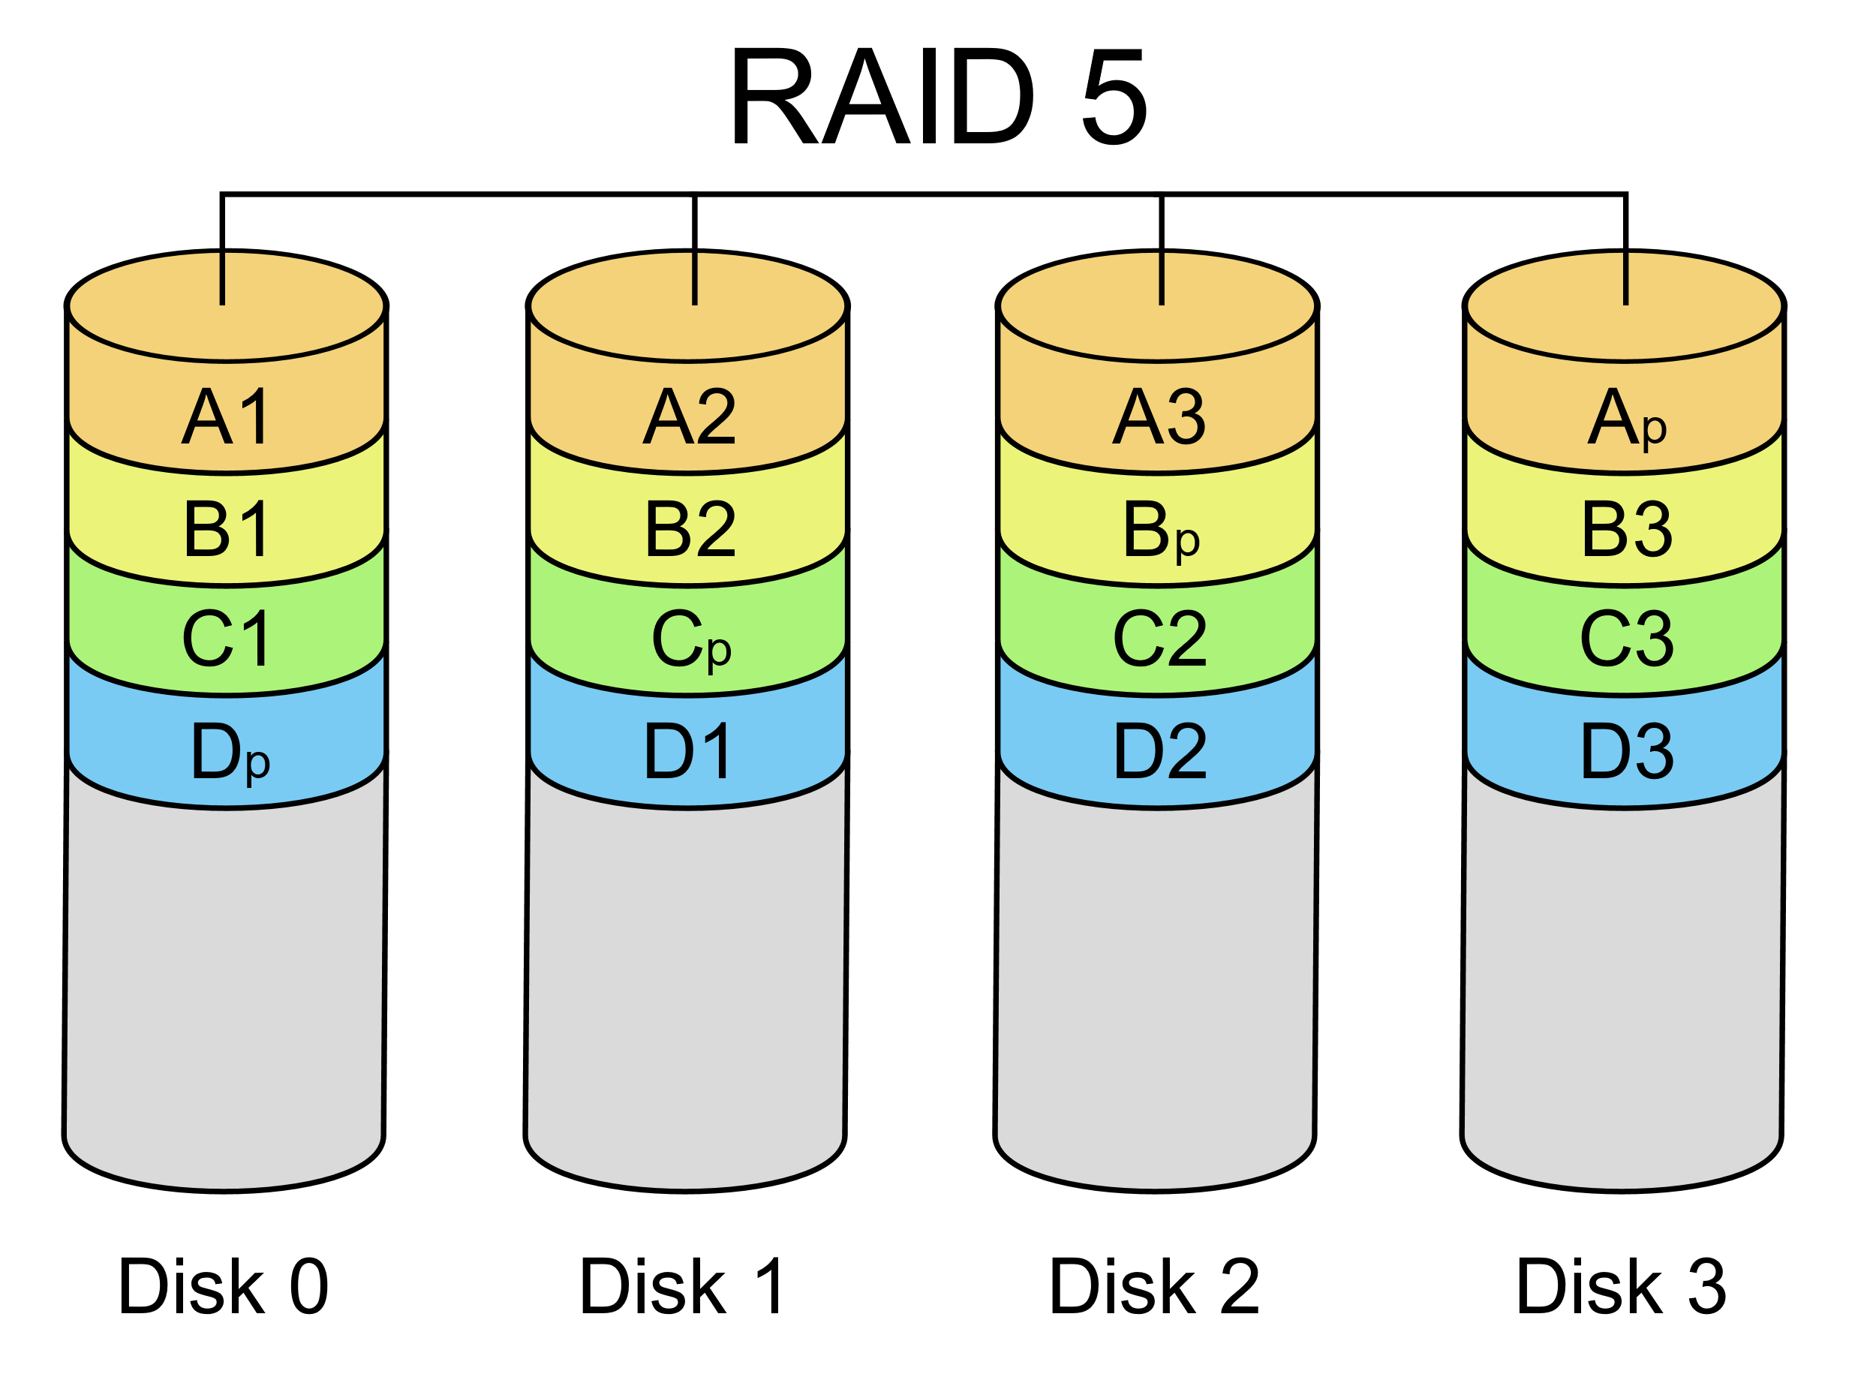
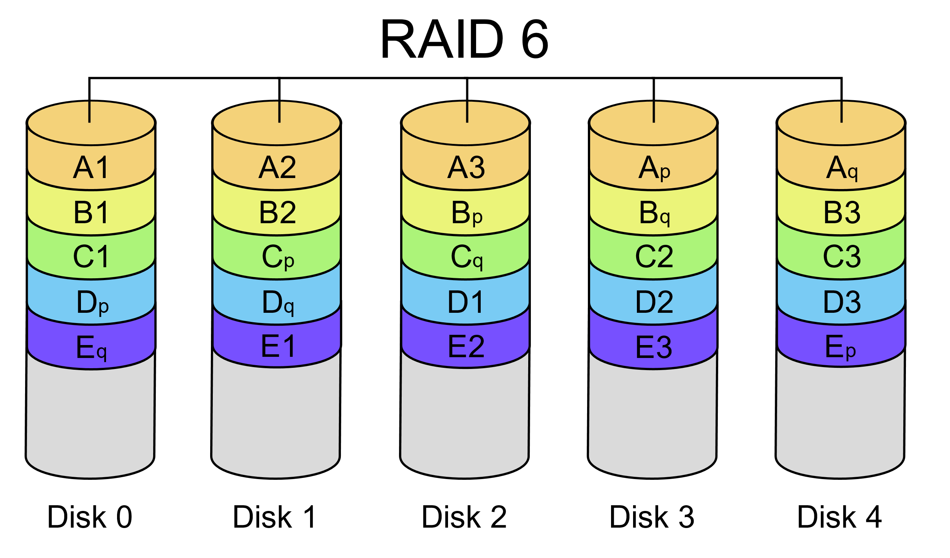
Standard RAID Levels
File
File
Base images by Wikipedia user Cburnett, CC BY-SA 3.0

Slide 16
Nested RAID Levels
RAID 0+1 - Creates two stripes, and then mirrors them. If a drive drops, one stripe is gone, but the other still functions. If this occurs, all data in the functioning stripe must be reread, causing the same problems and slowdown as RAID 5.
RAID 1+0 (aka 10) - Creates mirrors of stripes. If a drive goes down, data can be read from any drive in the mirrored set to fulfill the stripe. Rebuilding requires copying just one drive.

Slide 17
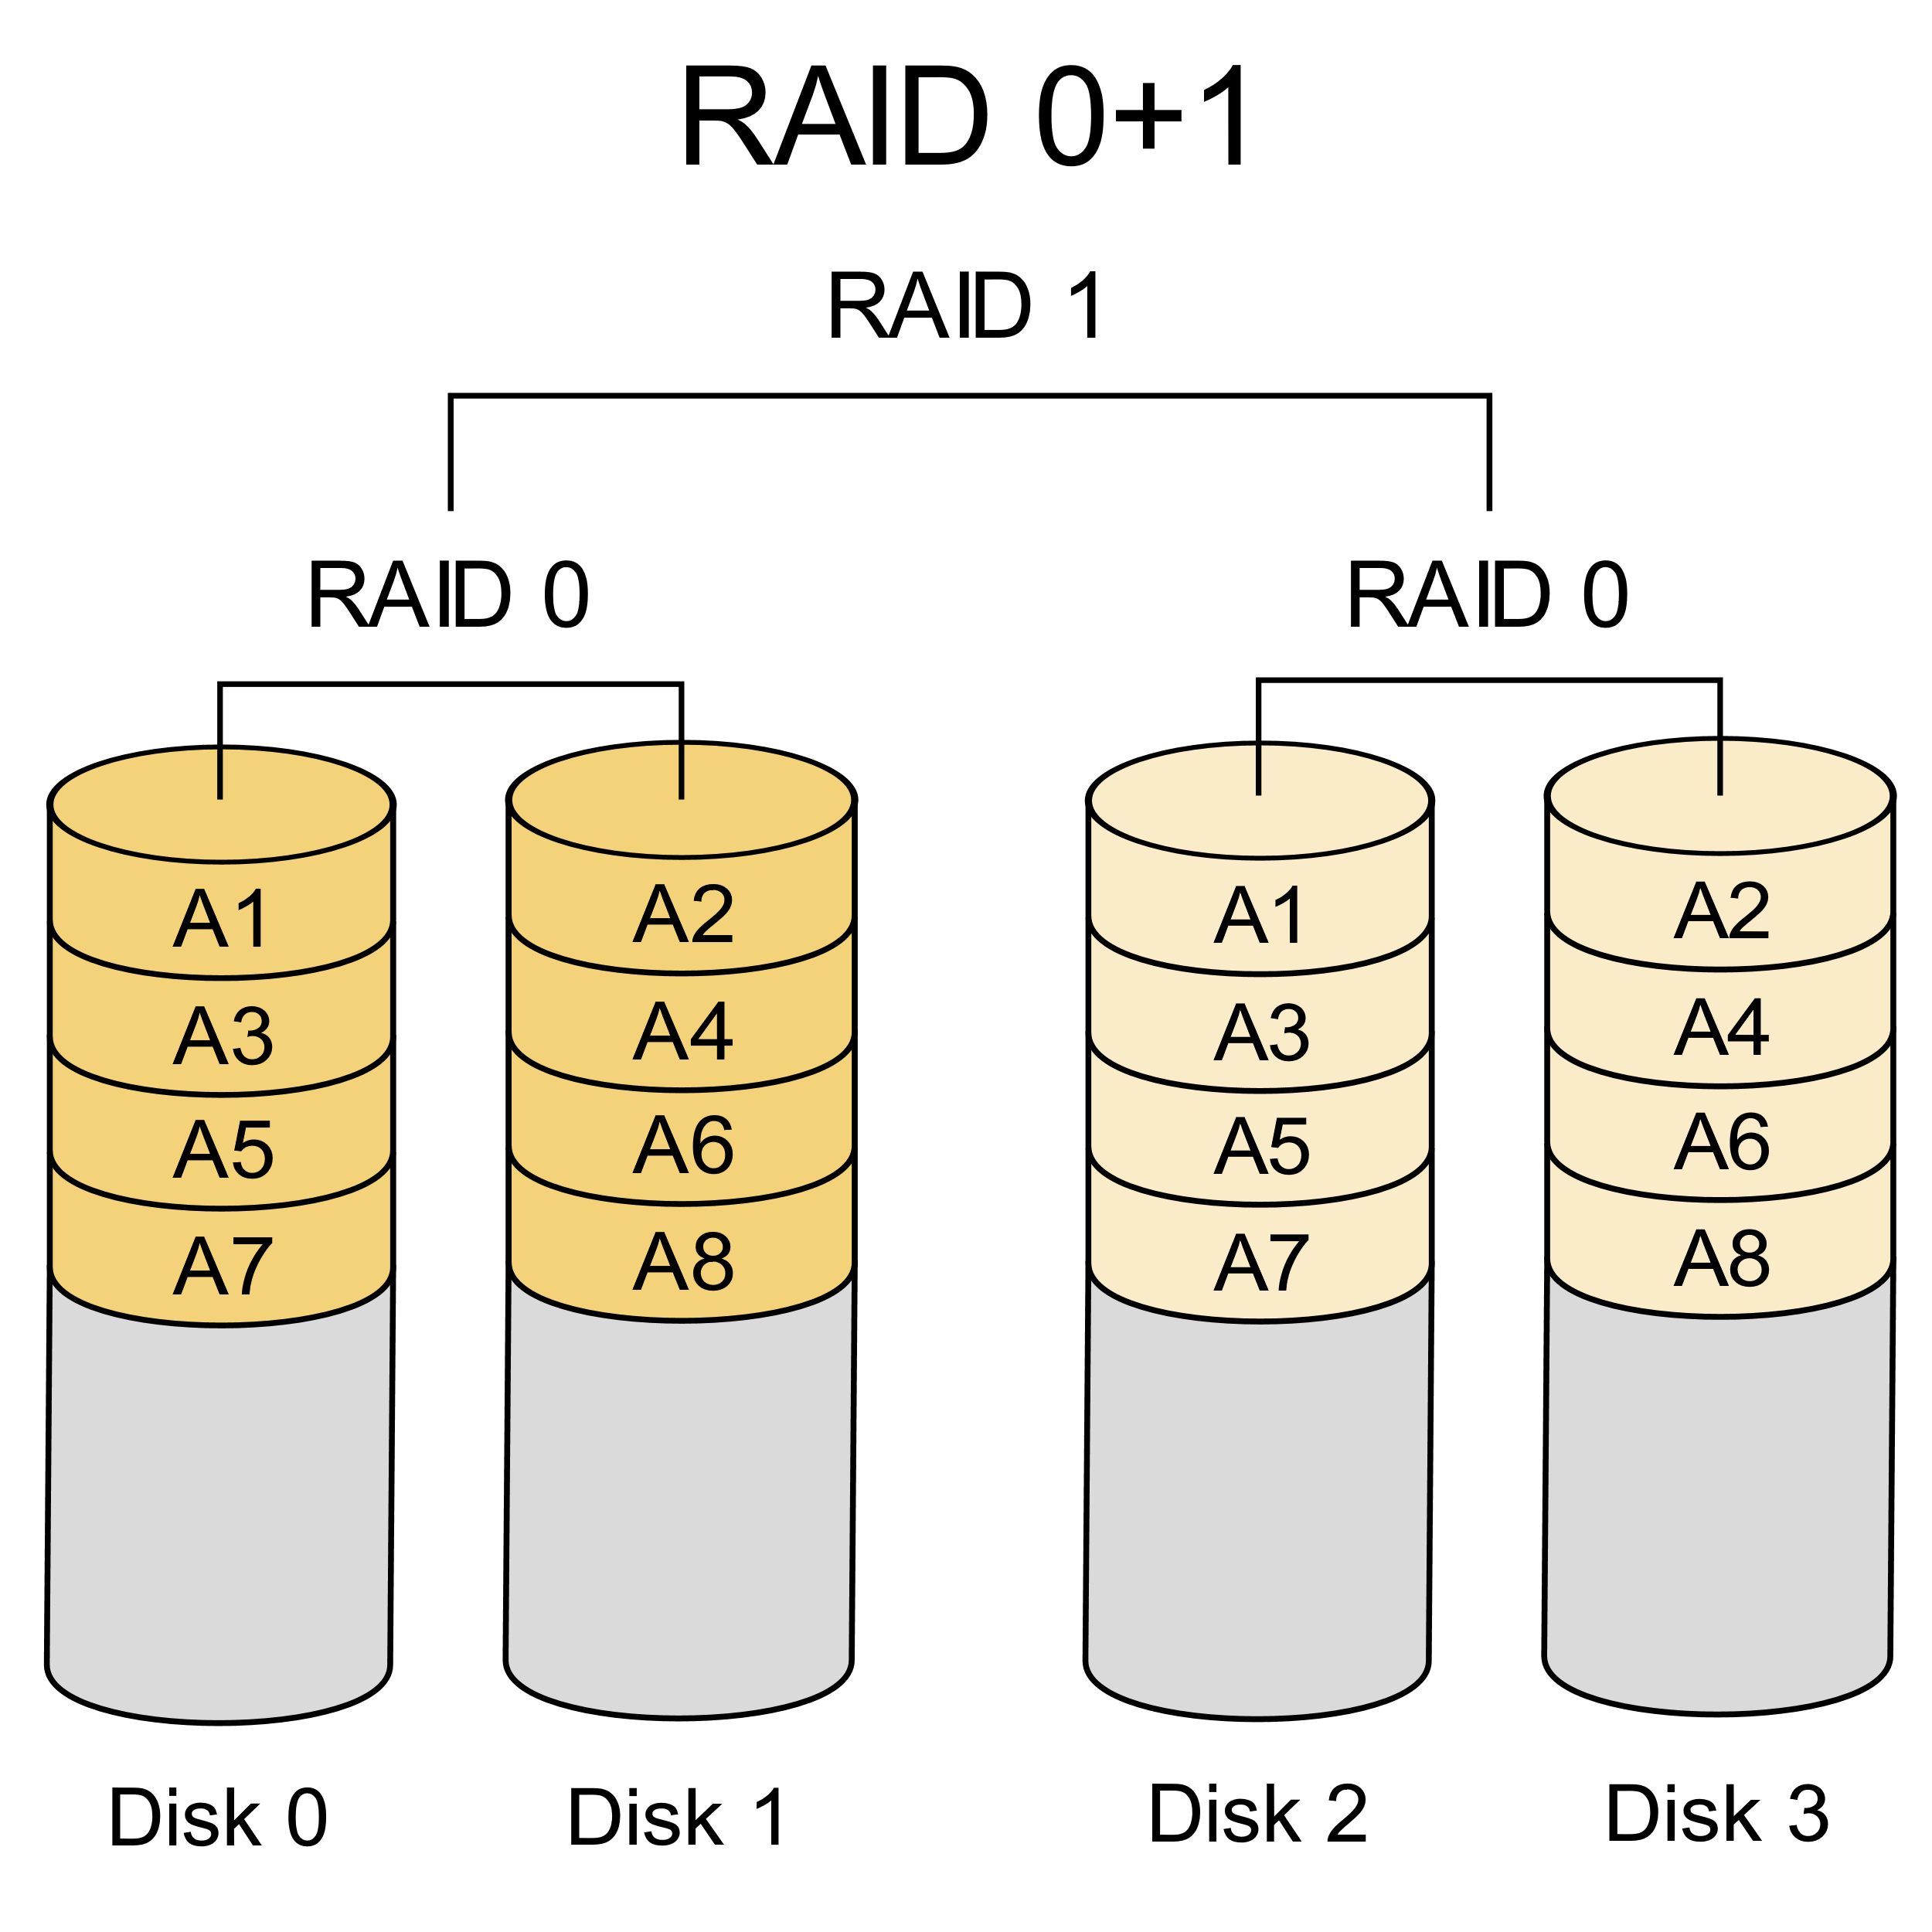
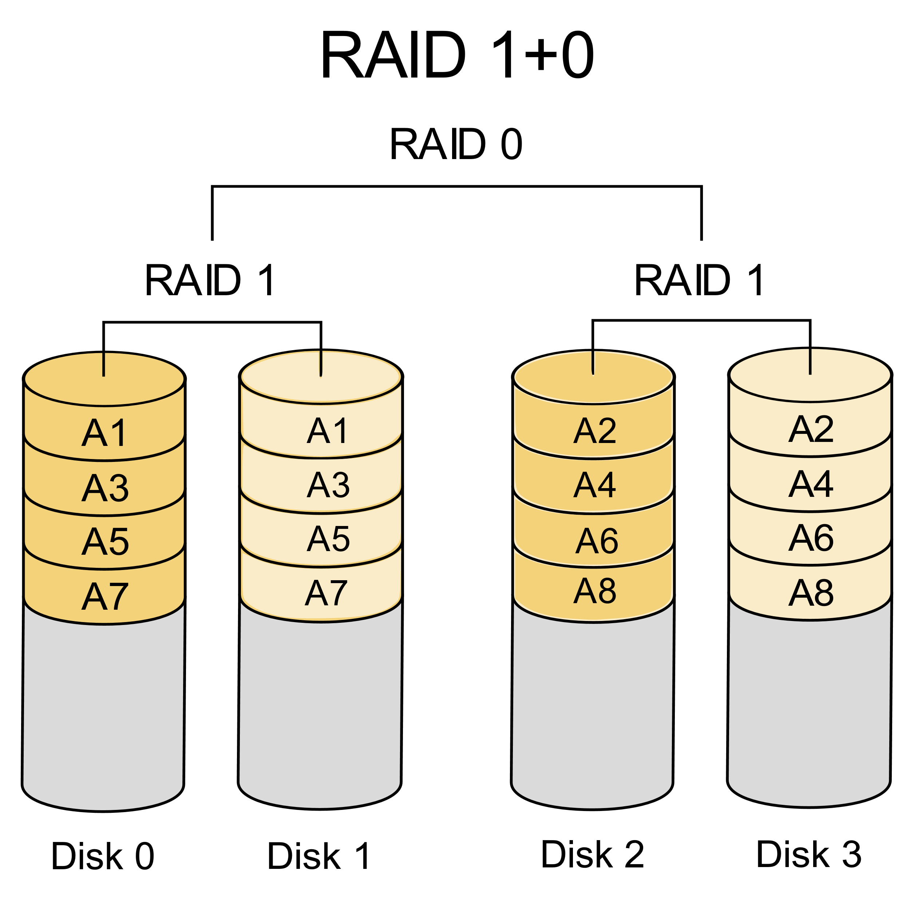
Nested RAID Levels
File
Piece
Copy
File
Piece
Copy
File
Copy
File
Copy
File
Base images by Wikipedia user Cburnett, CC BY-SA 3.0

Slide 18
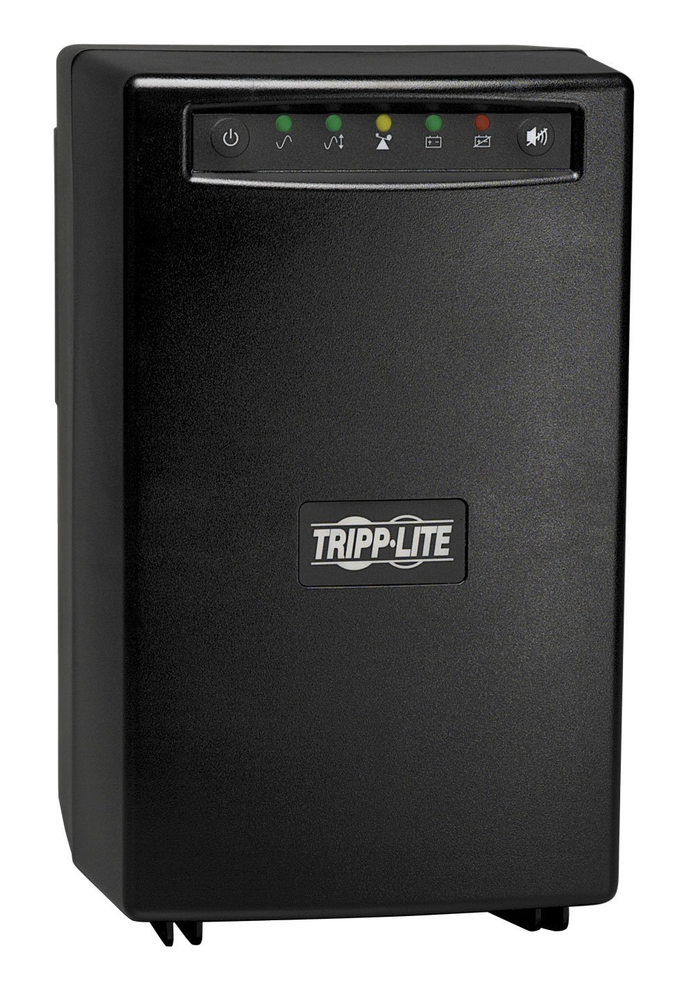
Uninterruptible Power Supplies
In the vein of business continuity, let's example UPS devices
Keep a consistent power level, no matter what the mains voltage does
Battery-backed
Pure sine wave
Consistent voltage
Alerting and reporting features
Can shutdown the server they're attached to (via network or USB cable) when the capacity is nearly exhausted
Tripp Lite SMART1500 :: Can provide almost one kilowatt @ 120VAC for ten minutes

Slide 19

Notifications
Speaking of notifications, we'll cover system monitoring and alerting in our last lecture
Knowing that a server or network is down is a BIG DEAL
I used a picture of a red Artisan KitchenAid mixer I own as the caller pic for the NOC when they would call, so that it would be bright red, and easy to see - I grew to loathe the call on sight, though I love the mixer

Slide 20
Log Files
Some people say that IT is just crawling through log files
...and they're right
We examined the Event Viewer in a previous lab: everything happening on a Windows box that writes to the logs can be viewed here, in excruciating detail
Logs can be pushed to a network or local server that runs a proprietary logging service, or to the industry standard syslog format
Logged message range in severity from "Emergency" to "Debug"

Slide 21
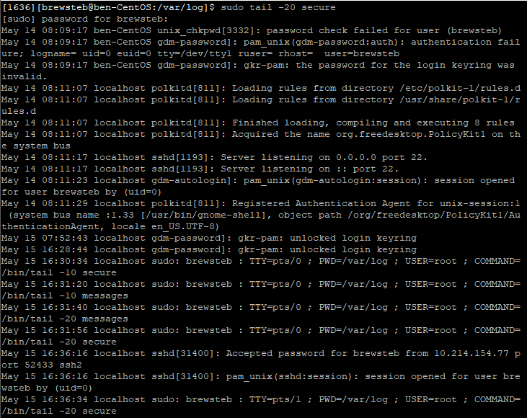
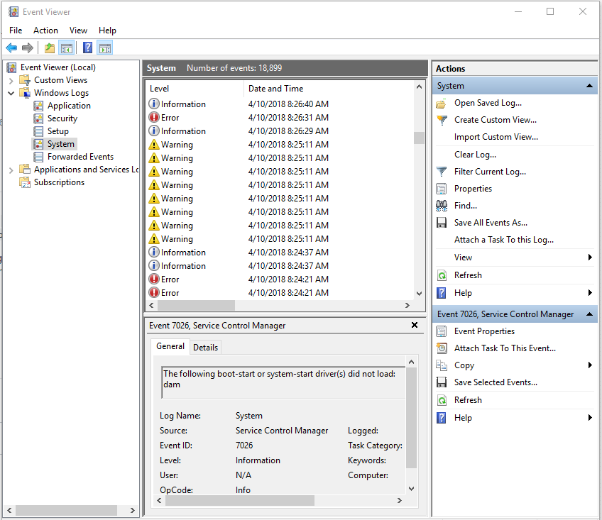

Slide 22
Environmental Concerns
The environment is out to destroy everything you hold dear by:
Flooding
Power surges
Overheating
Dust clogging
Earthquakes
Vermin invasion
There are sensors for pretty much all of this

Slide 23
Environmental Concerns
The environment is out to destroy everything you hold dear by:
Flooding (sometimes via frozen pipe explosion)
Power surges
Overheating
Dust clogging
Earthquakes
Vermin invasion
There are sensors for all of this!

Slide 24
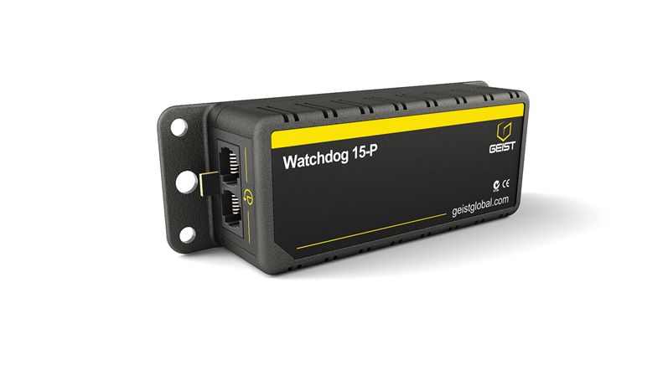

Environmental Concerns
This temperature, airflow, humidity, and dew point sensor plugs into this Watchdog 15-P climate monitor, and emails, texts, etc. when it reaches thresholds that you set

Slide 25
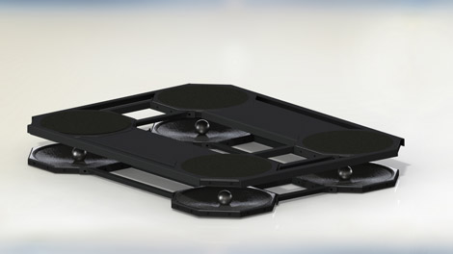
Environmental Concerns
This is the OCTO-Base seismic isolation system by WorkSafe Technologies
It's spec sheets tells the story: "Provides improved protection for larger seismic and blast events"

Slide 26
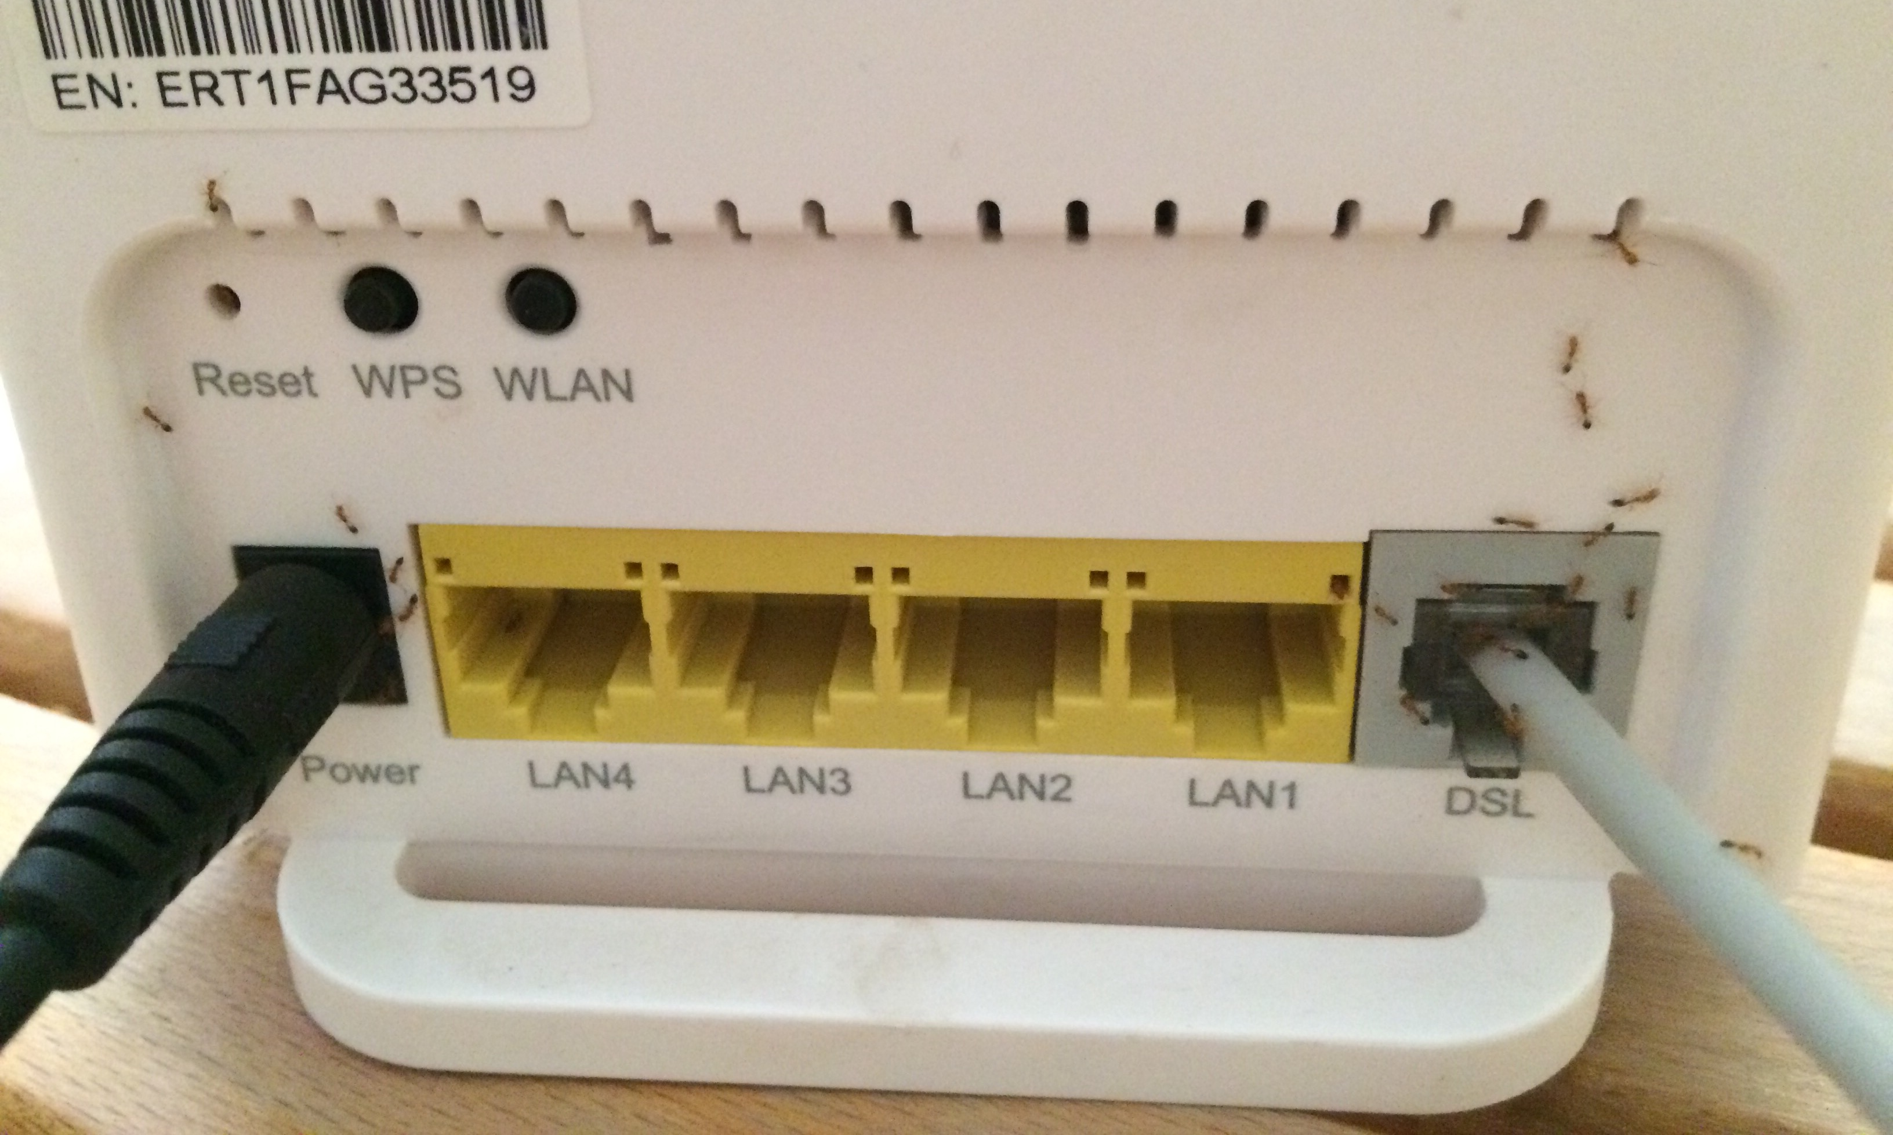
u/masafed on Reddit

Slide 27
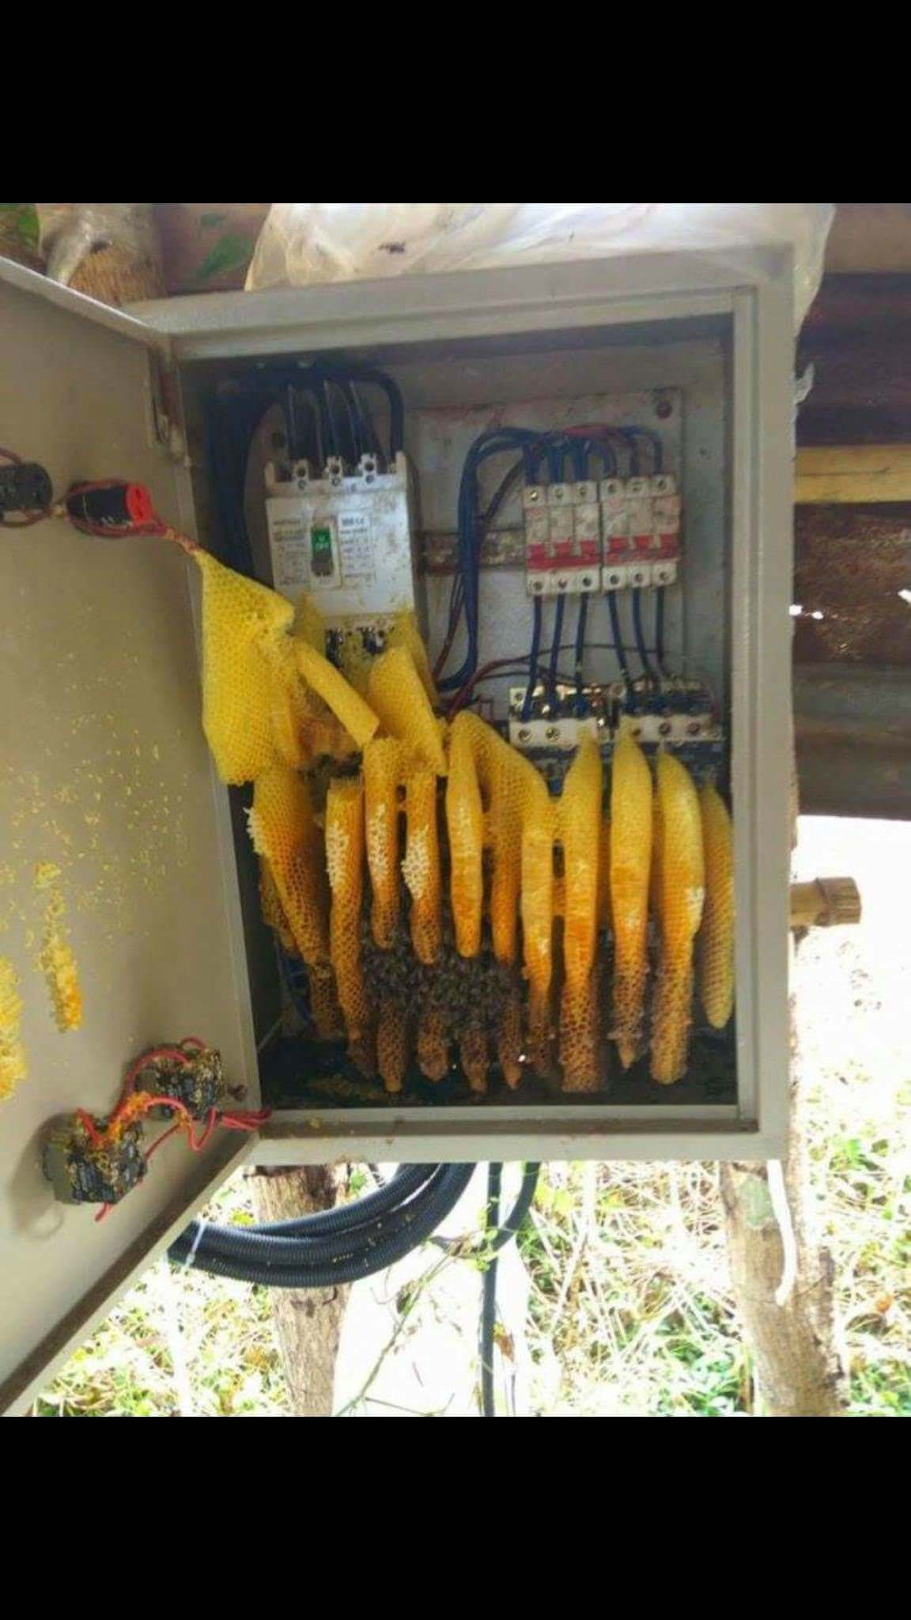
Peruse the r/techsupportgore subreddit for much more
https://www.reddit.com/r/techsupportgore/
u/Eskaminagaga on Reddit

Slide 28
Conclusion
Consumers always lie about what they did account, server, or network
Sometimes bombs will hit your servers - your backups had better be secure
Let the ants have the router (try peppermint oil)
Plan on having your hard drives fail in clusters, so keep spares on hand, and use drives from several manufacturers

