Slide 1
Computer Organization and Architecture (AT70.01)
Comp. Sc. and Inf. Mgmt.
Asian Institute of Technology
Instructor: Dr. Sumanta Guha
Slide Sources: Patterson &
Hennessy COD book website
(copyright Morgan Kaufmann)
adapted and supplemented

Slide 2
COD Ch. 4
Arithmetic for Computers

Slide 3
Arithmetic
Where we've been:
  performance
  abstractions
    instruction set architecture
    assembly language and machine language
What's up ahead:
  implementing the architecture
operation
a
32
ALU
result
32
b
32

Slide 4
Numbers
Bits are just bits (no inherent meaning)
  conventions define relationship between bits and numbers
Binary integers (base 2)
  0000 0001 0010 0011 0100 0101 0110 0111 1000 1001...
  decimal: 0, …, 2^{n}-1
Of course it gets more complicated:
  bit strings are finite, but
    for some fractions and real numbers, finitely many bits is not enough, so
    overflow & approximation errors: e.g., represent 1/3 as binary!
  negative integers
How do we represent negative integers?
  which bit patterns will represent which integers?
n bits

Slide 5
Possible Representations
Sign Magnitude: One's Complement Two's Complement
000 = 0 000 = 0 000 = 0
001 = +1 001 = +1 001 = +1
010 = +2 010 = +2 010 = +2
011 = +3 011 = +3 011 = +3
100 = 0 100 = -3 100 = -4
101 = -1 101 = -2 101 = -3
110 = -2 110 = -1 110 = -2
111 = -3 111 = 0 111 = -1
Issues:
  balance – equal number of negatives and positives
  ambiguous zero – whether more than one zero representation
  ease of arithmetic operations
Which representation is best? Can we get both balance and non-ambiguous zero?
ambiguous zero
unequal no. of negatives
and positives; unique zero
ambiguous zero

Slide 6
Representation Formulae
Two’s complement:
x_{n} x_{n-1}…x₀ = x_{n} * -2^{n} + x_{n-1} * 2^{n-1} + … + x₀ * 2⁰
or
x_{n}X’ = x_{n} * -2^{n} + X’ (writing rightmost n bits x_{n-1}…x₀ as X’)
= X’, if x_{n} = 0
-2^{n} + X’, if x_{n} = 1
One’s complement:
x_{n}X’ = X’, if x_{n} = 0
-2^{n} + 1 + X’, if x_{n} = 1

Slide 7
MIPS – 2’s complement
32 bit signed numbers:
0000 0000 0000 0000 0000 0000 0000 0000_{two} = 0_{ten}
0000 0000 0000 0000 0000 0000 0000 0001_{two} = + 1_{ten}
0000 0000 0000 0000 0000 0000 0000 0010_{two} = + 2_{ten}
...
0111 1111 1111 1111 1111 1111 1111 1110_{two} = + 2,147,483,646_{ten}
0111 1111 1111 1111 1111 1111 1111 1111_{two} = + 2,147,483,647_{ten}
1000 0000 0000 0000 0000 0000 0000 0000_{two} = – 2,147,483,648_{ten}
1000 0000 0000 0000 0000 0000 0000 0001_{two} = – 2,147,483,647_{ten}
1000 0000 0000 0000 0000 0000 0000 0010_{two} = – 2,147,483,646_{ten}
...
1111 1111 1111 1111 1111 1111 1111 1101_{two} = – 3_{ten}
1111 1111 1111 1111 1111 1111 1111 1110_{two} = – 2_{ten}
1111 1111 1111 1111 1111 1111 1111 1111_{two} = – 1_{ten}
maxint
minint
Negative integers are exactly those that have leftmost bit 1

Slide 8
Two's Complement Operations
Negation Shortcut: To negate any two's complement integer (except for minint) invert all bits and add 1
  note that negate and invert are different operations!
  why does this work? Remember we don’t know how to add in 2’s complement yet! Later…!
Sign Extension Shortcut: To convert an n-bit integer into an integer with more than n bits – i.e., to make a narrow integer fill a wider word – replicate the most significant bit (msb) of the original number to fill the new bits to its left
  Example: 4-bit 8-bit
  0010 = 0000 0010
  1010 = 1111 1010
  why is this correct? Prove!

Slide 9
MIPS Notes
lb vs. lbu
  signed load sign extends to fill 24 left bits
  unsigned load fills left bits with 0’s
slt & slti
  compare signed numbers
sltu & sltiu
  compare unsigned numbers, i.e., treat
  both operands as non-negative

Slide 10
Two’s Complement Addition
Perform add just as in junior school (carry/borrow 1s)
  Examples (4-bits):
  0101 0110 1011 1001 1111
  0001 0101 0111 1010 1110
  Do these sums now!! Remember all registers are 4-bit including result register!
  So you have to throw away the carry-out from the msb!!
Have to beware of overflow : if the fixed number of bits (4, 8, 16, 32, etc.) in a register cannot represent the result of the operation
  terminology alert: overflow does not mean there was a carry-out from the msb that we lost (though it sounds like that!) – it means simply that the result in the fixed-sized register is incorrect
    as can be seen from the above examples there are cases when the result is correct even after losing the carry-out from the msb

Slide 11
Two’s Complement Addition: Verifying Carry/Borrow method
Two (n+1)-bit integers: X = x_{n}X’, Y = y_{n}Y’
x_{n} = 0, y_{n} = 0 ok not ok(overflow!)
x_{n} = 1, y_{n} = 0 ok ok
x_{n} = 0, y_{n} = 1 ok ok
x_{n} = 1, y_{n} = 1 not ok(overflow!) ok
Prove the cases above!
Prove if there is one more bit (total n+2 then) available for the result then there is no problem with overflow in add!
Carry/borrow
add X + Y
0 ≤ X’ + Y’ < 2^{n}
(no CarryIn to last bit)
2^{n} ≤ X’ + Y’ < 2^{n+1} – 1
(CarryIn to last bit)

Slide 12
Two's Complement Operations
Now verify the negation shortcut!
  consider X + (X +1) = (X + X) + 1:
  associative law – but what if there is overflow in one of the adds on either side, i.e., the result is wrong…!
  think minint !
  Examples:
    –0101 = 1010 + 1 = 1011
    –1100 = 0011 + 1 = 0100
    –1000 = 0111 + 1 = 1000

Slide 13
Detecting Overflow
No overflow when adding a positive and a negative number
No overflow when subtracting numbers with the same sign
Overflow occurs when the result has “wrong” sign (verify!):
  Operation Operand A Operand B Result
  Indicating Overflow
  A + B ≥ 0 ≥ 0 < 0
  A + B < 0 < 0 ≥ 0
  A – B ≥ 0 < 0 < 0
  A – B < 0 ≥ 0 ≥ 0
Consider the operations A + B, and A – B
  can overflow occur if B is 0 ?
  can overflow occur if A is 0 ?

Slide 14
Effects of Overflow
If an exception (interrupt) occurs
  control jumps to predefined address for exception
  interrupted address is saved for possible resumption
Details based on software system/language
  SPIM: see the EPC and Cause registers
Don't always want to cause exception on overflow
  add, addi, sub cause exceptions on overflow
  addu, addiu, subu do not cause exceptions on overflow

Slide 15
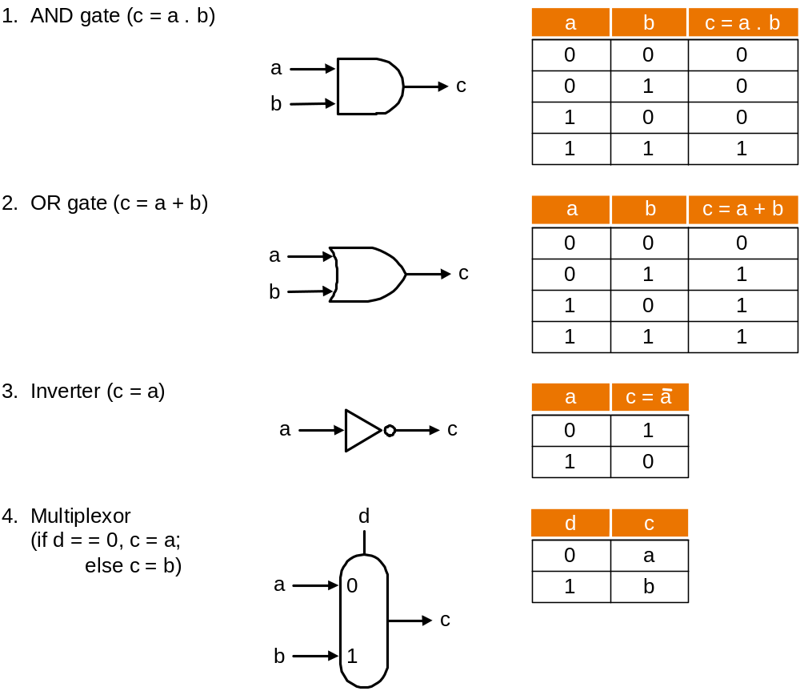
Review: Basic Hardware

Slide 16
Review: Boolean Algebra & Gates
Problem: Consider logic functions with three inputs: A, B, C.
  output D is true if at least one input is true
  output E is true if exactly two inputs are true
  output F is true only if all three inputs are true
Show the truth table for these three functions
Show the Boolean equations for these three functions
Show an implementation consisting of inverters, AND, and OR gates.

Slide 17
A Simple Multi-Function Logic Unit
To warm up let's build a logic unit to support the and and or instructions for MIPS (32-bit registers)
  we'll just build a 1-bit unit and use 32 of them
Possible implementation using a multiplexor :
operation
selector
a
output
b

Slide 18
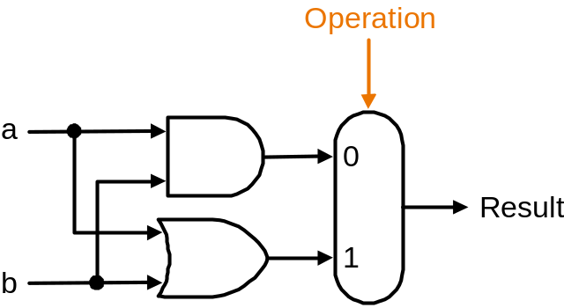
Implementation with a Multiplexor
Selects one of the inputs to be the output
based on a control input
Lets build our ALU using a MUX (multiplexor):
.
.
.
32 units

Slide 19
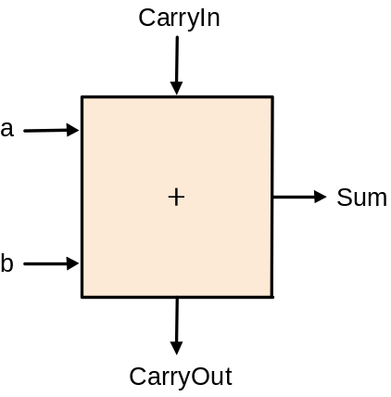
Implementations
Not easy to decide the best way to implement something
  do not want too many inputs to a single gate
  do not want to have to go through too many gates (= levels)
  for our purposes, ease of comprehension is important
Let's look at a 1-bit ALU for addition:
How could we build a 1-bit ALU for add, and, and or?
How could we build a 32-bit ALU?
c_{out} = a.b + a.c_{in} + b.c_{in}
sum = a.b.c_{in} + a.b.c_{in} +
a.b.c_{in} + a.b.c_{in}
= a ⊕ b ⊕ c_{in}
exclusive or (xor)

Slide 20
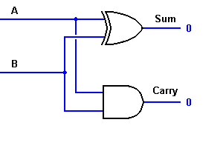
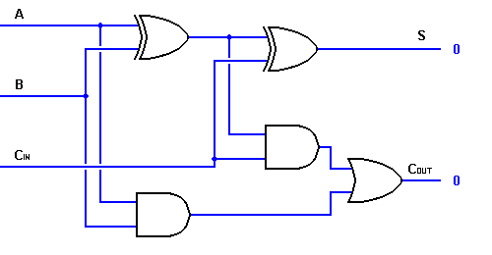
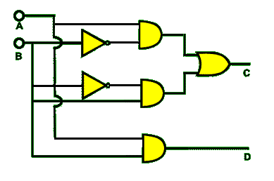
1-bit Adder Logic
xor
Half-adder with one xor gate
Full-adder from 2 half-adders and
an or gate
Half-adder with the xor gate replaced
by primitive gates using the equation
A⊕B = A.B +A.B

Slide 21
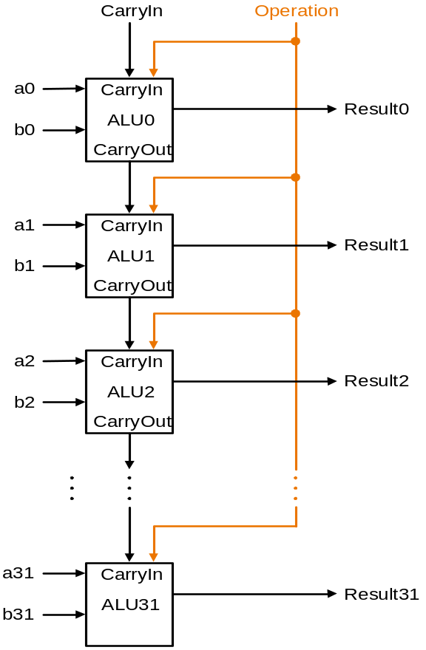
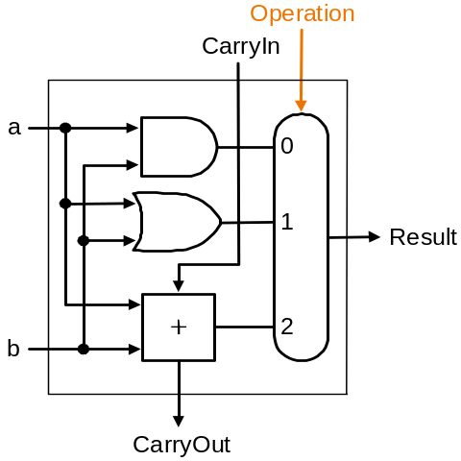
Building a 32-bit ALU
Multiplexor control line
1-bit ALU for AND, OR and add
Ripple-Carry Logic for 32-bit ALU

Slide 22
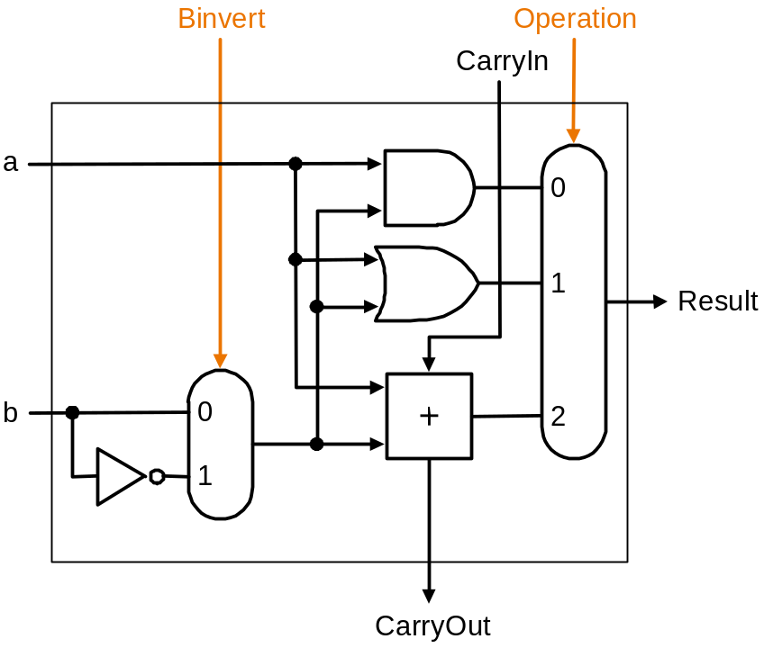
What about Subtraction (a – b) ?
Two's complement approach: just negate b and add.
How do we negate?
  recall negation shortcut : invert each bit of b and set CarryIn to least significant bit (ALU0) to 1

Slide 23
Tailoring the ALU to MIPS:
Test for Less-than and Equality
Need to support the set-on-less-than instruction
  e.g., slt $t0, $t3, $t4
  remember: slt is an R-type instruction that produces 1 if rs < rt and 0 otherwise
  idea is to use subtraction: rs < rt ⇔ rs – rt < 0. Recall msb of negative number is 1
  two cases after subtraction rs – rt:
    if no overflow then rs < rt ⇔ most significant bit of rs – rt = 1
    if overflow then rs < rt ⇔ most significant bit of rs – rt = 0
  why?
  e.g., 5_{ten} – 6_{ten} = 0101 – 0110 = 0101 + 1010 = 1111 (ok!)
  -7_{ten} – 6_{ten} = 1001 – 0110 = 1001 + 1010 = 0011 (overflow!)
  therefore
  set bit = msb of rs – rt ⊕ overflow bit
  where set bit, which is output from ALU31, gives the result of slt
    Fig. 4.17(lower) indicates set bit is the adder output – not correct !!
  set bit is sent from ALU31 to ALU0 as the Less bit at ALU0; all other Less bits are hardwired 0; so Less is the 32-bit result of slt

Slide 24
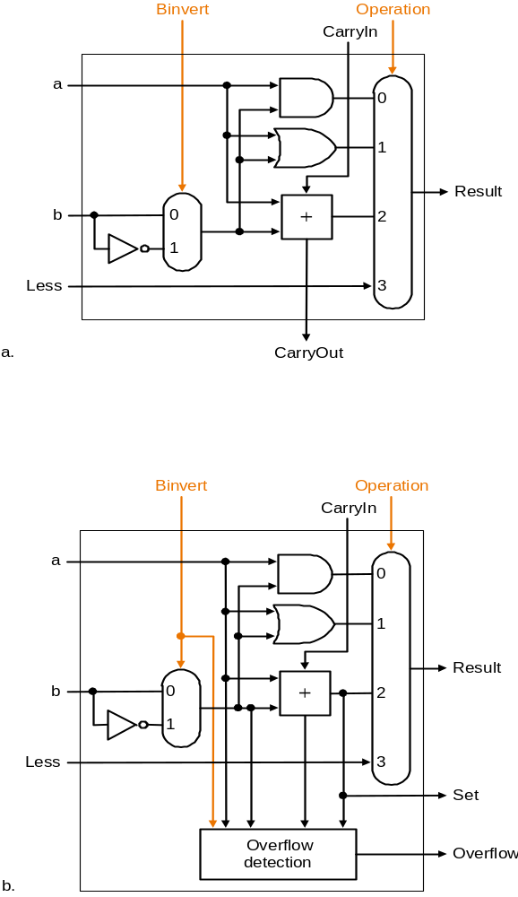
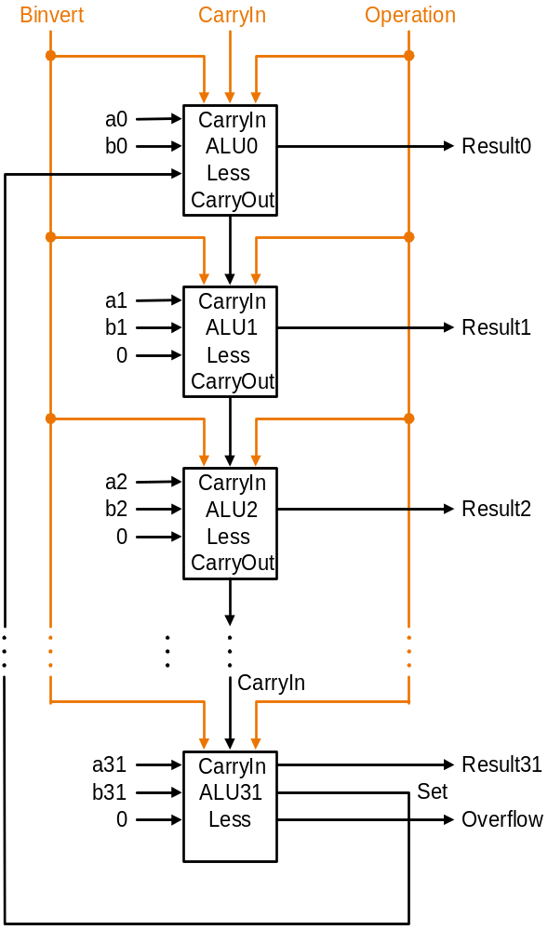
Supporting slt
Less input of
the 31 most significant ALUs
is always 0
1- bit ALU for the 31 least significant bits
Extra set bit, to be routed to the Less input of the least significant 1-bit
ALU, is computed from the most significant Result bit and the Overflow bit
(it is not the output of the adder as the figure seems to indicate)
32-bit ALU from 31 copies of ALU at top left and 1 copy
of ALU at bottom left in the most significant position
1-bit ALU for the most significant bit

Slide 25
Tailoring the ALU to MIPS:
Test for Less-than and Equality
What about logic for the overflow bit ?
  overflow bit = carry in to msb ⊕ carry out of msb
  verify!
  logic for overflow detection therefore can be put in to ALU31
Need to support test for equality
  e.g., beq $t5, $t6, $t7
  use subtraction: rs - rt = 0 ⇔ rs = rt
  do we need to consider overflow?

Slide 26
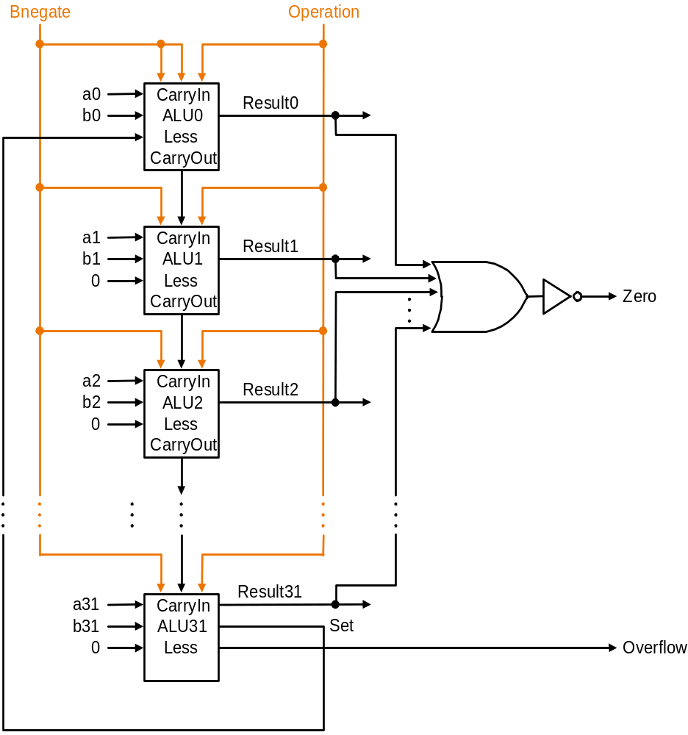
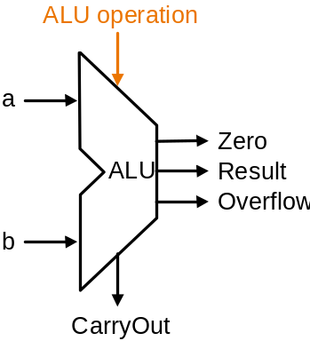
Supporting
Test for Equality
ALU
control
lines
Bneg- Oper- Func-
ate ation tion
0 00 and
0 01 or
0 10 add
1 10 sub
1 11 slt
Combine CarryIn
to least significant
ALU and Binvert to
a single control line
as both are always
either 1 or 0
Output is 1 only if all Result bits are 0
Symbol representing ALU
32-bit MIPS ALU

Slide 27
Conclusion
We can build an ALU to support the MIPS instruction set
  key idea: use multiplexor to select the output we want
  we can efficiently perform subtraction using two’s complement
  we can replicate a 1-bit ALU to produce a 32-bit ALU
Important points about hardware
  all gates are always working
  speed of a gate depends number of inputs (fan-in) to the gate
  speed of a circuit depends on number of gates in series
  (particularly, on the critical path to the deepest level of logic)
Speed of MIPS operations
  clever changes to organization can improve performance
  (similar to using better algorithms in software)
  we’ll look at examples for addition, multiplication and division

Slide 28
Problem: Ripple-carry Adder is Slow
Is a 32-bit ALU as fast as a 1-bit ALU? Why?
Is there more than one way to do addition? Yes:
  one extreme: ripple-carry – carry ripples through 32 ALUs, slow!
  other extreme: sum-of-products for each CarryIn bit – super fast!
  CarryIn bits:
c₁ = b₀.c₀ + a₀.c₀ + a₀.b₀
c₂ = b₁.c₁ + a₁.c₁ + a₁.b₁
= a₁.a₀.b₀ + a₁.a₀.c₀ + a₁.b₀.c₀ (substituting for c₁)
+ b₁.a₀.b₀ + b₁.a₀.c₀ + b₁.b₀.c₀ + a₁.b₁
c₃ = b₂.c₂ + a₂.c₂ + a₂.b₂
= … = sum of 15 4-term products…
    How fast? But not feasible for a 32-bit ALU! Why? Exponential complexity!!
Note: c_{i} is CarryIn bit into i th ALU;
c₀ is the forced CarryIn into the
least significant ALU

Slide 29
Two-level Carry-lookahead Adder: First Level
An approach between our two extremes
Motivation:
  if we didn't know the value of a carry-in, what could we do?
  when would we always generate a carry? (generate) g_{i} = a_{i} . b_{i}
  when would we propagate the carry? (propagate) p_{i} = a_{i} + b_{i}
Express (carry-in equations in terms of generate/propagates)
c₁ = g₀ + p₀.c₀
c₂ = g₁ + p₁.c₁ = g₁ + p₁.g₀ + p₁.p₀.c₀
c₃ = g₂ + p₂.c₂ = g₂ + p₂.g₁ + p₂.p₁.g₀ + p₂.p₁.p₀.c₀
c₄ = g₃ + p₃.c₃ = g₃ + p₃.g₂ + p₃.p₂.g₁ + p₃.p₂.p₁.g₀
+ p₃.p₂.p₁.p₀.c₀
Feasible for 4-bit adders – with wider adders unacceptable complexity.
  solution: build a first level using 4-bit adders, then a second level on top

Slide 30
Two-level Carry-lookahead Adder: Second Level for a
16-bit adder
Propagate signals for each of the four 4-bit adder blocks:
P₀ = p₃.p₂.p₁.p₀
P₁ = p₇.p₆.p₅.p₄
P₂ = p₁₁.p₁₀.p₉.p₈
P₃ = p₁₅.p₁₄.p₁₃.p₁₂
Generate signals for each of the four 4-bit adder blocks:
G₀ = g₃ + p₃.g₂ + p₃.p₂.g₁ + p₃.p₂.p₁.g₀
G₁ = g₇ + p₇.g₆ + p₇.p₆.g₅ + p₇.p₆.p₅.g₄
G₂ = g₁₁ + p₁₁.g₁₀ + p₁₁.p₁₀.g₉ + p₁₁.p₁₀.p₉.g₈
G₃ = g₁₅ + p₁₅.g₁₄ + p₁₅.p₁₄.g₁₃ + p₁₅.p₁₄.p₁₃.g₁₂

Slide 31
Two-level Carry-lookahead Adder: Second Level for a
16-bit adder
CarryIn signals for each of the four 4-bit adder blocks (see earlier carry-in equations in terms of generate/propagates):
C₁ = G₀ + P₀.c₀
C₂ = G₁ + P₁.G₀ + P₁.P₀.c₀
C₃ = G₂ + P₂.G₁ + P₂.P₁.G₀ + P₂.P₁.P₀.c₀
C₄ = G₃ + P₃.G₂ + P₃.P₂.G₁ + P₃.P₂.P₁.G₀ + P₃.P₂.P₁.P₀.c₀

Slide 32
Carry-lookahead
Logic
C
a
r
r
y
I
n
a
0
C
a
r
r
y
I
n
b
0
R
e
s
u
l
t
0
-
-
3
a
1
4bAdder0
b
1
CarryIn
a
2
P
0
Carry-lookahead Unit
b
2
G
0
a
3
b
3
C
1
a
4
a0
ALU0
b
4
C
a
r
r
y
I
n
b0
s0
a
5
R
e
s
u
l
t
4
-
-
7
b
5
4bAdder1
a
6
P
1
a1
ALU1
s1
b
6
G
1
b1
Logic to compute
c1, c2, c3, c4, P0, G0
a
7
b
7
C
2
Logic to compute C1, C2, C3, C4
a2
ALU2
s2
a
8
C
a
r
r
y
I
n
b2
b
8
4bAdder2
R
e
s
u
l
t
8
-
-
1
1
a3
a
9
ALU3
s3
a
b
9
b3
b
1
0
P
2
a
1
0
G
2
b
1
1
Blow-up of 4-bit adder:
(conceptually) consisting of
four 1-bit ALUs plus logic to
compute all CarryOut bits
and one super generate and
one super propagate bit.
Each 1-bit ALU is exactly as
for ripple-carry except c1, c2,
c3 for ALUs 1, 2, 3 comes
from the extra logic
1
1
C
3
a
1
2
C
a
r
r
y
I
n
b
1
2
R
e
s
u
l
t
1
2
-
-
1
5
a
1
3
4bAdder3
b
1
3
a
1
4
P
3
b
1
4
G
3
a
1
5
C
4
b
1
5
C
a
r
r
y
O
u
t
16-bit carry-lookahead adder from four 4-bit
adders and one carry-lookahead unit

Slide 33
Two-level Carry-lookahead Adder: Second Level for a 16-bit adder
Two-level carry-lookahead logic steps:
  compute p_{i}’s and g_{i}’s at each 1-bit ALU
  compute P_{i}’s and G_{i}’s at each 4-bit adder unit
  compute C_{i}’s in carry-lookahead unit
  compute c_{i}’s at each 4-bit adder unit
  compute results (sum bits) at each 1-bit ALU
E.g., add using carry-lookahead logic:
  0001 1010 0011 0011
  1110 0101 1110 1011
Compare times for ripple-carry vs. carry-lookahead for a 16-bit adder assuming unit delay at each gate

Slide 34
Multiply
Grade school shift-add method:
Multiplicand 1000
Multiplier 1001
1000
0000
0000
1000
Product 01001000
m bits x n bits = m+n bit product
Binary makes it easy:
  multiplier bit 1 => copy multiplicand (1 x multiplicand)
  multiplier bit 0 => place 0 (0 x multiplicand)
3 versions of multiply hardware & algorithm:
x

Slide 35
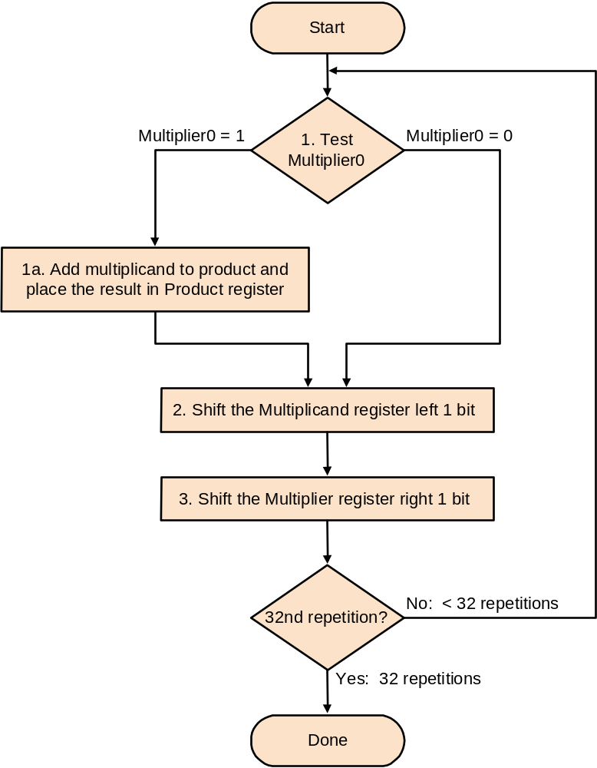
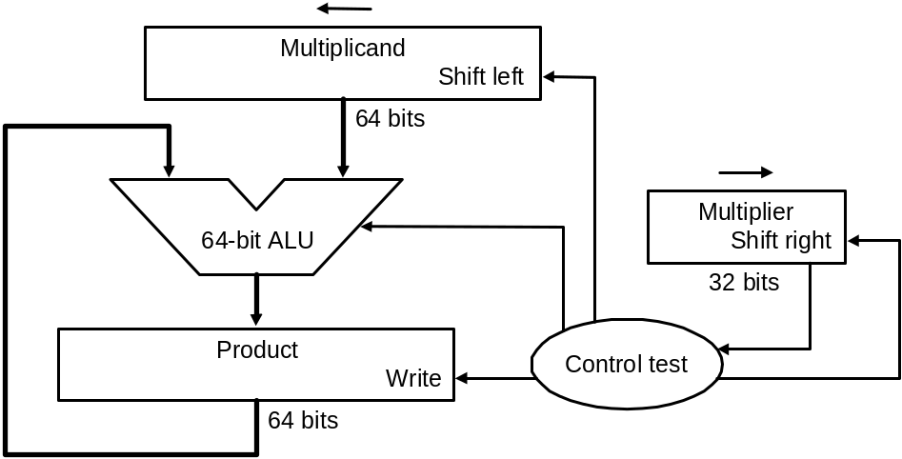
Shift-add Multiplier Version 1
32-bit multiplicand starts at right half of multiplicand register
Product register is initialized at 0
Multiplicand register, product register, ALU are
64-bit wide; multiplier register is 32-bit wide
Algorithm

Slide 36
Shift-add Multiplier Version1
Example: 0010 * 0011:
Itera Step Multiplier Multiplicand Product
-tion
0 init 0011 0000 0010 0000 0000
values
1 1a 0011 0000 0010 0000 0010
2 0011 0000 0100 0000 0010
3 0001 0000 0100 0000 0010
2 …
Algorithm
Notes:
M’ier: 0011 M’and: 0000 0010 P: 0000 0000
1a. 1=>P=P+Mcand M’ier: 0011 Mcand: 0000 0010 P: 0000 0010
2. Shl Mcand M’ier: 0011 Mcand: 0000 0100 P: 0000 0010
3. Shr M’ier M’ier: 0001 Mcand: 0000 0100 P: 0000 0010
1a. 1=>P=P+Mcand M’ier: 0001 Mcand: 0000 0100 P: 0000 0110
2. Shl Mcand M’ier: 0001 Mcand: 0000 1000 P: 0000 0110
3. Shr M’ier M’ier: 0000 Mcand: 0000 1000 P: 0000 0110
1. 0=>nop M’ier: 0000 Mcand: 0000 1000 P: 0000 0110
2. Shl Mcand M’ier: 0000 Mcand: 0001 0000 P: 0000 0110
3. Shr M’ier M’ier: 0000 Mcand: 0001 0000 P: 0000 0110
1. 0=>nop M’ier: 0000 Mcand: 0001 0000 P: 0000 0110
2. Shl Mcand M’ier: 0000 Mcand: 0010 0000 P: 0000 0110
3. Shr M’ier M’ier: 0000 Mcand: 0010 0000 P: 0000 0110

Slide 37
Observations on Multiply
Version 1
1 step per clock cycle ⇒ nearly 100 clock cycles to multiply two
32-bit numbers
Half the bits in the multiplicand register always 0
⇒ 64-bit adder is wasted
0’s inserted to right as multiplicand is shifted left
⇒ least significant bits of product never change once formed
Intuition: instead of shifting multiplicand to left, shift product to right…

Slide 38
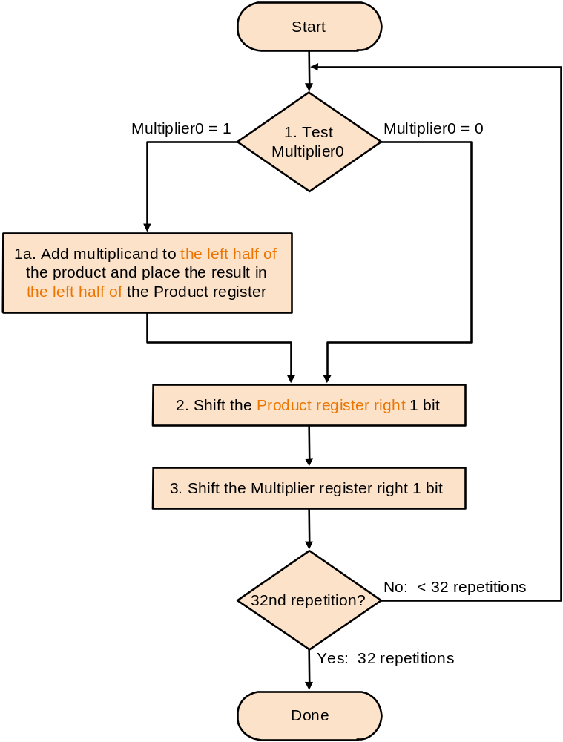
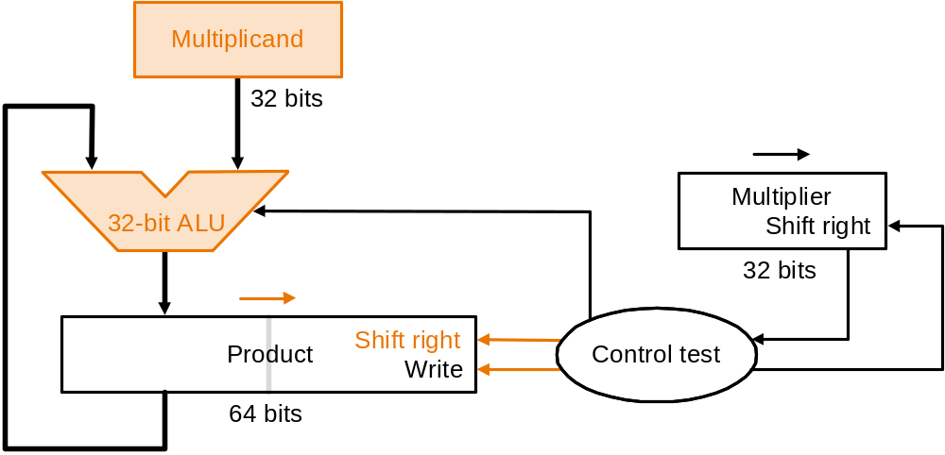
Shift-add Multiplier Version 2
Product register is initialized at 0
Multiplicand register, multiplier register, ALU
are 32-bit wide; product register is 64-bit wide;
multiplicand adds to left half of product register
Algorithm

Slide 39
Shift-add Multiplier Version 2
Example: 0010 * 0011:
Itera Step Multiplier Multiplicand Product
-tion
0 init 0011 0010 0000 0000
values
1 1a 0011 0010 0010 0000
2 0011 0010 0001 0000
3 0001 0010 0001 0000
2 …
Algorithm
Notes:
M’ier: 0011 Mcand: 0010 P: 0000 0000
1a. 1=>P=P+Mcand M’ier: 0011 Mcand: 0010 P: 0010 0000
2. Shr P M’ier: 0011 Mcand: 0010 P: 0001 0000
3. Shr M’ier M’ier: 0001 Mcand: 0010 P: 0001 0000
1a. 1=>P=P+Mcand M’ier: 0001 Mcand: 0010 P: 0011 0000
2. Shr P M’ier: 0001 Mcand: 0010 P: 0001 1000
3. Shr M’ier M’ier: 0000 Mcand: 0010 P: 0001 1000
1. 0=>nop M’ier: 0000 Mcand: 0010 P: 0001 1000
2. Shr P M’ier: 0000 Mcand: 0010 P: 0000 1100
3. Shr M’ier M’ier: 0000 Mcand: 0010 P: 0000 1100
1. 0=>nop M’ier: 0000 Mcand: 0010 P: 0000 1100
2. Shr P M’ier: 0000 Mcand: 0010 P: 0000 0110
3. Shr M’ier M’ier: 0000 Mcand: 0010 P: 0000 0110

Slide 40
Observations on Multiply
Version 2
Each step the product register wastes space that exactly matches the current size of the multiplier
Intuition: combine multiplier register and product register…

Slide 41
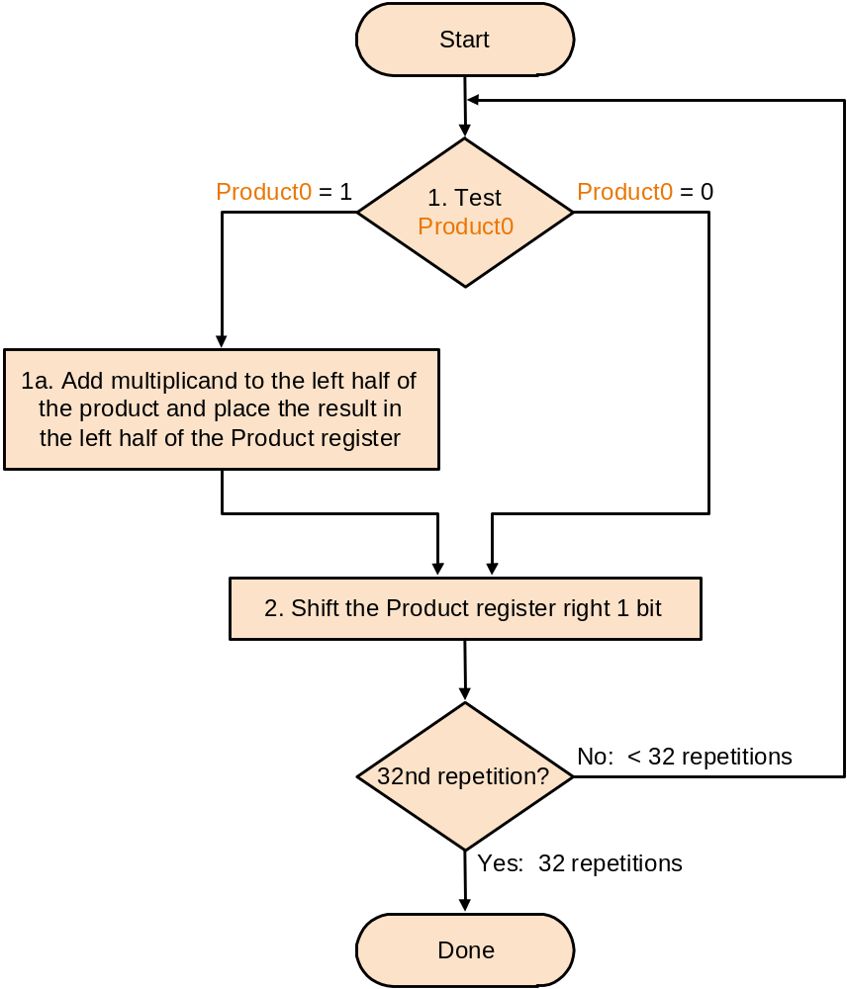
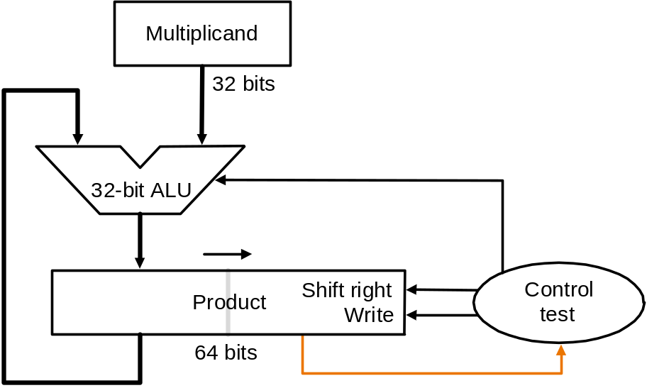
Shift-add Multiplier Version 3
Product register is initialized with multiplier on right
No separate multiplier register; multiplier
placed on right side of 64-bit product register
Algorithm

Slide 42
Shift-add Multiplier Version 3
Example: 0010 * 0011:
Itera Step Multiplicand Product
-tion
0 init 0010 0000 0011
values
1 1a 0010 0010 0011
2 0010 0001 0001
2 …
Algorithm

Slide 43
Observations on Multiply
Version 3
2 steps per bit because multiplier & product combined
What about signed multiplication?
  easiest solution is to make both positive and remember whether to negate product when done, i.e., leave out the sign bit, run for 31 steps, then negate if multiplier and multiplicand have opposite signs
Booth’s Algorithm is an elegant way to multiply signed numbers using same hardware – it also often quicker…

Slide 44
Motivating Booth’s algorithm
Example 0010 * 0110. Traditional:
0010
0110
0000 shift (0 in multiplier)
0010 add (1 in multiplier)
0010 add (1 in multiplier)
0000 shift (0 in multiplier)
00001100
Same example. But observe there are two successive 1’s in multiplier
0110 = 2² + 2¹ = 2³ – 2¹, so can replace successive 1’s by subtract and then add:
0010
0110
0000 shift (0 in multiplier)
-0010 sub (first 1 in multiplier)
0000 shift (middle of string of 1’s)
0010 add (previous step had last 1)
00001100
x

Slide 45
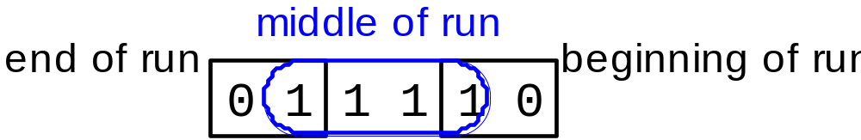
Motivating Booth’s Algorithm
Math idea: string of 1’s …011…10… has
value the sum 2^{n} + 2^{n-1} + … + 2^{m} = 2^{n+1} – 2^{m}
Replace a string of 1s in multiplier with an initial subtract when we first see a one and then later add after the last one
  What if the string of 1’s started from the left of the (2’s complement) number,
  e.g., 11110001 – would the formula above have to be modified?!
bit = 2^{n}
bit = 2^{m}
successive 1’s

Slide 46
Booth from Multiply Version 3
Modify Step 1 of the algorithm Multiply Version 3 to consider 2 bits of the multiplier: the current bit and the bit to the right (i.e., the current bit of the previous step). Instead of two outcomes, now there are four:
Case Current Bit Bit to the Right Explanation Example Op
1a 0 0 Middle of run of 0s 0001111000 none
1b 0 1 End of run of 1s 0001111000 add
1c 1 0 Begins run of 1s 0001111000 sub
1d 1 1 Middle of run of 1s 0001111000 none
Modify Step 2 of Multiply Version 3 to sign extend when the product is shifted right (arithmetic right shift, rather than logical right shift) because the product is a signed number
Now draw the flowchart for Booth’s algorithm !
Multiply Version 3 and Booth share the same hardware, except Booth requires one extra flipflop to remember the bit to the right of the current bit in the product register – which is the bit pushed out by the preceding right shift

Slide 47
Booth Example (2 x 7)
Operation Multiplicand Product next?
0. initial value 0010 0000 0111 0 10 -> sub P = P - M
1c. 0010 1110 0111 0 shift P (sign ext)
2. 0010 1111 0011 1 11 -> nop
1d. 0010 1111 0011 1 shift P (sign ext)
2. 0010 1111 1001 1 11 -> nop
1d. 0010 1111 1001 1 shift P (sign ext)
2. 0010 1111 1100 1 01 -> add P = P + M
1b. 0010 0001 1100 1 shift P (sign ext)
2. 0010 0000 1110 0 done

Slide 48
Booth Algorithm (2 * -3)
Operation Multiplicand Product next?
0.initial value 0010 0000 1101 0 10 -> sub P = P - M
1c. 0010 1110 1101 0 shift P (sign ext)
2. 0010 1111 0110 1 01 -> add P = P + M
1b. 0010 0001 0110 1 shift P (sign ext)
2. 0010 0000 1011 0 10 -> sub P = P - M
1c. 0010 1110 1011 0 shift P
2. 0010 1111 0101 1 11 -> nop
1d. 0010 1111 0101 1 shift P
2. 0010 1111 1010 1 done

Slide 49
Verifying Booth’s Algorithm
multiplier a = a₃₁ a₃₂… a₀, multiplicand = b
a_{i} a_{i-1} Operation
0 0 nop
0 1 add b
1 0 sub b
1 1 nop
0, nop
I.e., if a_{i-1} – a_{i} = +1, add b
–1, sub b
Therefore, Booth computes sum:
(a_{–1} – a₀) * b * 2⁰
+ (a₀ – a ₁) * b * 2¹
+ (a₁ – a₂) * b * 2²
…
+ (a₃₀ – a₃₁) * b * 2³¹
= … simplify telescopic sum! …

Slide 50
MIPS Notes
MIPS provides two 32-bit registers Hi and Lo to hold a 64-bit product
mult, multu (unsigned) put the product of two 32-bit register operands into Hi and Lo: overflow is ignored by MIPS but can be detected by programmer by examining contents of Hi
mflo, mfhi moves content of Hi or Lo to a general-purpose register
Pseudo-instructions mul (without overflow), mulo (with overflow), mulou (unsigned with overflow) take three 32-bit register operands, putting the product of two registers into the third

Slide 51
Divide
1001 Quotient
Divisor 1000 1001010 Dividend
–1000
10
101
1010
–1000
10 Remainder
Junior school method: see how big a multiple of the divisor can be subtracted, creating quotient digit at each step
Binary makes it easy ⇒ first, try 1 * divisor; if too big, 0 * divisor
Dividend = (Quotient * Divisor) + Remainder
3 versions of divide hardware & algorithm:

Slide 52
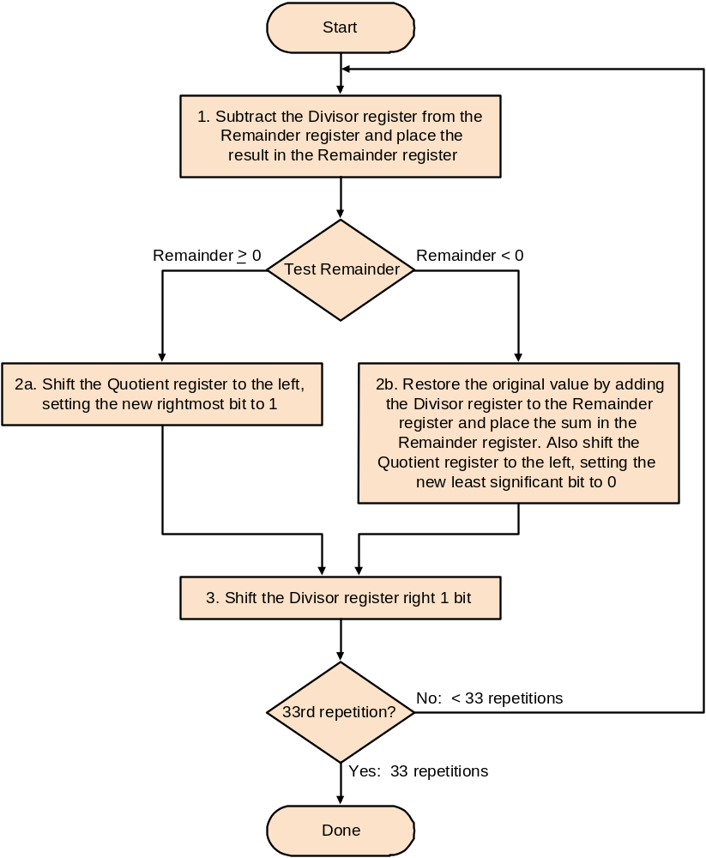
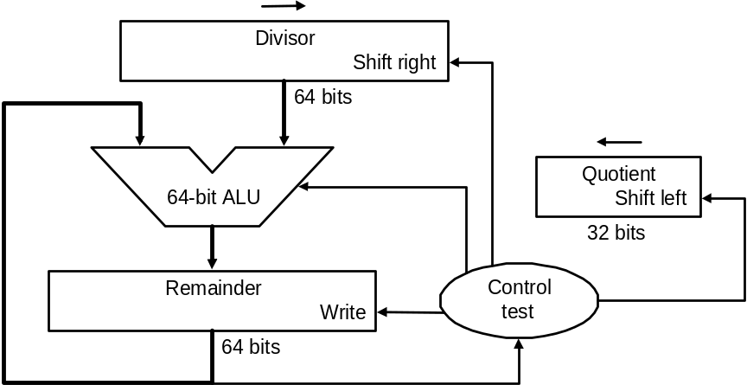
Divide Version 1
32-bit divisor starts at left half of divisor register
Quotient register is
initialized to be 0
Remainder register is initialized with the dividend at right
Divisor register, remainder register, ALU are
64-bit wide; quotient register is 32-bit wide
Why 33? We shall see later…
Algorithm

Slide 53
Divide Version 1
Example: 0111 / 0010:
Itera- Step Quotient Divisor Remainder
tion
0 init 0000 0010 0000 0000 0111
1 1 0000 0010 0000 1110 0111
2b 0000 0010 0000 0000 0111
3 0000 0001 0000 0000 0111
2 …
3
4
5
Algorithm

Slide 54
Observations on Divide Version 1
Half the bits in divisor always 0
  ⇒ 1/2 of 64-bit adder is wasted
  ⇒ 1/2 of divisor register is wasted
Intuition: instead of shifting divisor to right, shift remainder to left…
Step 1 cannot produce a 1 in quotient bit – as all bits corresponding to the divisor in the remainder register are 0 (remember all operands are 32-bit)
Intuition: switch order to shift first and then subtract – can save 1 iteration…

Slide 55
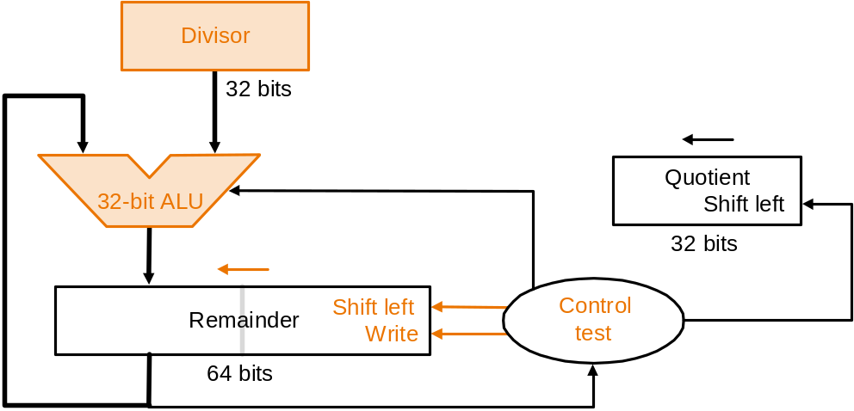
Divide Version 2
S
t
a
r
t
1
.
S
h
i
f
t
t
h
e
R
e
m
a
i
n
d
e
r
r
e
g
i
s
t
e
r
l
e
f
t
1
b
i
t
Remainder register is initialized
with the dividend at right
2
.
S
u
b
t
r
a
c
t
t
h
e
D
i
v
i
s
o
r
r
e
g
i
s
t
e
r
f
r
o
m
t
h
e
l
e
f
t
h
a
l
f
o
f
t
h
e
R
e
m
a
i
n
d
e
r
r
e
g
i
s
t
e
r
a
n
d
p
l
a
c
e
t
h
e
r
e
s
u
l
t
i
n
t
h
e
l
e
f
t
h
a
l
f
o
f
t
h
e
R
e
m
a
i
n
d
e
r
r
e
g
i
s
t
e
r
R
e
m
a
i
n
d
e
r
>
0
R
e
m
a
i
n
d
e
r
<
0
–
T
e
s
t
R
e
m
a
i
n
d
e
r
3
a
.
S
h
i
f
t
t
h
e
R
e
m
a
i
n
d
e
r
r
e
g
i
s
t
e
r
t
o
t
h
e
3
b
.
R
e
s
t
o
r
e
t
h
e
o
r
i
g
i
n
a
l
v
a
l
u
e
b
y
a
d
d
i
n
g
l
e
f
t, setting the new rightmost bit to 0.
t
h
e
D
i
v
i
s
o
r
r
e
g
i
s
t
e
r
t
o
t
h
e
l
e
f
t
h
a
l
f
o
f
t
h
e
Also shift the Quotient register to the left
setting to the new rightmost bit to 1.
R
e
m
a
i
n
d
e
r
r
e
g
i
s
t
e
r
a
n
d
p
l
a
c
e
t
h
e
s
u
m
Divisor register, quotient register,
ALU are 32-bit wide; remainder
register is 64-bit wide
i
n
t
h
e
l
e
f
t
h
a
l
f
o
f
t
h
e
R
e
m
a
i
n
d
e
r
r
e
g
i
s
t
e
r
.
A
l
s
o
s
h
i
f
t
t
h
e
R
e
m
a
i
n
d
e
r
r
e
g
i
s
t
e
r
t
o
t
h
e
l
e
f
t
,
s
e
t
t
i
n
g
t
h
e
n
e
w
r
i
g
h
t
m
o
s
t
b
i
t
t
o
0
Also shift the Quotient register to the left
setting to the new rightmost bit to 0.
3
2
n
d
r
e
p
e
t
i
t
i
o
n
?
N
o
:
<
3
2
r
e
p
e
t
i
t
i
o
n
s
Y
e
s
:
3
2
r
e
p
e
t
i
t
i
o
n
s
Algorithm
Why this correction step? We shall see later…
D
o
n
e
.
S
h
i
f
t
l
e
f
t
h
a
l
f
o
f
R
e
m
a
i
n
d
e
r
r
i
g
h
t
1
b
i
t
Notes:
Q: 0000 D: 0010 0000 R: 0000 0111 –D = 1110 0000
1: R = R–D Q: 0000 D: 0010 0000 R: 1110 0111
2b: +D, sl Q, 0 Q: 0000 D: 0010 0000 R: 0000 0111
3: Shr D Q: 0000 D: 0001 0000 R: 0000 0111 –D = 1111 0000
1: R = R–D Q: 0000 D: 0001 0000 R: 1111 0111
2b: +D, sl Q, 0 Q: 0000 D: 0001 0000 R: 0000 0111
3: Shr D Q: 0000 D: 0000 1000 R: 0000 0111 –D = 1111 1000
1: R = R–D Q: 0000 D: 0000 1000 R: 1111 1111
2b: +D, sl Q, 0 Q: 0000 D: 0000 1000 R: 0000 0111
3: Shr D Q: 0000 D: 0000 0100 R: 0000 0111 –D = 1111 1100
1: R = R–D Q: 0000 D: 0000 0100 R: 0000 0011
2a: sl Q, 1 Q: 0001 D: 0000 0100 R: 0000 0011
3: Shr D Q: 0000 D: 0000 0010 R: 0000 0011 –D = 1111 1110
1: R = R–D Q: 0000 D: 0000 0010 R: 0000 0001
2a: sl Q, 1 Q: 0011 D: 0000 0010 R: 0000 0001
3: Shr D Q: 0011 D: 0000 0001 R: 0000 0001
Recommend show 2’s comp of divisor, show lines for subtract divisor and restore remainder

Slide 56
Observations on Divide Version 2
Each step the remainder register wastes space that exactly matches the current size of the quotient
Intuition: combine quotient register and remainder register…

Slide 57
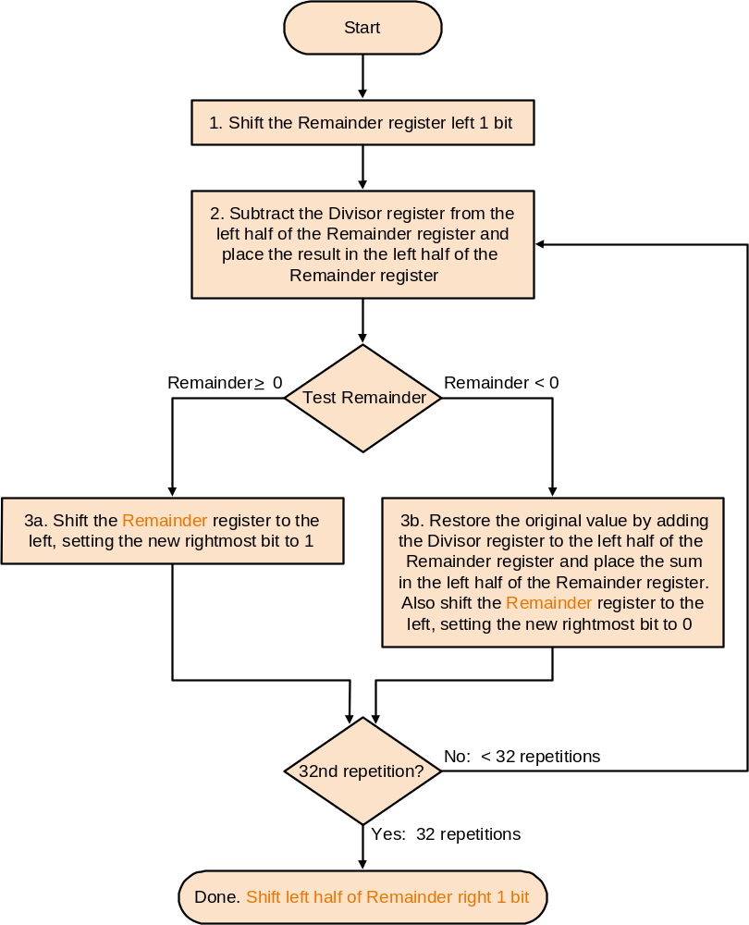
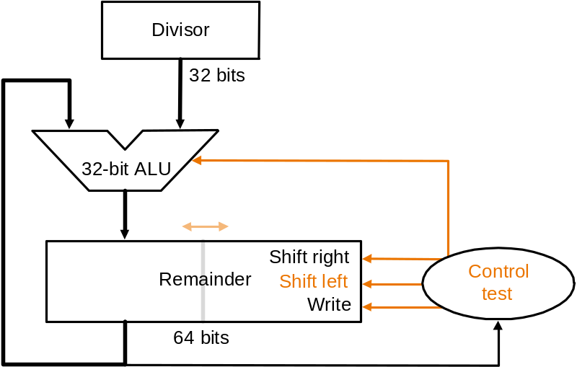
Divide Version 3
Remainder register is initialized with the dividend at right
No separate quotient register; quotient
is entered on the right side of the 64-bit
remainder register
Algorithm
Why this correction step? We shall see later…

Slide 58
Divide Version 3
Example: 0111 / 0010:
Itera- Step Divisor Remainder
tion
0 init 0010 0000 0111
1 0010 0000 1110
1 2 0010 1110 1110
3b 0010 0001 1100
2 …
3
4
Algorithm

Slide 59
Number of Iterations
Why the extra iteration in Version 1?
Why the final correction step in Versions 2 & 3?
shift1 shift2 … shift32 shift33
sub1 sub2 sub3 … sub32 sub33
Ovals represent loop iterations
Main insight – sub(i+1) must actually follow shifti of
the divisor (or remainder, depending on version) and
the resulting bit in the quotient appears on shift(i+1)
Shift: see the version descriptions
for which registers are shifted
V1 starts loop
here: unnecessary
sub step
One loop iteration
Critical situation! Only the quotient shift is
necessary as it corresponds to the
outcome of the previous sub.
So V1 is ok even though the last divisor
shift is redundant, as final divisor is ignored
any way; V2 & 3 must repair remainder
as it has shifted left one time too many
V2 & 3 start
loop here
V2 & 3 initial step:
before loop starts

Slide 60
Observations on Divide Version 3
Same hardware as Multiply Version 3
Signed divide:
  make both divisor and dividend positive and perform division
  negate the quotient if divisor and dividend were of opposite signs
  make the sign of the remainder match that of the dividend
  this ensures always
    dividend = (quotient * divisor) + remainder
    –quotient (x/y) = quotient (–x/y) (e.g. 7 = 3*2 + 1 & –7 = –3*2 – 1)

Slide 61
MIPS Notes
div (signed), divu (unsigned), with two 32-bit register operands, divide the contents of the operands and put remainder in Hi register and quotient in Lo; overflow is ignored in both cases
pseudo-instructions div (signed with overflow), divu (unsigned without overflow) with three 32-bit register operands puts quotients of two registers into third

Slide 62
Floating Point
We need a way to represent
  numbers with fractions, e.g., 3.1416
  very small numbers (in absolute value), e.g., .00000000023
  very large numbers (in absolute value) , e.g., –3.15576 * 10⁴⁶
Representation:
  scientific: sign, exponent, significand form:
    (–1)^{sign} * significand * 2^{exponent} . E.g., –101.001101 * 2¹¹¹⁰⁰¹
  more bits for significand gives more accuracy
  more bits for exponent increases range
  if 1 ≤ significand < 10_{two}(=2_{ten}) then number is normalized, except for number 0 which is normalized to significand 0
    E.g., –101.001101 * 2¹¹¹⁰⁰¹ = –1.01001101 * 2¹¹¹⁰¹¹ (normalized)
binary point

Slide 63
IEEE 754 Floating-point Standard
IEEE 754 floating point standard:
  single precision: one word
  double precision: two words
31
bits 30 to 23
bits 22 to 0
sign
8-bit exponent
23-bit significand
31
bits 30 to 20
bits 19 to 0
sign
11-bit exponent
upper 20 bits of 52-bit significand
bits 31 to 0
lower 32 bits of 52-bit significand

Slide 64
IEEE 754 Floating-point Standard
Sign bit is 0 for positive numbers, 1 for negative numbers
Number is assumed normalized and leading 1 bit of significand left of binary point (for non-zero numbers) is assumed and not shown
  e.g., significand 1.1001… is represented as 1001…,
  exception is number 0 which is represented as all 0s (see next slide)
  for other numbers:
  value = (–1)^{sign} * (1 + significand) * 2^{exponent value}
Exponent is biased to make sorting easier
  all 0s is smallest exponent, all 1s is largest
  bias of 127 for single precision and 1023 for double precision
  therefore, for non-0 numbers:
  value = (–1)^{sign} * (1 + significand) * 2^{(exponent – bias)}
equals exponent value

Slide 65
IEEE 754 Floating-point Standard
Special treatment of 0:
  if exponent is all 0 and significand is all 0, then the value is
  0 (sign bit may be 0 or 1)
  if exponent is all 0 and significand is not all 0, then the value is
  (–1)^{sign} * (1 + significand) * 2⁻¹²⁷
    therefore, all 0s is taken to be 0 and not 2⁻¹²⁷ (as would be for a non-zero normalized number); similarly, 1 followed by all 0’s is taken to be 0 and not
    - 2⁻¹²⁷
Example : Represent –0.75_{ten} in IEEE 754 single precision
  decimal: –0.75 = –3/4 = –3/2²
  binary: –11/100 = –.11 = –1.1 x 2⁻¹
  IEEE single precision floating point exponent = bias + exponent value
  = 127 + (-1) = 126_{ten} = 01111110_{two}
  IEEE single precision: 10111111010000000000000000000000
exponent
significand
sign

Slide 66
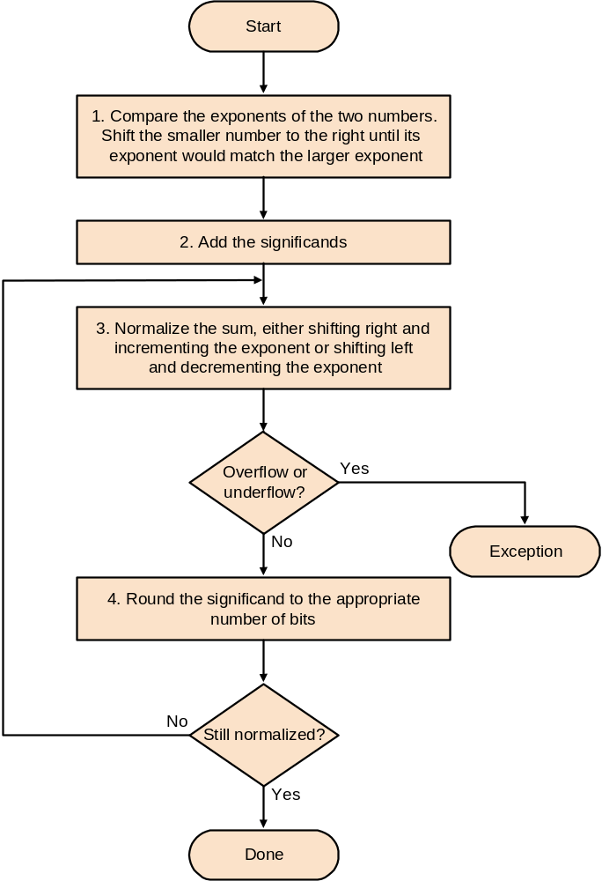
Floating Point
Addition
Algorithm:

Slide 67
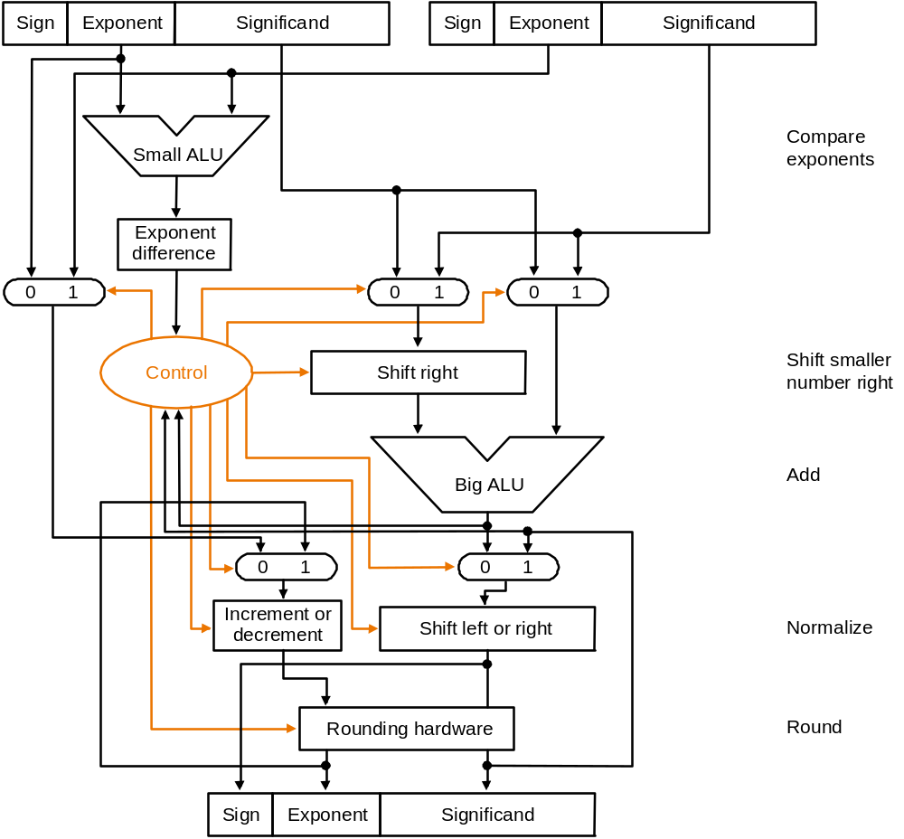
Floating Point
Addition
Hardware:

Slide 68
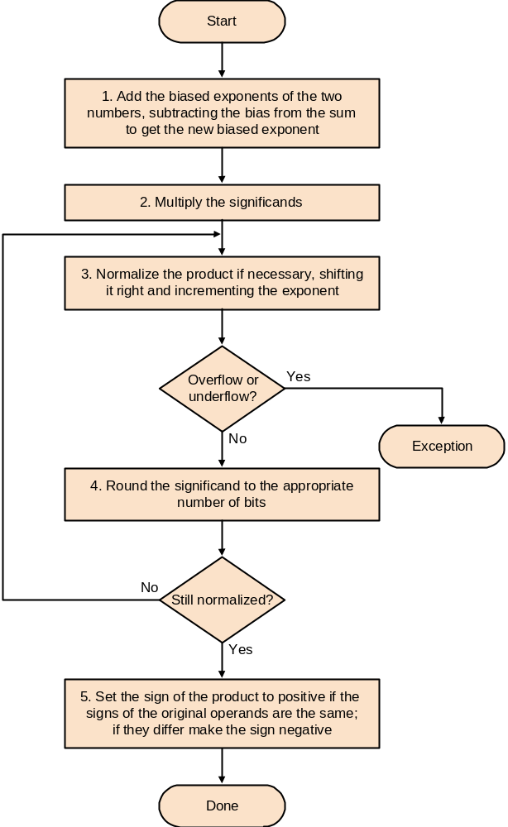
Floating Point
Multpication
Algorithm:

Slide 69
Floating Point Complexities
In addition to overflow we can have underflow (number too small)
Accuracy is the problem with both overflow and underflow because we have only a finite number of bits to represent numbers that may actually require arbitrarily many bits
  limited precision ⇒ rounding ⇒ rounding error
  IEEE 754 keeps two extra bits, guard and round
  four rounding modes
  positive divided by zero yields infinity
  zero divide by zero yields not a number
  other complexities
Implementing the standard can be tricky
Not implementing the standard can be even worse
  see text for discussion of Pentium bug!

Slide 70
MIPS Floating Point
MIPS has a floating point coprocessor (numbered 1, SPIM) with thirty-two 32-bit registers $f0 - $f31. Two of these are required to hold doubles. Floating point instructions must use only even-numbered registers (including those operating on single floats). SPIM simulates MIPS floating point.
Floating point arithmetic: add.s (single addition), add.d (double addition), sub.s, sub.d, mul.s, mul.d, div.s, div.d
Floating point comparison: c.x.s (single), c.x.d (double), where x may be eq, neq, lt, le, gt, ge
Other instructions…

Slide 71
Summary
Computer arithmetic is constrained by limited precision
Bit patterns have no inherent meaning but standards do exist:
  two’s complement
  IEEE 754 floating point
Computer instructions determine meaning of the bit patterns.
Performance and accuracy are important so there are many complexities in real machines (i.e., algorithms and implementation)
Read Computer Arithmetic Algorithms by I. Koren
  it is easy-to-read and shows new algorithms for arithmetic
  there will be assignment and projects based on Koren’s material

