Slide 1


Restaurant Design
Group 2
Caio Beojone
Murat Genc
Marti Montesinos
Jangwon Park

Slide 2
Problem Description

Slide 3
Simulation

Slide 4
Problem Description
Decision variables
Objective function

Slide 5
Reducing the Neighborhood Size
Weakness of baseline VNS
The neighborhood size for adding/removing tables grows non-linearly. E.g.
Adding 1 table: 4 neighbors
Adding 2 tables: 4² neighbors
Adding 3 tables: 4³ neighbors
…
Costly to check a sufficiently large number of neighbors.
Limiting the neighborhood size will likely lead to suboptimal profit.

Slide 6
Golden Section Method
Idea
The new restaurant can have anywhere from 200 to 400 seats.
Successively narrow this interval by optimizing mean profit at discrete points.
In the beginning, use a greedy heuristic to quickly narrow down the interval.
When the interval becomes “small enough”, use VNS.
We can eliminate the neighborhood structure for adding/removing tables.

Slide 7
Golden Section Method
Conditions
Mean profit as a function of number of seats must be concave (unimodal).
In the interval that greedy heuristic eliminates, its results must be consistent with the results of VNS.
e.g. f_{greedy}(300) > f_{greedy}(350) ⬄ f_{VNS}(300) > f_{VNS}(350)

Slide 8
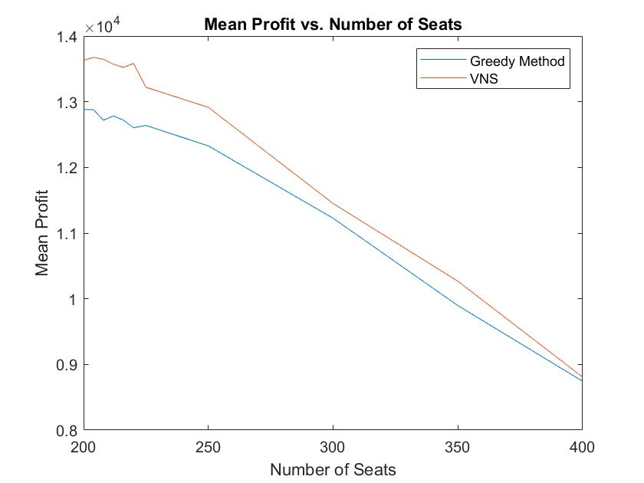
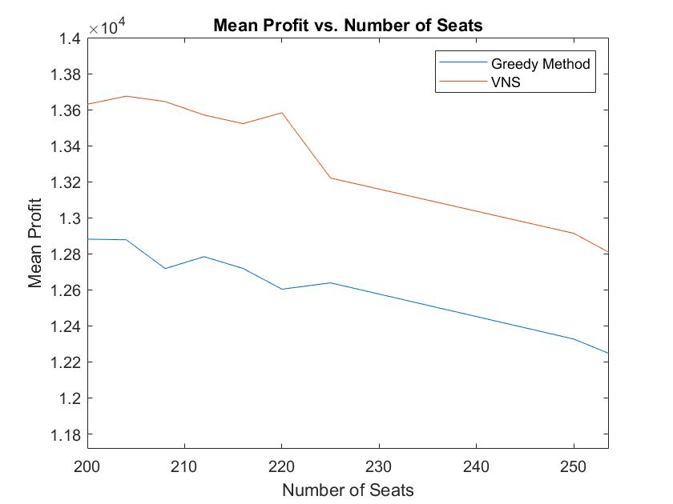
Golden Section Method

Slide 9
Golden Section Method

Slide 10
Golden Section Method

Slide 11
Golden Section Method
Our parameters
Threshold for switching: 50
Tolerance for termination: 5
Threshold:
Greedy => VNS
Final interval

Slide 12
Results
Baseline VNS

Slide 13
Results
Golden section VNS
Left Extreme | Right Extreme
200 | 323.6
200 | 276.4
200 | 247.2152
200 | 229.1848
200 | 218.0362
200 | 211.1486
204.2588 | 211.1486
204.2588 | 208.5167
Optimal number of seats | 204
Optimal table arrangement | Size 2: 22 tables Size 3: 18 tables Size 4: 14 tables Size 5: 15 tables
STOP

