Slide 1


Restaurant Design
Group 2
Caio Beojone
Murat Genc
Marti Montesinos
Jangwon Park

Slide 2
Problem Description

Slide 3
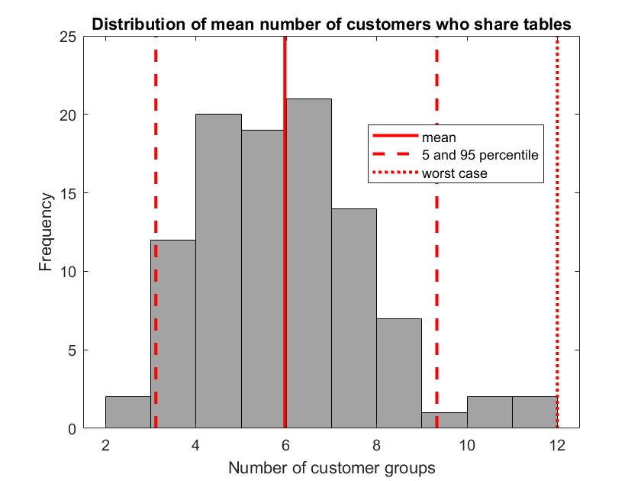
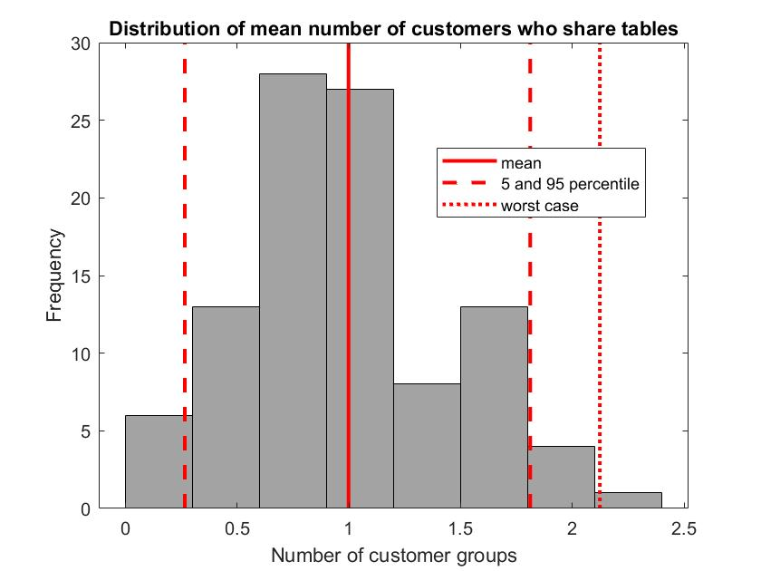
Simulation

Slide 4
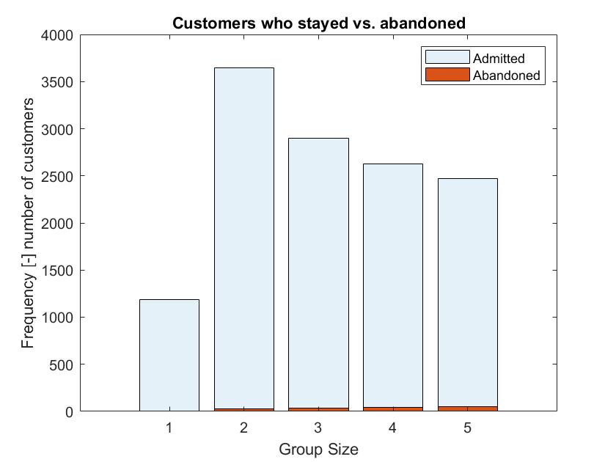
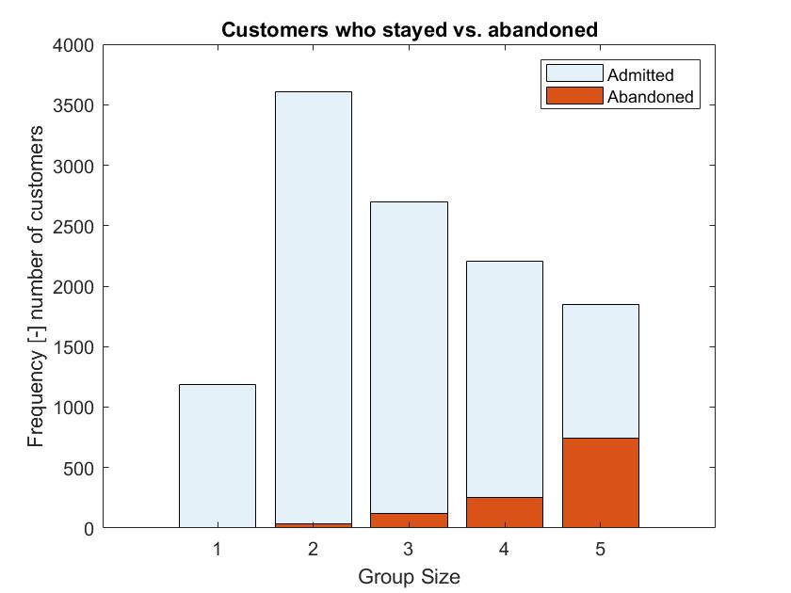
Simulation

Slide 5
Problem Description
Decision variables
Objective function

Slide 6
Reducing the Neighborhood Size
Limitation of baseline VNS
The neighborhood size for adding/removing tables grows non-linearly. E.g.
Adding 1 table: 4 neighbors
Adding 2 tables: 4² neighbors
Adding 3 tables: 4³ neighbors
…
Costly to check a sufficiently large number of neighbors.
Limiting the neighborhood size will likely lead to suboptimal profit.

Slide 7
Golden Section Method
Idea
The new restaurant can have anywhere from 200 to 400 seats.
Successively narrow this interval by optimizing mean profit at discrete points.
In the beginning, use a greedy heuristic to quickly narrow down the interval.
When the interval becomes “small enough”, use VNS.
We can eliminate the neighborhood structure for adding/removing tables.

Slide 8
Golden Section Method
Conditions
Mean profit as a function of number of seats must be concave (unimodal).
In the interval that greedy heuristic eliminates, its results must be consistent with the results of VNS.
e.g. f_{greedy}(300) > f_{greedy}(350) ⬄ f_{VNS}(300) > f_{VNS}(350)

Slide 9
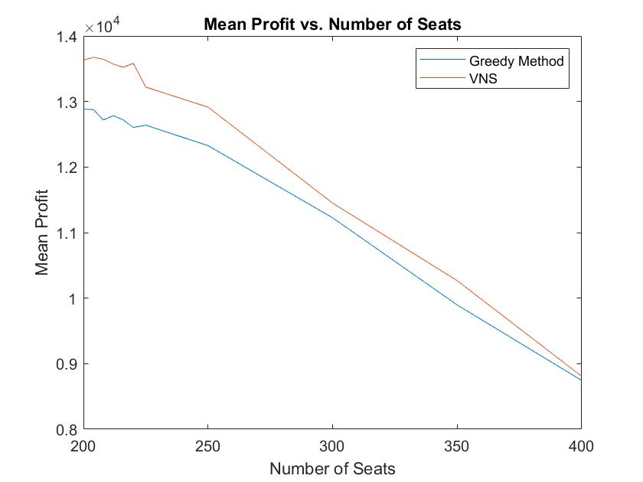
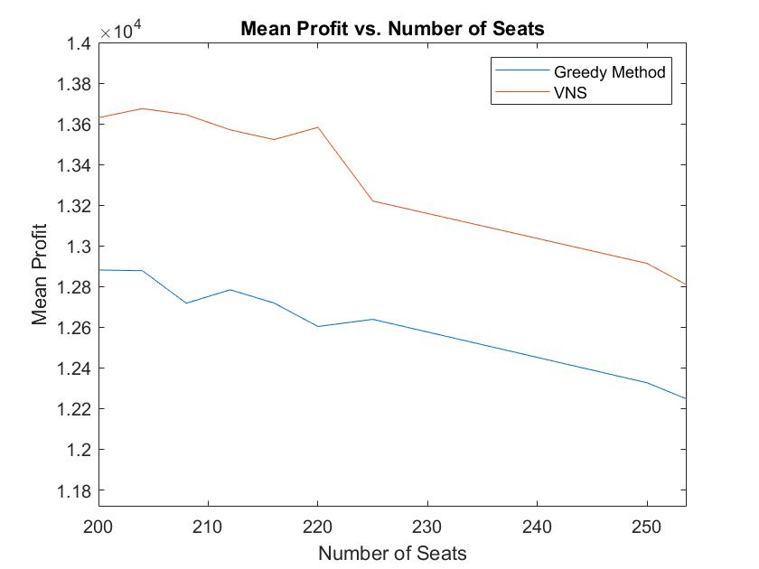
Golden Section Method

Slide 10
Golden Section Method

Slide 11
Golden Section Method

Slide 12
Golden Section Method
Our parameters
Threshold for switching: 50
Tolerance for termination: 5
Threshold:
Greedy => VNS
Final interval

Slide 13
Results: Baseline VNS vs. Golden Section VNS
Ideas for visualization:
Baseline VNS iterations plot
Golden section method curve (mean profit vs. number of seats curve)
Distributions of profits (baseline and golden section results overlaid)
Comparison table:
Comment on any differences in optimal profit, table arrangement, and seats
Reach a conclusion about which approach is better
e.g. Use ‘OUTPUT_baselineVNS_no_reservation.mat’ and ‘Arrangement_baselineVNS_no_reservation.mat’ to see results of baseline VNS
Method | Mean Profit | Optimal Table Arrangement | Optimal Number of Seats
Baseline
Golden Section

Slide 14
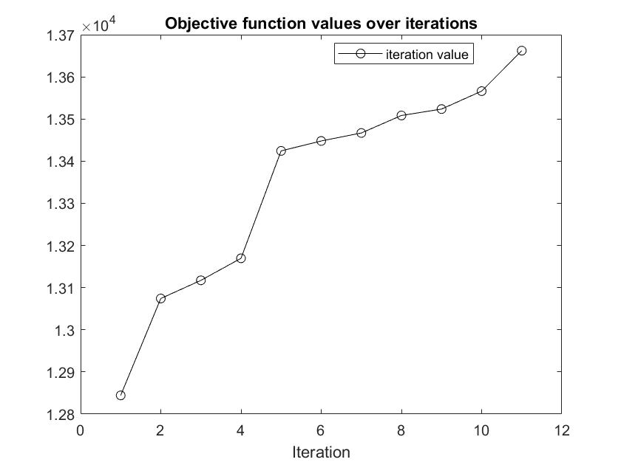
Results: Baseline VNS vs. Golden Section VNS
Baseline VNS

Slide 15
Results: Baseline VNS vs. Golden Section VNS
Golden section VNS
Iteration | Left Extreme | Right Extreme
1 | 200 | 323.6
2 | 200 | 276.4
3 | 200 | 247.2152
4 | 200 | 229.1848
5 | 200 | 218.0362
6 | 200 | 211.1486
7 | 200 | 206.8898
8 | 200 | 204.2588
Switch
STOP

Slide 16
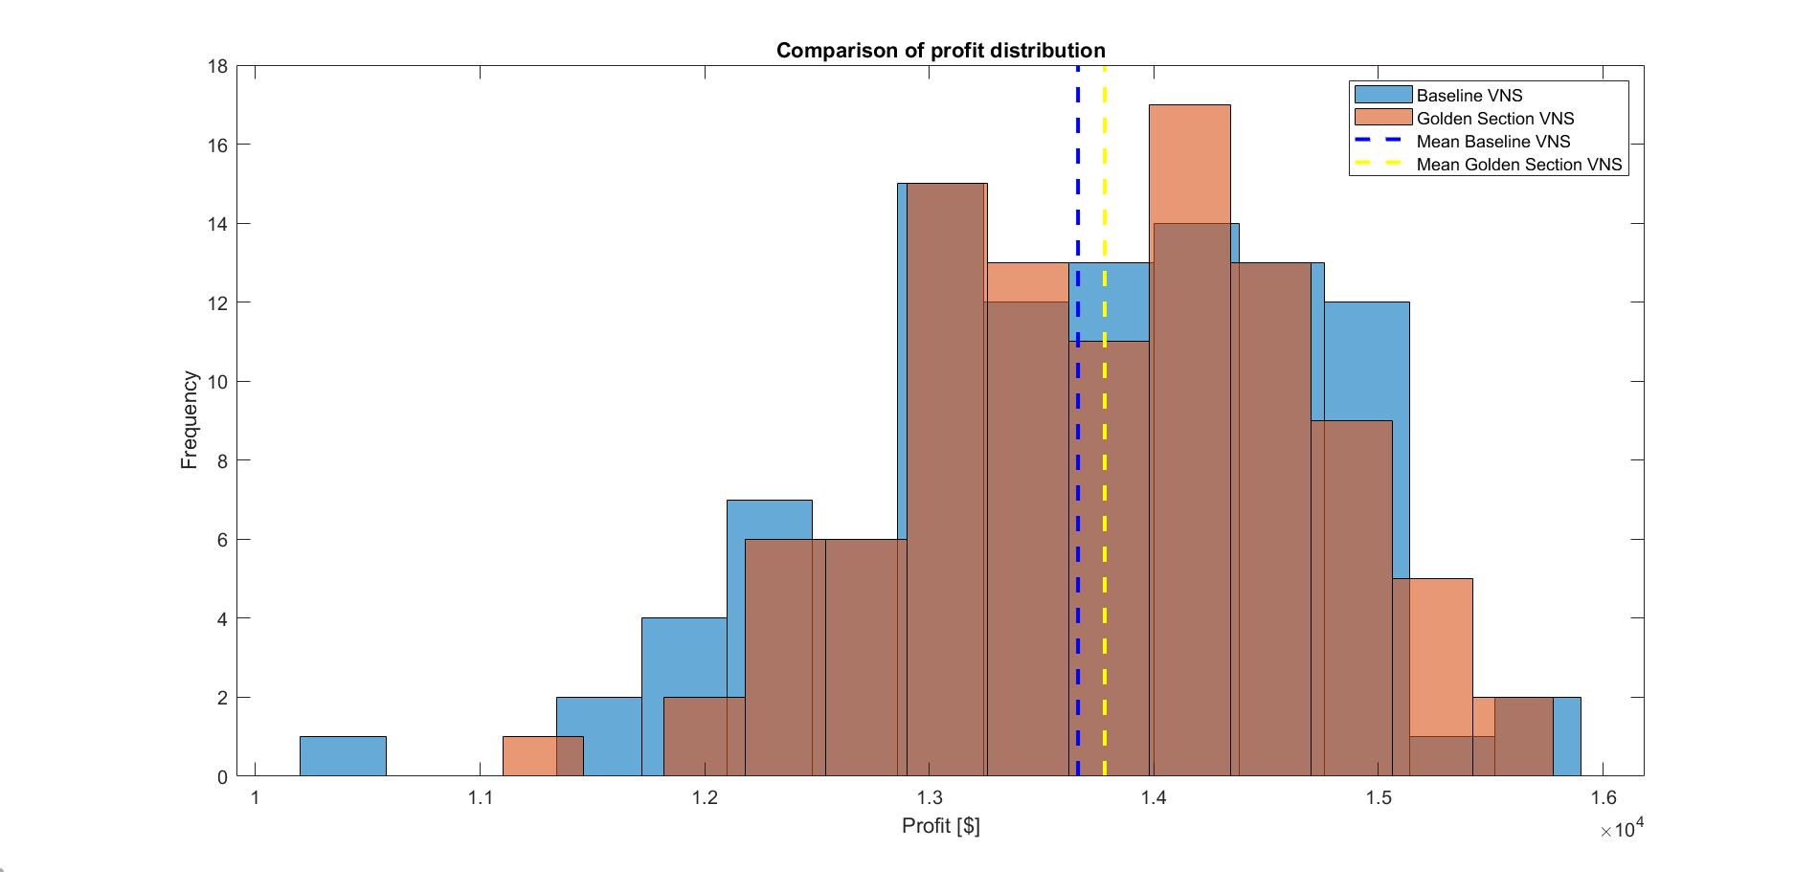
Results: Baseline VNS vs. Golden Section VNS

Slide 17
Results: Baseline VNS vs. Golden Section VNS
Method | Mean Profit | Optimal Table Arrangement | Optimal Number of Seats
Baseline | $13,662 | Size 2: 14 tables Size 3: 17 tables Size 4: 13 tables Size 5: 12 tables | 191
Golden Section | $13,781 | Size 2: 21 tables Size 3: 15 tables Size 4: 13 tables Size 5: 13 tables | 204

Slide 18
Results: Seating Policy Comparison
Ideas
Distributions of profits overlaid
Comparison table
Number of admitted groups by customer size
Odds of abandonment by customer size
(My guess is that more customer groups of size 5 are admitted while the rest remain more or less constant)
Comment on the differences (profit, table arrangement, number of seats)
Reach a conclusion about which policy is better

Slide 19
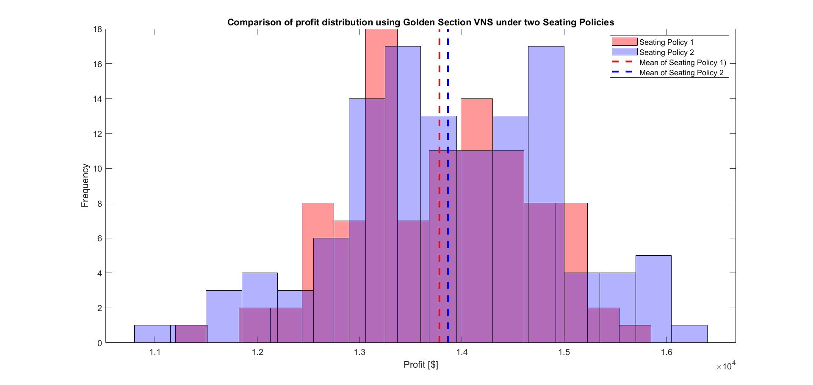
Results: Seating Policy Comparison

Slide 20
Results: Seating Policy Comparison
Policy | Mean Profit | Optimal Table Arrangement | Optimal Number of Seats
Default | $13,781 | Size 2: 21 tables Size 3: 15 tables Size 4: 13 tables Size 5: 13 tables | 204
Reservation | $13,865 | Size 2: 19 tables Size 3: 15 tables Size 4: 11 tables Size 5: 15 tables | 202
Notes:
Reduced tables of size 2 and 4 by two and gave them all to size 5 tables.
Otherwise, the number of seats remain more or less the same.

Slide 21
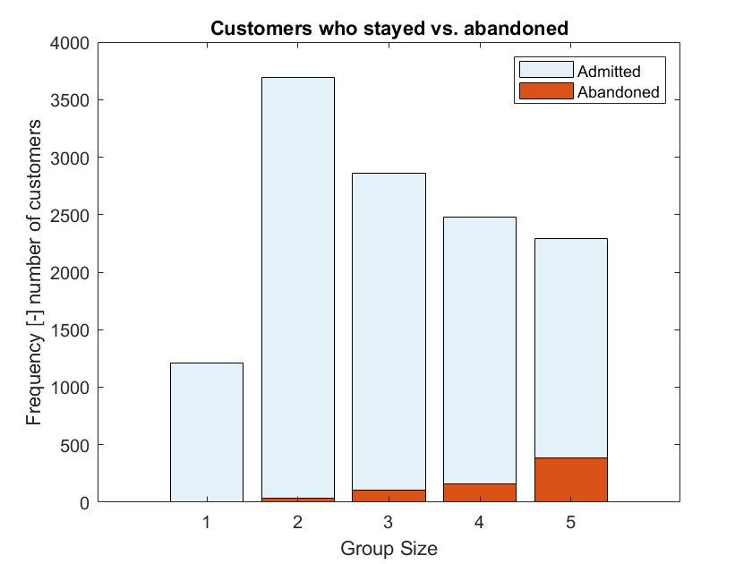
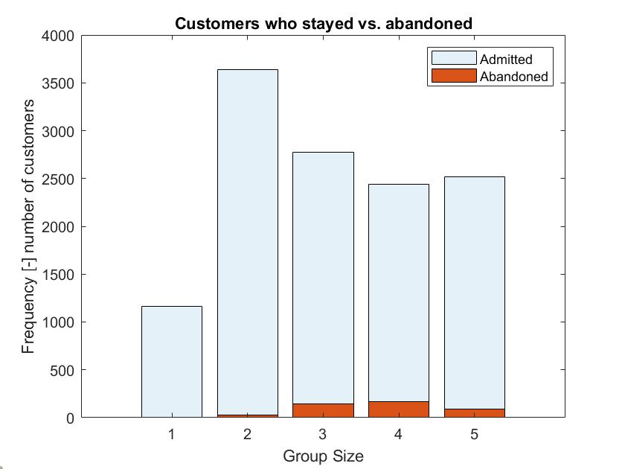
Results: Seating Policy Comparison
Seating Policy 1
Seating Policy 2
Notes:
Reduced proportion of customer groups of size 5 who abandoned by roughly 13% at a relatively small cost of losing 1.5% more of customer groups of size 3. The rest remains more or less the same.

