Slide 1


Restaurant Design
Group 2
Caio Beojone
Murat Genc
Marti Montesinos
Jangwon Park

Slide 2
Scenario Description
A restaurant
has space for up to 400 seats
various table sizes (for 2, 3, 4 and 5 customers)
different table arrangements constrained by the number of seats
table arrangements to be made at the beginning of the opening time
not possible to split a group into different tables
not possible to merge the tables
groups can sit together

Slide 3
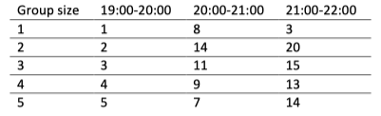
Scenario Description (cont.)
Customer Arrival (arrival rate: c)
are non-homogenous and vary among group sizes (group size: g)
Groups start arriving at 19:00 till 22:00
No arrival after 22:00 –> available service for customers in the queue

Slide 4

Scenario Description (cont.)
Service and Customer Behavior
Customer Abandonment: customers in the queue may decide to wait or leave (every five minutes)
duration of a dinner (d)
40 + t ~ exp (0.05) minutes
immediate table availability for the next customer
assumption: adequate staff capability and capacity

Slide 5
Scenario Description (cont.)
Billing
Bill per person: b
Proportional to the dinner duration (d) –> b = d * r
Customer-specific consumption rate (r)
r ~ unif (0.5, 1.2) –> € / minute
Sharing a table
decreased dinner duration –> d’ = d * 0.5
decreased consumption rate –> r’ = r * 0.8
Profit = b * ( # of customers served ) – ( € 0.10 * total operating time)

Slide 6
Problem Description
Running a successful business by
Maximizing the total profit of a restaurant
Decision variables:
Table arrangement (table size and quantity)
Seating policy for arriving customers
Evaluation of success
Defined parameters (described in the Simulation part)

Slide 7

Simulation

Slide 8
Discrete Event Simulation
Running a simulation of a scenario
Input parameters described in the previous section
Different scenarios for varying table arrangement and seating policy
Returning the variables:
Customers
Tables
Time
Queue (s)
# of busy seats (for each table size)
# of busy tables (at the event times)

Slide 9
Discrete Event Simulation (cont.)
Events
Events that occur at time “t”
Arrival
always the first event
Duration
refers to being in the queue or being served
Abandonment
A customer leaves the system
Simulation End

Slide 10
Table Arrangement
Default arrangements
# of tables [size 1, size 2, size 3, size 4, size 5]
Arrangement 1: [0, 0, 0, 0, 40]
Arrangement 2: [0, 50, 0, 0, 20]
Modified arrangements
Arrangement 3: [19, 28, 15, 10, 8]
Arranged according to the arrival rate
Arrangement 4: [1, 28, 15, 12, 10]
Modified the number of size 1

Slide 11
Table Arrangement
Default arrangements
# of tables [size 1, size 2, size 3, size 4, size 5]
Arrangement 1: [0, 0, 0, 0, 40]
Arrangement 2: [0, 50, 0, 0, 20]
Modified arrangements
Arrangement 3: [19, 28, 15, 10, 8]
Arranged according to the arrival rate
Arrangement 4: [1, 28, 15, 12, 10]
Modified the number of size 1

Slide 12
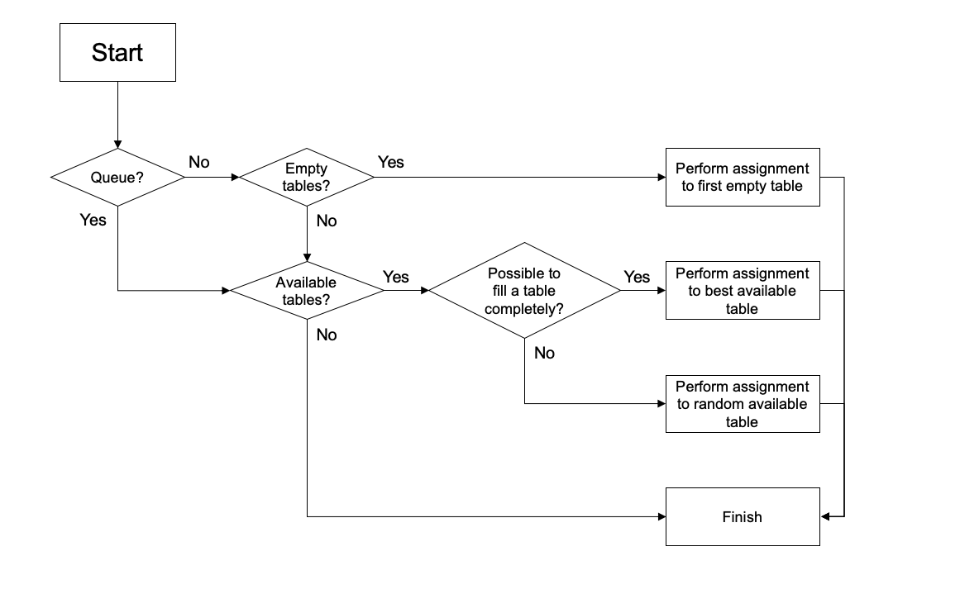
Seating Policy
Initial approach:
First-come, First-served basis

Slide 13
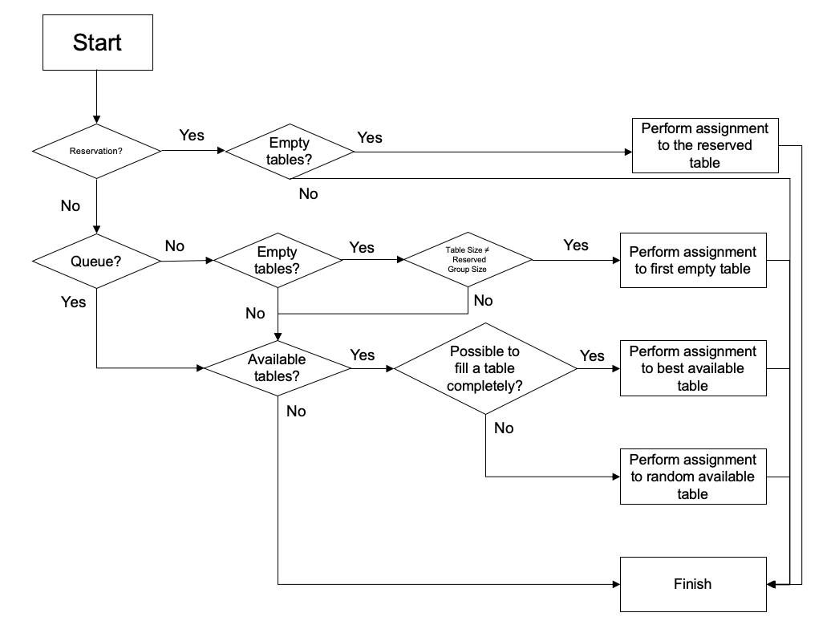
Seating Policy
Modified approach:
Reservation Policy
Consisting the reservation of a table (size n) to a group (size n)
First-come, first-served policy except the “prioritized customers”

Slide 14
Variance Reduction
Method:
Control Variate;
Number of groups that arrived;
Usual number of runs: 100 (minimum accepted);

Slide 15
Simulation results
Table arrangement:
200 seats;
40 tables size 5;

Slide 16
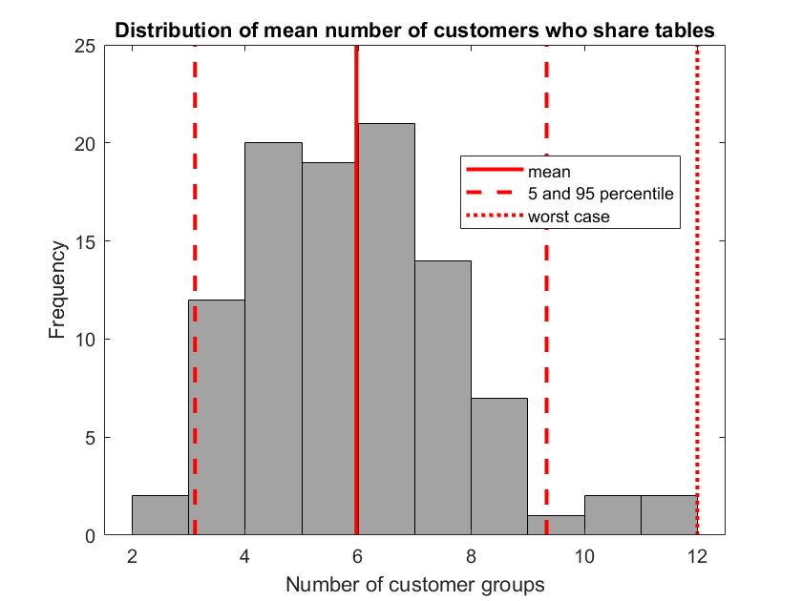
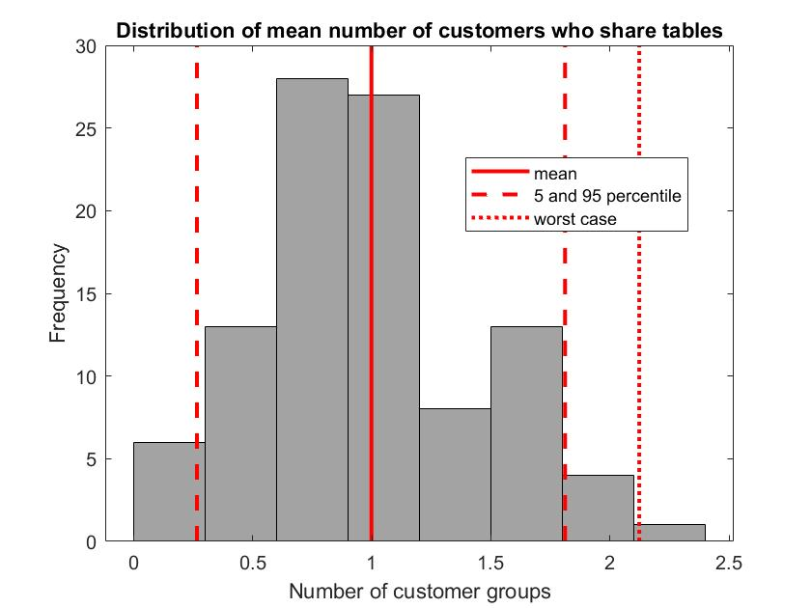
Simulation

Slide 17
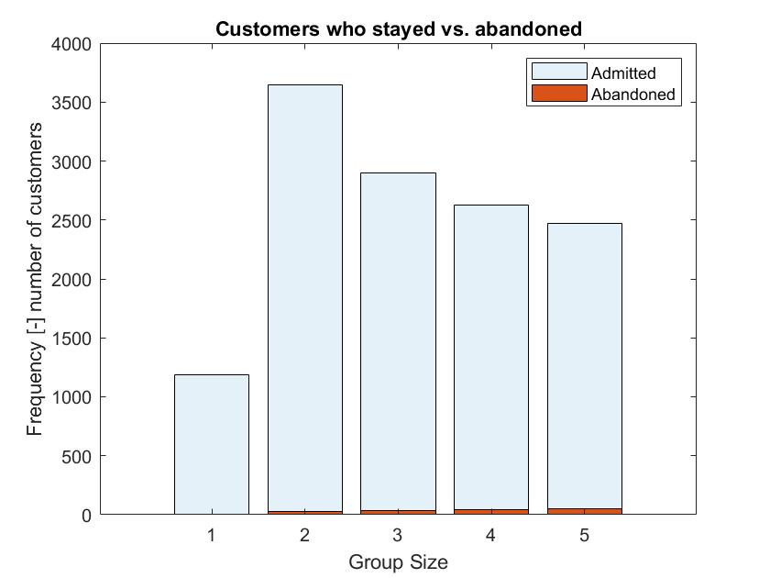
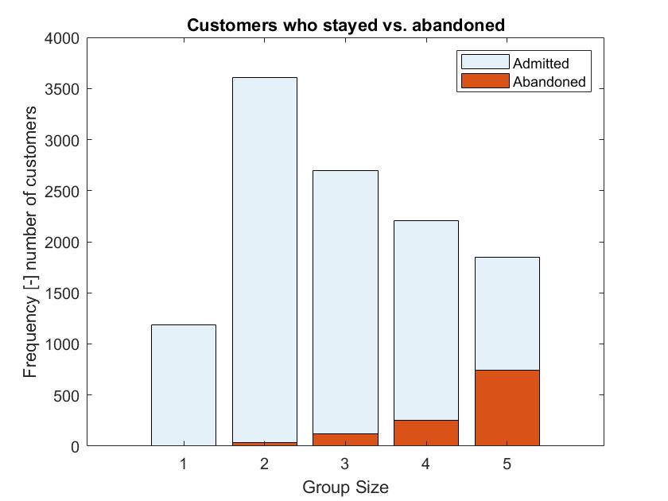
Simulation

Slide 18

Optimization

Slide 19
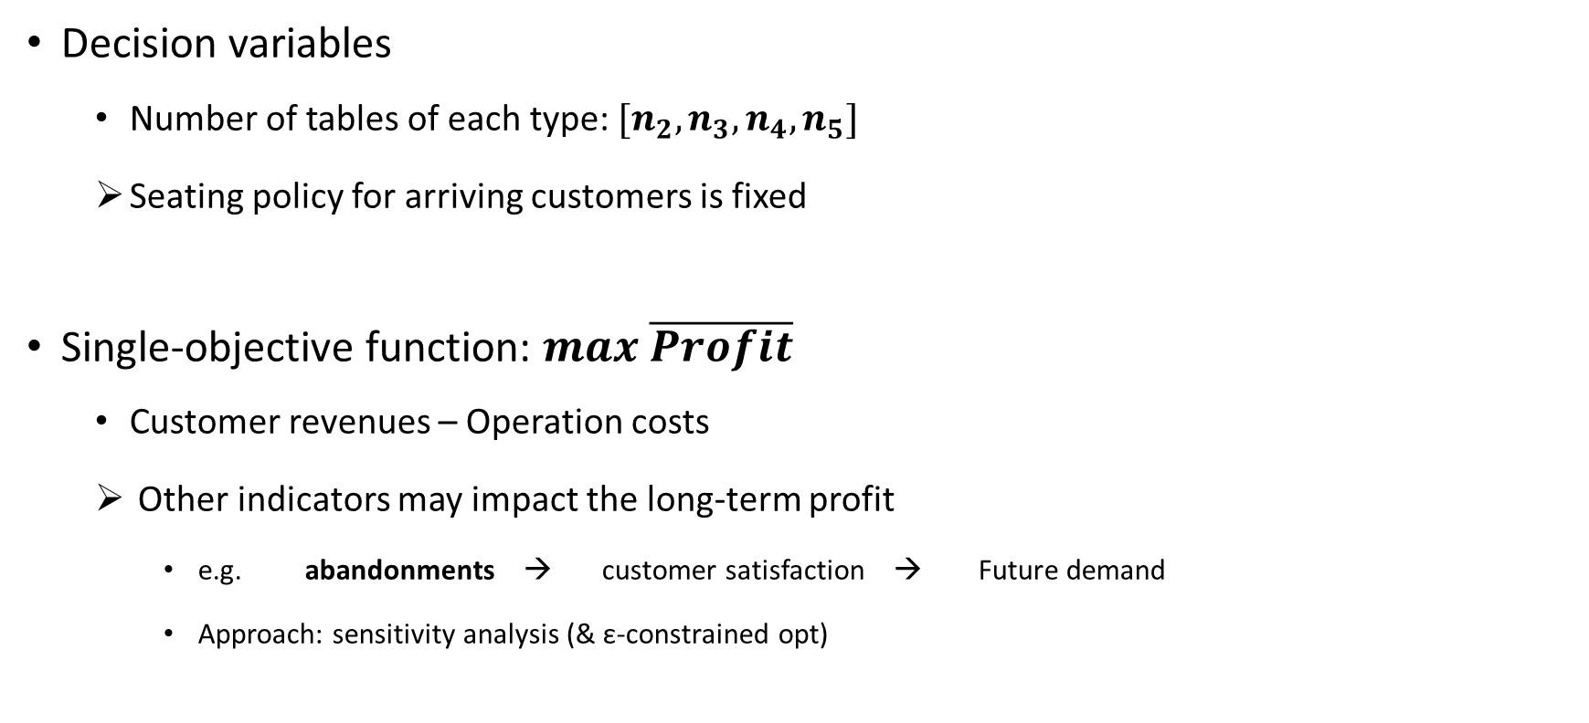
Problem Description
Decision variables
Number of tables of each type: $[n_{2}, n_{3}, n_{4}, n_{5}]$
Seating policy for arriving customers is fixed
Single-objective function: $max \overline{Profit}$
Customer revenues – Operation costs
Other indicators may impact the long-term profit
e.g. abandonments → customer satisfaction → Future demand
Approach: sensitivity analysis (& ε-constrained opt)
Notes:
According to the problem definition we have only one objective: maximize the profit
The mean profit we get for a day is the best proxy of the total profits in a week or a month. We have already seen that the distribution of the profit is unimodal, so the mean is a good indicator.
In the long-run the number of abandonments could impact the business. The unserved customers are clearly unsatisfied and they may not want to visit again the restaurant in the future. Therefore, we also analyze the impact of the different table arrangements and seating policies in the number of abandonments. A high number of abandonments will impact negatively our future demand.
As there’s no clear way to compare profit & abandonments, epsilon constrained optimization could be a good option. But first, we need to analyze the trade-offs between profit and abandonments. Then we can impose an upper bound for the abandonments.

Slide 20


Neighborhoods
$V_{1n}$
Merge/Split tables
Number of seats remains constant
$n=\left\{1,2\right\}$
Neighborhood size
$V_{2n}$
Add/Remove tables
Number of seats changes
$n=\left\{1,2,3,4,5\right\}$
Neighborhood size
2
4
4
4
2
2
2
2
2
2
2
2
2
4
4
4
2
2
2
2
2
2
2
2
Notes:
Mention the order we use them
-To refine a solution (find a local optimum)
-To escape from a local optimum

Slide 21
Neighborhoods
$V_{1n}$
Merge/Split tables
Number of seats remains constant
$n=\left\{1,2\right\}$
Neighborhood size
$V_{2n}$
Add/Remove tables
Number of seats changes
$n=\left\{1,2,3,4,5\right\}$
Neighborhood size
2
4
4
4
2
Refine a solution
2
2
2
2
2
2
2
2
4
4
4
Escape from a
local optimum
2
2
2
2
2
2
2
2
Notes:
Mention the order we use them
-To refine a solution (find a local optimum)
-To escape from a local optimum

Slide 22
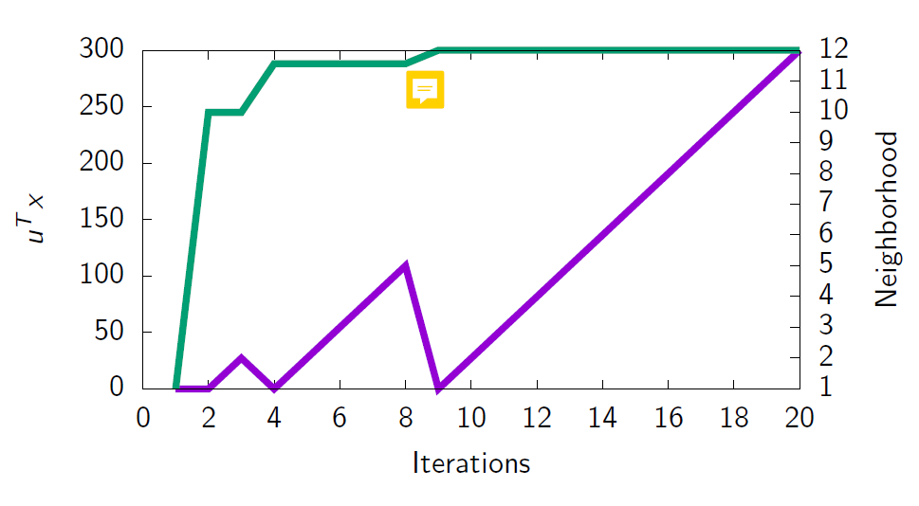
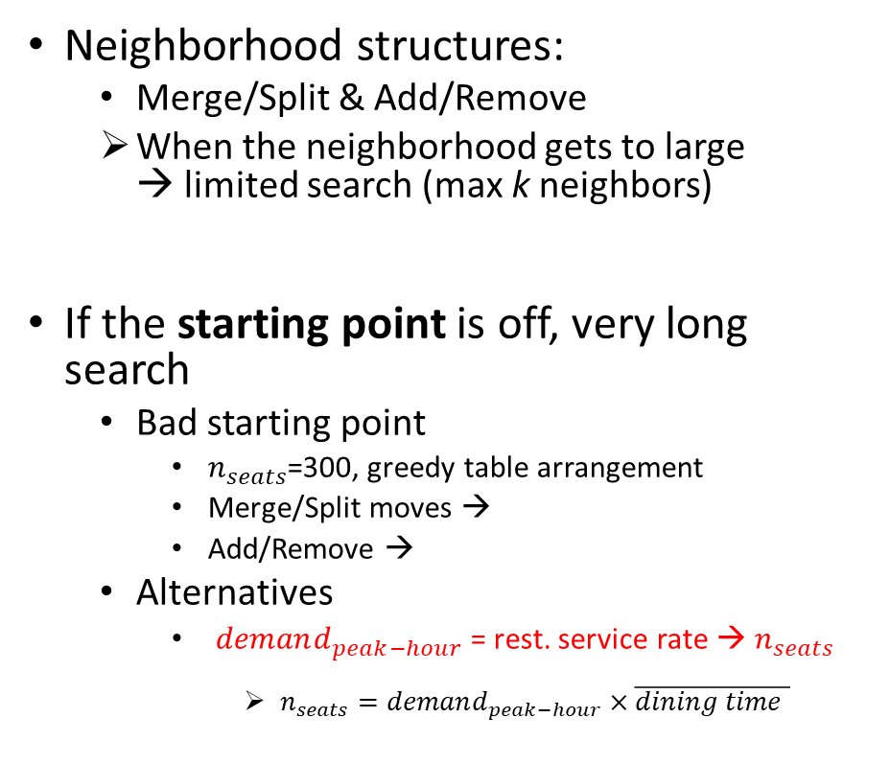
Baseline VNS
Neighborhood structures:
Merge/Split & Add/Remove
When the neighborhood gets to large → limited search (max k neighbors)
If the starting point is off, very long search
Bad starting point
$n_{seats}$=300, greedy table arrangement
Merge/Split moves →
Add/Remove →
Alternatives
$demand_{peak−hour}$= rest. service rate → $n_{seats}$
$n_{seats}=demand_{peak−hour}×\overline{dining time }$
Caio’s new graph:
Replicate this class figure with n=300, group the neighborhoods in Merge, Split, Add, Remove or just show the seats evolution (we see if Merge/Split or Add/Remove)
Notes:
It is not obvious which is the best starting point. For instance if the demand varies a lot along the opening hours.
Explain that starting point of 200 seats perfomed better than 210

Slide 23
Baseline VNS
Neighborhood structures:
Merge/Split & Add/Remove
When the neighborhood gets to large → limited search (max k neighbors)
If the starting point is off, very long search
Bad starting point
$n_{seats}$=300, greedy table arrangement
Merge/Split moves →
Add/Remove →
Alternatives
$demand_{peak−hour}$= rest. service rate → $n_{seats}$
$n_{seats}=demand_{peak−hour}×\overline{dining time }$
Caio’s new graph:
Replicate this class figure with n=200 or 210, group the neighborhoods in Merge, Split, Add, Remove or just show the seats evolution (we see if Merge/Split or Add/Remove)
Notes:
It is not obvious which is the best starting point. For instance if the demand varies a lot along the opening hours.
Explain that starting point of 200 seats perfomed better than 210

Slide 24
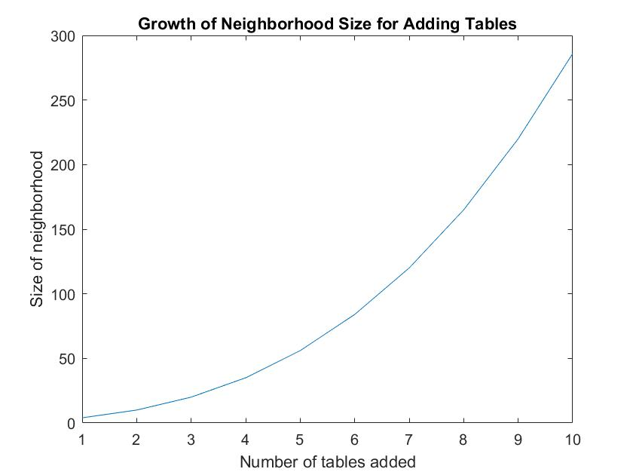
Reducing the Neighborhood Size
Limitation of baseline VNS
Size of the neighborhood grows non-linearly. Example: “adding tables”
_{4+n-1}C_{n}
where n = number of tables to add
Increasingly more costly to check a sufficiently large number of neighbors.
Limiting the neighborhood size will likely lead to suboptimal profit.

Slide 25
Golden Section Method
Idea
The new restaurant can have anywhere from 200 to 400 seats.
Successively narrow this interval by optimizing mean profit at discrete points.
In the beginning, use a greedy heuristic to quickly narrow down the interval.
When the interval becomes “small enough”, use VNS.
We can eliminate the neighborhood structure for adding/removing tables.

Slide 26
Golden Section Method
Conditions
Mean profit as a function of number of seats must be concave (unimodal).
In the interval that greedy heuristic eliminates, its results must be consistent with the results of VNS.
e.g. f_{greedy}(300) > f_{greedy}(350) ⬄ f_{VNS}(300) > f_{VNS}(350)

Slide 27
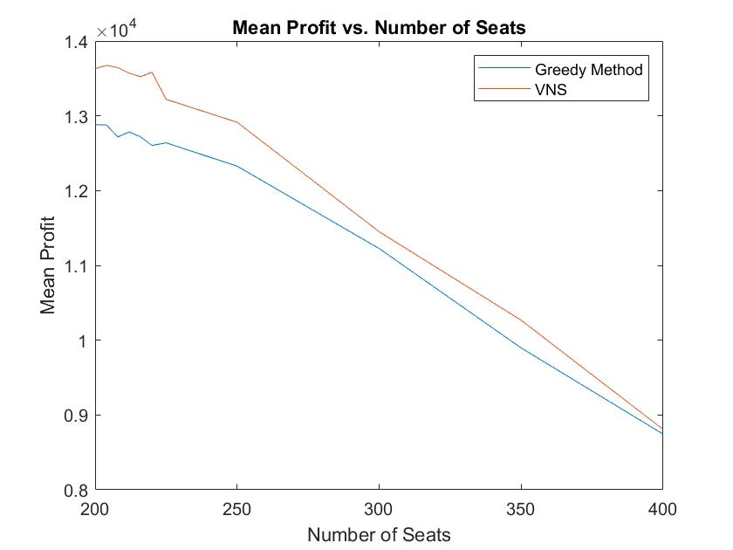
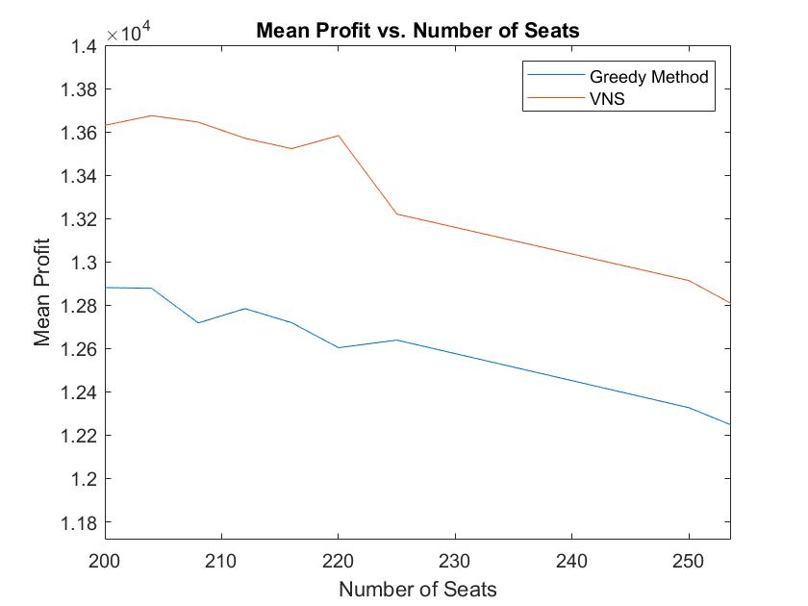
Golden Section Method

Slide 28
Golden Section Method

Slide 29
Golden Section Method

Slide 30
Golden Section Method
Our parameters
Threshold for switching: 50
Tolerance for termination: 5
Threshold:
Greedy => VNS
Final interval

Slide 31
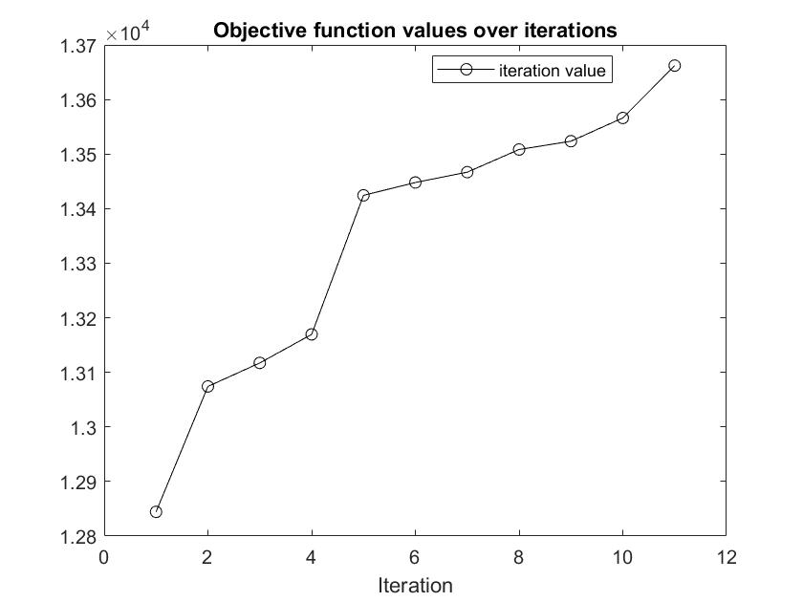
Results: Baseline VNS vs. Golden Section VNS
Baseline VNS

Slide 32
Results: Baseline VNS vs. Golden Section VNS
Golden section VNS
Iteration | Left Extreme | Right Extreme
1 | 200 | 323.6
2 | 200 | 276.4
3 | 200 | 247.2152
4 | 200 | 229.1848
5 | 200 | 218.0362
6 | 200 | 211.1486
7 | 200 | 206.8898
8 | 200 | 204.2588
Switch
STOP

Slide 33
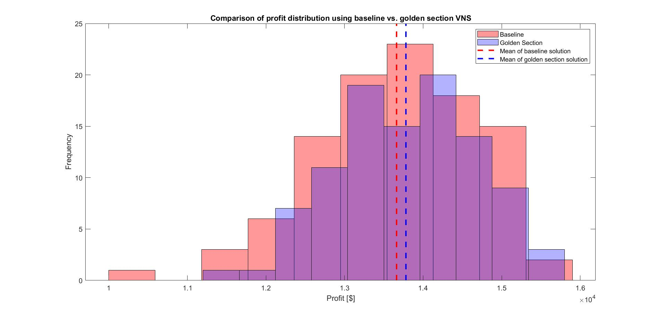
Results: Baseline VNS vs. Golden Section VNS

Slide 34
Results: Baseline VNS vs. Golden Section VNS
Method | Mean Profit | Optimal Table Arrangement | Optimal Number of Seats
Baseline | $13,662 | Size 2: 14 tables Size 3: 17 tables Size 4: 13 tables Size 5: 12 tables | 191
Golden Section | $13,781 | Size 2: 21 tables Size 3: 15 tables Size 4: 13 tables Size 5: 13 tables | 204

Slide 35
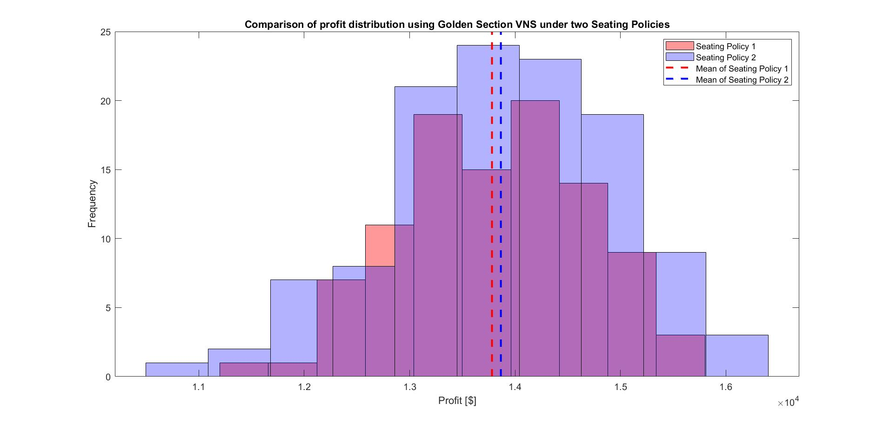
Results: Seating Policy Comparison

Slide 36
Results: Seating Policy Comparison
Policy | Mean Profit | Optimal Table Arrangement | Optimal Number of Seats
Default | $13,781 | Size 2: 21 tables Size 3: 15 tables Size 4: 13 tables Size 5: 13 tables | 204
Reservation | $13,865 | Size 2: 19 tables Size 3: 15 tables Size 4: 11 tables Size 5: 15 tables | 202
Notes:
Reduced tables of size 2 and 4 by two and gave them all to size 5 tables.
Otherwise, the number of seats remain more or less the same.

Slide 37
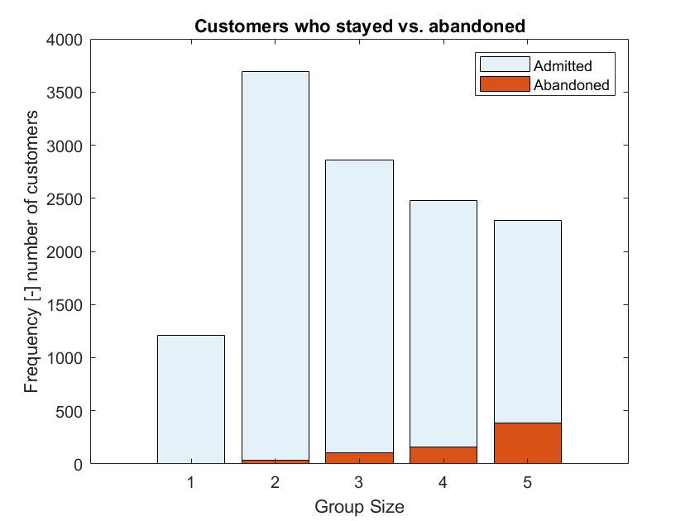
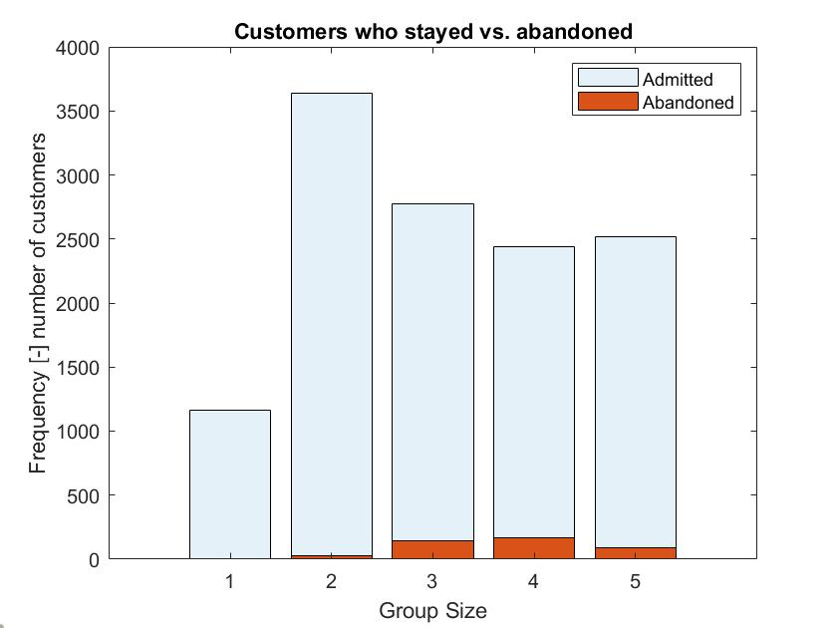
Results: Seating Policy Comparison
Seating Policy 1
Seating Policy 2
Notes:
Reduced proportion of customer groups of size 5 who abandoned by roughly 13% at a relatively small cost of losing 1.5% more of customer groups of size 3. The rest remains more or less the same.

Slide 38
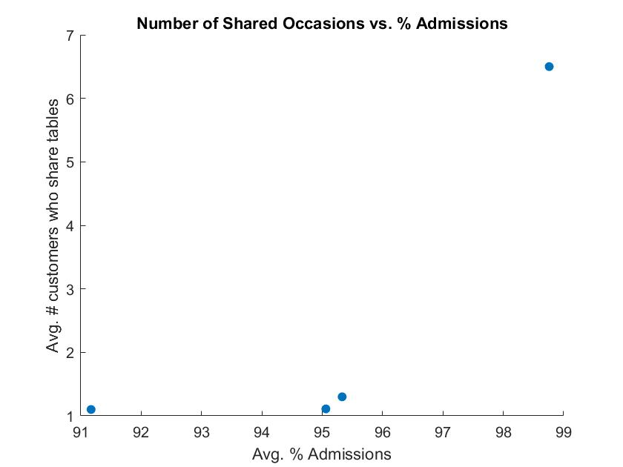
Results: Summary
Our solution as a way to:
Prevent customers from leaving the restaurant
But not increase the average number of occasions of sharing tables significantly
Naïve Solution
Mean Profit: 11,419
Greedy Solution
Mean Profit: 12,238
Golden section VNS (policy 2)
Mean Profit: 13,865
Golden section VNS (policy 1)
Mean Profit: 13,781

Slide 39
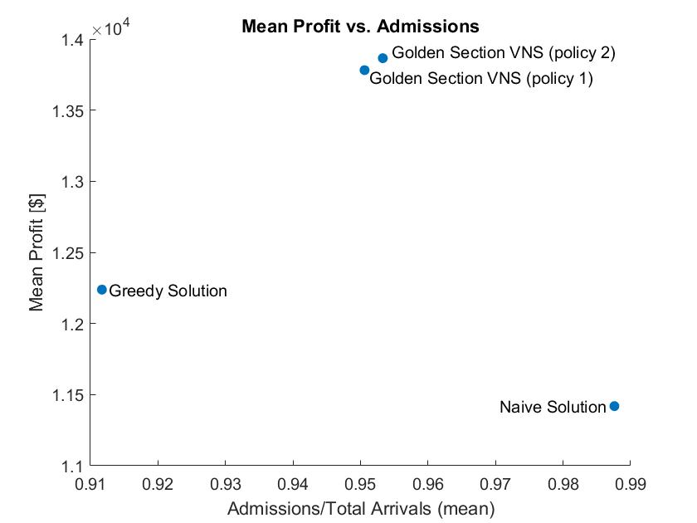
Results: Summary
Our solution as a way to:
Prevent customers from leaving our restaurant
But not increase the average number of occasions of sharing tables significantly
Avg. number of customers who share tables (per day):
Naïve solution: 6.5
Greedy solution: 1.1
Golden section VNS (policy 1): 1.1
Golden section VNS (policy 2): 1.3

