Slide 1
Preliminary results
I = 5
J = 10
nS = 1000
After clustering, exclude subproblems from each cluster that did not generate a violated cut.
Among remaining subproblems in each cluster, select one cut.

Slide 2
Computational Times
MultiCut: ~85 s
Pure random strategy in selecting one subproblem from each cluster
*in seconds | Min_samples
Epsilon | 1 | 2 | 3 | 4 | 5
0.1 | 79.44 | 78.39 | 78.42 | 78.48 | 78.60
0.2 | 112.25 | 111.67 | 79.02 | 79.94 | 80.02
0.3 | > 30 min | - | - | - | -
0.4 | - | - | - | - | -
0.5 | - | - | - | - | -
These are equal to standard multi-cut approach
Expected to be even longer than (0.3,1) because larger epsilon produces larger clusters, and in turn, bigger loss of information

Slide 3
Why So Bad?
Subproblems might not be as similar as we initially expected (i.e., every demand vector is kind of different from all others)
See sample plot in Github repository, or see next slide.
Selecting only one cut from each cluster may mean a lot of information loss (other cuts in the cluster are all violated cuts that we could potentially add)
Perhaps there is a candidate number 1 < k < |cluster| that works best.
Perhaps we should use an adaptive rule for changing how many subproblems to use from each cluster.

Slide 4
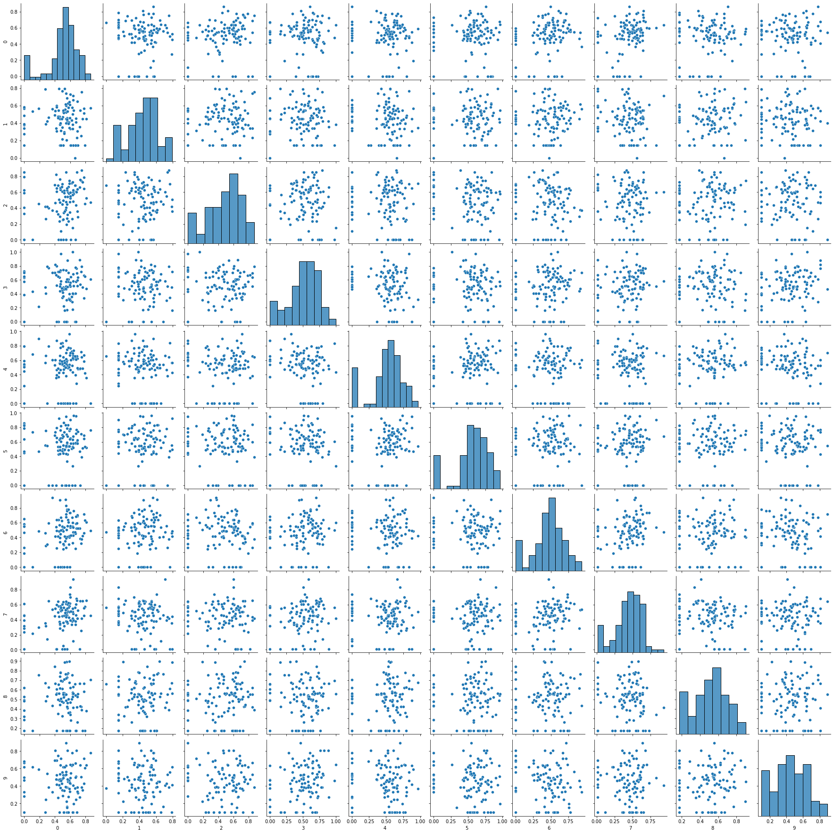

Slide 5
Preliminary Results (2)
Hypothesis: Each subproblem is unique, so clustering implies loss of information. Adding more cuts from each cluster should help.
Now, instead of selecting a single cut from each cluster, select multiple cuts.
Heuristic: Take sqrt(|cluster|), rounded to nearest integer
E.g.,:
|cluster| = 1 => 1 cut
|cluster| = 5 => 2 cuts
|cluster| = 144 => 12 cuts

Slide 6
Computational Times
MultiCut: ~85 s
With larger clusters, including more cuts improves time dramatically.
*in seconds | Min_samples
Epsilon | 1 | 2 | 3 | 4 | 5
0.1 | 78.50 | 80.18 | 87.55 | 79.25 | 81.37
0.2 | 104.19 | 111.73 | 80.25 | 88.36 | 84.13
0.3 | 180.59 | 185.54 | 216.95 | 164.19 | 88.85
0.4 | 339.78 | 89.02 | 99.11 | 107.96 | 106.23
0.5 | 54.15 | 63.42 | 61.54 | 129.52 | 155.53
Max: 135
Med: 1
Max: 923
Med: 1
Max: 923
Med: 3
Outliers: 56
Max: 923
Med: 6
Outliers: 62
These are almost single-cut, but worse (single-cut is ~10s).

Slide 7
Preliminary Results (3)
Aggregate cuts from each cluster instead.
Aggregating prevents loss of information compared to selecting just one cut.
Include if the aggregated cut is violated.

Slide 8
Computational Times
MultiCut: ~85 s | SingleCut: 11.37 s (avg. from 15 trials)
With larger clusters, including more cuts improves time dramatically.
*in seconds | Min_samples
Epsilon | 1 | 2 | 3 | 4 | 5
0.1 | 76.42 | 82.44 | 80.85 | 81.05 | 88.08
0.2 | 94.49 | 65.08 | 82.78 | 82.54 | 83.08
0.3 | 45.88 | 32.45 | 39.06 | 42.87 | 42.00
0.4 | 20.35 | 17.05 | 21.12 | 19.88 | 20.91
0.5 | 12.35 | 12.39 | 12.13 | 11.02 | 12.77
0.6 | 10.22 | 9.26 | 9.18 | 14.43 | 9.56
0.7 | 11.21 | 10.12 | 10.24 | 10.19 | 13.07

Slide 9
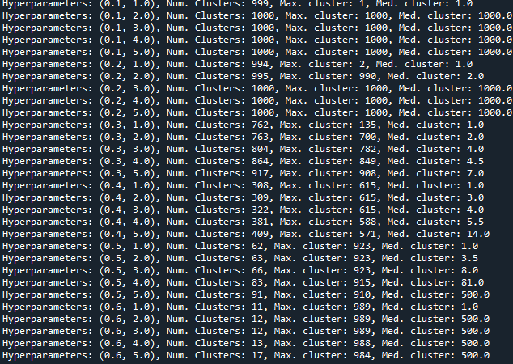

Slide 10
I = 5
J = 10
nS = 5000
SingleCut 5-trial average: 54.21 s
ClusterSub 5-trial average: 51.01 s (eps=0.5, min_samples = 3)
Number of clusters = ~140 (a giant cluster and many individual subproblems)
Min_samples = 3 seems to work well generally.
Epsilon needs to be adapted to problem parameters
Rule of thumb?: Fix min_samples to 3 and find the first epsilon (starting from 2.0 and going to 0.1) which produces number of clusters >= sqrt(nS). Then take the “previous” epsilon.

Slide 11
Testing Rule of Thumb
Usually produces 1 < # clusters < sqrt(nS), but closer to 1.
I=5, J=10, nS=1000: SingleCut ~11s vs. ClusterSub ~9s
I=5, J=10, nS=5000: SingleCut ~54s vs. ClusterSub ~51s
I=10, J=15, nS=1000: SingleCut ~272s vs. ~361s
three-trial average

Slide 12
Preliminary Results (4)
Aggregate cuts based on dual solutions and objective values
Include if aggregated cut is violated

Slide 13
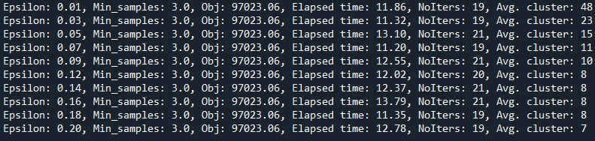
Computational Times
MultiCut: ~85 s | SingleCut: 11.37 s (avg. from 15 trials)

Slide 14
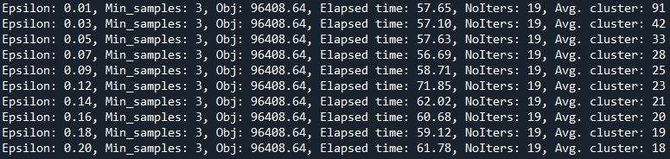
Computational Times
I=5, J=10, nS=5000: SingleCut ~54s vs. ClusterCut ~57s
I=10, J=15, nS=1000: SingleCut ~272s vs. ~382s

Slide 15
Preliminary Results (5)
Aggregate cuts based on objective values only
Include if aggregated cut is violated

Slide 16
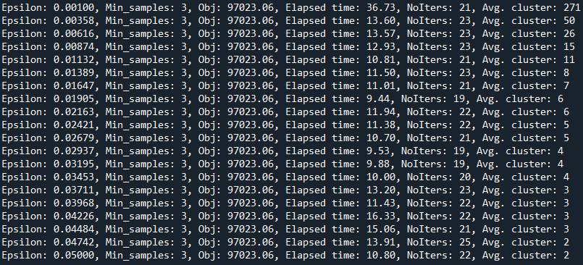
Computational Times
I=5, J=10, S=1000

Slide 17
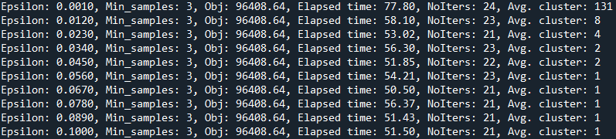
Computational Times
I=5, J=10, nS=5000: SingleCut ~54s vs. ClusterCut ~52s
I=10, J=15, nS=1000: SingleCut ~272s vs. ClusterCut ~262s
Averaged from three trials
I=10, J=15, nS=2500: SIngleCut ~617s vs. ClusterCut ~674s
Conclusions:
Adaptive clustering on objective values only seems to work best
eps=0.03 and min_samples = 3 seem to work ok in general.

Slide 18
Ventilator Allocation Problem

Slide 19
Preliminary Results (1)
N = 20, K = 500
Aggregate cuts based on dual solutions and objective values
3-trial average:
MultiCut: 7.56 s
SingleCut: 141.60 s

Slide 20
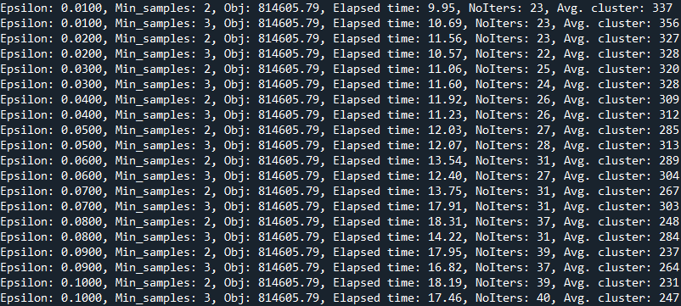
Computational Results

Slide 21
Preliminary Results (2)
Aggregate cuts based on some dual solutions and objective values

Slide 22
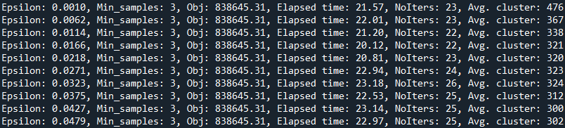
Computational Results (K=500)
MultiCut: 19.20 s (3-trial average)

Slide 23
Computational Results (K=3000)
MultiCut: 142.10 s (3-trial average)

Slide 24
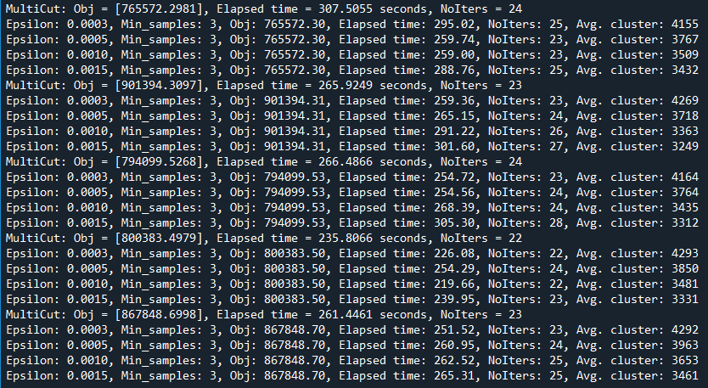
Computational Results (K=5000)
Seed # = 1
Seed # = 2
Seed # = 3
Seed # = 4
Seed # = 5

Slide 25
Computational Results (K=5000)
MultiCut: 275.98 s (seed #: 5)
MultiCut: 281.63 s (seed #: 33)
MultiCut: 286.42 s (seed #: 111)

