Slide 1
Preliminary results
I = 5
J = 10
nS = 1000
After clustering, exclude subproblems from each cluster that did not generate a violated cut.
Among remaining subproblems in each cluster, select one cut.

Slide 2
Computational Times
MultiCut: ~85 s
Pure random strategy in selecting one subproblem from each cluster
*in seconds | Min_samples
Epsilon | 1 | 2 | 3 | 4 | 5
0.1 | 79.44 | 78.39 | 78.42 | 78.48 | 78.60
0.2 | 112.25 | 111.67 | 79.02 | 79.94 | 80.02
0.3 | > 30 min | - | - | - | -
0.4 | - | - | - | - | -
0.5 | - | - | - | - | -
These are equal to standard multi-cut approach
Expected to be even longer than (0.3,1) because larger epsilon produces larger clusters, and in turn, bigger loss of information

Slide 3
Why So Bad?
Subproblems might not be as similar as we initially expected (i.e., every demand vector is kind of different from all others)
See sample plot in Github repository, or see next slide.
Selecting only one cut from each cluster may mean a lot of information loss (other cuts in the cluster are all violated cuts that we could potentially add)
Perhaps there is a candidate number 1 < k < |cluster| that works best.
Perhaps we should use an adaptive rule for changing how many subproblems to use from each cluster.

Slide 4
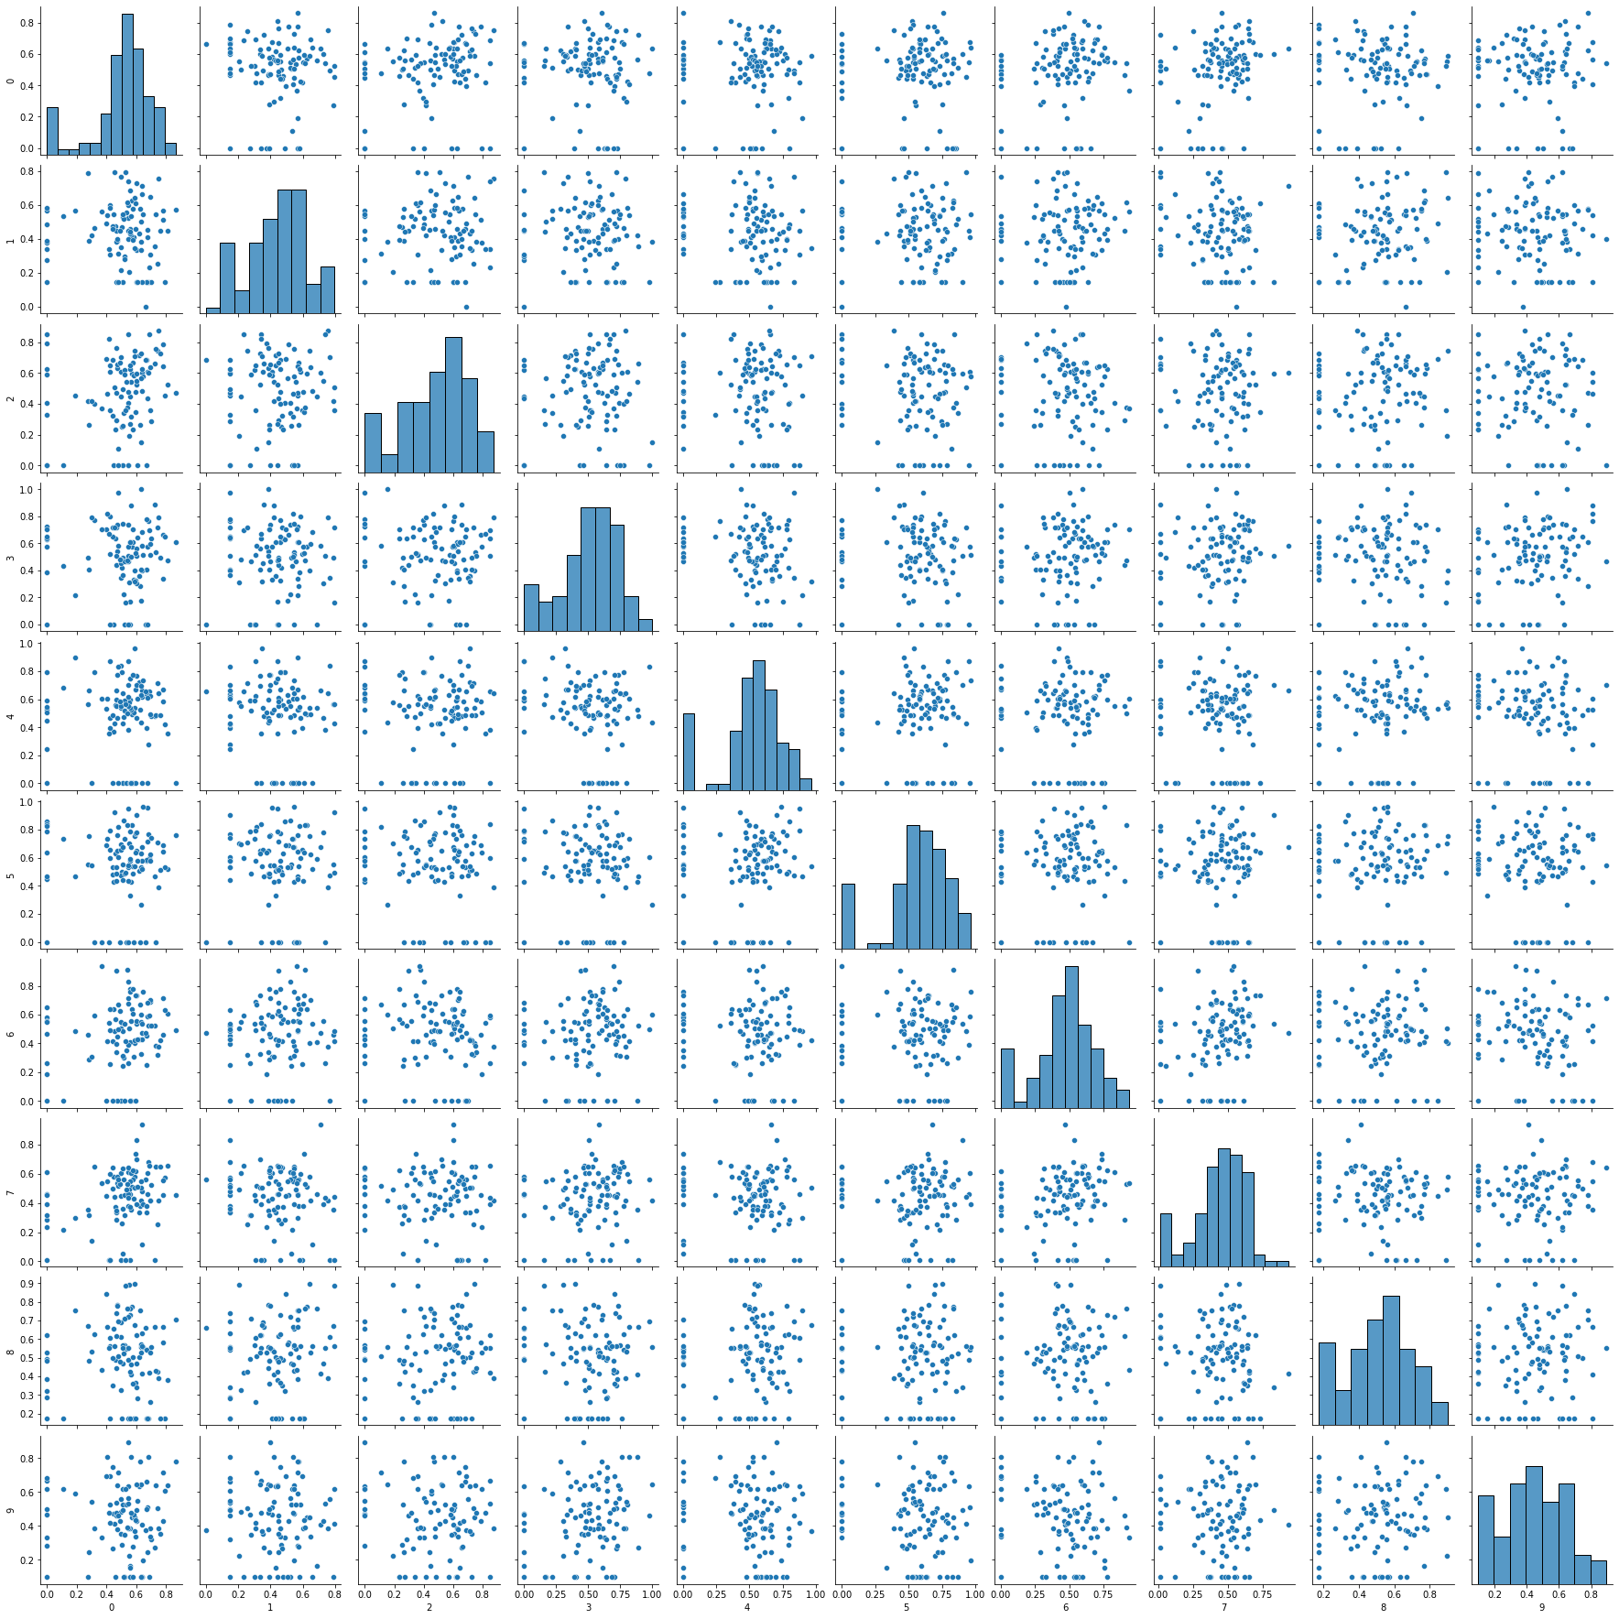

Slide 5
Preliminary Results (2)
Hypothesis: Each subproblem is unique, so clustering implies loss of information. Adding more cuts from each cluster should help.
Now, instead of selecting a single cut from each cluster, select multiple cuts.
Heuristic: Take sqrt(|cluster|), rounded to nearest integer
E.g.,:
|cluster| = 1 => 1 cut
|cluster| = 5 => 2 cuts
|cluster| = 144 => 12 cuts

Slide 6
Computational Times
MultiCut: ~85 s
With larger clusters, including more cuts improves time dramatically.
*in seconds | Min_samples
Epsilon | 1 | 2 | 3 | 4 | 5
0.1 | 78.50 | 80.18 | 87.55 | 79.25 | 81.37
0.2 | 104.19 | 111.73 | 80.25 | 88.36 | 84.13
0.3 | 180.59 | 185.54 | 216.95 | 164.19 | 88.85
0.4 | 339.78 | 89.02 | 99.11 | 107.96 | 106.23
0.5 | 54.15 | 63.42 | 61.54 | 129.52 | 155.53
Max: 135
Med: 1
Max: 923
Med: 1
Max: 923
Med: 3
Outliers: 56
Max: 923
Med: 6
Outliers: 62
These are almost single-cut, but worse (single-cut is ~10s).

