Slide 1
5강. Temporal Difference(TD) Methods

Slide 2
Contents
Temporal Difference
On-Policy TD Methods
Off-Policy TD Methods
Code Exercise
N-Step TD Methods

Slide 3
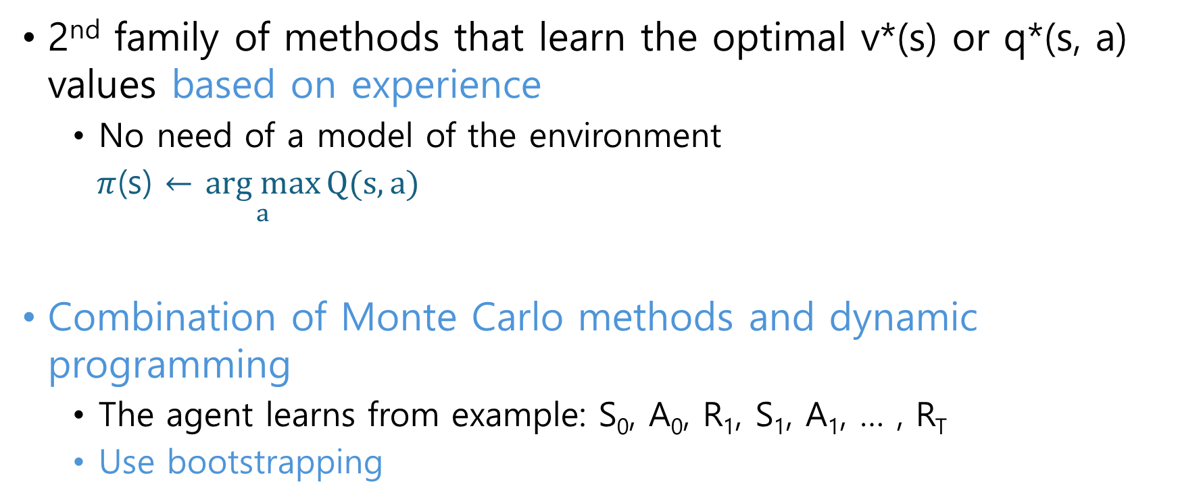
TD
2nd family of methods that learn the optimal v*(s) or q*(s, a) values based on experience
No need of a model of the environment
$π$(s) $←$ $\underset{a}{arg max}{Q(s, a)}$
Combination of Monte Carlo methods and dynamic programming
The agent learns from example: S₀, A₀, R₁, S₁, A₁, … , R_{T}
Use bootstrapping

Slide 4

TD
Monte Carlo methods wait until the return Gt is available before updating Q(s, a):
TD update Q and $π$ every time the agent takes an action, during the episode without waiting until the end
Learning process is constant and uniform. Now we learn every step. This is advantage because the learning at the beginning of the episode influences the policy during the rest of the episode, improving its decision making.

Slide 5
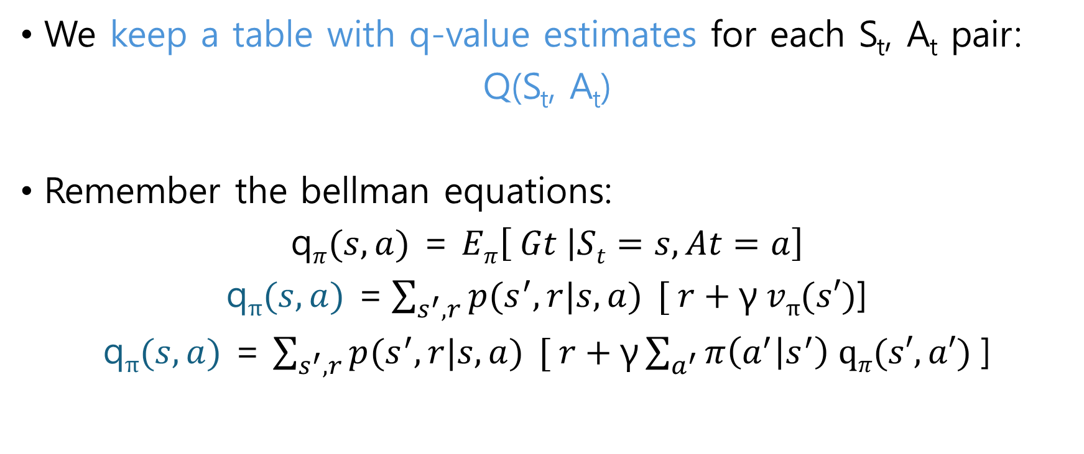
TD
We keep a table with q-value estimates for each S_{t}, A_{t} pair:
Q(S_{t}, A_{t})
Remember the bellman equations:
q$π(s, a)$ = $Eπ\left[ Gt | St=s, At=a\right]$
q$π(s,a)$ =$\sum_{s^{′},r}{p(s^{′},r|s,a) }[ r+\text{γ} vπ(s′)$]
q$π(s,a)$ = $\sum_{s^{′},r}{p(s^{′},r|s,a) }[ r+\text{γ}\sum_{a^{′}}{π\left(a^{′} | s^{′}\right) \text{q}π(s′,a′)}$]

Slide 6
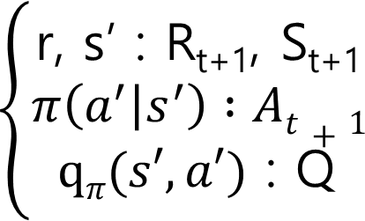
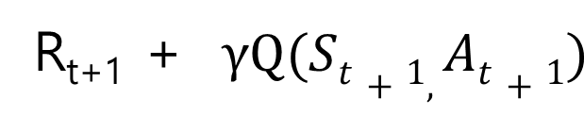

TD
Remember the bootstrapping
q$π(s,a)$ = $\sum_{s^{′},r}{p(s^{′},r|s,a) }[ r+\text{γ}\sum_{a^{′}}{π\left(a^{′} | s^{′}\right) \text{q}π(s′,a′)}$]
$\text{q}π(St,At)$ can also be estimates as:
In TD, n-step MC + Bootstrapped Q function is the target!

Slide 7
TD
Temporal difference error between the new one and old one
Compare the two estimates. Note the new one incorporates real information from the environment
Estimates are updated based on the temporal difference error:

Slide 8
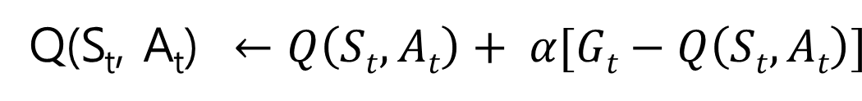
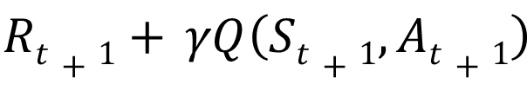
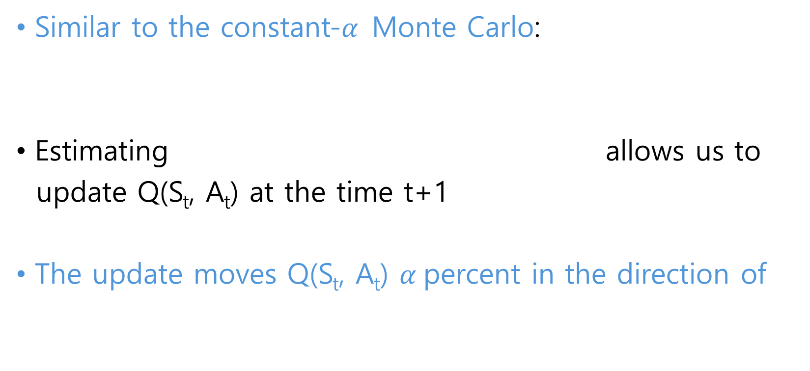
TD
Similar to the constant-$α$Monte Carlo:
Estimating allows us to
update Q(S_{t}, A_{t}) at the time t+1
The update moves Q(S_{t}, A_{t}) $α$percent in the direction of

Slide 9
Advantage of TD
Monte Carlo methods need to wait until an episode ends.
So, no Q(s, a) table update in-between.
TD method can start to update the Q-value table immediately after taking the first action
So, the actions taken at the beginning of the episode start
influencing the behavior of the agent immediately.

Slide 10
On-policy TD

Slide 11
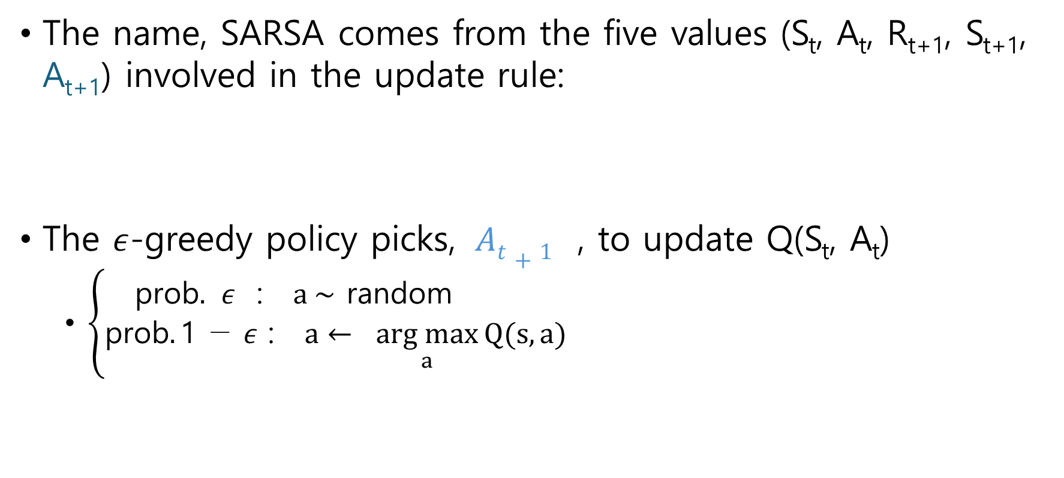
SARSA
The name, SARSA comes from the five values (S_{t}, A_{t}, R_{t+1}, S_{t+1}, A_{t+1}) involved in the update rule:
The $ε$-greedy policy picks, $At+1$ , to update Q(S_{t}, A_{t})
$\left\{\begin{aligned}\text{prob}. ε\text{ : } a \sim \text{random} \\ \text{prob}.\text{1 − }ε \text{: } a← \underset{a}{arg max}{Q(s, a)}\end{aligned}\right.$

Slide 12
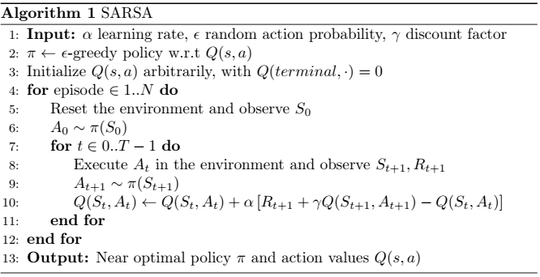
SARSA

Slide 13
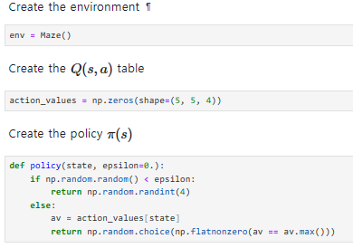
SARSA

Slide 14
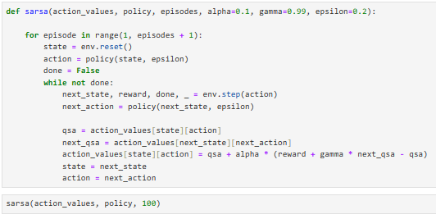
SARSA

Slide 15
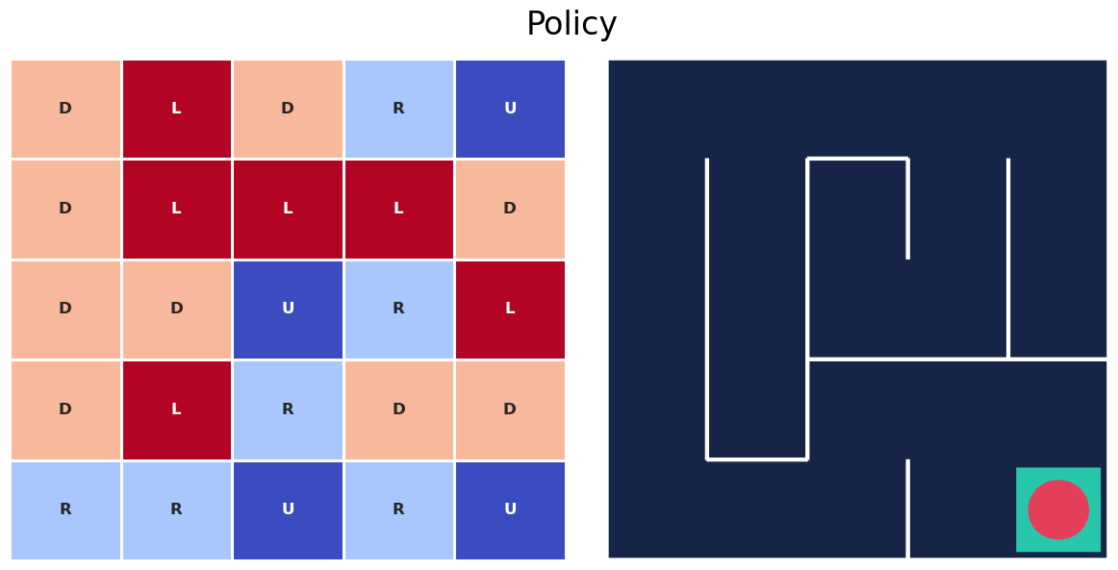
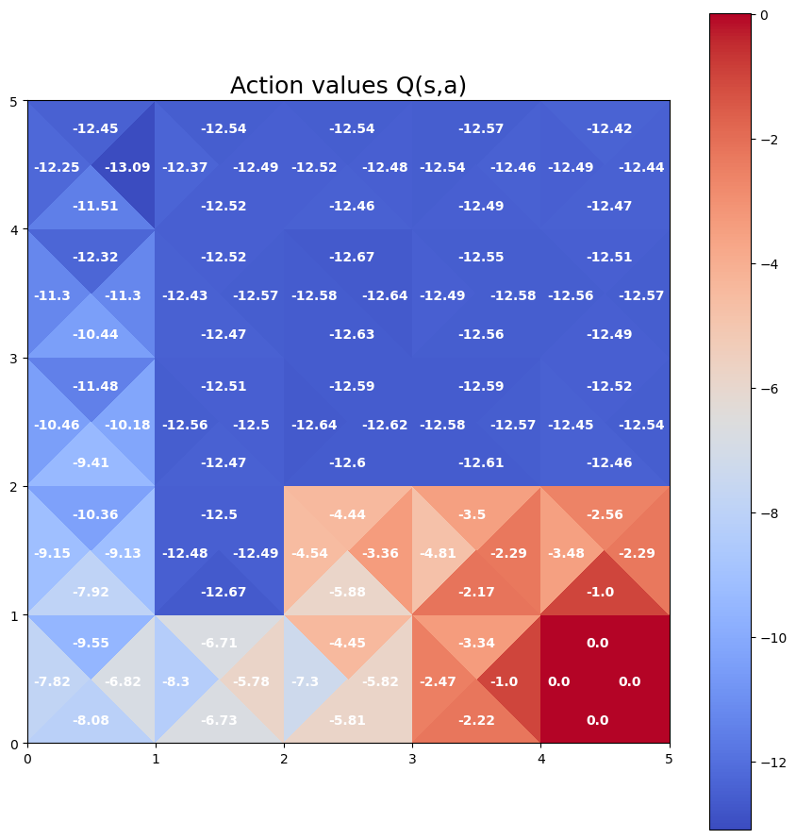
SARSA

Slide 16
Code Ex.

Slide 17
Off-policy TD

Slide 18
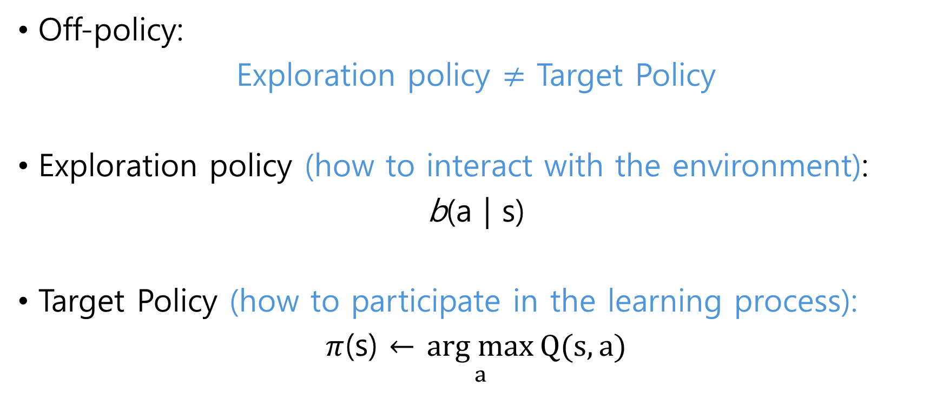
Q-learning
Off-policy:
Exploration policy $≠$ Target Policy
Exploration policy (how to interact with the environment):
b(a | s)
Target Policy (how to participate in the learning process):
$π$(s) $←$ $\underset{a}{arg max}{Q(s, a)}$

Slide 19
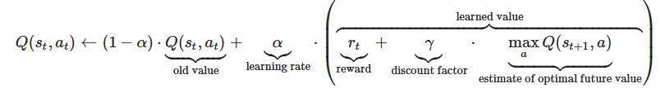

Q-learning
We’ll choose action A_{t+1} according to the target policy
Update rule:
Target policy update Q(S_{t}, A_{t}) based on the best available action (defines how to update the Q values)
Note: $ε$-greedy policy (SARSA) → argmax policy (Q-learning)

Slide 20
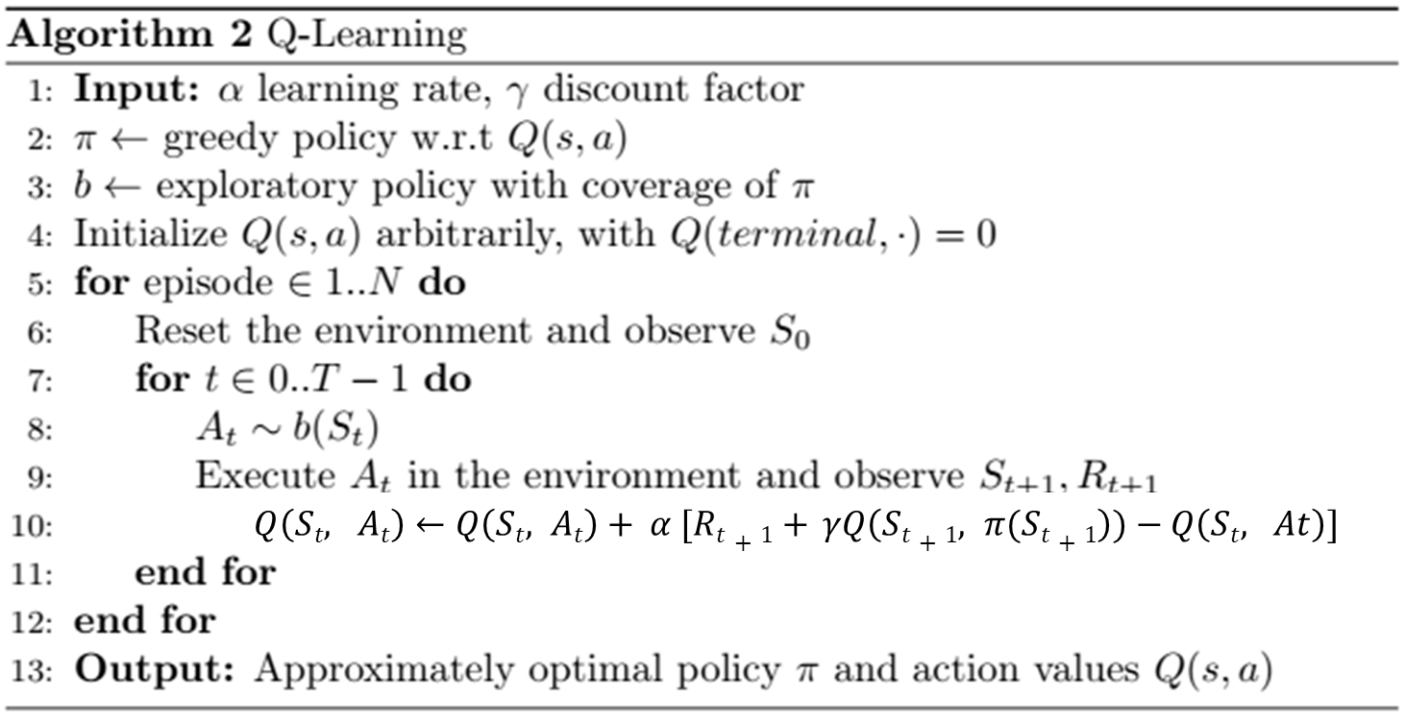
Q-learning
$Q\left(St, At\right)←Q\left(St, At\right)+ α [Rt+1+ γQ\left(St+1, π(St+1\right))−Q\left(St, At\right)]$

Slide 21
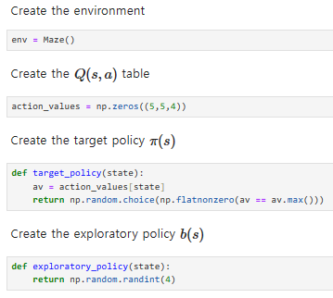
Q-learning

Slide 22
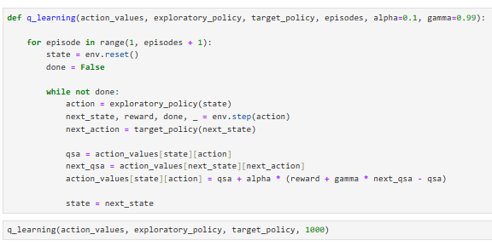
Q-learning

Slide 23
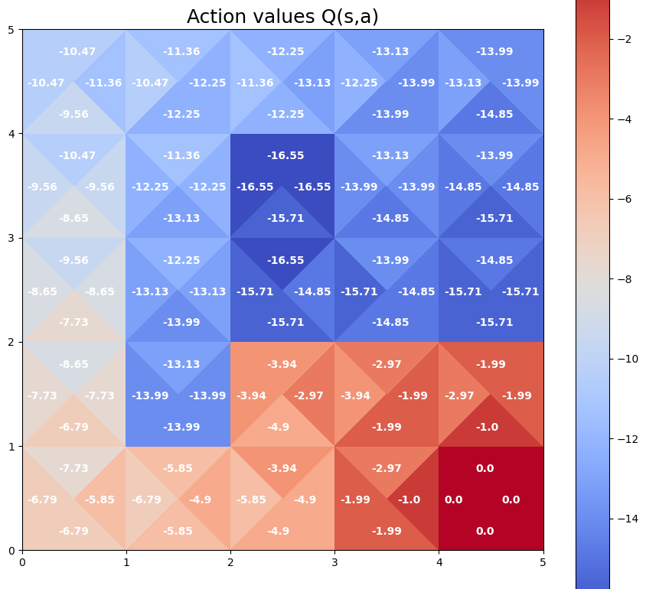
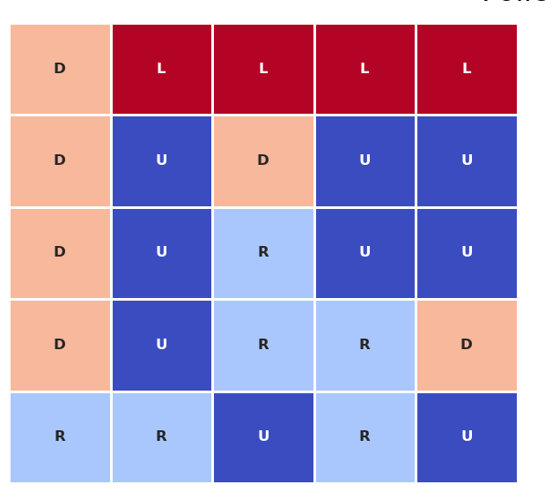
Q-learning
Note that now in all states, the policy also leads us to the goal.
It’s because the exploratory policy has visited quite frequently, all the states.

Slide 24
Q-learning
Exploratory policy has been a random policy throughout the entire process giving the agent the opportunity to explore all of these states and get a good idea of the real Q values and optimal action in all of them
Advantage is we can separate the learning process from the exploration.
We can use either a policy that selects the optimal action most of the time and only every once in a while explores (SARSA), or we can choose a policy that is much more aggressive in its exploration (Q-learning)

Slide 25
Advantage of TD
Unlike Monte Carlo,
TD allows us to update Q(s, a) while experience is being collected
This means that the decision making of the agent can be improved during the episode without to wait until the end. In practice they converge faster.
Unlike Dynamic Programming,
More efficient. focusing the effort on the states that lead to goals.
Don’t require a model of the environment

Slide 26
Code Ex.

Slide 27
N-Step TD

Slide 28
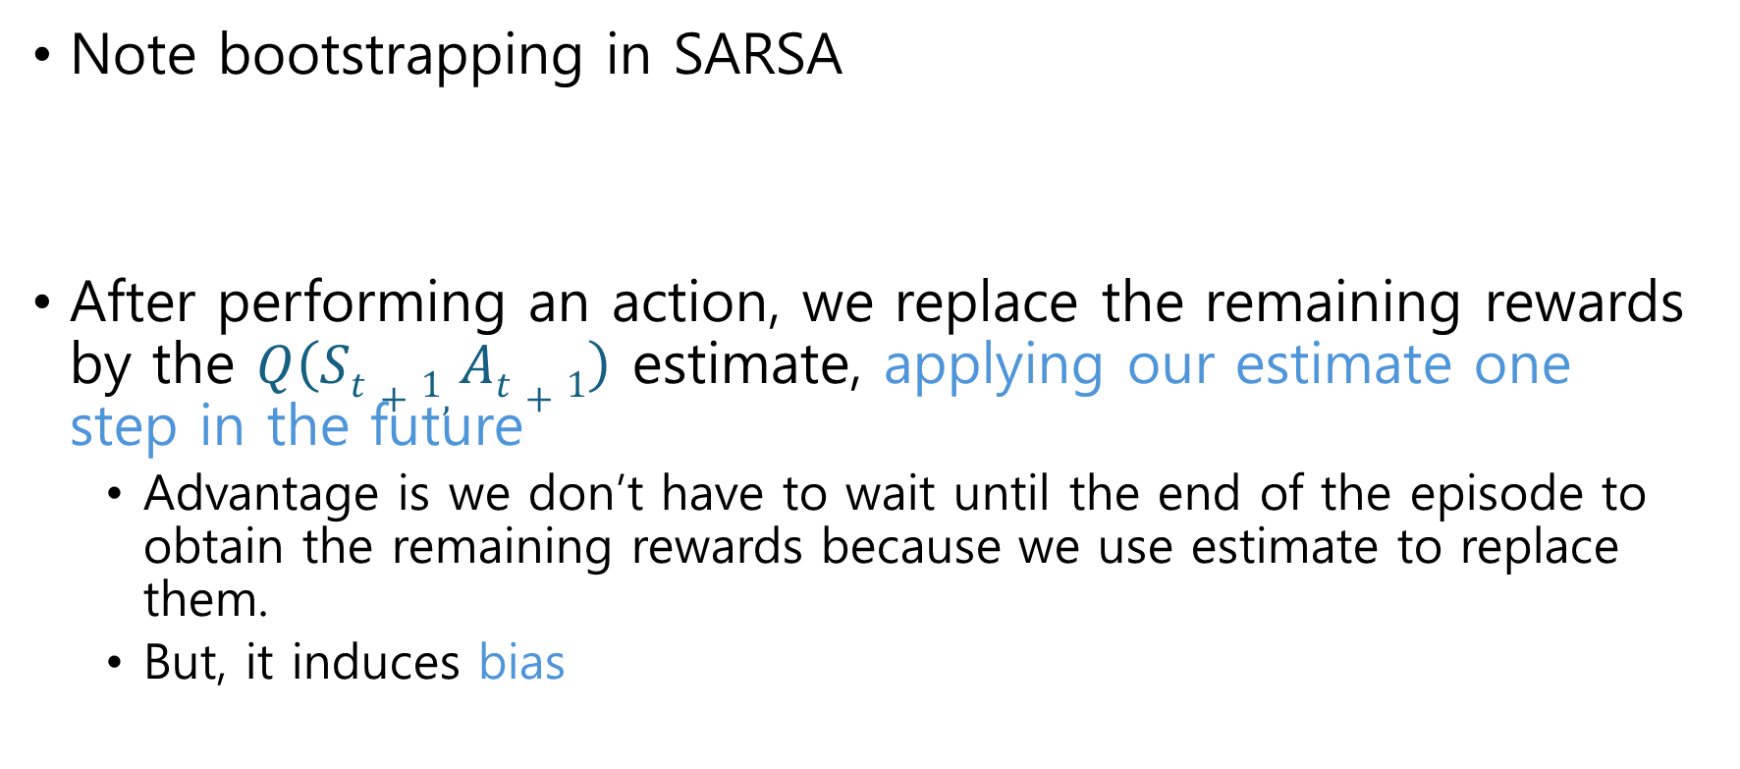
N-step TD
Note bootstrapping in SARSA
After performing an action, we replace the remaining rewards by the $Q\left(St+1, At+1\right)$ estimate, applying our estimate one step in the future
Advantage is we don’t have to wait until the end of the episode to obtain the remaining rewards because we use estimate to replace them.
But, it induces bias

Slide 29
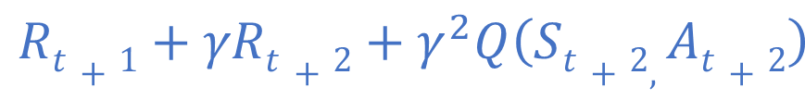
N-step TD
Note that TD is a mix of MC and Dynamic Programming
How many actual rewards vs. how many estimate using Q val.
2-step bootstrapping
3-step bootstrapping
n-step bootstrapping

Slide 30
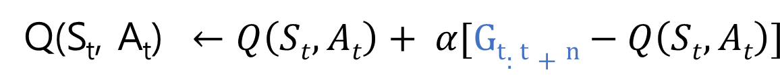
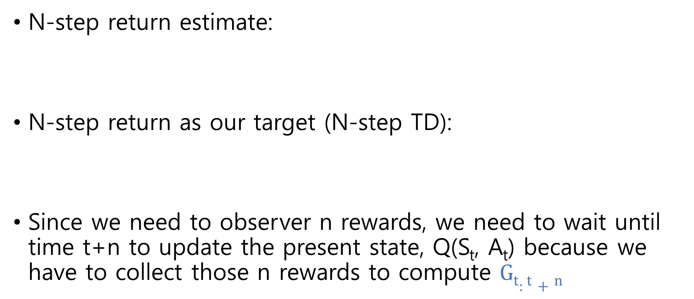
N-step TD
N-step return estimate:
N-step return as our target (N-step TD):
Since we need to observer n rewards, we need to wait until time t+n to update the present state, Q(S_{t}, A_{t}) because we have to collect those n rewards to compute $Gt:t+n$

Slide 31
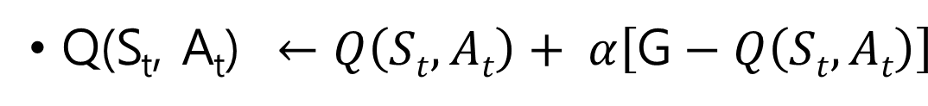


N-step TD
If n $≥$T: G_{t} = $Gt:t+n$
If n = 1: G_{t} $= Rt+1+ γQ\left(St+1, At+1\right)$
If n = k:

Slide 32

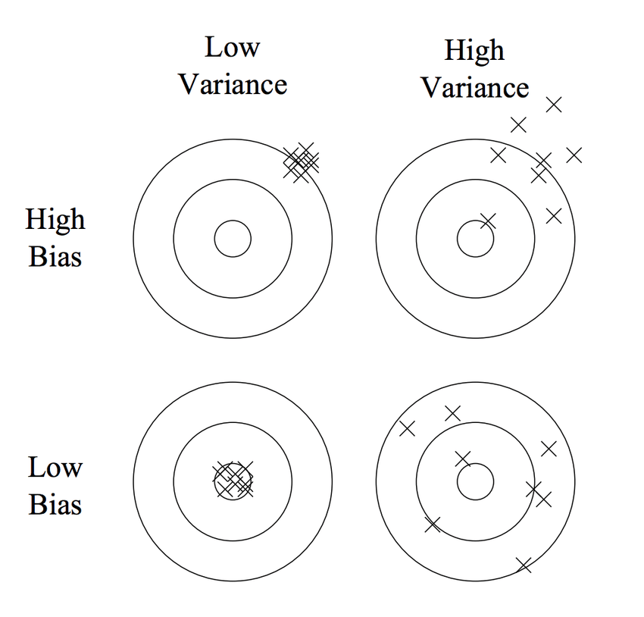


Bias vs Variance Tradeoff
$Q\left(St+1, At+1\right)$ is an estimate of future rewards. The estimate improves throughout the learning process.
$Q\left(St+1, At+1\right)$ introduces bias in the estimate.
The higher n, the more heavily discounted the estimate $Q\left(St+n, At+n\right)$ by $γ^{n}$.
The higher the n, the lower the bias

Slide 33
Bias vs Variance Tradeoff
Each reward is a random variable that depends on the state s and action a preceding it.
Even if they have the same expected value, every observation of the return, G_{t} , samples will be very different from each other.
The higher the n, the higher the variance
* If a policy choose a different action at the beginning of the episode, the rewards that will obtain throughout the rest can vary a lot because we’ll visit different states and probably choose other actions.

Slide 34

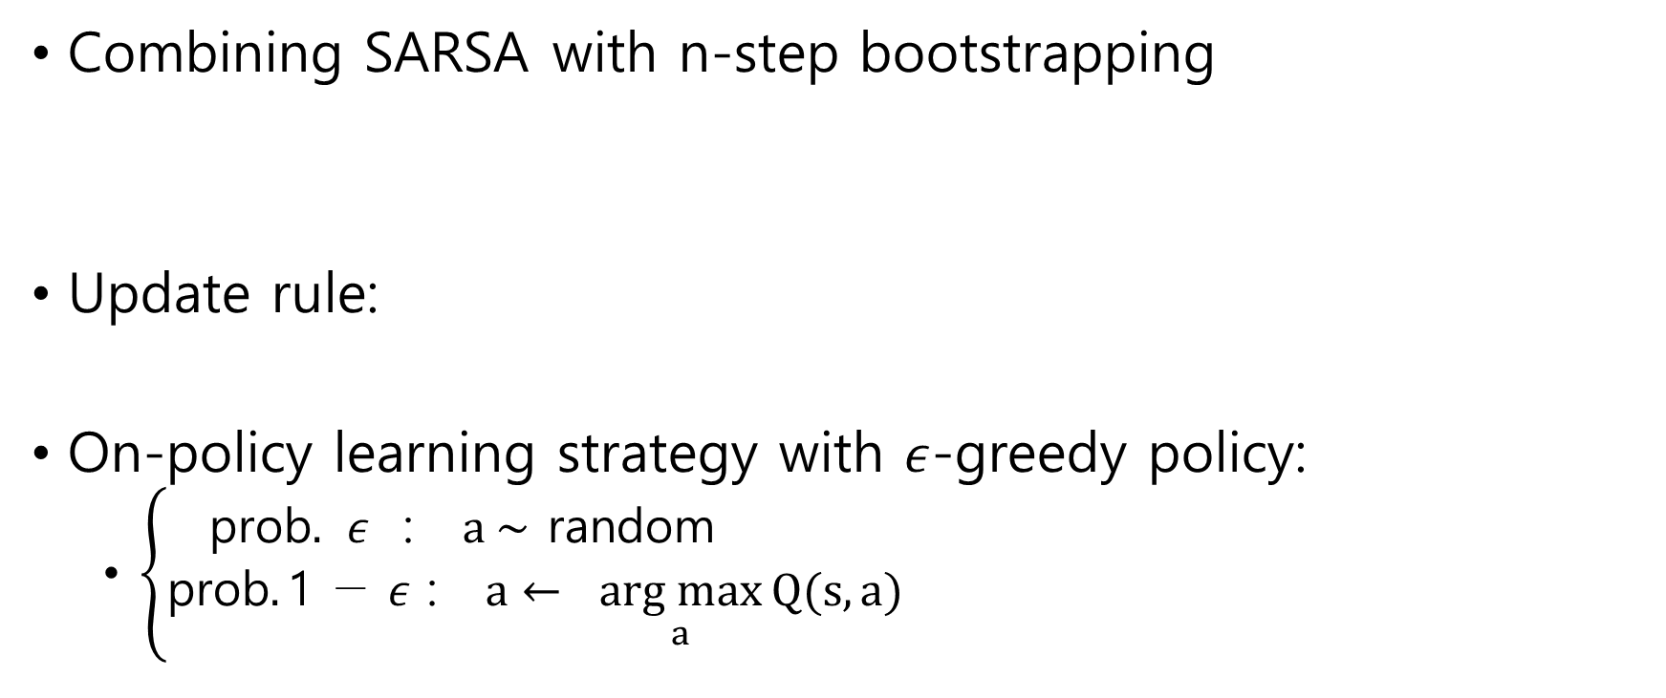
N-step SARSA
Combining SARSA with n-step bootstrapping
Update rule:
On-policy learning strategy with $ε$-greedy policy:
$\left\{\begin{aligned}\text{prob}. ε\text{ : } a \sim \text{random} \\ \text{prob}.\text{1 − }ε \text{: } a← \underset{a}{arg max}{Q(s, a)}\end{aligned}\right.$

Slide 35
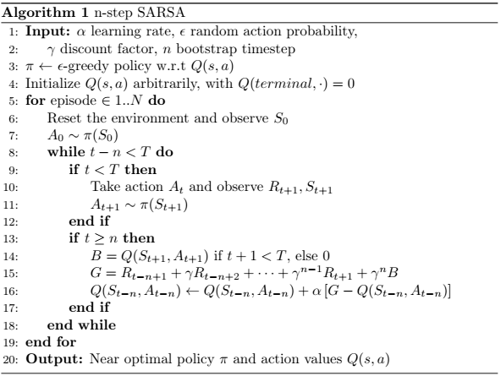

Slide 36
N-step SARSA
So on the one hand, using SARSA, we have to wait and steps until we are able to start the learning process.
But on the other hand, those estimates will include more information from the environment instead of a single reward, they will include n.
And that will be a more reliable estimate of the return.

Slide 37
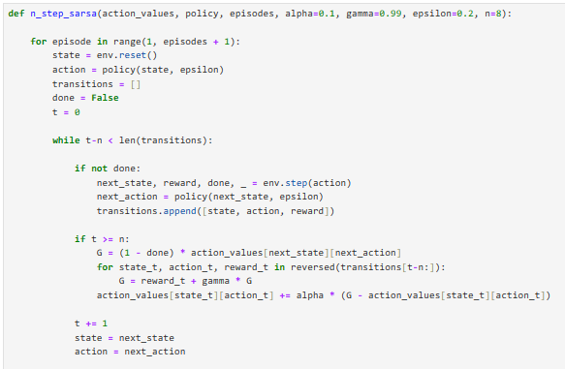

Slide 38
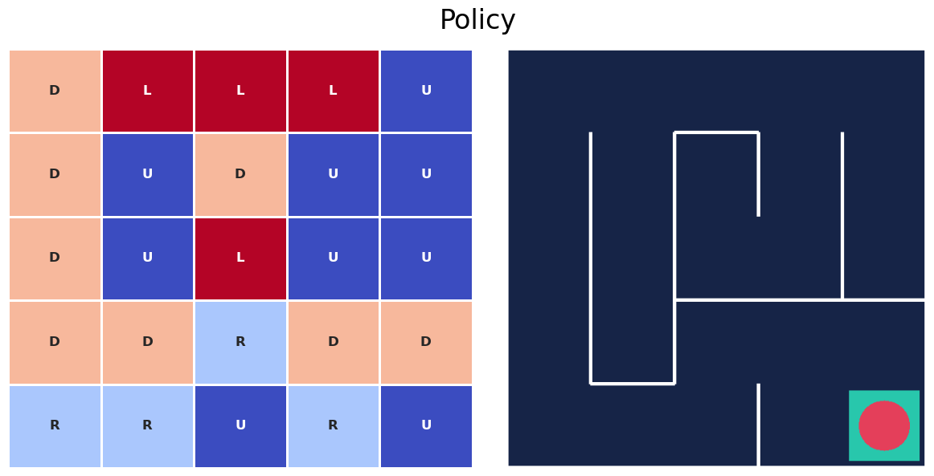
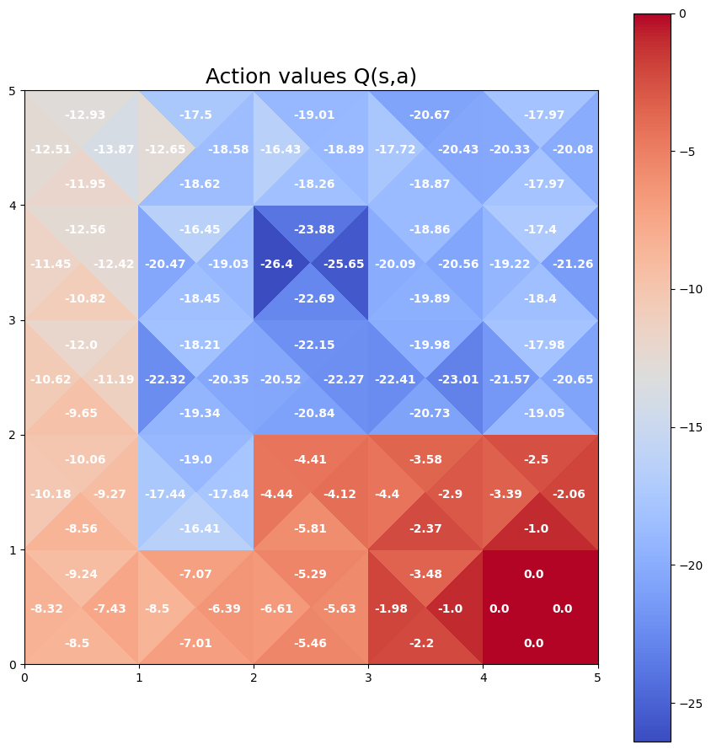
N-step SARSA

