Slide 1
9강. DQN활용 (Kuka RL)

Slide 2
Pybullet

Slide 3
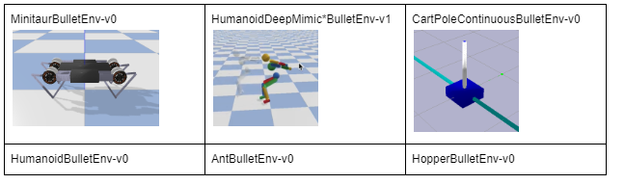
Pybullet

Slide 4
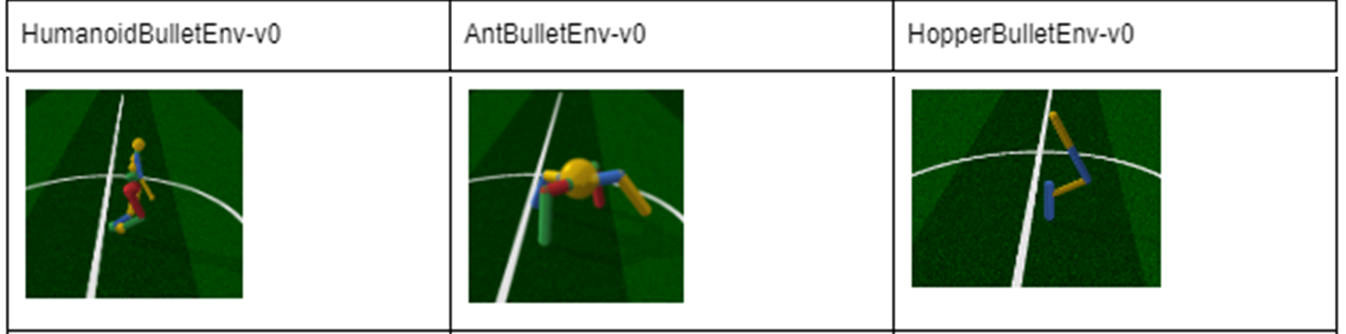
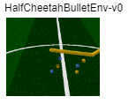
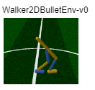
Pybullet

Slide 5
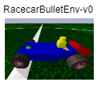
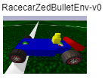
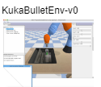
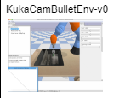
Pybullet

Slide 6
Pybullet
A suite of RL Gym Environments are installed during "pip install pybullet“
This includes PyBullet versions of the OpenAI Gym environments such as ant, hopper, humanoid and walker.
There are also environments that apply in simulation as well as on real robots, such as the Ghost Robotics Minitaur quadruped, the MIT racecar and the KUKA robot arm grasping environments.

Slide 7
Pybullet
The source code of pybullet, pybullet_envs, pybullet_data and the examples are here:
https://github.com/bulletphysics/bullet3/tree/master/examples/pybullet/gym
You can train the environments with RL training algorithms such as DQN, PPO, TRPO and DDPG.

Slide 8
Pybullet
Several pre-trained examples are available, you can enjoy them like this:
pip install gym, pybullet, tensorflow, torch
python -m pybullet_envs.examples.kukaGymEnvTest
python -m pybullet_envs.examples.minitaur_gym_env_example

Slide 9
Pybullet
Windows Gym Package Install:
conda install -c conda-forge box2d-py
pip install gym==0.23.1
Pip install pybullet
Pip install numpy==1.23.1
Pip install matplotlib

Slide 10
Kuka Robotic Arm

Slide 11
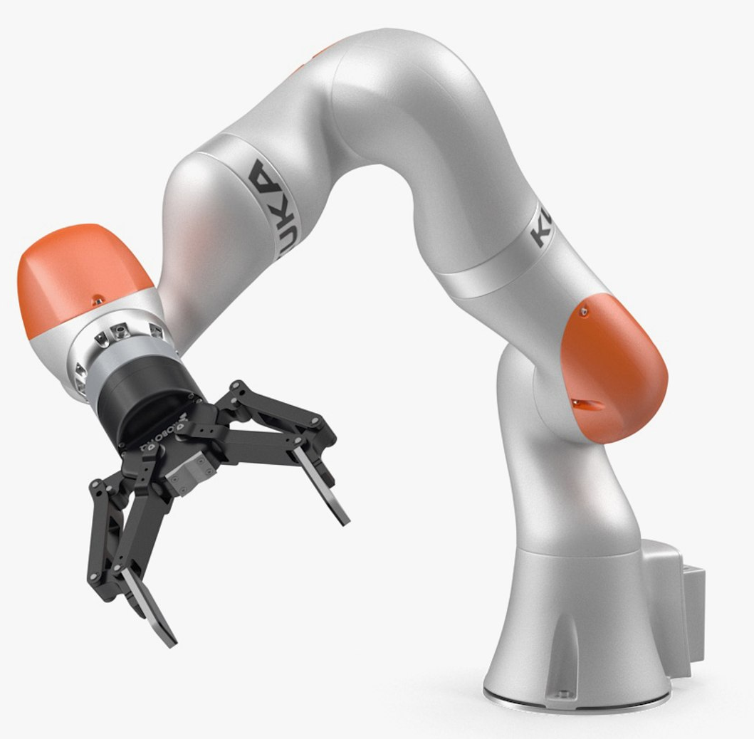
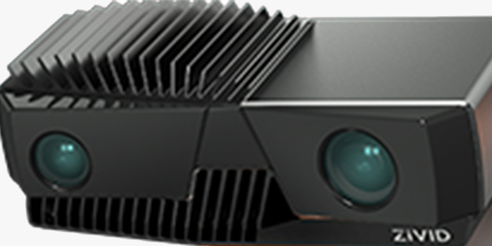
Kuka Robotic Arm

Slide 12
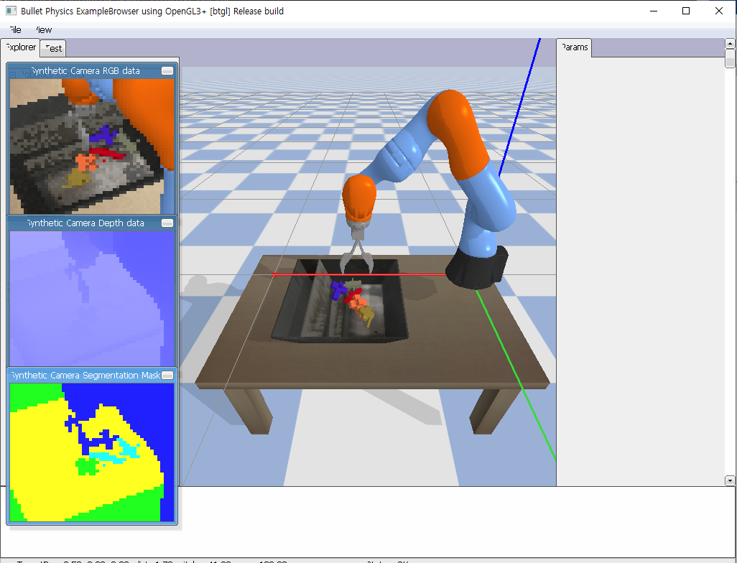
Kuka Pybullet

Slide 13
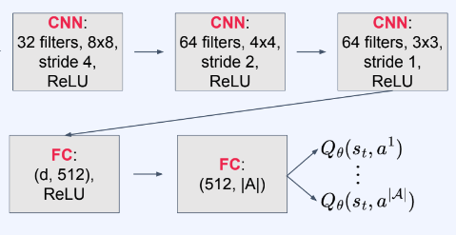
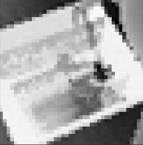
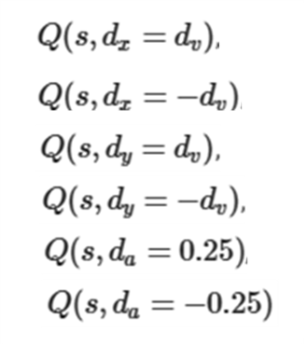
Q-network
(48, 48,3)
5 frame Stack
(40, 40)
5 frame Stack
dv = 0.06 is the velocity in PyBullet
da = 0.25 is vertical angle offset for the gripper

Slide 14
States
The input image signal is (48, 48, 3) RGB image and timestep t
Timestep, t is included in the state, since the policy must know how many steps remain in the episode to decide whether it must immediately move into a good grasping position.
NN can solve the task purely by looking at the scene.
So, we'll use a stack of consecutive screens as an input.
In this way, we are hoping to capture the dynamics of the environment.

Slide 15
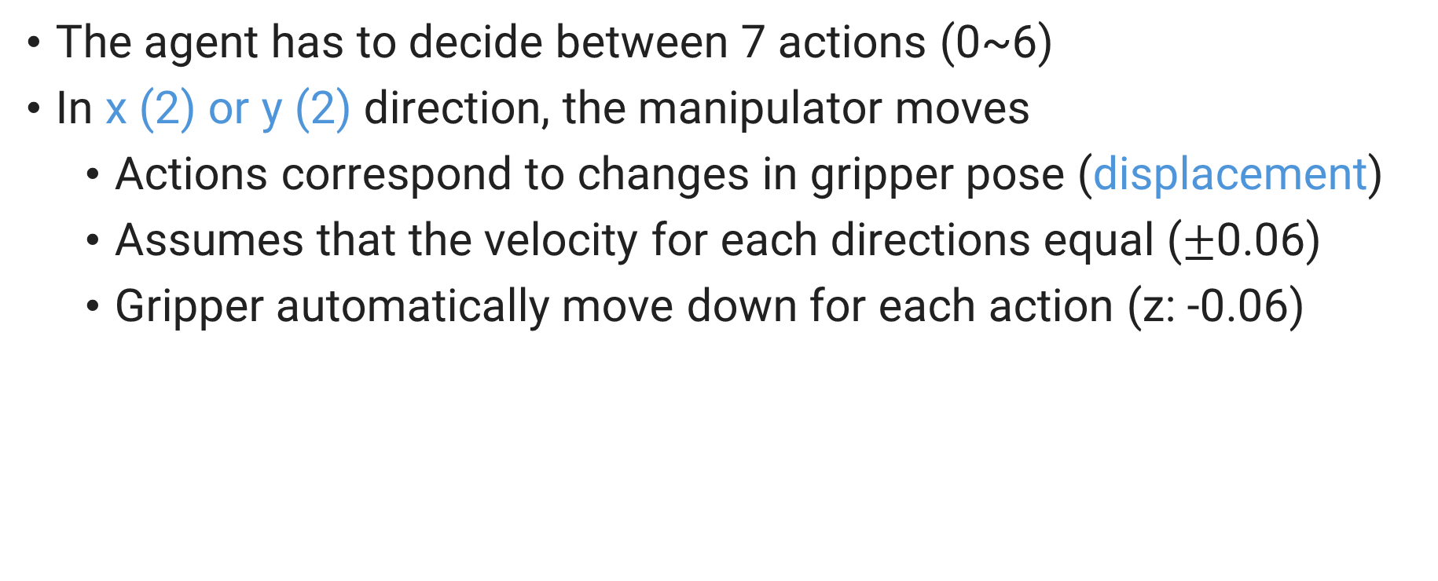
Actions
The agent has to decide between 7 actions (0~6)
In x (2) or y (2) direction, the manipulator moves
Actions correspond to changes in gripper pose (displacement)
Assumes that the velocity for each directions equal ($±$0.06)
Gripper automatically move down for each action (z: -0.06)

Slide 16
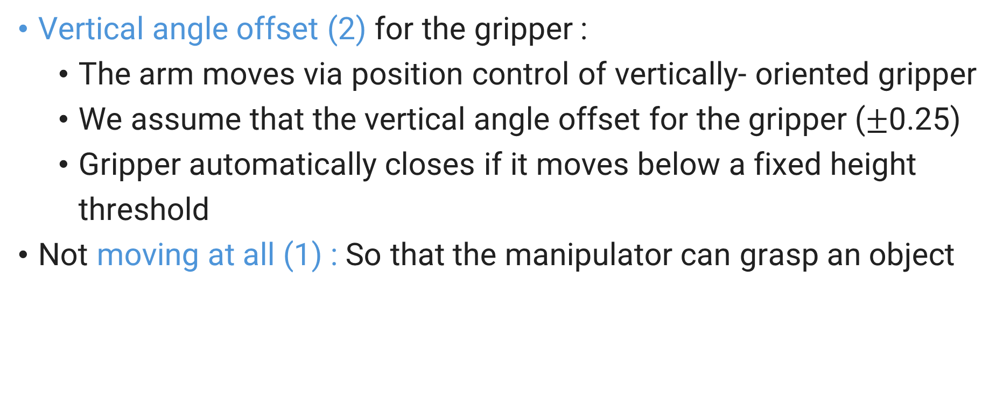
Actions
Vertical angle offset (2) for the gripper :
The arm moves via position control of vertically- oriented gripper
We assume that the vertical angle offset for the gripper ($±$0.25)
Gripper automatically closes if it moves below a fixed height threshold
Not moving at all (1) : So that the manipulator can grasp an object

Slide 17
Reward
The reward is binary and provided only at the last step.
1 if one of the objects is above height .2 (successful grasp)
0 for a failed grasp
The arm has a fixed number of timesteps (T = 15) to find a good grasp, at which the episode ends

Slide 18
Setup Code Env.
Git download: https://git-scm.com/downloads
Windows Package설치:
가상환경: Create: conda create –n [이름] python=3.8
Pytorch설치: https://pytorch.kr/get-started/locally/ 명령어라인 복사
pip install pybullet
pip install tensorboardX
pip install gym==0.23.1
Pip install numpy==1.23.1
Pip install matplotlib
Code:
Colab:
https://colab.research.google.com/github/mahyaret/kuka_rl/blob/master/kuka_rl.ipynb#scrollTo=5B4fbx6MUnnE
Windows:
Train with ‘bullet_kuka_train.py’ (use ‘policy_dqn.pt’ after training)
Evaluate with ‘bullet_kuka_eval.py’

Slide 19
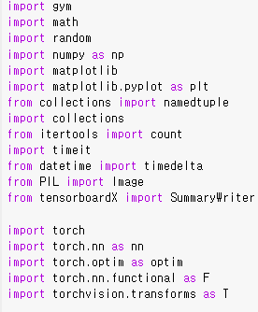
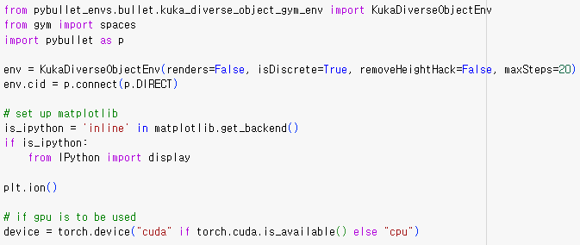
Env.
Image transform
pybullet

Slide 20
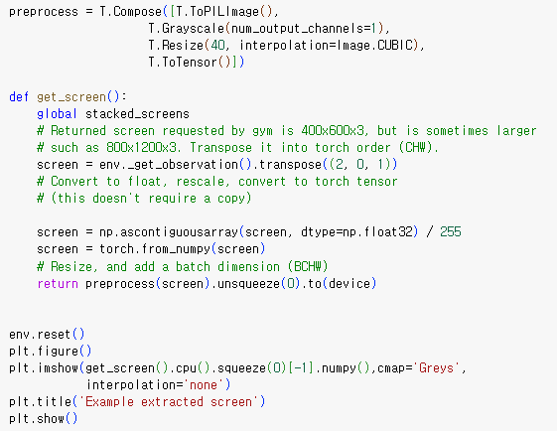
Env.
Gripper automatically move down for each action (z: -0.06
does Matplotlib backend support
Jupyter notebook’s line display?
torchvision image transform:
Color: black&whilte
Resize :(40x40)
Interpolation: cubic function
Normalize: 0~1

Slide 21
Preprocess
torchvision image transform:
Color: black&whilte
Resize :(40x40)
Interpolation: cubic function
Normalize: 0~1
Numpy:(48, 48, 3)->(3, 48, 48)
Store array as memory sequence to improve r/w time delay
Numpy:(3, 48, 48)->(1, 40, 40)
-> Tensor:([1, 1, 40, 40])
-> Cuda tensor([1, 1, 40, 40])

Slide 22
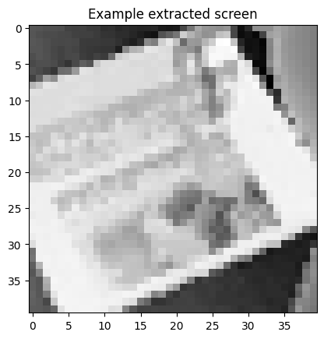
Preprocess
get_screen() returns Cuda tensor([1, 1, 40, 40]). Change it to CPU tensor
To display with matplotlib, remove batch dim. and get the dim. :
->torch.Size([1, 40, 40])
->torch.Size([40, 40])

Slide 23
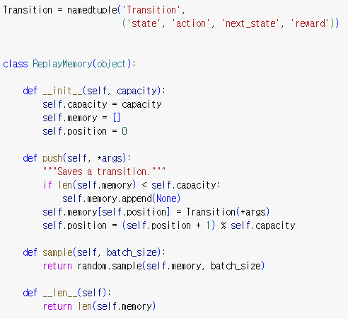
Replay buffer
namedtuple returns ‘Transition’ class We can access Transition class
a cyclic buffer of bounded size
Uniform-random picking by the amount of batch_size

Slide 24
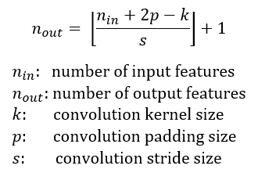
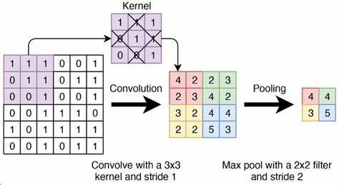
Q network
How to calculate the output size of a convolution layer

Slide 25
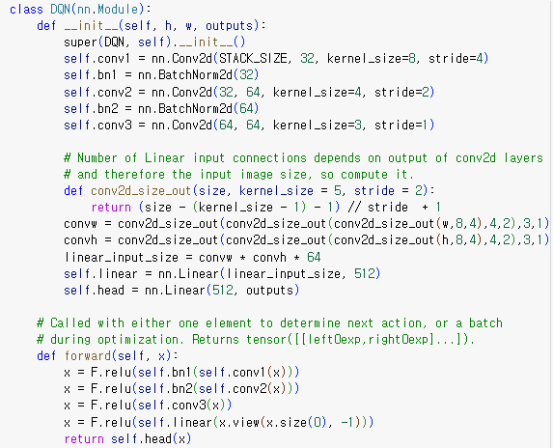
Q network
STACK_SIZE = 5
torch.nn.Conv2d(in_channels, out_channels, kernel_size, stride=1, padding=0,…
e.g., when w=10 kernel=4 stride=2,
Output is (10–3-1)// 2 + 1 = 4
:

Slide 26
Q network
Net() or net.forward()
Note: the function is called with either 1 element to determine next action,
Or a batch during optimization
Returns tensor( [ [ Q(s, dx=dv),
Q(s, dx=−dv),
Q(s, dy=dv),
Q(s, dy=−dv),
Q(s, da=0.25),
Q(s, da=−0.25) ] ] )

Slide 27
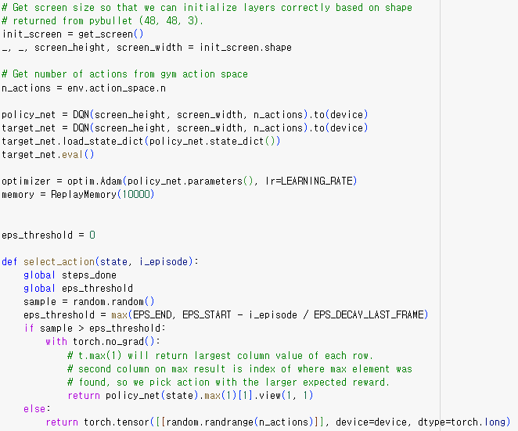
Q network
Output is torch.Size([1, 1, 40, 40])
Discrete(7)
Send network to GPU
Learning rate is 1e-4

Slide 28
Q network
EPS_START = 0.9
EPS_END = 0.1
EPS_DECAY = 200
EPS_DECAY_LAST_FRAME = 10**4
i_episode: 0~ 10**7
2nd column on max result is the max. action index where max element was found
Send action data GPU

Slide 29
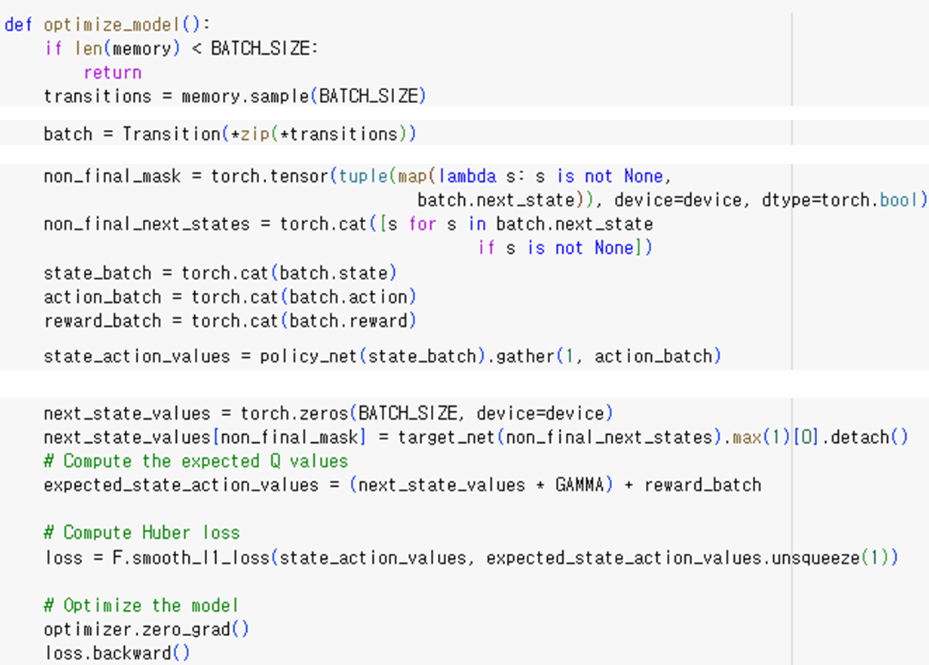
Training
BATCH_SIZE = 32
*transitions: (s,a,s’,r), (s,a,s’,r),..
*zip: (s,s,..), (a,a,…), (s’,s;,..), (r,r,…)
batch: (state 32개(s,s,...),
action 32개(a,a,…),
next_state 32개(s’,s,...),
reward 32개(r,r,…))
torch.Size([32])
:tensor([T,T,..F,F,T])
is used as mask to retrieve non-None next-states
torch.Size([28, 5, 40, 40])
stores non-None next-states
tuple(map(f, tuple))
batch.next_state: 32개(s’,s’,...)
torch.Size([32, 5, 40, 40])
torch.Size([32, 1])
torch.Size([32])

Slide 30
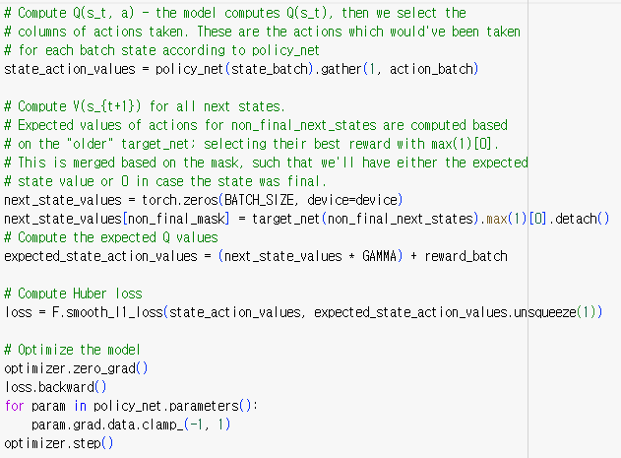


Training
Compute Q(s_t, a): the model computes Q(s_t),
then we select the columns of action taken
torch.gather(input, dim, index, …) → gathers values along an axis specified by dim.
e.g.,
→
Compute V(s_t+1) for all next states.
(either the expected state value or 0)
max(1)[0] selects the best return.

Slide 31
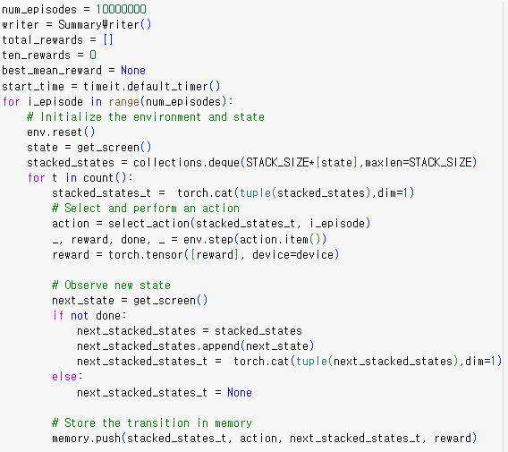
Training loop

Slide 32
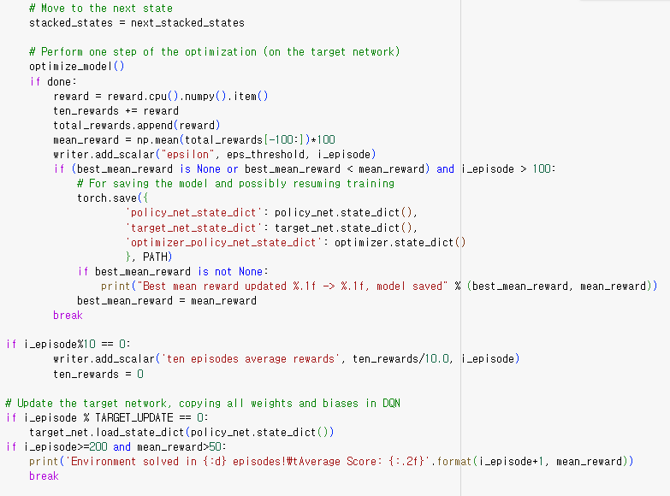
:
function that performs a single step of the optimization
Store the best network parameters
Store the score for tensorboard
Update target network
Exit condition

Slide 33
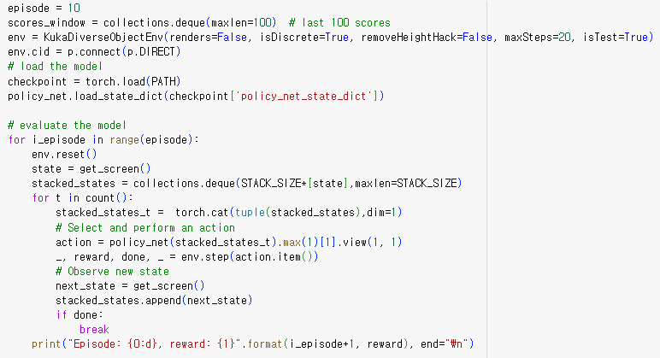
evaluation

Slide 34

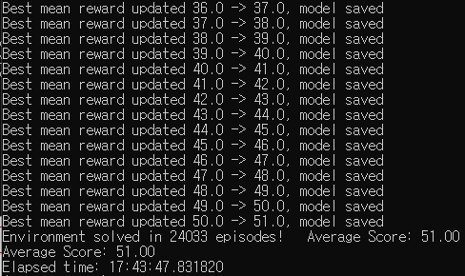
train

Slide 35

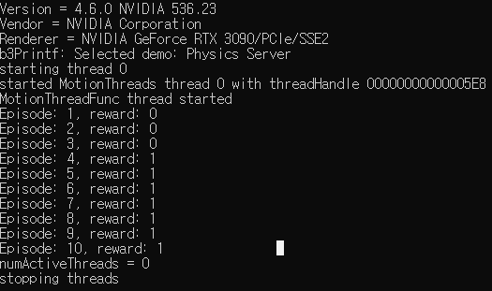
evaluation

Slide 36
