Slide 1
1강. Introduction

Slide 2
Contents
RL Overview
What is Reinforcement Learning ?
How RL is different from other machine learning ?
(w.r.t why Reinforcement Learning ?)
What types of RL algorithms ?
Course Intro.
MDP (w/ Code example)

Slide 3
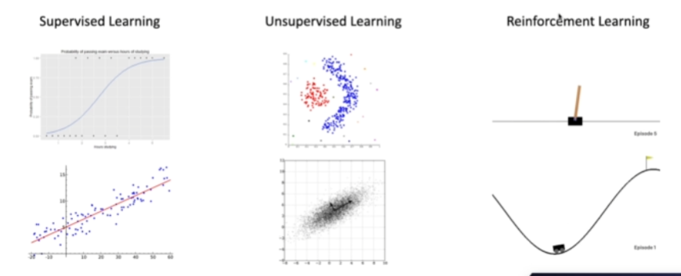
Three paradigms of Machine Learning

Slide 4
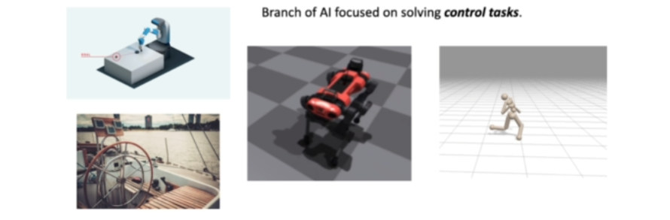
What is RL ?
Mathematical formalism for learning-based decision-making
Approach for learning decision-making and control from experience

Slide 5
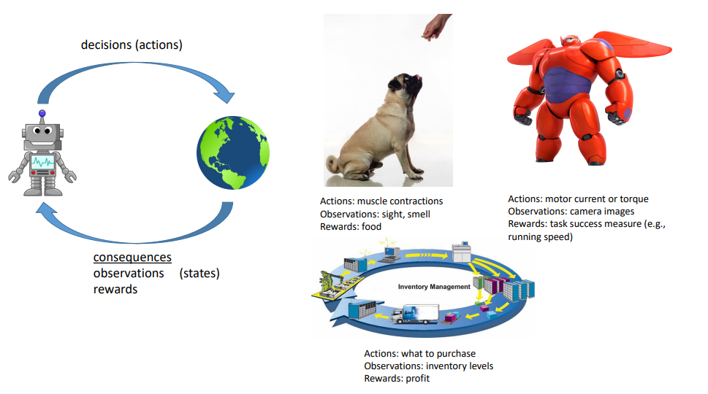
What is RL ?

Slide 6
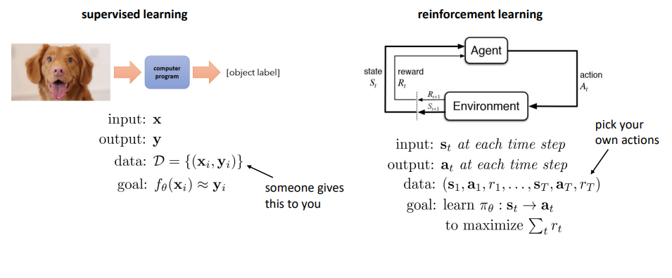
Supervised vs. Reinforcement Learning

Slide 7
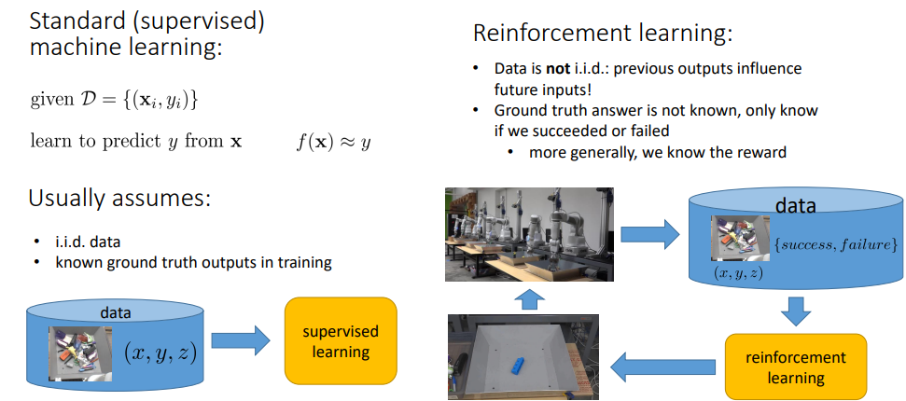
Supervised vs. Reinforcement Learning

Slide 8
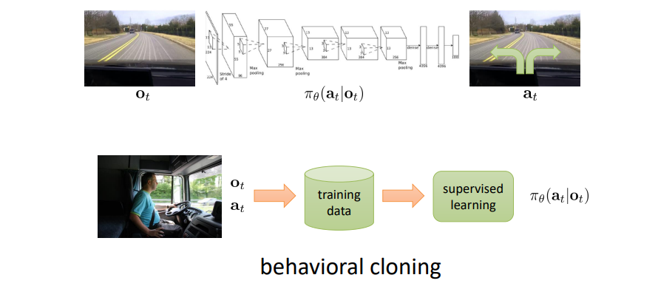
Supervised vs. Reinforcement Learning

Slide 9
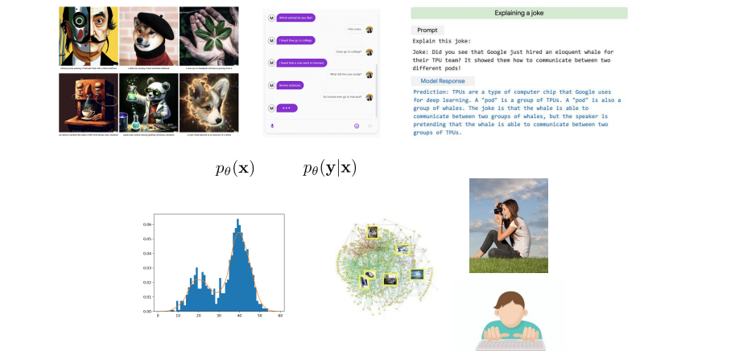
Data-Driven AI vs. RL

Slide 10
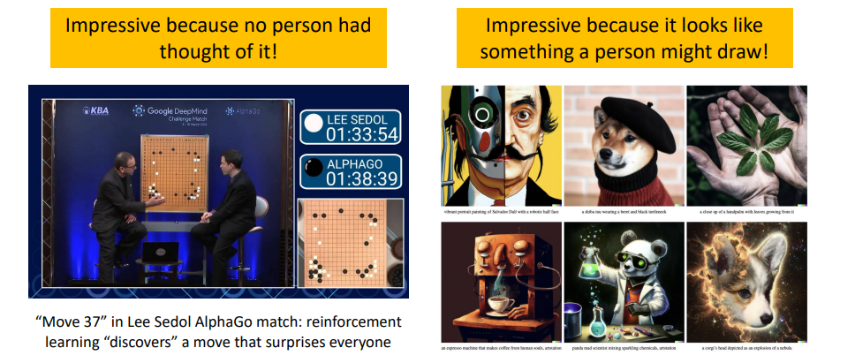
Data-Driven AI vs. RL

Slide 11
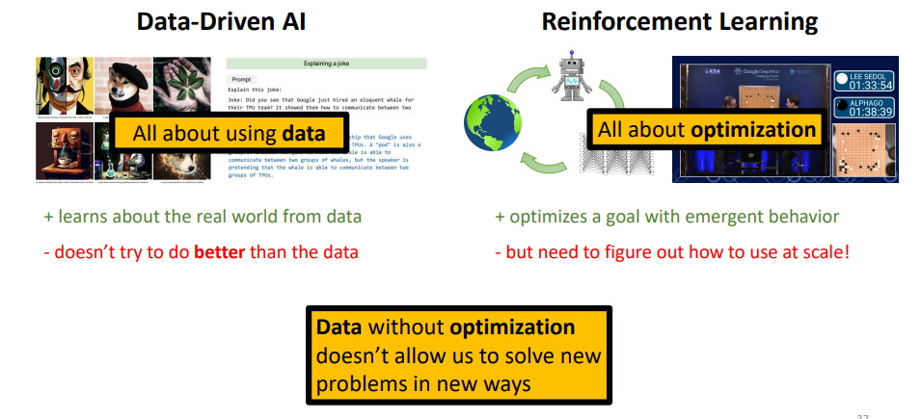
Data-Driven AI vs. RL
RL can discover new solutions

Slide 12
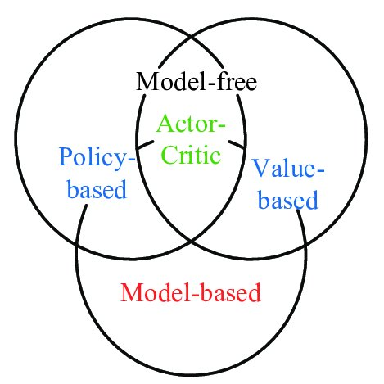
RL Algorithms Classification

Slide 13
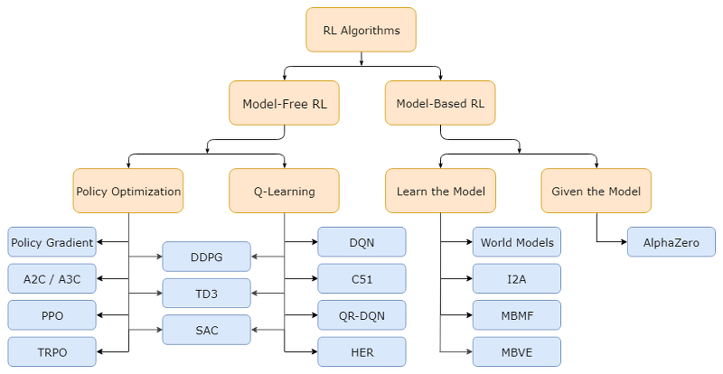
RL Algorithms Classification

Slide 14
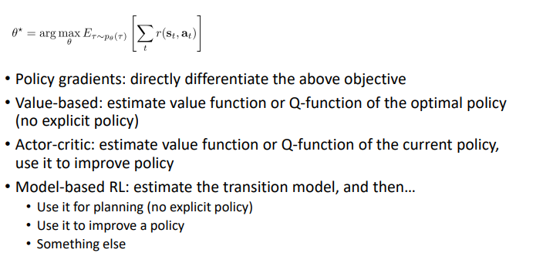
Types of algorithms

Slide 15
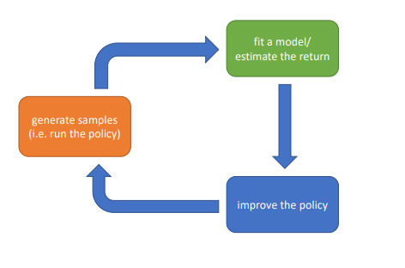
The anatomy of RL algorithm

Slide 16
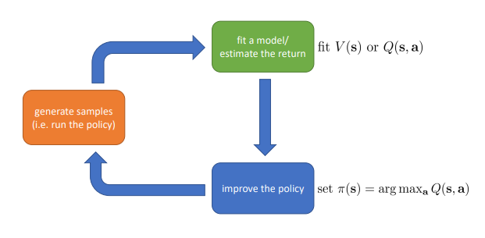
Value-based algorithms

Slide 17
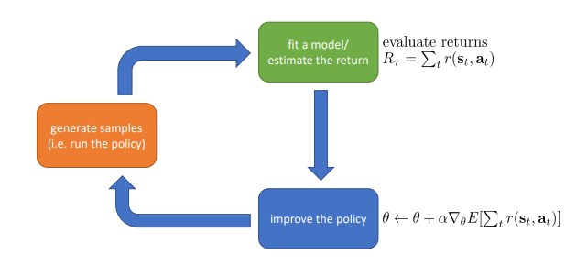
Direct policy gradients

Slide 18
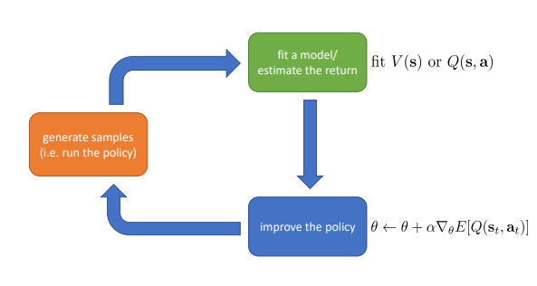
Actor-critic: value functions + policy gradients

Slide 19
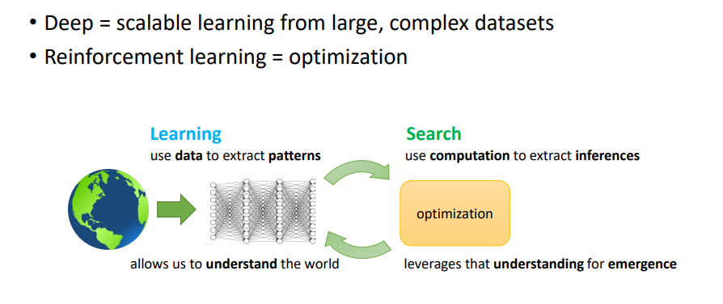
Deep Reinforcement Learning

Slide 20
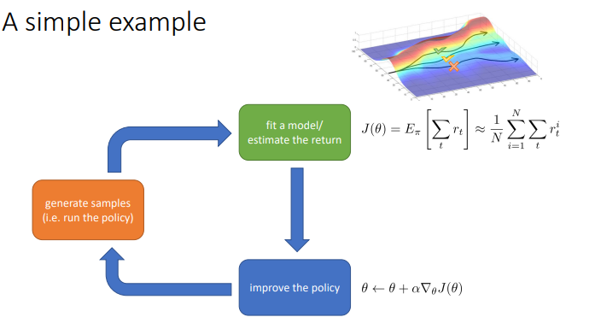
Deep Reinforcement Learning

Slide 21
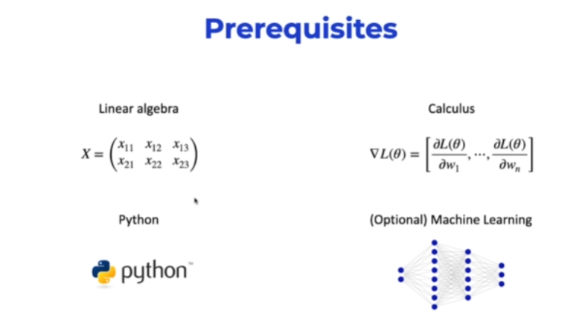

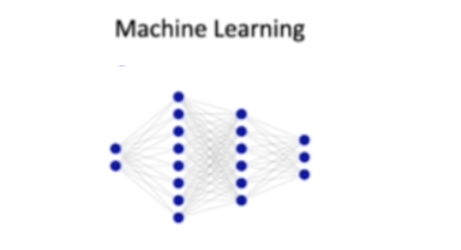
Prerequisites

Slide 22
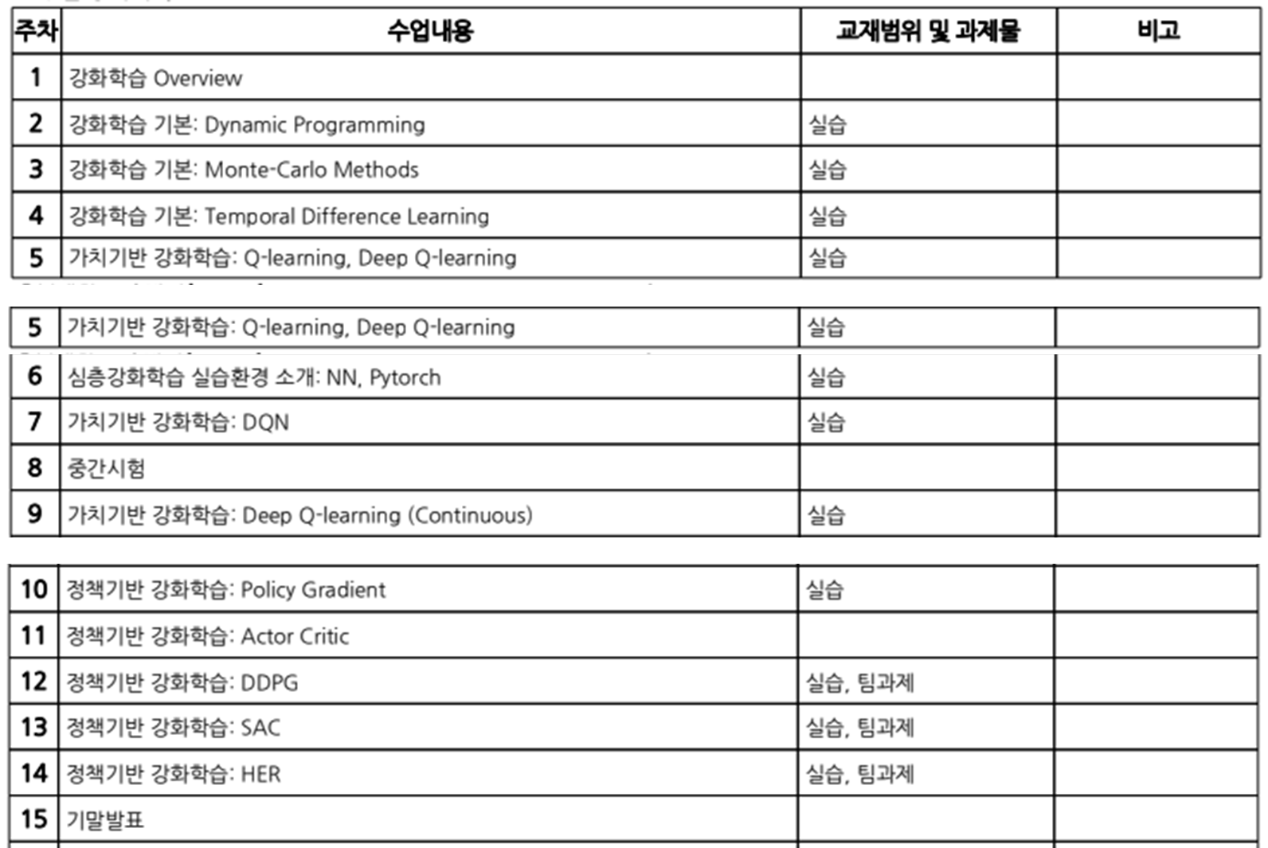
Schedule

Slide 23
Markov Decision Process (MDP)

Slide 24

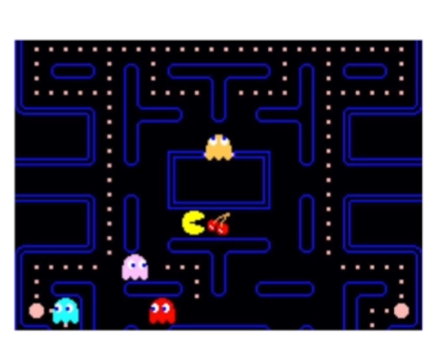

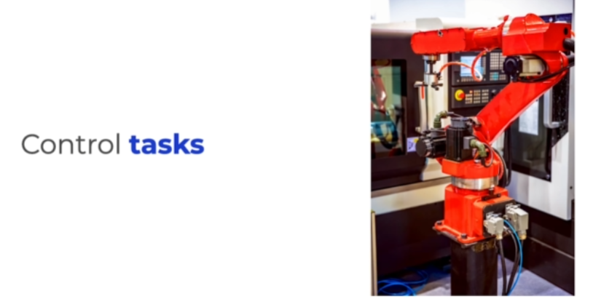
Markov Decision Process(MDP)
Discrete-time stochastic control process
Time moves forward in finite intervals: t {1,2,3,4}
Future states depend only partially on the actions taken
It is based on decision making to reach the target state
Formalism to define a control task problem

Slide 25
Agent interaction with Env.
Env
R_{t}
S_{t+1}
S_{t}
A_{t}
Agent

Slide 26
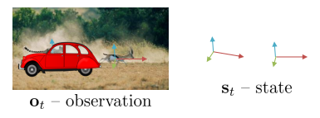
(S,A,R,P)
Set of possible states of the task
Set of actions that can be taken in each of the states
Set of rewards for each (s, a) pair
Probabilities of passing from one state to another when taking each possible action (Transition Probabilities)

Slide 27
Markov Property
The process has no memory:
The next state depends only on the current state, not on the previous ones
If a process meets this property, it is known as Markov process (would it be valid in the real world ?)

Slide 28
Markov chain vs. MDP
Differences are actions and rewards
0.3
S0
0.3
S0
0.7
A1
A2
0.1
0.9
0.7
0.7
1
A3
A4
0.9
0.1
0.3
S1
S1

Slide 29
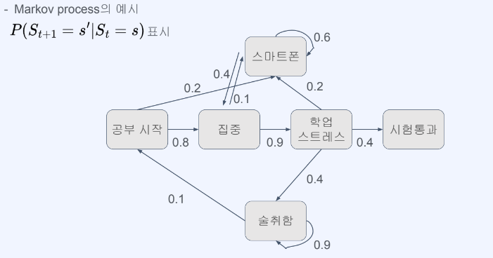
Example: Markov Process(MP)
그림 출처: Fastcampus 권태환

Slide 30
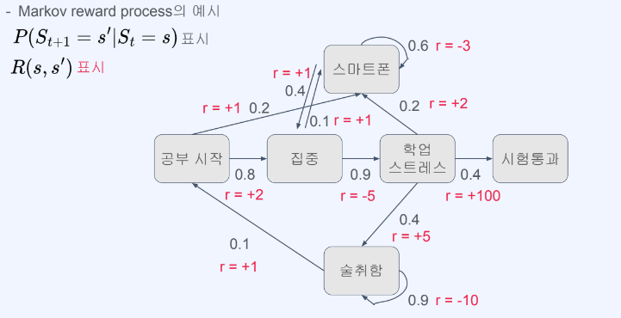
Example: Markov Reward Process(MRP)
그림 출처: Fastcampus 권태환

Slide 31
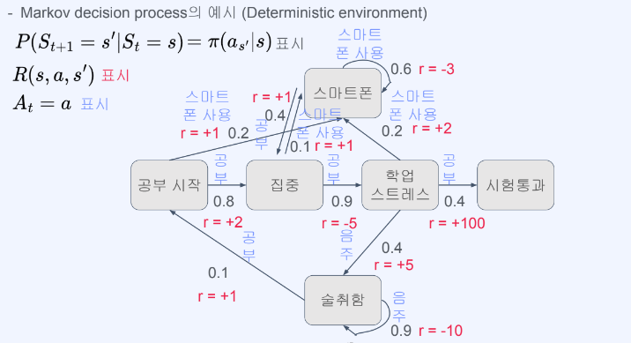
Example: Markov Decision Process(MDP)
➔ I choose where to go
A_{t}
그림 출처: Fastcampus 권태환

Slide 32

Types of MDP
Finite vs. Infinite
Episodic vs Continuing

Slide 33
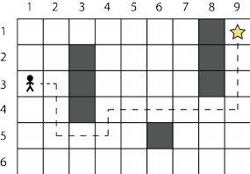
Trajectory and episode
Trajectory:
Elements that are generated when the agent moves from one state to another
{tau} = S₀, A₀, R₁, S₁, A₁, R₂, S₂, A₂, R₃, S₃

Slide 34
Reward vs Return
The goals of the task are represented by the rewards(Rt)
We want to maximize the sum of rewards
A short-term reward can worsen long-term results
We want to maximize the long-term sum of rewards
Reward: R_{t}
Return: G_{t} = R_{t+1} + R_{t+2} + R_{t+3} + …. + R_{T}
We want to maximize the episode’s return

Slide 35
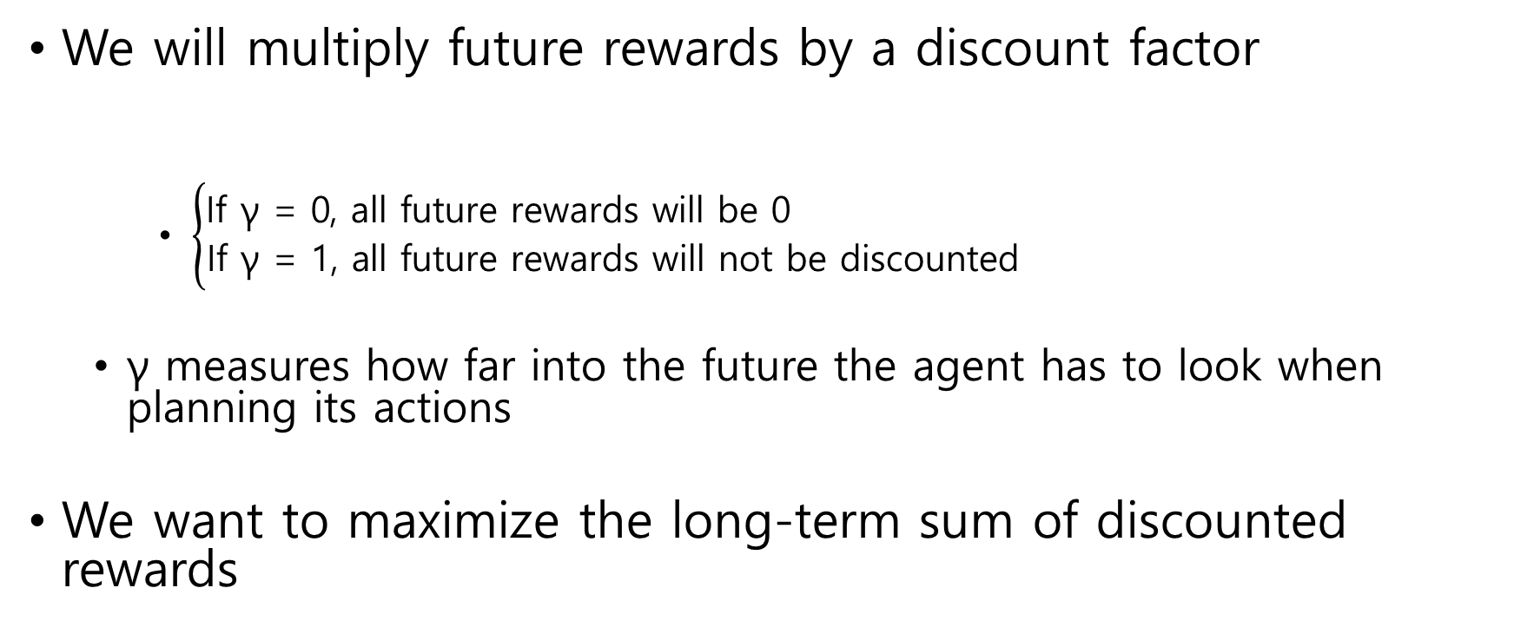
Discount factor
We will multiply future rewards by a discount factor
$\left\{\begin{aligned}\text{If} \text{γ}\text{ = 0, }\text{all} \text{future} \text{rewards} \text{will} \text{be}\text{ 0} \\ \text{If} \text{γ}\text{ = 1, }\text{all} \text{future} \text{rewards} \text{will} \text{not} \text{be} \text{discounted}\end{aligned}\right.$
γ measures how far into the future the agent has to look when planning its actions
We want to maximize the long-term sum of discounted rewards

Slide 36
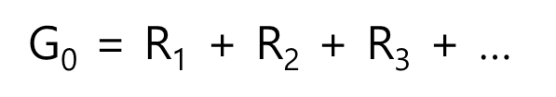
Discount factor
The agent has no incentive to go to the goal through the shortest route

Slide 37
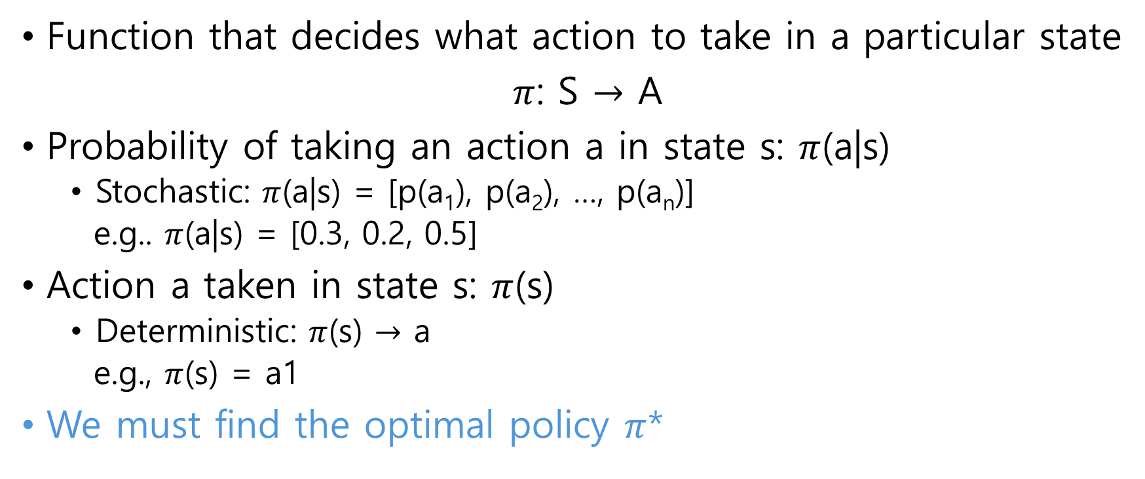

Policy $π$(s)
Function that decides what action to take in a particular state
$π$: S $→$ A
Probability of taking an action a in state s: $π$(a|s)
Stochastic: $π$(a|s) = [p(a₁), p(a₂), …, p(a_{n})]
e.g.. $π$(a|s) = [0.3, 0.2, 0.5]
Action a taken in state s: $π$(s)
Deterministic: $π$(s) $→$ a
e.g., $π$(s) = a1
We must find the optimal policy $π$*

Slide 38
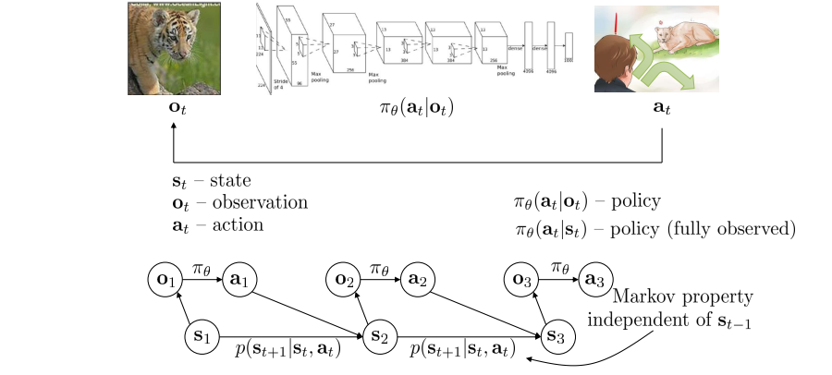
Terminology(Overall)

Slide 39
MDP Code Example

Slide 40
Setup Code Env.
Git download: https://git-scm.com/downloads
Git clone https://github.com/parkjin-nim/rl_lecture.git
Install Anaconda
conda create -n <your env. name> -f environment.yml
Open Jupyter notebook
Open MDP_introduction.ipynb

