Slide 1
3강. Dynamic Programming (Part 2)

Slide 2
Contents
Dynamic Programming Review
Policy Iteration
Code Exercise
Dynamic Programming Limitations
Generalized Policy Iteration

Slide 3
Dynamic Programing Review

Slide 4
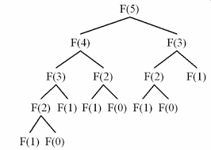
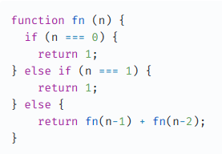
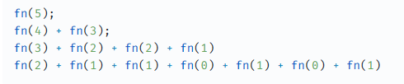
Definition
Methods that find the solution to a problem by breaking it down into smaller, easier problems.
Remember Fibonacci sequence problem from your CS class

Slide 5
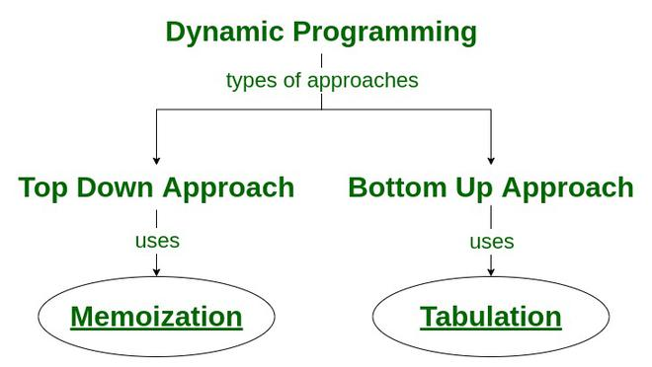
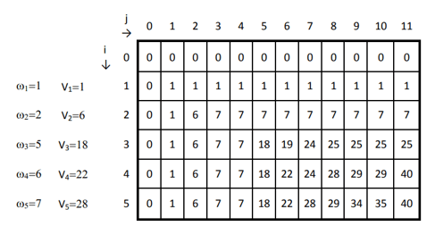
Memoization

Slide 6




Optimal substructure
In finding the solution to each of its subproblems and joining those individual solutions, we’ll have found the optimal solution to the original problem
P*
$π$*
A*
B*
C*
$π$*(s1)
$π$*(s2)
$π$*(s3)

Slide 7
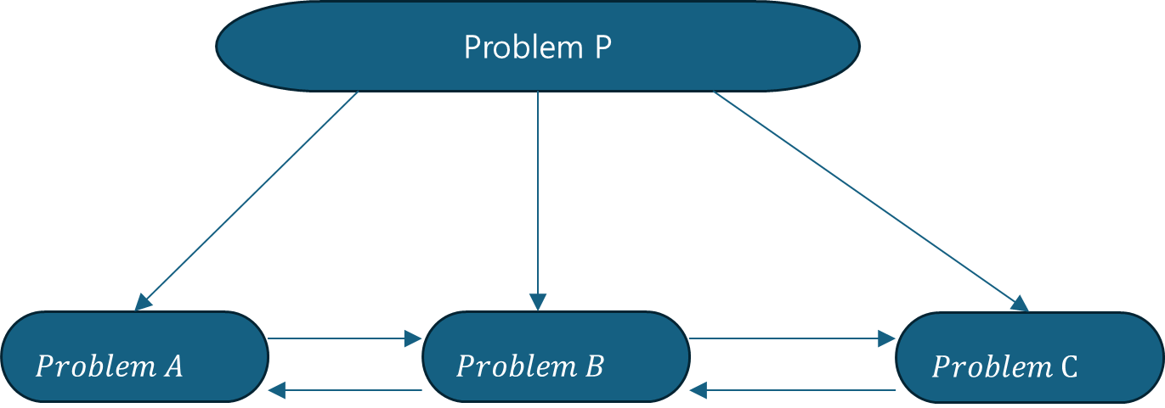
Overlapping subproblems
The solution to the subproblems are mutually dependent
The optimal solution to the problem A will be dependent on problem B and the problem B will be dependent on both problem A and problem C
The optimal solution to all subproblems produces the optimal solution to the original problem

Slide 8

Our task: Find $π∗$
We can guide and structure the search for the policy using value functions
The optimal policy takes actions based on state or q-values
Therefore, to find the optimal policy, we need to find the optimal values

Slide 9
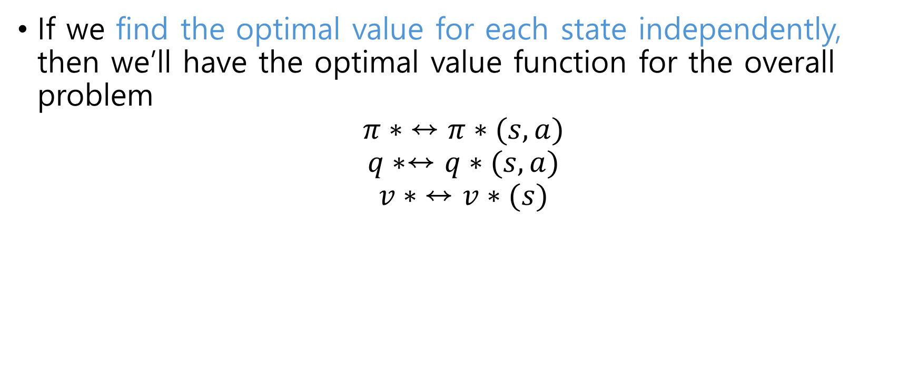
Our task: Find $π∗$
If we find the optimal value for each state independently, then we’ll have the optimal value function for the overall problem
$$π∗ ↔π∗(s,a)$$
$$q∗↔q∗(s,a)$$
$$v∗ ↔v∗(s)$$

Slide 10
Find v*, q*,

Slide 11
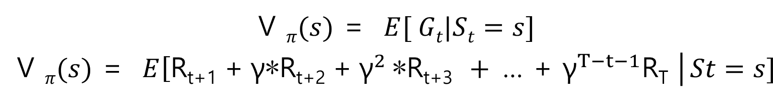
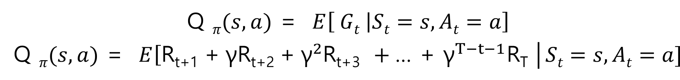

State value(v) vs state-action(q) value
State value, following policy $π$:
State-action value, following policy $π$:

Slide 12
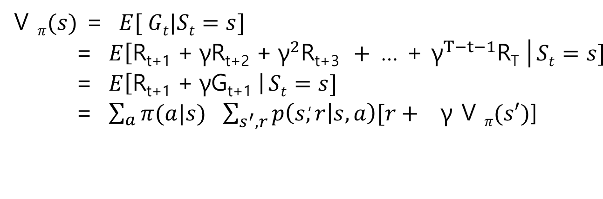
Bellman Equation for v(s)
Bellman Eq. to search for optimal policy to solve a control task
Expected return is, the prob. of taking each action following the policy, multiplied by the return we expect to get from taking that action.
The return is, the prob. of reaching each possible successor state, multiplied by the reward obtained upon reaching that state, plus the discounted value of that state
Notice we discovered a recursive relationship btw. The value of one state and the values of other states

Slide 13
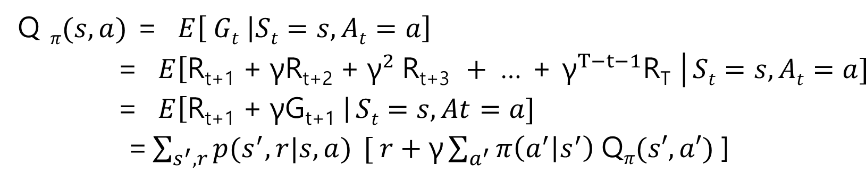
Bellman Equation for q(s, a)
Bellman Eq. to search for optimal policy to solve a control task
Multiplied by ①the reward obtained upon reaching that successor state, ②plus the discounted sum of q values of each action in the successor state, ③weighted the prob. of choosing that action by the policy
Expected return is the prob. of each successor state, knowing that we have chosen action a.
Recursive relationship is expressed as Q value in terms of other Q values

Slide 14
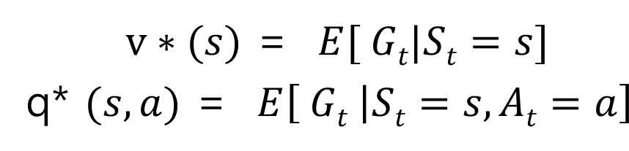
Solving a MDP
The value of a state is precisely the expected return
Solving a control task consists of maximizing the expected return
Solving a task involves maximizing the value of every state
The optimal value of a state is the expected return following the optimal policy:

Slide 15
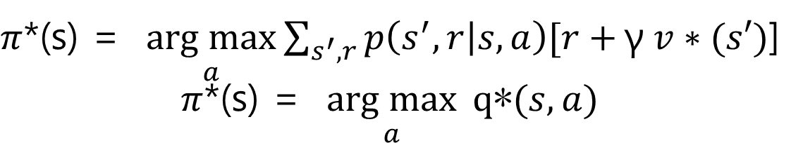
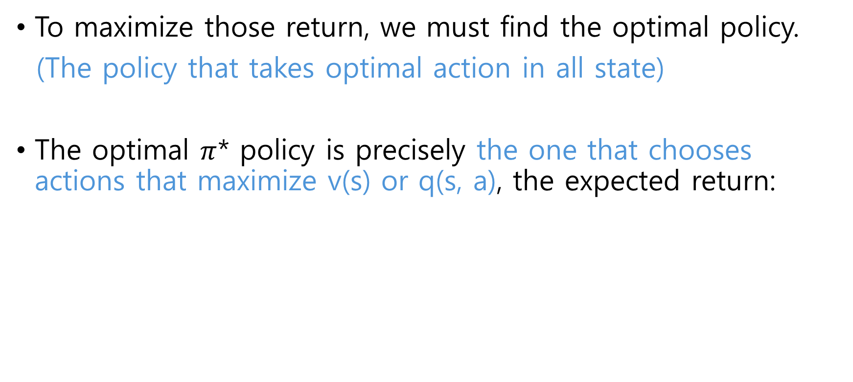
Solving a MDP
To maximize those return, we must find the optimal policy.
(The policy that takes optimal action in all state)
The optimal $π$* policy is precisely the one that chooses actions that maximize v(s) or q(s, a), the expected return:

Slide 16
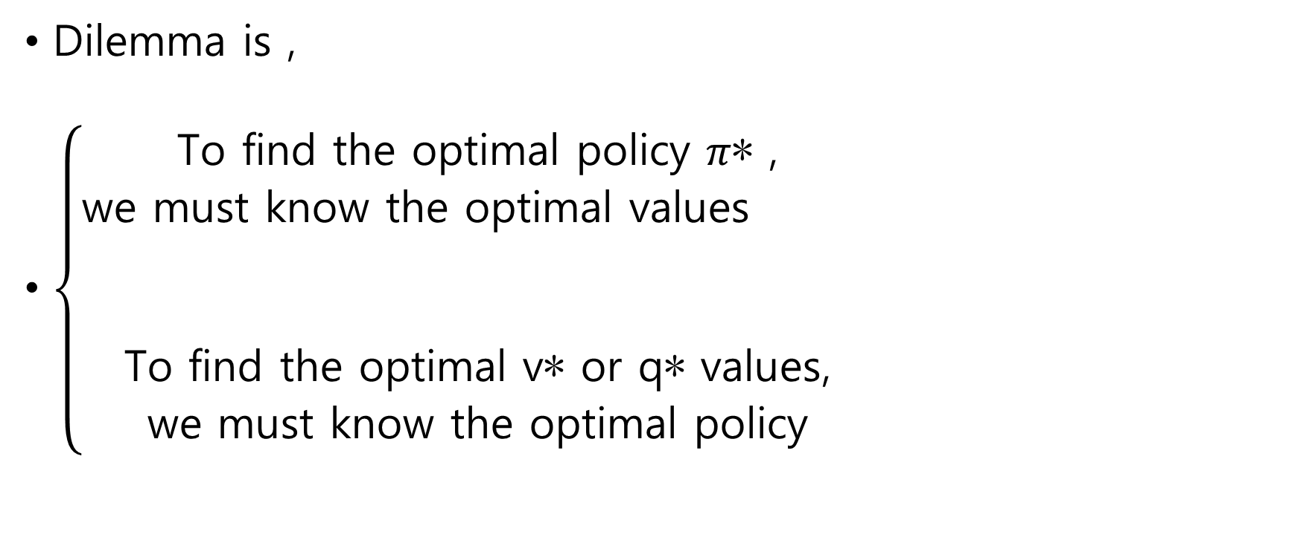
Solving a MDP
Dilemma is ,
$\left\{\begin{aligned}\text{To} \text{find} \text{the} \text{optimal} \text{policy} π\text{∗ }\text{, } \\ \text{we} \text{must} \text{know} \text{the} \text{optimal} \text{values} \\ \\ \\ \text{To} \text{find} \text{the} \text{optimal} \text{v}\text{∗ }\text{or} \text{q}\text{∗ }\text{values}\text{,} \\ \text{we} \text{must} \text{know} \text{the} \text{optimal} \text{policy} \end{aligned}\right.$

Slide 17
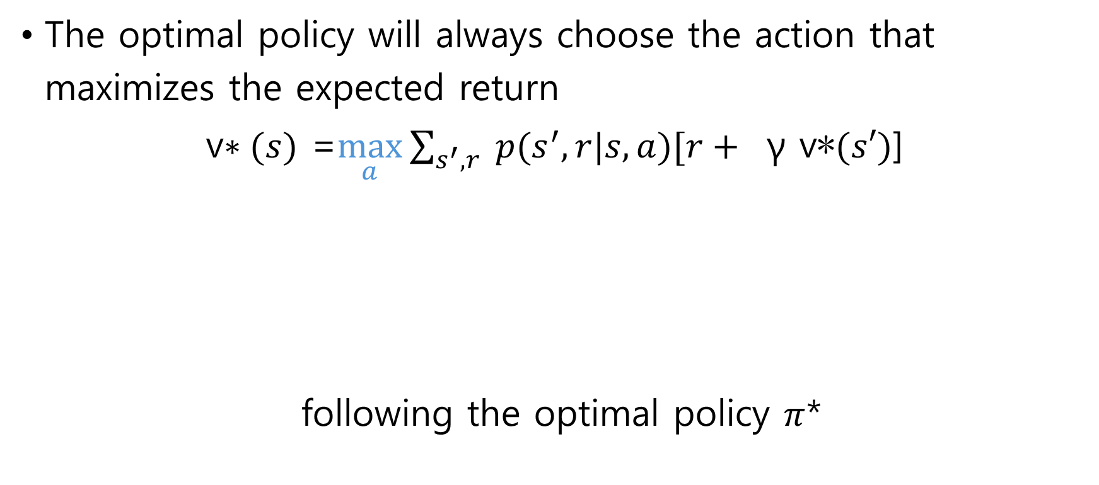
Bellman Optimality Equations
The optimal policy will always choose the action that maximizes the expected return
v$∗(s)$ =$\max_{a}{\sum_{s^{′},r}{ p(s^{′},r|s,a)[r+ } \text{γ} \text{v}\text{∗}(s′)\text{]}}$
following the optimal policy $π$*
The prob. of reaching each successor state by taking the optimal action,
multiplied by the reward achieved by reaching that state, plus the discounted optimal value of that state

Slide 18
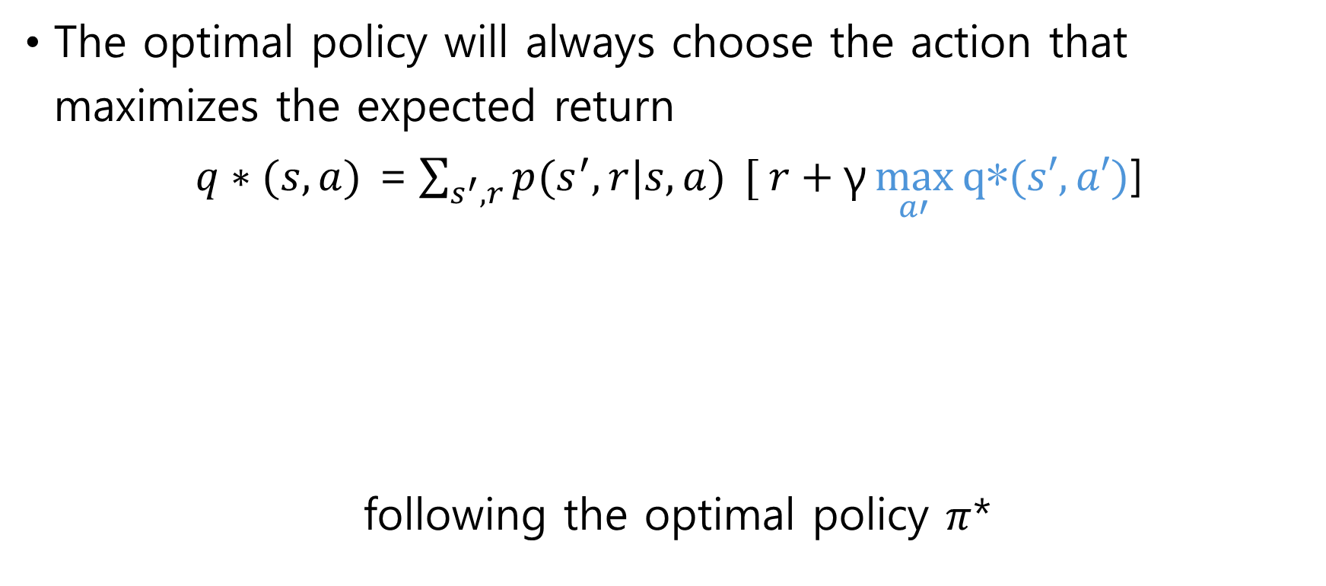
Bellman Optimality Equations
The optimal policy will always choose the action that maximizes the expected return
$q∗(s,a)$ =$\sum_{s^{′},r}{p(s^{′},r|s,a) }[ r+\text{γ}\max_{a′}{\text{q}\text{∗}(s′, a′)}$]
following the optimal policy $π$*
Optimal Q value for an action in a state is the weighted sum of returns
obtained by reaching each of possible successor state, weighted by the prob. of reaching that successor state.
The return is reward achieved upon reaching the successor state, plus the maximum Q value among the actions for that achieved state

Slide 19

Update Rules
DP turns Bellman equations into update rules
V$(s)$ =$\max_{a}{\sum_{s^{′},r}{ p(s^{′},r|s,a)[r+ } \text{γ} \text{V}(s′)\text{]}}$
V$(s)$ ← $\max_{a}{\sum_{s^{′},r}{ p(s^{′},r|s,a)[r+ } \text{γ} \text{V}(s′)\text{]}}$

Slide 20
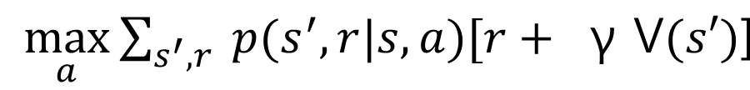
Update Rules
Sweep the state space and update the estimated value of each state according to:
Each time we update the estimated value of a state, we’ll have better estimates for the related values, therefore, the new estimate will be more accurate than the old one

Slide 21
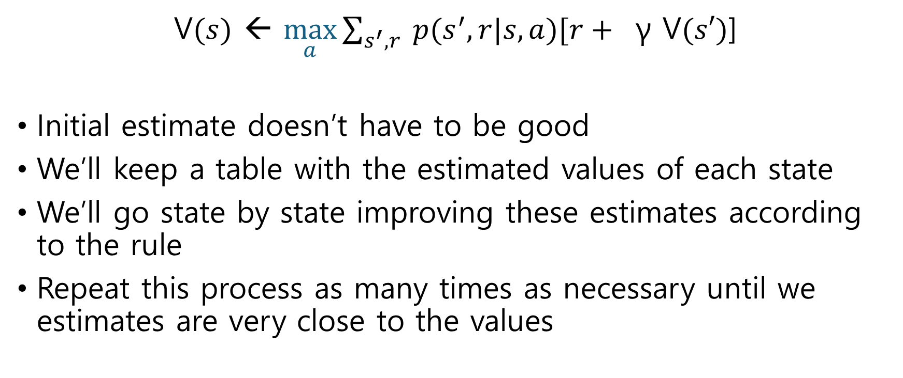
Value Iteration
V$(s)$ ← $\max_{a}{\sum_{s^{′},r}{ p(s^{′},r|s,a)[r+ } \text{γ} \text{V}(s′)\text{]}}$
Initial estimate doesn’t have to be good
We’ll keep a table with the estimated values of each state
We’ll go state by state improving these estimates according to the rule
Repeat this process as many times as necessary until we estimates are very close to the values

Slide 22
Policy Iteration

Slide 23
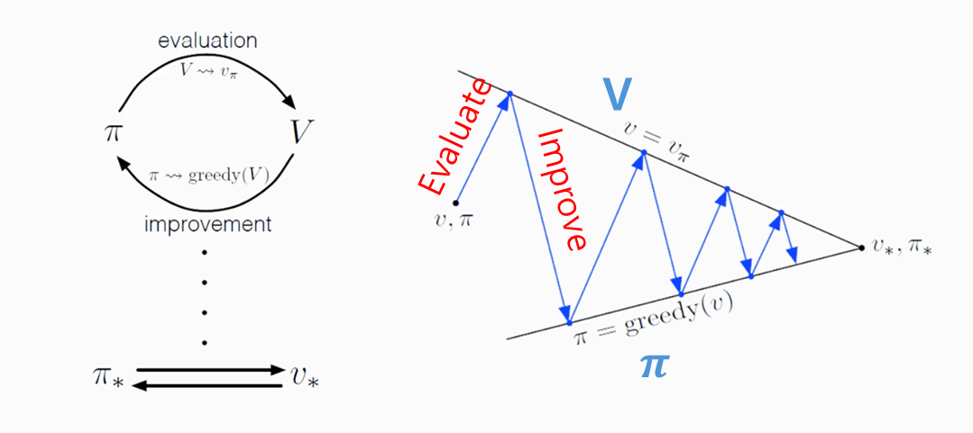
Policy Iteration
Policy Iteration solves control tasks, but besides that, it will serve as inspiration to design the vast majority of reinforcement learning
A process that alternately improves the estimated values and the policy
Alternating two processes compete each other
$π$₀ → v $π$⁰ → $π$₁ → v $π$¹ → $π$₂ → v $π$² … → $π n$
v, $π$both in competition and collaboration

Slide 24
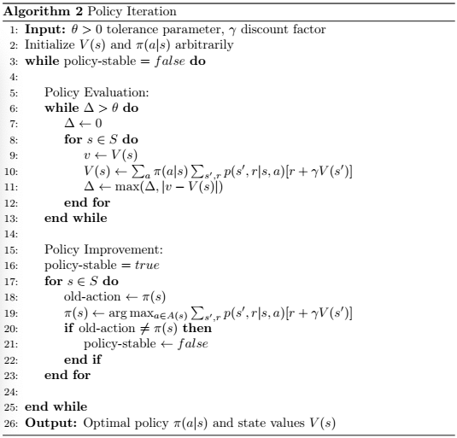
Policy Iteration

Slide 25
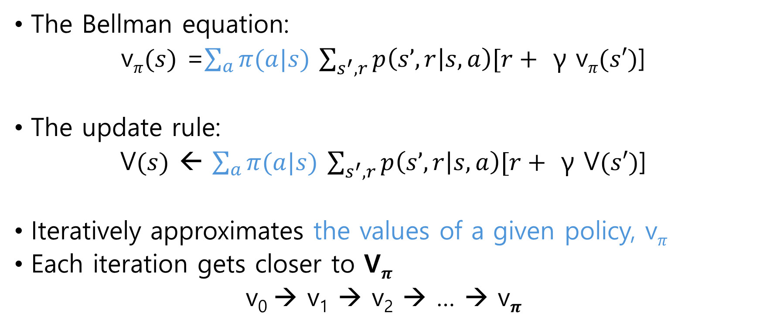
Iterative policy evaluation
The Bellman equation:
v$π(s)$ =$\sum_{a}{π(a|s)}$ $\sum_{s^{′},r}{p\left(s’,r | s,a\right)[r+ }$ $\text{γ}$ v$π(s′)$]
The update rule:
V$(s)$ ← $\sum_{a}{π(a|s)}$ $\sum_{s^{′},r}{p\left(s’,r | s,a\right)[r+ }$ $\text{γ}$ V$(s′)$]
Iteratively approximates the values of a given policy, v$π$
Each iteration gets closer to V$π$
v₀ → v₁ → v₂ → … → v$π$

Slide 26

Iterative policy evaluation
Each iteration gets closer to V$π$
v₀ → v₁ → v₂ → … → v$π$
Update the state values according to probabilities that the policy assigns to each action

Slide 27
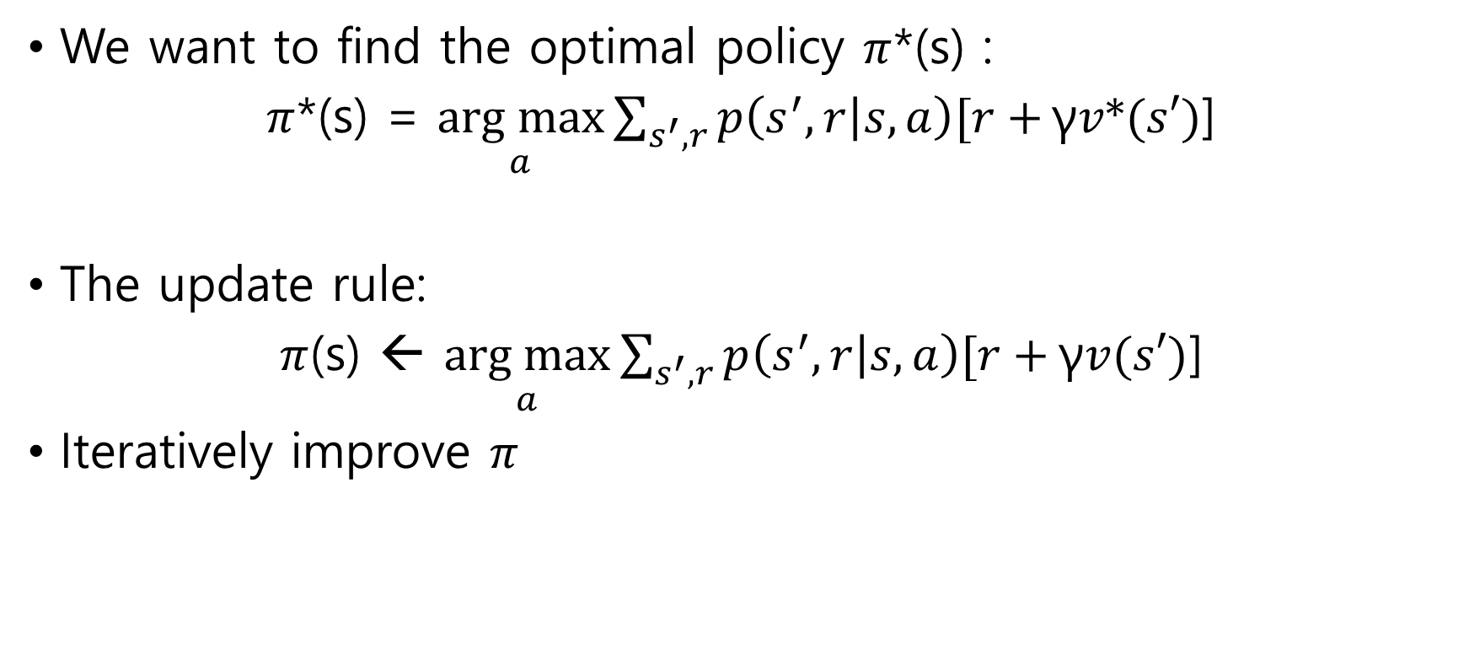
Iterative policy improvement
We want to find the optimal policy $π$*(s) :
$π$*(s) = $\underset{a}{arg max}{\sum_{s^{′}, r}{p\left(s^{′},r | s,a\right)[r+}}\text{γ}v*(s′)$]
The update rule:
$π$(s) ← $\underset{a}{arg max}{\sum_{s^{′}, r}{p\left(s^{′},r | s,a\right)[r+}}\text{γ}v(s′)$]
Iteratively improve $π$

Slide 28
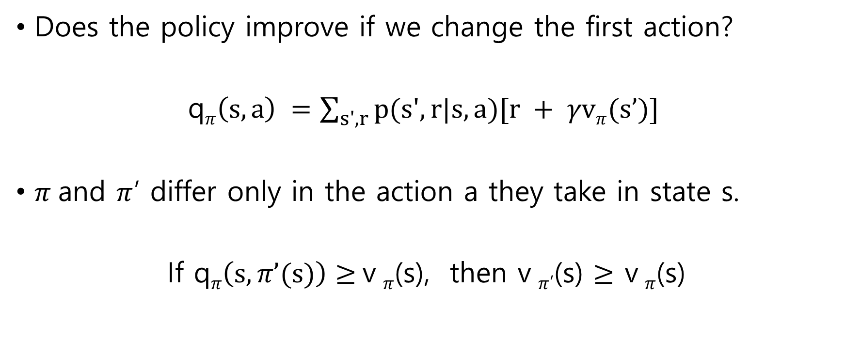
Iterative policy improvement
Does the policy improve if we change the first action?
q$π\left(s,a\right) =\sum_{s',r}{p(s',r|s,a)[r + γvπ(s’)] }$
$π$and $π$’ differ only in the action a they take in state s.
If q$π\left(s,π’(s)\right)≥$v $π$(s), then v $π$’(s) $≥$ v $π$(s)

Slide 29

Iterative policy improvement
Each iteration gets closer to $π$*
$π$₀ → $π$₁ → $π$₂ → … → $π n$

Slide 30
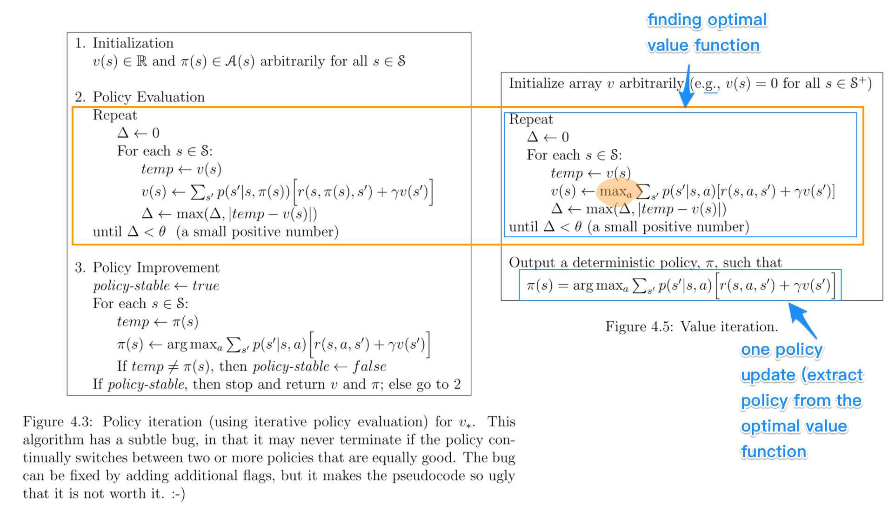
Compare PI vs. VI
Update the state values using the action that maximize the return
Policy-iteration is more computationally efficient as it often takes considerably fewer number of iterations to converge although each iteration is more computationally expensive.

Slide 31
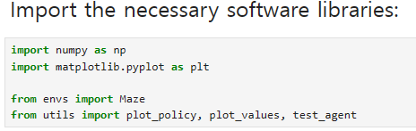
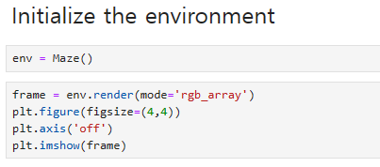
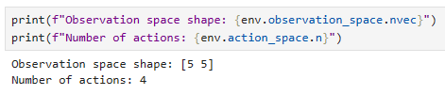
Code Exercise

Slide 32
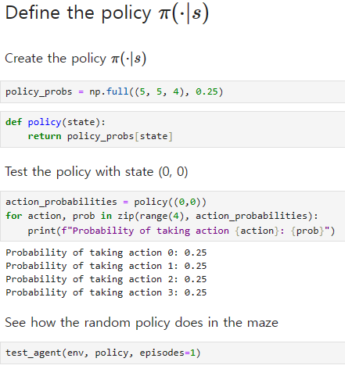
Code Exercise

Slide 33
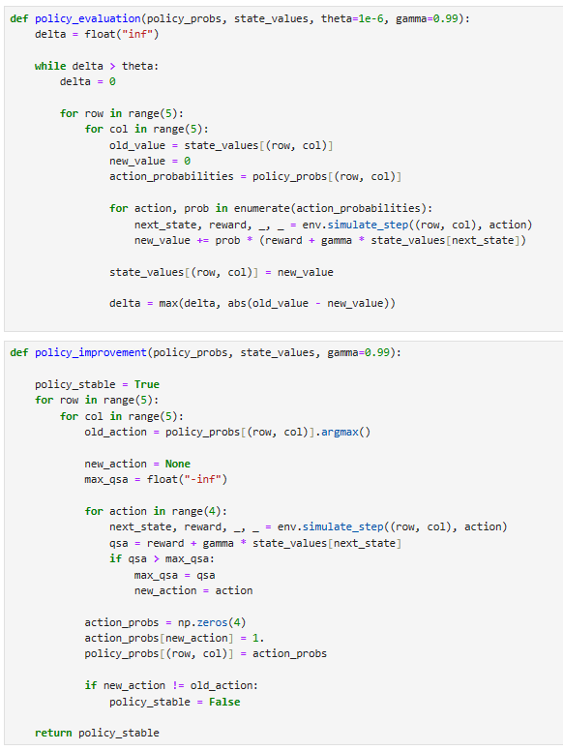
Code Exercise

Slide 34
Code Exercise

Slide 35
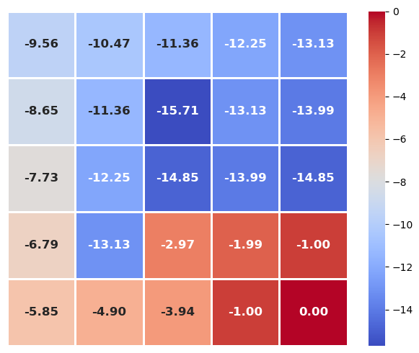
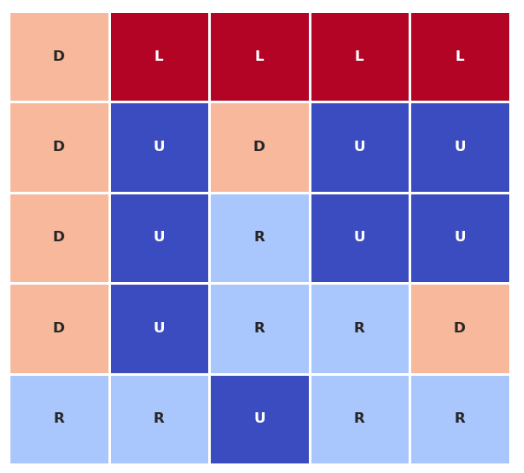
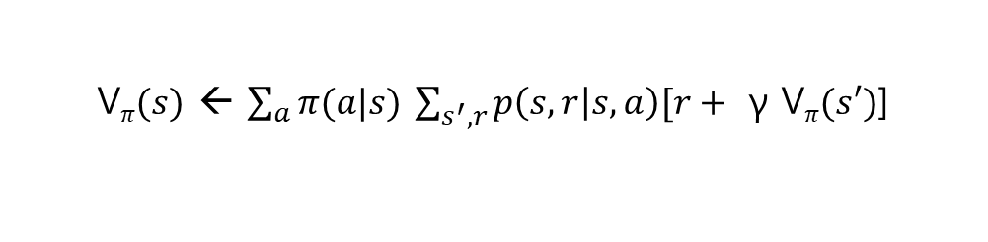
Policy Iteration
V$π(s)$ ← $\sum_{a}{π(a|s)}$ $\sum_{s^{′},r}{p\left(s,r | s,a\right)[r+ }$ $\text{γ}$ V$π(s′)$]
Value table vs. Policy table (Same as VI)

Slide 36
Dynamic Programming Limitations

Slide 37
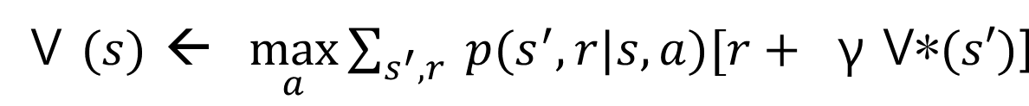
Dynamic Programming Limitations
We need to know in advance how the state changes and what rewards we get from performing each action in each state
Assumes the knowledge of environment
One big limitation is that it needs a perfect model of the environment

Slide 38
Dynamic Programming Limitations
Needs to access to the state transition dynamics of environment
Takes into an account every possible outcome of taking an action and uses it to update the estimated values
Needs to know the result of taking every action in every state in advance without having to perform that action
Note that Dynamic Programing solves problems using expected values, not trial and error

Slide 39
Dynamic Programming Limitations
Dynamic Programing has high computational cost for control:
To solve the task, we have to update over and over again
In each sweep we update all the states
Complexity grows very rapidly with the number of states
But, real life control problems have a vast or even infinite number of states

Slide 40
Dynamic Programming Limitations
In most tasks, we won’t have a perfect model of the environment with all state transitions
Most control tasks have many factors affecting their dynamics (some of them random).
Then, why we learn Dynamic Programing?
Thanks to it we have a strategy to design better algorithm.

Slide 41
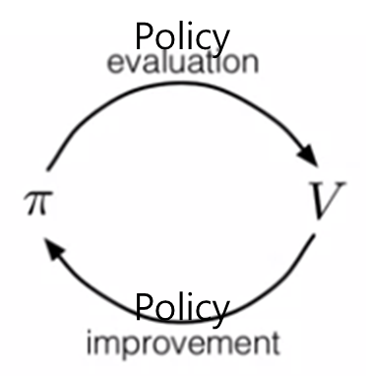
Generalized Policy Iteration
Policy iteration results in the following iterative process:
From the next class, algorithms we learn won’t have a model. They interact with env. trying to solve the task by trial and error.
However, they still follow the two alternating processes

Slide 42
Generalized Policy Iteration
Next, Model-free RLs works without the model.
Model-free methods use experience samples collected by the agent interacting with the environment (by trial and error) to update the estimated value
The difference is that the value updates will be made using experience collected from the environment

Slide 43
Generalized Policy Iteration
They try to replicate the results of dynamic programming, but in a more efficient way and without the need of a model of the environment dynamics.
The process serves as a template followed by the rest of the RL methods

