Slide 1
10강.DQN Variants

Slide 2
Contents
Double DQN
Prioritized Experience Replay(PER)
Dueling DQN
Code Ex.

Slide 3
Double DQN

Slide 4
Overview
Q-learning overestimates action-value:
Overestimation happens in the earlier stage of training
(when action-value is not accurate)
Overestimation may help exploration, but
Overestimation may be non-uniform throughout all action
(Change optimal action accidentally)
DQN is degraded by Overestimation problem
(sub-optimal policy)

Slide 5
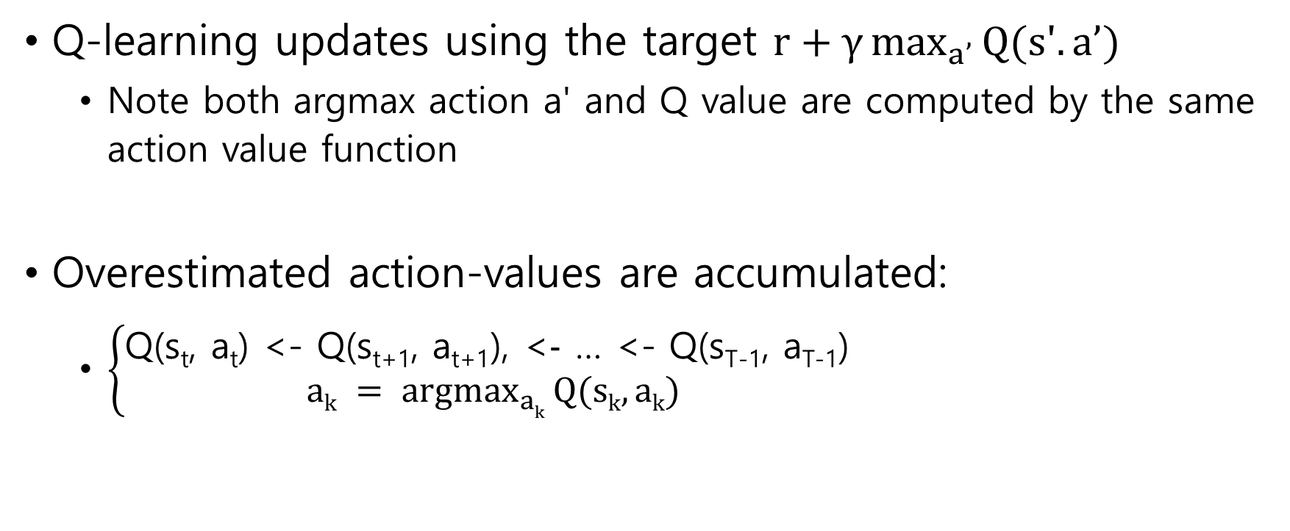
Problem: Overestimation
Q-learning updates using the target $r+γ\max_{a’}{Q(s'. a’)}$
Note both argmax action a' and Q value are computed by the same action value function
Overestimated action-values are accumulated:
$\left\{\begin{aligned}\text{Q}\text{(}\text{st}\text{, }\text{at}\text{) <- }\text{Q}\text{(}\text{st}\text{+1, }\text{at}\text{+1),}\text{ <}-\text{ … <- }\text{Q}\text{(}\text{sT}\text{-1, }\text{aT}\text{-1)} \\ \underset{ak}{ak = argmax}{Q(sk, ak)}\end{aligned}\right.$

Slide 6
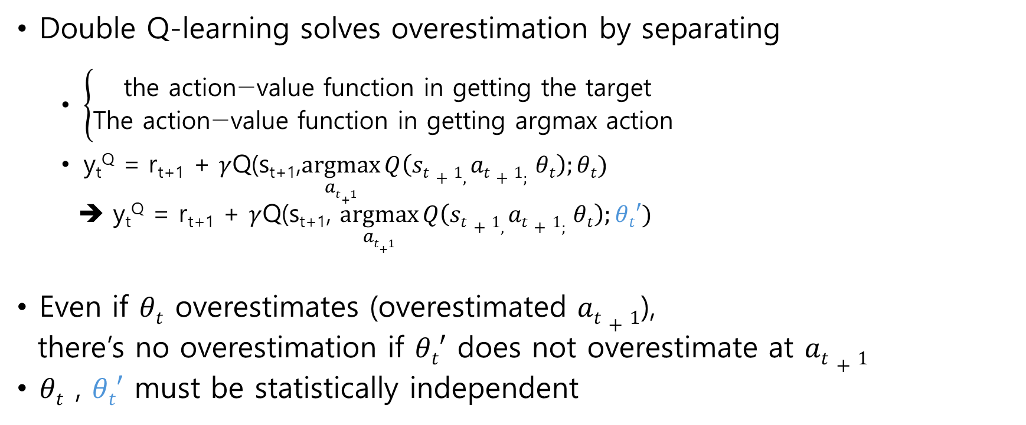
Solution: Double Q
Double Q-learning solves overestimation by separating
$\left\{\begin{aligned}\text{the} \text{action}\text{−}\text{value} \text{function} \text{in} \text{getting} \text{the} \text{target} \\ \text{The} \text{action}\text{−}\text{value} \text{function} \text{in} \text{getting} \text{argmax} \text{action} \end{aligned}\right.$
y_{t}^{Q} = r_{t+1} + $γ$Q(s_{t+1},$\underset{at+1}{argmax}{Q\left(st+1, at+1; θt\right);θt)}$
➔ y_{t}^{Q} = r_{t+1} + $γ$Q(s_{t+1}, $\underset{at+1}{argmax}{Q\left(st+1, at+1; θt\right);θt′)}$
Even if $θt$ overestimates (overestimated $at+1$),
there’s no overestimation if $θt′$ does not overestimate at $at+1$
$θt$ , $θt′$ must be statistically independent

Slide 7
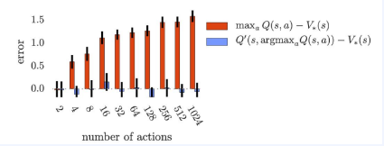
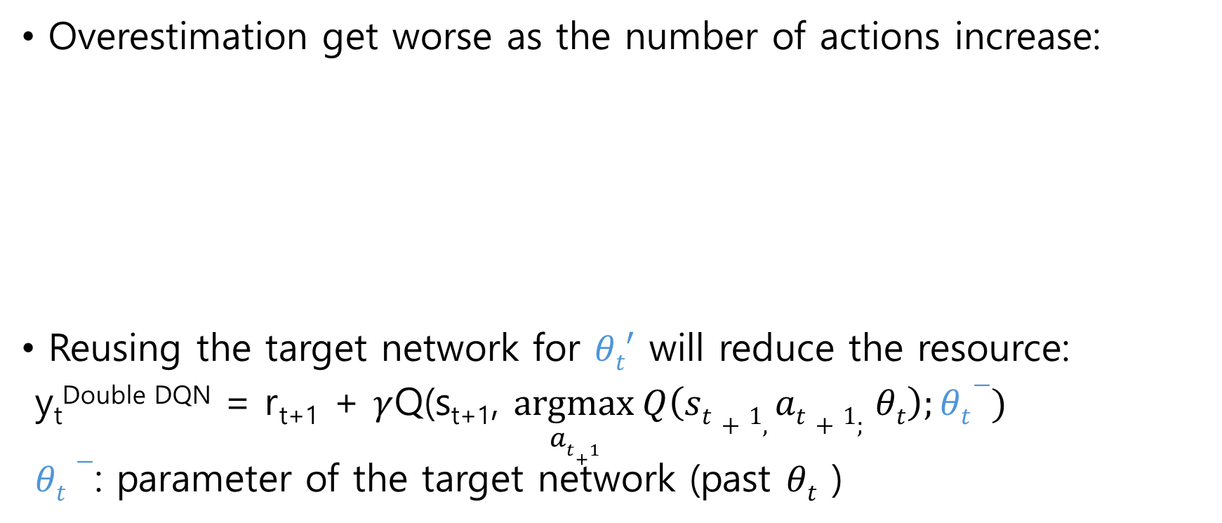
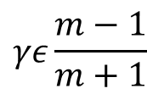
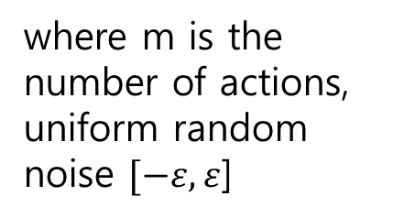
Solution: Double Q
Overestimation get worse as the number of actions increase:
Reusing the target network for $θt′$ will reduce the resource:
y_{t}^{Double DQN} = r_{t+1} + $γ$Q(s_{t+1}, $\underset{at+1}{argmax}{Q\left(st+1, at+1; θt\right);θt−)}$
$θt−$: parameter of the target network (past $θt$ )
where m is the number of actions,
uniform random noise $[−ε,ε$]
$$γε\frac{m−1}{m+1}$$

Slide 8
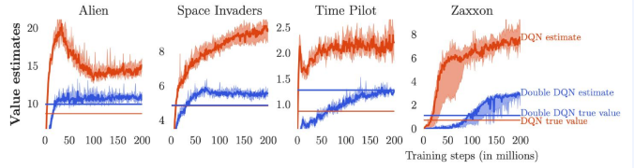
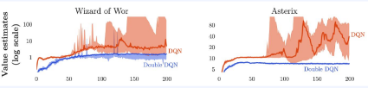
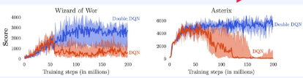
Results

Slide 9


Results
Mean and media performance comparison over 49 games starting after several no-ops:
Mean and media performance comparison over 49 games with agent starting after human playing:

Slide 10
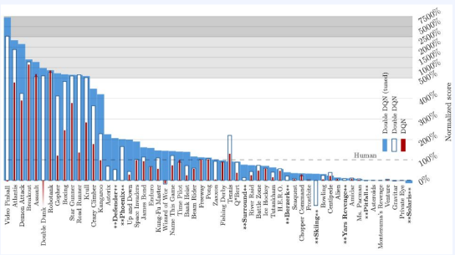
Results

Slide 11
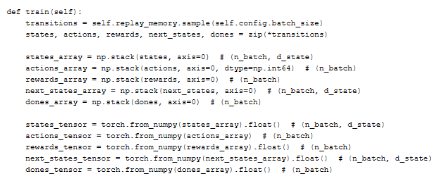
Code

Slide 12
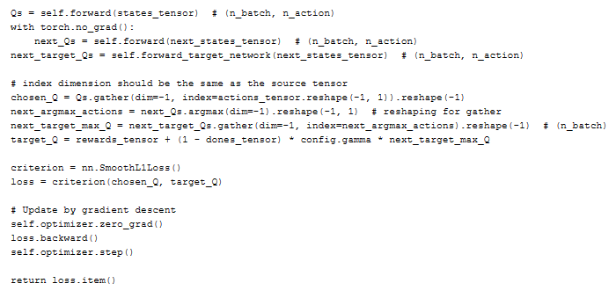
Code

Slide 13
Prioritized Experience Replay(PER)

Slide 14
Overview
Replay buffer:
Solves correlation of samples in an episode
Reduces data distribution shift caused by policy update
Reuses old data
Problem:
Important samples (linked to the reward) deserves more replay
Well learnt (s, a) does not need more replaying
Uniform random mini-batch sampling is not always good

Slide 15
Overview
Ordering samples by importance and taking top m samples may seriously harm data diversity
➔ Stochastic sampling take both importance and diversity into account
➔ the importance is measured by |TD error|

Slide 16
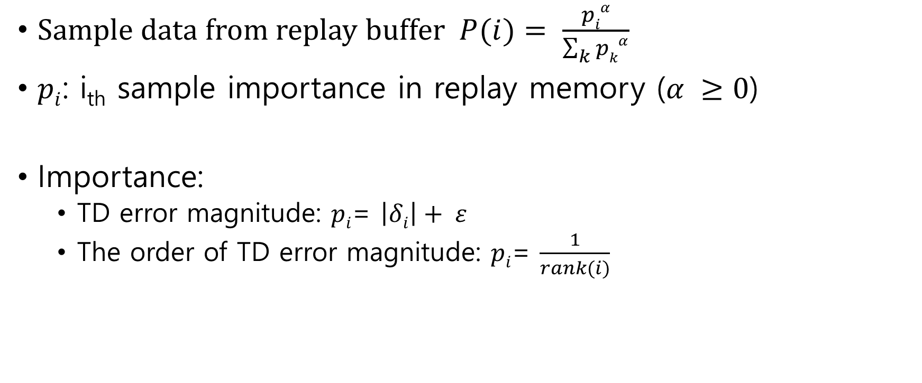
Method
Sample data from replay buffer $P(i)= \frac{piα}{\sum_{k}{pkα}}$
$pi$: i_{th} sample importance in replay memory ($α ≥0$)
Importance:
TD error magnitude: $pi$= $\left|δi\right|+ ε$
The order of TD error magnitude: $pi$= $\frac{1}{rank(i)}$

Slide 17
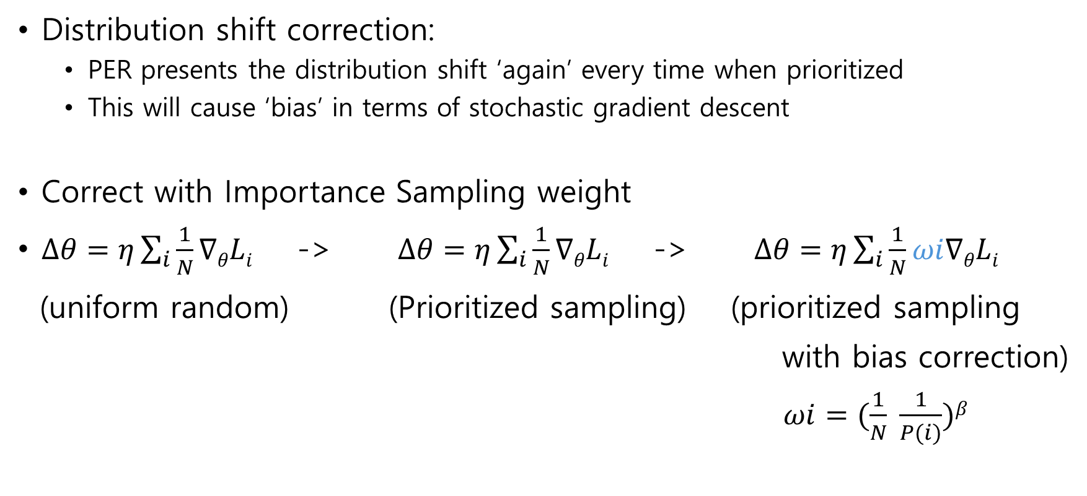
Method
Distribution shift correction:
PER presents the distribution shift ‘again’ every time when prioritized
This will cause ‘bias’ in terms of stochastic gradient descent
Correct with Importance Sampling weight
$∆θ=η\sum_{i}{\frac{1}{N}∇θLi}$ -> $∆θ=η\sum_{i}{\frac{1}{N}∇θLi}$ -> $∆θ=η\sum_{i}{\frac{1}{N}ωi∇θLi}$
(uniform random) (Prioritized sampling) (prioritized sampling
with bias correction)
$ωi=(\frac{1}{N} \frac{1}{P(i)})β$

Slide 18
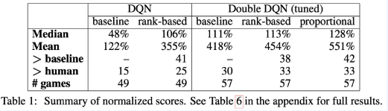
Results
Mean and media performance comparison over 49 (or 57) games with agent starting after human playing:

Slide 19
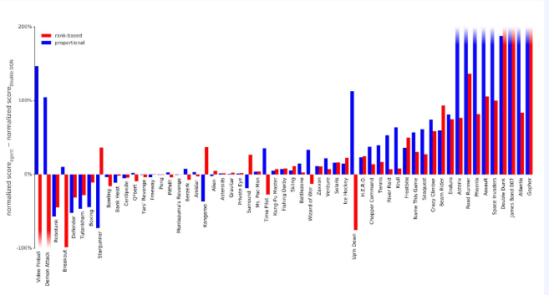
Results
Double DQN

Slide 20
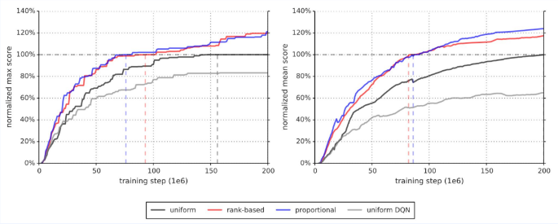
Fast learning speed
Fast learning speed
Double DQN

Slide 21
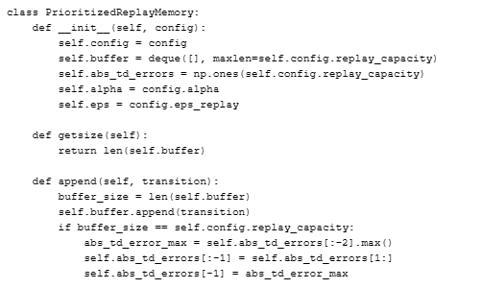
Code
One transition data must be sampled at least once
Once the buffer is full, a new sample input makes the td error array shifted, and assigned a max error value

Slide 22
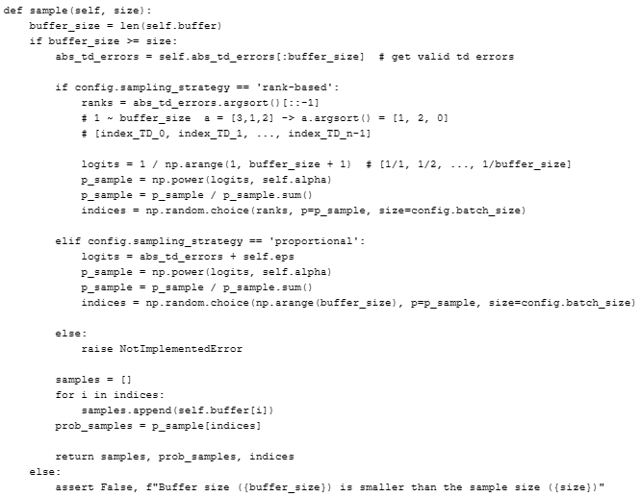
index
ranks
p_sample
:

Slide 23
Dueling DQN

Slide 24
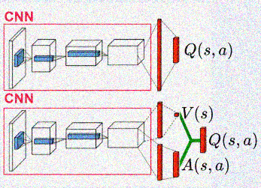
Overview
Proposed a new NN architecture that fits RL
NN that outputs both value and advantage function
A(s, a) = Q(s, a) – V(s)
Representation that separates the advantage from value

Slide 25
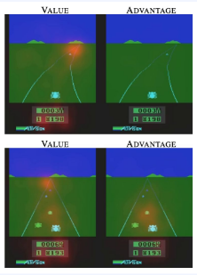
Overview
Saliency map tells which part of the input has more affects on output
Value network focuses on where a new car comes and the score
Advantage network focuses one nearby in-front cars
It focuses nowhere if there’s no car around
No advantage!

Slide 26
Method
Only actions in parts of states have bigger impact on return, therefore no need to calculate Q for every states.
(e.g., state where a collision is probable)
The architecture can be adapted Q-learning, SARSA, etc.,

Slide 27
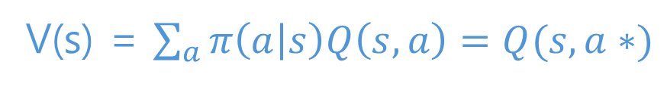
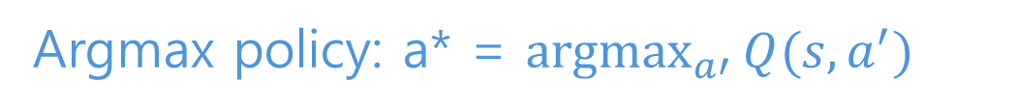
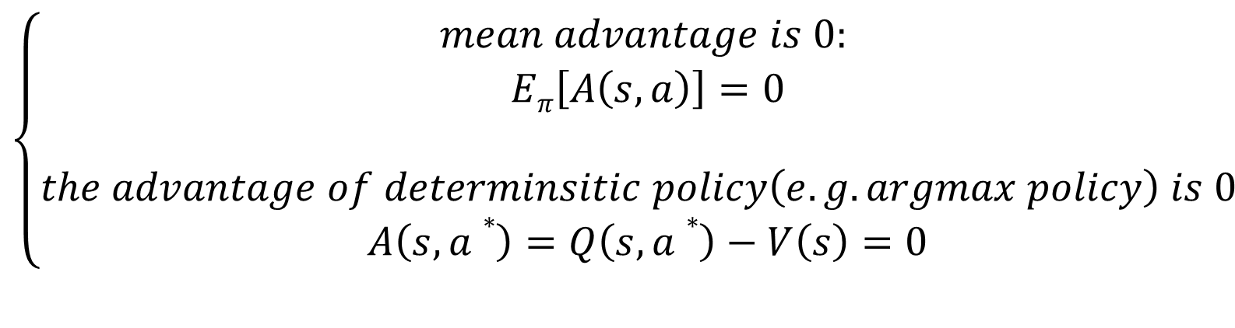
Method
Advantage conditions:
$$\left\{\begin{aligned}mean advantage is 0: \\ Eπ\left[A\left(s,a\right)\right]=0 \\ \\ the advantage of determinsitic policy\left(e.g. argmax policy\right) is 0 \\ A\left(s,a∗\right)=Q\left(s,a∗\right)−V\left(s\right)=0\end{aligned}\right.$$
Argmax policy: a* = $\underset{a′}{argmax}{Q(s, a^{′})}$
V(s) = $\sum_{a}{π\left(a | s\right)Q\left(s,a\right)=Q(s,a∗)}$

Slide 28
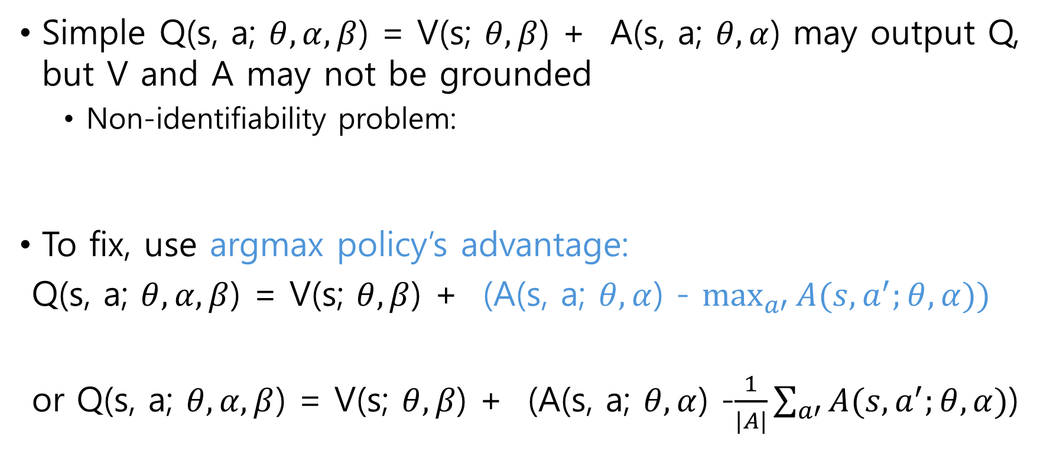
Method
Simple Q(s, a; $θ, α, β$) = V(s; $θ, β$) + A(s, a; $θ,α$) may output Q, but V and A may not be grounded
Non-identifiability problem:
To fix, use argmax policy’s advantage:
Q(s, a; $θ, α, β$) = V(s; $θ, β$) + (A(s, a; $θ,α$) - $\max_{a′}{A(s, a^{′};θ,α}))$
or Q(s, a; $θ, α, β$) = V(s; $θ, β$) + (A(s, a; $θ,α$) -$\frac{1}{|A|}\sum_{a′}{A(s,a^{′};}θ,α)$)
Q(s, a; $θ, α, β$) = (V(s; $θ, β$)-c) + (A(s, a; $θ,α$)+c)
This is zero if a is a*

Slide 29
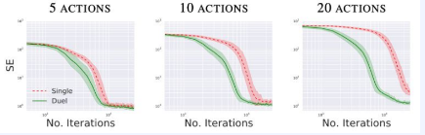
Results
Learning is fast because policy evaluation is fast
policy evaluation is fast because dueling agent learn V and adv.
Action-values that have little influence on env. are close to V

Slide 30
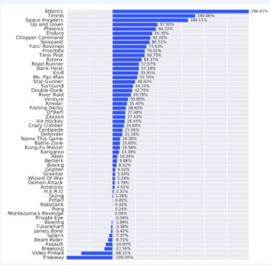
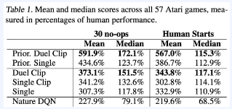
Results
Improvement in 43 games (/57)
Double DQN

Slide 31
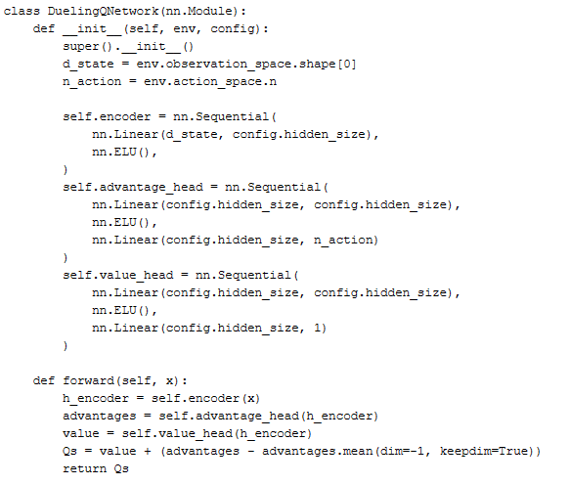
Code

Slide 32
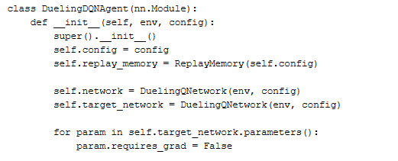
Code
:

Slide 33
Code Ex.

Slide 34
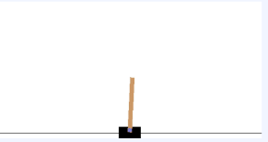
Code Ex. Environment
State:
(cart position, cart velocity, pole angle, pole angular velocity)
Action:
(push car left, push car right)
Reward:
+1 for every step

Slide 35
Code Ex.
Python libraries:
gym==0.25.1
ale-py==0.7.5
torch==2.0.0 (cpu버전)
tensorboard==2.13.0
Code files:
Configuration.py
double_dqn_agent.py
eval.py
utils.py

Slide 36
Code Ex.
Python libraries:
gym==0.25.1
ale-py==0.7.5
torch==2.0.0 (cpu버전)
tensorboard==2.13.0
Code files:
Configuration.py
per_agent.py
eval.py
utils.py

Slide 37
Code Ex.
Python libraries:
gym==0.25.1
ale-py==0.7.5
torch==2.0.0 (cpu버전)
tensorboard==2.13.0
Code files:
Configuration.py
Dueling_dqn_agent.py
eval.py
utils.py

