Slide 1
BigData Procesing
Prof Aziz Nasridinov

Slide 2
Introduction
Lee u seog
Park Ji su
Presentation
regression analysis
data collection
Ppt production Decision tree
Hwang Se young
Jang hee ju
Knn
Data Processing
Data Processing
Basic StatisticalAnalysis

Slide 3


Movie
범죄도시
Until This year 19 movies have reached 10 million. The number of movie audiences increases as the level of people's cultural life increases.
We analyzed the movie data to predict the number of audiences in the movie.

Slide 4
Number of visits person by region in 2016
4
5.9
Information
4.81
4.01
4.70
Population by area group Number of visitors per person Station The city of Seoul was the highest at 5.90. Gwangju Metropolitan City recorded 5.40 times, the second highest viewing Respectively.
3.91
2.36
seoul
kyunggi
busan
kyungbuk
Deagu
Ulsan
출처 : 한국문화산업 진흥회
Notes:
© Copyright PresentationGo.com – The free PowerPoint template library

Slide 5
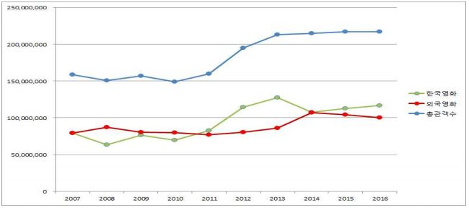
In 2016, the total number of audiences in theaters totaled 211.72 million, down 0.1% from the previous year. Since 2011 By 2015, the total number of audiences in the theater has increased for the fifth consecutive year. . The number of Korean movie audiences rose to 111.55 million, up 3.2% from the previous year. With this Korean films have surpassed 100 million audiences for five consecutive years since 2012.
Korean Film Industry Closing in 2016

Slide 6
Analysis sequence
6
01
Step 1.
Step 4.
Information of Data set
02
06
Decision tree
Step 2.
Step 5.
Regression analysis
Basic statistical analysis
03
05
Step 3.
04
Step 6.
knn
apply
Notes:
© Copyright PresentationGo.com – The free PowerPoint template library

Slide 7

Step 1.
Information of data

Slide 8
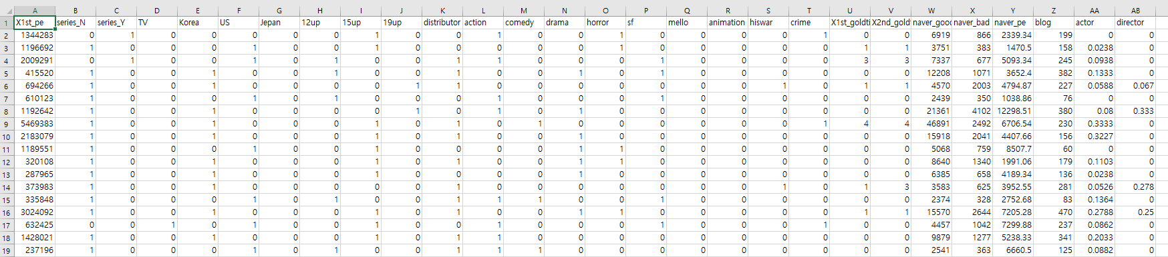
Step 1.
Movie Data Set
Initial data set, Source: Competition

Slide 9
01
X1st_pe
04
Korea , US, Japen
07
X1st_goldtimes ,2nd
1st Cumulative number of movie theaters
Korea, United States, Japan Which country's movies. Other is 0
How much overlap with Golden Holidays
02
Series_N & Y
05
12,15,19 up, distributor
08
naver_good,bad ,pe
Whether or not there is existence of series.
Age limit of movies Whether or not there is a distributor
Good, bad evaluation from Naver.
Multiply with Movie audience and Rating
03
TV
06
Genre
09
Blog,actor,director
TV simultaneous screening
Various genres such as action, horror, comedy,etx..
Number of posting
The influence of actors and directors

Slide 10
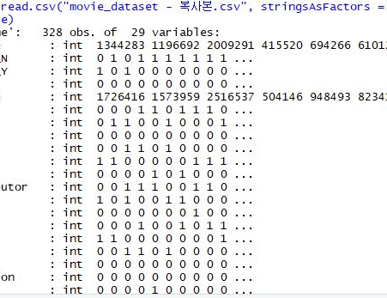
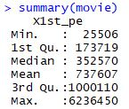
Big data
Movie Data Set
str(movie)
summary(movie)

Slide 11

Step 2. Basic Statistical Analysis

Slide 12
Because We have too many independent variables and we do not know which variables are affecting the cumulative number of movie viewers, we should choose an independent variable with reference to the correlation coefficient.
It is good to choose the independent variables which has the correlation coefficient from 0.3 to 0.7.
(reference to blog)
We can get the correlation coefficient between the cumulative number of 1st week cinema audience and other variables by function ‘cor()’ in R.
Step 2.
Basic
Statistical
Analysis

Slide 13
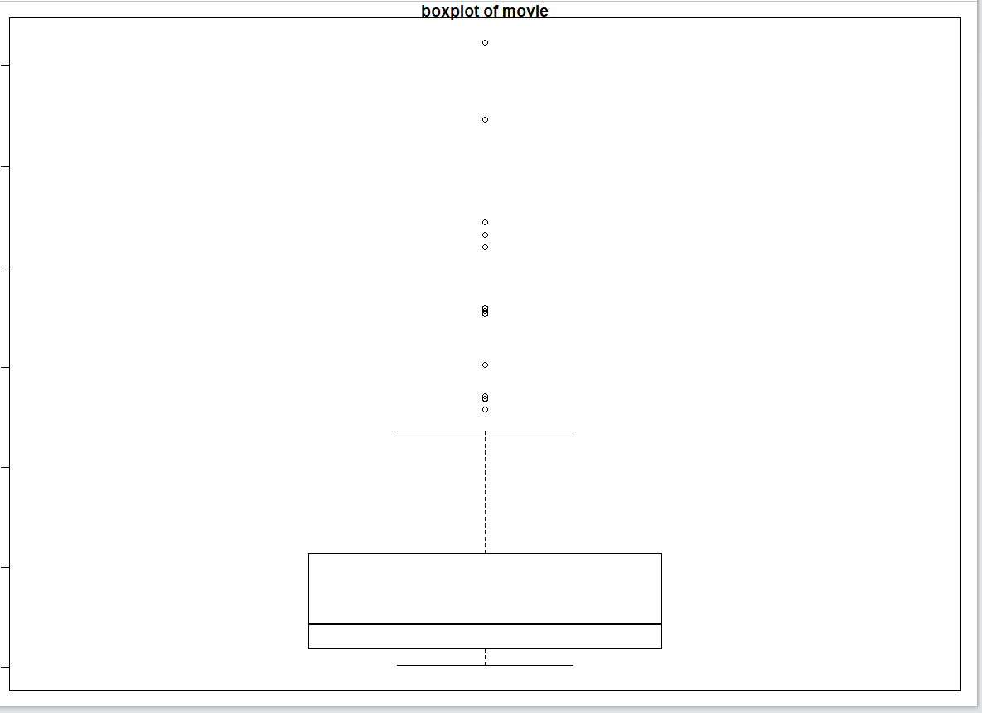
13
Box plot
This is a boxplot about the cumulative number of 1st week cinema audience.
There are many outliers, so it help us to process the data.
Because there are many outliers, if K It was confirmed that the small outline would be sensitive to the outliers and the accuracy could be lowered.

Slide 14
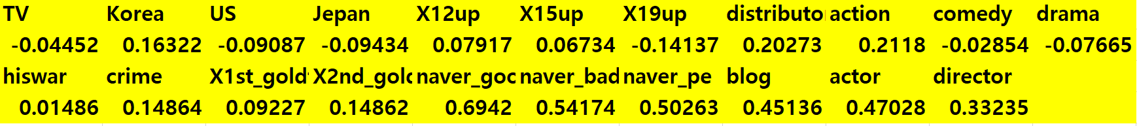
Choose independent
value
We concluded the it is right to analyze 6 variables except the variables which is too small absolute values like country, limitation of age, genre

Slide 15
Six meaningful independent variables
0.3~0.7
naver_good
blog
0.69
0.45
naver_bad
actor
0.54
0.47
naver_pe
director
0.50
0.33
15

Slide 16

Step 3.

Slide 17
Knn
We classify the cumulative number of 1st cinema audience by the class , like High, Medium, Low, to implement the machine learning , Knn and decision tree.
The standard of classifying the class is calculated referring to the cumulative number of 1st cinema audience in the Internet news articles and five-number summary of it.
New Project

Slide 18
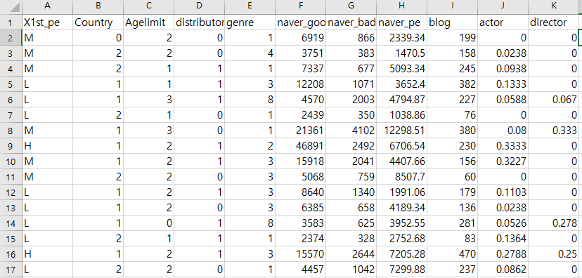
2nd_pre-processing
We pre-processed the data again to perform the knn analysis.

Slide 19
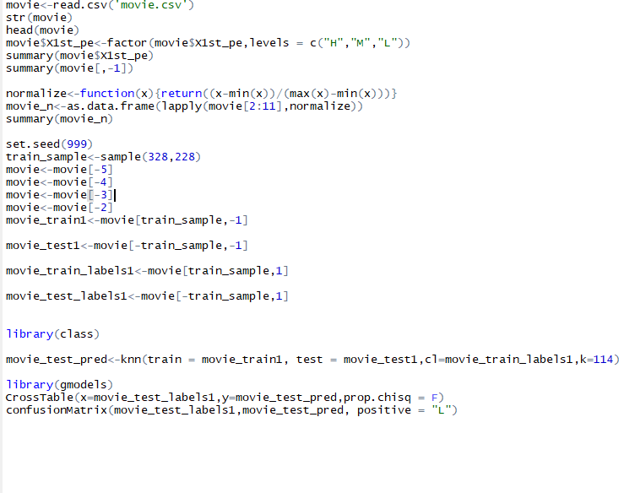
Knn
R-code
In order to use Knn about this data, We set the class 'H' by more than two million, the class 'M' from 700 thousand, and the class 'L' by less than 700 thousand.
설명

Slide 20
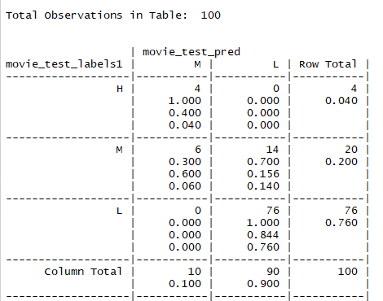
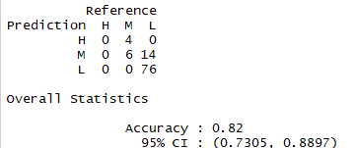
Result about
using Knn
Cross table →
↓ Accuracy

Slide 21
Accuracy depending on choosing different K.
68%
75%
82%
K =35
K = 70
K = 114
21

Slide 22

New Project
Step 4.
Decision Tree

Slide 23
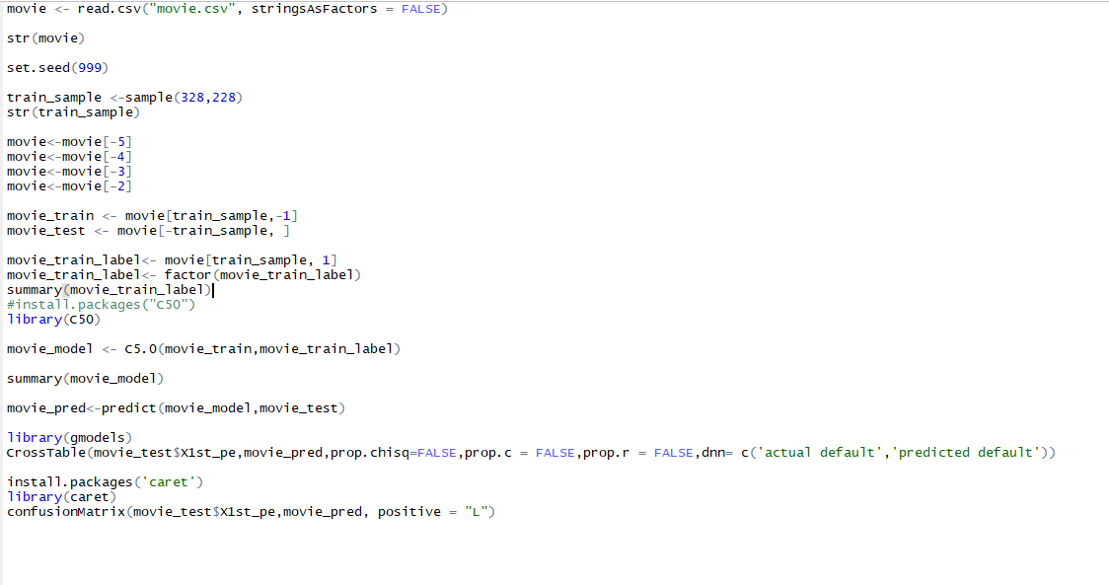
Decision tree R-Code

Slide 24
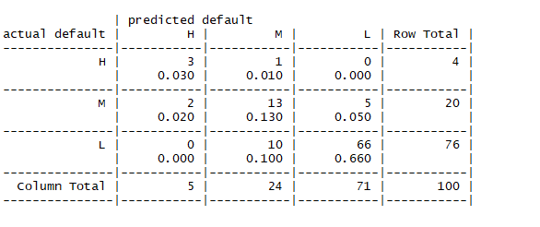
Result using decision tree
Cross table

Slide 25
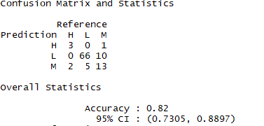
Accuracy of decision tree
82%
25

Slide 26
Comparison of
Knn and DecisionTree
 | knn | Desion tree
H(4) | 0/4 | 3/4
M(20) | 6/20 | 13/20
L(76) | 76/76 | 66/76
knn selects neightbor based on Euclidean distance.
By the way Since there are many outliers, we could not properly classify the H data included in outliers because we got high K
On the other hand, since the decision tree is not so, the data included in H is classified well.
However, if the tree is too large and detailed, the accuracy is lowered and the accuracy of M and L is somewhat lower than that of Knn.

Slide 27
Conclusion
We can predict the cumulative number of 1st cinema audience by 6 independent variables.
However, it is not exact value but only the class. So, by regression analysis We can get the regression formula and analyze the exact value.

Slide 28

Step 4.

Slide 29
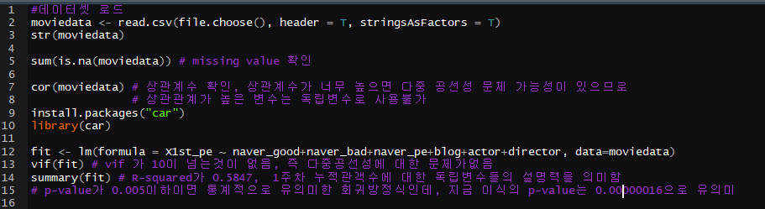
Regression Analysis
Regression Code

Slide 30
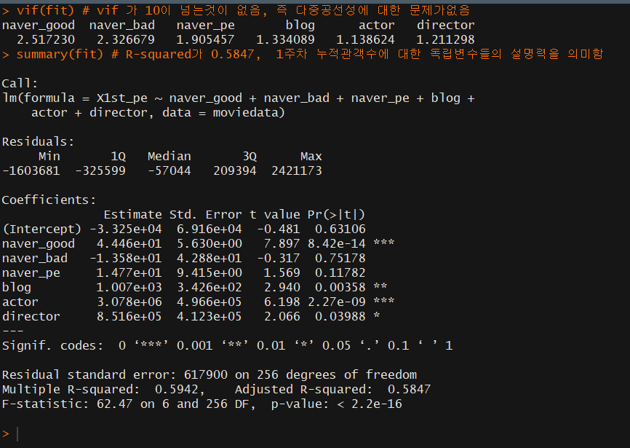
Result using
regression analysis
Looking at the first line of the output screen, we checked the Vif value to determine if there is a multicollinearity problem.
Multi-collinearity refers to a problem that affects regression analysis negatively because of high correlation between independent variables.
The next Vif value is called the Dispersion Expansion Factor, which is a value that determines whether there is a high correlation between independent variables and can range from 1 to infinity.
If this Vif value exceeds 10, it is judged that there is a problem in multi-collinearity.
Y(1주차 누적 관객수) = 44.46naver_good -13.58naver_bad
+ 14.77naver_pe + 1007Blog +30780100Actor
+ 851600Director - 33250
Regression formula

Slide 31
R – squard ?
Definition
Meaning
Explain
"R-Suared" is the square of the correlation coefficient between variables. This value is more than 0.6 in academia and 0.4 in marketing research It is interpreted as meaningful.
"R -square" is 0.58, which means that each independent variable accounts for 58.47% of the dependent variable. At first glance, this regression equation may seem insignificant because the explanatory power of the independent variable is less than 60%
Given that it is difficult to explain 10% of the social phenomena, 58.47% is not small. When regression analysis is performed, if the R squared value is less than 0.4, the remaining indicator is not necessary to see and meaningless.
31

Slide 32
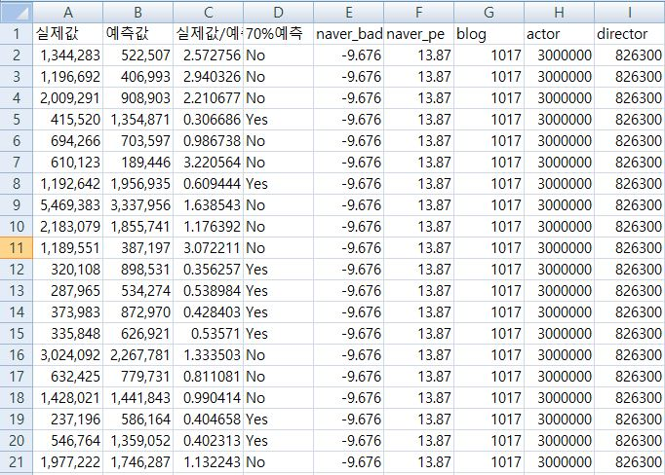
Analysis result
We express the predicted value by regression formula and accurate value., If value obtained by dividing the actual value into the forecast value is greater than 0.7 or less than 1.3, it is 'Yes'.
Otherwise, it is 'No'.
Then we checked the accuracy.

Slide 33
problem
80%
Accuracy is very low.
Because We think we need to a standard We choose 'Yes' and analyze it.
If the variables about actors and directors is near to 0 or the variables about the number of blog postings is near to 0, then predicted value is not exact.
So we need to choose predicted model which is appropriate to the value about actors, director, and blog postings.
40%
The percentage of 'Yes'
The reason why the percentage of 'Yes' is low is because of actors, directors, and blog postings.
If the model has the variables about actors and directors which is not near to 0 or the variables about blog postings which is greater than 50, then it is a good predictive model.
Since Most of Korean films are satisfied with this standard, there is no big problem to analyze it by this formula.

Slide 34

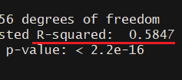
apply
Step 6.
R-squard
We choose some films that more than 50 posting in blog are uploaded (one week before the opening week) and influence of actors and directors is not 0. We judged that the model is accurate.
Since R-squared is 0.58, it can be interpreted that it is quite reasonable to predict social phenomenon.
34

Slide 35



35
example
Crime Town
Taxi Driver
The Swindlers
Release 2017.10.03
diretor : 강윤성 actor : 윤계상 마동석
Release 2017.08.02
diretor : 장훈 actor : 송강호
Release : 2017.11.22
diretor :장창원 actor : 현빈 , 유지태

Slide 36



36
example
I can speak
Let me eat your pancreas
If only
Release : 2017.09.21
diretor : 김현석, actor : 나문희 이제훈
Release :2017.10.25
diretor : 츠키카와 쇼 actor : 하마베,키타무라
Release : 2017.11.29
diretor :길 정거 ,
actor :제니퍼 러브 휴잇, 폴 니콜스

Slide 37
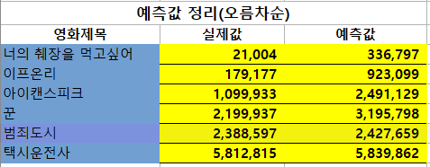
The values for each independent variable were treated as a result of the discoveries found in Naver blogs and sites.
There were quite a few similar results, and there were many different results.
The reason was highly influenced since the coefficient about actors and directors is too high in regression formula.
The film's actors and directors did not have enough film works to deduct accurate predictions.
http://www.kobis.or.kr/kobis/business/mast/mvie/searchMovieList.do

Slide 38


YES
NO
Is the director's influence appropriate?
New actor or new director without work
YES
NO
Is the actor's influence appropriate?
Lack of blog postings

Slide 39
39
I felt that…
I learned bigdata processing through only paper. But this time, I learned practical skills about it inR directly. I already learned R programming, but I only learned the basic skills of R. Then I didn't know how to apply R to the real work and it wasn't touched to me. In that sense, this lecture is very beneficial to learn various analytical methods
by _ park ji su
During this semester, while taking a big data processing class. It was nice to learn various classification techniques and analysis techniques. I think it is a good opportunity to have a good base for R language..
by – Lee u seok

Slide 40
40
I felt that…
Before I took this lecture, I already studied the basic skills in R. Although I just heard that R is very useful, i didn't know how to apply R in the real world. However, through this lecture I knew how to use R in real work and studied the various classification methods. I thought that classification methods are very difficult. But there are many simple machine learning like Knn and skyline. It was surprising. Through the project, it's good to apply the machine learning to some data.
by – hwang se young
Last year, when i was learning R, I just wrote code. I did not know what it meant. However, during this semester, this class was very informative lecture that learned various analysis methods and its meaning.
by – jang hee ju

Slide 41
Question

Slide 42
42
thank you

