Slide 1
Galarm
Rise and Earn

Slide 2
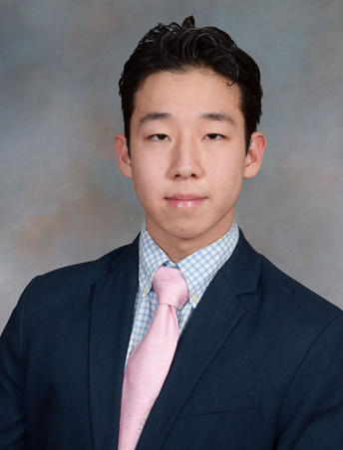
The Team

