Slide 1
Programming Languages
2nd edition
Tucker and Noonan
Chapter 13
Object-Oriented Programming
I am surprised that ancient and Modern writers have not attributed greater importance to the laws of inheritance ...
Alexis de Tocqueville

Slide 2
Contents
13.1 Prelude: Abstract Data Types
13.2 The Object Model
13.3 Smalltalk
13.4 Java
13.5 Python

Slide 3
  Ask not what you can do
  for your classes,
  Ask what your classes can do
  for you.
  Owen Astrachan

Slide 4
13.1 Prelude: Abstract Data Types
Imperative programming paradigm
  Algorithms + Data Structures = Programs [Wirth]
  Produce a program by functional decomposition
    Start with function to be computed
    Systematically decompose function into more primitive functions
    Stop when all functions map to program statements

Slide 5
Procedural Abstraction
Concerned mainly with interface
  Function
  What it computes
  Ignore details of how
  Example: sort(list, length);

Slide 6
Data Abstraction
Or: abstract data types
Extend procedural abstraction to include data
  Example: type float
Extend imperative notion of type by:
  Providing encapsulation of data/functions
  Example: stack of int's
  Separation of interface from implementation

Slide 7
Defn: Encapsulation is a mechanism which allows logically related constants, types, variables, methods, and so on, to be grouped into a new entity.
Examples:
Procedures
Packages
Classes

Slide 8
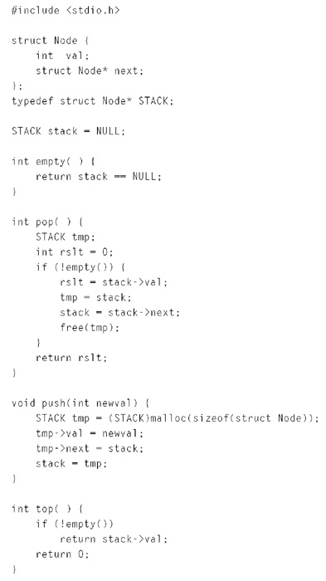
A Simple Stack in C
Figure 13.1

Slide 9
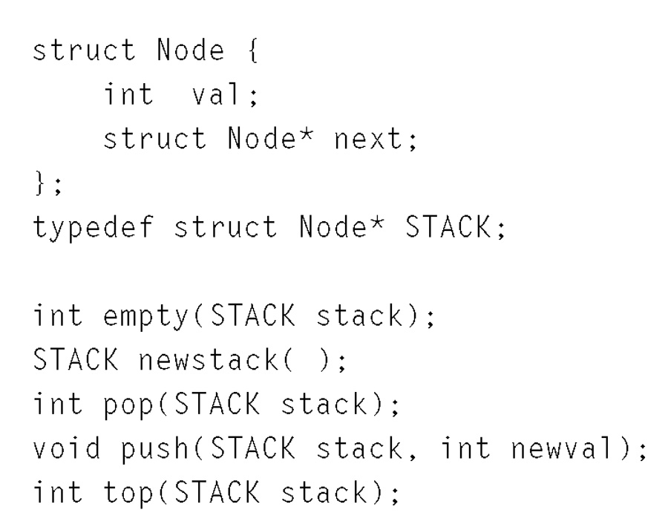
A Stack Type in C
Figure 13.2

Slide 10
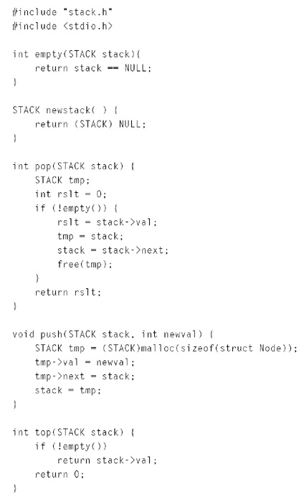
Implementation of
Stack Type in C
Figure 13.3

Slide 11
Goal of Data Abstraction
Package
  Data type
  Functions
Into a module so that functions provide:
  public interface
  defines type

Slide 12
generic
type element is private;
package stack_pck is
type stack is private;
procedure push (in out s : stack; i : element);
procedure pop (in out s : stack) return element;
procedure isempty(in s : stack) return boolean;
procedure top(in s : stack) return element;

Slide 13
private
type node;
type stack is access node;
type node is record
val : element;
next : stack;
end record;
end stack_pck;

Slide 14
package body stack_pck is
procedure push (in out s : stack; i : element) is
temp : stack;
begin
temp := new node;
temp.all := (val => i, next => s);
s := temp;
end push;

Slide 15
procedure pop (in out s : stack) return element is
temp : stack;
elem : element;
begin
elem := s.all.val;
temp := s;
s := temp.all.next;
dispose(temp);
return elem;
end pop;

Slide 16
procedure isempty(in s : stack) return boolean is
begin
return s = null;
end isempty;
procedure top(in s : stack) return element is
begin
return s.all.val;
end top;
end stack_pck;

Slide 17
13.2 The Object Model
Problems remained:
Automatic initialization and finalization
No simple way to extend a data abstraction
Concept of a class
Object decomposition, rather than function decomposition

Slide 18
Defn: A class is a type declaration which encapsulates constants, variables, and functions for manipulating these variables.
A class is a mechanism for defining an ADT.

Slide 19
class MyStack {
class Node {
Object val;
Node next;
Node(Object v, Node n) { val = v;
next = n; }
}
Node theStack;
MyStack( ) { theStack = null; }
boolean empty( ) { return theStack == null; }

Slide 20
Object pop( ) {
Object result = theStack.val;
theStack = theStack.next;
return result;
}
Object top( ) { return theStack.val; }
void push(Object v) {
theStack = new Node(v, theStack);
}
}

Slide 21
Constructor
Destructor
Client of a class
Class methods (Java static methods)
Instance methods

Slide 22
OO program: collection of objects which communicate by sending messages
Generally, only 1 object is executing at a time
Object-based language (vs. OO language)
Classes
  Determine type of an object
  Permit full type checking

Slide 23
Visibility
public
protected
private

Slide 24
Inheritance
Class hierarchy
  Subclass, parent or super class
is-a relationship
  A stack is-a kind of a list
  So are: queue, deque, priority queue
has-a relationship
  Identifies a class as a client of another class
  Aggregation
  A class is an aggregation if it contains other class objects

Slide 25
In single inheritance, the class hierarchy forms a tree.
Rooted in a most general class: Object
Inheritance supports code reuse
Remark: in Java a Stack extends a Vector
Good or bad idea?
Why?
Single inheritance languages: Smalltalk, Java

Slide 26
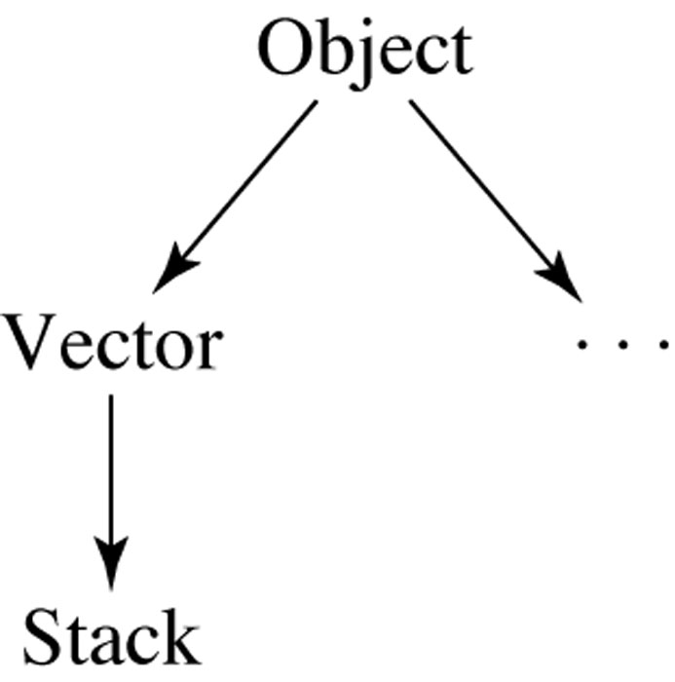

Slide 27
Multiple Inheritance
Allows a class to be a subclass of zero, one, or more classes.
Class hierarchy is a directed graph
Adv: facilitates code reuse
Disadv: more complicated semantics
Re: Design Patterns book mentions multiple inheritance in conjunction with only two of its many patterns.

Slide 28
Defn: A language is object-oriented if it supports
an encapsulation mechanism with information hiding for defining abstract data types,
virtual methods, and
inheritance

Slide 29
Polymorphism
Polymorphic - having many forms
Defn: In OO languages polymorphism refers to the late binding of a call to one of several different implementations of a method in an inheritance hierarchy.

Slide 30
Consider the call: obj.m( );
obj of type T
All subtypes must implement method m( )
In a statically typed language, verified at compile time
Actual method called can vary at run time depending on actual type of obj

Slide 31
for (Drawable obj : myList)
obj.paint( );
// paint method invoked varies
// each graphical object paints itself
// essence of OOP

Slide 32
Defn: A subclass method is substitutable for a parent class method if the subclass’s method performs the same general function.
Thus, the paint method of each graphical object must be transparent to the caller.
The code to paint each graphical object depends on the principle of substitutability.

Slide 33
Polymorphism
Essence: same call evokes a different method depending on class of object
Ex: obj.paint(g);
  Button
  Panel
  Choice Box
Substitutability principle

Slide 34
Templates or Generics
A kind of class generator
Can restrict a Collections class to holding a particular kind of object
Defn: A template defines a family of classes parameterized by one or more types.
Prior to Java 1.5, clients had to downcast an object retrieved from a Collection class.

Slide 35
ArrayList<Drawable> list = new ArrayList<Drawable> ();
...
for (Drawable d : list)
d.paint(g);

Slide 36
Abstract Classes
Defn: An abstract class is one that is either declared to be abstract or has one or more abstract methods.
Defn: An abstract method is a method that contains no code beyond its signature.

Slide 37
Any subclass of an abstract class that does not provide an implementation of an inherited abstract method is itself abstract.
Because abstract classes have methods that cannot be executed, client programs cannot initialize an object that is a member an abstract class.
This restriction ensures that a call will not be made to an abstract (unimplemented) method.

Slide 38
abstract class Expression { ... }
class Variable extends Expression { ... }
abstract class Value extends Expression { ... }
class IntValue extends Value { ... }
class BoolValue extends Value { ... }
class FloatValue extends Value { ... }
class CharValue extends Value { ... }
class Binary extends Expression { ... }
class Unary extends Expression { ... }

Slide 39
Interfaces
Defn: An interface encapsulates a collection of constants and abstract method signatures.
An interface may not include either variables,
constructors, or non-abstract methods.

Slide 40
public interface Map {
public abstract boolean containsKey(Object key);
public abstract boolean containsValue(Object value);
public abstract boolean equals(Object o);
public abstract Object get(Object key);
public abstract Object remove(Object key);
...
}

Slide 41
Because it is not a class, an interface does not have a constructor, but an abstract class does.
Some like to think of an interface as an alternative
to multiple inheritance.
Strictly speaking, however, an interface is not quite the same since it doesn't provide a means of reusing code;
i.e., all of its methods must be abstract.

Slide 42
An interface is similar to multiple inheritance
in the sense that an interface is a type.
A class that implements multiple interfaces
appears to be many different types,
one for each interface.

Slide 43
Virtual Method Table (VMT)
How is the appropriate virtual method is called at run time.
At compile time the actual run time class of any object may be unknown.
MyList myList;
...
System.out.println(myList.toString( ));

Slide 44
Each class has its own VMT, with each instance of the class having a reference (or pointer) to the VMT.
A simple implementation of the VMT would be a hash table, using the method name (or signature, in the case of overloading) as the key and the run time address of the method invoked as the value.

Slide 45
For statically typed languages,
the VMT is kept as an array.
The method being invoked is converted to an index
into the VMT at compile time.

Slide 46
class A {
Obj a;
void am1( ) { ... }
void am2( ) { ... }
}
class B extends A {
Obj b;
void bm1( ) { ... }
void bm2( ) { ... }
void am2( ) { ... }
}

Slide 47
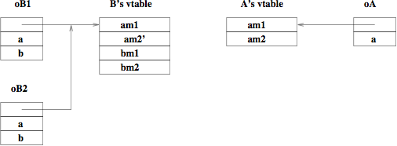

Slide 48
Run Time Type Identification
Defn: Run time type identification (RTTI) is the ability of the language to identify at run time the actual type or class of an object.
All dynamically typed languages have this ability, whereas most statically typed imperative languages, such as C, lack this ability.
At the machine level, recall that data is basically untyped.

Slide 49
In Java, for example, given any object reference, we can determine its class via:
Class c = obj.getClass( );

Slide 50
Reflection
Reflection is a mechanism whereby a program can discover and use the methods of any of its objects and classes.
Reflection is essential for programming tools that allow plugins (such as Eclipse -- www.eclipse.org) and for JavaBeans components.

Slide 51
In Java the Class class provides the following information about an object:
The superclass or parent class.
The names and types of all fields.
The names and signatures of all methods.
The signatures of all constructors.
The interfaces that the class implements.

Slide 52
Class class = obj.getClass( );
Constructor[ ] cons = class.getDeclaredConstructors( );
for (int i=0; i < cons.length; i++) {
System.out.print(class.getName( ) + "(" );
Class[ ] param = cons[i].getParameterTypes( );
for (int j=0; j < param.length; j++) {
if (j > 0) System.out.print(", ");
System.out.print(param[j].getName( );
}
System.out.println( ")" );
}

