Slide 1
Programming Languages
2nd edition
Tucker and Noonan
Chapter 13
Object-Oriented Programming
I am surprised that ancient and Modern writers have not attributed greater importance to the laws of inheritance ...
Alexis de Tocqueville

Slide 2
Contents
13.1 Prelude: Abstract Data Types
13.2 The Object Model
13.3 Smalltalk
13.4 Java
13.5 Python

Slide 3
13.4 Java
1.0 released in 1995
1.5 (or Java 5) in 2004
major language changes: 1.1, 1.5
steady growth in SE libraries
mixed language
  primitive types: int, double, boolean
  objects
statically typed
single inheritance

Slide 4
Direct support for:
inner classes
visibility modifiers
abstract classes
interfaces
generics
run time type identification
reflection

Slide 5
Example: Symbolic Differentiation
Implement symbolic differentiation
State rules
Simplification separate
Use of abstract syntax

Slide 6
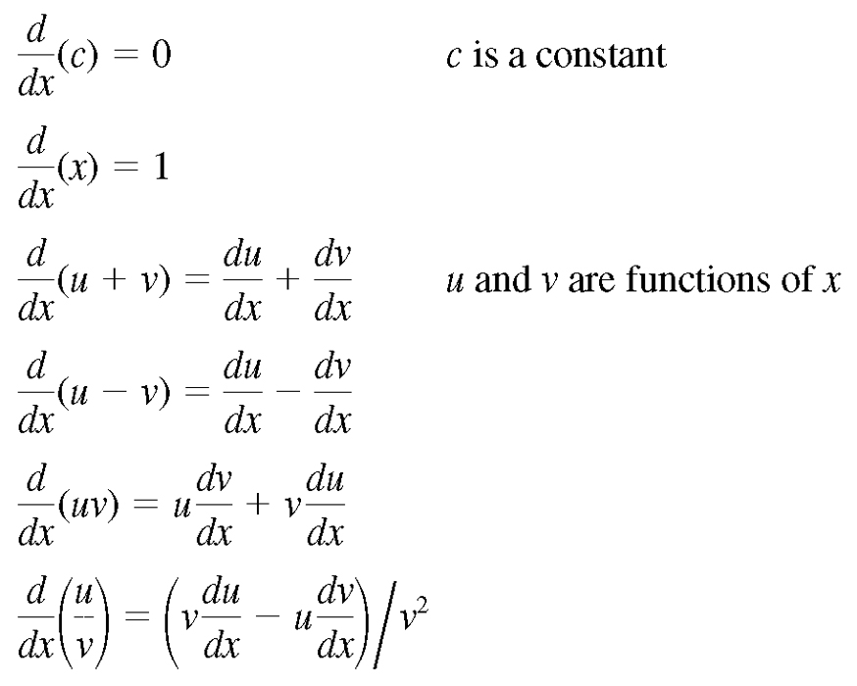
Symbolic Differentiation Rules
Figure 13.19

Slide 7
Example
d/dx (2*x+1)
d/dx (2*x+1) = d/dx (2*x) + d/dx 1
  = x * d/dx 2 + 2 * d/dx x + 0
  = x * 0 + 2 * 1 + 0
  -- simplified algebraically: 2

Slide 8
Abstract Syntax of Expressions
Expression = Variable | Value | Binary
Variable = String id
Value = int value
Binary = Add | Subtract | Multiply | Divide
Add = Expression left, right
Subtract = Expression left, right
Multiply = Expression left, right
Divide = Expression left, right

Slide 9
public abstract class Expression {
public abstract Expression diff(Variable x);
}

Slide 10
class Value extends Expression {
private int value;
public Value(int v) { value = v; }
public Expression diff(Variable x) {
return new Value(0);
}
}

Slide 11
class Variable extends Expression {
private String id;
static final private Value zero = new Value(0);
static final private Value one = new Value(1);
public Variable(String s) { id = s; }
public Expression diff(Variable x) {
return id.equals(x.id) ? one : zero;
}
}

Slide 12
abstract class Binary extends Expression {
protected Expression left, right;
protected Binary(Expression u, Expression v) {
left = u; right = v;
}
}

Slide 13
class Add extends Binary {
public Add(Expression u, Expression v) {
super(u, v);
}
public Expression diff(Variable x) {
return new Add(left.diff(x), right.diff(x));
}
}

