Slide 1
Programming Languages
2nd edition
Tucker and Noonan
Chapter 12
Imperative Programming
I really hate this darn machine; I wish they would sell it;
It won’t do what I want it to, but only what I tell it.
Programmer’s lament (anonymous)

Slide 2
Contents
12.1 What Makes a Language Imperative?
12.2 Procedural Abstraction
12.3 Expressions and Assignment
12.4 Library Support for Data Structures
12.5 C
12.6 Ada
12.7 Perl

Slide 3
Imperative Programming
Oldest and most well-developed paradigm
Mirrors computer architecture
Languages
  Fortran, Pascal
  C, Clite
  Ada 83

Slide 4
12.1 What Makes a Language Imperative?
In a von Neumann machine memory holds:
  Instructions
  Data
  Intellectual heart: assignment statement
  Others:
    Conditional branching
    Unconditional branch (goto)

Slide 5
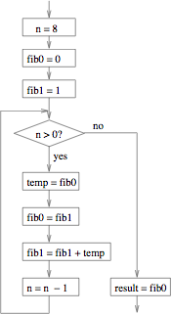
Flowchart

Slide 6
12.2 Procedural Abstraction
Procedural abstraction allows the programmer to be concerned mainly with a function interface, ignoring the details of how it is computed.
The process of stepwise refinement utilizes procedural abstraction to develop an algorithm starting with a general form and ending with an implementation.
Ex: sort(list, len)

Slide 7
12.3 Expressions and Assignment
Assignment statement is fundamental:
target = expression
Copy semantics: Expression is evaluated to a value, which is copied to the target; used by imperative languages
Reference semantics: Expression is evaluated to an object, whose pointer is copied to the target; used by object-oriented languages.

Slide 8
There exist vast libraries of functions for most imperative languages.
Partially accounts for the longevity of languages like Fortran, Cobol, and C.

Slide 9
Turing Complete
Integer variables, values, operations
Assignment
If
Goto
Re: Structured programming revolution of 1970s replace the goto with while loops.

