Slide 1
Boosting Cyclistic Annual Memberships
By Justin Park

Slide 2
General Question: How Do Casual Riders and Annual Members Differ in Their Use of Cyclistic Bikes?
Specific Questions:
How Does Usage Behavior Vary by Month, Week, and Hour?
What Are the Primary Purposes for Using Cyclistic Bikes for Each Group?
How Does the Geographic Distribution of Casual Riders and Annual Members Differ?
Do Casual Riders and Annual Members Have Different Preferences in Bike Types?

Slide 3
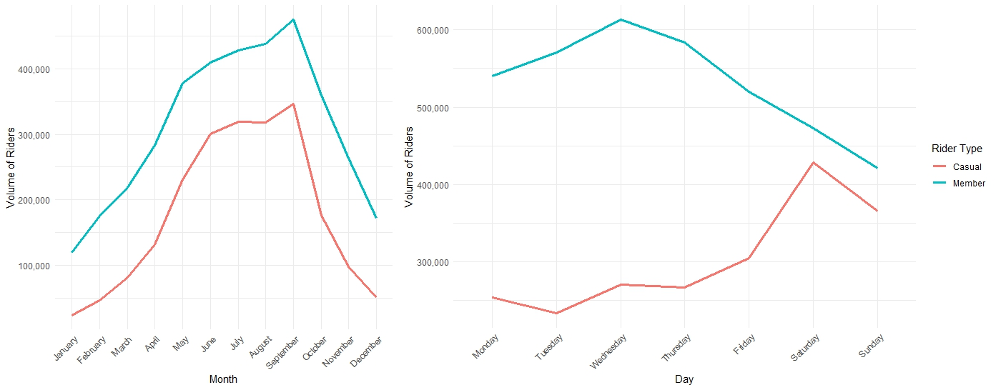
Members use bikes more during the weekdays,
Casual rider use is highest on the weekends.
Summer is peak Cyclistic season.
Monthly
Weekly
Hourly

Slide 4
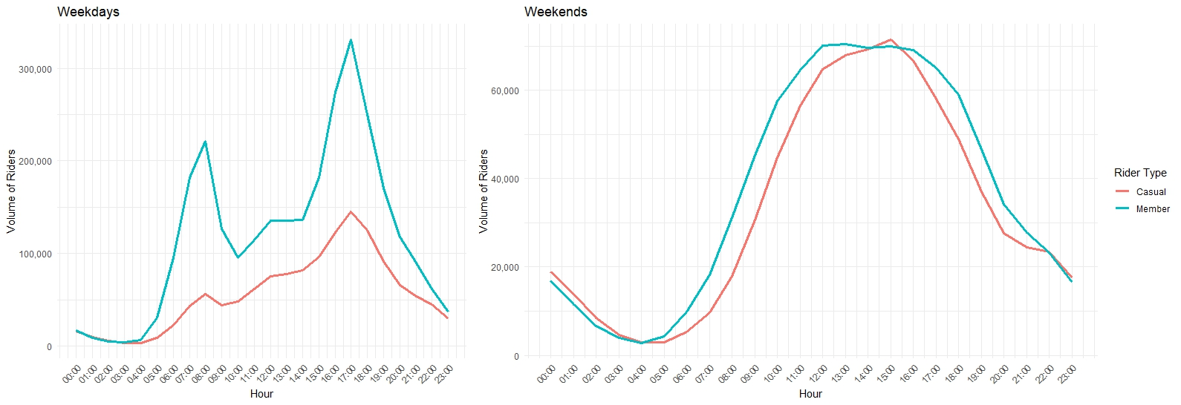
Morning and afternoon rush hours are peak hours.
The biggest disparity in bike use between members and casual riders occurs during work hours on weekdays.

Slide 5
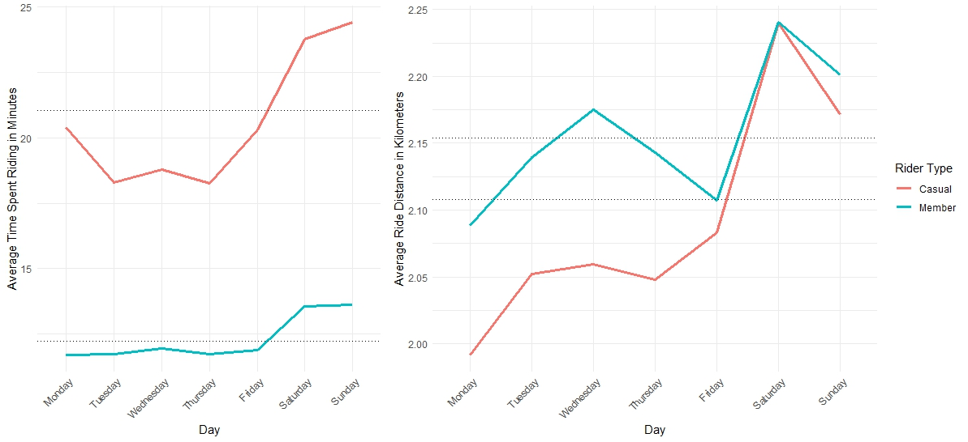
Casual riders spend ~1.75x longer on bikes than members.
On average, members and casual riders travel roughly the same distance, but casual riders take longer.
~21 mins
~2.15 km
~2.11 km
~12 mins

Slide 6
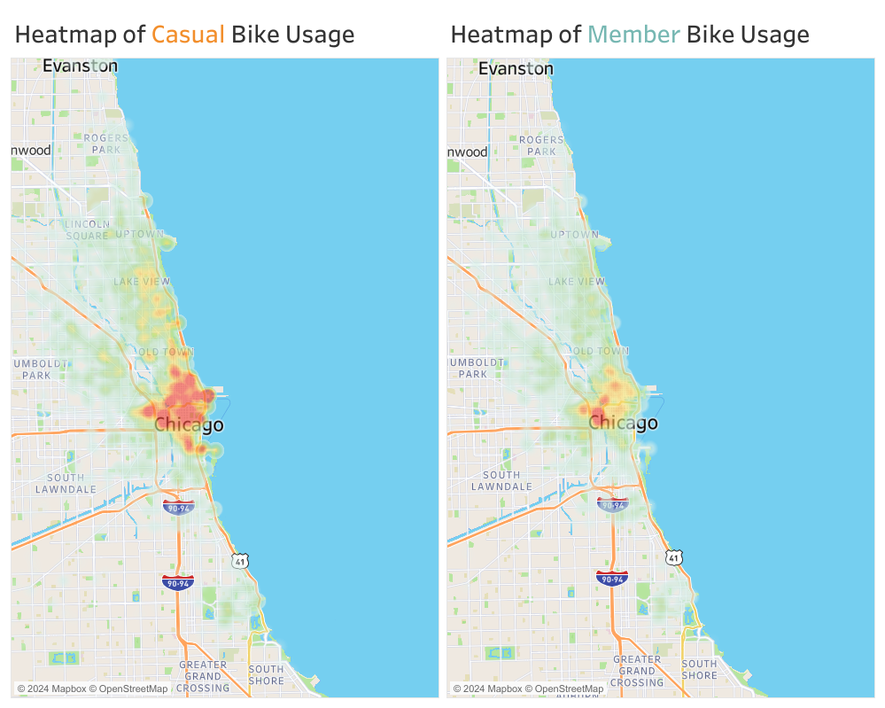
Members
Bike use is mainly concentrated in the downtown Chicago area.
Casual Riders
Bike use is spread toward and along the coastline.

Slide 7
Key Differences
Casual riders are more likely to use Cyclistic bikes for leisurely activity (eg. longer weekend rides near the water).
Members are more likely to use Cyclistic bikes functionally for commuting to and from work.

Slide 8
Recommendations
Tailored annual memberships:
Annual weekend plan for casual riders.
Annual weekday plan for commuters.
Full annual plan for week-round riders.
Switch pricing plans from pay per use/day to hourly:
Appealing for infrequent Cyclistic users.
Annual plans will become more cost-beneficial for leisurely riders.

