Slide 1

Slide <number> out of 8
  Name: Keon Hee Park
  Project: Googlify is a web music streaming service that offers unlimited amount of music for $9.99 a month
Date: September 14, 2016

Slide 2
Slide 2 out of 8
Project
Web Programming Project:
  Googlify is a web music streaming service that offers unlimited amount of music for $9.99 a month
Tools to accomplish:
  HTML knowledge
  CSS knowledge
  Git knowledge

Slide 3
Slide 4 out of 8
Keon Hee Park
Roles: Everything.
  Project idea
  Programming
  Design
  User Experience (Image content)
  Tester
Responsibilities:
Oversee management
Interact with the client
Provide expert management of funds and project scope
Set and meet delivery time with optimal quality

Slide 4
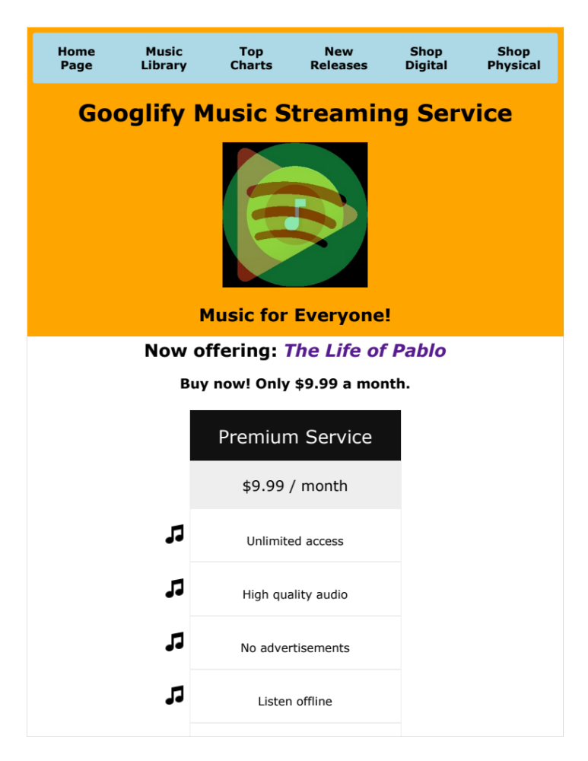
User requirements
  Statement of problem:
  One streaming service that is combined from popular streaming services by Google and Spotify.
  General requirements:
    Homepage introducing the service and its price
    Offering music service of trending album
    Playing user’s music library
    External resources to top charts and shops

Slide 5
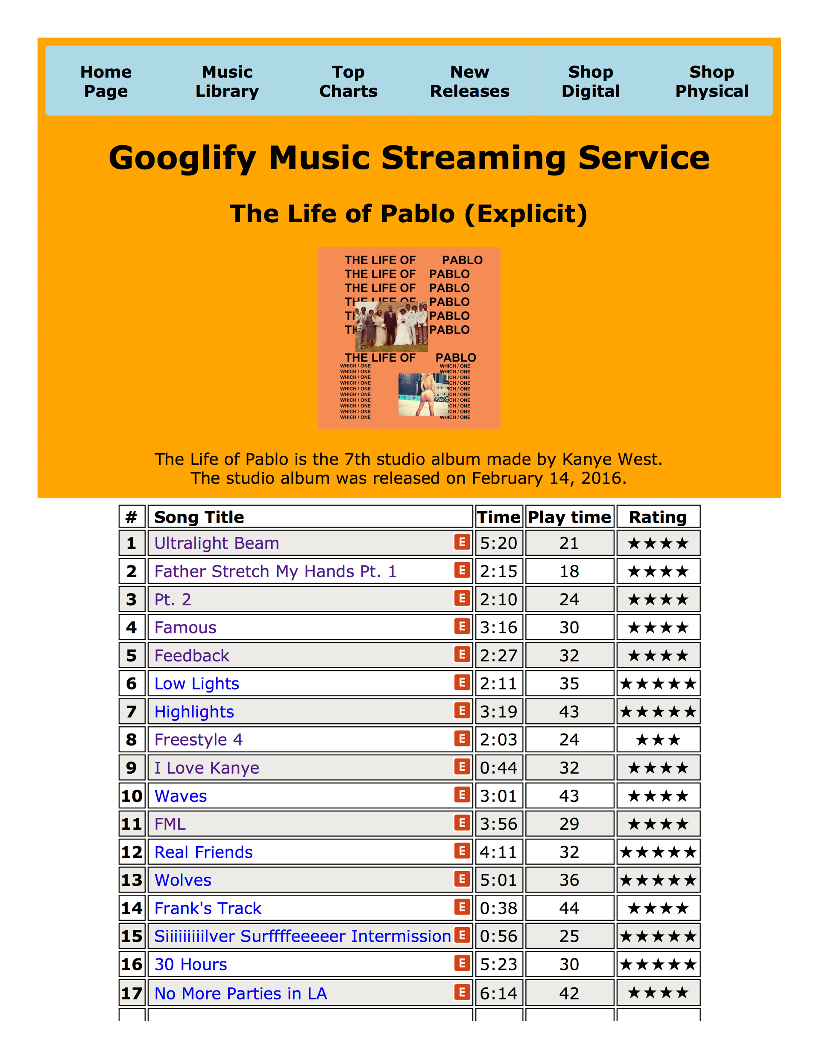
Design requirements:
Easy to use interface
  Navigation bar
List of tracks on the album
Explicit content logo
Song time
Play time
Song Ratings’

Slide 6
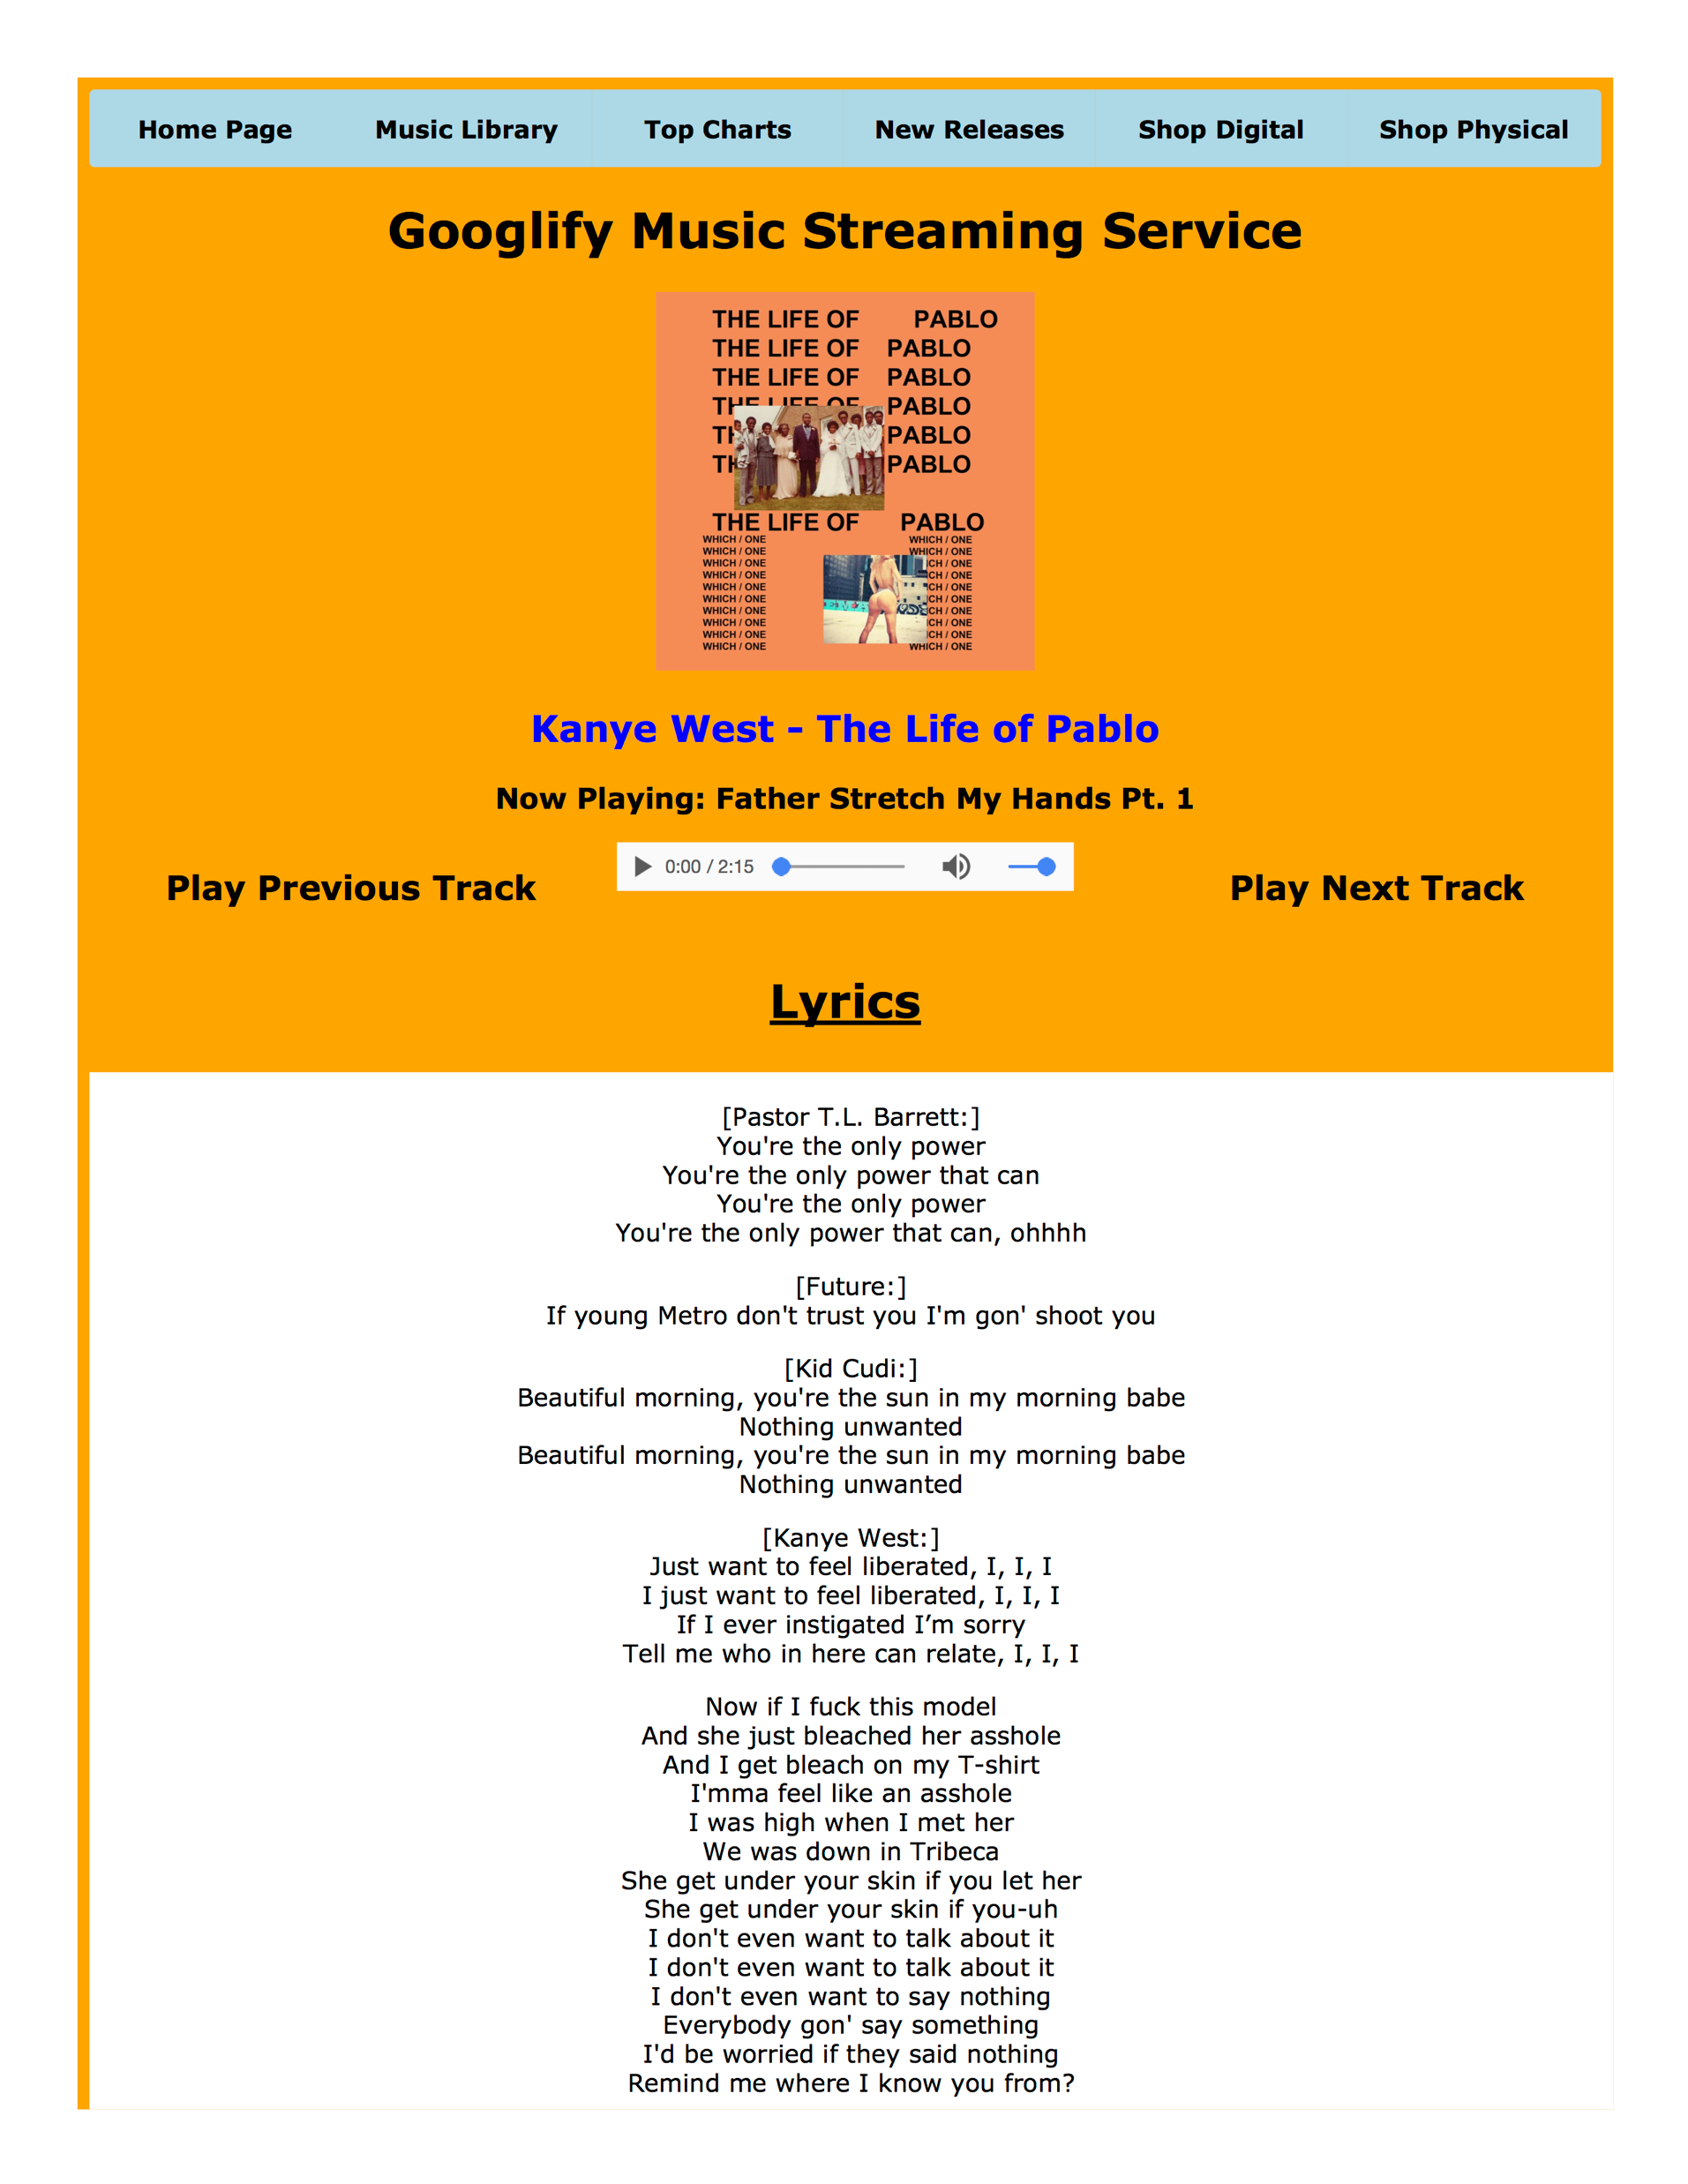
Design requirements (Part 2):
Interact with the client
  Music button
    Play
    Pause
  Lyrics
  Previous/next track
  Back to album tracklist

Slide 7
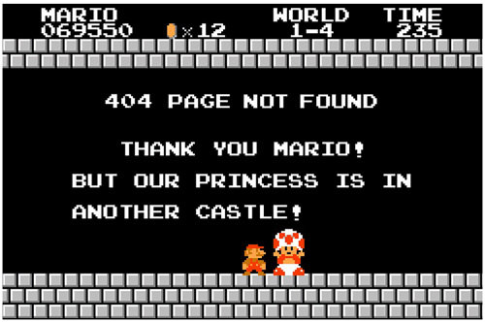


Testing requirements:
Checking for 404 not found
Check for any errors or warning in HTML and CSS
Obtain success validations for HTML and CSS
Comment on top for documentations
  Name
  Project name
  Date

Slide 8

Slide 3 out of 8
Completion Time
Today days worked:
  3 days.
  Monday to Wednesday (September 12 – 14).
Total amount of hours worked:
  10 hours

Slide 9

Slide 8 out of 8
Q&A?

