Slide 1
Defensive Python
檔案輸入/輸出
正則表示式(Regular expression)
Set操作
網路封包分析

Slide 2
檔案輸入/輸出
Python file operations are all handled by the file object
1
OR
2
filehandle = open("complete file path",mode)
with open("complete file path",mode) as filehandle:
#code block to process file using file_handle
Mode name | Description
r | read-only mode
w | write-only mode
a | append mode
rt | read text and interpret unicode string (\n or \r\n as end of line)
rb | read binary and no interpret any unicode or end of lines

Slide 3
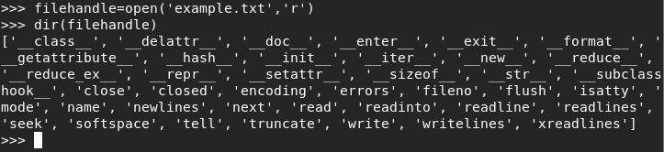
檔案輸入/輸出(常用方法)
seek(),tell():隨機讀檔/寫檔
  seek(offset[, whence]) 設定檔案指針位置 (offset:偏移量,whence:位置（0:開頭,1:當前,2:結尾）)
  tell() 回傳檔案指針位置
read(),readline(),readlines():讀檔
write(),writeline(),writelines():寫檔
close():關閉檔案

Slide 4
檔案輸入/輸出(範例)
讀檔
#Read one line at a time
filehandle = open("filepath",'r')
for oneline in filehandle:
print(oneline)
filehandle.close()
#Read the entire file into a list
filehandle = open("filepath",'r')
listoflines=filehandle.readlines()
filehandle.close()
#Read the entire file into a single string
filehandle = open("filepath",'r')
listoflines=filehandle.read()
filehandle.close()
可使用迴圈察看
檔案內容
將檔案中每行文句
轉成list
將檔案內容
轉成單一字串

Slide 5
檔案輸入/輸出(範例)
寫檔
#Writing to the file(overwrite the contents)
filehandle = open("filepath",'w')
filehandle.write("write this line.\n")
filehandle.write("write these\nTwo lines\n")
filehandle.close()
#Append to a file
filehandle = open("filepath",'a')
filehandle.write("Add this to file.\n")
filehandle.close()

Slide 6
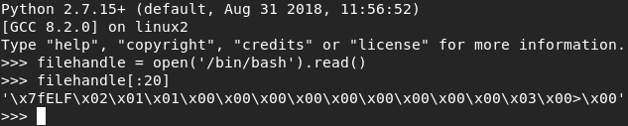
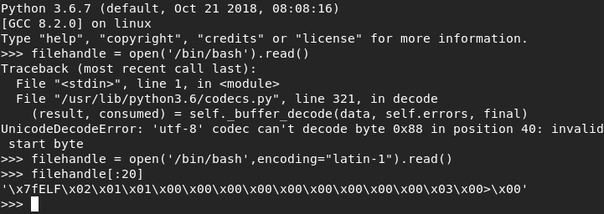
檔案輸入/輸出(範例)
讀檔(Binary)
Python 2
Python3

Slide 7
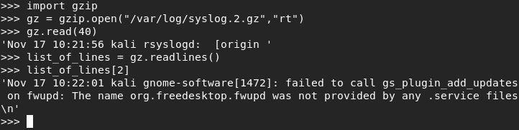
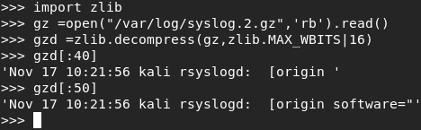
檔案輸入/輸出（模組功能）
讀取gzip壓縮檔
Linux 會自動將log檔做壓縮(gzip)
python提供gzip模組，可以輕鬆的讀取gzip壓縮檔
此外也可使用zlib讀取gzip壓縮檔

Slide 8
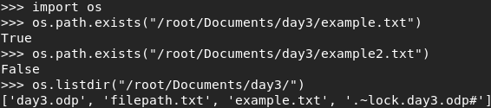
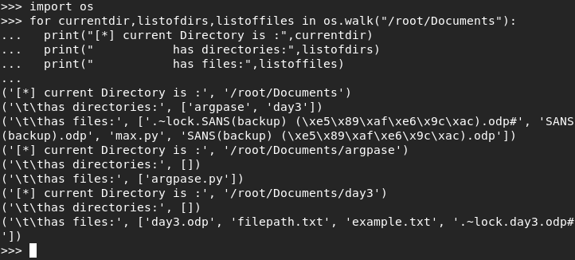
檔案輸入/輸出（模組功能）
可以使用"os"模組檔案查找以及察看資料夾內容
  os.path.exists("filepath") : 判斷檔案是否存在
  os.listdir("filepath"):列出資料夾內之內容
  os.walk("filepath"):列出資料夾內之內容(deep)

Slide 9
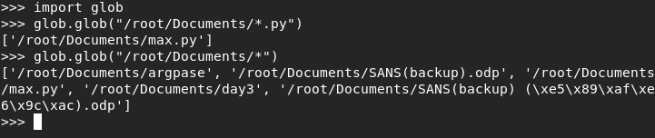
檔案輸入/輸出（模組功能）
另外也可使用"glob"模組檔案查找以及察看資料夾內容
與"os"模組不同，可使用檔案命名規則尋找檔案

Slide 10
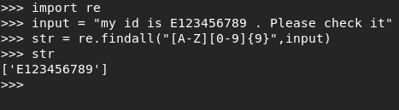
正則表示式
非常重要的技巧
模組：Import re

Slide 11
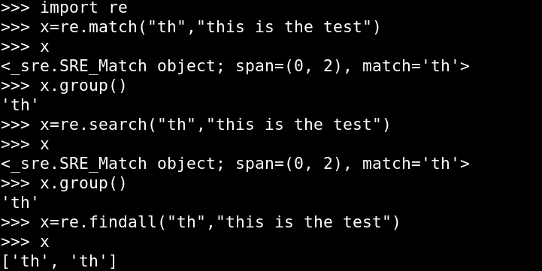
正則表示式
.match(re,data):Start at the beginning of data searching for pattern
.search(re,data):Match pattern anywhere in data
.findall(re,data):Find all occurrences of pattern in data

Slide 12
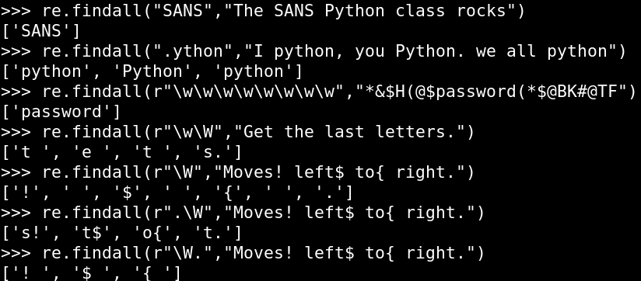
正則表示式
.(period):Wildcard for any one character
\w: Any text character(a-z,A-Z,0-9, and_)-no special characters
\W: Opposite of \w

Slide 13
正則表示式
\d: Match digits(0-9)
\D: Opposite of \d
\s: Matches any white-space character(space,tab,newlines)
\S: Opposite of \s
[set of characters]: define your own sets of characters
\b: Border of a word character(Transition \w <-> \W)
^: Matches from the start of the search string
$: Matches to the end of the search string
\: Escapes special characters; that is,”\.” means it should really find a period

Slide 14
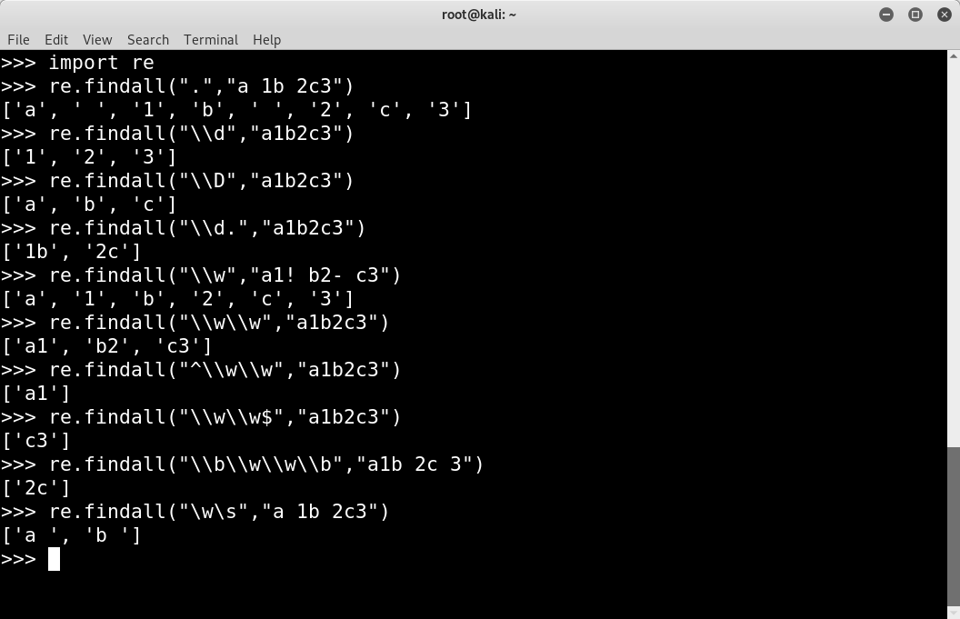
正則表示式

Slide 15
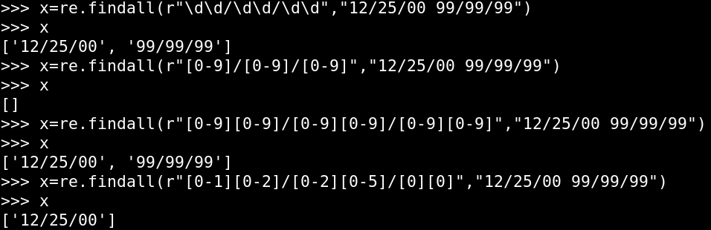
正則表示式
[set of characters]: define your own sets of characters

Slide 16
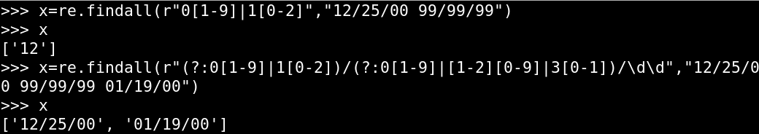
正則表示式
(?:text1|text2|text3) match text1 or text2 or text3

Slide 17
正則表示式
What if you want 100 \d characters? Or a variable number?
+ : One or more of the previous character
*: Zero or more of the previous
?: The previous character is optional(match 0 or 1)
{x}: Match exactly x copies of the previous character
{x,y}: Match between x and y of the previous character

Slide 18
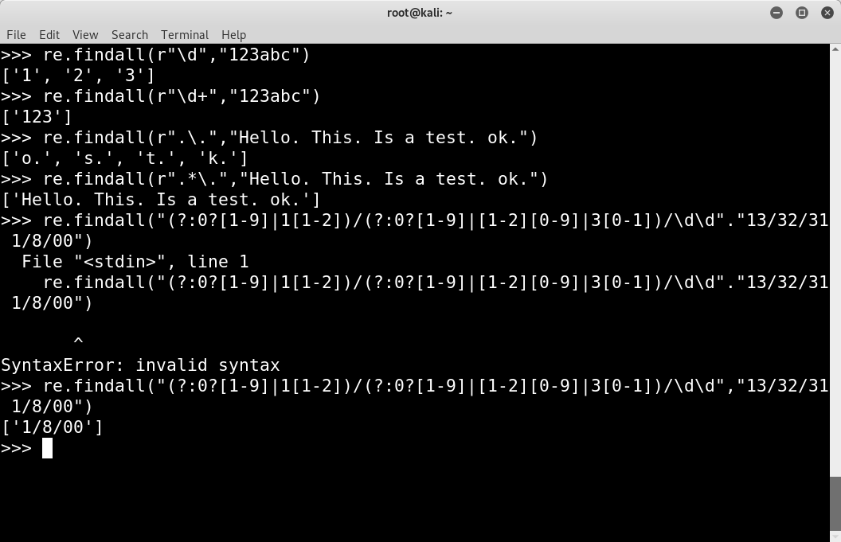
正則表示式

Slide 19
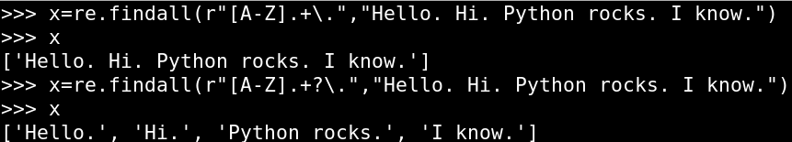
正則表示式(Greedy Matching)
* and + are greedy! They match as much as they can.
*?,+?: The? Turns off “greedy” matching

Slide 20
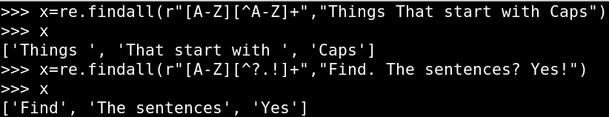
正則表示式(Not Custom Set)
[^...] :Match定義之外的元素

Slide 21
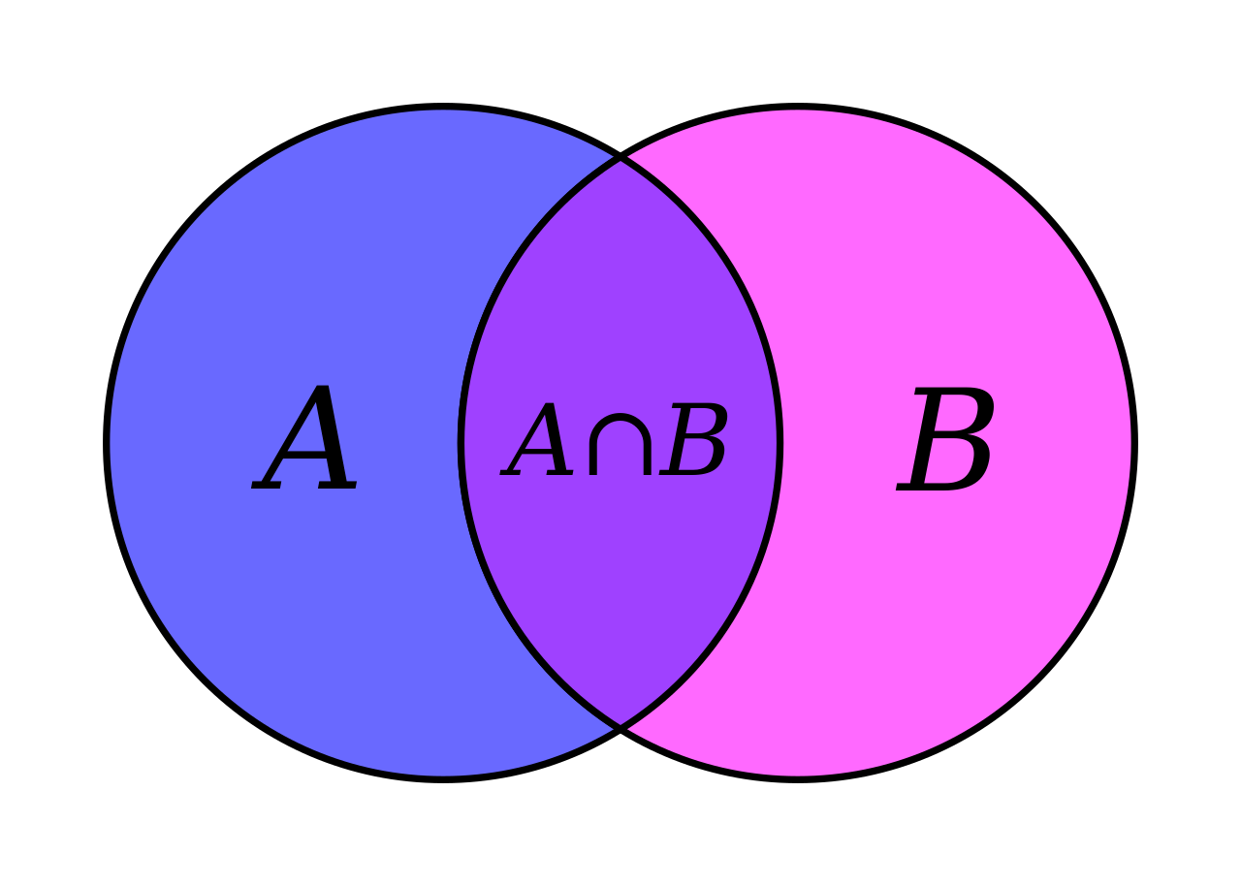
Set操作
A
A
B
B
AUB
AUB

Slide 22
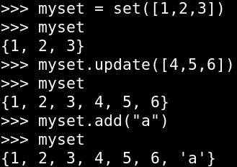
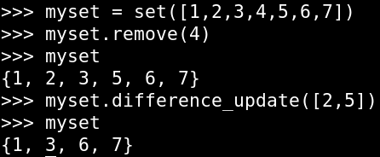
Set操作
{} can also be used to create a set
.add() adds one item
.update() can add everything from another list

Slide 23
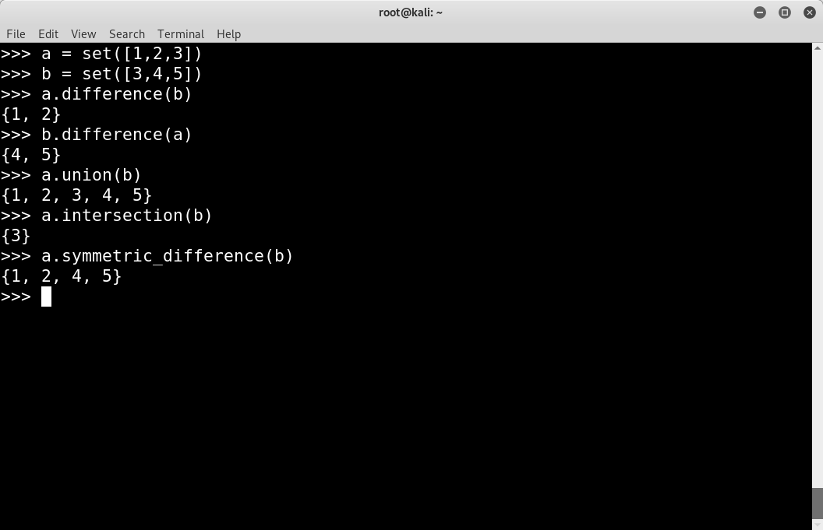
Set操作
.union() :Combines sets
.intersection() :Is items common to both sets
.symmetric_difference: All the items in the sets and remove the intersection from them.

Slide 24
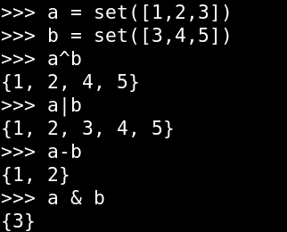
Set操作
^: symmetric_difference
|: union
-: difference
&: intersection

Slide 25
網路封包分析
Scapy是一款由python撰寫的網路封包分析模組
像 Wireshark 一樣
有嗅探(Sniffer)功能，也可以下條件式(BPF)過濾封包
$ python
>>> from scapy.all import *

Slide 26
Scapy
rdpcap(filename) will read a file containing pcaps into a scapy.PcaketLIst Data structure
  packetlist=rdpcap(“example.pcap”)
wrpcap(filename,packrtlist) will write a PacketList to a pcap file
  wrpcap(“newpacketcpture.pcap”,PacketList2write)
sniff() can also be used to capture live packets

Slide 27
Scapy
Use sniff() to capture all packets matching BPF(Berkeley Packet Filter) and pass them to function analyze()
  sniff(iface=”eth0”,filter=”HOST 10.10.10.10”,store=0,prn=analyze)
Use sniff() to capture 100 packets matching the BPF(Berkeley Packet Filter)
  sniff(iface=”eth0”,filter=”SRC HOST 10.10.10.10”,count=100)
Use sniff() to read a pcap and apply a BPF(Berkeley Packet Filter)
  sniff(offline=”sample.pcap”,filter=”TCP PORT 80”)

Slide 28
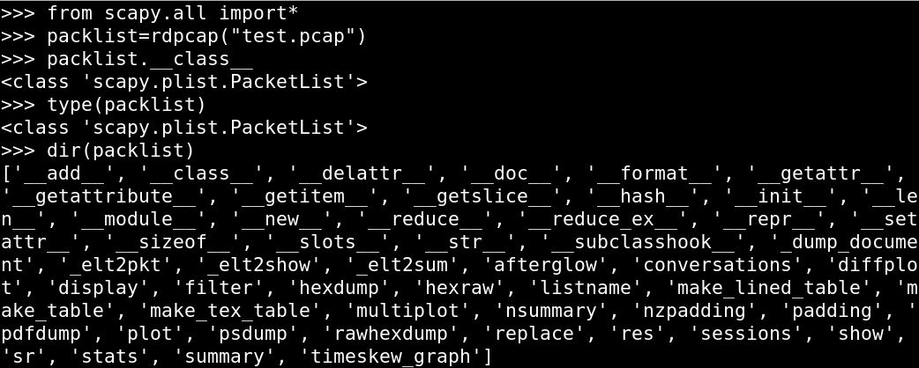
Scapy
“scapy.PcaketLIst”: The sniff() and rdpcap() functions return this type variable

Slide 29
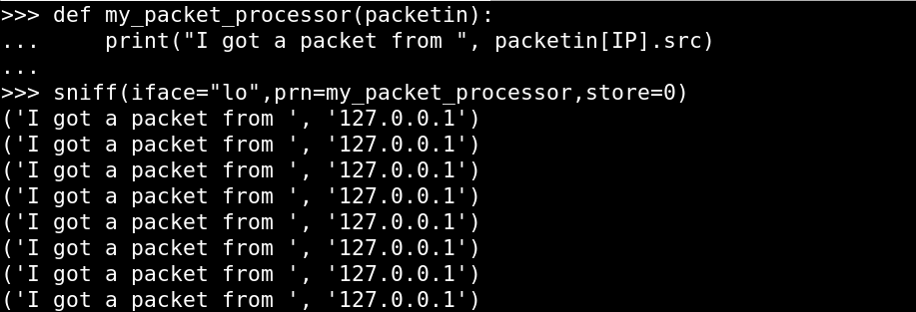
Scapy
sniff()`s callback function

Slide 30
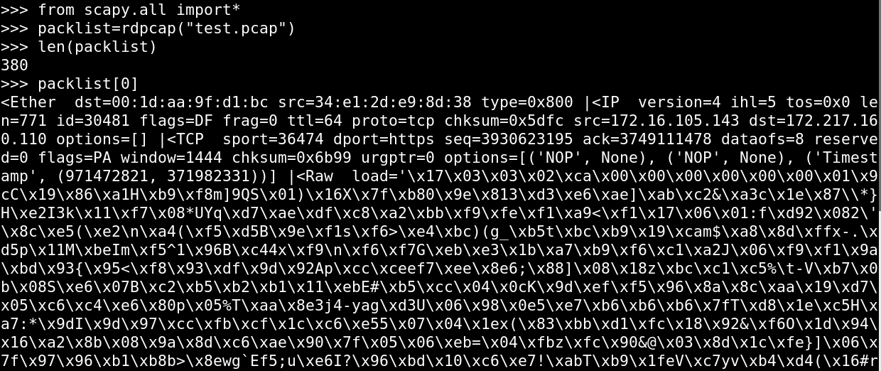
Scapy
Follow Streams

Slide 31
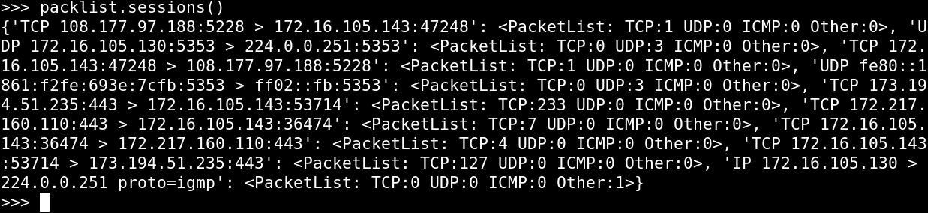
Scapy
.Sessions()return a dictionary of streams
{ :[ ] }
PROTO SRCIP:SPORT
>DSTIO:DPORT
PROTO SRCIP:SPORT
>DSTIO:DPORT
PROTO SRCIP:SPORT
>DSTIO:DPORT
0
PKT1
1
PKT2
2
PKT3
3
PKT4

Slide 32
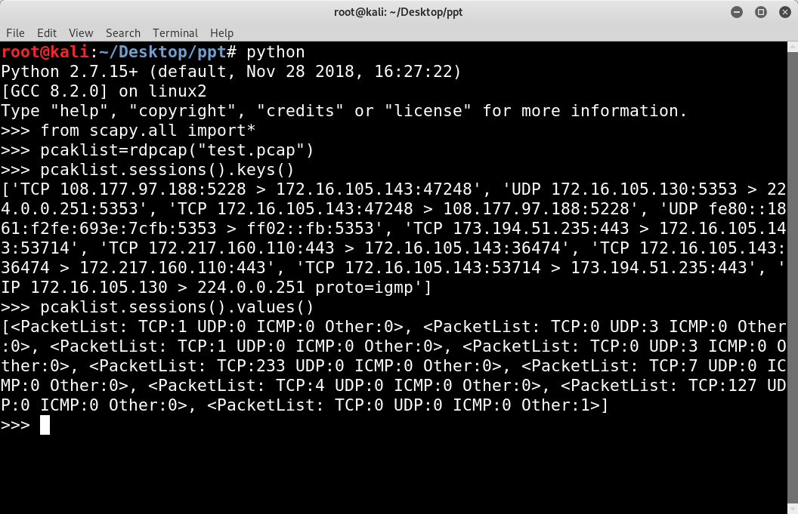
Scapy
.sessions().keys()=A list of strings
.sessions().values()=A list of PacketLists

Slide 33
Scapy
PacketList[]
Packet 0 {}
Ether
PacketList Data Structure
A PacketList contains one or more
packet, similar to a list
Packets contain one or more layers, similar
to “nested” dictionary
Layers have attributes, similar to an object
IP
TCP
Src,dst,sport,
dport
Packet 1 {}
Ether
IP
TCP
Src,dst,sport,
dport

Slide 34
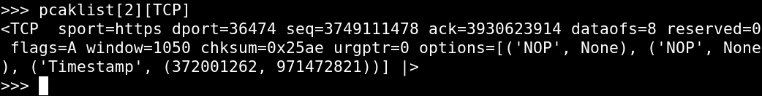
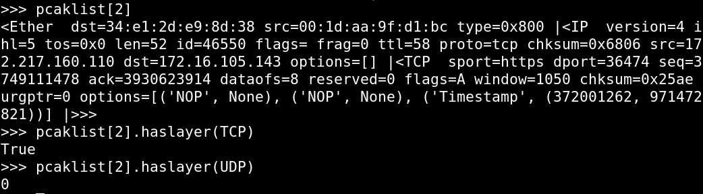
Scapy
PacketLists Have Packets, Packets Have Layers
Each of packet layers displayed can be addressed by treating the name of the layer as an index. Its value includes the layer and sublayers.
PacketList[<packet number>][<layer name>]
You can determine if your packet has a layer with .haslayer(layer)

Slide 35
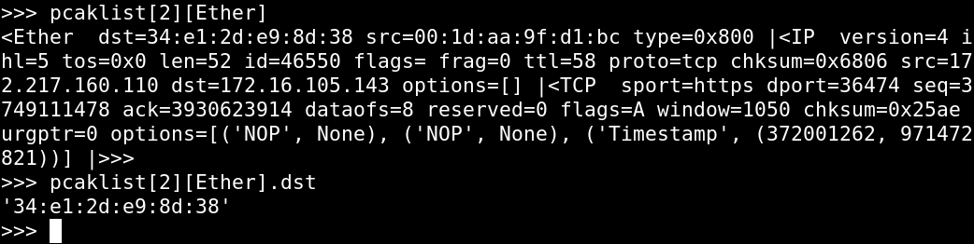
Scapy
PacketList[<packet number>][<Layer name>].<Field name>

Slide 36
Thank you for your attention

