Slide 1
Forensics Python
Forensic File Carving
Processing Data with Struct
Python`s Image Library
Database Operations
  Structured Query Language
Steganography

Slide 2
Forensic with Python
Forensic is one of the most rapidly changing fields
  New artifacts discovered in old operating systems
  New artifacts created by new applications and operating system features
If you want to make your mark as a new tool developer,there is a HUGE opportunity in Forensics
SANS FOR500-Windows Forensics and FOR508-Advanced Digital Forensics are great to learn of new techniques and artifacts that need tools written
The Cuckoo's Egg

Slide 3
Forensics Artifact Carving
Data Stream Carving
  Text from chat sessions in Sqlite3 database
  Commands typed at CMD.EXE prompts from memory
  Passwords, session-negotiated encryption keys from disk swap space/page files
File Carving
  Images such as JPG,GIF,and so on
  Documents such as DOC,DOCX,XLS,and so on
  Media such as MP3,MOV,WMV,and so on

Slide 4
Carving Forensic Artifacts
At a high level, the steps for doing this are the same for all types of data sources
We will cover the following four steps:
  Getting read access to the data
  Understand the “Metadata” structures that organizes/breaks up your target data and extracts your data
      Hard drives:Directory structures containing files such as MFTM,Block headers, etc.
      Memory:Paging system, OS Data Structures,etc.
      Network:PCAP headers, Frame headers, etc.
      Unknown Structures:Cover Channels,Malware,etc.
  Extract relevant parts with a regular expression
  Analyze the data

Slide 5
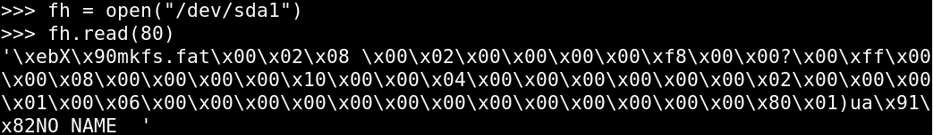
Forensic File Carving
On both Linux and Windows, the hard drives can be treated as a (very large) file and read using standard file I/0
Linux
  “/dev/sda”:First physical drive
  “/dev/sda1”:First logical drive on first physical drive
Windows
  \\.\PhysicalDriveo:First physical drive
  \\.\C:Contents of logical drive C:

Slide 6
Live Memory Carving
You can carve artifacts from live memory
  On windows, you use Winpmem, which is part of Rekall
  Winpmem.exe creates a file called \\.\pmem that will give you access to live memory
https://isc.sans.edu/diary/Searching+live+memory+on+a+running+machine+with+winpmem/17063
https://www.dshield.org/diary/%22In+the+end+it+is+all+PEEKS+and+POKES.%22/17069
On Linux Kernels 2.6 and later, /dev/mem less than reliable but can be used
Installing third-party kernel extension FMEM will work modern Linux systems

Slide 7
Linux Live Network Capture(sniffing)
Linux “raw sockets” enable you to sniff everything promiscuously
The socket options determine what types of packets you see
  Capture EVERYTHING
  socket.socket(socket.AF_PACKET, socket.SOCK_RAW,socket.ntohs(0x0003))
  Capture TCP
  socket.socket(socket.AF_INET, socket.SOCK_RAW,socket.IPPROTO_TCP)
  Capture UDP
  socket.socket(socket.AF_INET, socket.SOCK_RAW,socket.IPPROTO_UDP)
  Capture ICMP
  socket.socket(socket.AF_INET, socket.SOCK_RAW,socket.IPPROTO_ICMP)

Slide 8
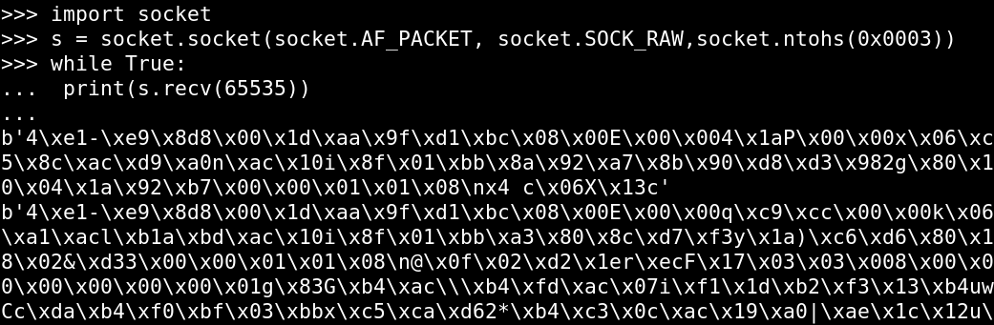
Linux Live Network Capture(sniffing)
For example:

Slide 9
Understanding the Structure
You can parse a PCAP by just using standard file I/O
But, you have to understand the pcap file data structure and where the data is scattered across the file`s data structures
It is easier for you if you use a library like scapy that has rdpcap(),tcp() and so on, which already understands that structure!
The same is true when dealing with all the previous LIVE captures OR a static forensics artifact such as a disk dump or a memory capture
network_packets = open(“test.pcap”).read()
PCAP HEADER | Ethernet HEADER | IP HEADER | TCP HEADER | MY DATA PART1 | Ethernet HEADER | ICMP HEADER | OTHER DATA | Ethernet HEADER | IP HEADER | TCP HEADER | MY DATA PART2
FILE SYSTEM | Directory Information | Sector HEADER | Cluster HEADER | MY DATA PART1 | Cluster HEADER | OTHER DATA | Cluster HEADER | MY DATA PART2

Slide 10
Third-Party Modules
There are third-party modules that understand this
  Hard Drives:Plaso, GRR,AnalyzeMFT
  Memory:Rekall, Volatility
  Network:DPKT,Scapy
  Document:pyPDF,zipfile
If these modules exist for your data structure, then you should use them!
But, what do you do when they don`t exist?
Parse the data structures yourself as a plug-in to one of those modules or as a standalone carver

Slide 11
Alert on Unknown Unknowns
Consider this example of parsing network communications
Bad!!
Good!
for eachpacket in listofpackets:
if eachpacket[proto] ==’icmp’:
do important analysis
if eachpacket[proto] ==’tcp’:
do important analysis
for eachpacket in listofpackets:
if eachpacket[proto] ==’icmp’:
do important analysis
elif eachpacket[proto] ==’tcp’:
do important analysis
else:
print(“WARNING: UNKNOWN PROTOCOL”)

Slide 12
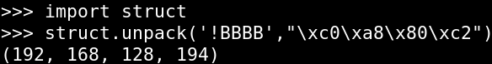
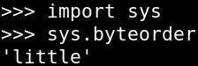
The STRUCT Module
The struct module is used for interpreting binary data
Converts a string of binary to a tuple of integers and strings
struct.unpack(): Similar to regex, you create a string that says how you want to extract the data
That string is created to match the format of the data you are trying to extract
!BBBB = 4個1byte INTs
The struct format string:
  First character indicates little or big endian
    ! or > indicates to interpret data as BIG ENDIAN
    < indicates to interpret data as LITTLE ENDIAN
    = or @ indicates to interpret data based on the system it script is running on (I.e.sys.byteorder)
  REMAINING characters indicate how to interpret data

Slide 13
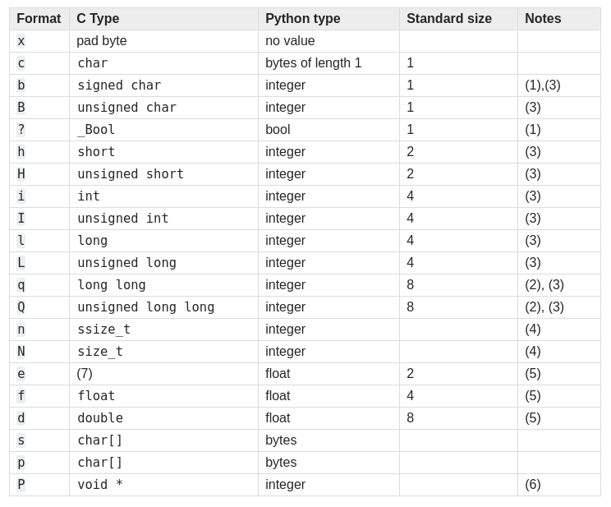
Struct Format Characters
https://docs.python.org/3/library/struct.html

Slide 14
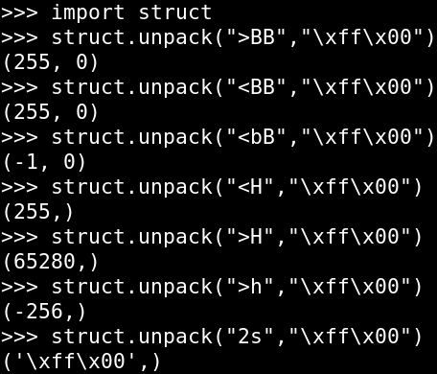
Struct Unpack(I)

Slide 15
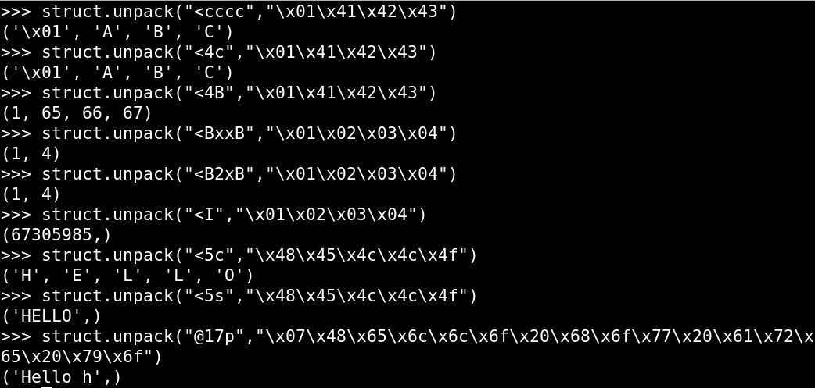
Struct Unpack(II)
Pascal String “Hello how are yo”

Slide 16
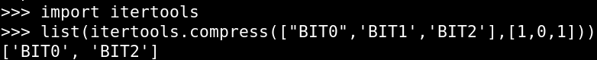
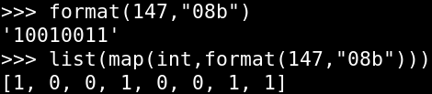
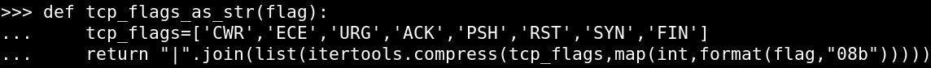
Unpacking Bits as Flags
A binary bit is often used as flag. For example, the TCP SYN flag is represented by the 2nd bit in byte 13 of the TCP header
itertools.compress() will convert SET bits to words
You need bits as a list of integers
Combine these two techniques to convert byte flags to words

Slide 17
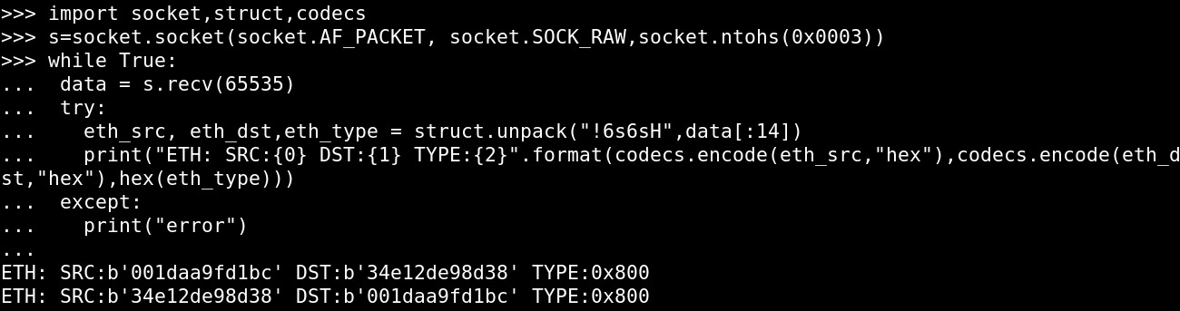
Ether Header Struct
Let`s make a struct string to capture the Ethernet header
All network traffic is BIG ENDIAN, so it will start with a!
Destination MAC(6 bytes)
DST MAC continued | SRC MAC(6 bytes)
Source MAC continued
Ether Type(2 bytes)
= !6s6sH

Slide 18
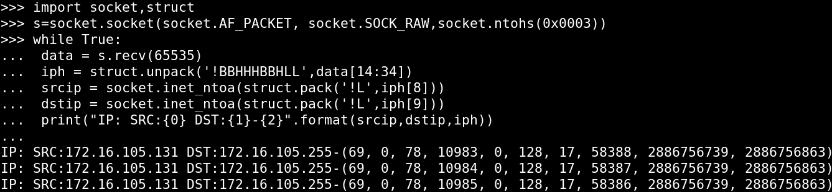
IP Header Struct
Vers | Hlen | SVC(1 byte) | Total Length(2 bytes)
Identification(2 bytes) |  |  | unused | DF | MF | Fragment Offset
TTL(1) | Protocol(1) |  | Header Checksum(2 bytes)
Source IP Address(4 bytes)
Destination IP Address (4 bytes)
IP Options(if any 4 byte boundaries)
= !BBHHHBBHLL

Slide 19
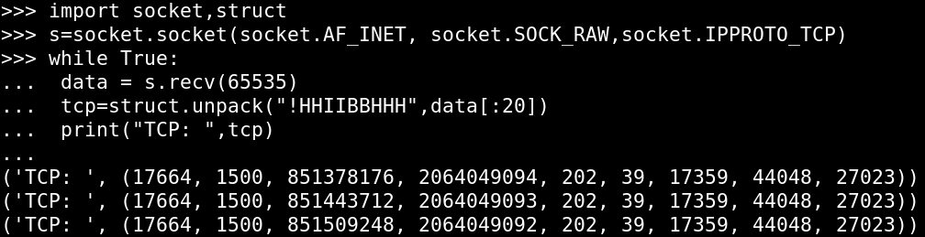
TCP Header Struct
Source Port(2 bytes) |  |  | Destination Port(2 bytes)
Sequence Number(4 bytes)
Acknowledgment Number(4 bytes)
Hlen | Rsvd | Flags(1 byte) | Window(2 bytes)
Checksum(2 bytes) |  | Urgent Pointer(2 bytes)
TCP Options(if any 4-byte boundaries)
= !HHIIBBHHH

Slide 20
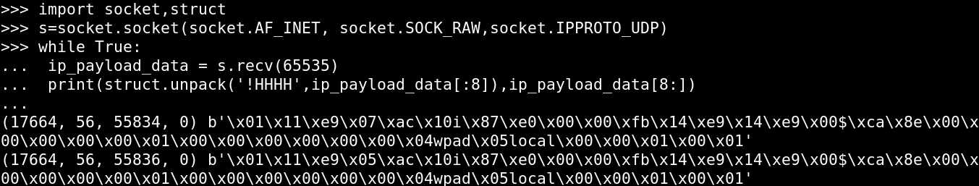
UDP Header Struct
Source Port(2 bytes) | Destination Port(2 bytes)
Total Length(2 bytes) | UDP Checksum(2 bytes)
The UDP header has four uniform 2-byte components and is trivially easy to unpack
= !HHHH
(sport,dport,len,chksum) = struct.unpack(“!HHHH”,ip_payload_data[:8])

Slide 21
ICMP Header Struct
Type(1 byte) | Code(1 byte) | Checksum(2 bytes)
ICMP Data(4 or more bytes)
ICMP is not a very complex structure either
  Type and Code are each 1 byte
  Checksum is 2 bytes
  Data is 4 bytes or more
The TYPE code indicates what kind of ICMP traffic
  If type ==8,then it is a “PING REQUEST”
  If type ==0,then it is a “PING REPLY”
  If type ==3,then it is a “Unreachable” and the contents of the code field say why it can`t be reached
= ?????

Slide 22
Use Regex to Get Data
JPEG(Joint Photographic Experts Group) image is well-defined file format. It has markers throughout the file to indicate blocks of data
Wikipedia has good reference on the JPEG file standard
  https://en.wikipedia.org/wiki/JPEG#The_JPEG_standard
JPEG images start with a hex magic value of \xff\xd8 and end of \xff\xd9
We can use regex to GREEDILY match from \xff\xd8 until \xff\xd9
Def string2jpg(rawstring):
if not ‘\xff\xd8’ in rawstring or not ‘\xff\xd9’ in rawstring:
print(“ERROR : Invalid or corrupt image! ”,rawstring[:100])
return None
jpg = re.findall(r’\xff\xd8 .* \xff\xd9’,rawstring,reDOTALL)[0]
return jpg

Slide 23
Analyzing the Data
You can write a parser and manually interact with the document/artidact
You can use a third-party module to analyze it
  ZIP:pyzip
  PDF:pypdf,pdf-parder.py, PDFMiner
  Office Doc: PyWin32 and COM
  Office Docx:Extract zip and XML
  Media(JPG,MOV):PIL,PyMedia,OpenCV,pySWF
  EXE,DLL:pefile
Find them with PIP!

Slide 24
Installing the PILLLOW Image Package
PILLOW is current maintained fork, It is 100% backward compatible and has new features.
PILLOW is not included with the standard libraries. It must be downloaded and installed.
Free download here:https://python-pillow.org/
Features include:
  READ and WRITE images from disk
  Crop,resize,rotate and otherwise manipulate the images
  Read/write image metadata
  Support multiple image formats include JPG,BMP,TGA, more
pip3 install pillow

Slide 25
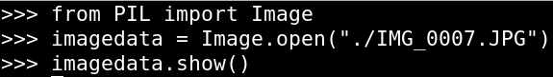
Opening Images with PILLOW
You create a PILLOW image object with the Image.open() method
But, if your images aren`t on a disk? What if they are stores in a variable?
You have two easy options:
  Option1: write the variable to disk and then open it from disk with the PILLOW
  Option2: use the cStringIO.StringIO(Python2) or io.BytesIO and io.StringIO(Python3) libraries to treat the bytes of string as an open file object
Option 2 will be much faster because it doesn`t require any disk IO

Slide 26
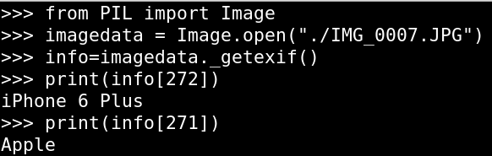
Listing Metadata(1)
Image._getexif() will return a dictionary full of the Exif information that was extracted from the image
The KEYS in the dictionary are EXIF tags
Exif TAGS are standardized integers that are assigned to specific data types
Exif TAG 271 contains the MAKE of the camera
Exif TAG 272 contains the MODEL of the camera
Exif TAG 34853 contains GPS information about the photo!

Slide 27
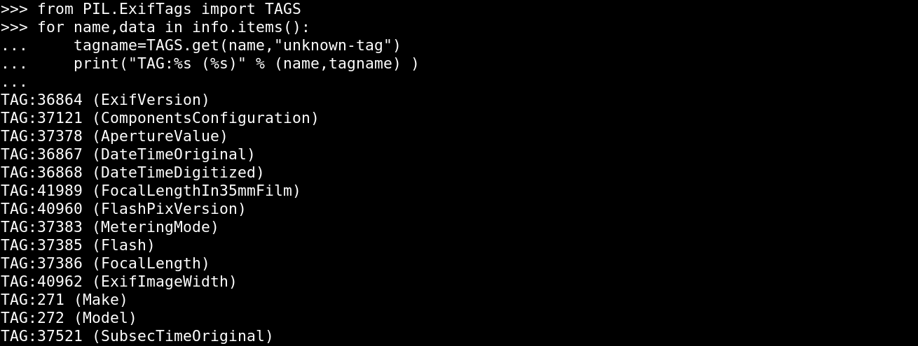
Listing Metadata(2)

Slide 28
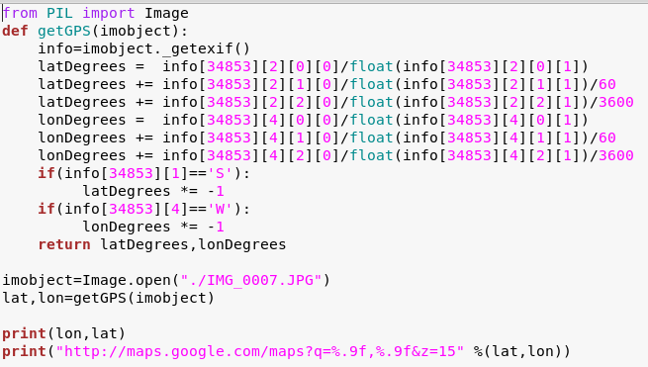
Listing Metadata(2)

Slide 29
Python SQL Database Modules
Python modules exist for most common SQL formats; they enable you to log in and select data directly from the tables in the database
  MySQL; Many including mysql-connector-python, pyMysql,MySQL-Python, and more
  MSSQL:pymssql,pytds
  SQLITE:sqlite3 is built into Python
  Oracle: sqlpython,cx_Oracle

Slide 30
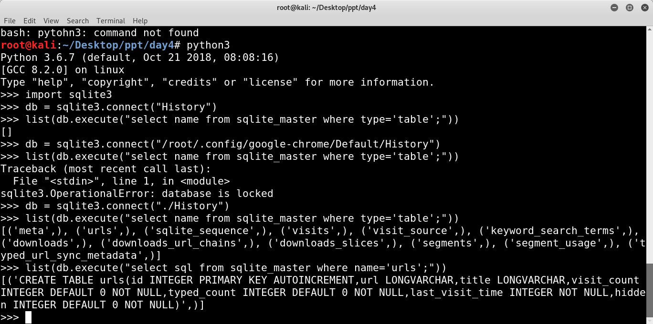
Sqlite3 Connect and Retrieve Table and Column Names
.connect(<path>):Open a file from local drive
.execute(): Run an SQL statement!
  Sqlite3 keeps its schema with table names in sqlite_master
The SQL field has the statement that created the table with the column names

Slide 31
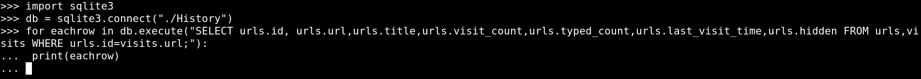
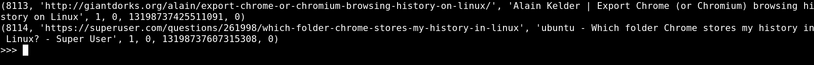
Sqlite3 Query the Record from the Database
Use a for loop to iterate through rows

Slide 32

Steganography

Slide 33





Steganography

Slide 34
Example

Slide 35
Thank you for your attention

