Slide 1
Offensive Python
Socket Essentials
Exception Handling
Process Execution
Python Backdoor

Slide 2
What is a backdoor?
What is a backdoor?
  A backdoor is a method, often secret, of bypassing normal authentication or encryption in a computer system
Exclusive: Secret contract tied NSA and security industry pioneer
  https://www.reuters.com/article/us-usa-security-rsa/exclusive-secret-contract-tied-nsa-and-security-industry-pioneer-idUSBRE9BJ1C220131220

Slide 3
Using TCP/UDP Sockets
Sockets module makes it easy to establish TCP and UDP connections and transfer data
STRUCT and RAW sockets can produce protocols embedded in the IP layer, but that is a lot of work
Resolve hostnames and IP addresses
The sockets.connect(),.send(),.recv(), and .close() are generally what are needed to act as a simple TCP client

Slide 4
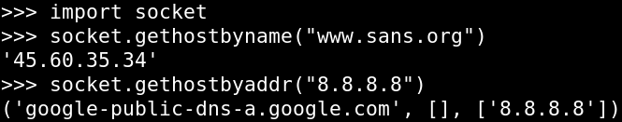
DNS Queries
The Sockets module provides two methods for resolving hosts to IP addresses and vice versa
socket.gethostbyname(hostname): given a hostname, it will return an IP address
socket.gethostbyaddr(ipaddress): Return a tuple containing the hostname , alist of aliases, and a list of address

Slide 5

UDP Sockets
Udpsocket = socket.socket(socket.AF_INET,socket.SOCK_DGRAM)
  AF_INET = IPv4, AF_INET6 = IPv6
  Socket.SOCK_DGRAM = UDP Protocol
  A server uses bind((“<IP ADDRESS>”,port))
  Client or server receives using udpsocket.recvfrom(<bytes>)
  Client or server sends using udpsocket.sendto(<data to send>,(“<IP ADDRESS>”,port))
UDP client sendto() then recvfrom()
UDP server bind() to port, recvfrom(),sendto()

Slide 6
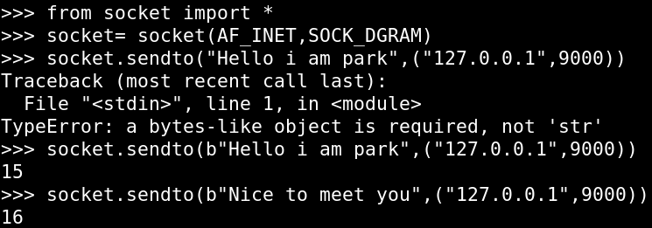
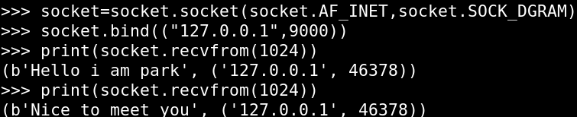
UDP Sockets
Client
Server

Slide 7
TCP Sockets
tcpsocket = socket.socket(socket.AF_INET,socket.SOCK_STREAM)
  AF_INET = IPv4, AF_INET6 = IPv6
  socket.SOCK_STREAM = TCP protocol
  Establishes a socket object to facilitate TCP communications
  Three-way handshake occurs when connect() is called
A socket is a unique SRC IP/Port and DST IP/Port
Syn:seq=HostA-ISN
Syn:Ack: seq=HostB-ISN Ack=HostA-ISN+1
Ack: ACK = HostB-ISN+1
TCP Socket-Unique IP:PORT→ Unique IP:PORT

Slide 8
Establish Connections
Create outbound connections
  socket.connect((<dest ip>,<dest port>))
Accept inbound connections
  socket.bind((<ip>,<port>))
  socket.listen(<number of connections>)
  socket.accept()

Slide 9
Transmitting and Receiving
sockets send and receive bytes
socket.send(“string”.encode(“latin-1”)): Transmits the byte encoded string across the existing socket connection
Socket.recv(max # of bytes).decode(“latin-1”):
Receives up to the specified number of bytes over the existing socket connection
  Possible responses:
    len(recv) ==0 when connection dropped
    Recv() returns data when there is data in the TCP buffer
    Recv() will sit and if there is no data to receive

Slide 10
Socket Essentials
This lab has two parts:
Use netcat to interact whih python3 sockets and discover the nuances of sockets
  Netcat Listener and Socket Client
  Netcat Client and a Socket Server
Write a program that connects outbound to a netcat listener,downloads a file, and prints it to the screen

Slide 11
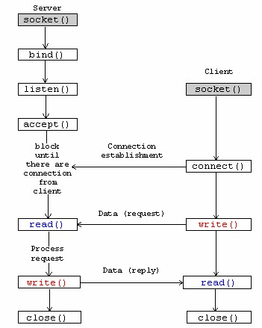
Flowchart(Server & client)

Slide 12
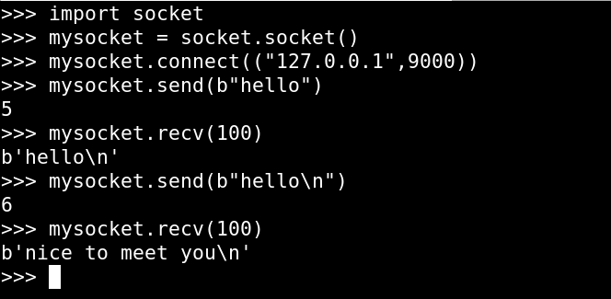
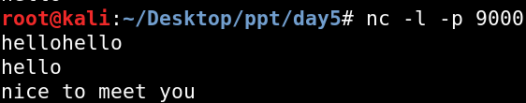
Part 1:Socket Client
STEP2
STEP1
STEP3
STEP4

Slide 13
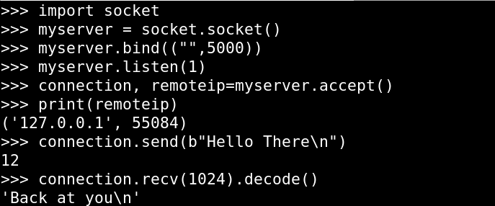
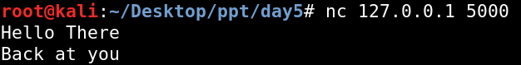
Part 1:Socket Server
STEP1
STEP2
STEP4
STEP3

Slide 14
Part 2:Plant a File on a Target
Your penetration tests require that you plant a file on target systems
Write a script to read from a netcat listener
Client connects out through firewall
Retrieves file and displays it
python3 filegrabberclient.py
Nc -l -p 8000 <./filetoplant.txt

Slide 15
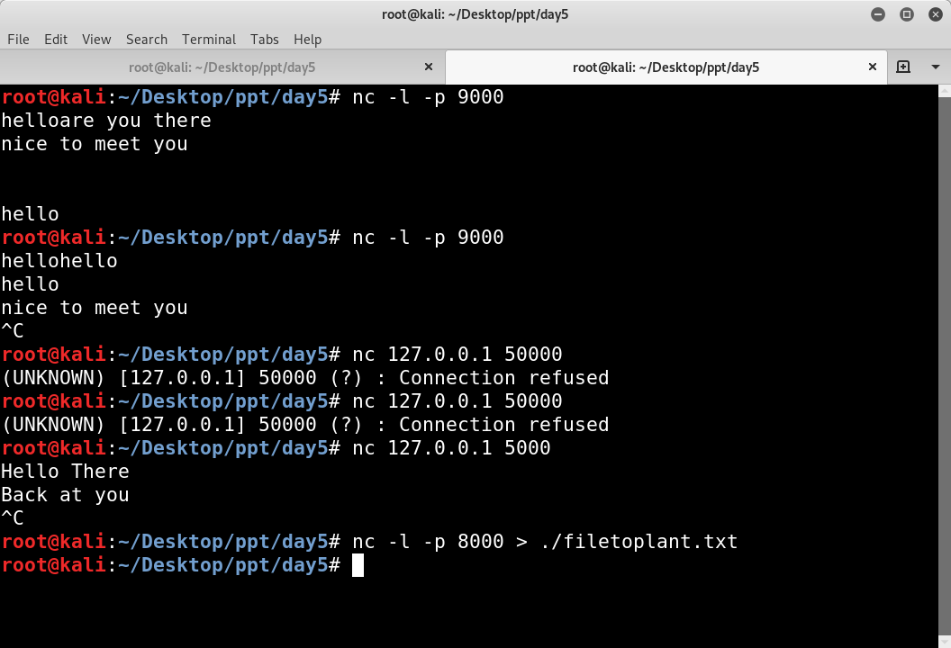
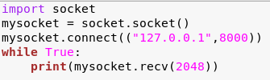
Part 2:Write the Script
Start your favorite text editor and begin writing your Python script

Slide 16
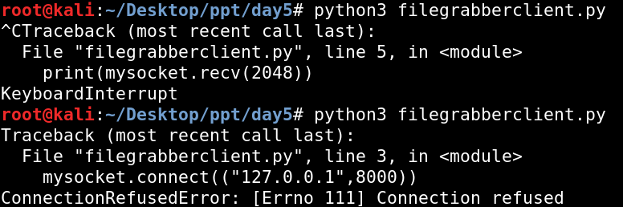
Sample Run of the Script
1.Start netcat
2.Run your script, verify
It transferred you
File, and
press Control -C
2.Run it again. We
still have a problem.
We will fix this next!

Slide 17
Exception Handling
Lots of things could prevent our connection from succeeding
  What if the server we connect to isn`t listening?
  What if a firewall blocks our connection?
We need to detect and gracefully handle these errors
Python provides exceptional exception handling!

Slide 18
Exception Handling(1)
If Pthon encounters an error that it dosen`t know how to handle, it crashes and prints a “traceback”
It is often desirable for us , as developers, to capture that crash and try to handle it ourselves or give a friendly error message to the user
Error handling is don with the keywords ”try” and “except”
try:
print(500/0)
except:
print(“An error has occurred”)

Slide 19
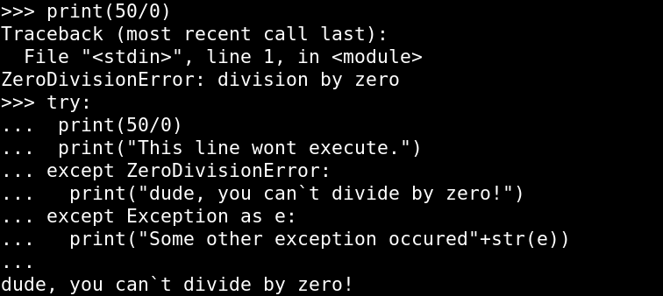
Exception Handling(2)

Slide 20
try/except/else
Try to ipen a URL
That doesn`t exist
try:
urllib2.urlopen(“http://doesntexist.tgt”)
except urllib2.URLError:
print(“That URL doesn`t exist”)
sys.exit(2)
except:
print(“Some error occurred”)
else:
print(“success without error”)
finally:
print(“always do this”)
Specific exception
handler
Generic exception
handler
Do this if it worked
Do this whether it
worked or not

Slide 21
Exception Handling(1)
Now, let`s try to add exception handling to our file grabber client
Try ports 21,22,81,443 and 8000
If a connection fails, try another port until we have a good connection!
Delay one second between each attempt
Import time
time.sleep(number of seconds)

Slide 22
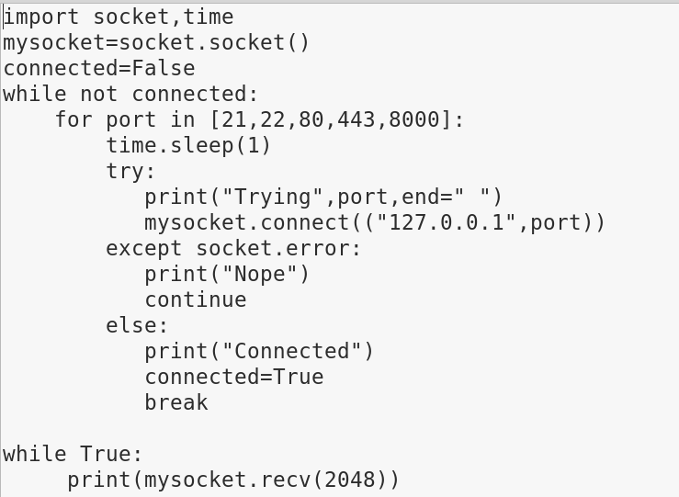
Exception Handling(2)

Slide 23
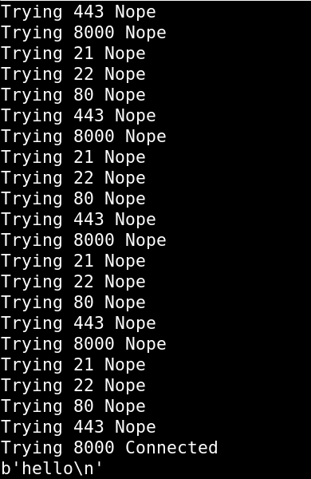
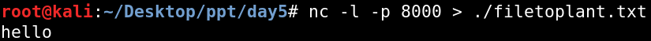
Exception Handling(3)

Slide 24
Process Execution
Interacting with Subprocesses
The subprocesses module supersedes the use of os.system, os.popen,os.popen2, and other modules that support code execution
The subprocess modules enable you to start a new process, provide it input ,and capture the output
processhandle = subprocess.Popen(“run this command”,
shell = True,
stdout = subprocess.PIPE,
stderr = subprocess.PIPE,
srdin = subprocess.PIPE)
procresult = processhandle.stdout.read()
procerrors = processhandle.stderr.read()
returns bytes()

Slide 25
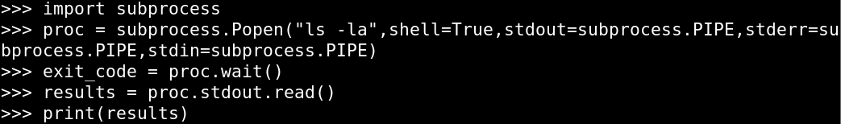
Capturing Process Execution
Execute “ls -la”
And capture output
Wait until it finishes
and capture the exit
code
Read the output of the
command into a string

Slide 26
Popen.wait(),Buffers and Popen.commnuicate()
These three lines are guaranteed to lock up your program:
Why does wait() lock up your program?
  Wait only returns after the program is completely finished
  Popen pauses execution when the stdout read buffer is full
For commands that generate a lot of output use .communicate()
.communicate() returns a tuple of bytes(). The output and the errors.
from sunprocess import Popen,PIPE
ph = Popen(“ls -laR / ”,shell=True,stdin=PIPE,stdout=PIPE,stderr=PIPE)
ph.wait()
from sunprocess import Popen,PIPE
ph = Popen(“ls -laR / ”,shell=True,stdin=PIPE,stdout=PIPE,stderr=PIPE)
output, errors = ph.communicate()

Slide 27
Example
We want modify it

Slide 28
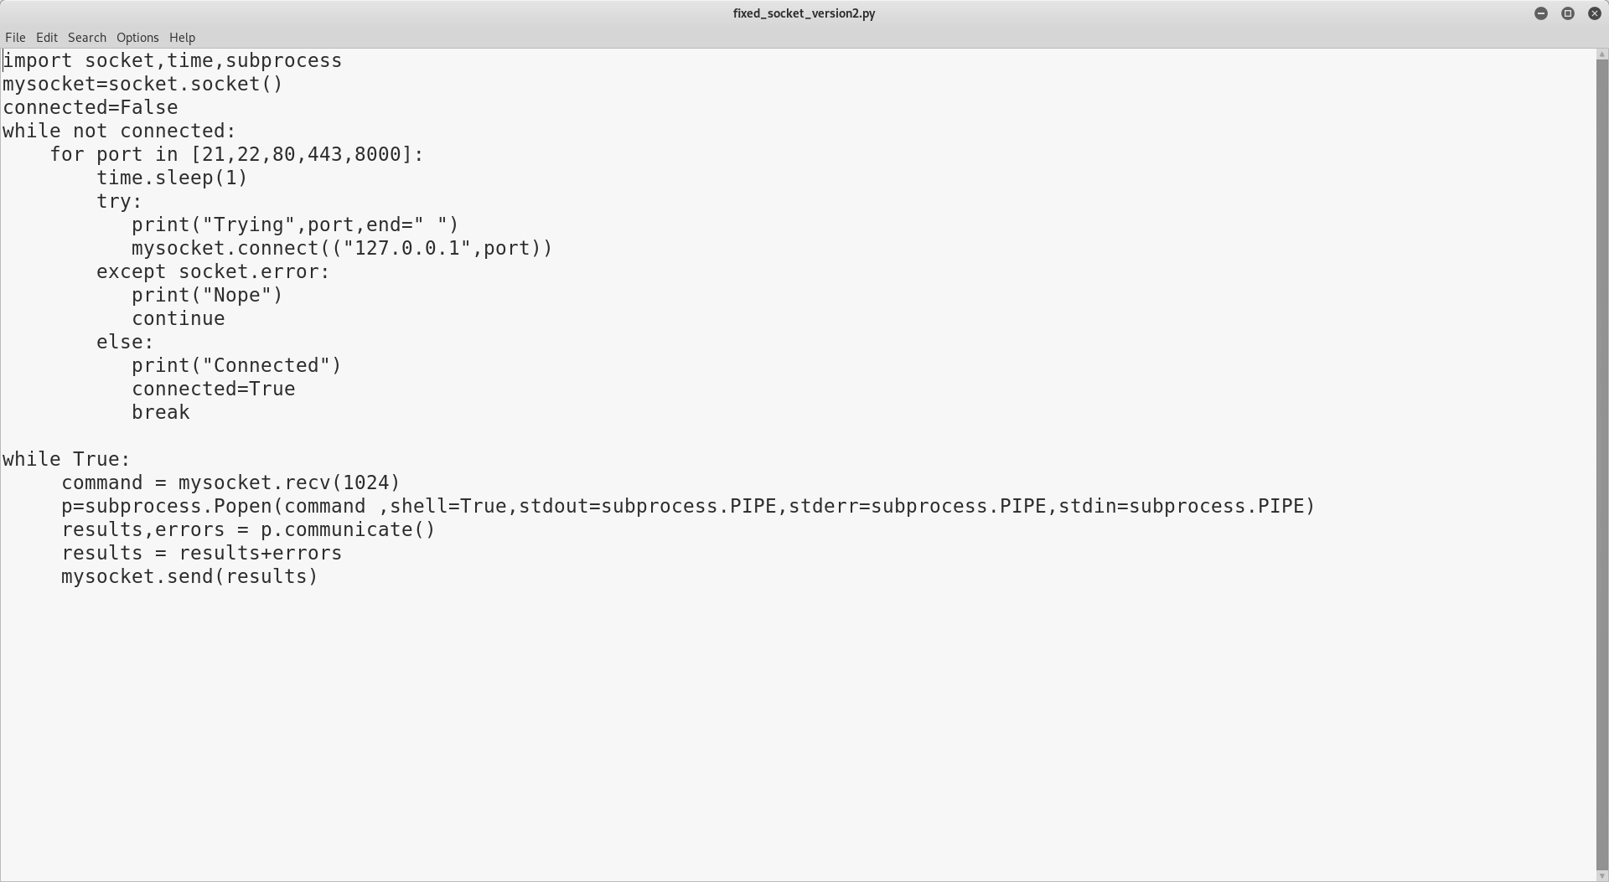
Example

Slide 29
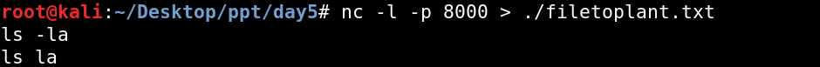
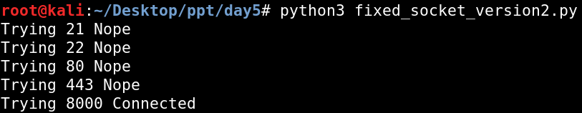
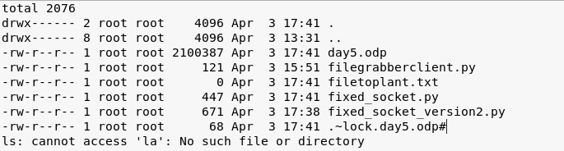
Example

Slide 30
Set command
?

Slide 31
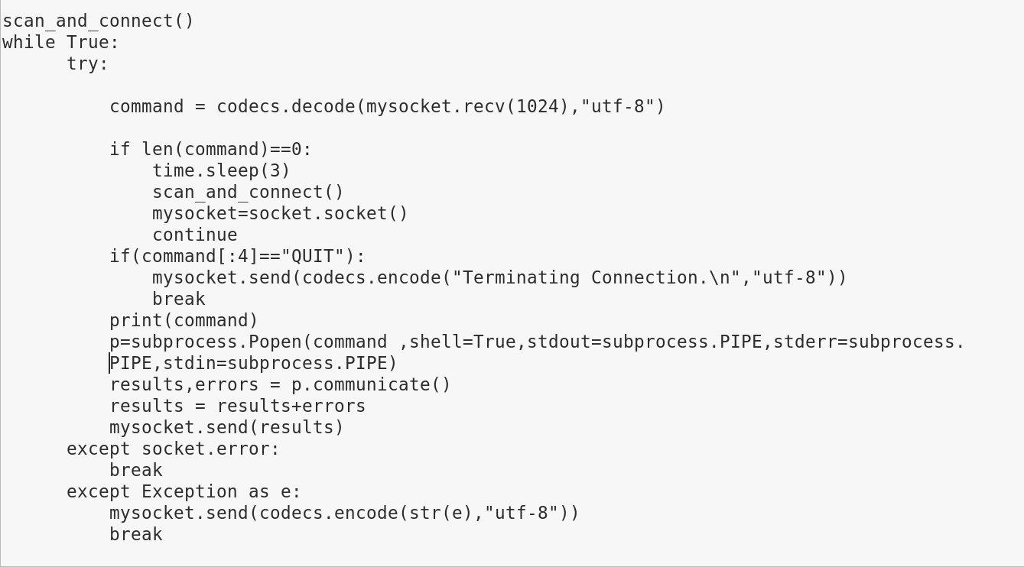
Set command

Slide 32
Python Backdoor
We have a basic backdoor that is a great initial foothold. Use it to disable defenses and then upload additional tools like Meterpreter, Mimikatz,WCE,Incognito,vssown.vbs, and so on
Add upload and download capability to backdoor
  Before we can upload or download, we have to understand the limits of send() and recv()
Understanding send,recv,and sendall

Slide 33
Send(),recv() and sendall
There is a practical limit to what can be received by a single cell to recv()
  Approximate maximum of 32664 bytes with Python2
  Approximate maximum of 984305 bytes with Python3
If you want send all data, you can use sendall()
That is not what is causing problem
The problem is in our recv() function

Slide 34
Why not call recvall()?
Great idea! But it doesn`t exist
It is the responsibility of application to establish a protocol to ensure that all data is transmitted back and forth between the client and the server
Loop through multiple recv() calls and limit each receive to around 8k or 8192
What happens if both sides of the conversation call recv()?
  Each sides sits at .recv() until the other sends
  AKA,DEADLOCK
You have to know when to stop receiving data!
>>> data = “”
>>> while still_transmitting_or_something():
… data += socket.recv(4096)

Slide 35
How to recvall()
Approaches to knowing when to stop recv():
  Fixed bytes:
    Client will transmit one line saying how many bytes to receive
    While the bytes are less than that number, call recv()
  Delimiters:
    Continue to recv() until a predetermined end-of-transmission marker is transmitted by the client
  Timeout-based:
    Turn off “Blocking” sockets and receive until the other side stops transmitting and is silent for some period of time
  select.select():
    Use select.select to see if data is being sent

Slide 36
Option 1:Fixed-Byte Recvall()
Assumes you`re coding both the sender and receiver
Sender has to send the length in exactly 100 bytes followed by data
Receiver receives length in the first 100 bytes and then loops until that amount of data has been received
def mysendall(thesocket,thedata):
thesocket.send(“{0:0>100}”.format(len(thedata)).encode())
return thesocket.sendall(thedata)
100 bytes
def recvall(thesocket):
datalen=int(thesocket.recv(100))
data=b””
while len(data)<datalen:
data+=thesocket.recv(4096)
return data.decode()
The first 100 bytes contain the size

Slide 37
Option 2:Delimiter-Based Recvall()
Your delimiter cannot appear anywhere in your data
If you Base64-encode your data, your data should include only characters A-Z,a-z,0-9,+/=
Sender encodes data and adds the delimiter
Receiver loops until it receives the delimiter, then strips the delimiter off and decodes the data
def mysendall(thesocket,thedata,delimiter=b”!@#$%^&”):
senddata=codecs.encode(thedata,”base64”)+delimiter
return thesocket.sendall(senddata)
def recvall(thesocket,delimiter=b”!@#$%^&”):
data=b””
while not data.endswith(delimiter):
data+=thesocket.recv(4096)
return codecs.decode(data[:-len(delimiter)],”base64”)

Slide 38
Option 3:Timeout-Based Non-Blocking Recvall()
Disadvantage: Speed
  Sockets must wait for timeout period seconds between transmissions
  We are “guessing” that the socket is done based on a time window. May get more than one sendall() in a single call or may get only part of a slow transmission
Advantage: Requires no special coding of the sender
  Sending side doesn`t require knowledge of a special delimiter or encoding
  Sending side doesn`t have to send size of transmission before transmitting

Slide 39
Non-Blocking Sockets
Blocking sockets: Normally, a socket will sit and wait when you call recv() until there is something to receive
Non-blocking sockets do not wait. They return an exception if no data is ready when recv() is called
Possible responses when calling recv():
  len(recv())==0 when connection dropped
  recv() returns data when there is data
  recv() will raise an exception when there is no data to receive

Slide 40
Timeout-Based Non-Blocking
def recvall(thesocket,timeout=2):
data=thesocket.recv(1)
thesocket.setblocking(0)
starttime=time.time()
while time.time()-starttime<timeout:
try:
newdata=thesocket.recv(4096)
If len(newdata)==0:
Break
except:
Pass
else:
data+=newdata
starttime=time.time()
thesocket.setblocking(1)
return data.decode

Slide 41
Option 4:select.select() based recvall
select.select() can be used to see when sockets are ready to recv, send,or are in error
Send it three lists of sockets(the list can have one item)
select.select([sockets],[sockets],[sockets])
Returns three lists of sockets that are ready to receive,send,and in error in that order
def recvall(thesocket,pause=0.15):
data=thesocket.recv(1)
rtr,rts,err=select.select([thesocket],[thesocket],[thesocket])
while rtr:
data+=thesocket.recv(4096)
time.sleep(pause)
rtr,rts,err=select.select([thesocket],[thesocket],[thesocket])
return data.decode()

Slide 42
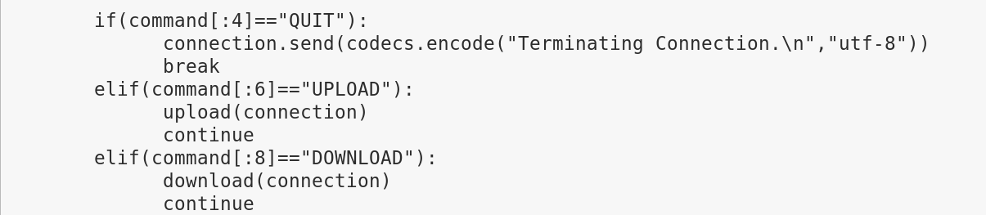
Example
Add Upload or Download
I added the following preprocessor code to call your upload and download functions

Slide 43
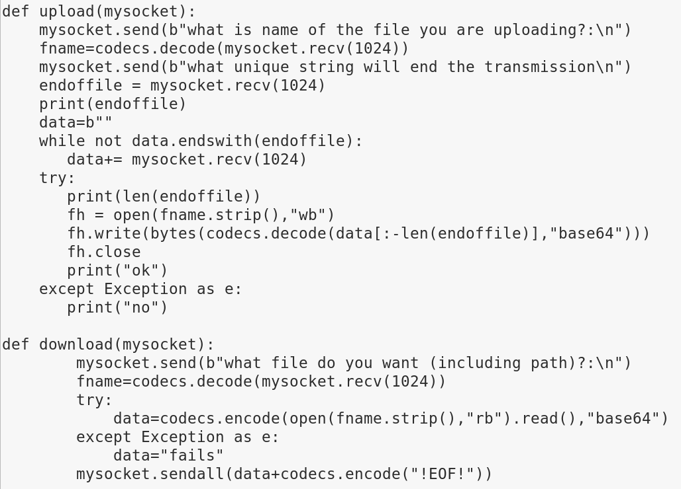
Upload and Download Example(Server)
將資料轉成bytes
將資料轉成str

Slide 44
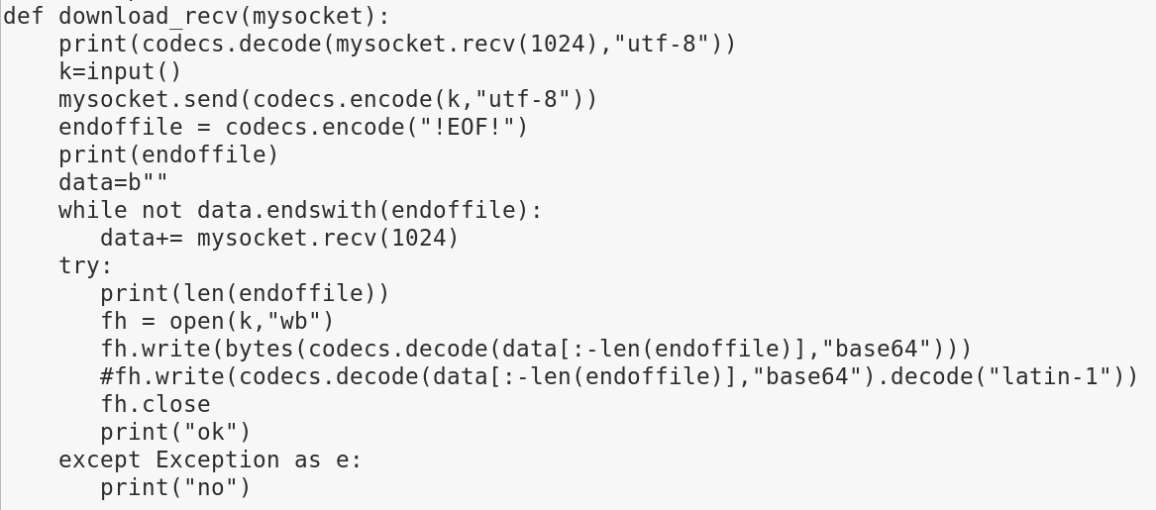
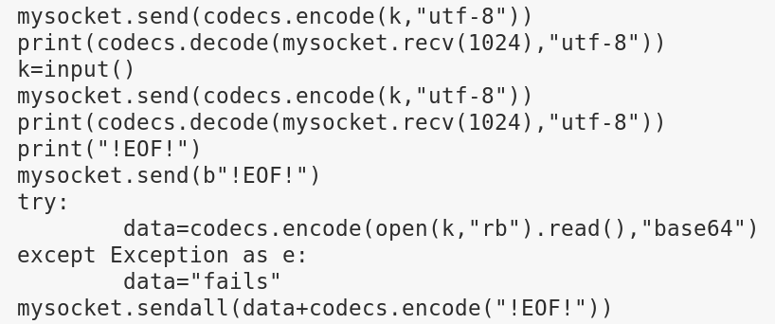
Upload and Download Example(Client)

Slide 45
Capture the flag
搶旗競賽
現場分組（3人或5人,亂數選）
比賽時間4小時
題目共計22道（題目分數1~8分）

Slide 46
Capture the flag
得獎方式
  1.題目全解完
  2第1名隊伍
困難點
  1.所有人沒有互相合作過
  2.題目難易度與CTF一樣
  3.語言隔閡

Slide 47
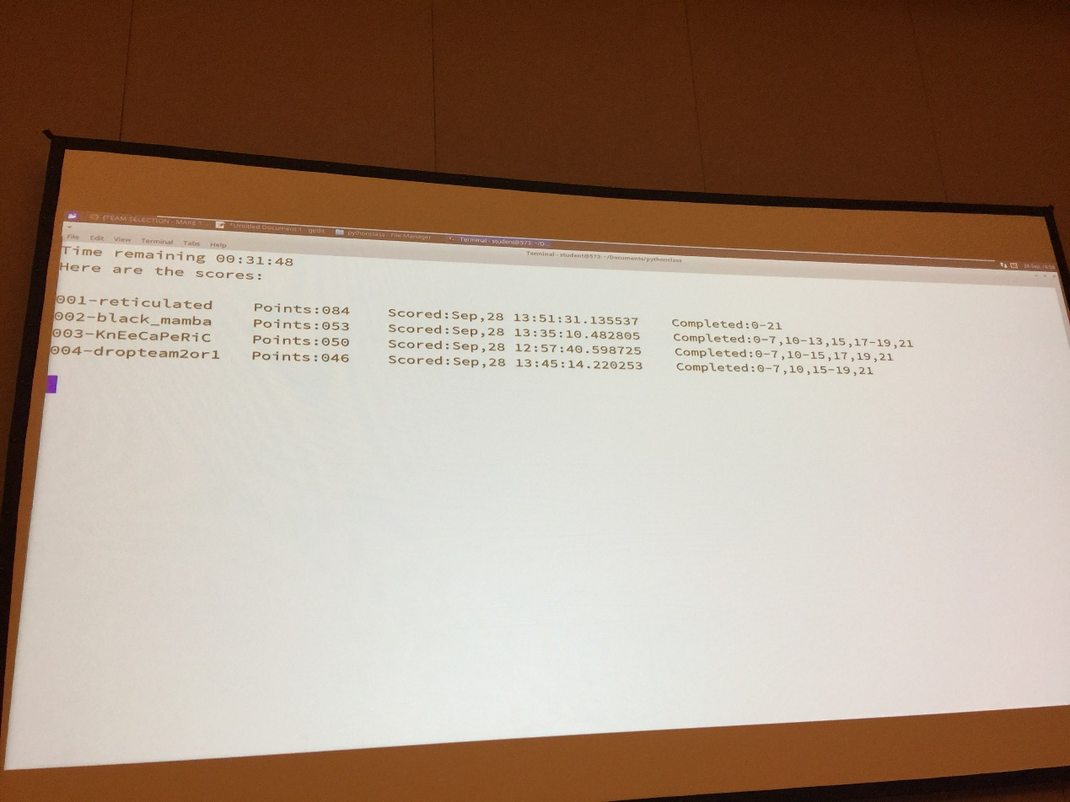
計分版

Slide 48

獎品

Slide 49
心得
拉斯維加斯是一個充滿創意的地方
講師十分幽默，實作經驗豐富
舉手發言或私底下問老師是最好的選擇
“不懂” 不會被瞧不起
不會主動問問題，無法面對自己的不足，才會

Slide 50
Thank you for your attention

