Slide 1
Computer Science beyond the AP Test
Rachel Gardner
Stanford CS Major

Slide 2
About Me
4 years of Westlake CS
Founded Chap Research
Interned at Silicon Labs
Study Computer Science at Stanford

Slide 3
Overview of C/C++
both are “lower level” than Java (closer to the hardware)
C++ is the object-oriented version of C
Important when optimizing for speed or memory (esp. embedded systems)

Slide 4
mainCode.c
math.h
#include <stdio.h>
#include “math.h”
#include “display.h”
int main() {
int result = integerAdd(2,4);
displayInt(result);
printf(“Circumference: ”);
printf(“%f\n”, getCircumference(2));
return 0;
}
#define APPROX_PI 3.14
// returns the sum of two ints
int integerAdd(int x, int y);
// approximates the circumference
double getCircumference(int r);
display.c
#include “display.h”
void displayInt(int x) {
printf("Integer: %d\n", x);
}
math.c
#include “math.h”
int integerAdd(int x, int y) {
return x + y;
}
// returns approximate circumference
double getCircumference(int radius) {
return 2*APPROX_PI*radius;
}
display.h
// prints an int to the console
void displayInt(int x);

Slide 5
Recap
#include
#include “math.h”
note: no semicolon is used!
used to add header files
function prototypes
void functionName(int arg, CustomClass &arg2);
used to outline what a function will be
Why split into .c and .h?
it’s good code! (aka abstraction/decomposition, maintainability)
Notes:
The double quotes are usually used to indicate files in the same directory, or in a special header files directory. Sometimes you will have to be more specific about where the file is, or use <> to indicate it’s a class or language library.

Slide 6
Recap
#define
#define SOME_CONSTANT someValue
note: no semicolon, usually all caps
used to set some program-level constant
Why not just use a variable?
it only changes with each run of the program, if at all

Slide 7
Step 1 - Preprocessor
math.h
#define APPROX_PI 3.14
// returns the sum of two ints
int integerAdd(int x, int y);
// approximates the circumference
double getCircumference(int r);
“mainCode.c”
mainCode.c
/* complicated c source goes here */
int integerAdd(int x, int y);
double getCircumference(int r);
void displayInt(int x);
int main() {
int result = integerAdd(2,4);
displayInt(result);
printf(“Circumference: ”);
printf(“%d\n”, getCircumference(2));
}
#include <stdio.h>
#include “math.h”
#include “display.h”
int main() {
int result = integerAdd(2,4);
displayInt(result);
printf(“Circumference: ”);
printf(“%d\n”, getCircumference(2));
return 0;
}
display.h
// prints an int to the console
void displayInt(int x);
APPROX_PI = 3.14

Slide 8
Step 1 - Preprocessor
math.c
“math.c”
math.h
#include “math.h”
int integerAdd(int x, int y)
{
return x + y;
}
double getCircumference(int radius) {
return 2*APPROX_PI*radius;
}
int integerAdd(int x, int y);
double getCircumference(int r);
int integerAdd(int x, int y)
{
return x + y;
}
double getCircumference(int radius) {
return 2*3.14*radius;
}
#define APPROX_PI 3.14
// returns the sum of two ints
int integerAdd(int x, int y);
// approximates the circumference
double getCircumference(int r);
display.c
“display.c”
#include “display.h”
void displayInt(int x) {
printf("Integer: %d\n", x);
}
display.h
void displayInt(int x);
void displayInt(int x) {
printf("Integer: %d\n", x);
}
// prints an int to the console
void displayInt(int x);

Slide 9
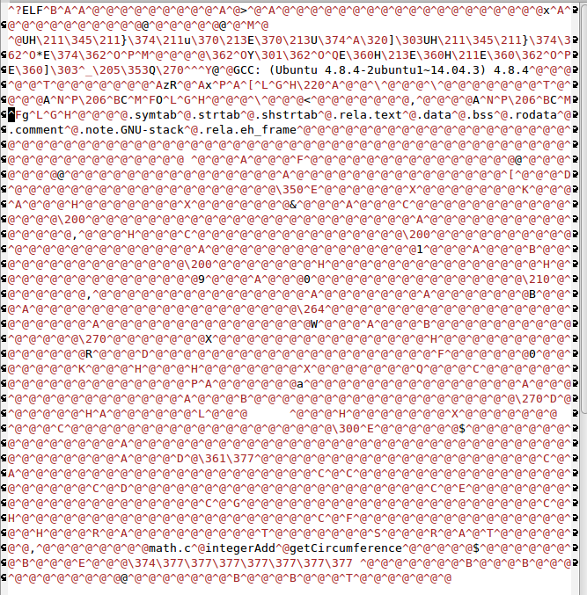
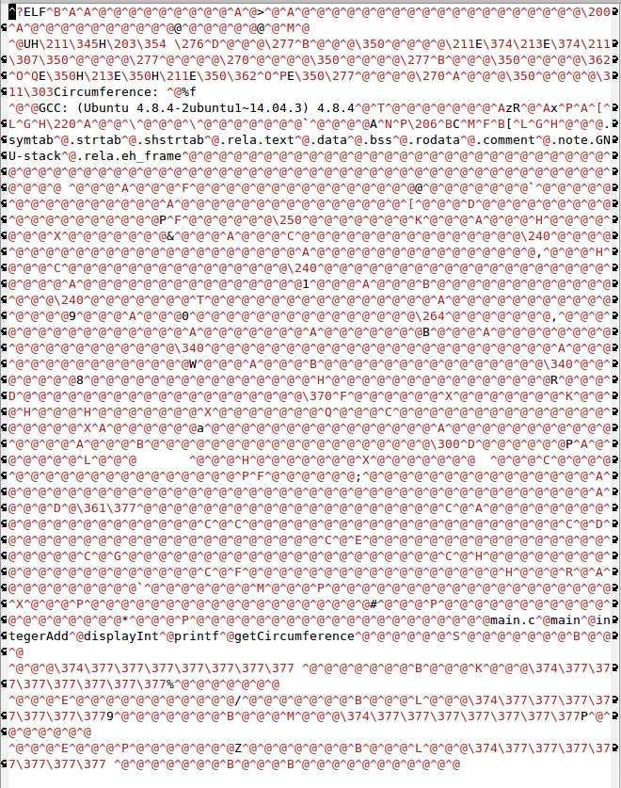
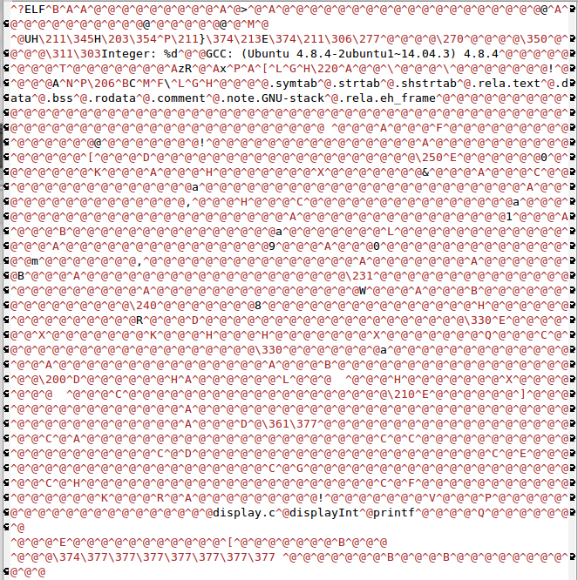
Step 2 - Compilation
“math.c”
math.obj
int integerAdd(int x, int y);
double getCircumference(int r);
int integerAdd(int x, int y)
{
return x + y;
}
double getCircumference(int radius) {
return 2*3.14*radius;
}
“mainCode.c”
mainCode.obj
int integerAdd(int x, int y);
double getCircumference(int r);
void displayInt(int x);
/* complicated c source goes here */
int main() {
int result = integerAdd(2,4);
displayInt(result);
printf(“Circumference: ”);
printf(“%d\n”, getCircumference(2));
return 0;
}
display.obj
“display.c”
void displayInt(int x);
void displayInt(int x) {
printf("Integer: %d\n", x);
}

Slide 10

Step 3 - Linking
math.obj
mainCode.obj
[library code]
output.exe
display.obj
8.7kB
Notes:
note: library code is random; none of the other ones are
also, this PPT is nearly 900 kB (for perspective)

Slide 11
Full Process
.c
preprocessor
compiler
linker
“.c”
.obj
.exe
.h
OUTPUT
Integer: 6
Circumference: 12.560000

Slide 12
Recap
Preprocessor
handles “#” directives and removes comments
Compiler
“compiles” final code into machine code
Linker
“links” all object (usually .obj) files together
manages dependencies
build system
combination of preprocessor/compiler/linker for your target
declaration order is important!

Slide 13
Recap
Note: there are different ways of doing this!
mainCode.c
mainCode.c
#include “math.h”
void displayInt(int result) {
printf("Integer: %d\n", x);
}
int main() {
int result = integerAdd(2,4);
displayInt(result);
printf(“Circumference: ”);
printf(“%d\n”, getCircumference(2));
return 0;
}
#include “math.h”
void displayInt(int result);
int main() {
int result = integerAdd(2,4);
displayInt(result);
printf(“Circumference: ”);
printf(“%d\n”, getCircumference(2));
return 0;
}
void displayInt(int result) {
printf("Integer: %d\n", x);
}

Slide 14
C++ Objects
C++ objects look weird, but they are a lot like Java
customClass.h
customClass.cpp
CustomClass {
public:
CustomClass(int arg);
int someFunction();
private:
void otherFunction();
String otherVariable;
char someVariable;
};
#include “customClass.h”
CustomClass::CustomClass(int arg) {
// constructor
}
int CustomClass::someFunction() { // do something
}
void CustomClass::otherFunction() {
// do something else
}
[Calling Code]
CustomClass newObj(4);
newObj.someFunction();

Slide 15
Pointers
C++ Code
Memory
int number = 8;
Point p;
p.x = 7;
p.y = 12;
cout << number << endl;
cout << &number << endl;
int *ptr = &number;
cout << ptr << endl;
cout << &ptr << endl;
cout << *ptr << endl;
number
 | 0x123456
 | 0x123458
 | 0x12345B
 | 0x12345E
8
p.x
7
p.y
12
ptr
0x123456

Slide 16
Recap
&
&variable
used to give the address for a variable
*
*variable
used to dereference a pointer (in order to give its value)

Slide 17
Use Case
Linked Lists (among many others)
Node {
int data;
Node* next;
}
Node {
int data;
Node* next;
}
Node {
int data;
Node* next;
}

Slide 18
High School CS vs College/Industry CS
Good code is important!
Style guides are provided
Code reviews are mandatory
Starting from scratch
You make design/implementation decisions
Working in groups
College classes have partners, industry has whole divisions
Large code bases
Source control systems are essential

Slide 19
Is it hard?
No
If you don’t get it, keep trying
“CS is not a competitive sport”
Ready for an internship after taking one CS class
Fundamentals are essential
you can get away with only half-understanding them or forgetting them
Classes don’t teach you everything anyway

Slide 20
(Some) Areas of CS
Web development (back-end and front-end)
Server management, databases
App development
Artificial intelligence (including deep learning)
Computer vision and graphics
Networking
Biocomputation
Human-Computer Interaction
Theory
Data science
Robotics
Cybersecurity and cryptocurrencies
Computer engineering
Embedded development (IoT, wearables)
Game development
PC software
Other applications
Notes:
bonus points if you find one I forgot

Slide 21
Internships
Silicon Labs: Jason.Savage@silabs.com & austem.org
Start getting your resume out there!

Slide 22
Questions?
Ask me anything!

