Slide 1
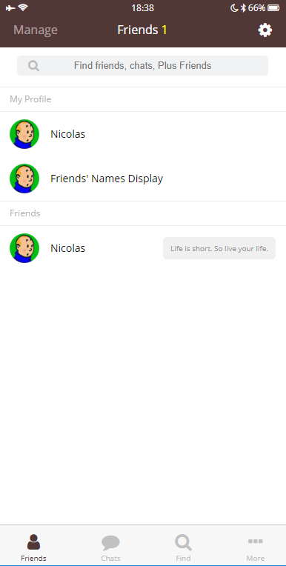
<header .top-header>
.top-header
→ position: fixed
→ top: 0
→ width: 100%
.friends__section-row
→ display: flex
→ align-items: center
<div .header__top>
<div .header__bottom>
<div .search-bar>
.header__top, header__bottom
→ dispaly: flex
→ flex-direction: row
→ justify-content: space-between
.friends__section-column
→ display: flex
→ justify-content: space-between
<section .friends__section >
.header__column
→ width: 33%
<div .friends__section-header>
<div .friends__section-rows>
.header__column:last-child
→ text-align: right
<div .friends__section-row>
.header__column:nth-child(2)
→ text-align: center
<section .friends__section >
.tab-bar
→ position: fixed
→ bottom: 0
→ display: flex;
→ justify-content: spapce-between
→ width: 100%
<section .friends__section-column >
<main .friends>
.tab-bar__tab
→ display: flex
→ flex-direction: column
→ align-items: center
<div .header__column>
.search-bar
→ position: relative (돋보기 아이콘 → position: absolute)
.search-bar input
→ box-sizing: border-box
→ width: 100%
→ padding: 5px 7px
<nav .tab-bar>
<a .tab-bar__tab .tab-bar__tab--selected>

