Slide 1
STOL 항공기의 공력 및 성능 연구
박세환
한화에어로스페이스

Slide 2
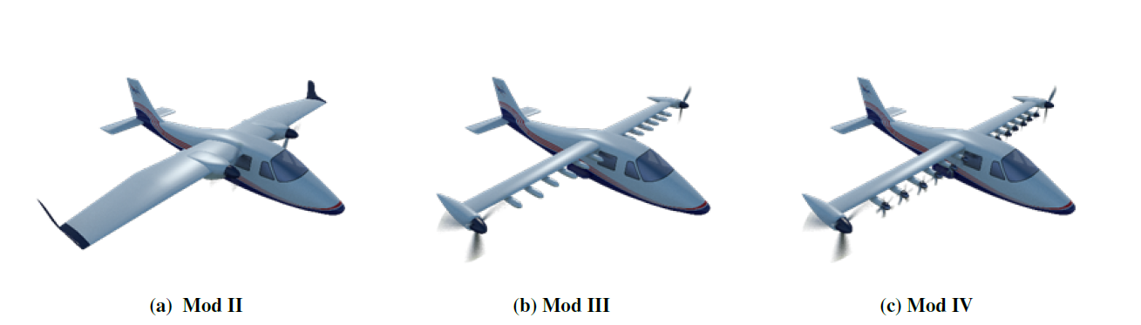

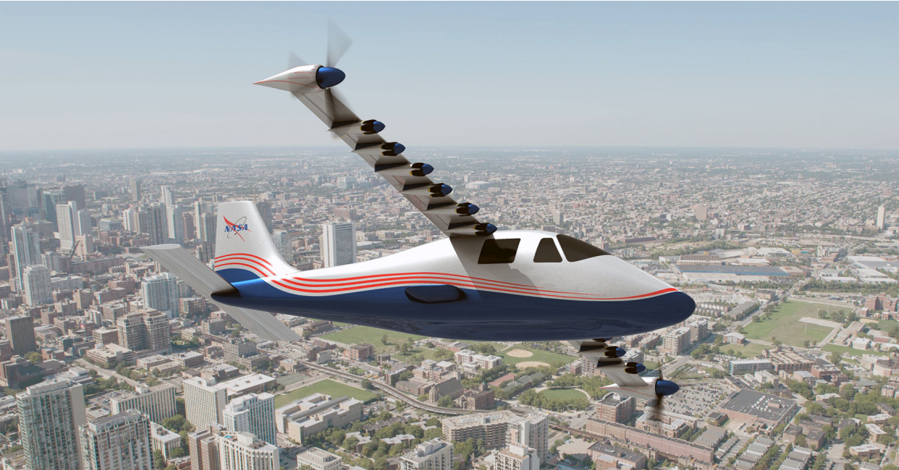
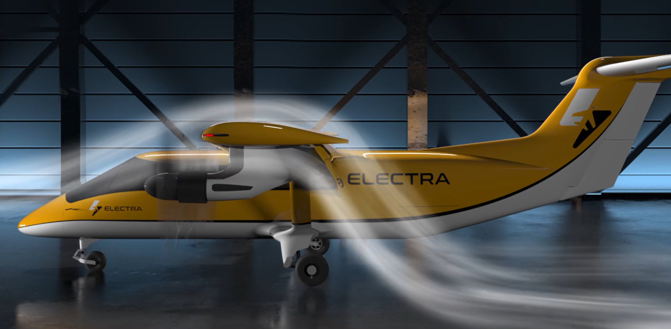
Introduction
Blown-Lift Wing
  NASA X-57 Maxwell
    Leading Edge Asynchronous Propeller (LEAP) Technology
  Electra Aero
    Ultra STOL Aircraft with 150 ft Ground Roll

Slide 3
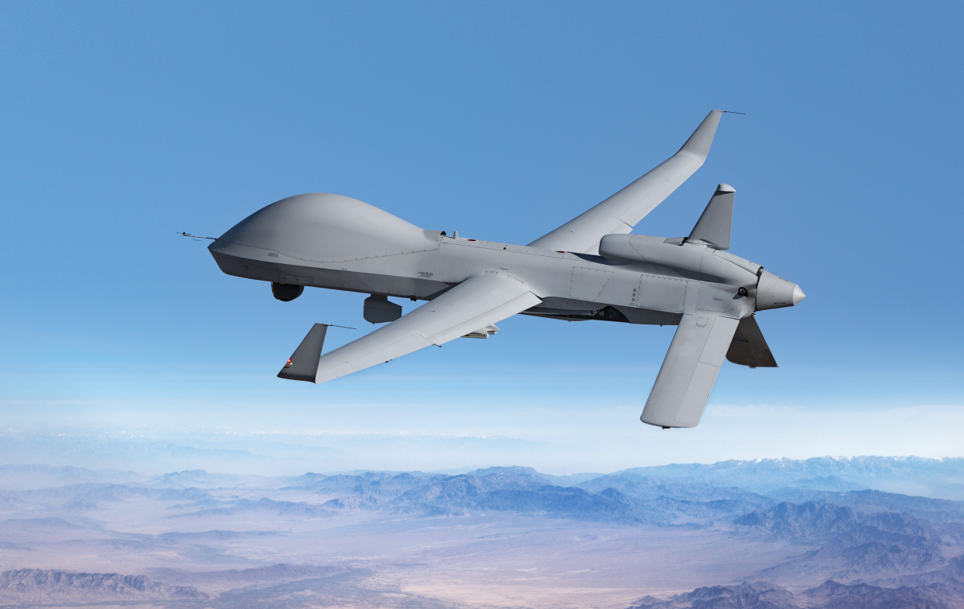
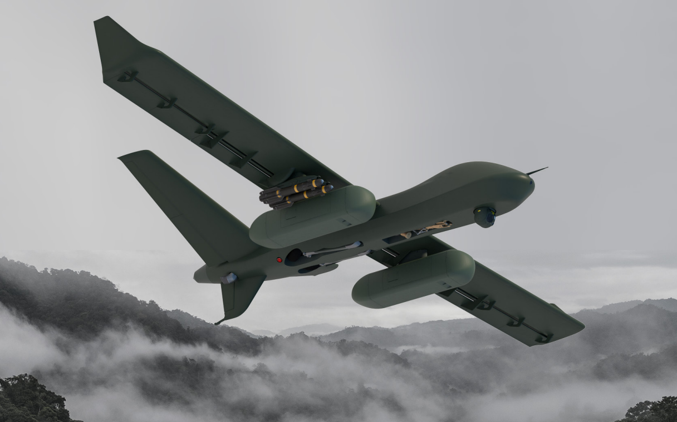
Introduction
Short Takeoff and Landing (STOL)
  Gray Eagle 25M
    200-HP Heavy Fuel Engine 2.0
    Maximum Gross Takeoff Weight: 4,200 lb
    Maximum airspeed: 167 kts
  Mojave STOL
    Rolls Royce M250 (450 SHP)
    Maximum Gross Takeoff Weight: 7,000 lb
    Maximum airspeed: 140 kts
    Takeoff Distance: 400 – 1,000 ft

Slide 4
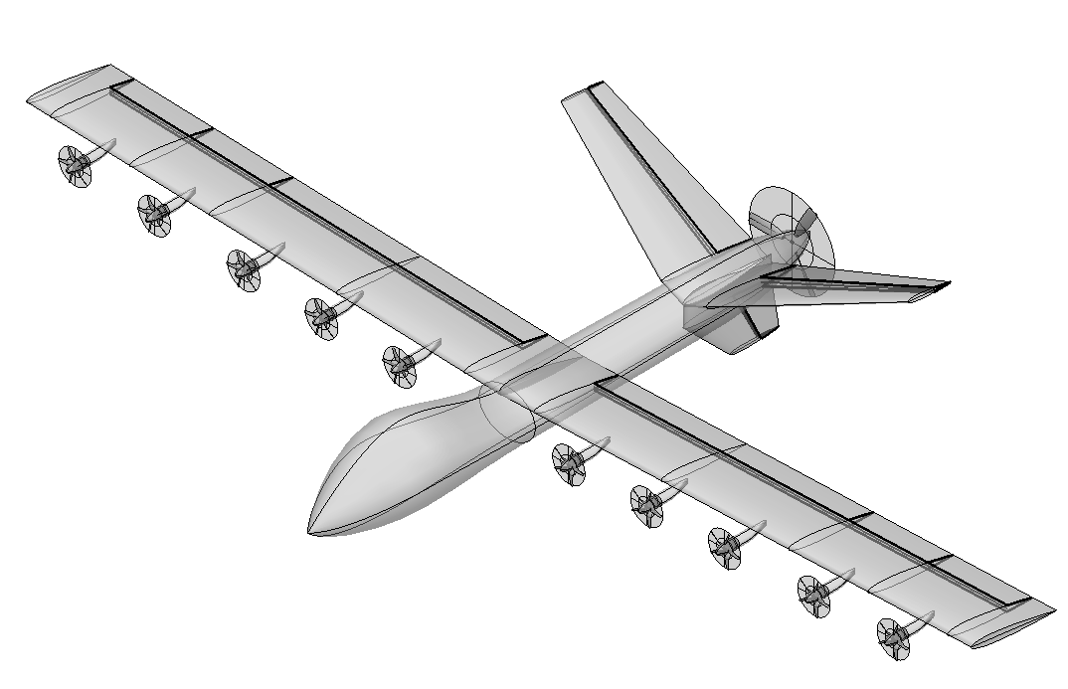
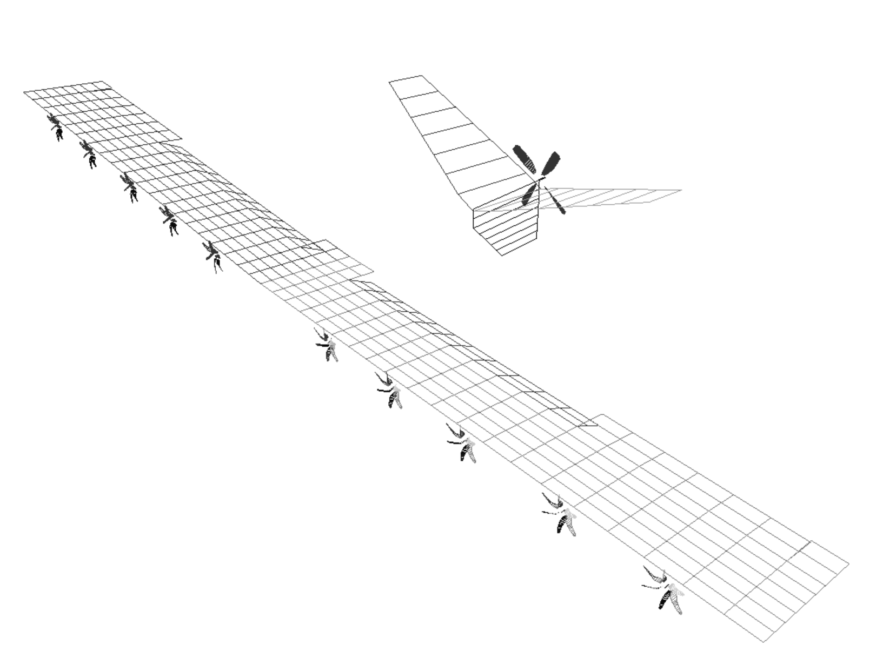
Aerodynamic Modeling
Wing Modeling
  Vortex Lattice Method
  Flap/Aileron Surface Deflected
Wake Modeling
  Free-wake
  Constant Vorticity Contour Wake Model
Automation
  OpenVSP-to-CHARM process
  CHARM Run/Post-Process
OpenVSP Model
CHARM Model

Slide 5
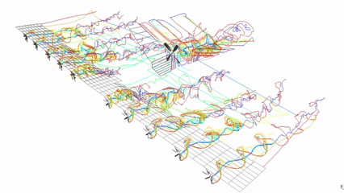
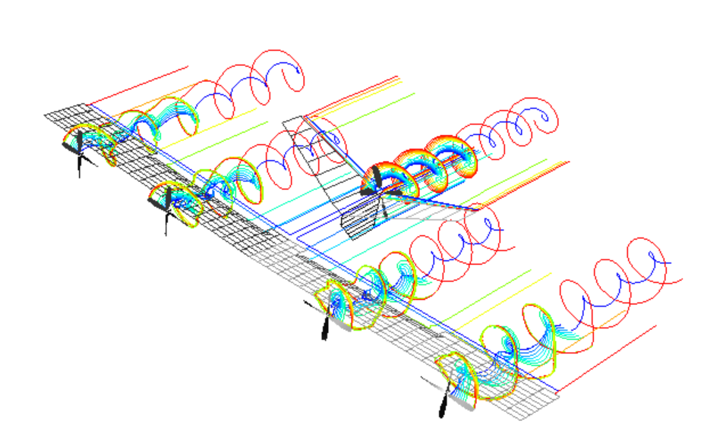
Aerodynamics Analysis
Blown-Lift Effect
CaseID |  | Small Prop | Large Prop | delta CL | CL Multiplier
000 | Flap 0 deg, Aileron 0 deg | - | - | -0.66 | 0.60
001 | Flap 30 deg, Aileron 10 deg | - | - | - | 1.00
002 |  | Inboard/Outboard | - | 0.12 | 1.07
003 |  | Inboard | - | 0.10 | 1.06
004 |  | Outboard | - | 0.00 | 1.00
005 |  | - | Inboard/Outboard | 0.59 | 1.36
006 |  | - | Inboard | 0.46 | 1.28
007 |  | - | Outboard | 0.18 | 1.11

Slide 6












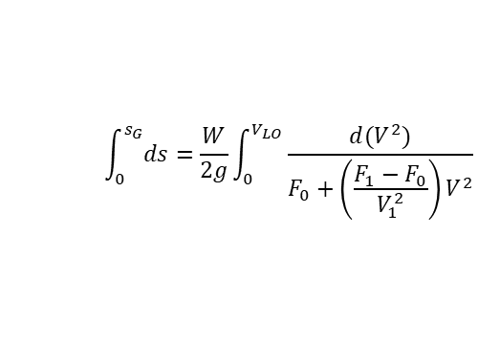


Takeoff Performance
Ground Roll Distance
Airborne Distance
  Transition
  Remaining Climb
$$F_{a}=T−D−μ(W−L)$$
$$R=\frac{V_{TR}^{2}}{g(n_{TR}−1)}$$
$$γ=\sin^{−1}\left(\frac{T−D}{W}\right)$$
$$\frac{W}{g}\left(\frac{dV}{dt}\right)=\frac{W}{g}\left(V\frac{dV}{ds}\right)=F_{a}$$
$$ds=\frac{Wd(V^{2})}{2gF_{a}}$$
$$F_{a}=F_{0}+\left(\frac{F_{1}−F_{0}}{V_{1}^{2}}\right)V^{2}$$
$h_{TR}=R(1−cosγ)$ altitude gained during transition
$$V_{LO}=1.1 V_{stall} (Liftoff Speed)$$
$$F_{0}=T−μW$$
$s_{TR}=Rsinγ$ horizontal transition distance
$$F_{1}=T−D$$
$$\int_{0}^{s_{G}}{ds}=\frac{W}{2g}\int_{0}^{V_{LO}}{\frac{d(V^{2})}{F_{0}+\left(\frac{F_{1}−F_{0}}{V_{1}^{2}}\right)V^{2}}}$$
$$h_{C}=50ft−h_{TR}$$
$$s_{C}=\frac{50−h_{TR}}{tanγ}$$
$$s_{G}=\frac{W}{2g}\left(\frac{V_{LO}^{2}}{F_{1}−F_{0}}\right)ln\frac{F_{0}}{F_{1}}$$
$$s_{TO,50}=s_{G}+s_{TR}+s_{C}$$
Source: Pamadi, B., Performance, Stability, Dynamics, and Control of Airplanes, 2015

Slide 7

Takeoff Performance
Runway Condition
  Unbraked $μ$
    Paved Runway: 0.025 for Dry (Source: MIL-STD-3013B)
    Semi-Prepared: 0.040 for Firm Dirt (Source: Raymer, 0.05 for hard turf, 0.04 for firm dirt, 0.07 for soft turf)
    Martime: 0.050 for Wet (Source: MIL-STD-3013B)
250 ft
Ground Roll Distance

Slide 8

Takeoff Performance
Runway Condition
  Unbraked $μ$
    Paved runway: 0.025 for Dry (Source: MIL-STD-3013B)
    Semi-prepared: 0.040 for Firm Dirt (Source: Raymer, 0.05 for hard turf, 0.04 for firm dirt, 0.07 for soft turf)
    Martime: 0.050 for Wet (Source: MIL-STD-3013B)
250 ft
50ft Clearnace Takeoff Distance

Slide 9

Takeoff Performance
Altitude Effect
  Variations in air density and engine available power with altitude were considered
    $SHP=SHP_{c}δ\sqrt{ θ}$ where $δ=p/p_{0}$ and $θ=T/T_{0}$
250 ft
Altitude effect on ground roll distance

Slide 10
Landing Performance
Landing Distance Analysis
  Numerical integration of deceleration from touchdown to stop
  Aerodynamic drag, wheel braking, rolling resistance, and reverse thrust considered
  Tire–runway friction, brake-force limit, and landing-gear load transfer accounted for
  Runway-condition-dependent friction coefficients applied
250 ft
Landing Distance

Slide 11
Rejected Takeoff Distance
Rejected Takeoff
  Phase 1 – Acceleration
  Phase 2 – Recognition/Transition
  Phase 3 – Braking

Slide 12
Conclusion
Summary
  High-lift propeller was adopted to increase the maximum lift coefficient
  Blown-lift effects were captured using medium-fidelity aerodynamic simulations
  Predicted blown-lift effects were incorporated into takeoff and landing performance analysis
  Improved low-speed performance demonstrated the potential of distributed high-lift propulsion for STOL operations
Future Works
  Optimization of high-lift propeller location, geometry, and operating conditions
  Wing chord/area reduction leveraging blown lift to improve cruise efficiency and maximum-speed capability
  Assessment of high-lift prop system weight penalty and its impact on overall aircraft performance

