Slide 1
Analysis of the East Asian Air Transportation Network
Using R iGraph package

Slide 2
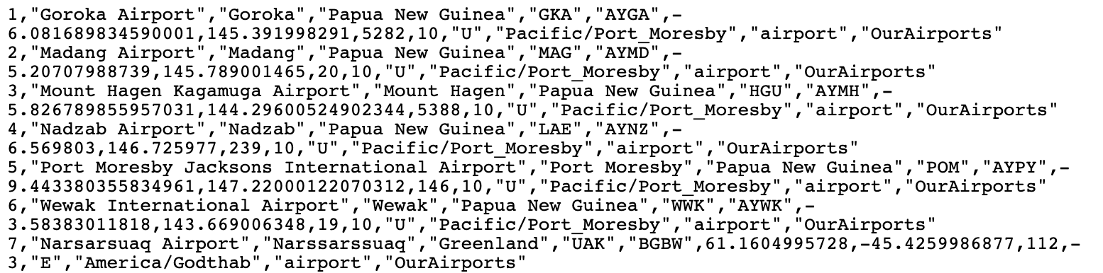
Data Format: airports.dat
airport ID, name, city, country, IATA, ICAO, latitude, longitude, altitude, timezone, DST, timezone, type, source
Data retrieved from OpenFlights (https://openflights.org/data.html)

Slide 3
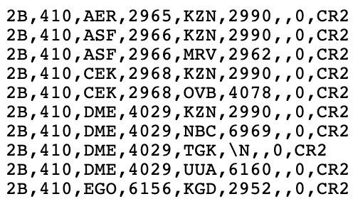
Data Format: routes.dat
airline, airline ID, source airport, source airport ID, destination airport, destination airport ID, codeshare, stops, equipment
Data retrieved from OpenFlights (https://openflights.org/data.html)

Slide 4
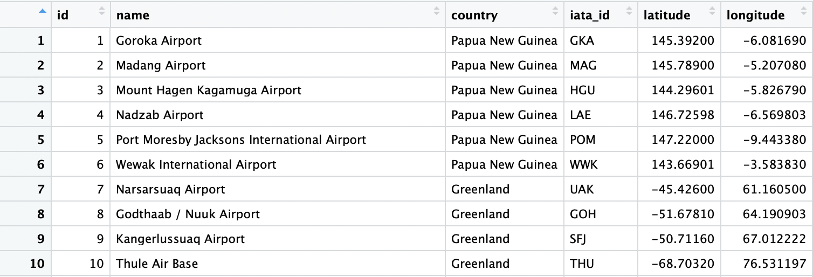
Data Preprocessing: airports.dat
Store only the necessary columns

Slide 5
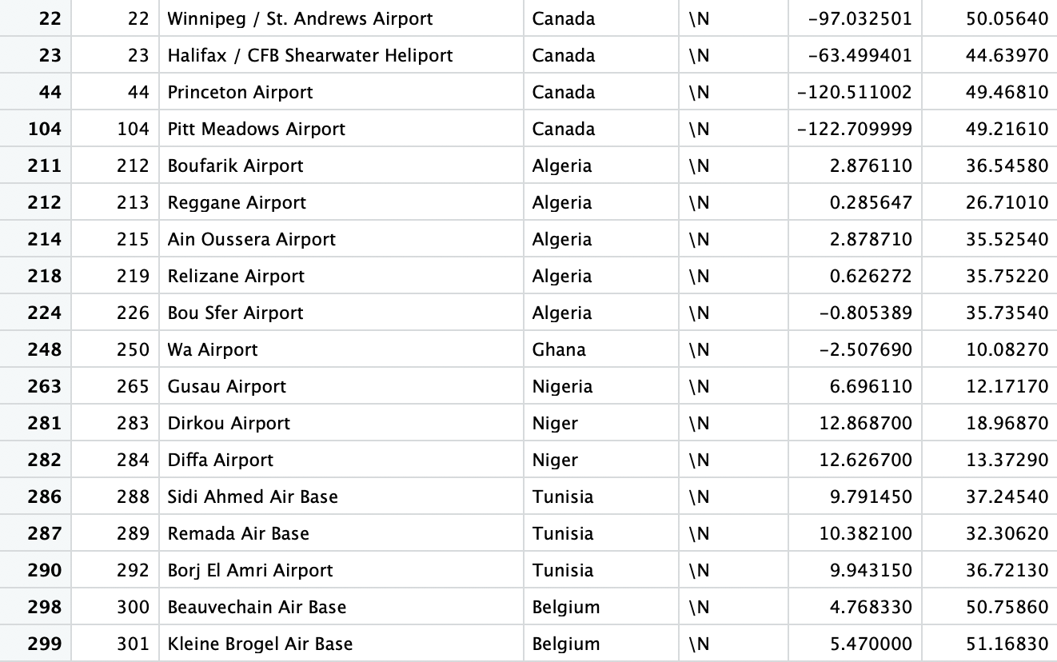
Data Preprocessing: airports.dat
Delete all rows without a valid IATA code (regional airports / air force base)

Slide 6
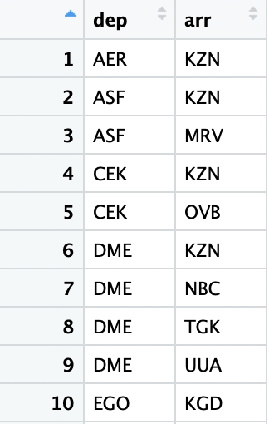
Data Preprocessing: routes.dat
Store only the necessary columns

Slide 7

Data Preprocessing: routes.dat
Delete routes whose origin/destination airports do not appear in airports.dat
Most are routes insignificant in the overall network

Slide 8
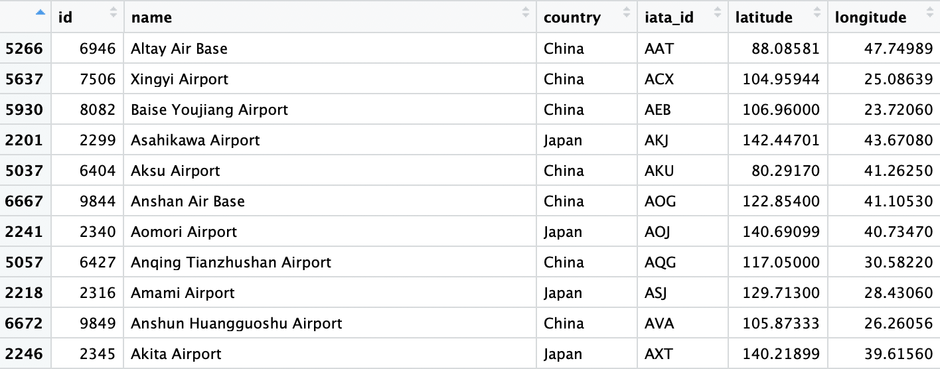
Data Preprocessing
Extract data from the East Asian region
South Korea, Chinese mainland, Japan, Taiwan, Hong Kong, Macau

Slide 9
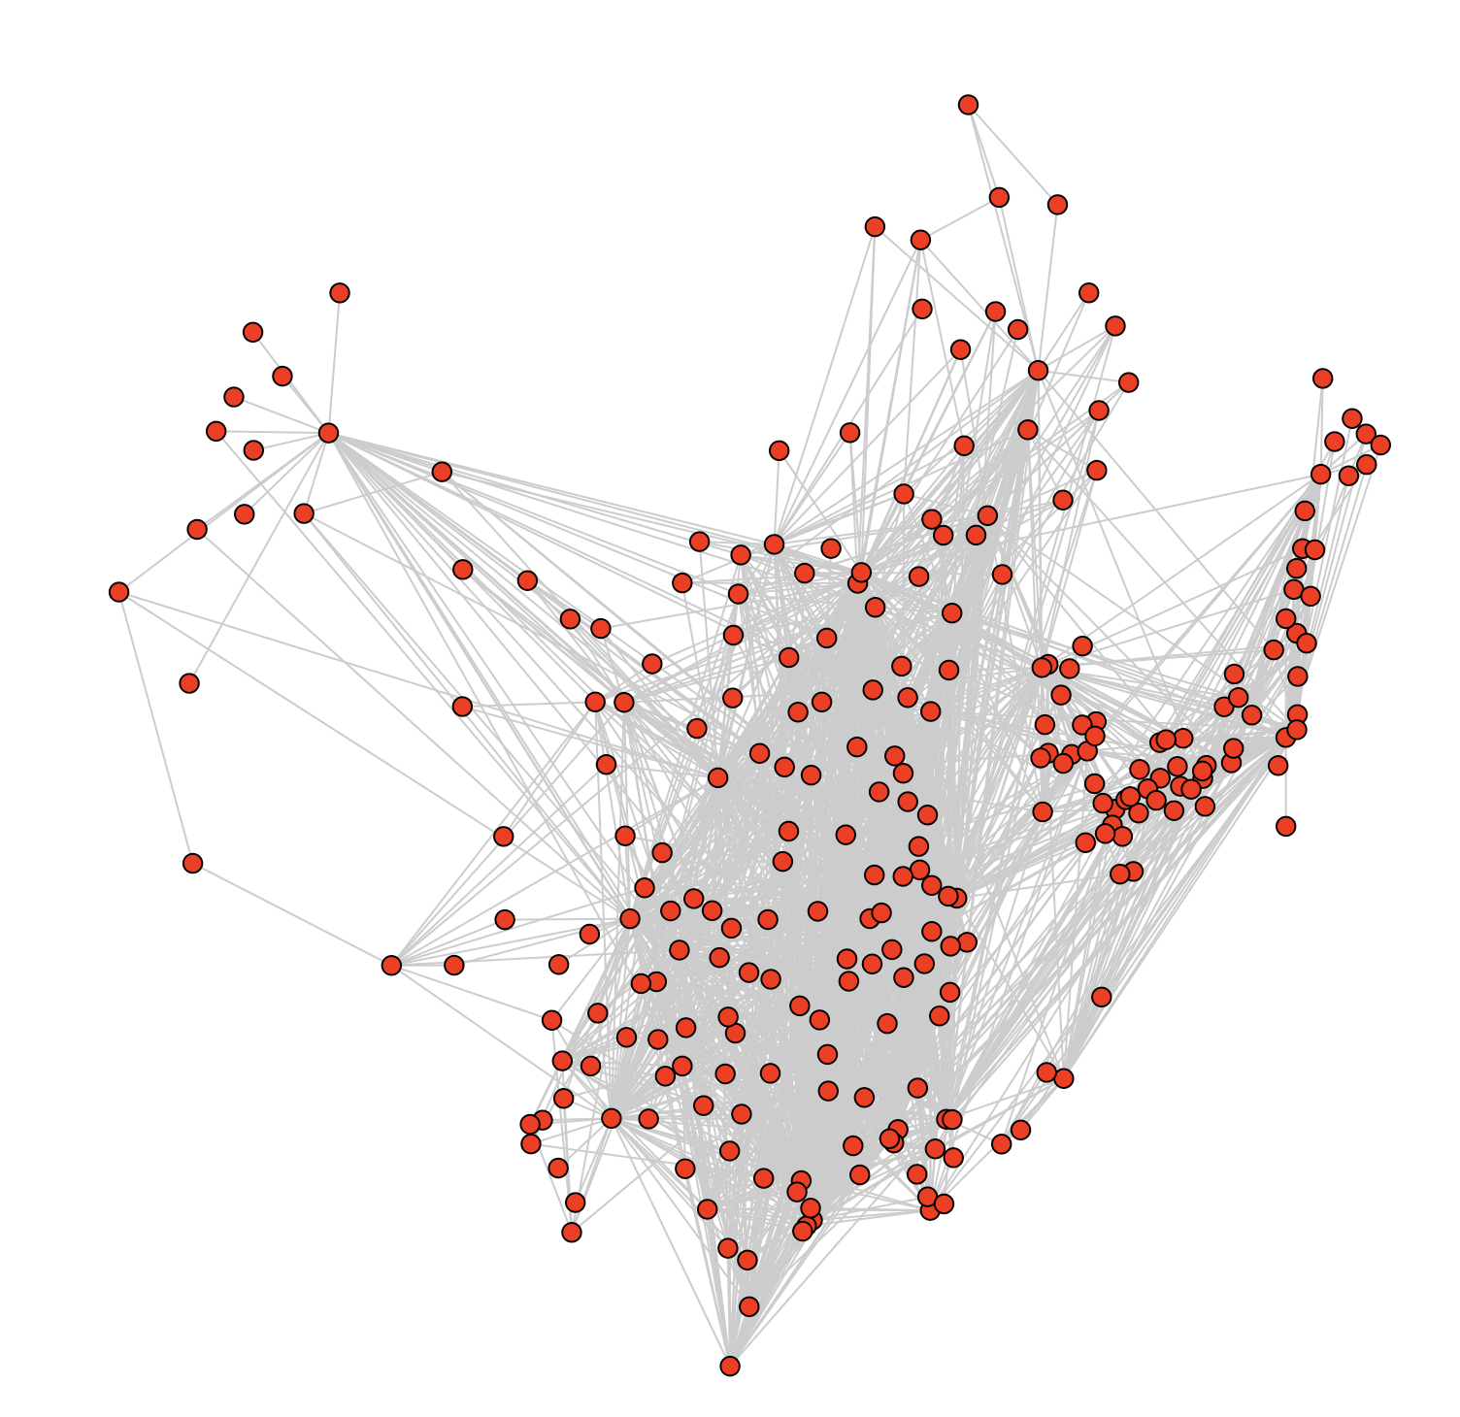
Network Analysis
Use the iGraph package to generate a graph model of the ATN

Slide 10
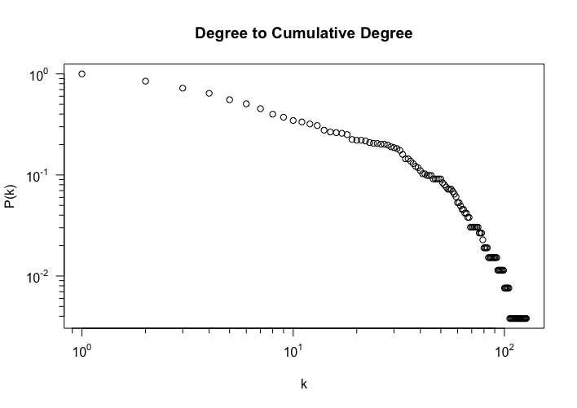
Network Analysis
Degree distribution follows a truncated degree distribution
Similar to “Robustness of the air transport network (Lordan, 2014)”

Slide 11
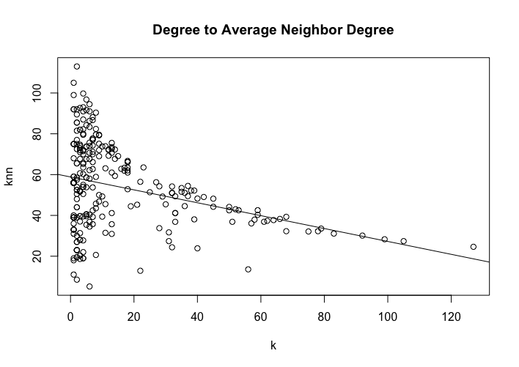
Network Analysis
Slightly disassortative network
Similar to “Analysis of the Chinese air route network as a complex network (Cai, 2011)”

Slide 12
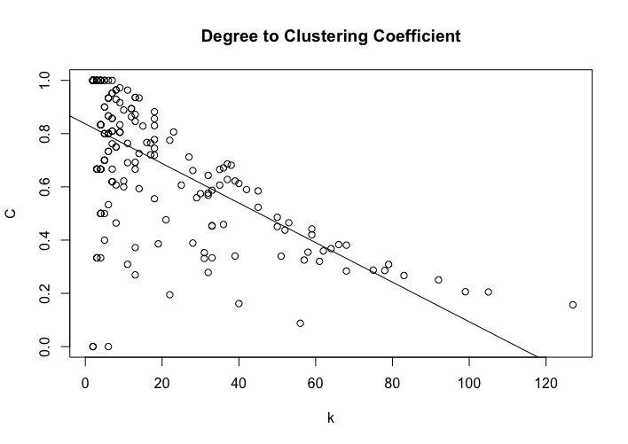
Network Analysis
Negative lcorrelation between degree and clustering coefficient
Hubs tend to have large degrees, but they have higher chance to connecting to two regional airports that are not linked among themselves

Slide 13
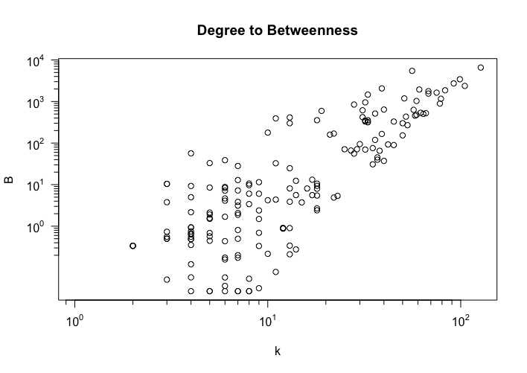
Network Analysis
Close-to-power-law-relation between degree and betweenness
Nodes with low degrees may have high betweenness but not vice versa

Slide 14
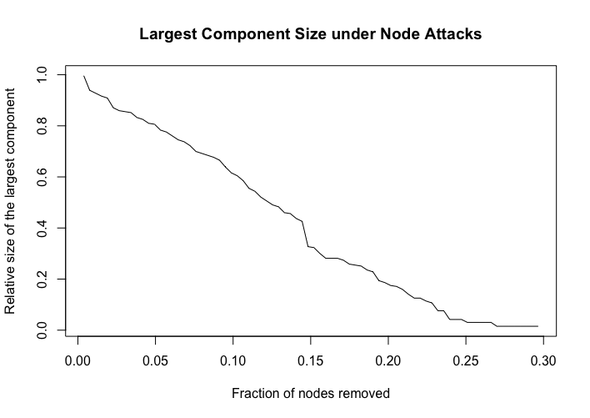
Robustness Analysis
Simulating node attacks based on betweenness
Size of the largest component decreases fairly linearly
Different from “On node criticality of the Northeast Asian air route network (Kim, 2019)”

Slide 15
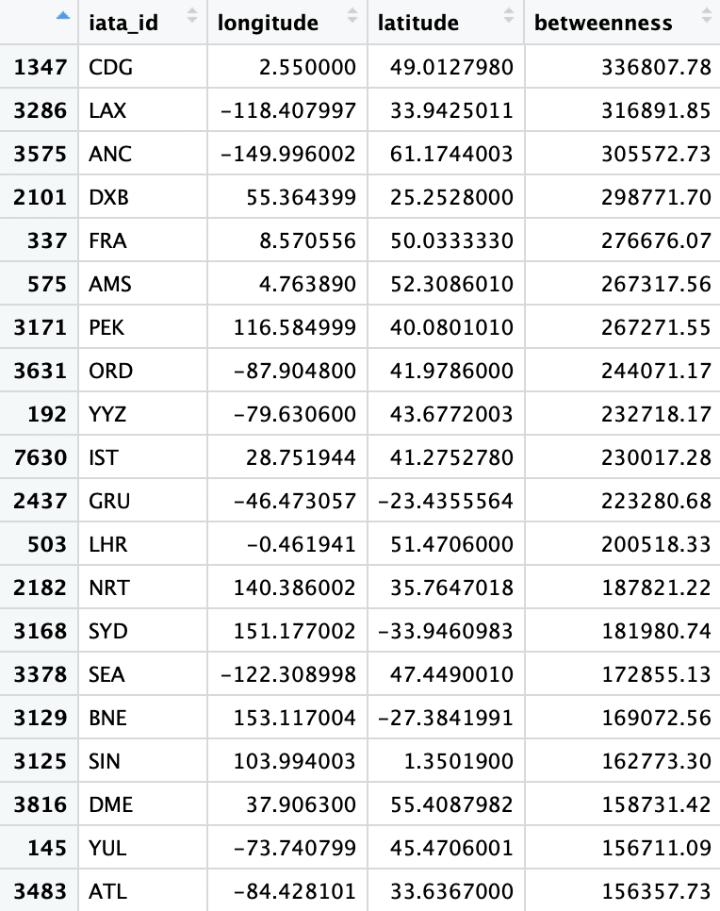
East Asia vs World
Constructing the global network and recalculated the betweenness
Simulated node attacks on the global network based on global betweenness
Simulated node attacks on the East Asian network based on global betweenness

Slide 16
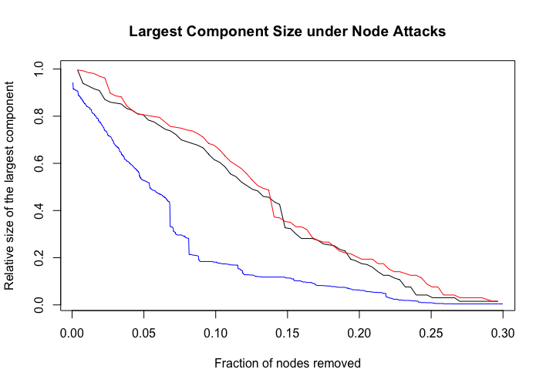
Robustness Analysis
Blue: removing global airports from global network
Global network is affected more by removing the top few airports (relies more heavily on hubs)
East Asian network is more spread throughout regional airports

Slide 17
Robustness Analysis
Red: removing East Asian airports based on betweenness from global network
No perceivable difference from the original node attack simulation

Slide 18
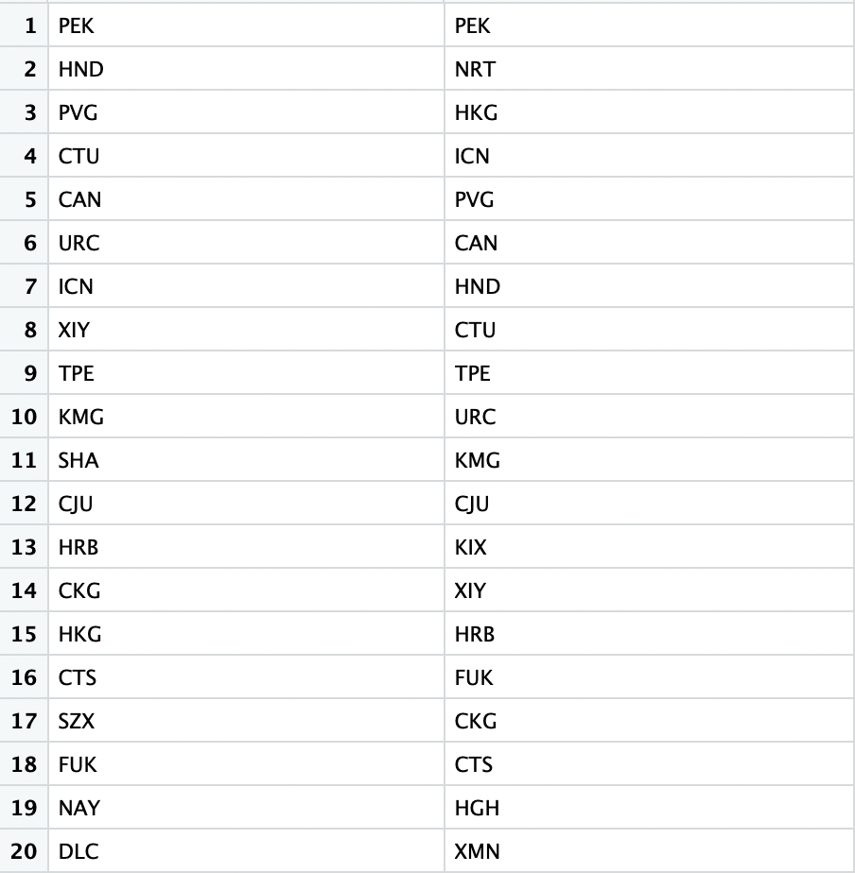
Comparison between Global Network Betweenness and Subnetwork Betweenness
Left: airports with the highest betweenness in the subnetwork
Right: airports with the highest betweenness in the global network

Slide 19
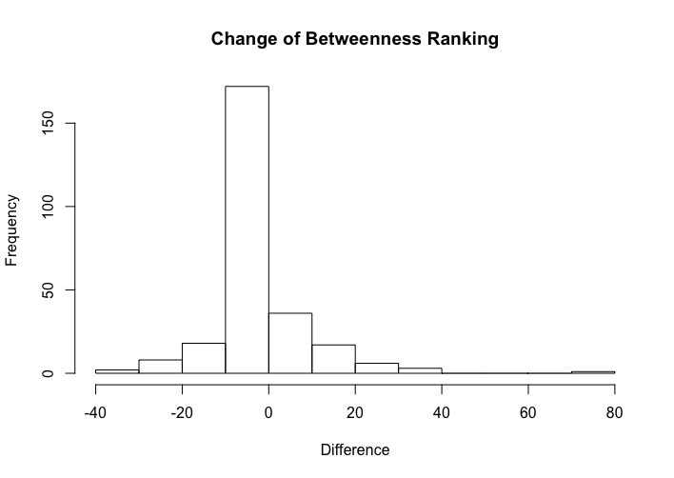
Comparison between Global Network Betweenness and Subnetwork Betweenness
Most airports have have the same relative betweenness ranking

Slide 20
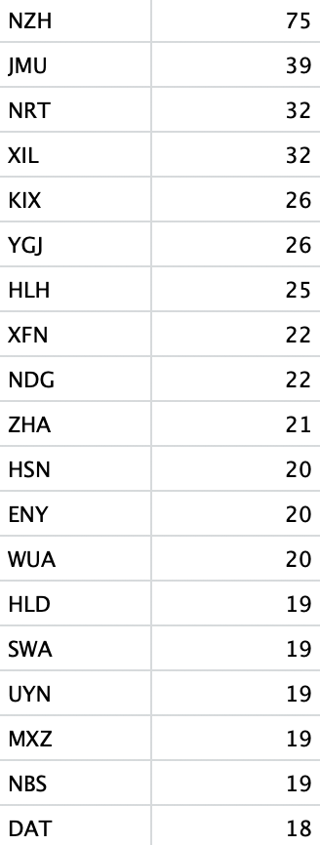
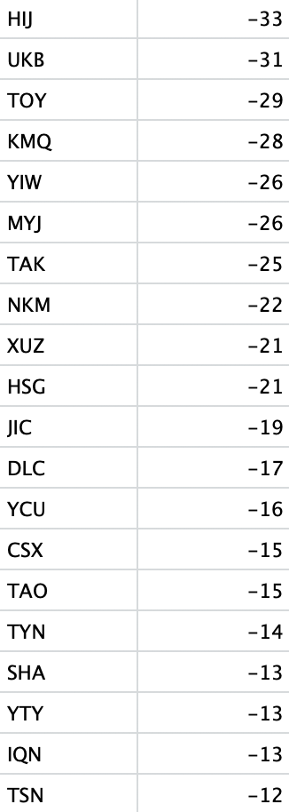
Comparison between Global Network Betweenness and Subnetwork Betweenness
Left: airports whose ranking increased
Right: airports whose ranking decreased

Slide 21
Comparison between Global Network Betweenness and Subnetwork Betweenness
Point of interest: Tokyo Narita (NRT) and Osaka Kansai (KIX) both primarily focus on international routes, and thus have relatively higher betweenness in the global network

Slide 22
Comparison between Global Network Betweenness and Subnetwork Betweenness
Other airports are mostly regional hubs that connect to at least one foreign airport that is relatively isolated from the domestic airport network
For example, Manzhouli (NZH) connects to Choibalsan (COQ), which in turn only connects to Manzhouli and Hailar (HLD) in the East Asian network

Slide 23
Comparison between Global Network Betweenness and Subnetwork Betweenness
Point of Interest: Dalian (DLC) is a very large hub of China Southern that connects to at least 60 airports in the East Asia region, but does not connect to any airport outside the region

Slide 24
Comparison between Global Network Betweenness and Subnetwork Betweenness
Other airports are also regional hubs that rarely connect outside the East Asia region
Even if they connect to foreign airports, they are big international airports that do not help increase the betweenness of the airports of discussion

