Slide 1
Estimating incubation period

Slide 2
Exponential growth simulation
Assuming an exponential growth from day 0 to day 40
Randomly sample 10,000 infections and draw incubation periods from a gamma distribution
Truncate incubation periods at day 40 and fit various methods

Slide 3
Truncated mean incubation period
Higher growth rate corresponds to shorter mean incubation period
But lower growth rate (r < 0) doesn’t go above the true mean because of left-truncation…
This is a sort of an average of truncated backward distribution
Essentially, truncation always leads to lower mean

Slide 4
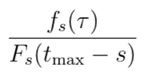
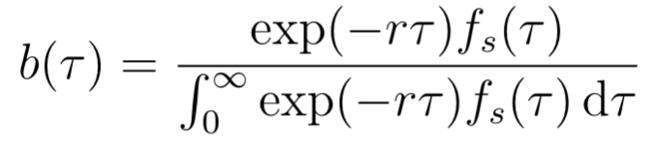
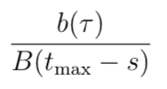
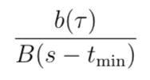
Methods
Right truncation:
Exponential growth:
Right truncation + exponential growth:
Exponential growth + left truncation:

Slide 5
Fits
Accounting for right truncation always works
Accounting for right truncation + exponential growth over compensates
Accounting for exponential growth rate works if r >> 0
Accounting for exponential growth rate + left truncation works too

Slide 6
Zoomed in

Slide 7
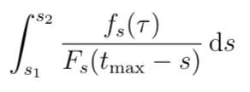
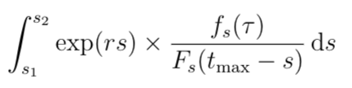
Uncertainties in infection time
Assuming there’s uncertainty in when a person became infected… assuming uncertainty is s1 day to s2 day
Right truncation:
Right truncation + exponential growth (in infection time):

Slide 8
Very little difference in this case... Probably not enough uncertainty…

Slide 9
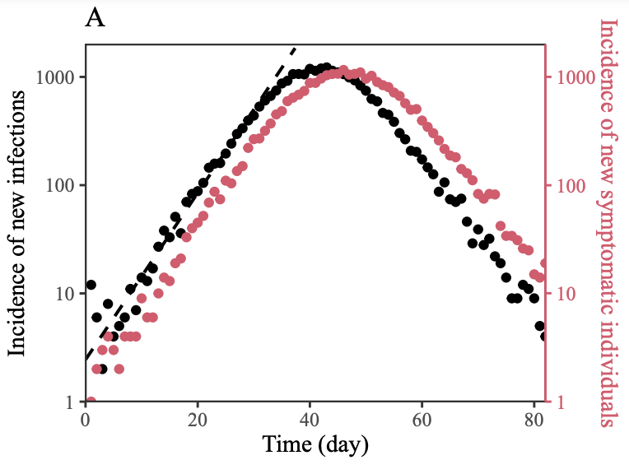
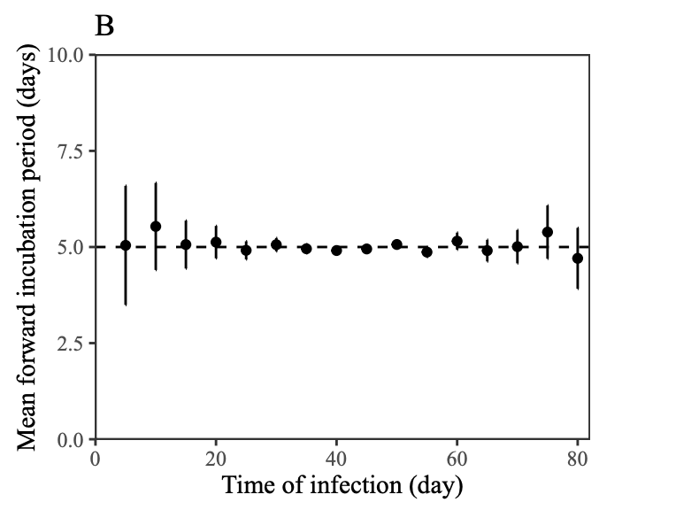
Epidemic simulation

Slide 12
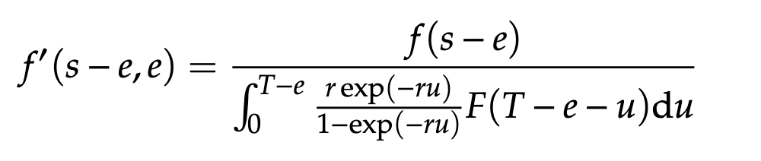
Linton et al
Denominator looks very weird… integration by parts:

Slide 13
