Slide 1
Antigenic evolution of influenza during & after NPIs

Slide 2
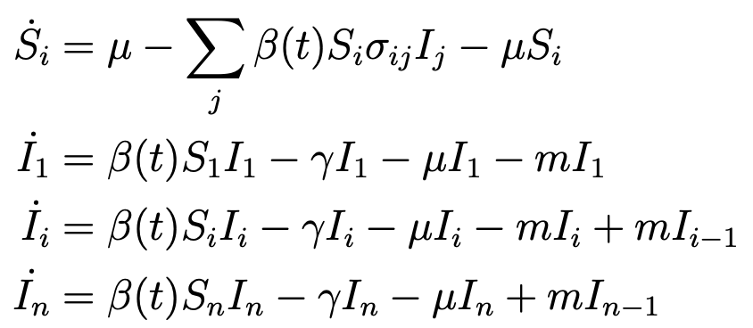
Model
Based on Gog and Grenfell (2002)
Assumes a uni-directional evolution from i-1 to i

Slide 3
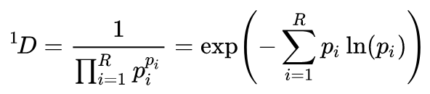
Hill Diversity
We are interested in how the diversity of strains changes over time
Hill diversity measures allow us to quantify “effective” number of strains

Slide 4
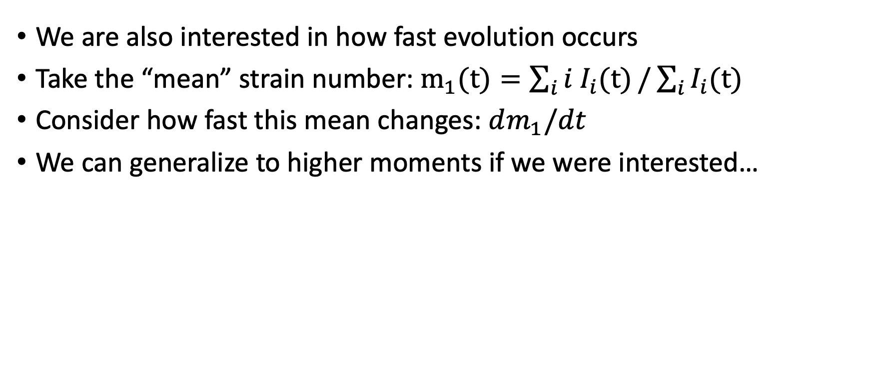
Evolution rate
We are also interested in how fast evolution occurs
Take the “mean” strain number: $m_{1}(t)=\sum_{i}{i I_{i}(t)}/\sum_{i}{I_{i}(t)}$
Consider how fast this mean changes: $dm_{1}/dt$
We can generalize to higher moments if we were interested…

Slide 5
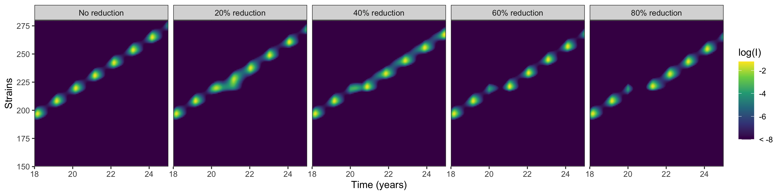
6 month control

Slide 6
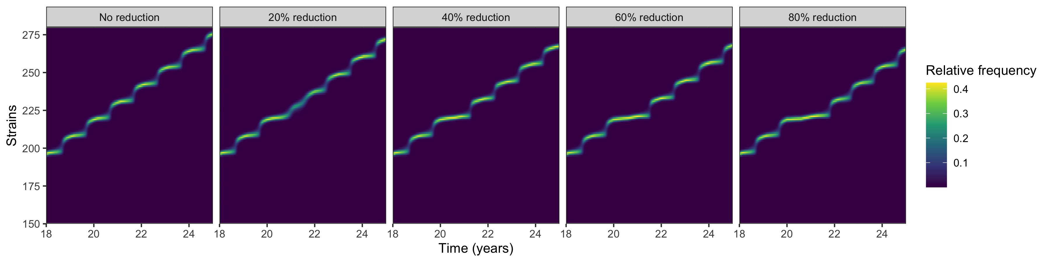
6 month control

Slide 7
6 month control

Slide 8
6 month control

Slide 9
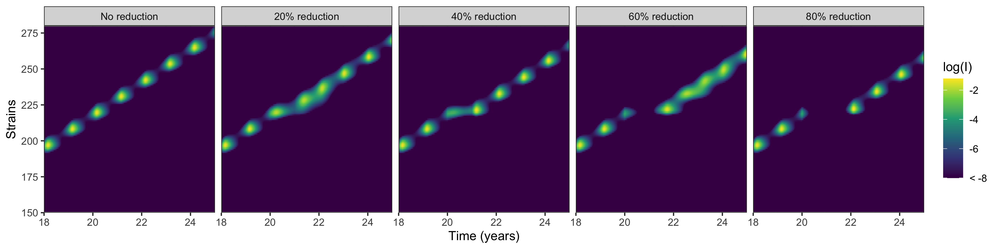
1 year control

Slide 10
1 year control

Slide 11
1 year control

