Slide 1
Flagged Items Summary (1/2)
Cat1 | Cat2 | Cat3 | MSR | Score | Dir
PERI | BL | BL_2 | Peri_BL_122 | 0.74 | Up
CELL | TCMC | TCMC_1 | Cell_TCMC_207 | 0.67 | Up
CELL | TCMC | TCMC_2 | Cell_TCMC_235 | 0.66 | Up
CELL | TCMC | TCMC_2 | Cell_TCMC_234 | 0.66 | Up
CELL | TCMC | TCMC_1 | Cell_TCMC_212 | 0.66 | Up
PERI | PB | PB_1 | Peri_PB_004 | 0.63 | Up
CELL | TCMC | TCMC_1 | Cell_TCMC_203 | 0.59 | Up
PERI | BL | BL_2 | Peri_BL_121 | 0.55 | Up
PERI | BL | BL_3 | Peri_BL_141 | 0.55 | Up
CELL | WLS | WLS_2 | Cell_WLS_196 | 0.55 | Up
PERI | BL | BL_3 | Peri_BL_139 | 0.55 | Up
CELL | WTC | WTC_2 | Cell_WTC_290 | 0.54 | Up
PERI | PB | PB_2 | Peri_PB_034 | 0.53 | Up
CELL | TCMC | TCMC_1 | Cell_TCMC_219 | 0.53 | Up
CELL | WTC | WTC_1 | Cell_WTC_271 | 0.52 | Up

Slide 2
Flagged Items Summary (2/2)
Cat1 | Cat2 | Cat3 | MSR | Score | Dir
CELL | WLS | WLS_2 | Cell_WLS_193 | 0.52 | Up

Slide 3
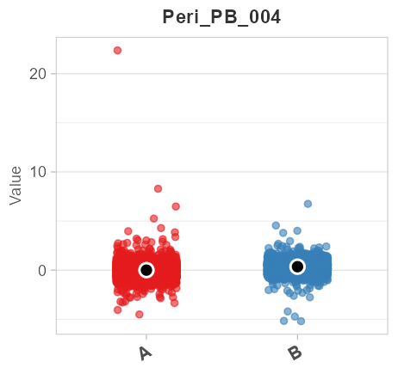
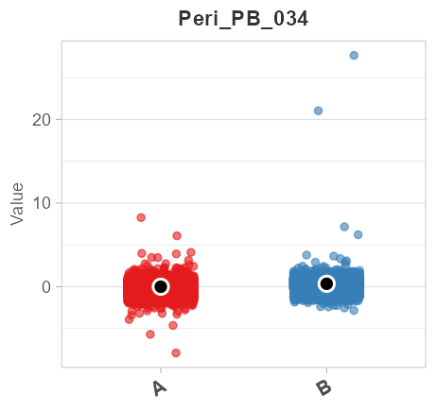
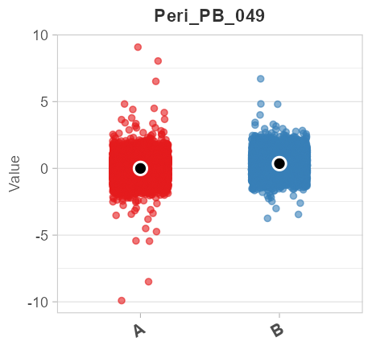
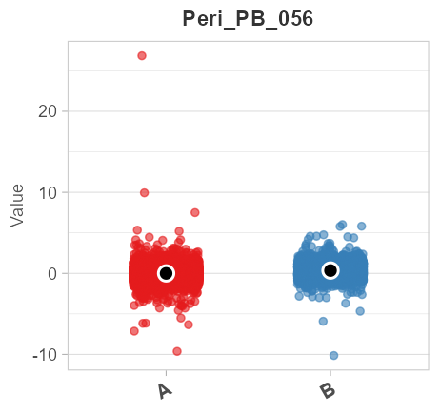
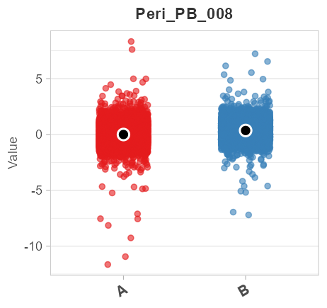
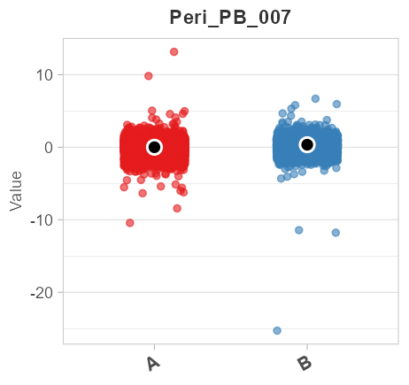
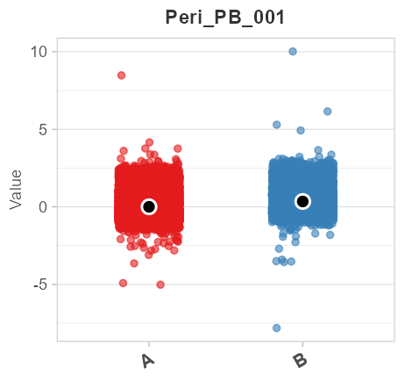
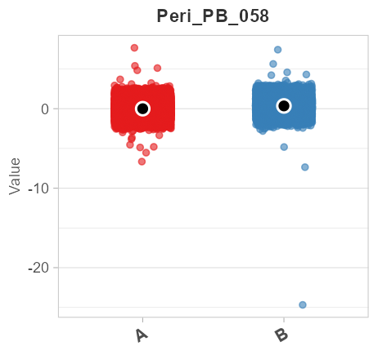
Category: PB - Top 8 Sigma Delta

Slide 4
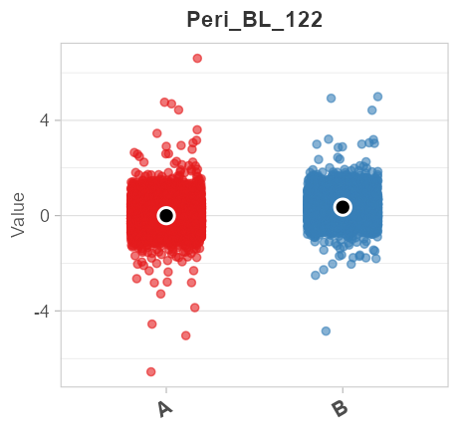

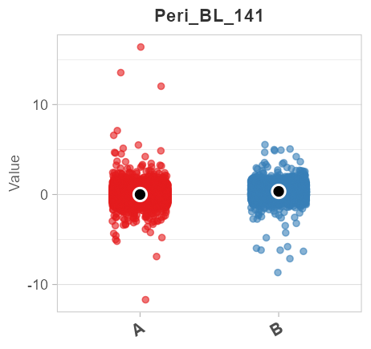
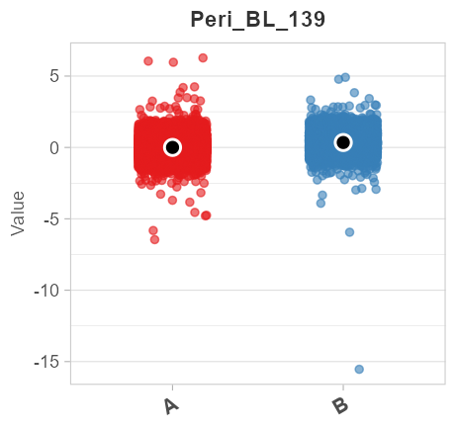
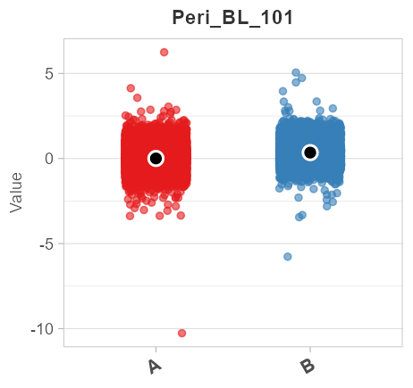
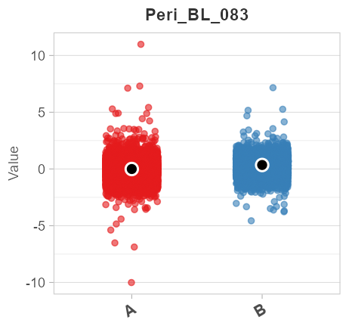
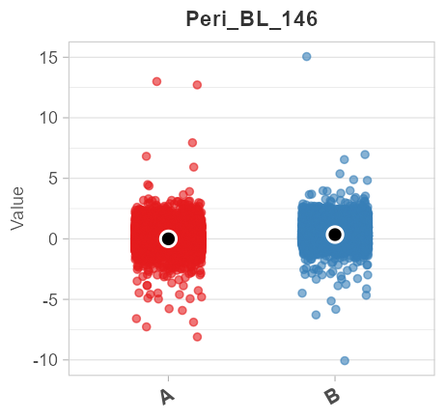
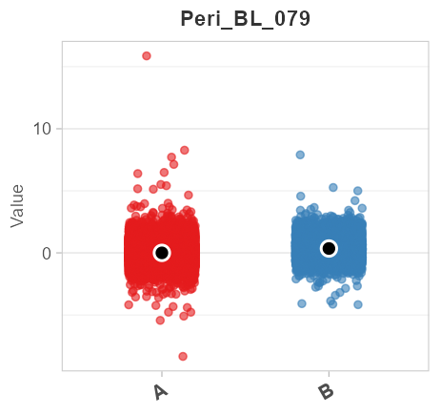
Category: BL - Top 8 Sigma Delta

Slide 5
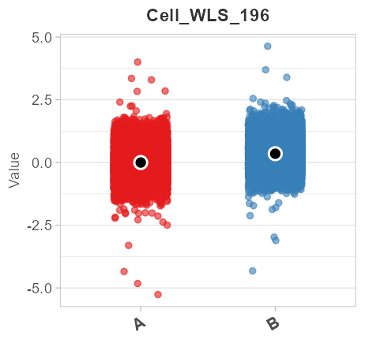
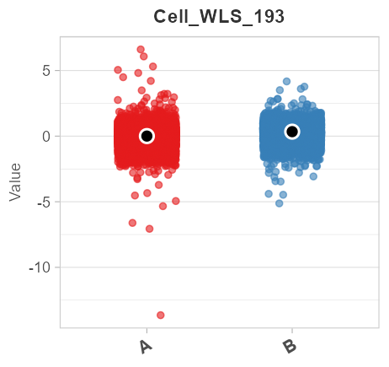
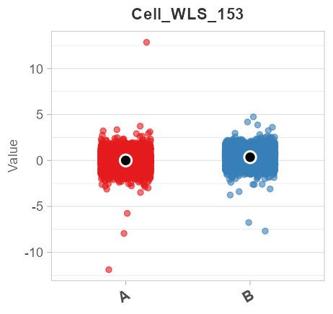
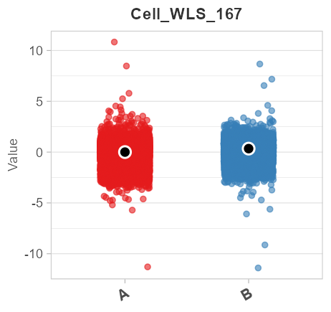
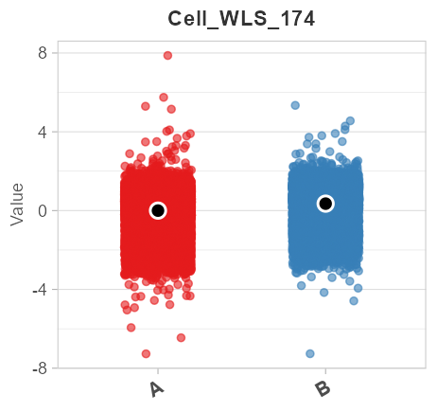
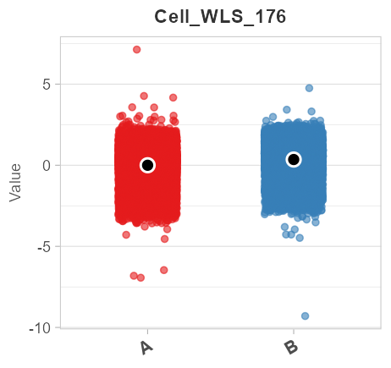
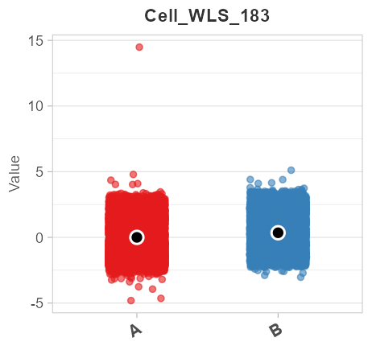
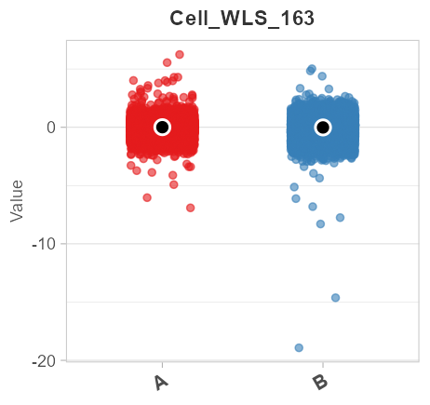
Category: WLS - Top 8 Sigma Delta

Slide 6
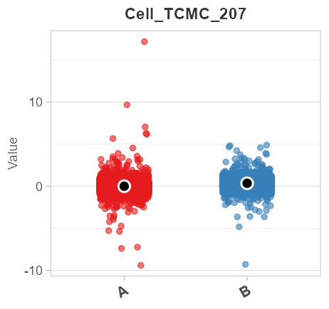
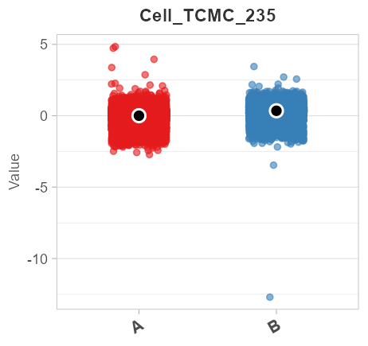
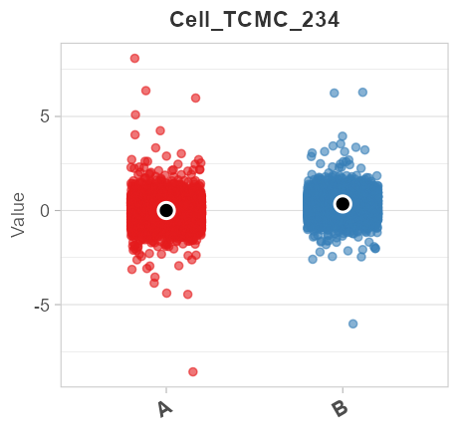
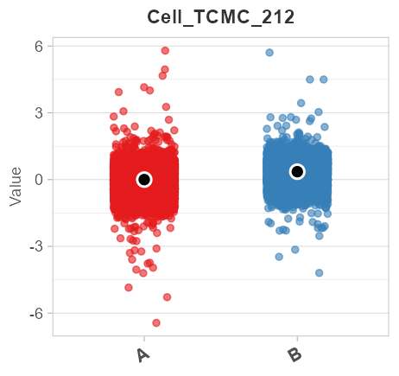
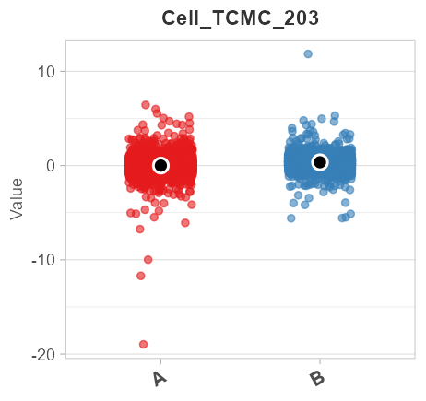
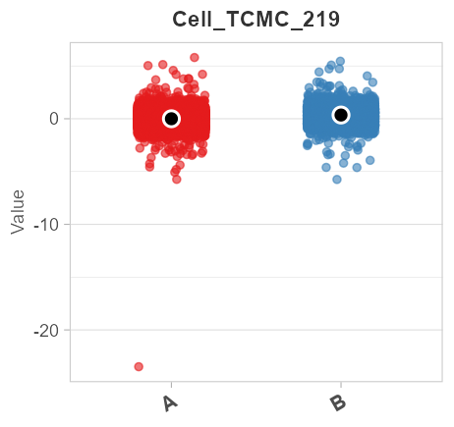
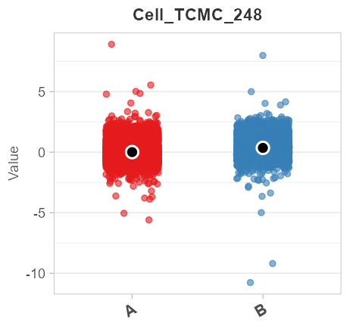
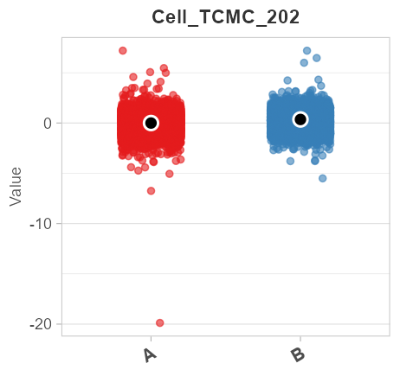
Category: TCMC - Top 8 Sigma Delta

Slide 7
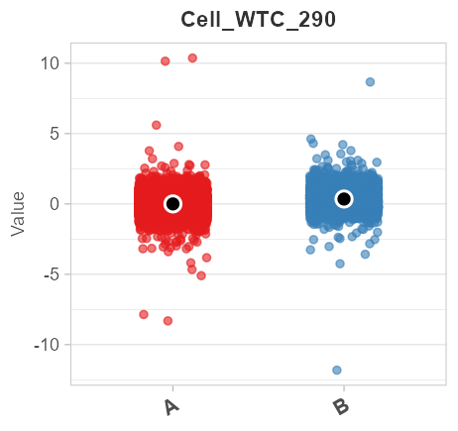
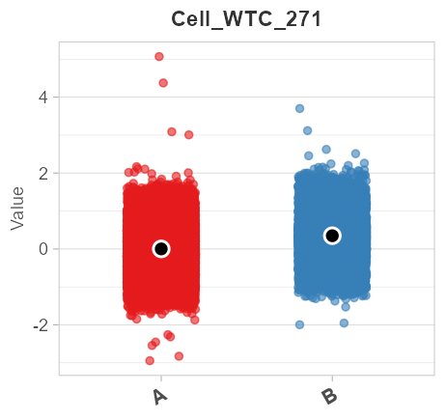
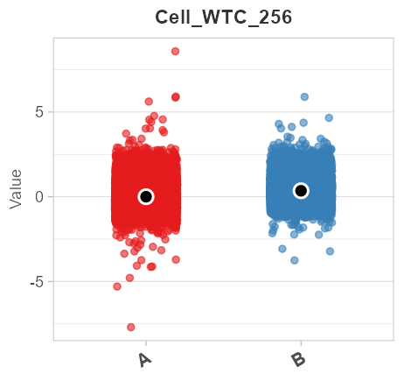
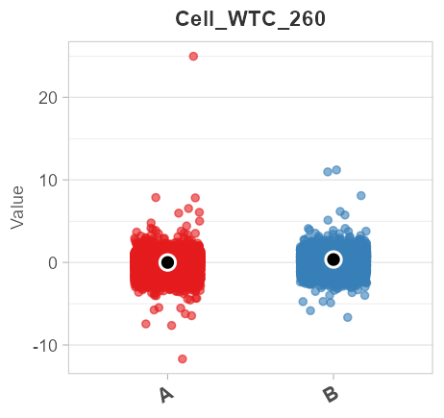
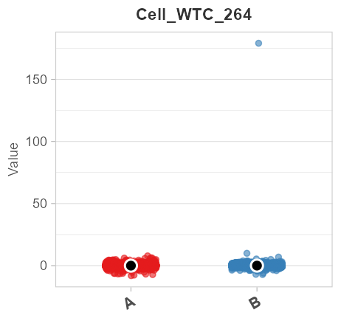
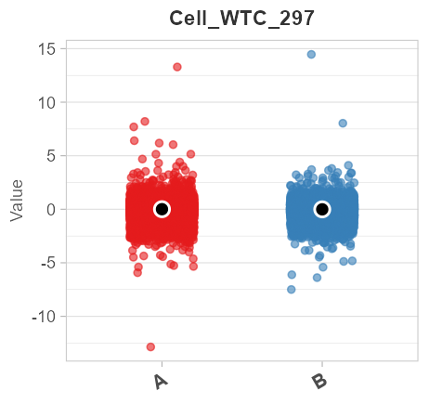
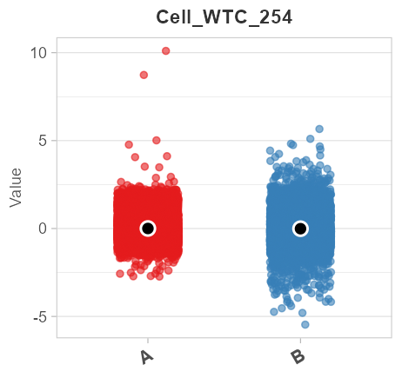
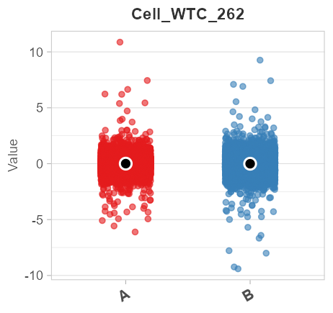
Category: WTC - Top 8 Sigma Delta

