Slide 1
[DM] Data Review Board Auto Report
■ comment
■ comment
■ comment
Cat1 | Cat2 | Cat3 | MSR | Score | Dir
PERI | BL | BL_2 | Peri_BL_122 | 0.73 | Up
CELL | TCMC | TCMC_1 | Cell_TCMC_207 | 0.67 | Up
CELL | TCMC | TCMC_1 | Cell_TCMC_212 | 0.67 | Up
CELL | TCMC | TCMC_2 | Cell_TCMC_234 | 0.67 | Up
CELL | TCMC | TCMC_2 | Cell_TCMC_235 | 0.67 | Up
PERI | PB | PB_1 | Peri_PB_004 | 0.63 | Up
CELL | TCMC | TCMC_1 | Cell_TCMC_203 | 0.59 | Up
CELL | WLS | WLS_2 | Cell_WLS_196 | 0.55 | Up
PERI | BL | BL_3 | Peri_BL_139 | 0.55 | Up
PERI | BL | BL_3 | Peri_BL_141 | 0.54 | Up
PERI | PB | PB_2 | Peri_PB_034 | 0.54 | Up
PERI | BL | BL_2 | Peri_BL_121 | 0.54 | Up
CELL | TCMC | TCMC_1 | Cell_TCMC_219 | 0.53 | Up
CELL | WTC | WTC_2 | Cell_WTC_290 | 0.53 | Up
CELL | WTC | WTC_1 | Cell_WTC_271 | 0.52 | Up

Slide 2
[DM] Data Review Board Auto Report
■ comment
■ comment
■ comment
Cat1 | Cat2 | Cat3 | MSR | Score | Dir
CELL | WLS | WLS_2 | Cell_WLS_193 | 0.52 | Up
PERI | BL | BL_2 | Peri_BL_101 | 0.50 | Up

Slide 3
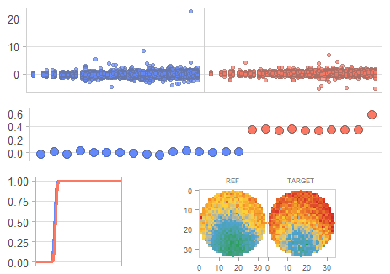
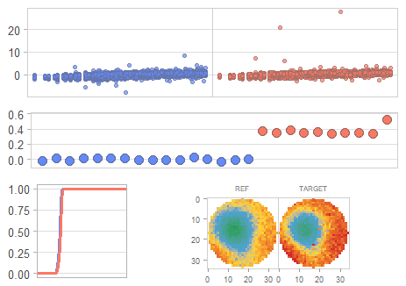
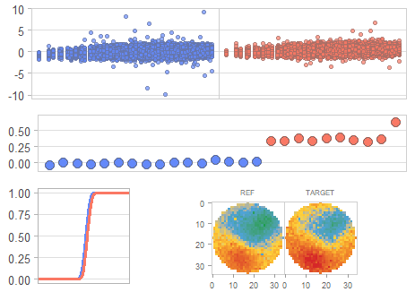
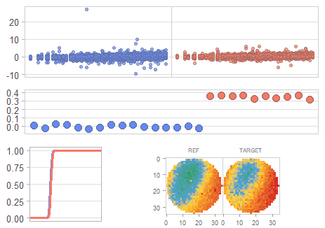
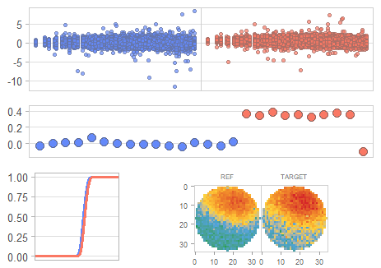
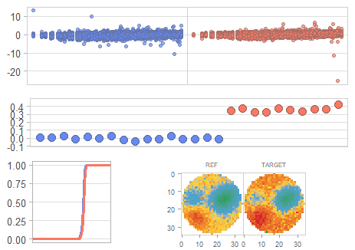
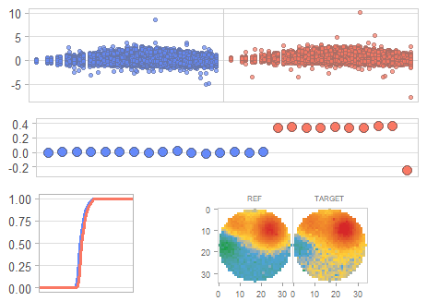
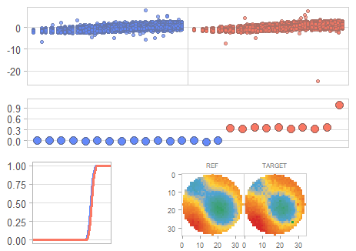
[DM] Data Review Board Auto Report
■ comment
■ comment
■ comment
Category: PB - Top 8 Sigma Delta
⬤ (ML_MSR_004) Peri_PB_004
⬤ (ML_MSR_034) Peri_PB_034
⬤ (ML_MSR_049) Peri_PB_049
⬤ (ML_MSR_056) Peri_PB_056
⬤ (ML_MSR_008) Peri_PB_008
⬤ (ML_MSR_007) Peri_PB_007
⬤ (ML_MSR_001) Peri_PB_001
⬤ (ML_MSR_058) Peri_PB_058
● A (REF, 16매) ● B (TARGET, 10매)

Slide 4
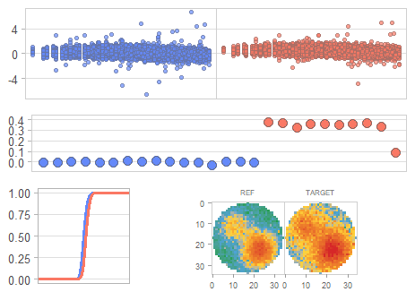
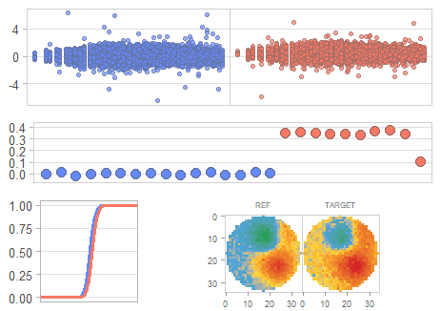
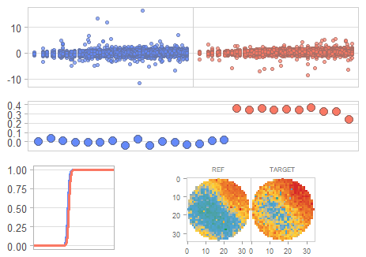
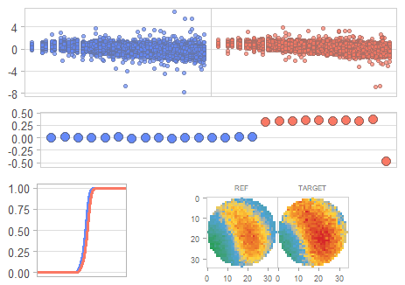
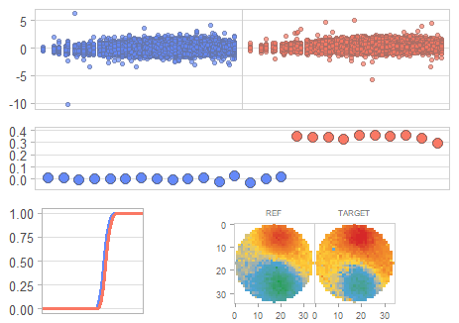
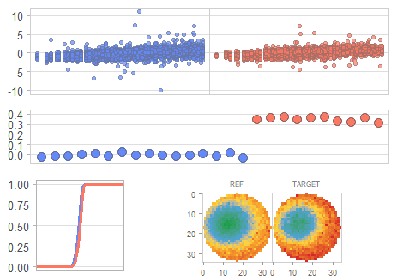
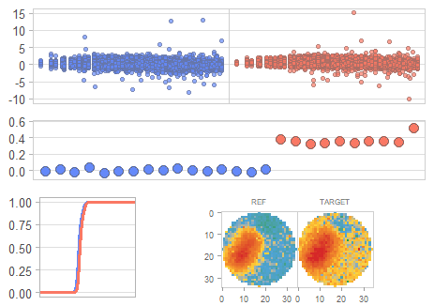
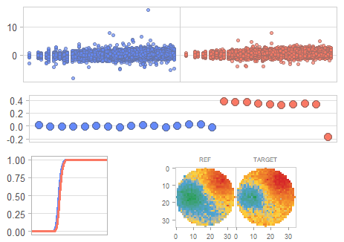
[DM] Data Review Board Auto Report
■ comment
■ comment
■ comment
Category: BL - Top 8 Sigma Delta
⬤ (ML_MSR_122) Peri_BL_122
⬤ (ML_MSR_139) Peri_BL_139
⬤ (ML_MSR_141) Peri_BL_141
⬤ (ML_MSR_121) Peri_BL_121
⬤ (ML_MSR_101) Peri_BL_101
⬤ (ML_MSR_083) Peri_BL_083
⬤ (ML_MSR_146) Peri_BL_146
⬤ (ML_MSR_079) Peri_BL_079
● A (REF, 16매) ● B (TARGET, 10매)

Slide 5
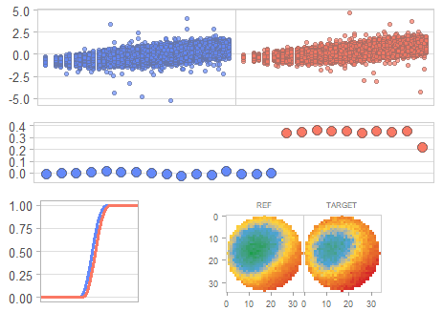
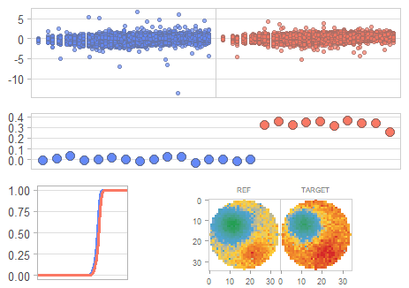
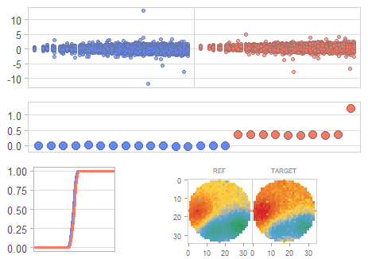
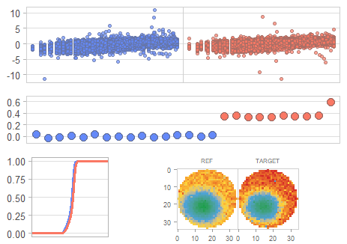
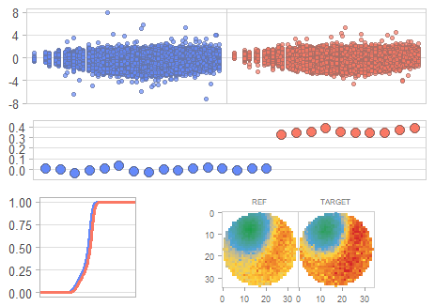
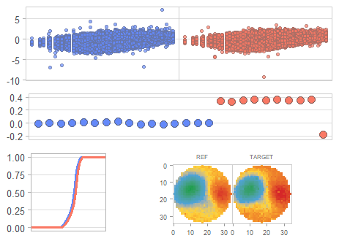
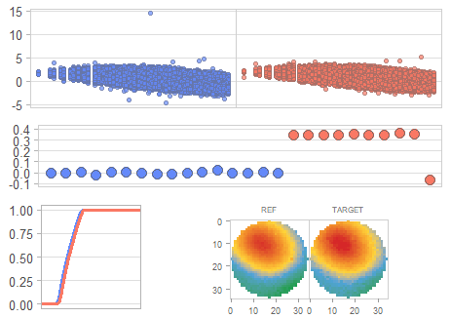
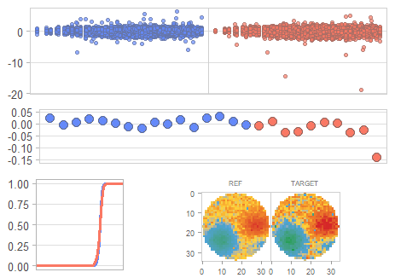
[DM] Data Review Board Auto Report
■ comment
■ comment
■ comment
Category: WLS - Top 8 Sigma Delta
⬤ (ML_MSR_196) Cell_WLS_196
⬤ (ML_MSR_193) Cell_WLS_193
⬤ (ML_MSR_153) Cell_WLS_153
⬤ (ML_MSR_167) Cell_WLS_167
⬤ (ML_MSR_174) Cell_WLS_174
⬤ (ML_MSR_176) Cell_WLS_176
⬤ (ML_MSR_183) Cell_WLS_183
⬤ (ML_MSR_163) Cell_WLS_163
● A (REF, 16매) ● B (TARGET, 10매)

Slide 6
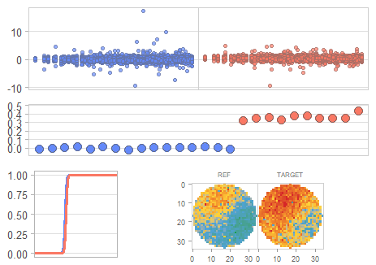
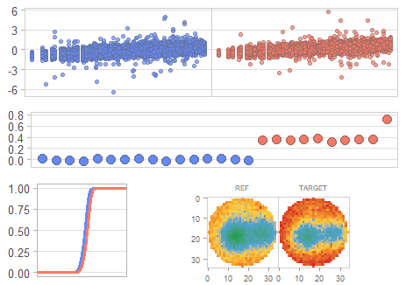
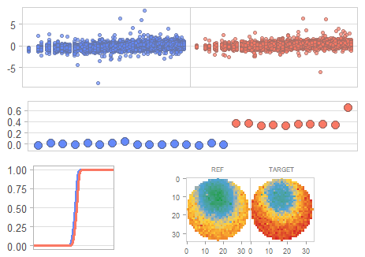
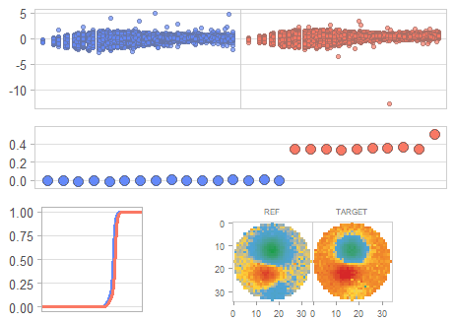
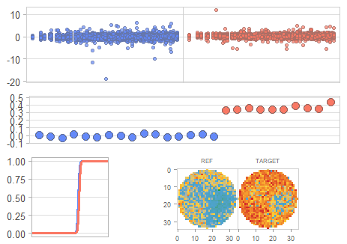
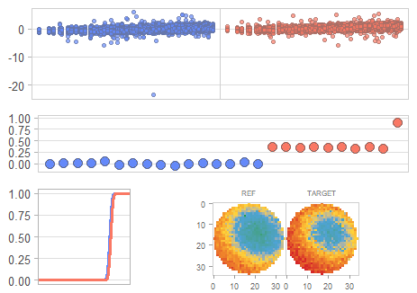
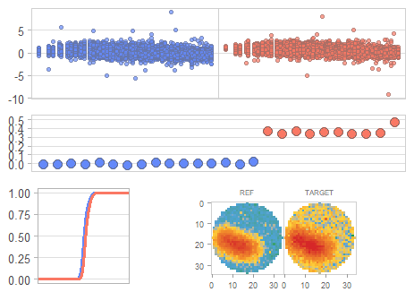
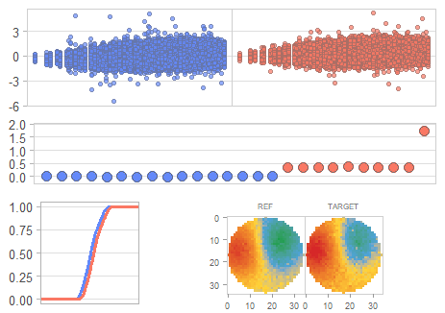
[DM] Data Review Board Auto Report
■ comment
■ comment
■ comment
Category: TCMC - Top 8 Sigma Delta
⬤ (ML_MSR_207) Cell_TCMC_207
⬤ (ML_MSR_212) Cell_TCMC_212
⬤ (ML_MSR_234) Cell_TCMC_234
⬤ (ML_MSR_235) Cell_TCMC_235
⬤ (ML_MSR_203) Cell_TCMC_203
⬤ (ML_MSR_219) Cell_TCMC_219
⬤ (ML_MSR_248) Cell_TCMC_248
⬤ (ML_MSR_241) Cell_TCMC_241
● A (REF, 16매) ● B (TARGET, 10매)

Slide 7
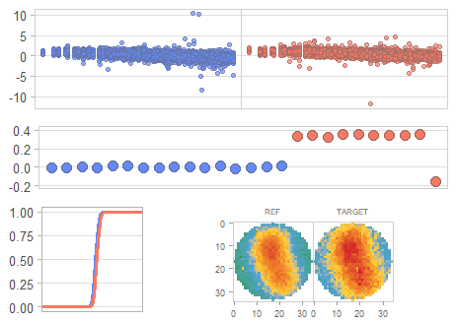
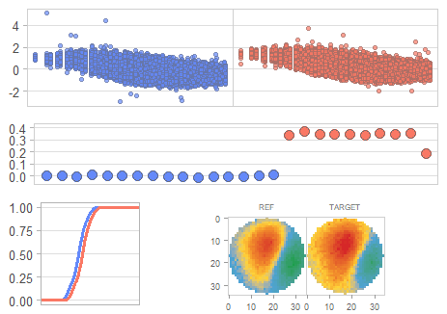
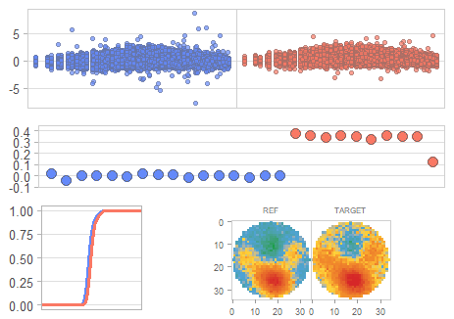
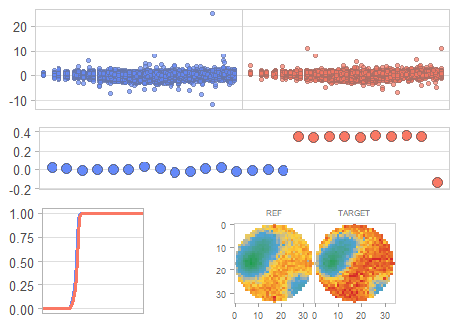
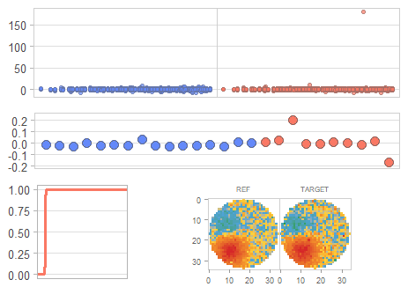
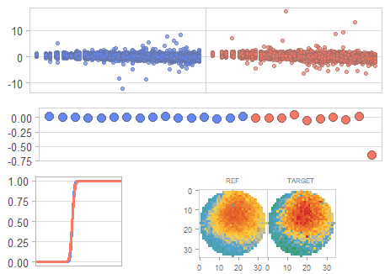
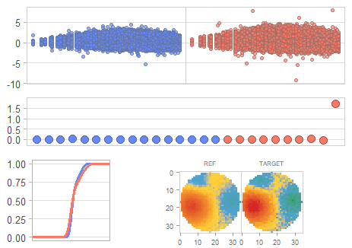
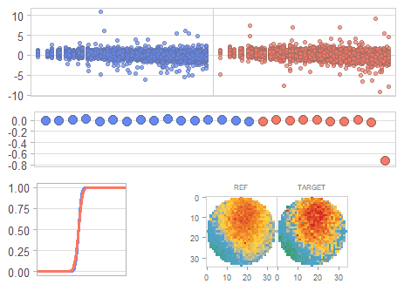
[DM] Data Review Board Auto Report
■ comment
■ comment
■ comment
Category: WTC - Top 8 Sigma Delta
⬤ (ML_MSR_290) Cell_WTC_290
⬤ (ML_MSR_271) Cell_WTC_271
⬤ (ML_MSR_256) Cell_WTC_256
⬤ (ML_MSR_260) Cell_WTC_260
⬤ (ML_MSR_264) Cell_WTC_264
⬤ (ML_MSR_259) Cell_WTC_259
⬤ (ML_MSR_293) Cell_WTC_293
⬤ (ML_MSR_262) Cell_WTC_262
● A (REF, 16매) ● B (TARGET, 10매)

