Slide 1
DRB Automated Analysis Report
■ Required와 Alarm 결과를 한 파일에서 순서대로 확인합니다.
■ Summary → GOOBAE → Category Detail
실행 정보 | 값
분석 일시 | 2026-08-05 23:51:49
분석 소요시간 | 00:03
총 매수 | 16 pages
분석 MSR | 300 MSR
Required 상세 | 8 MSR
Alarm MSR | 17 MSR
비교 그룹 | A → B
Sigma 기준 | 0.5
카테고리 범위 | ALL
입력 데이터 | raw.csv
Category | Required | Alarm
WTC | 2 | 2
WLS | 1 | 2
PB | 4 | 2
BL | 1 | 5
TCMC | 0 | 6
Flash PE / 홍길동

Slide 2
Contents
■ Summary → GOOBAE → Category Detail
■ Contents 1/1 | Total 16 slides
Summary (Required) | ······················ | 3
Summary (Alarm-all) | ······················ | 4-5
GOOBAE | ······················ | 6
WTC (Required) | ······················ | 7
WTC (Alarm) | ······················ | 8
WLS (Required) | ······················ | 9
WLS (Alarm) | ······················ | 10
PB (Required) | ······················ | 11
PB (Alarm) | ······················ | 12
BL (Required) | ······················ | 13
BL (Alarm) | ······················ | 14
TCMC (Required) | ······················ | 15
TCMC (Alarm) | ······················ | 16
Flash PE / 홍길동

Slide 3
[DM] Data Review Board Auto Report
■ Summary (Required) | 12 MSR
■ TREND: plot 수동 부착 / 비고: 수동 작성
구분 | 구분 | 구분 | 주요 항목 | 지수수준 | 지수수준 | Diff | Diff | 변동결과 | 비고 | TREND
Cat1 | Cat2 | Cat3 |  | REF | TGT | Delta | Sigma Delta
CELL | WTC | WTC_1 | Cell_WTC_259 | 0.00 | -0.01 | -0.02 | -0.0sig | ⬤ Stable
CELL | WTC | WTC_2 | Cell_WTC_290 | 0.00 | 0.34 | +0.34 | +0.5sig | ⬤ Up
CELL | WLS | WLS_1 | Cell_WLS_153 | -0.00 | 0.36 | +0.36 | +0.5sig | ⬤ Stable
CELL | WLS | WLS_2 | Cell_WLS_196 | -0.00 | 0.35 | +0.35 | +0.5sig | ⬤ Up
PERI | PB | PB_1 | Peri_PB_004 | 0.00 | 0.35 | +0.35 | +0.6sig | ⬤ Up
PERI | PB | PB_2 | Peri_PB_033 | -0.00 | 0.00 | +0.01 | +0.0sig | ⬤ Stable
PERI | PB | PB_3 | Peri_PB_052 | -0.00 | 0.34 | +0.35 | +0.3sig | ⬤ Stable
PERI | BL | BL_1 | Peri_BL_079 | -0.00 | 0.35 | +0.35 | +0.4sig | ⬤ Stable
PERI | BL | BL_2 | Peri_BL_122 | -0.00 | 0.35 | +0.35 | +0.7sig | ⬤ Up
PERI | BL | BL_3 | Peri_BL_134 | 0.00 | -0.00 | -0.00 | -0.0sig | ⬤ Stable
CELL | TCMC | TCMC_1 | Cell_TCMC_207 | 0.00 | 0.35 | +0.35 | +0.7sig | ⬤ Up
CELL | TCMC | TCMC_2 | Cell_TCMC_234 | 0.00 | 0.35 | +0.35 | +0.7sig | ⬤ Up
Flash PE / 홍길동

Slide 4
[DM] Data Review Board Auto Report
■ Summary (Alarm-all) | Page 1/2 | 17 MSR
■ TREND: plot 수동 부착 / 비고: 수동 작성
구분 | 구분 | 구분 | 주요 항목 | 지수수준 | 지수수준 | Diff | Diff | 변동결과 | 비고 | TREND
Cat1 | Cat2 | Cat3 |  | REF | TGT | Delta | Sigma Delta
CELL | WTC | WTC_1 | Cell_WTC_271 | 0.00 | 0.35 | +0.35 | +0.5sig | ⬤ Up
CELL | WTC | WTC_2 | Cell_WTC_290 | 0.00 | 0.34 | +0.34 | +0.5sig | ⬤ Up | Required 요약
CELL | WLS | WLS_2 | Cell_WLS_196 | -0.00 | 0.35 | +0.35 | +0.5sig | ⬤ Up | Required 요약
CELL | WLS | WLS_2 | Cell_WLS_193 | 0.00 | 0.34 | +0.34 | +0.5sig | ⬤ Up
PERI | PB | PB_1 | Peri_PB_004 | 0.00 | 0.35 | +0.35 | +0.6sig | ⬤ Up | Required 요약
PERI | PB | PB_2 | Peri_PB_034 | 0.00 | 0.35 | +0.35 | +0.5sig | ⬤ Up
PERI | BL | BL_2 | Peri_BL_122 | -0.00 | 0.35 | +0.35 | +0.7sig | ⬤ Up | Required 요약
PERI | BL | BL_2 | Peri_BL_121 | 0.00 | 0.34 | +0.34 | +0.5sig | ⬤ Up
PERI | BL | BL_2 | Peri_BL_101 | 0.00 | 0.35 | +0.34 | +0.5sig | ⬤ Up
PERI | BL | BL_3 | Peri_BL_139 | 0.00 | 0.35 | +0.34 | +0.5sig | ⬤ Up
PERI | BL | BL_3 | Peri_BL_141 | -0.00 | 0.35 | +0.35 | +0.5sig | ⬤ Up
CELL | TCMC | TCMC_1 | Cell_TCMC_207 | 0.00 | 0.35 | +0.35 | +0.7sig | ⬤ Up | Required 요약
CELL | TCMC | TCMC_1 | Cell_TCMC_212 | -0.00 | 0.36 | +0.36 | +0.7sig | ⬤ Up
CELL | TCMC | TCMC_1 | Cell_TCMC_203 | -0.00 | 0.35 | +0.35 | +0.6sig | ⬤ Up
CELL | TCMC | TCMC_1 | Cell_TCMC_219 | -0.00 | 0.36 | +0.36 | +0.5sig | ⬤ Up
Flash PE / 홍길동

Slide 5
[DM] Data Review Board Auto Report
■ Summary (Alarm-all) | Page 2/2 | 17 MSR
■ TREND: plot 수동 부착 / 비고: 수동 작성
구분 | 구분 | 구분 | 주요 항목 | 지수수준 | 지수수준 | Diff | Diff | 변동결과 | 비고 | TREND
Cat1 | Cat2 | Cat3 |  | REF | TGT | Delta | Sigma Delta
CELL | TCMC | TCMC_2 | Cell_TCMC_234 | 0.00 | 0.35 | +0.35 | +0.7sig | ⬤ Up | Required 요약
CELL | TCMC | TCMC_2 | Cell_TCMC_235 | 0.00 | 0.35 | +0.35 | +0.7sig | ⬤ Up
Flash PE / 홍길동

Slide 6
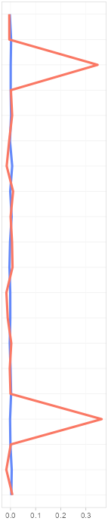
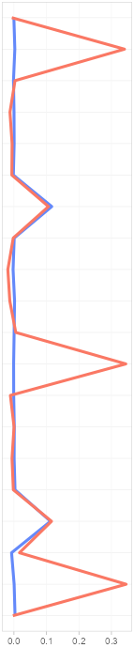
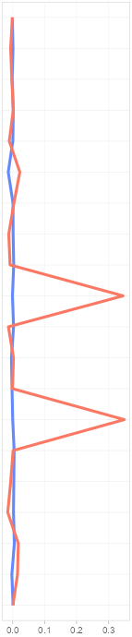
[DM] Data Review Board Auto Report
■ GOOBAE: WL trend | Showing 1-3 of 3
■ REF: A / TARGET: B | Threshold: 0.5
WLS | WLS | WTC
1WL | 2WL | 1WL
● A (REF, 16매) ● B (TARGET, 10매)
Flash PE / 홍길동

Slide 7
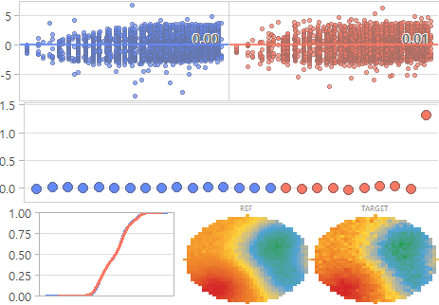
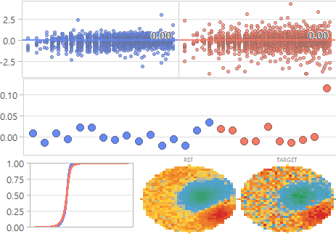
[DM] Data Review Board Auto Report
■ Category: WTC (Required) | Showing MSR 1-2 of 2
■ REF: A / TARGET: B | Threshold: 0.5
WTC (Required)
⬤ (ML_MSR_298) Cell_WTC_298
⬤ (ML_MSR_266) Cell_WTC_266
+0.0sig
+0.0sig
● A (REF, 16매) ● B (TARGET, 10매)
Flash PE / 홍길동

Slide 8
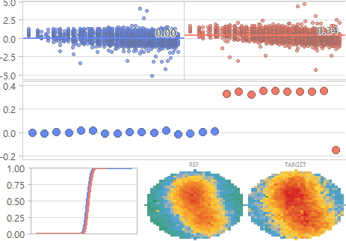
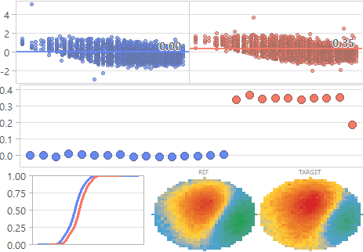
[DM] Data Review Board Auto Report
■ Category: WTC (Alarm) | Showing MSR 1-2 of 2
■ REF: A / TARGET: B | Threshold: 0.5
WTC (Alarm)
⬤ (ML_MSR_290) Cell_WTC_290
⬤ (ML_MSR_271) Cell_WTC_271
+0.5sig
+0.5sig
● A (REF, 16매) ● B (TARGET, 10매)
Flash PE / 홍길동

Slide 9
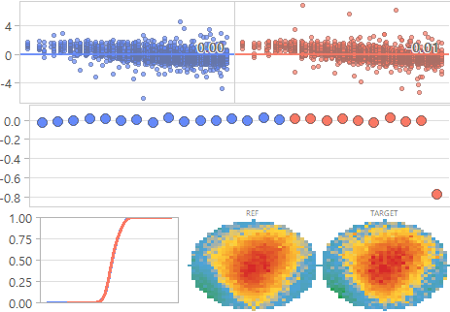
[DM] Data Review Board Auto Report
■ Category: WLS (Required) | Showing MSR 1 of 1
■ REF: A / TARGET: B | Threshold: 0.5
WLS (Required)
⬤ (ML_MSR_180) Cell_WLS_180
-0.0sig
● A (REF, 16매) ● B (TARGET, 10매)
Flash PE / 홍길동

Slide 10
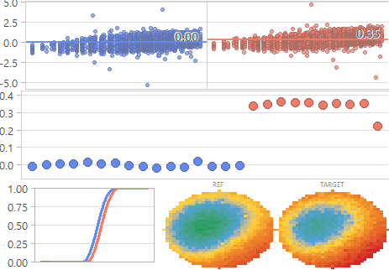
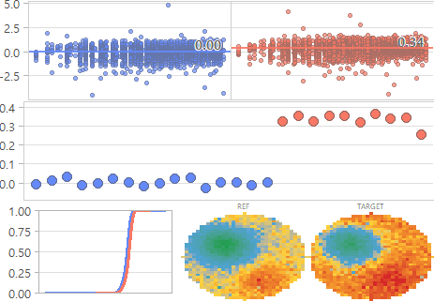
[DM] Data Review Board Auto Report
■ Category: WLS (Alarm) | Showing MSR 1-2 of 2
■ REF: A / TARGET: B | Threshold: 0.5
WLS (Alarm)
⬤ (ML_MSR_196) Cell_WLS_196
⬤ (ML_MSR_193) Cell_WLS_193
+0.5sig
+0.5sig
● A (REF, 16매) ● B (TARGET, 10매)
Flash PE / 홍길동

Slide 11
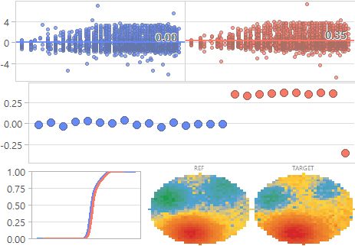
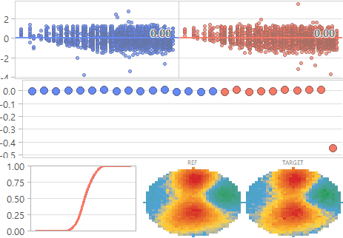
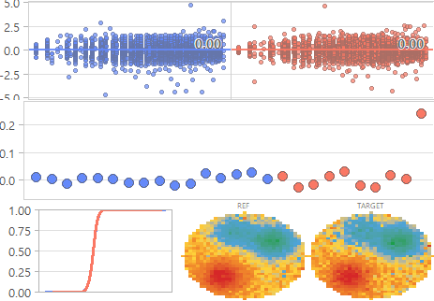
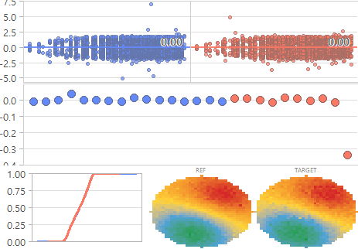
[DM] Data Review Board Auto Report
■ Category: PB (Required) | Showing MSR 1-4 of 4
■ REF: A / TARGET: B | Threshold: 0.5
PB (Required)
⬤ (ML_MSR_052) Peri_PB_052
⬤ (ML_MSR_046) Peri_PB_046
⬤ (ML_MSR_070) Peri_PB_070
⬤ (ML_MSR_023) Peri_PB_023
+0.3sig
-0.0sig
-0.0sig
-0.0sig
● A (REF, 16매) ● B (TARGET, 10매)
Flash PE / 홍길동

Slide 12
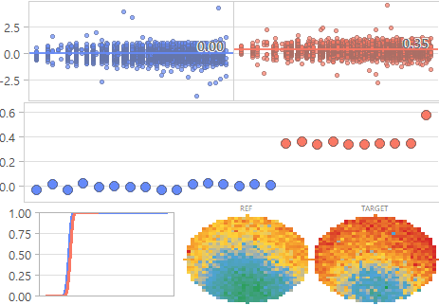
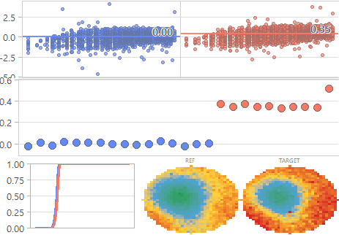
[DM] Data Review Board Auto Report
■ Category: PB (Alarm) | Showing MSR 1-2 of 2
■ REF: A / TARGET: B | Threshold: 0.5
PB (Alarm)
⬤ (ML_MSR_004) Peri_PB_004
⬤ (ML_MSR_034) Peri_PB_034
+0.6sig
+0.5sig
● A (REF, 16매) ● B (TARGET, 10매)
Flash PE / 홍길동

Slide 13
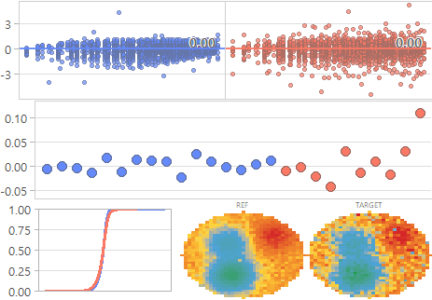
[DM] Data Review Board Auto Report
■ Category: BL (Required) | Showing MSR 1 of 1
■ REF: A / TARGET: B | Threshold: 0.5
BL (Required)
⬤ (ML_MSR_134) Peri_BL_134
-0.0sig
● A (REF, 16매) ● B (TARGET, 10매)
Flash PE / 홍길동

Slide 14
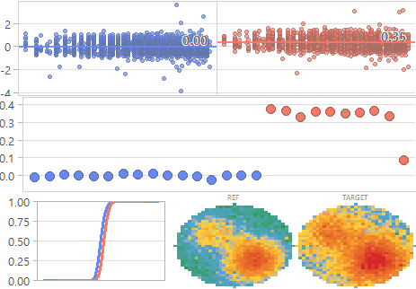
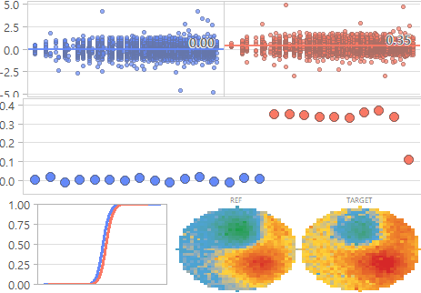
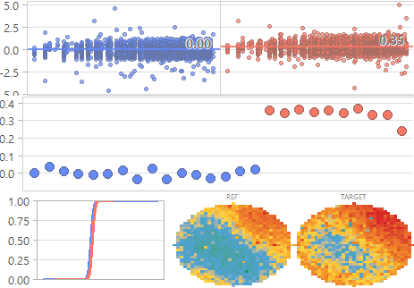
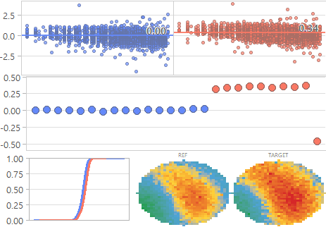
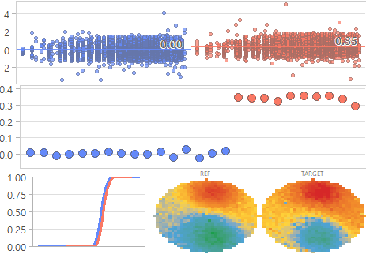
[DM] Data Review Board Auto Report
■ Category: BL (Alarm) | Showing MSR 1-5 of 5
■ REF: A / TARGET: B | Threshold: 0.5
BL (Alarm)
⬤ (ML_MSR_122) Peri_BL_122
⬤ (ML_MSR_139) Peri_BL_139
⬤ (ML_MSR_141) Peri_BL_141
⬤ (ML_MSR_121) Peri_BL_121
+0.7sig
+0.5sig
+0.5sig
+0.5sig
⬤ (ML_MSR_101) Peri_BL_101
+0.5sig
● A (REF, 16매) ● B (TARGET, 10매)
Flash PE / 홍길동

Slide 15
[DM] Data Review Board Auto Report
■ Category: TCMC (Required) | Showing MSR 0 of 0
■ REF: A / TARGET: B | Threshold: 0.5
TCMC (Required)
● A (REF, 16매) ● B (TARGET, 10매)
Flash PE / 홍길동

Slide 16
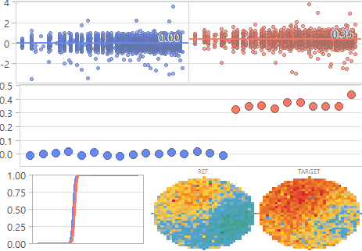
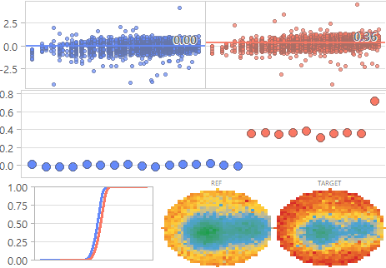
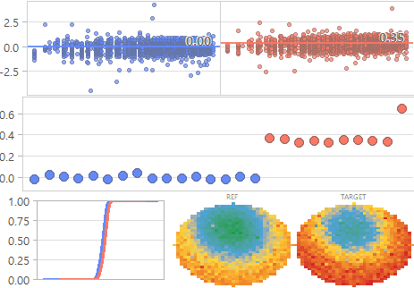
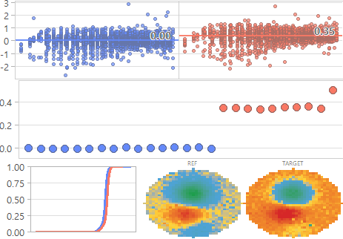
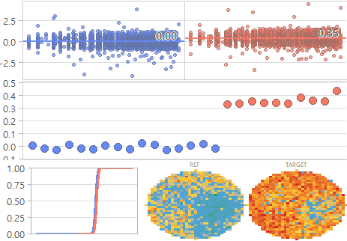
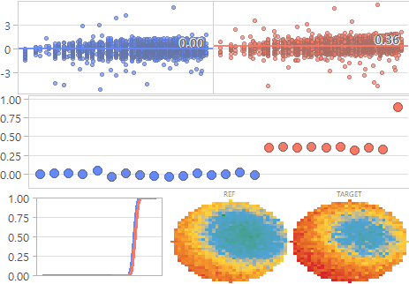
[DM] Data Review Board Auto Report
■ Category: TCMC (Alarm) | Showing MSR 1-6 of 6
■ REF: A / TARGET: B | Threshold: 0.5
TCMC (Alarm)
⬤ (ML_MSR_207) Cell_TCMC_207
⬤ (ML_MSR_212) Cell_TCMC_212
⬤ (ML_MSR_234) Cell_TCMC_234
⬤ (ML_MSR_235) Cell_TCMC_235
+0.7sig
+0.7sig
+0.7sig
+0.7sig
⬤ (ML_MSR_203) Cell_TCMC_203
⬤ (ML_MSR_219) Cell_TCMC_219
+0.6sig
+0.5sig
● A (REF, 16매) ● B (TARGET, 10매)
Flash PE / 홍길동

