Slide 1
[DM] DRB Suggested Review
■ Suggested: |Sigma| > 0.5 | 17 MSR (1/2)
■ REF: A / TARGET: B
구분 | 구분 | 구분 | 주요 항목 | 지수수준 | 지수수준 | Diff | Diff | 변동결과 | 비고 | TREND
Cat1 | Cat2 | Cat3 |  | REF | TGT | Delta | Sigma Delta
CELL | TCMC | TCMC_1 | Cell_TCMC_207 | 0.00 | 0.35 | +0.35 | +0.7sig | ⬤ Up | Main 요약
CELL | TCMC | TCMC_1 | Cell_TCMC_212 | -0.00 | 0.36 | +0.36 | +0.7sig | ⬤ Up
CELL | TCMC | TCMC_1 | Cell_TCMC_203 | -0.00 | 0.35 | +0.35 | +0.6sig | ⬤ Up
CELL | TCMC | TCMC_1 | Cell_TCMC_219 | -0.00 | 0.36 | +0.36 | +0.5sig | ⬤ Up
CELL | TCMC | TCMC_2 | Cell_TCMC_234 | 0.00 | 0.35 | +0.35 | +0.7sig | ⬤ Up | Main 요약
CELL | TCMC | TCMC_2 | Cell_TCMC_235 | 0.00 | 0.35 | +0.35 | +0.7sig | ⬤ Up
CELL | WLS | WLS_2 | Cell_WLS_196 | -0.00 | 0.35 | +0.35 | +0.5sig | ⬤ Up | Main 요약
CELL | WLS | WLS_2 | Cell_WLS_193 | 0.00 | 0.34 | +0.34 | +0.5sig | ⬤ Up
CELL | WTC | WTC_1 | Cell_WTC_271 | 0.00 | 0.35 | +0.35 | +0.5sig | ⬤ Up
CELL | WTC | WTC_2 | Cell_WTC_290 | 0.00 | 0.34 | +0.34 | +0.5sig | ⬤ Up | Main 요약
PERI | BL | BL_2 | Peri_BL_122 | -0.00 | 0.35 | +0.35 | +0.7sig | ⬤ Up | Main 요약
PERI | BL | BL_2 | Peri_BL_121 | 0.00 | 0.34 | +0.34 | +0.5sig | ⬤ Up
PERI | BL | BL_2 | Peri_BL_101 | 0.00 | 0.35 | +0.34 | +0.5sig | ⬤ Up
PERI | BL | BL_3 | Peri_BL_139 | 0.00 | 0.35 | +0.34 | +0.5sig | ⬤ Up
PERI | BL | BL_3 | Peri_BL_141 | -0.00 | 0.35 | +0.35 | +0.5sig | ⬤ Up
Flash PE / 홍길동

Slide 2
[DM] DRB Suggested Review
■ Suggested: |Sigma| > 0.5 | 17 MSR (2/2)
■ REF: A / TARGET: B
구분 | 구분 | 구분 | 주요 항목 | 지수수준 | 지수수준 | Diff | Diff | 변동결과 | 비고 | TREND
Cat1 | Cat2 | Cat3 |  | REF | TGT | Delta | Sigma Delta
PERI | PB | PB_1 | Peri_PB_004 | 0.00 | 0.35 | +0.35 | +0.6sig | ⬤ Up | Main 요약
PERI | PB | PB_2 | Peri_PB_034 | 0.00 | 0.35 | +0.35 | +0.5sig | ⬤ Up
Flash PE / 홍길동

Slide 3
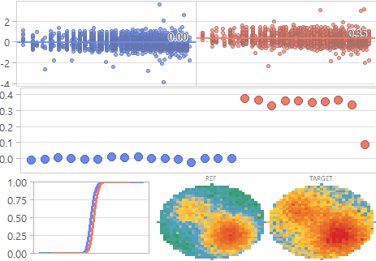
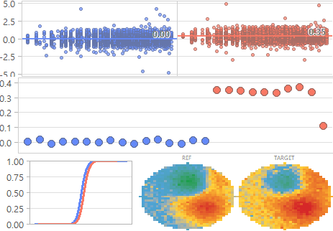
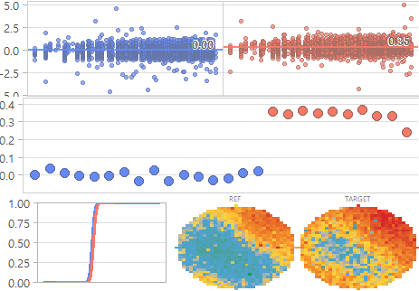
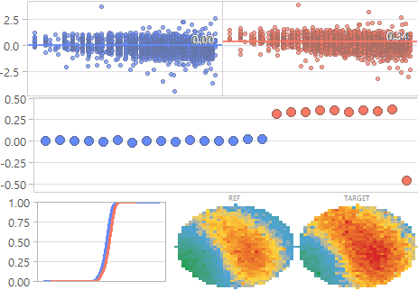
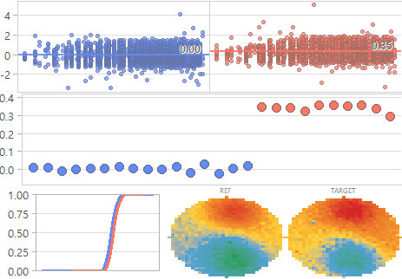
[DM] DRB Suggested Review
■ Category: Category2: BL | Showing MSR 1-5 of 5
■ REF: A / TARGET: B | Threshold: 0.5
Category2: BL - MSR 1-5 of 5
⬤ (ML_MSR_122) Peri_BL_122
⬤ (ML_MSR_139) Peri_BL_139
⬤ (ML_MSR_141) Peri_BL_141
⬤ (ML_MSR_121) Peri_BL_121
+0.7sig
+0.5sig
+0.5sig
+0.5sig
⬤ (ML_MSR_101) Peri_BL_101
+0.5sig
● A (REF, 16매) ● B (TARGET, 10매)
Flash PE / 홍길동

Slide 4
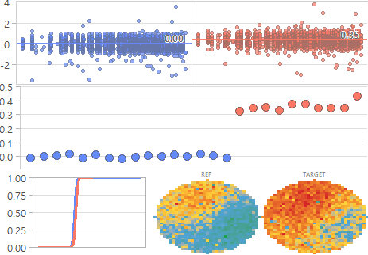
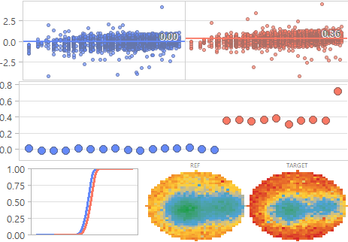
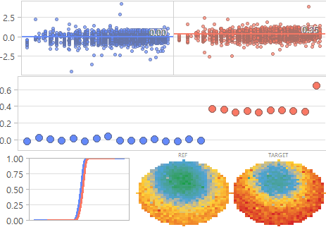
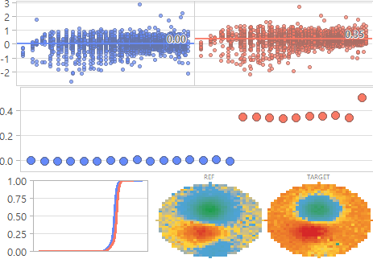
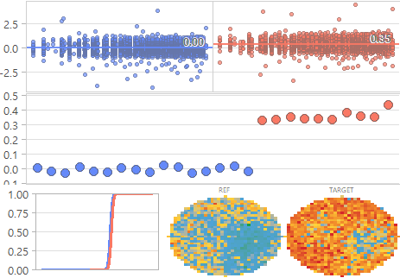
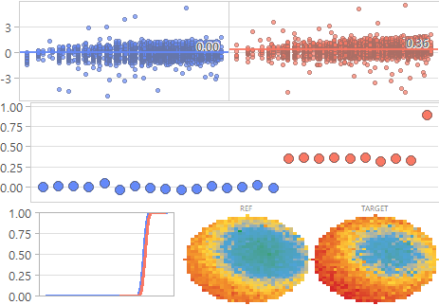
[DM] DRB Suggested Review
■ Category: Category2: TCMC | Showing MSR 1-6 of 6
■ REF: A / TARGET: B | Threshold: 0.5
Category2: TCMC - MSR 1-6 of 6
⬤ (ML_MSR_207) Cell_TCMC_207
⬤ (ML_MSR_212) Cell_TCMC_212
⬤ (ML_MSR_234) Cell_TCMC_234
⬤ (ML_MSR_235) Cell_TCMC_235
+0.7sig
+0.7sig
+0.7sig
+0.7sig
⬤ (ML_MSR_203) Cell_TCMC_203
⬤ (ML_MSR_219) Cell_TCMC_219
+0.6sig
+0.5sig
● A (REF, 16매) ● B (TARGET, 10매)
Flash PE / 홍길동

Slide 5
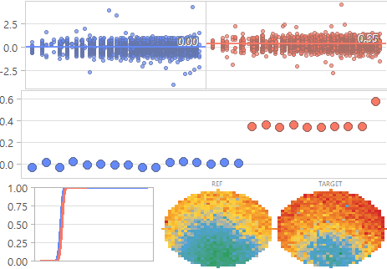
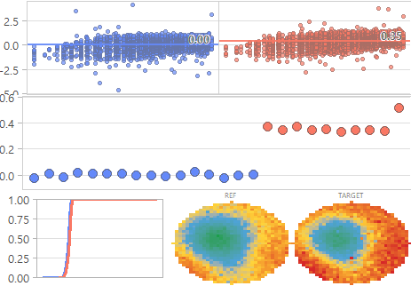
[DM] DRB Suggested Review
■ Category: Category2: PB | Showing MSR 1-2 of 2
■ REF: A / TARGET: B | Threshold: 0.5
Category2: PB - MSR 1-2 of 2
⬤ (ML_MSR_004) Peri_PB_004
⬤ (ML_MSR_034) Peri_PB_034
+0.6sig
+0.5sig
● A (REF, 16매) ● B (TARGET, 10매)
Flash PE / 홍길동

Slide 6
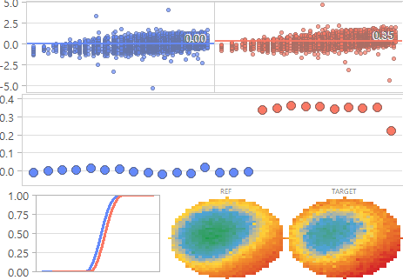
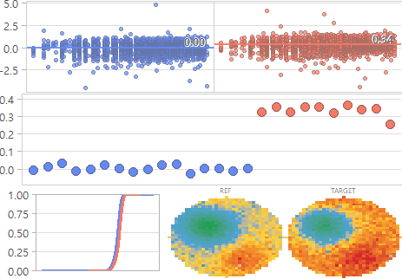
[DM] DRB Suggested Review
■ Category: Category2: WLS | Showing MSR 1-2 of 2
■ REF: A / TARGET: B | Threshold: 0.5
Category2: WLS - MSR 1-2 of 2
⬤ (ML_MSR_196) Cell_WLS_196
⬤ (ML_MSR_193) Cell_WLS_193
+0.5sig
+0.5sig
● A (REF, 16매) ● B (TARGET, 10매)
Flash PE / 홍길동

Slide 7
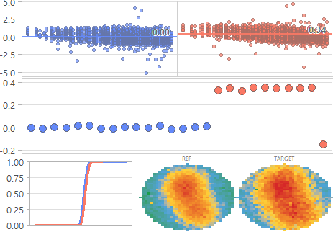
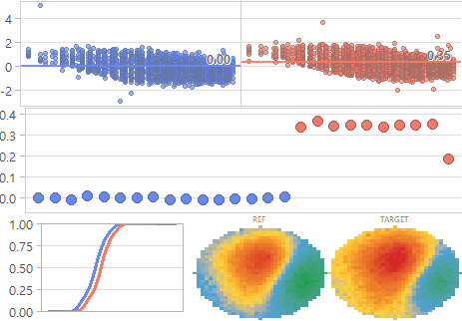
[DM] DRB Suggested Review
■ Category: Category2: WTC | Showing MSR 1-2 of 2
■ REF: A / TARGET: B | Threshold: 0.5
Category2: WTC - MSR 1-2 of 2
⬤ (ML_MSR_290) Cell_WTC_290
⬤ (ML_MSR_271) Cell_WTC_271
+0.5sig
+0.5sig
● A (REF, 16매) ● B (TARGET, 10매)
Flash PE / 홍길동

