Slide 1
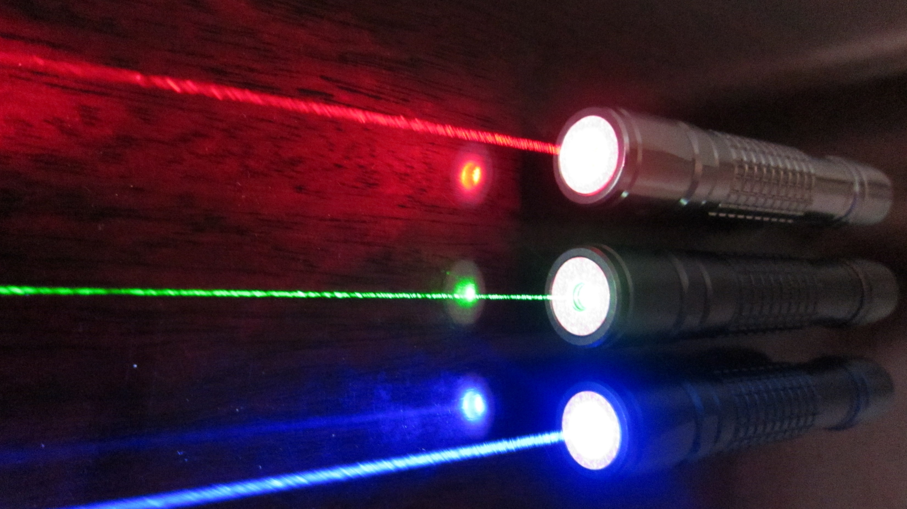
LASER OPTIX!
By Kyeo-Reh PARK

