Slide 1


ANTHONY, BILLY, LUIS & PARLEY
GEOGRAPHICAL MONITORING AND FORECASTING OF DEMENTIA IN ENGLAND

Slide 2
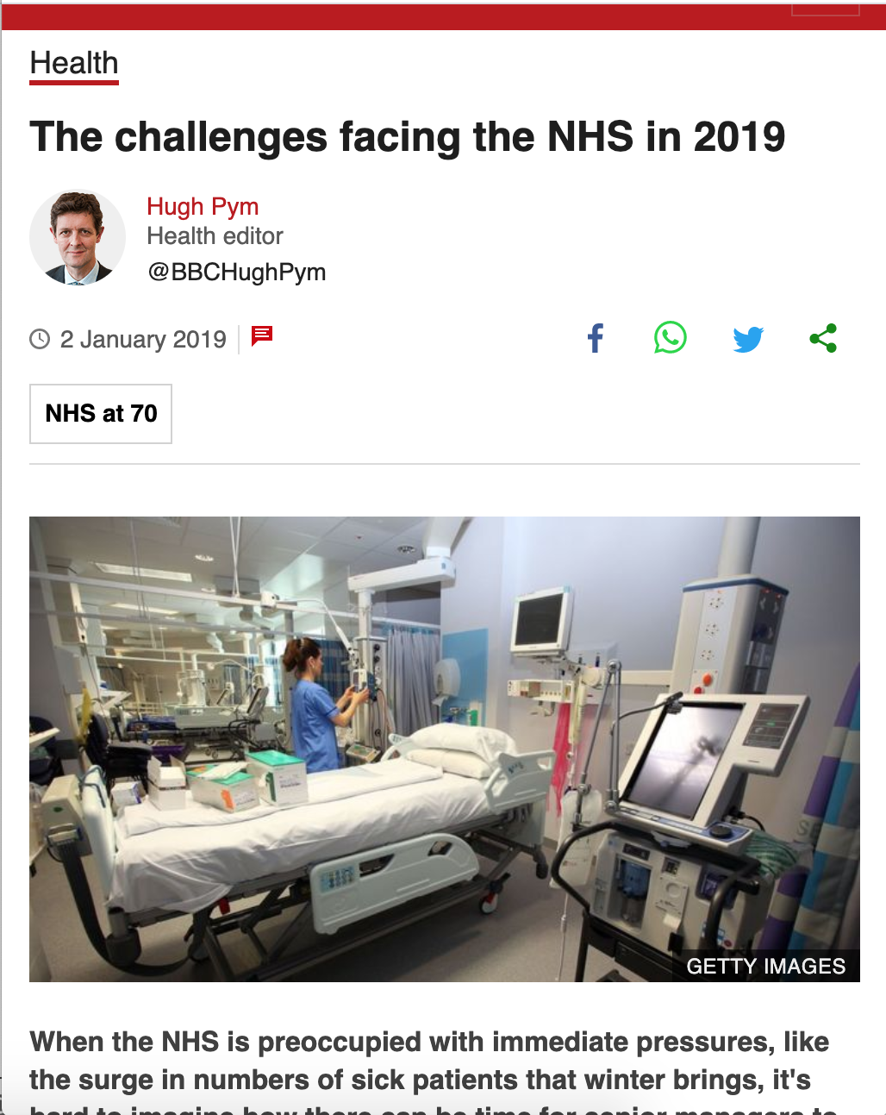
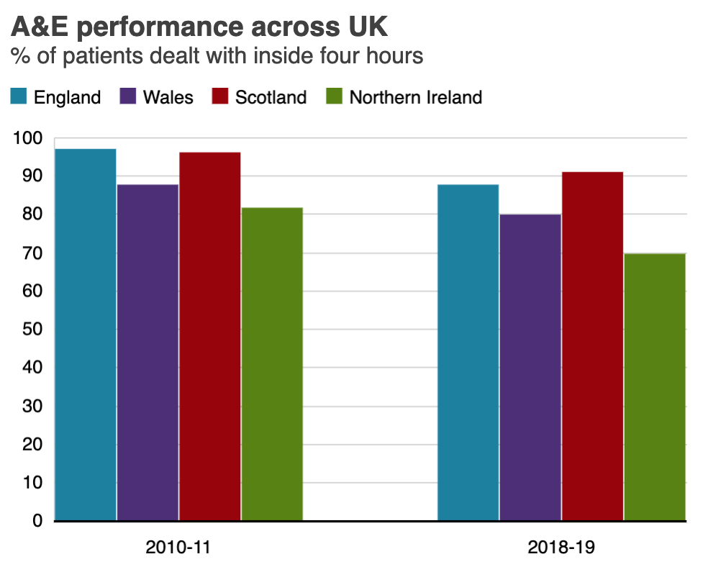
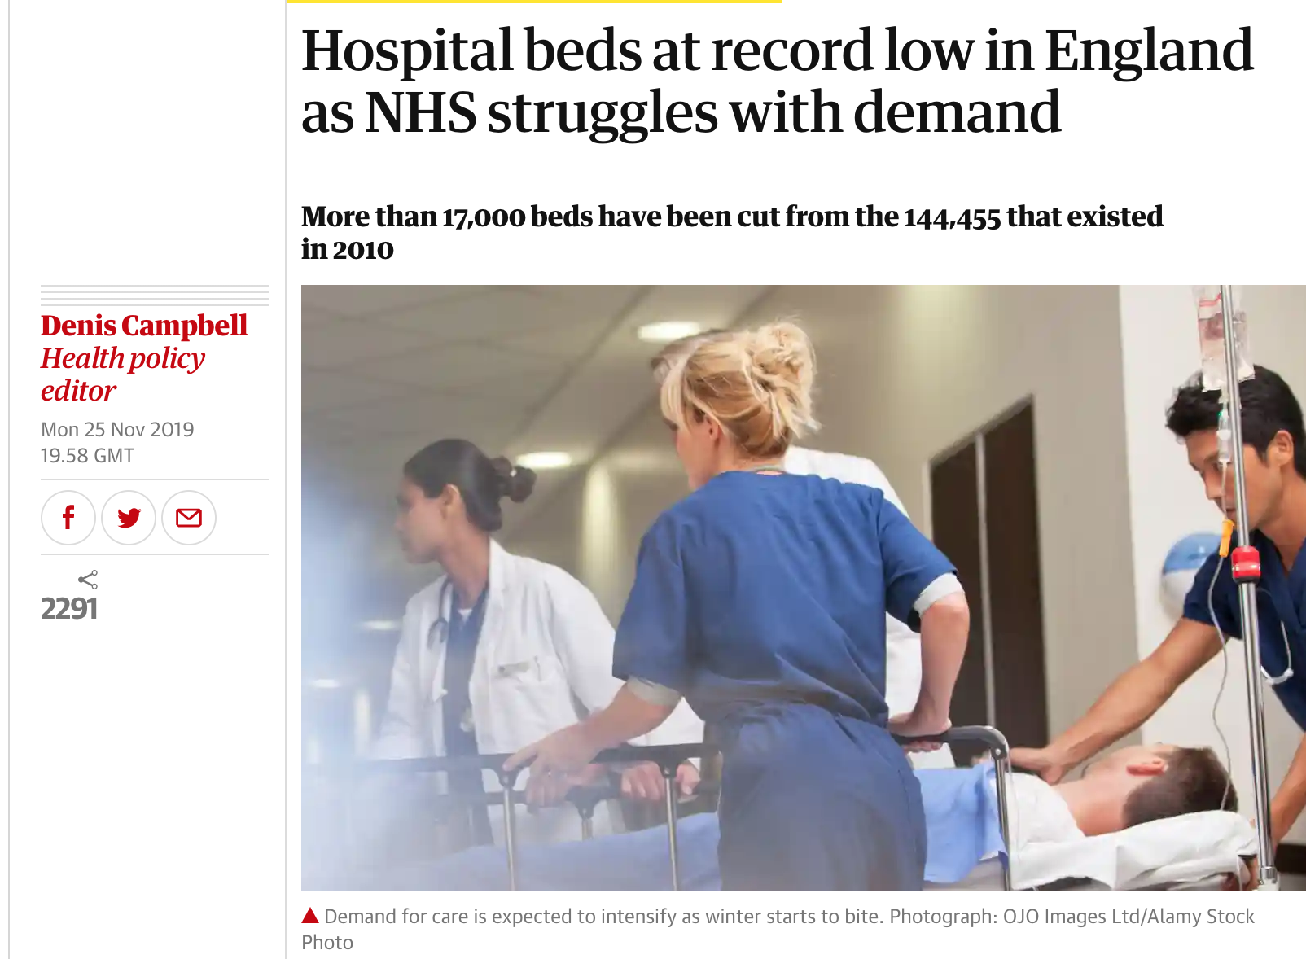
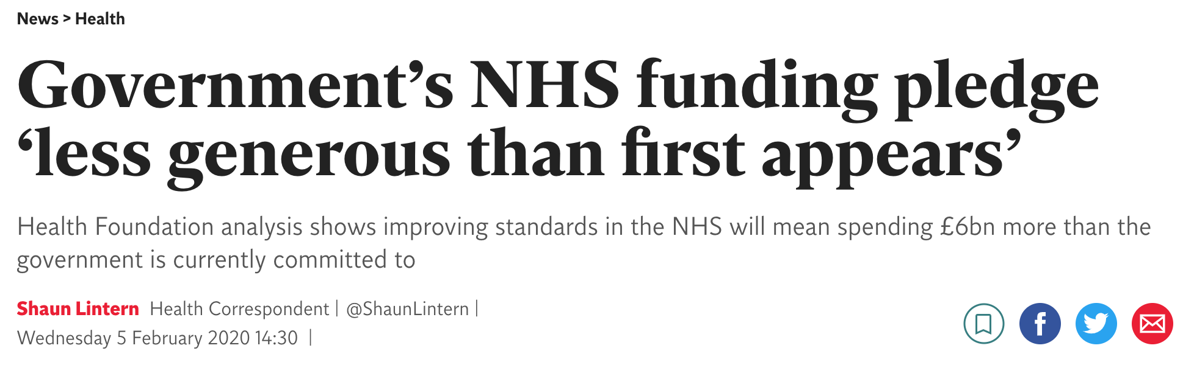
The NHS struggles...

Slide 3
DEMENTIA IN ENGLAND:
KEY FIGURES
More costly than cancer, CVD and diabetes
Condition caused by brain damage, most prevalent in the elderly. It affects:
Memory
Thinking and mental sharpness
Judgement
Patient’s relative
£23 B per year.
676,000 people in England have dementia
Risk of dementia x2 every 5 years in the old population
Notes:
expenditure on dementia equivalent to ⅙ of nhs budget

Slide 4
Building a forecasting model
https://parleyyang.github.io/AIHACK_pres.pdf
Notes:
The problem causes much burden to individuals, relatives and it is very costly for the NHS. We want to help the NHS monitor and forecast the prevalence of this disease so that early intervention plans (resource allocation, coordination of resources) can take place at the CCG level. NHS digital has already built some tools to facilitate understanding of regional data. We have built a tool that allows to not only visualise the current and previous prevalence of a disease but also have estimates of how the condition is going to evolve over time while giving insight on the reason for the change over time (risk factors).
NHS data is challenging, at the moment the platform are not ready for large scale automated data extraction and we have collected data from several data sources to improve the accuracy of our estimates (all at ccg level)

Slide 5
Data Sources & GUI
* Prescription dataset (https://openprescribing.net/api/) - we access the stem type ‘0411’ which corresponds to dementia. The prepared data is in the quantity of medications. We also accessed medication quantity from Obesity (sub category Diabetes can be seen as a risk factor for Dementia), Alcohol Dependence and Nicotine Dependence (These two can be seen as proxy data for smoking and drinking behaviours which are also risk factors for Dementia)
* GP work force data from (https://app.powerbi.com/view?r=eyJrIjoiNmY4NGNiMWQtMGVkZi00MzU2LThiZGMtMTFlZjY2NGE0NTZmIiwidCI6IjUwZjYwNzFmLWJiZmUtNDAxYS04ODAzLTY3Mzc0OGU2MjllMiIsImMiOjh9) - the intention was to find out about GP work force split by ethinicity group at each pratice but this didn’t work out. We can split the GP work force on gender though.
* NHS Stop Smoking data is also explored (https://digital.nhs.uk/data-and-information/publications/statistical/statistics-on-nhs-stop-smoking-services-in-england) but these were not used to proximate the smoking behaviour because the number of people are sparse and hard to join past data together (highly manual process). Instad the ONS data is consulted, adult smoking habits (https://www.ons.gov.uk/peoplepopulationandcommunity/healthandsocialcare/drugusealcoholandsmoking/datasets/adultsmokinghabitsingreatbritain) and (https://www.ons.gov.uk/peoplepopulationandcommunity/healthandsocialcare/drugusealcoholandsmoking/datasets/adultdrinkinghabits). The general trend is slowly dropping for the population group (65+) we are concerned with so we opted for prescription data asr

Slide 6
## Datasets outside of the Hackathon Challenge Briefing
* Recorded Dementia Diagnoses (https://digital.nhs.uk/data-and-information/publications/statistical/recorded-dementia-diagnoses). Data are manually scraped from this page going back in 3-4 years on Number of Diagnosed patients registered by CCG by ethinicity.
* Prevalence for each practice for Dementia (https://qof.digital.nhs.uk/). Prevalance for all disease codes that are included in the Quality and Outcomes Framework (QOF) which is a voluntary annual reward and incentive programme for all GP surgeries in England, detailing practice achievement results.
* Population data by CCGs from Office for National Statistics (https://www.ons.gov.uk/peoplepopulationandcommunity/populationandmigration/populationestimates/datasets/clinicalcommissioninggroupmidyearpopulationestimates)
* Population estimates from 2016 looking into the future by CCGs from Office for National Statistics (https://www.ons.gov.uk/peoplepopulationandcommunity/populationandmigration/populationprojections/datasets/clinicalcommissioninggroupsinenglandtable3)
* Social Deprivation stats: in the report (https://assets.publishing.service.gov.uk/government/uploads/system/uploads/attachment_data/file/733065/Dying_with_dementia_data_analysis_report.pdf) Social deprivation is highlighted as a factor contributing to Dementia death especially for the most deprived, the death rate is twice as high as people who are midly deprived.* 2011 Census data ethinic group by age (https://www.ons.gov.uk/census/2011census/2011censusdata/2011censusdatacatalogue) - thsi is extracted to analyse if some of the CCGs are underserving some ethinic groups or not recording enough data to know. This can highlight some needs for outreach need within the CCGs.

