Slide 1



My Constituency App
User guide and overview of iPad App and datasets provided
Datasets and data visualisation

Slide 2
Welcome to the My Constituency App
This guide details the datasets available in the My Constituency iPad App from the House of Commons Library. The guide is the second in the series and should be viewed after the Getting started guide.
How to use this guide
Datasets
Data visualisation

Slide 3


How to use this guide
This guide is based on a PowerPoint presentation and utilises animations to simulate App interactions. The guide can be navigated by using the following key strokes or mouse clicks
  Left mouse click - next slide or action
  n key - next slide or action
  p key - previous or action
To simulate screen interaction arrows are used. Please click your mouse button or press n key now
To draw your attention to an area on the App screen an eye icon is used (click or press n key)
When the next set of slides are fully animated the following symbol appears at the bottom of the page. A mouse click or press of the n key will start the animated sequence

Slide 4
Datasets
The My Constituency App contains four datasets
  Population
    2002 to 2011 estimates
  Unemployment
    June 2011 to current
  Youth unemployment
    June 2011 to current
  2010 General Election results
    No data for subsequent by-elections

Slide 5
Datasets
Each data set is controlled and displayed in different ways due to the nature of the data

Slide 6
Datasets
Population
Has the following user controls
  Year slider
  Comparison to other constituency
  Chart type
    Bar
    Line

Slide 7
Dataset - Population
Year slider
  To change the year range tap and hold on one of the green squares moving it horizontally left or right until the desired year is displayed and release the green slider
  Both green sliders can be used in combination

Slide 8
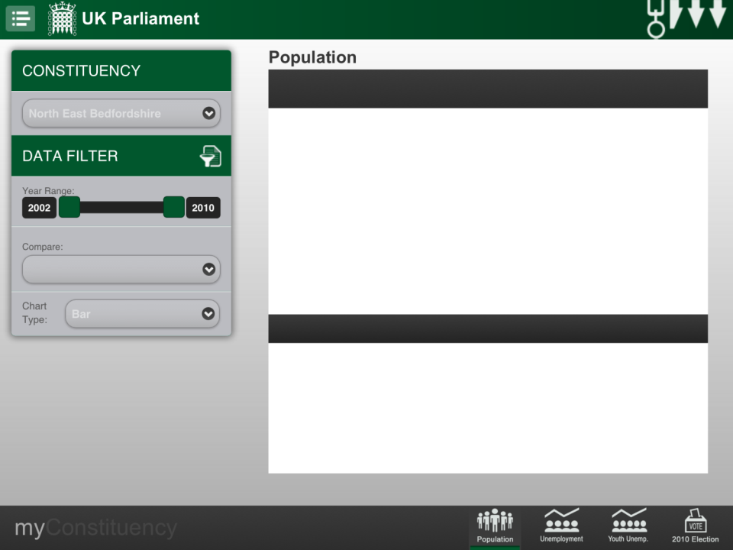

Slide 9
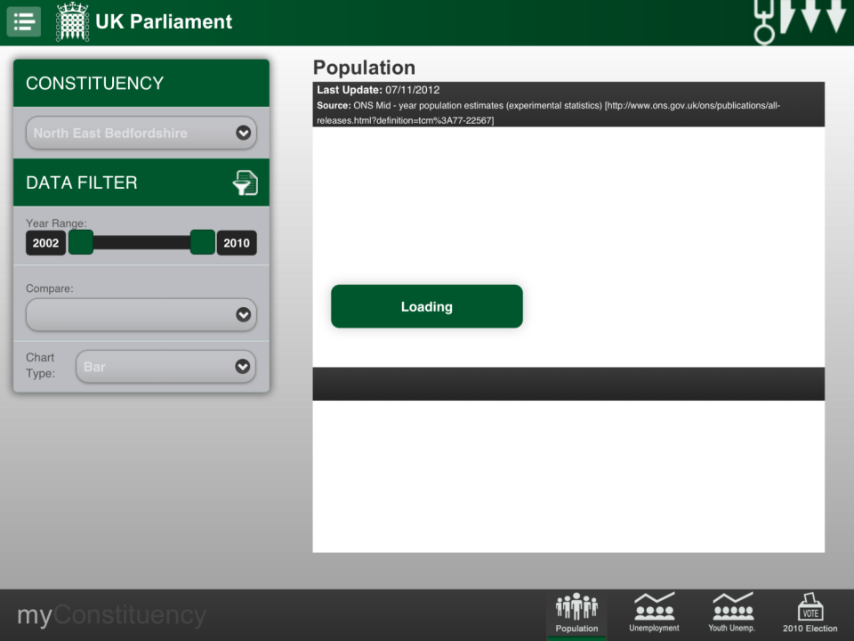

Slide 10
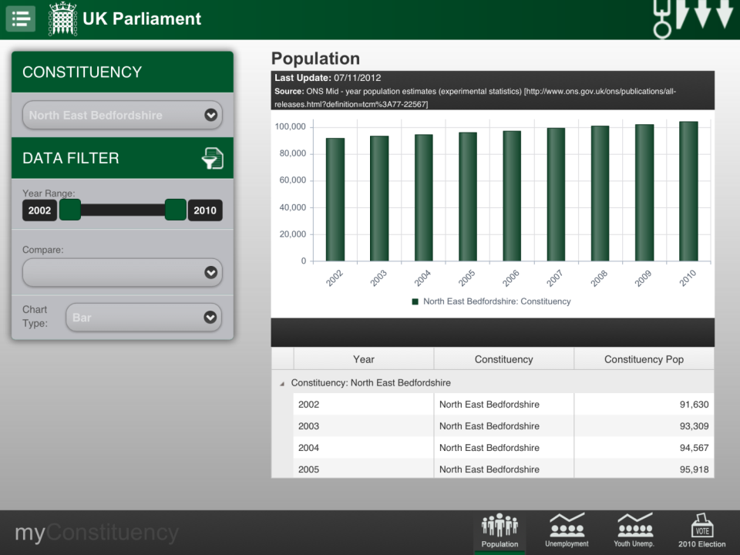

Slide 11
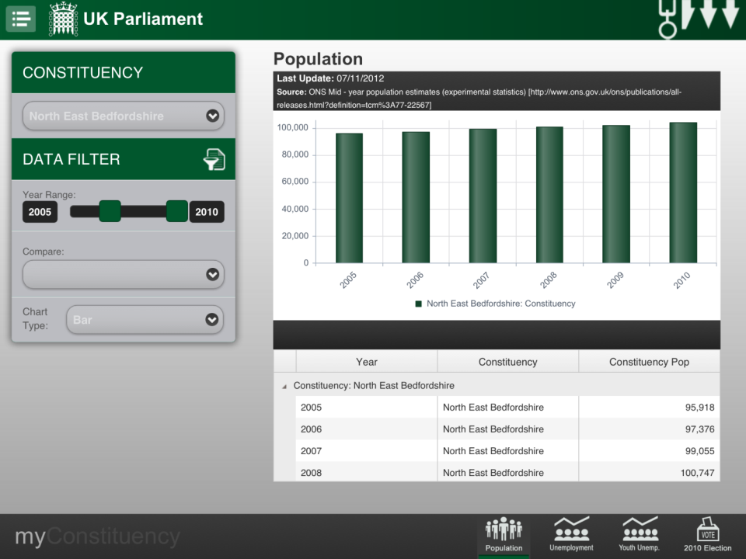

Slide 12


Slide 13
Dataset - Population
Comparison to other constituency
  To set the comparison constituency tap on the blank box with a dropdown arrow
  In the pop-up list use your finger to scroll down the list to find the constituency then tap on the constituency name to select it

Slide 15
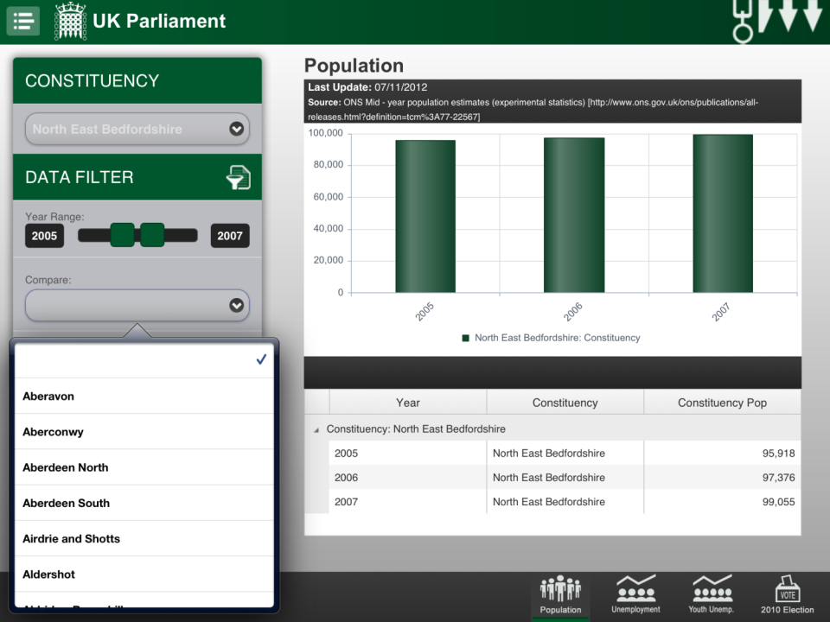

Slide 16
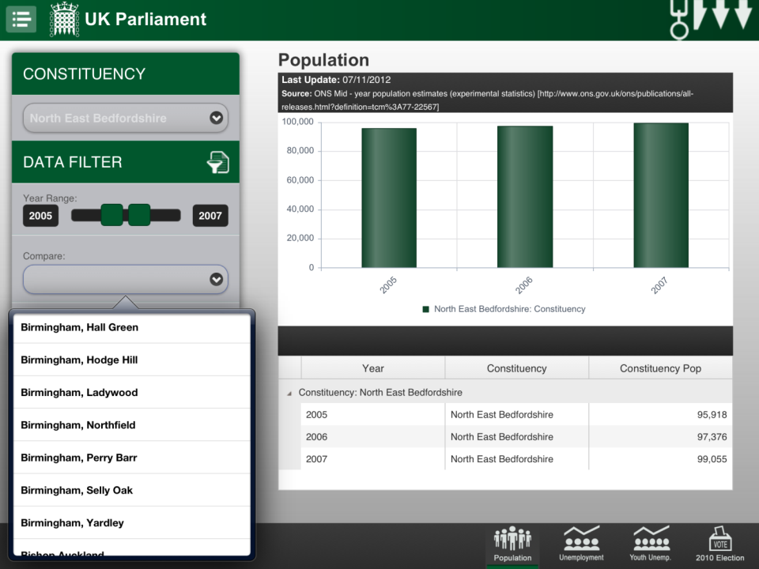

Slide 17
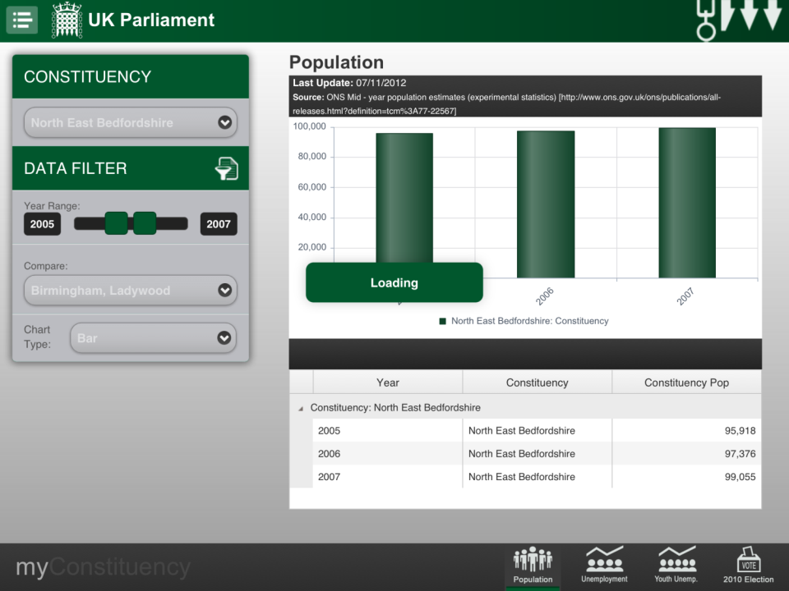

Slide 18
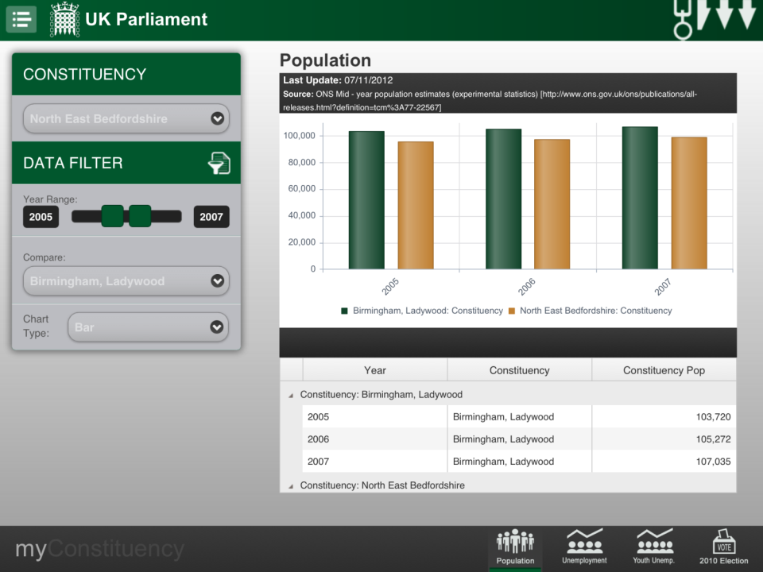

Slide 19
Dataset - Population
Chart type
  Tap on the chart type box (default type is Bar)
  From the pop-up list select the desired chart type

Slide 21
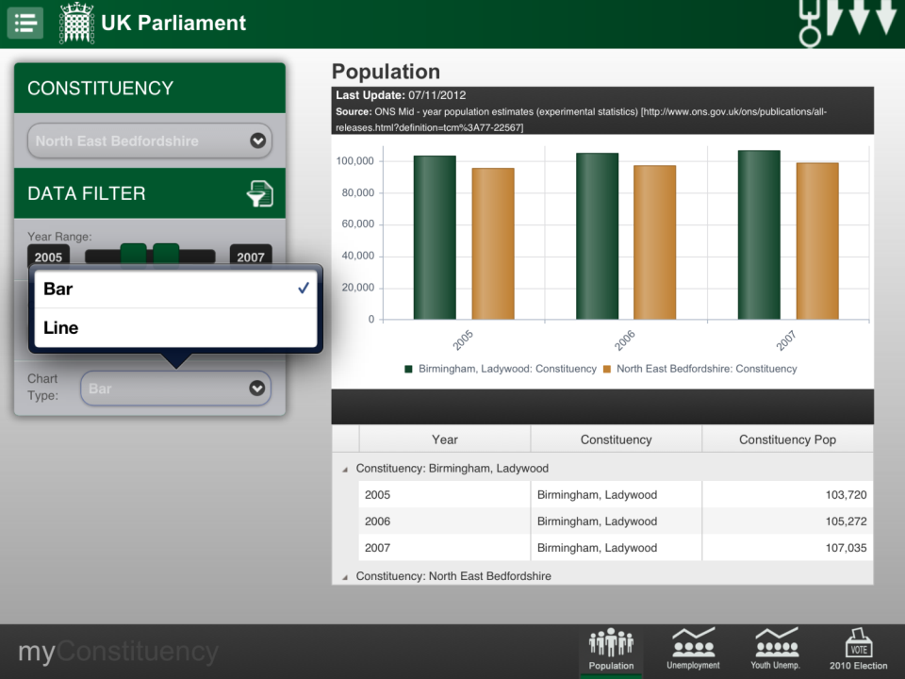

Slide 22
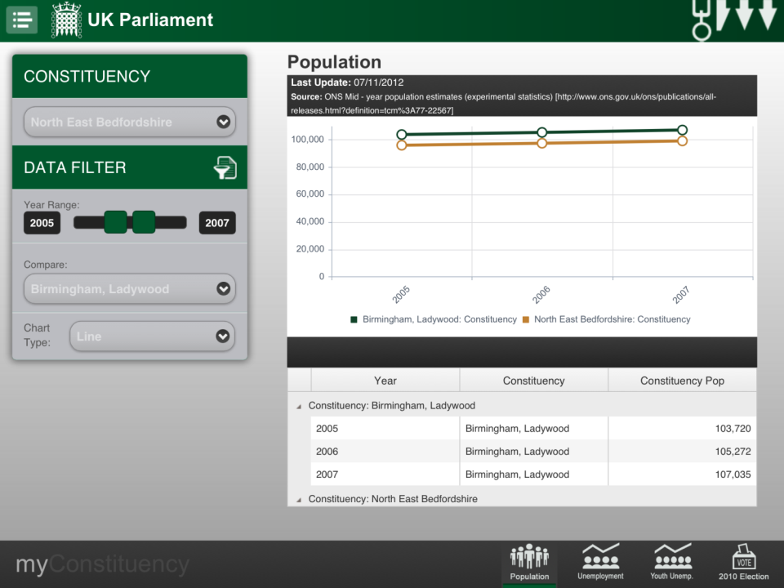

Slide 23
Datasets
Unemployment and Youth employment
    Month range slider
    Data displayed as
      percentage (Rate %)
      counts (Total (#)
    Comparison to other constituency (same as Population)
    Comparison to constituency region
    Comparison to UK
    Chart type (same as Population)
      Bar
      Line

Slide 24
Datasets – Unemployment and Youth unemployment
Month range slider
  To change the number of month in the range tap and hold on the green square moving it horizontally left or right until the desired range value is displayed and release the green slider

Slide 26
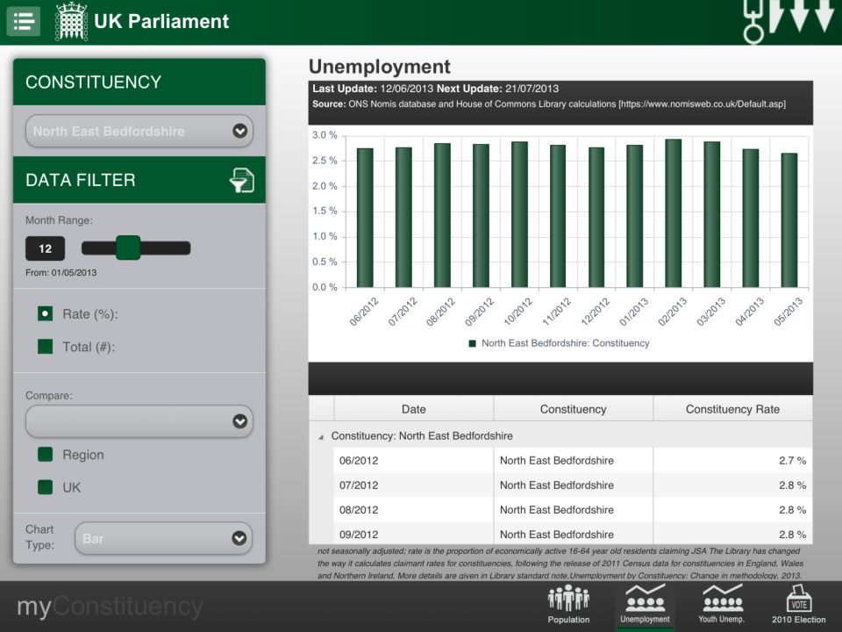

Slide 27
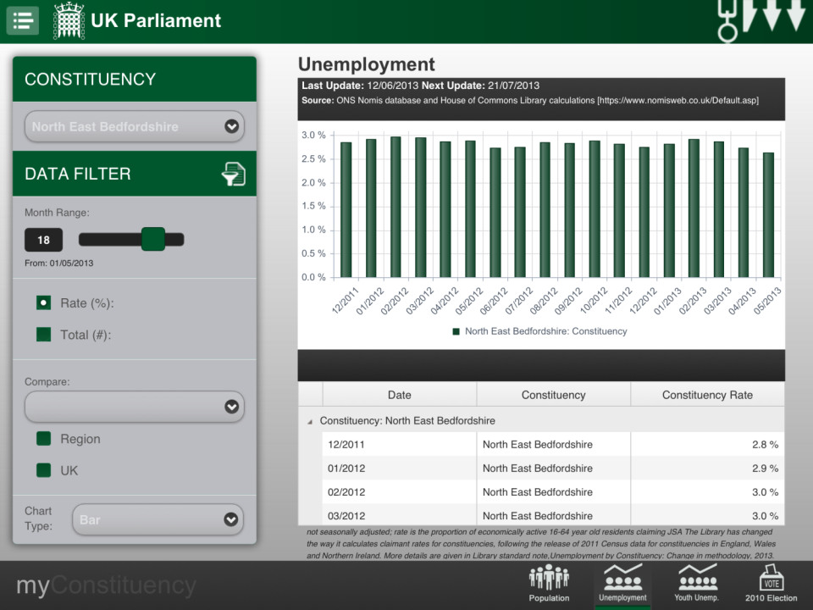

Slide 28
Datasets – Unemployment and Youth unemployment
Data displayed as
  Tap on the box next to Rate(%) to set the chart and table to this data type
  Tap on the box next to Total(#) to set the chart and table to this data type

Slide 30
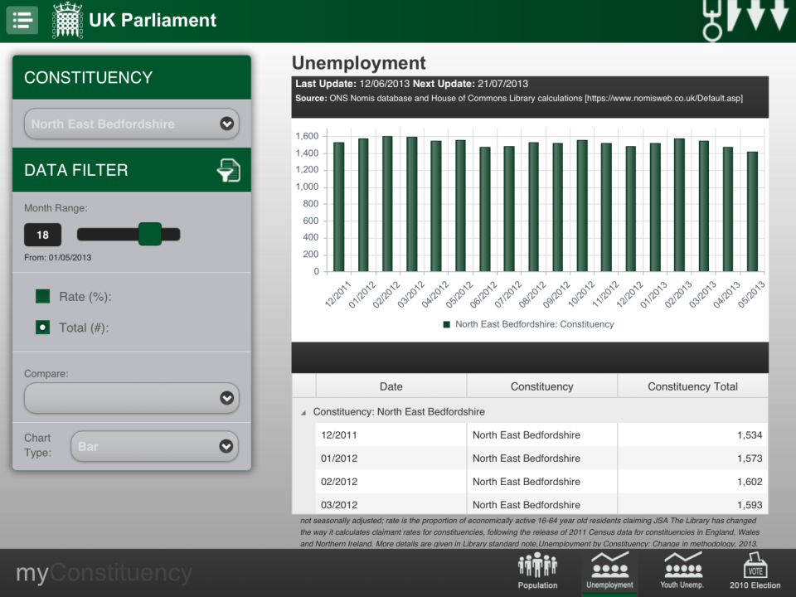

Slide 32
Datasets – Unemployment and Youth unemployment
Tap on the box next to Region to add to the chart and table this data type
Tap on the box next to UK to add to chart and table this data type
Note these comparisons are not available when Total(#) is selected

Slide 34
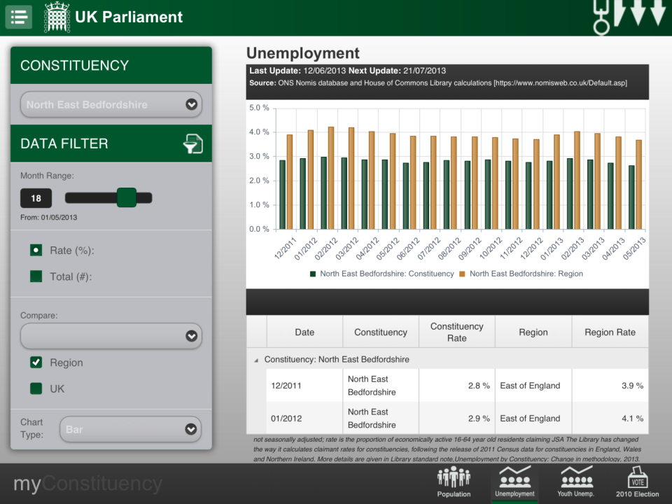

Slide 35
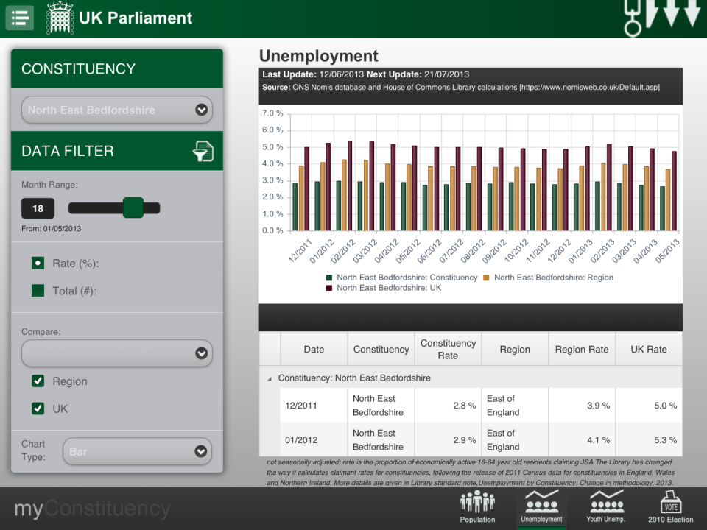

Slide 36
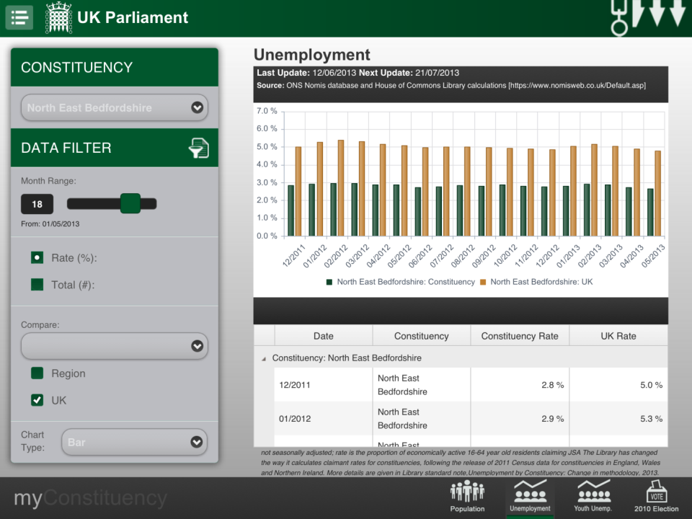

Slide 37
Datasets
2010 General Election results
  Single constituency only
    To change the constituency away from the default use the dropdown box provided
    The data table can be scrolled through to view all the candidate data

Slide 39
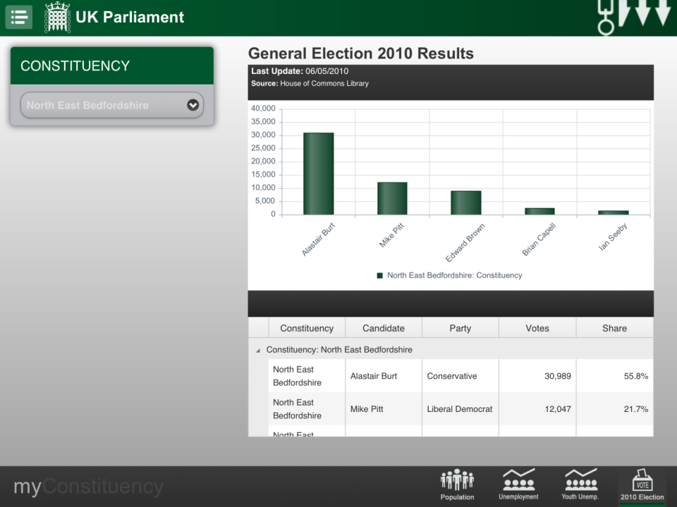

Slide 40


Slide 41


Slide 42
This guide has been completed. It is recommended that you complete the following guide:
- Mapping and thematic maps
The development team hope you find the My Constituency App useful and enjoyable to use. Any feedback to webmaster@parliament.uk

