Slide 1
GROUP 2
HOUSE PROFIT TRACKER SYSTEM

Slide 2
Introduction
Technology helps people and businesses track finances more easily, but many real estate sellers still use manual records, which can lead to errors and lost information. The House Profit Tracker System offers a simple digital way to record house sales and expenses, making financial tracking easier, faster, and more organized even for users with limited computer skills.

Slide 3
Statement of the problem
Many house selling business owners struggle to organize their financial records because they still rely on notebooks or paper, which can lead to lost information and wrong calculations.

Slide 4
Objectives of the Study
To create a system that records house sales and business expenses in an organized way.
To provide an automated computation of total sales, total expenses and net profit.
To generate a simple summary report that helps users clearly understand the records.

Slide 5
Scope and Limitation
SCOPE
The system allows users to record house sales
The system allows users to input different business expenses related to house selling.
The system provides an automated summary that shows total sales, total expenses, and net profit.
The system offers a simple and user friendly menu that guides users.
LIMITATION
Records are not saved permanently, all data is lost when the program closes.
Users cannot edit or delete entries, so mistakes require restarting the program.
No advanced features like data export, user accounts, or database storage.
Only uses a console interface no graphical interface or mobile access.

Slide 6
Software Requirements
Hardware
Processor: Intel Core i3
Memory (RAM): 4GB
Storage: 500MB of available storage
Monitor: Any display that supports text output (console/terminal view)
Keyboard: For typing sales, expenses, and menu choices
Optional: Mouse
Software
Operating System: Windows 10 or higher
Programming Language: Python
Code Editor: Visual Studio Code
Console or Terminal: Command Prompt, PowerShell or terminal

Slide 7
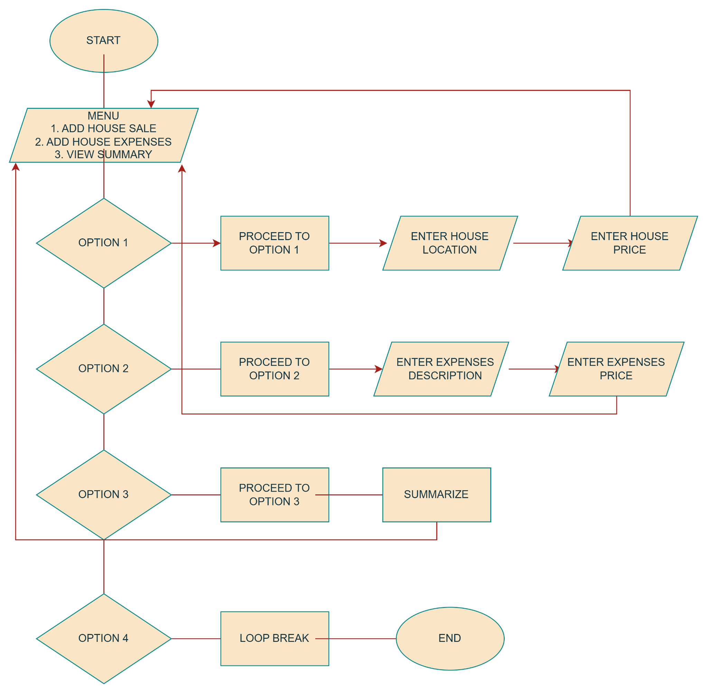
Flow Chart

Slide 8
THANK YOU!

