Slide 1



PROGRAMMING PRACTICES - 3 (JAVA) (05BC2304)
Unit – 1
Introduction to Java and OOP
Prof. Hardik Chavda
FOCA,MU

Slide 2
Unit -1
Features of the Java Language, Object-oriented Concepts
Programming Creating an Application in Java, Compiling and executing Applications in Java Program comments,
Primitive data types Data Types, Scanner Class Operators,
Type Casting Arrays, single and multi-dimensional arrays, Other reference types,
classes, interfaces, enums and annotations,
Unicode escapes in Java source code Understanding super types and sub types,
Understanding the narrowing and widening ,
Statements-if, if-else, switch-case,
for, while, do-while, break, continue and return statements.
Members of a class, Garbage collector and finalize method Static variables and methods Initializer blocks & Class Initializer blocks
Syllabus Analysis

Slide 3
Introduction to Java
Java is a general purpose object oriented Programming language. It is developed by Sun Microsystems of USA.
Its original name was Oak given by James Gosling, who is one of the inventors of the language.
Java was initially Developed for Softwares for Consumer Electronics Devices like TVs, VCRs, and others.

Slide 4
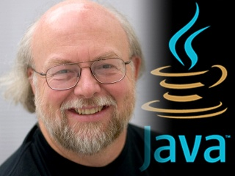
The father of Java – James Gosling

Slide 5
Java is an advance level programming language specially to design client side as well as server side applications.
Java is not only a programming language but it is a whole package which contains huge library, reusable codes and execution environment that provides many services such as security, portability across different operating system.

Slide 6
Java supports object oriented concepts so it is a one type of Object oriented programming language.
One of the main feature of java language is “Write Once, Run Anywhere” which means, you just write code once and it can be reused at anytime, anywhere.
In the application developing operation this feature will be very useful as the code which has written once can be reused whenever a developer want to build same type of another module.

Slide 7
History of Java
Year | Development
1990 | Sun Microsystems decided to develop a special software for consumer electronics devices. A Team has been formed to undertake this task. James Gosling was the head of that team.
1991 | The team announce a new language called “Oak”
1992 | The team known as “Green Project” team, have demonstrated the use of language on a list of home appliances.
1993 | World Wide Web (WWW) has given support to Green Project Team and they have started thinking for development of Web Applets
1994 | A new Web browser called HotJava has been developed by the Team to run applets.
1995 | Oak was rename to Java due to some legal problems.
1996 | Sun release Java Development Kit 1.0 (JDK 1.0)

Slide 8
Year | Development
1997 | Sun release JDK 1.1
1998 | Sun release Java 2 with JDK 1.2
1999 | Sun release J2SE and J2EE
2000 | JDK 1.3
2002 | JDK 1.4
2004 | JDK 1.5
2006 | JDK 1.6
2011 | JDK 1.6
2014 | JDK 1.8
2017 | JDK 1.9
2018 | JDK 10, 11
2019 | JDK 12, 13
2020 | JDK 14, 15
2021 | JDK 16, 17
2022 | JDK 18

Slide 9
Summary of C, C++ and Java
C++
Java
C

Slide 10
Comparison between C and Java
Java does not have sizeof or typedef
Java does not have struct and union
Java does not have pointers
Java does not have preprocessors like #include, #define etc.
Java has new operator instanceof
Java has various features of OOP which are not there in C

Slide 11
Java Editions
Java SE / J2SE stands for Java standard edition and is normally for developing desktop applications, forms the core/base API.
Java EE / J2EE stands for Java enterprise edition for applications which run on servers, for example web sites.
Java ME / J2ME stands for Java micro edition for applications which run on resource constrained devices (small scale devices) like cell phones, for example games.

Slide 12
Features to Java
Java has various features which makes it simple, secure and compact. They are as follows:
Compiled and Interpreted
Platform Independent and Portable
Object Oriented
Secure
Multithreaded
Distributed System
Simple and easy
Robust
Portable
High Performance
Dynamic and extensible

Slide 13
(1) Compiled and Interpreted :
Usually a computer language is either compiled or interpreted. But java combines both the approaches. First java compiler translates the source code into byte code instructions.
Bytecode is a highly optimized set of instructions designed to be executed by the Java run-time system, which is called the Java Virtual Machine (JVM).
Bytecodes are not machine instructions so in second stage, Java Interpreter generates machine code and execute the code. So we can say that java has Compiler and Interpreter.

Slide 14
(2) Platform Independent and Portable :
Java programs can be moved easily from one system to another, anywhere and anytime. Due to this reason only the java is the most popular language on the internet.
Java is Platform independent because it does not generates the machine code but it generates a code for JVM (Java Virtual Machine) The Java Virtual machine (JVM) is the virtual machine that run the Java bytecodes. so the program can be run on any machine without any problem.

Slide 15
(3) Object Oriented :
Java is pure Object Oriented Programming Language. Almost everything in java is an object. All programs, codes and data always resides inside the objects and classes.

Slide 16
(4) Secure :
Java is a secure language.
It has compile time and run time checking for data types.
On the other hand java provides the assurance that no viruses will be communicated with applets.
One more thing is java does not support pointers so no question of memory address to user.

Slide 17
(5) Multithreaded:
Multithreaded means handling a multiple tasks simultaneously and it is a one of the best feature in Java.
Java is able to perform multiple tasks simultaneously and that’s why it is very much beneficial for service side application developing.
(At here, Thread is a tiny unit of one process and process is a collection of different threads)

Slide 18
(6) Distributed System :
Java contain many components from client tier to EIS(Enterprise Information System) tier and each tier has few component which played a very important role to build a server side application.
Its call a distributed architecture where all Java components are separated and has its own separate process and roles in the building an application. The Java RMI (Remote Method Invocation) method is a special mechanism to establish communication between these components.

Slide 19
(7) Simple and easy :
Java has many inbuilt and readymade features for developing an application means it is very easy to write therefore it is very easy to use and run.

Slide 20
(8) Robust :
Java is a robust language which provides a facility that at the time of compile, it automatically detects whether it has any errors or not in the application. (At here the word “Robust” means Reliable)

Slide 21
(9) Portable:
Java ensures portability because it is platform independent. For Example an int in Java is always a 32-bit integer.
In C/C++, int can be a 16-bit integer, 32-bit or any other size integer whatever the compiler vendor likes.
The only restriction is that the int type must have at least as many bytes as a short int and can not have more bytes than a long int. Having a fixed size for number types eliminates a major porting headache.
Binary data is stored and transmitted in a fixed format, eliminating confusion about byte ordering. Strings are saved in standard Unicode format.

Slide 22
(10) High Performance:
Performance of java is such a great and impressive because it has to interpret the compiled bytecode.
The feature of multithreading also responsible for making the performance faster.
Java approach speeds up commonly used code tremendously because one has to do interpretation only once.

Slide 23
(11) Dynamic and extensible :
This is an important feature of java that supports the developer to develop dynamic content in web application with the help of JSP.
In Dynamic concept the code is to added at runtime. Java is a dynamic language because it is capable for generating dynamic content.

Slide 24
Phase – I (Compilation)
Java Program
Source Code
Java Compiler
Virtual Machine
Byte Code
Phase – II (Interpretation)
Virtual Machine
Byte Code
Java Interpreter
Output

Slide 25
Process of Building and Running Java Application
Text Editor
Java Source Code
javac (Compiler)
Java class file
java (Interpreter)
Java Program Output

Slide 26
JVM
JVM (Java Virtual Machine) is an abstract machine. It is a specification that provides runtime environment in which java bytecode can be executed.
JVMs are available for many hardware and software platforms. JVM, JRE and JDK are platform dependent because configuration of each OS differs. But, Java is platform independent.
The JVM performs following main tasks:
Loads code
Verifies code
Executes code
Provides runtime environment

Slide 27
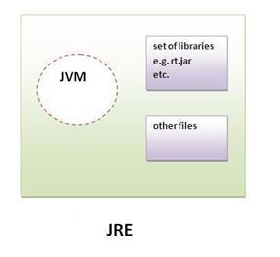
JRE
JRE is an acronym for Java Runtime Environment. It is used to provide runtime environment. It is the implementation of JVM. It physically exists. It contains set of libraries + other files that JVM uses at runtime.
Implementation of JVMs are also actively released by other companies besides Sun Micro Systems.

Slide 28
JDK
JDK is an acronym for Java Development Kit. It physically exists. It contains JRE + development tools.
What does Java Development Kit (JDK) mean?
The Java Development Kit (JDK) is a software development environment used for developing Java applications and applets.
It includes the Java Runtime Environment (JRE), an interpreter/loader (java), a compiler (javac), an archiver (jar), a documentation generator (javadoc) and other tools needed in Java development.

Slide 29
JDK
Java developers are initially presented with two JDK tools, java and javac. Both are run from the command prompt. Java source files are simple text files saved with an extension of .java. After writing and saving Java source code, the javac compiler is invoked to create .class files. Once the .class files are created, the 'java' command can be used to run the java program.
For developers who wish to work in an integrated development environment (IDE), a JDK bundled with NetBeans can be downloaded from the Oracle website. Such IDEs speed up the development process by introducing point-and-click and drag-and-drop features for creating an application.
There are different JDKs for various platforms. The supported platforms include Windows, Linux and Solaris. Mac users need a different software development kit, which includes adaptations of some tools found in the JDK.

Slide 30
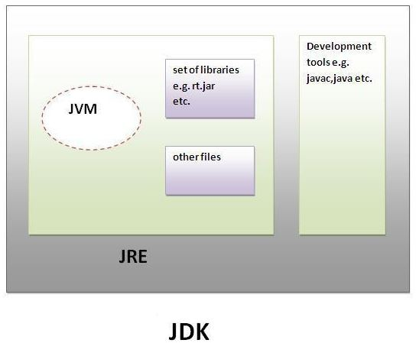
JDK

Slide 31
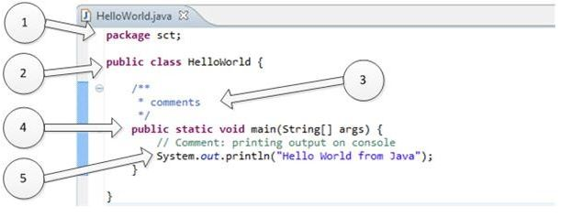
Java Program Structure
Let’s use example of HelloWorld Java program to understand structure and features of class. This program is written on few lines, and its only task is to print “Hello World from Java” on the screen. Refer the following picture.

Slide 32
1. “package sct”:
It is package declaration statement. The package statement defines a name space in which classes are stored. Package is used to organize the classes based on functionality.
If you omit the package statement, the class names are put into the default package, which has no name. Package statement cannot appear anywhere in program.
2. “public class HelloWorld”:
This line has various aspects of java programming.
public: This is access modifier keyword which tells compiler access to class. Various values of access modifiers can be public, protected, private or default (no value).
class: This keyword used to declare class. Name of class (HelloWorld) followed by this keyword.

Slide 33
3. Comments section:
We can write comments in java in two ways.
Line comments: It start with two forward slashes (//) and continue to the end of the current line. Line comments do not require an ending symbol.
Block comments or Multiline Comments start with a forward slash and an asterisk (/*) and end with an asterisk and a forward slash (*/).Block comments can also extend across as many lines as needed.

Slide 34
4.“public static void main (String [ ] args)”:
Its method (Function) named main with string array as argument.
public : Access Modifier
static: static is reserved keyword which means that a method is accessible and usable even though no objects of the class exist.
void: This keyword declares nothing would be returned from method. Method can return any primitive or object.
Method content inside curly braces. { }

Slide 35
5. System.out.println("Hello World from Java") :
System: It is name of Java utility class.
out: It is an object which belongs to System class but actually it is object of PrintStream class of io package
println: It is utility method of PrintStream class which is used to send any String to console.
“Hello World from Java”: It is String literal set as argument to println method.

Slide 36
Object Oriented Programming
Object Oriented Programming is a paradigm that provides many concepts such as inheritance, data binding, polymorphism etc.
Simula is considered as the first object-oriented programming language. The programming paradigm where everything is represented as an object, is known as truly object-oriented programming language.

Slide 37
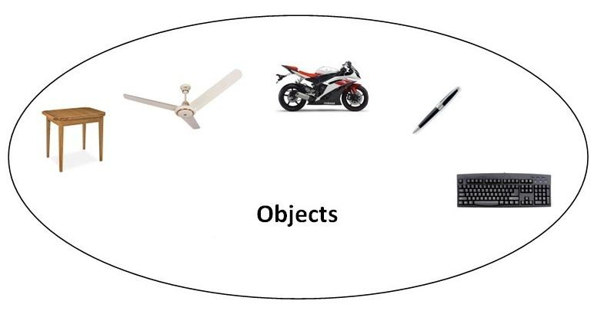
Smalltalk is considered as the first truly object-oriented programming language. OOPs (Object Oriented Programming System)

Slide 38
Object-Oriented Programming is a methodology or paradigm to design a program using classes and objects.
It simplifies the software development and maintenance by providing a paradigm of:
Object
Class
Inheritance
Polymorphism
Abstraction
Encapsulation

Slide 39
Object
Any entity that has state and behaviour is known as an object. For example: chair, pen, table, keyboard, bike etc. It can be physical and logical.
Class
Collection of objects is called class. It is a logical entity. It is also called a blue print of your whole programming structure which contains all the members of your class.

Slide 40
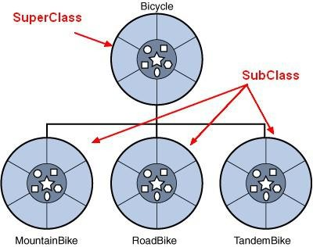
Inheritance
When one object acquires all the properties and behaviours of parent object i.e. known as inheritance. It provides code reusability. It is used to achieve runtime polymorphism.

Slide 41
* Different Terms used in Inheritance
Parent Class | Child Class
Super Class | Sub Class
Class | Derived Class

Slide 42
Polymorphism
“Poly” means many and “Morph” means Forms. “One Name Many Forms”.
When one task is performed by different ways is known as polymorphism.
Example: To draw something shape Or rectangle etc.
In java, we use method overloading and method overriding to achieve polymorphism.

Slide 43
Abstraction
Hiding internal details and showing functionality is known as abstraction.
Example: phone call, we don't know the internal processing.
In java, we use abstract class and interface to achieve abstraction.

Slide 44

Encapsulation
Binding (or wrapping) code and data together into a single unit is known as encapsulation.
Example: capsule, it is wrapped with different medicines.
A java class is the example of encapsulation. Java bean is the fully encapsulated class because all the data members are private here.

Slide 45
Advantage of OOPs over Procedure-oriented programming language
OOPs make development and maintenance easier where as in Procedure-oriented programming language it is not easy to manage if code grows as project size grows.
OOPs provide data hiding whereas in Procedure-oriented programming language a global data can be accessed from anywhere.
OOPs provide ability to simulate real-world event much more effectively. We can provide the solution of real word problem if we are using the Object-Oriented Programming language.

Slide 46
Object-Oriented Programming Language VS Object-Based Programming Language?
Object based programming language follows all the features of OOPs except Inheritance.
JavaScript and are examples of object based programming languages. VBScript

Slide 47
Keywords
Keywords have special meaning to the Java compiler. They help in identifying a data type name or program construct name.
Java Programming Language Keywords:
Keywords also termed as a reserve keyword and it cannot be used as a name of variable, class, method etc.
 | abstract | continue | for | new | switch
 | assert | default | goto | package | synchronized
 | boolean | do | if | private | this
 | break | double | implements | protected | throw
 | byte | else | import | public | throws
 | case | enum | instanceof | return | transient
 | catch | extends | int | short | try
 | char | final | interface | static | void
 | class | finally | long | strictfp | volatile
 | const | float | native | super | while

Slide 48
Identifiers in Java
All Java components require names. Name used for classes, methods, interfaces and variables are called Identifier. Identifier must follow some rules. Here are the rules:
All identifiers must start with either a letter ( a to z or A to Z) or currency character($) or an underscore.
After the first character, an identifier can have any combination of characters.
A Java keyword cannot be used as an identifier.
Identifiers in Java are case sensitive, foo and Foo are two different identifiers.

Slide 49
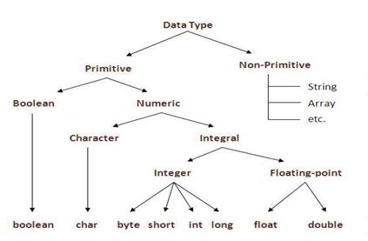
Data Types in Java
Java language has a rich implementation of data types. Data types specify size and the type of values that can be stored in an identifier. In java, data types are classified into two categories:
Primitive Data type
Non-Primitive Data type

Slide 50
1) Primitive Data Type
A primitive data type can be of eight types:
Once a primitive data type has been declared its type can never change, although in most cases its value can change. These eight primitive type can be put into four groups
Primitive Data types
char | boolean | byte | short | int | long | float | double

Slide 51
1) Primitive Data Type
Integer
This group includes byte, short, int long.
byte : It is 8 bit integer data type. Value range from -128 to 127. Default value zero. example: byte b=10;
short : It is 16 bit integer data type. Value range from -32768 to 32767. Default value zero. example: short s=11;
int : It is 32 bit integer data type. Value range from -2147483648 to 2147483647. Default value zero. example: int i=10;
long : It is 64 bit integer data type. Value range from -9,223,372,036,854,775,808 to 9,223,372,036,854,775,807. Default value zero. example: long l=100012;

Slide 52
1) Primitive Data Type
Floating-Point Number
This group includes float, double
float : It is 32 bit float data type. Default value 0.0f. example: float ff=10.3f;
double : It is 64 bit float data type. Default value 0.0d. example: double db=11.123;
Characters
This group represents char, which represent symbols in a character set, like letters and numbers.
char : It is 16 bit unsigned Unicode character. Range 0 to 65,535. example: char c='a';
Boolean
This group represent boolean, which is a special type for representing true/false values. They are defined constant of the language.
example: boolean b=true;

Slide 53
2) Non-Primitive (Reference) Data type
A reference data type is used to refer to an object. A reference variable is declared to be of specific and that type can never be change.
Classes, Arrays, Interface are an example of Non Primitive types.

Slide 54
Scanner Class
Scanner class in Java is found in the java.util package. Java provides various ways to read input from the keyboard, the java.util.Scanner class is one of them.
The Java Scanner class breaks the input into tokens using a delimiter which is whitespace by default. It provides many methods to read and parse various primitive values.
The Java Scanner class is widely used to parse text for strings and primitive types using a regular expression. It is the simplest way to get input in Java. By the help of Scanner in Java, we can get input from the user in primitive types such as int, long, double, byte, float, short, et

Slide 55
The Java Scanner class provides next() methods to return the type of value such as nextInt(), nextByte(), nextShort(), next(), nextLine(), nextDouble(), nextFloat(), nextBoolean(), etc.
To get a single character from the scanner, you can call next().charAt(0) method which returns a single character.
import java.util.*;
public class ScannerExample {
public static void main(String args[]){
Scanner in = new Scanner(System.in);
System.out.print("Enter your name: ");
String name = in.nextLine();
System.out.println("Name is: " + name);
in.close();
}
}

Slide 56
Operators in Java
Java provides a rich set of operators to manipulate variables. We can divide all the Java operators into the following groups:
(1) Arithmetic Operators
(2) Relational Operators
(3) Bitwise Operators
(4) Logical Operators
(5) Assignment Operators
(6) Miscellaneous / Other Operator

Slide 57
(1) Arithmetic Operators:
Operator | Description | Example
+ | Addition - Adds values on either side of the operator | A + B will give 30
- | Subtraction - Subtracts right hand operand from left hand operand | A - B will give -10
* | Multiplication - Multiplies values on either side of the operator | A * B will give 200
/ | Division - Divides left hand operand by right hand operand | B / A will give 2
% | Modulus - Divides left hand operand by right hand operand and returns remainder | B % A will give 0
++ | Increment - Increases the value of operand by 1 | B++ gives 21
-- | Decrement - Decreases the value of operand by 1 | B-- gives 19

Slide 58
(2) Relational Operators:
Operator | Description | Example
== | Checks if the values of two operands are equal or not, if yes then condition becomes true. | (A ==B) is not true.
!= | Checks if the values of two operands are equal or not, if values are not equal then condition becomes true. | (A != B) is true.
> | Checks if the value of left operand is greater than the value of right operand, if yes then condition becomes true. | (A > B) is not true.
< | Checks if the value of left operand is less than the value of right operand, if yes then condition becomes true. | (A < B) is true.
>= | Checks if the value of left operand is greater than or equal to the value of right operand, if yes then condition becomes true. | (A >= B) is not true.
<= | Checks if the value of left operand is less than or equal to the value of right operand, if yes then condition becomes true. | (A <= B) is true.

Slide 59
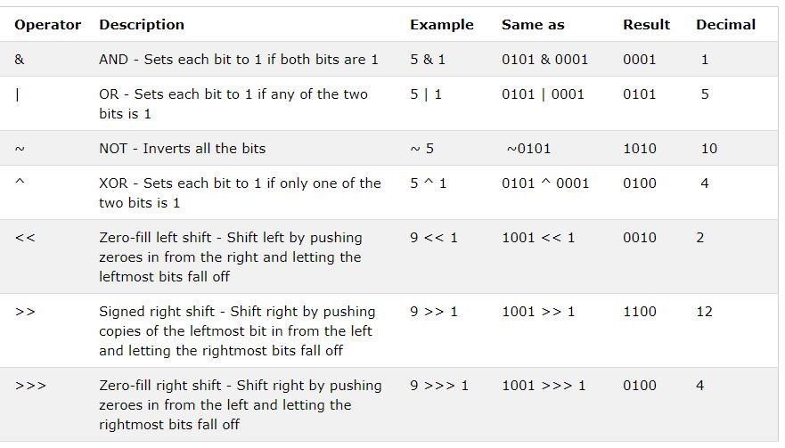
(3) Bitwise Operators:

Slide 60
(4) Logical Operators:
The following table lists the logical operators:
Assume Boolean variables A holds true and variable B holds false, then:
Show Examples
Operator | Description | Example
&& | Called Logical AND operator. If both the operands are non- zero, then the condition becomes true. | (A && B) is false.
|| | Called Logical OR Operator. If any of the two operands are non-zero, then the condition becomes true. | (A || B) is true.
! | Called Logical NOT Operator. Use to reverses the logical state of its operand. If a condition is true then Logical NOT operator will make false. | !(A && B) is

Slide 61
(5) Assignment Operator:
There are following assignment operators supported by Java language:
Operator | Description | Example
= | Simple assignment operator, Assigns values from right side operands to left side operand | C = A + B will assign value of A + B into C
+= | Add AND assignment operator, It adds right operand to the left operand and assign the result to left operand | C += A is equivalent to C = C + A
-= | Subtract AND assignment operator, It subtracts right operand from the left operand and assign the result to left operand | C -= A is equivalent to C = C - A
*= | Multiply AND assignment operator, It multiplies right operand with the left operand and assign the result to left operand | C *= A is equivalent to C = C * A
/= | Divide AND assignment operator, It divides left operand with the right operand and assign the result to left operand | C /= A is equivalent to C = C / A

Slide 62
(5) Assignment Operator:
%= | Modulus AND assignment operator, It takes modulus using two operands and assign the result to left operand | C %= A is equivalent to C = C % A
<<= | Left shift AND assignment operator | C <<= 2 is same as C = C << 2
>>= | Right shift AND assignment operator | C >>= 2 is same as C = C >> 2
&= | Bitwise AND assignment operator | C &= 2 is same as C = C & 2
^= | bitwise exclusive OR and assignment operator | C ^= 2 is same as C = C ^ 2
|= | bitwise inclusive OR and assignment operator | C |= 2 is same as C = C | 2

Slide 63
(6) Misc./ Other Operators
(i) Conditional Operator ( ? : ):
Conditional operator is also known as the ternary operator. This operator consists of three operands and is used to evaluate Boolean expressions. The goal of the operator is to decide which value should be assigned to the variable. The operator is written as:
variable x = (expression) ? value if true : value if false
Following is the example:
public class Test {
public static void main(String args[]){
int a , b;
a = 10;
b = (a == 1) ? 20: 30;
System.out.println( "Value of b is : " + b );
b = (a == 10) ? 20: 30;
System.out.println( "Value of b is : " + b );
}
}
This would produce the following result: Value of b is : 30
Value of b is : 20

Slide 64
(6) Misc./ Other Operators
(ii) Instanceof Operator:
This operator is used only for object reference variables. The operator checks whether the object is of a particular type (class type or interface type). Instance of operator is written as:
(Object reference variable ) instanceof (class/interface type)
If the object referred by the variable on the left side of the operator passes the IS-A check for the class/interface type on the right side, then the result will be true. Example:
public class Test { public static void main(String args[]) {
String name = “Hardik"; // following will return true since name is type of String
boolean result = name instanceof String;
System.out.println( result );
}
}
This would produce the following result:
true

Slide 65
Type Conversion (Typecasting)
Java supports two types of castings
primitive data type casting and
reference type casting
Reference type casting is nothing but assigning one Java object to another object. It comes with very strict rules and is explained clearly in Object Casting. Now let us go for data type casting.
Java data type casting comes with 2 types.
Implicit casting
Explicit casting

Slide 66
1. Implicit casting (widening conversion)
A data type of lower size (occupying less memory) is assigned to a data type of higher size. This is done implicitly by the JVM. The lower size is widened to higher size. This is also named as automatic type conversion.
Examples:
double y;
int x = 10; // occupies 4 bytes double
y = x; // occupies 8 bytes
System.out.println(y); // prints 10.0
In the above code 4 bytes integer value is assigned to 8 bytes double value.

Slide 67
2. Explicit casting (narrowing conversion)
A data type of higher size (occupying more memory) cannot be assigned to a data type of lower size. This is not done implicitly by the JVM and requires explicit casting; a casting operation to be performed by the programmer. The higher size is narrowed to lower size.
In the above code, 8 bytes double value is narrowed to 4 bytes int value. It raises error.
Let us explicitly type cast it.
The double x is explicitly converted to int y. The thumb rule is, on both sides, the same data type should exist.
double x = 10.5; // 8 bytes
int y = x; // 4 bytes ; raises compilation error
double x = 10.5;
int y = (int) x;

Slide 68
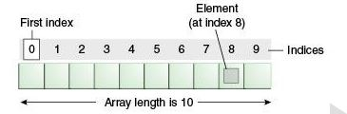
Java Array
Normally, array is a collection of similar type of elements that have contiguous memory location. Java array is an object the contains elements of similar data type. It is a data structure where we store similar elements. We can store only fixed set of elements in a java array.
Array in java is index based, first element of the array is stored at 0 index.

Slide 69
Advantage of Java Array
• Code Optimization: It makes the code optimized, we can retrieve or
sort the data easily.
• Random access: We can get any data located at any index position.
Disadvantage of Java Array
• Size Limit: We can store only fixed size of elements in the array. It doesn't grow its size at runtime. To solve this problem, collection framework is used in java.
Types of Array in java
There are two types of array.
Single Dimensional Array
Multidimensional Array

Slide 70
Single Dimensional Array in java
It is a simple array which can store the multiple elements inside which must belong to the same data type.
Syntax to Declare an Array in java
dataType[] arr;
(or)
dataType arr[];

Slide 71
class ArrayEx
{
public static void main(String args[])
{
int a[]=new int[3];
a[0]=10;
a[1]=20;
a[2]=30;
for(int i=0;i<3;i++)
{
System.out.println(a[i]);
}
}
}

Slide 72
Multidimensional array in java
In such case, data is stored in row and column based index (also known as matrix form).
Syntax to Declare Multidimensional Array in java
dataType[][] arrayRefVar; (or) dataType [][]arrayRefVar; (or) dataType arrayRefVar[][]; (or) dataType []arrayRefVar[];
* Example to instantiate Multidimensional Array in java
int[][] arr=new int[3][3];//3 row and 3 column

Slide 73
class MultiArray
{
public static void main(String args[])
{
int arr[][]=new int[3][3];
arr[0][0]=1;
arr[0][1]=2;
arr[0][2]=3;
arr[1][0]=4;
arr[1][1]=5;
arr[1][2]=6;
arr[2][0]=7;
arr[2][1]=8;
arr[2][2]=9;
for(int i=0;i<3;i++)
{
for(int j=0;j<3;j++)
{
System.out.print(arr[i][j]+" ");
}
System.out.print("\n");
}
}
}

Slide 74
Classes & Objects
A class is a group of objects which have common properties. It is a template or blueprint from which objects are created. It is a logical entity. It can't be physical.
A class in Java can contain:
Fields
Fields hold data.
Methods
Methods also known as functions of class.
Constructors
A Method that can be executed when object of class is created.
Blocks
For Creating Scope
Nested class and interface
Inner classes and Interfaces(will be learned later.)

Slide 75
//Defining a Student class.
class Student{
//defining fields
int id; //field or data member or instance variable
String name;
//creating main method inside the Student class
public static void main(String args[]){
//Creating an object
Student s1=new Student(); //creating an object of Student
//Printing values of the object
System.out.println(s1.id);
//accessing member through reference variable
System.out.println(s1.name);
}
}

Slide 76
Decision Making Statement
Here are two types of decision making statements in Java.
if statements
switch statements

Slide 77
IF Statements
(a) IF Statement:
IF statement consists of a Boolean expression followed by one or more statements.
Syntax:
The syntax of a if statement is:
if(Boolean_expression)
{
//Statements will execute if the Boolean expression is true
}
If the Boolean expression evaluates to true then the block of code inside the if statement will be executed. If not the first set of code after the end of the if statement (after the closing curly brace) will be executed.

Slide 78
Example:
public class Test {
public static void main(String args[]) {
int x = 10;
if (x < 20) {
System.out.print("This is if statement");
}
}
}
OUTPUT
This is if statement

Slide 79
(b) if...else Statement:
A if statement can be followed by an optional else statement, which executes when the Boolean expression is false.
Syntax:
The syntax of a if...else is: if(Boolean_expression) {
//Executes when the Boolean expression is true
} else {
//Executes when the Boolean expression is false
}

Slide 80
Example:
public class Test {
public static void main(String args[]) {
int x = 30;
if (x < 20) {
System.out.print("This is if statement");
} else {
System.out.print("This is else statement");
}
}
}
This would produce the following result: This is else statement

Slide 81
The if...else if...else Statement: (Multiple IF)
if statement can be followed by an optional else if...else statement, which is very useful to test various conditions using single if...else if statement.
When using if, else if, else statements there are few points to keep in mind.
• if can have zero or one else's and it must come after any else if's.
• if can have zero to many else if's and they must come before the else.
• Once an else if succeeds, none of the remaining else if's or else's will be tested.

Slide 82
Syntax:
The syntax of an if...else is:
if(Boolean_expression 1) {
//Executes when the Boolean expression 1 is true
} else if(Boolean_expression 2) {
//Executes when the Boolean expression 2 is true
} else if(Boolean_expression 3) {
//Executes when the Boolean expression 3 is true
} else {
//Executes when the none of the above condition is true.
}

Slide 83
(d) Nested if...else Statement:
It is always legal to nest if-else statements which means you can use one if or else if statement inside another if or else if statement.
Syntax:
The syntax for a nested if...else is as follows:
if(Boolean_expression 1) { //Executes when the Boolean expression 1 is true
if(Boolean_expression 2) { //Executes when the Boolean expression 2 is true
}
}
You can nest else if...else in the similar way as we have nested if statement.

Slide 84
Example:
public class Test {
public static void main(String args[]) {
int x = 30;
int y = 10;
if (x == 30) {
if (y == 10) {
System.out.print("X = 30 and Y = 10");
}
}
}
}
This would produce the following result:
X = 30 and Y = 10

Slide 85
(2) The switch Statement:
A switch statement allows a variable to be tested for equality against a list of values.
Each value is called a case, and the variable being switched on is checked for each case.
Syntax:
The syntax of switch is: switch(expression) {
case value :
// Statements
break; //optional
case value :
// Statements
break; //optional
You can have any number of case statements.
default : //Optional
Statements
}

Slide 86
The following rules apply to a switch statement:
The variable used in a switch statement can only be a byte, short, int, or char.
You can have any number of case statements within a switch. Each case is followed by the value to be compared to and a colon.
The value for a case must be the same data type as the variable in the switch and it must be a constant or a literal.
When the variable being switched on is equal to a case, the statements following that case will execute until a break statement is reached.
When a break statement is reached, the switch terminates, and the flow of control jumps to the next line following the switch statement.
Not every case needs to contain a break. If no break appears, the flow of control will fall through to subsequent cases until a break is reached.
A switch statement can have an optional default case, which must appear at the end of the switch.
The default case can be used for performing a task when none of the cases is true. No break is needed in the default case.

Slide 87
Loops in Java
There may be a situation when we need to execute a block of code several number of times, and is often referred to as a loop.
Java has very flexible three looping mechanisms. You can use one of the following three loops:
(1) while Loop
(2) do...while Loop
(3) for Loop
As of Java 5, the enhanced for loop was introduced. This is mainly used for Arrays.

Slide 88
(1) while Loop:
A while loop is a control structure that allows you to repeat a task a certain number of times.
Syntax:
while(Boolean expression)
{
//Statements
}
When executing, if the boolean_expression result is true, then the actions inside the loop will be executed. This will continue as long as the expression result is true.
Here, key point of the while loop is that the loop might not ever run. When the expression is tested and the result is false, the loop body will be skipped and the first statement after the while loop will be executed.

Slide 89
(1) while Loop:
Example:
public class Test {
public static void main(String args[]) {
int x = 10;
while (x < 15) {
System.out.print("value of x : " + x);
x++;
System.out.print("\n");
}
}
}
OUTPUT:
value of x : 10
value of x : 11
value of x : 12
value of x : 13
value of x : 14

Slide 90
(2) do...while Loop:
A do...while loop is similar to a while loop, except that a do...while loop is guaranteed to execute at least one time.
Syntax:
{
//Statements
} while(Boolean expression);
Notice that the Boolean expression appears at the end of the loop, so the statements in the loop execute once before the Boolean is tested.
If the Boolean expression is true, the flow of control jumps back up to do, and the statements in the loop execute again. This process repeats until the Boolean expression is false.

Slide 91
(2) do...while Loop:
Example:
public class Test {
public static void main(String args[]) {
int x = 10;
do {
System.out.print("value of x : " + x);
x++;
System.out.print("\n");
} while (x < 20);
}
}
This would produce the following result:
value of x : 10
value of x : 11 value of x : 12 value of x : 13 value of x : 14 value of x : 15 value of x : 16 value of x : 17 value of x : 18 value of x : 19

Slide 92
(3) for Loop:
A for loop is a repetition control structure that allows you to efficiently write a loop that needs to execute a specific number of times.
A for loop is useful when you know how many times a task is to be repeated.
Syntax:
for(initialization; Boolean_expression; update)
{
//Statements
}

Slide 93
Here is the flow of control in a for loop:
• The initialization step is executed first, and only once. This step allows you to declare and initialize any loop control variables. You are not required to put a statement here, as long as a semicolon appears.
• Next, the Boolean expression is evaluated. If it is true, the body of the loop is executed. If it is false, the body of the loop does not execute and flow of control jumps to the next statement past the for loop.
• After the body of the for loop executes, the flow of control jumps back up to the update statement. This statement allows you to update any loop control variables. This statement can be left blank, as long as a semicolon appears after the Boolean expression.
• The Boolean expression is now evaluated again. If it is true, the loop executes and the process repeats itself (body of loop, then update step, then Boolean expression). After the Boolean expression is false, the for loop terminates.

Slide 94
Example:
public class Test {
public static void main(String args[]) {
for (int x = 10; x < 20; x = x + 1) {
System.out.print("value of x : " + x);
System.out.print("\n");
}
}
}

Slide 95
(4) Enhanced for loop in Java:
As of Java 5, the enhanced for loop was introduced. This is mainly used for Arrays.
Syntax:
The syntax of enhanced for loop is: for(declaration : expression)
{
//Statements
}
• Declaration: The newly declared block variable, which is of a type compatible with the elements of the array you are accessing. The variable will be available within the for block and its value would be the same as the current array element.
• Expression: This evaluates to the array you need to loop through. The expression can be an array variable or method call that returns an array.

Slide 96
The break Keyword
The break keyword is used to stop the entire loop. The break keyword must be used inside any loop or a switch statement. The break keyword will stop the execution of the innermost loop and start executing the next line of code after the block.
Example:
public class Test {
public static void main(String args[]) {
int[] numbers = { 10, 20, 30, 40, 50 };
for (int x : numbers) {
if (x == 30) {
break;
}
System.out.print(x);
System.out.print("\n");
}
}
}
This would produce the following result: 10
20

Slide 97
The continue Keyword:
The continue keyword can be used in any of the loop control structures. It causes the loop to immediately jump to the next iteration of the loop. In a for loop, the continue keyword causes flow of control to immediately jump to the update statement.
In a while loop or do/while loop, flow of control immediately jumps to the Boolean expression.
Syntax:
The syntax of a continue is a single statement inside any loop: continue;
Example:
public class Test {
public static void main(String args[]) {
int [] numbers = {10, 20, 30, 40, 50};
for(int x : numbers ) { if( x == 30 ) {
continue;
}
System.out.print( x ); System.out.print("\n");
}
}}
This would produce the following result:
10
20
40
50

Slide 98
Member of Class
A member is some entity that belongs to a class.
If a class has a function, this is a member function - you might know it as "a method".
If a class has a variable, this is a member variable - you might know it as "a property".
Example
int a;
void f () {};
class A{
int m_A;
void m_F(){}
}
a is a global variable.
f is a global function.
m_A is a member variable or "property" of the class A.
m_F is a member function or "method" of the class A.

Slide 99
Difference between object and class
No. Object Class
1) | Object is an instance of a class. | Class is a blueprint or template from which objects are created.
2) | Object is a real world entity such as pen, laptop, mobile, bed, keyboard, mouse, chair etc. | Class is a group of similar objects.
3) | Object is a physical entity. | Class is a logical entity.
4) | Object is created through new keyword mainly e.g. Student s1=new Student(); | Class is declared using class keyword e.g. class Student{}
5) | Object is created many times as per requirement. | Class is declared once.
6) | Object allocates memory when it is created. | Class doesn't allocated memory when it is created.

Slide 100
Java Garbage Collection
In java, garbage means unreferenced objects. Garbage Collection is process of reclaiming the runtime unused memory automatically. In other words, it is a way to destroy the unused objects. To do so, we were using free() function in C language and delete() in C++. But, in java it is performed automatically. So, java
provides better memory management.
Advantage of Garbage Collection
It makes java memory efficient because garbage collector removes the unreferenced objects from heap memory.
It is automatically done by the garbage collector(a part of JVM) so we don’t need to make extra efforts.
How can an object be unreferenced?
There are many ways:
o By nulling the reference
o By assigning a reference to another
o By annonymous object etc.

Slide 101
Java Garbage Collection
1) By nulling a reference:
Employee e=new Employee(); e=null;
By assigning a reference to another:
Employee e1=new Employee();
Employee e2=new Employee();
e1=e2; //now the first object referred by e1 is available
for garbage collection
3) By anonymous object:
new Employee();

Slide 102
Java Garbage Collection
finalize() method
The finalize() method is invoked each time before the object is garbage collected. This method can be used to perform cleanup processing. This method is defined in Object class as:
protected void finalize(){}
gc() method
The gc() method is used to invoke the garbage collector to perform cleanup processing. The gc() is found in System and Runtime classes.
public static void gc(){}
Note: Garbage collection is performed by a daemon thread called Garbage Collector(GC). This thread calls the finalize() method before object is garbage collected.

Slide 103
Java Garbage Collection
public class TestGarbage1 {
public void finalize() {
System.out.println("object is garbage collected");
}
public static void main(String args[]) {
TestGarbage1 s1 = new TestGarbage1();
TestGarbage1 s2 = new TestGarbage1();
s1 = null;
s2 = null;
System.gc();
}
}
output:
object is garbage collected
object is garbage collected
Note: Neither finalization nor garbage collection is guaranteed.

Slide 104
Instance initializer block:
In a Java program, operations can be performed on methods, constructors, and initialization blocks. Instance Initialization Blocks or IIBs are used to initialize instance variables.
So firstly, the constructor is invoked and the java compiler copies the instance initializer block in the constructor after the first statement super(). They run each time when the object of the class is created.
Initialization blocks are executed whenever the class is initialized and before constructors are invoked.
They are typically placed above the constructors within braces.
It is not at all necessary to include them in your classes.
We can also have multiple IIBs in a single class.
If the compiler finds multiple IIBs, then they all are executed from top to bottom i.e. the IIB which is written at the top will be executed first.

Slide 105
// Java program to illustrate
// Instance Initialization Block
class IIB{
// Instance Initialization Block
{
System.out.println("IIB block");
}
// Constructor of GfG class
IIB() {
System.out.println("Constructor Called");
}
public static void main(String[] args)
{
IIB a = new IIB();
}
}
OutPut:
IIB block
Constructor Called

