Slide 1
Categories of Thread Implementation
There are two broad categories of thread implementation: user-level threads
User Level Thread (ULT)
Kernel level Thread (KLT) also called:
kernel-supported threads
lightweight processes.
User Threads
Thread management done by user-level threads library
Supported above the kernel, via a set of library calls at the user level.
Threads do not need to call OS and cause interrupts to kernel - fast.
Example thread libraries:
POSIX threads
Win32 threads
Java threads

Slide 2
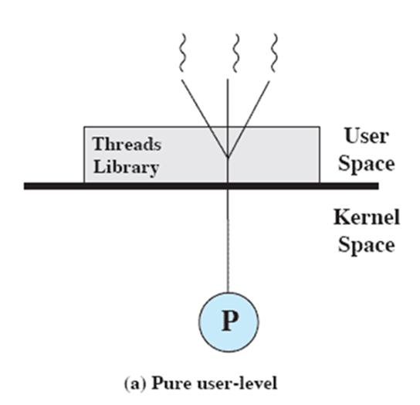
User-Level Threads
All thread management is done by the application
The kernel is not aware of the existence of threads
Figure 4.6a illustrates the pure ULT approach.
Any application can be programmed to be multithreaded by using a threads library, which is a package of routines for ULT management.
By default, an application begins with a single thread and begins running in that thread.
This application and its thread are allocated to a single process managed by the kernel.

Slide 3
Disadvantages Of User-Level Threads
There are two distinct disadvantages of ULTs compared to KLTs:
1.
In a typical OS, many system calls are blocking.
As a result, when a ULT executes a system call, not only is that thread blocked, but
also all of the threads within the process are blocked.
2.
In a pure ULT strategy, a multithreaded application cannot take advantage of
multiprocessing.
A kernel assigns one process to only one processor at a time.
Therefore, only a single thread within a process can execute at a time.

Slide 4
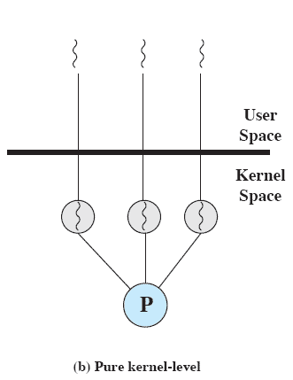
Kernel -Level Threads
All of the work of thread management is
done by the kernel.
There is no thread management code in the
application level.
Figure 4.6b depicts the pure KLT approach.
The kernel maintains context information for the process as a whole and for individual threads within the process.
Scheduling by the kernel is done on a thread basis.

Slide 5
Advantages of KLT
The kernel can simultaneously schedule multiple threads from the same process on multiple processors.
If one thread in a process is blocked, the kernel can schedule another thread of the same process.
Kernel routines themselves can be multithreaded.
Disadvantages of KLT
The transfer of control from one thread to another within the same process requires a mode switch to the kernel

Slide 6
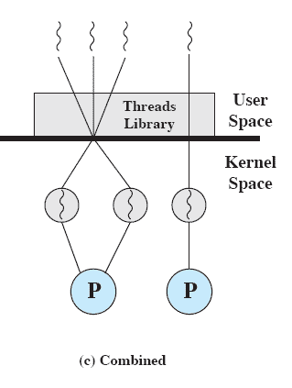
Combined Approaches
Thread creation is done completely in user space, as is the bulk of the scheduling and synchronization of threads within an application.
The multiple ULTs from a single application are mapped onto some (smaller or equal) number of KLTs
Multiple threads within the same
application can run in parallel on multiple
processors, and a blocking system call need
not block the entire process
Notes:
In a combined approach, multiple threads within the same application can run in parallel on multiple processors,
and a blocking system call need not block the entire process.
If properly designed, this approach should combine the advantages of the pure ULT and KLT approaches while minimizing the disadvantages.

Slide 7
ULT vs. KLT
Sr. No | User-Level Threads | Kernel-Level Threads
1 | User-level threads are faster to create and manage. | Kernel-level threads are slower to create and manage
2 | Implementation is by a thread library at the user level | Operating system supports creation of Kernel threads.
3 | User-level thread is generic and can run on any operating system | Kernel-level thread is specific to the operating system
4 | Multi-threaded applications cannot take advantage of multiprocessing. | Kernel routines themselves can be multithreaded

