Slide 1
Unit-2 Process management and thread management

Slide 2
Roadmap – Part-1
Process
Process Control Block
Process State model
Process concepts
Process Control Structure
Notes:
Note: In this chapter, reference is occasionally made to virtual memory. Much of the time, we can ignore this concept in dealing with processes, but at certain
points in the discussion, virtual memory considerations are pertinent. Virtual memory is not discussed in detail until Chapter 8.
Refer students to a brief overview which is provided in Chapter 2.

Slide 3
Requirements of an Operating System
Fundamental Task: Process Management
The process retains the attributes of resource
ownership,
The thread retains the attributes of multiple,
concurrent execution streams running within a
process.
The Operating System must
Interleave the execution of multiple processes
Allocate resources to processes, and protect the resources of each process from other processes,
Enable processes to share and exchange information,
Enable synchronization among processes.

Slide 4
What is a “process”?
A program in execution
An instance of a program running on a computer
The entity that can be assigned to and executed on a processor
A unit of activity characterized by the execution of a sequence of instructions, a current state, and an associated set of system instructions
A process is comprised of:
Program code (possibly shared)
A set of data
A number of attributes describing the state of the process

Slide 5
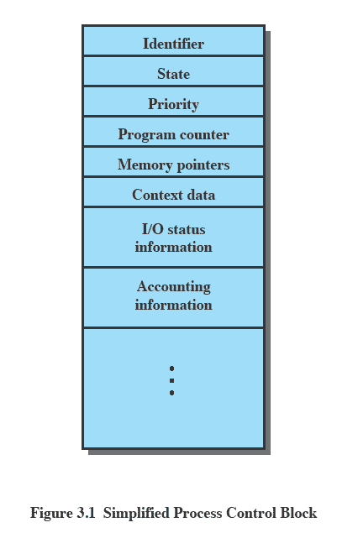
Process Control Block
Contains the process elements
Created and manage by the operating system
Allows support for multiple processes
Emphasise that the Process Control Block contains sufficient information so that it is possible to interrupt a running process and later resume execution as if the interruption had not occurred.
(Figure 3.1) shows process control block that is created and managed by the OS.

Slide 6
Process Control Block
While the program is executing, this process can be uniquely characterized by a
number of elements, including the following:
Identifier:
A unique identifier associated with this process, to distinguish it from all other processes.
State:
If the process is currently executing, it is in the running state.
Priority:
Priority level relative to other processes.
Program counter:
The address of the next instruction in the program to be executed.
Memory pointers:
Includes pointers to the program code and data associated with this process, plus any memory blocks shared with other processes.
Context data:
These are data that are present in registers in the processor while the process is executing.

Slide 7
I/O status information:
Includes outstanding I/O requests, I/O devices assigned to this process, a list of
files in use by the process, and so on.
Accounting information:
May include the amount of processor time and clock time used, time limits,
account numbers, and so on.

Slide 8
Trace of the Process
Trace:-
The behavior of an individual process is shown by listing the sequence of instructions that are executed This list is called a Trace.
Dispatcher:-
It is a small program which switches the processor from one process to another.
Process Execution Example
Consider three processes being executed
All are in memory (plus the dispatcher)
Lets ignore virtual memory for this.

Slide 9
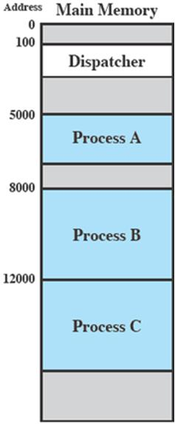
Process Execution Example
We assume that the OS only
allows a process to continue
execution for a maximum of six
instruction cycles,
After which it is interrupted; this
prevents any single process from
monopolizing processor time

Slide 10
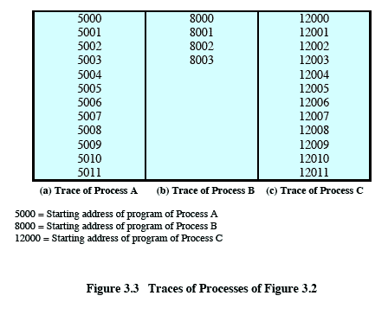
Trace from the processes point of view:
Each process runs to completion
Notes:
Animated slide
Wipes down to give impression of process progression

Slide 11
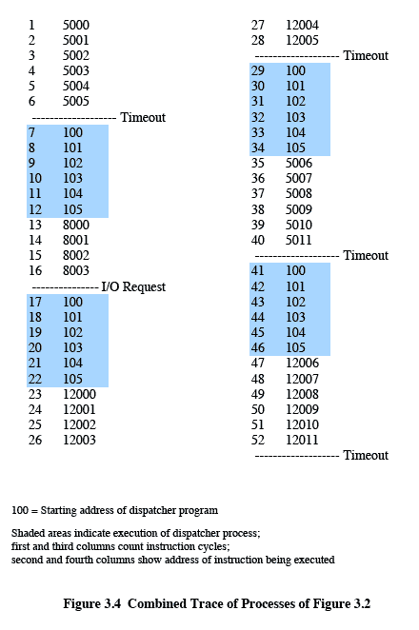
Trace from Processors point of view
Timeout
Timeout
Timeout
I/O
Notes:
Animated slide
Explain the scenario then click for the animation
The shaded areas represent code executed by the dispatcher.
The same sequence of instructions is executed by the dispatcher in each instance because the same functionality of the dispatcher is being executed.
We assume that the OS only allows a process to continue execution for a maximum of six instruction cycles, after which it is interrupted; this prevents any single process from monopolizing processor time.
Animate here
The first six instructions of process A are executed, followed by a time-out and the execution of some code in the dispatcher, which executes six instructions before turning control to process B2.
After four instructions are executed, process B requests an I/O action for which it must wait. Therefore, the processor stops executing process B and moves on, via the dispatcher, to process C.
After a time-out, the processor moves back to process A. When this process times out, process B is still waiting for the
I/O operation to complete, so the dispatcher moves on to process C again.

Slide 12
Two-State Process Model
The operating system’s principal responsibility is controlling the execution of
processes;
This includes determining the interleaving pattern for execution and allocating
resources to processes.
The first step in designing an OS to control processes is to describe the behaviour that
we would like the processes to exhibit.
When the OS creates a new process, it creates a process control block for the process
and enters that process into the system in the Not Running state.
The process exists, is known to the OS, and is waiting for an opportunity to execute.
From time to time, the currently running process will be interrupted and the
dispatcher portion of the OS will select some other process to run.
The former process moves from the Running state to the Not Running state, and one
of the other processes moves to the Running state.

Slide 13
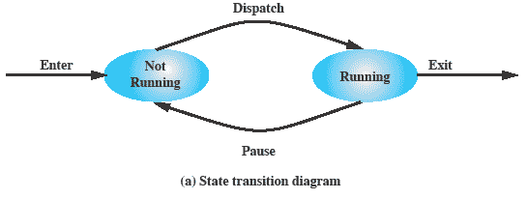
Two-State Process Model
In this model, a process may be in one of two states:
Running or Not Running, as shown in Figure 3.5a.
Notes:
Emphasize that you are introducing a Simple model and that this will be expanded.
The operating system’s principal responsibility is controlling the execution of processes;
this includes determining the interleaving pattern for execution and allocating resources to processes.
The first step in designing an OS to control processes is to describe the behaviour that we would like the processes to exhibit. In the most simple model, a process is either running, or it is not.

Slide 14
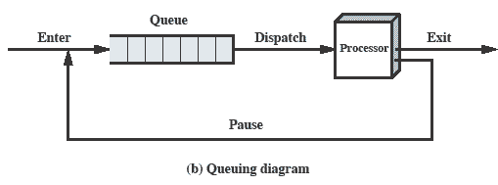
Queuing Diagram for Two state Process Model
Processes that are not running must be kept in some sort of queue, waiting their turn
to execute.
Figure 3.5b suggests a structure.
There is a single queue in which each entry is a pointer to the process control block of
a particular process.
A process that is interrupted is transferred to the queue of waiting processes.
If the process has completed or aborted, it is discarded
In either case, the dispatcher takes another process from the queue to execute.

Slide 15
Queuing Diagram
Etc … processes moved by the dispatcher of the OS to the CPU then back to the queue until the task is competed
Notes:
Animated slide The animation only shows one process moving.
There needs to be some structure so that the OS can keep track of the processes. This could be a simple queue which is managed by the dispatcher routine of the OS.

Slide 16
Process Creation
Process Creation and Termination
When a new process is to be added to those currently being managed,
The OS builds the data structures that are used to manage the process and allocates address space in main memory to the process.
Four common events lead to the creation of a process, as indicated in Table 3.1.
1^{st,} In a batch environment, a process is created in response to the submission of a job.
2nd In interactive environment, a process is created when a new user logs on.
3rd An OS may create a process on behalf of an application. For example, if a user requests for printing, Os creates a process that will manage the printing.
4th One process will create the another. For example, an application process may generate another process to receive data that the application is generating.
Process Spawning:-
When the OS creates a process at the explicit request of another process, the action is referred to as process spawning.
Notes:
Typically, the “related” processes need to communicate and cooperate with each other. Achieving this cooperation is a difficult task for the programmer; discussed further in Chapter 5.

Slide 17
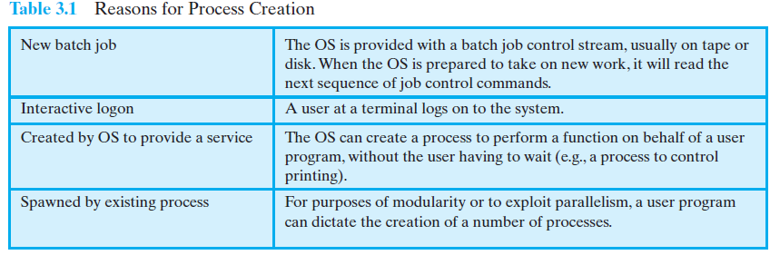
Process Creation

Slide 18
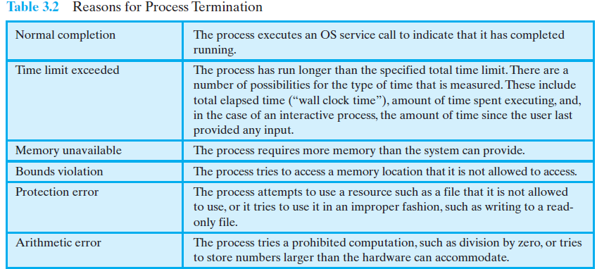
Process Termination
There must be some way that a process can indicate completion.
This indication may be:
A HALT instruction generating an interrupt alert to the OS.
A user action (e.g. log off, quitting an application)
A fault or error
Parent process terminating

Slide 19
Five-State Process Model
Problem With Two State Process Model:-
If all processes were always ready to execute, then the queuing discipline suggested
by Figure 3.5b would be effective.
But, when some processes in the Not Running state
are ready to execute, and
While others are blocked, waiting for an I/O operation to complete.
Thus, using a single queue, the dispatcher could not just select the process at the
oldest end of the queue.
Rather, the dispatcher would have to scan the list looking for the process that is not
blocked and that has been in the queue the longest.
The solution to this situation is to split the Not Running state into two states:
Ready and Blocked.
As shown in Figure 3.6
Notes:
If all processes were always ready to execute, then the simple FIFO queuing model would suffice.
However, even with simple examples, this implementation is inadequate:
some processes in the Not Running state are ready to execute,
while others are blocked, waiting for an I/O operation to complete.
In a two state model, the dispatcher would have to scan the list looking for the process that is not blocked and that has been in the queue the longest.
But we could split the Not Running state into two states:
Ready and
Blocked.
For good measure, we have added two additional states that will prove useful (new and exit)
Suggestion:
Mention that “Wait” and “Blocked” have the same meaning here.
Talk through the state transitions.

Slide 20
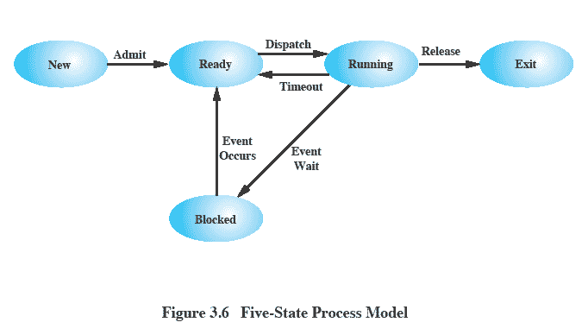
Five-State Process Model

Slide 21
Five-State Process Model
The five states in this new diagram are as follows:
• Running:-
The process that is currently being executed.
Ready:-
A process that is prepared to execute when given the opportunity.
Blocked/Waiting:-
A process that cannot execute until some event occurs, such as the
completion of an I/O operation.
New:-
A process that has just been created but has not yet been admitted to the pool
of executable processes by the OS.
Exit:
A process that has been released from the pool of executable processes by the OS.

Slide 22
Possible state transitions for this model are as follows:-
• Null -> New: A new process is created to execute a program.
New -> Ready:
The OS will move a process from the New state to the Ready state when it is
prepared to take on an additional process.
Ready -> Running:
When it is time to select a process to run, the OS chooses one of the processes in the Ready state.
Running -> Exit:
The currently running process is terminated by the OS if it is completed.
Running -> Ready:
The most common reason for this transition is that the running process has timeout.
Running ->Blocked:
A process is put in the Blocked state if it requests something for which it must wait.
Blocked ->Ready:
A process in the Blocked state is moved to the Ready state when the event for which it has been waiting occurs.
Ready -> Exit:
For clarity, this transition is not shown on the state diagram. E.g If Parent terminates all its child processes.
Blocked -> Exit:
The comments under the preceding item apply.

Slide 23
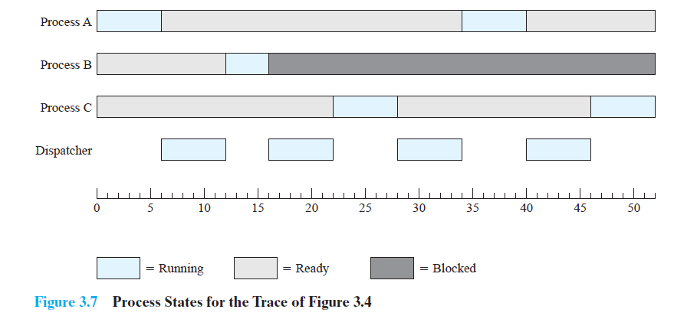
Process State Example :-

Slide 24
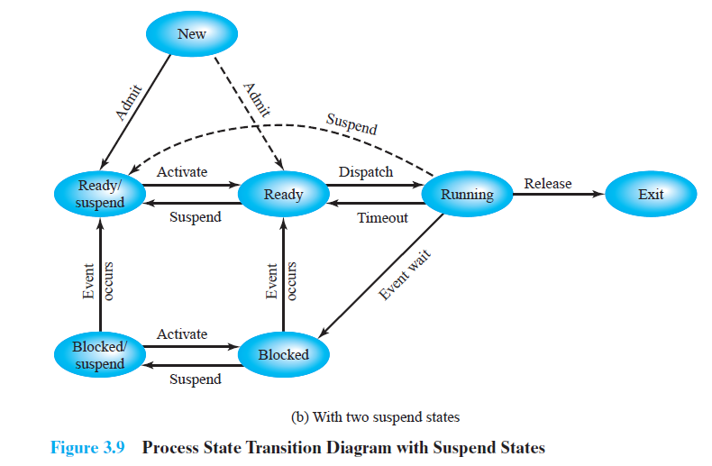
Seven State Process Model
Notes:
Two suspend states allow all processes which are not actually running to be swapped.
Run through the four states:
Ready: The process is in main memory and available for execution.
• Blocked: The process is in main memory and awaiting an event.
• Blocked/Suspend: The process is in secondary memory and awaiting an event.
• Ready/Suspend: The process is in secondary memory but is available for execution as soon as it is loaded into main memory.
It would be useful to also summarise the main transitions (abridged)
Blocked → Blocked/Suspend: If there are no ready processes, then at least one blocked process is swapped out to make room for another process that is not blocked. This transition can be made even if there are ready processes available, if the OS determines that the currently running process or a ready process that it would like to dispatch requires more main memory to maintain adequate performance.
Blocked/Suspend → Ready/Suspend: A process in the Blocked/Suspend state is moved to the Ready/Suspend state when the event for which it has been waiting occurs.
Ready/Suspend S → Ready: When there are no ready processes in main memory, or if a suspended process has a higher priority, the OS will need to bring one in to continue execution.
Ready → Ready/Suspend: Normally, the OS would prefer to suspend a blocked process rather than a ready one, because the ready process can now be executed, whereas the blocked process is taking up main memory space and cannot be executed. However, it may be necessary to suspend a ready process if that is the only way to free up a sufficiently large block of main memory.
Several other transitions that are worth considering are the following:
New → Ready/Suspend and New →Ready: When a new process is created, it can either be added to the Ready queue or the Ready/Suspend queue. In either case, the OS must create a process control block and allocate an address space to the process. It might be preferable for the OS to perform these housekeeping duties at an early time, so that it can maintain a large pool of processes that are not blocked. With this strategy, there would often be insufficient room in main memory for a new process; hence the use of the (New → Ready/Suspend) transition.
Blocked/Suspend → Blocked: Inclusion of this transition may seem to be poor design. After all, if a process is not ready to execute and is not already in main memory, what is the point of bringing it in? But consider the following scenario:
A process terminates, freeing up some main memory.
There is a process in the (Blocked/Suspend) queue with a higher priority than any of the processes in the (Ready/Suspend) queue and
the OS has reason to believe that the blocking event for that process will occur soon.
Under these circumstances, it would seem reasonable to bring a blocked process into main memory in preference to a ready process.
Running → Ready/Suspend: Normally, a running process is moved to the Ready state when its time allocation expires. If, however, the OS is pre-empting the process because a higher-priority process on the Blocked/Suspend queue has just become unblocked, the OS could move the running process directly to the (Ready/Suspend) queue and free some main memory.
Any State → Exit: Typically, a process terminates while it is running, either because it has completed or because of some fatal fault condition. However, in some operating systems, a process may be terminated by the process that created it or when the parent process is itself terminated. If this is allowed, then a process in any state can be moved to the Exit state.

Slide 25
With two suspend states:-
Two suspend states allow all processes which are not actually running to be swapped.
Run through the four states:
Ready:
The process is in main memory and available for execution.
• Blocked:
The process is in main memory and awaiting an event.
• Blocked/Suspend:
The process is in secondary memory and awaiting an event.
• Ready/Suspend:
The process is in secondary memory but is available for execution as soon as it is loaded
into main memory
Important new transitions are the following:
• Blocked -> Blocked/Suspend:
If there are no ready processes, then at least one blocked process is swapped out to
make room for another process that is not blocked.
Blocked/Suspend -> Ready/Suspend:
A process in the Blocked/Suspend state is moved to the Ready/Suspend state when
the event for which it has been waiting occurs.

Slide 26
Ready/Suspend -> Ready:
When there are no ready processes in main memory, the OS will need to bring
one in to continue execution.
Ready -> Ready/Suspend:
Normally, it is not possible , it may be necessary to suspend a ready process if that is
the only way to free up a sufficiently large block of main memory.
New → Ready/Suspend and New →Ready:
When a new process is created, it can either be added to the Ready queue or the
Ready/Suspend queue.
Blocked/Suspend -> Blocked:
There is a process in the (Blocked/Suspend) queue with a higher priority than any of
the processes in the (Ready/Suspend) queue and
The OS has reason to believe that the blocking event for that process will occur
soon.
Running -> Ready/Suspend:
The OS could move the running process directly to the (Ready/Suspend) queue to free some main memory.
Any State -> Exit:
Typically, a process terminates while it is running, either because it has completed or because of some fatal fault condition.
A process can be terminated by the parent process or if the parent has been terminated then it is moved to the exit state.

Slide 27
ROADMAP – PART-2 threads
Multithreading
Benefits of threads and uses of threads
Process Vs Thread
Thread Control Structure
Thread Synchronization

Slide 28
threads
A thread is a single sequence stream within a process.
Because threads have some of the properties of processes, They are called lightweight processes.
A thread (or lightweight process) consists of:
program counter, register set and stack space
A thread shares the following with peer threads:
code section, data section and OS resources (open files, signals)
Threads share code section, data section etc with other threads so the threads are not independent of one another like processes.

Slide 29
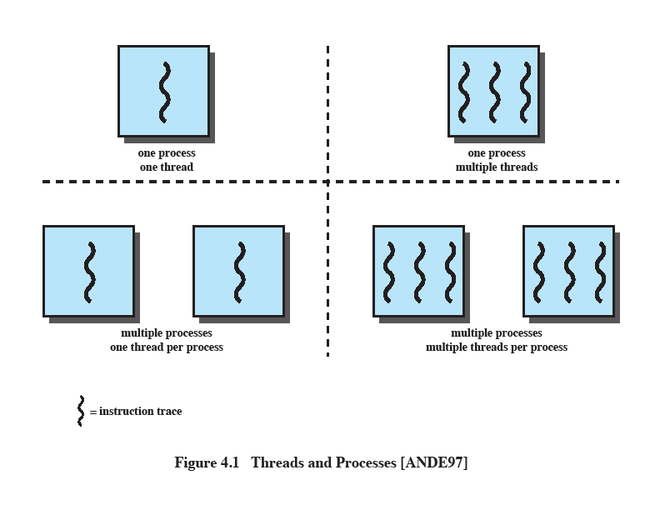
Multithreading
The ability of an OS to support multiple, concurrent paths of execution within a single process.
Notes:
Multithreading refers to the ability of an OS to support multiple, concurrent paths of execution within a single process.

Slide 30
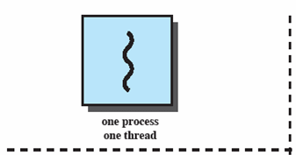
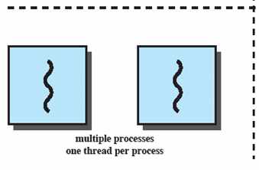
Single Thread Approaches
MS-DOS supports a single user process and a single thread.
Some UNIX, support multiple user processes but only support one thread per process
Notes:
Animated Slide
Onload Enlarges top-left to discuss DOS
Click1: Enlarges bottom-left for Unix
Single Threaded approach: The traditional approach of a single thread of execution per process, in which the concept of a thread is not recognized, examples are
MS DOS (single process, single thread)
Unix (multiple, single threaded processes)

Slide 31
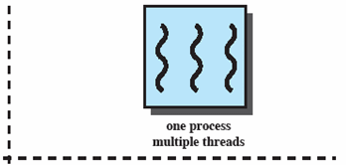
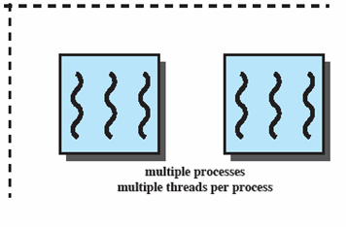
Multithreading
Java run-time environment is a single process with multiple threads
Multiple processes and threads are found in Windows, Solaris, and many modern versions of UNIX
Notes:
Animated Slide
Onload: Emphasis on top-right and JRE (single process, multiple thread),
Click 1: Emphasis on multiple processes with multiple threads – this is the main topic of this chapter
JRE is an example of a system of one process with multiple threads.
Of main interest in this chapter is the use of multiple processes, each of which support multiple threads.
Examples include:
Windows,
Solaris,
and many modern versions of UNIX.

Slide 32
Benefits Of Threads
The key benefits of threads derive from the performance implications:
(1) It takes far less time to create a new thread in an existing process than to create a brand-new process.
(2) It takes less time to terminate a thread than a process.
(3) It takes less time to switch between two threads within the same process than to switch between processes.
(4) Threads enhance efficiency in communication between different executing programs.

Slide 33
Thread uses in a Single-User System
Uses of threads in a single-user multiprocessing system:
Foreground and background work :
e.g. Spreadsheet - one thread looking after display and Another thread updating results of formula.
Asynchronous processing:
e.g. Protection against power failure within a word processor-
A thread writes random access memory (RAM) buffer to disk once every minute.
this thread schedules itself directly with the OS;
Speed of execution:
A multithreaded process can compute one batch of data while reading the next batch from a device.
On a multiprocessor system, multiple threads from the same process may be able to execute simultaneously.
Notes:
Foreground and background work
e.g. Spreadsheet
– one thread looking after display
Another thread updating results of formulae
Asynchronous processing
E.G. protection against power failure within a word processor,
A thread writes random access memory (RAM) buffer to disk once every minute.
this thread schedules itself directly with the OS;
no need for fancy code in the main program to provide for time checks or to coordinate input and output.
Speed of execution
- On thread can compute one batch of data while another thread reading the next batch from a device.
On a multiprocessor system, multiple threads from the same process may be able to execute simultaneously.
Even though one thread may be blocked for an I/O operation to read in a batch of data, another thread may be executing.
Modular program structure
- Threads make it easier to design programs which involve a variety of activities or a variety of sources and destinations of input and output.

Slide 34
Differences:-
SR. NO: | PROCESSES | THREADS
1 | Process is unit of allocation i.e. Resources, privileges, etc. | Threads are unit of execution which includes pc,sp and register
2 | Each process has one or more threads | Each thread belongs to one process.
3 | Inter process communication is expensive i.e Context switching required | Inter thread communication is cheap. Don't required process switching.
4 | These are secure because one process can not corrupt another process | These are not secure because a thread can write memory used by another thread.
5 | Take more time to create a process. | Takes less time to create a thread.
6 | Take more time to terminate a process | Takes less time to terminate a thread
7 | Take more time to switch between processes | Take less time to switch between threads
8 | It has more communication overheads | It has less communication overheads
9 | Processes are independent of one another. | Threads are not independent of one another.

Slide 35
Thread synchronization
Thread Synchronization All of the threads of a process share the same address space and other resources, such as open files.
Any alteration of a resource by one thread affects the environment of the other threads in the same process.
It is therefore necessary to synchronize the activities of the various threads so that they do not interfere with each other or corrupt data structures.
For example, if two threads each try to add an element to a doubly linked list at the same time, one element may be lost or the list may end up malformed.
The issues raised and the techniques used in the synchronization of threads are, in general, the same as for the synchronization of processes

Slide 36
Thread control structure
Thread Control Block (TCB) is a data structure in the operating system kernel which contains thread-specific information needed to manage it.
The TCB is "the manifestation of a thread in an operating system."

Slide 37
An example of information contained within a TCB is:
Thread Identifier: Unique id (tid) is assigned to every new thread
Stack pointer: Points to thread's stack in the process
Program counter: Points to the current program instruction of the thread state of the thread (running, ready, waiting, start, done)
Thread's register values Pointer to the Process control block (PCB) of the process that the thread lives on
The Thread Control Block acts as a library of information about the threads in a system.
Specific information is stored in the thread control block highlighting important information about each process.

Slide 38
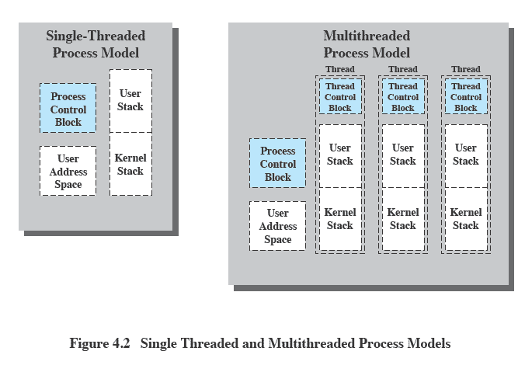

Slide 39
Each thread has
An execution state (running, ready, etc.)
Saved thread context when not running
An execution stack
Some per-thread static storage for local variables
Access to the memory and resources of its process (all threads of a process share this)
One way to view a thread is as an independent program counter operating within a process

