Slide 1
UNIT - 4
SCHEDULING

Slide 2

Roadmap
Types of Processor Scheduling
Scheduling Algorithms
Notes:
Memory management is a complex interrelationship between processor hardware and operating system software.
We focus first on the hardware aspect of virtual memory, looking at the use of paging, segmentation, and combined paging and segmentation.
Then we look at the issues involved in the design of a virtual memory facility in operating systems.

Slide 3
Scheduling
An OS must allocate resources amongst competing processes.
The resource provided by a processor is execution time
The resource is allocated by means of a schedule
Overall Aim of Scheduling
The aim of processor scheduling is to assign processes to be executed by the processor over time,
in a way that meets system objectives, such as response time, throughput, and processor efficiency.
Notes:
An operating system must allocate computer resources among the potentially competing requirements of multiple processes.
In the case of the processor, the resource to be allocated is execution time on the processor and the
means of allocation is scheduling.

Slide 4
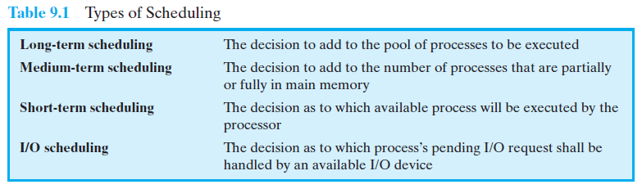
Scheduling Objectives
The scheduling function should
Share time fairly among processes
Prevent starvation of a process
Use the processor efficiently
Have low overhead
Prioritise processes when necessary (e.g. real time deadlines)
Notes:
The scheduling function must be designed to satisfy a number of objectives, including fairness, lack of starvation of any particular process, efficient use of processor time, and low overhead.
In addition, the scheduling function may need to take into account different levels of priority or real-time deadlines for the start or completion of certain processes.

Slide 5
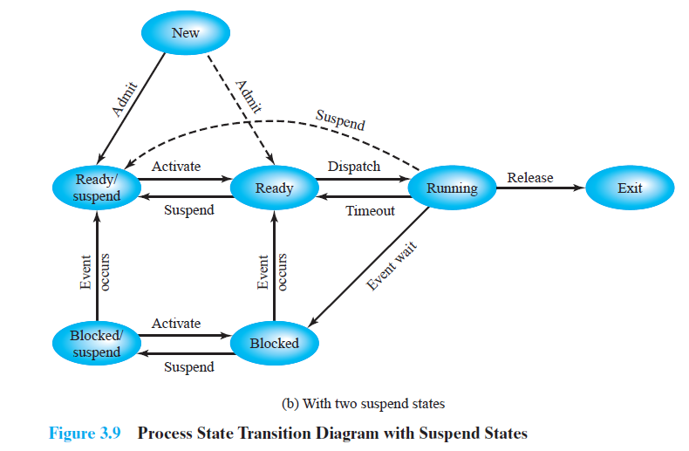
Two Suspend States
Notes:
Figure 3.9b
Two suspend states allow all processes which are not actually running to be swapped.
Ready: The process is in main memory and available for execution.
• Blocked: The process is in main memory and awaiting an event.
• Blocked/Suspend: The process is in secondary memory and awaiting an event.
• Ready/Suspend: The process is in secondary memory but is available for execution as soon as it is loaded into main memory.

Slide 6
Scheduling and Process State Transitions
Figure 9.1 relates the scheduling functions to
the process state transition diagram
(first shown in Figure 3.9b).
Long-term scheduling is performed when a
new process is created.
This is a decision whether to add a new
process to the set of processes that are
currently active.
Medium-term scheduling is a part of the
swapping function.
This is a decision whether to add a process to
those that are at least partially in main memory
and therefore available for execution.
Short-term scheduling is the actual decision of
which ready process to execute next.

Slide 7
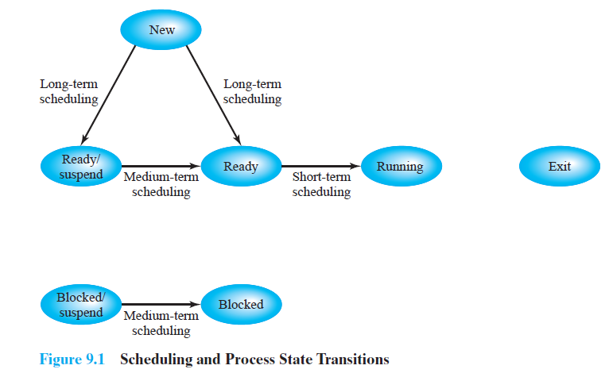
Scheduling and Process State Transitions
Above are the scheduling functions to the process state transition diagram for Figure 3.9b).
Nesting of Scheduling Functions
Figure 9.2 reorganizes the state transition diagram of Figure 3.9b to suggest the nesting of scheduling functions.

Slide 8
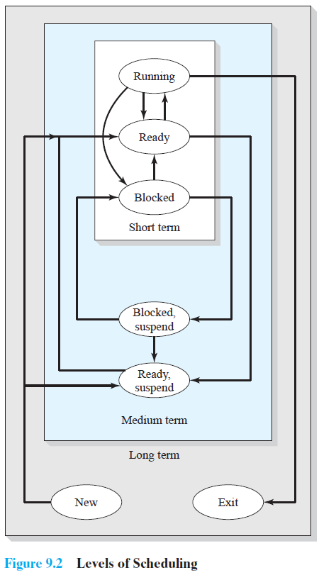
Nesting of Scheduling Functions
Notes:
This figure reorganizes the state transition diagram to suggest the nesting of scheduling functions.

Slide 9
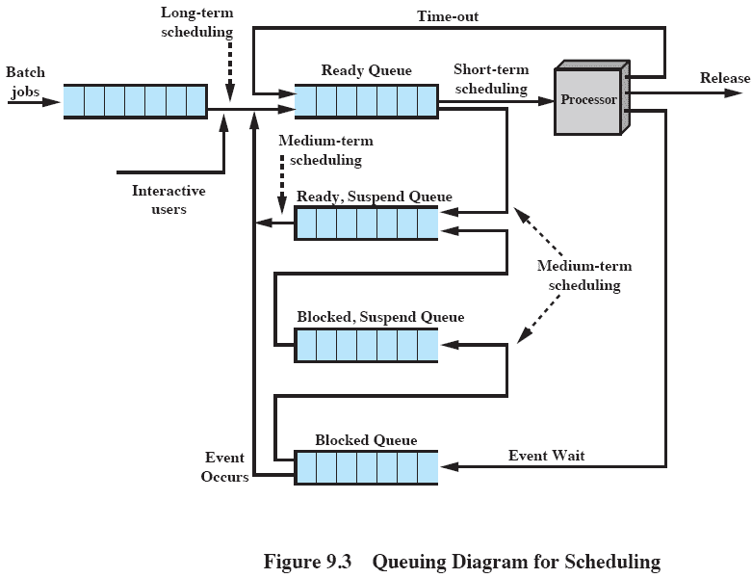
Queuing Diagram For Scheduling
Notes:
This figure shows that scheduling affects the performance of the system because it determines which processes will wait and which will progress.
The figure shows the queues involved in the state transitions of a process.
For simplicity, new processes are shown going directly to the Ready state, whereas the earlier figures (9.1 and 9.2) show the option of either the Ready state or the Ready/Suspend state.
Fundamentally, scheduling is a matter of managing queues to minimize queuing delay and to optimize performance in a queuing environment.

Slide 10
Queuing Diagram For Scheduling
This figure shows that scheduling affects the
performance of the system because it determines
which processes will wait and which will progress.
The figure shows the queues involved in the state
transitions of a process.
For simplicity, new processes are shown going directly
to the Ready state, whereas the earlier figures (9.1
and 9.2) show the option of either the Ready state or
the Ready/Suspend state.
Fundamentally, scheduling is a matter of managing
queues to minimize queuing delay and to optimize
performance in a queuing environment.

Slide 11
Long-Term Scheduling
The long-term scheduler determines which programs are admitted to the system for processing. Thus, it controls the degree of multiprogramming.
Once admitted, a job or user program becomes a process and is added to the queue for the short-term scheduler. OR
A newly created process begins in a swapped-out condition, in which case it is added to a queue for the medium-term scheduler.
The criteria used may include
priority, expected execution time, and I/O requirements.
The decision as to when to create a new process is generally driven by the desired degree of multiprogramming.

Slide 12
Medium-Term Scheduling
The medium-term scheduler is executed somewhat more frequently.
Medium-term scheduling is part of the swapping function.
Typically, the swapping-in decision is based on the need to manage the degree of multiprogramming.
On a system that does not use virtual memory, memory management is also an issue.
Thus, the swapping-in decision will consider the memory requirements of the swapped-out processes

Slide 13
Short-Term Scheduling
Also known as the dispatcher, executes most frequently and makes the fine-grained decision of which process to execute next.
The short-term scheduler is invoked whenever an event occurs that may lead to the blocking of the current process or that may provide an opportunity to preempt a currently running process in favour of another.
Examples of such events include
Clock interrupts
I/O interrupts
Operating system calls
Signals (e.g., semaphores)

Slide 14
Roadmap
Types of Processor Scheduling
Scheduling Algorithms
Notes:
Memory management is a complex interrelationship between processor hardware and operating system software.
We focus first on the hardware aspect of virtual memory, looking at the use of paging, segmentation, and combined paging and segmentation.
Then we look at the issues involved in the design of a virtual memory facility in operating systems.

Slide 15
Aim of Short Term Scheduling
Main objective is to allocate processor time to optimize certain aspects of system behaviour.
A set of criteria is needed to evaluate the scheduling policy.
Notes:
The main objective of short-term scheduling is to allocate processor time in such a way as to optimize one or more aspects of system behavior.
Generally, a set of criteria is established against which various scheduling policies may be evaluated.

Slide 16
Short-Term Scheduling Criteria: User vs. System
The commonly used criteria can be categorized along two dimensions.
We can make a distinction between user-oriented and system-oriented criteria.
User oriented criteria relate to the behaviour of the system as perceived by the individual user or process.
E.g. response time in an interactive system which is the elapsed time between the submission of a request until the response begins to appear as output.
We would like a scheduling policy that provides “good” service to various users.
System oriented criteria is the focused on effective and efficient utilization of the processor.
An example is throughput, i.e. the rate at which processes are completed. Thus, throughput is of concern to a system administrator but not to the user population.

Slide 17
Short-Term Scheduling Criteria: Performance
Another dimension along which criteria can be classified is those that are performance related and those that are not directly performance related.
Performance-related criteria are quantitative and generally can be readily measured.
e.g. include response time and throughput.
Criteria that are not performance related are either qualitative in nature or do not lend themselves readily to measurement and analysis.
e.g. predictability. We would like for the service provided to users to exhibit the same characteristics over time, independent of other work being performed by the system.

Slide 18
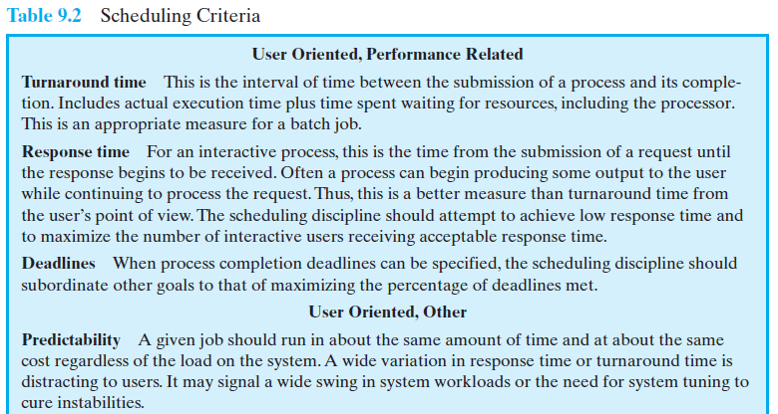
Interdependent Scheduling Criteria
Notes:
This table summarizes key scheduling criteria.
These are interdependent, and it is impossible to optimize all of them simultaneously.
Thus, the design of a scheduling policy involves compromising among competing requirements;
The relative weights given the various requirements will depend on the nature and intended use of the system.
In most interactive operating systems, whether single user or time shared, adequate response time is the critical requirement.

Slide 19
Interdependent Scheduling Criteria
This table summarizes key scheduling criteria.
These are interdependent, and it is impossible to optimize all of them simultaneously.
Thus, the design of a scheduling policy involves compromising among competing requirements;
The relative weights given the various requirements will depend on the nature and intended use of the system.
In most interactive operating systems, whether single user or time shared, adequate response time is the critical requirement.

Slide 20
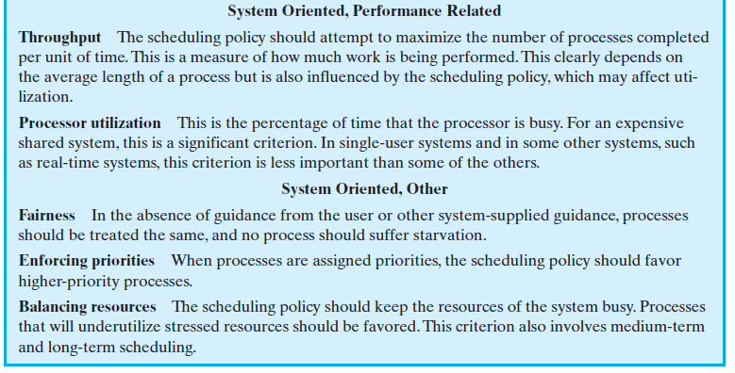
Interdependent Scheduling Criteria cont.

Slide 21
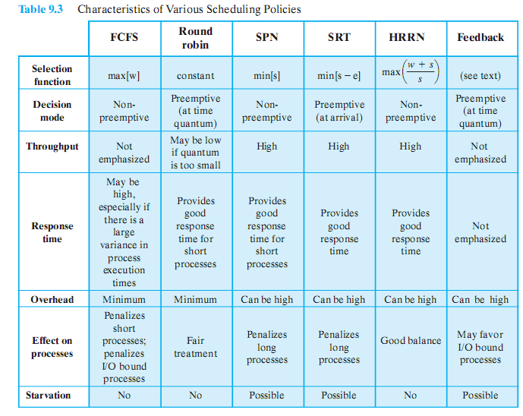
Alternative Scheduling Policies
Notes:
This table may be difficult to read depending on the display – refer to table 9.3 in textbook
Animation on-click enlarges the image

Slide 22
Selection Function
Selection function determines which process, among ready processes, is selected next for execution.
May be based on priority, resource requirements, or the execution characteristics of the process.
In the latter case, three quantities are significant:
w = time spent in system so far, waiting
e = time spent in execution so far
s = total service time required by the process, including e;
Decision Mode
Specifies the instants in time at which the selection function is exercised.
Two categories:
Nonpreemptive
Preemptive

Slide 23
Non preemptive vs. Preemptive
Non-preemptive
In this case, once a process is in the Running state, it continues to execute until
it terminates or
it blocks itself to wait for I/O or to request some operating system service.
Pre-emptive:
The currently running process may be interrupted and moved to the Ready state by the operating system.
The decision to preempt may be performed
when a new process arrives;
when an interrupt occurs that places a blocked process in the Ready state;
or periodically, based on a clock interrupt.

Slide 24
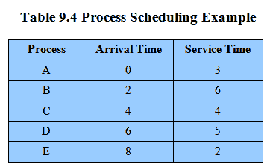
Process Scheduling Example
Example set of processes, consider each a batch job
Service time represents total execution time
Notes:
We can think of these as batch jobs, with the service time being the total execution time required.
Movie button links to animation of Process Scheduling Algorithms at http://gaia.ecs.csus.edu/%7ezhangd/oscal/pscheduling.html

Slide 25
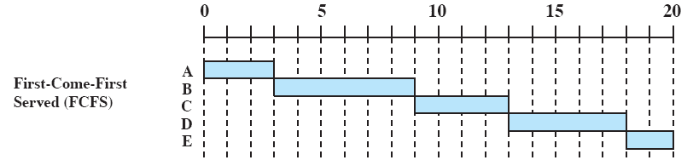
First-Come- First-Served
The simplest scheduling policy is first-come-first-served (FCFS),
first-in-first-out (FIFO) or a strict queuing scheme.
As each process becomes ready, it joins the ready queue.
When the currently running process ceases to execute, the process that has been in the ready queue the longest is selected for running.

Slide 26
First-Come- First-Served
Process | A | B | C | D | E
Arrival TIme | 0 | 2 | 4 | 6 | 8
Service Time (Ts) | 3 | 6 | 4 | 5 | 2
FCFS |  |  |  |  |  | MEAN
FinishTIme | 3 | 9 | 13 | 18 | 20
Turnaround Time (Tr) (FT – AT) | 3 | 7 | 9 | 12 | 12 | 8.60
Tr / Ts | 1 | 1.17 | 2.25 | 2.40 | 6.00 | 2.56

Slide 27
First-Come- First-Served
Process | Arrival Time | Service Time (Ts) | Start Time | Finish Time | Turnaround Time(Tr) (FT – AT) | Tr / Ts
w | 0 | 1 | 0 | 1 | 1 | 1
x | 1 | 100 | 1 | 101 | 100 | 1
y | 2 | 1 | 101 | 102 | 100 | 100
z | 3 | 100 | 102 | 202 | 199 | 1.99
MEAN |  |  |  |  | (400 / 4) 100 | (103 .99 /4) 26

Slide 28
First-Come- First-Served
FCFS performs much better for long processes than short ones.
Another difficulty with FCFS is that it tends to favor processor-bound processes over I/O-bound processes.
FCFS is not an attractive alternative on its own for a uniprocessor system.
However, it is often combined with a priority scheme to provide an effective scheduler.
Thus, the scheduler may maintain a number of queues, one for each priority level, and dispatch within each queue on a first-come-first-served basis.

Slide 29
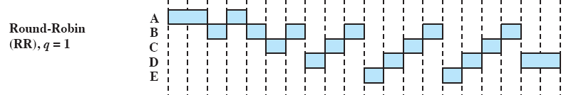
Round Robin
A straightforward way to reduce the penalty that short jobs suffer with FCFS is to
use preemption based on a clock.
The simplest such policy is round robin.
Also known as time slicing, because each process is given a slice of time before
being preempted.

Slide 30
Round Robin
Clock interrupt is generated at periodic intervals
When an interrupt occurs, the currently running process is placed in the ready queue
Next ready job is selected
Notes:
A clock interrupt is generated at periodic intervals.
When the interrupt occurs, the currently running process is placed in the ready queue, and the next ready job is selected on a FCFS basis.

Slide 31
Round Robin
Process | A | B | C | D | E
Arrival TIme | 0 | 2 | 4 | 6 | 8
Service Time (Ts) | 3 | 6 | 4 | 5 | 2
RR (q=1) |  |  |  |  |  | MEAN
FinishTIme | 4 | 18 | 17 | 20 | 15
Turnaround Time (Tr) | 4 | 16 | 13 | 14 | 7 | 10.80
Tr / Ts | 1.33 | 2.67 | 3.25 | 2.80 | 3.50 | 2.71
RR (q=4) |  |  |  |  |  | MEAN
FinishTIme | 3 | 17 | 11 | 20 | 19
Turnaround Time (Tr) | 3 | 15 | 7 | 14 | 11 | 10.00
Tr / Ts | 1.00 | 2.5 | 1.75 | 2.80 | 5.50 | 2.71

Slide 32
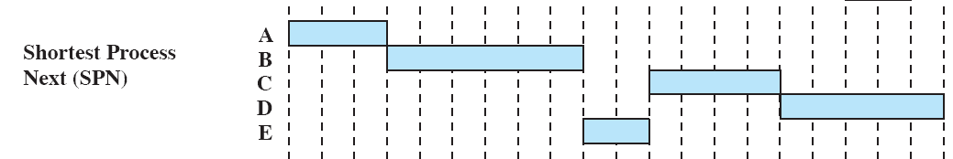
Shortest Process Next
Non preemptive policy
Process with shortest expected processing time is selected next
Short process jumps ahead of longer processes
0 5 10 15 20
Notes:
A non-preemptive policy in which the process with the shortest expected processing time is selected next.
Thus a short process will jump to the head of the queue past longer jobs.

Slide 33
Shortest Process Next
Overall performance is significantly improved in terms of response time.
However, the variability of response times is increased, especially for longer
processes, and thus predictability is reduced.
One difficulty with the SPN policy is the need to know or at least estimate the
required processing time of each process.
For batch jobs, the system may require the programmer to estimate the
value and supply it to the operating system.
If the programmer’s estimate is substantially under the actual running time,
the system may abort the job.

Slide 34
Shortest Process Next
Process | A | B | C | D | E
Arrival TIme | 0 | 2 | 4 | 6 | 8
Service Time (Ts) | 3 | 6 | 4 | 5 | 2
SPN |  |  |  |  |  | MEAN
FinishTIme | 3 | 9 | 15 | 20 | 11
Turnaround Time (Tr) | 3 | 7 | 11 | 14 | 3 | 7.60
Tr / Ts | 1.00 | 1.17 | 2.75 | 2.80 | 1.50 | 1.84

Slide 35
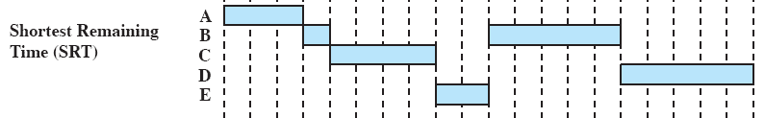
Shortest Remaining Time
Preemptive version of shortest process next policy
Must estimate processing time and choose the shortest
0 5 10 15 20
A pre-emptive version of SPN.
In this case, the scheduler always chooses the process that has the shortest expected remaining
processing time.
SRT does not have the bias in favor of long processes found in FCFS.
Unlike round robin, no additional interrupts are generated, reducing overhead.
On the other hand, elapsed service times must be recorded, contributing to overhead.
SRT should also give superior turnaround time performance to SPN, because a short job is given
immediate preference to a running longer job.
Notes:
A pre-emptive version of SPN.
In this case, the scheduler always chooses the process that has the shortest expected remaining processing time.
SRT does not have the bias in favor of long processes found in FCFS.
Unlike round robin, no additional interrupts are generated, reducing overhead.
On the other hand, elapsed service times must be recorded, contributing to overhead.
SRT should also give superior turnaround time performance to SPN, because a short job is given immediate preference to a running longer job.

Slide 36
Shortest Remaining Time
Process | A | B | C | D | E
Arrival TIme | 0 | 2 | 4 | 6 | 8
Service Time (Ts) | 3 | 6 | 4 | 5 | 2
SRT |  |  |  |  |  | MEAN
FinishTIme | 3 | 15 | 8 | 20 | 10
Turnaround Time (Tr) | 3 | 13 | 4 | 14 | 2 | 7.20
Tr / Ts | 1.00 | 2.17 | 1.00 | 2.80 | 1.00 | 1.59

Slide 37

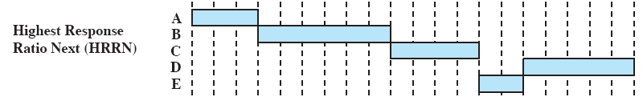
Highest Response Ratio Next
Choose next process with the greatest ratio
0 5 10 15 20
A smaller denominator yields a larger ratio so that shorter jobs are favored, but aging without service increases the ratio so that a longer process will eventually get past competing shorter jobs.
As with SRT and SPN, the expected service time must be estimated to use highest response ratio next (HRRN).
Notes:
A smaller denominator yields a larger ratio so that shorter jobs are favored, but aging without service increases the ratio so that a longer process will eventually get past competing shorter jobs.
As with SRT and SPN, the expected service time must be estimated to use highest response ratio next (HRRN).

Slide 38
Highest Response Ratio Next
Process | A | B | C | D | E
Arrival TIme | 0 | 2 | 4 | 6 | 8
Service Time (Ts) | 3 | 6 | 4 | 5 | 2
HRRN |  |  |  |  |  | MEAN
FinishTIme | 3 | 9 | 13 | 20 | 15
Turnaround Time (Tr) | 3 | 7 | 9 | 14 | 7 | 8.00
Tr / Ts | 1.00 | 1.17 | 2.25 | 2.80 | 3.5 | 2.14

