Slide 1
ROADMAP - Concurrency
Key terms
Principles of concurrency :
Requirement of mutual exclusion
Semaphores

Slide 2
Concurrency
The central themes of operating system design are all concerned with the management of processes and threads:
Multiprogramming:
The management of multiple processes within a uniprocessor system.
Multiprocessing:
The management of multiple processes within a multiprocessor.
Distributed processing:
The management of multiple processes executing on multiple, distributed computer systems.
Concurrency: It is a property of systems in which several computations are executing simultaneously, and potentially interacting with each other.
It means managing the interaction of all of the processes.

Slide 3
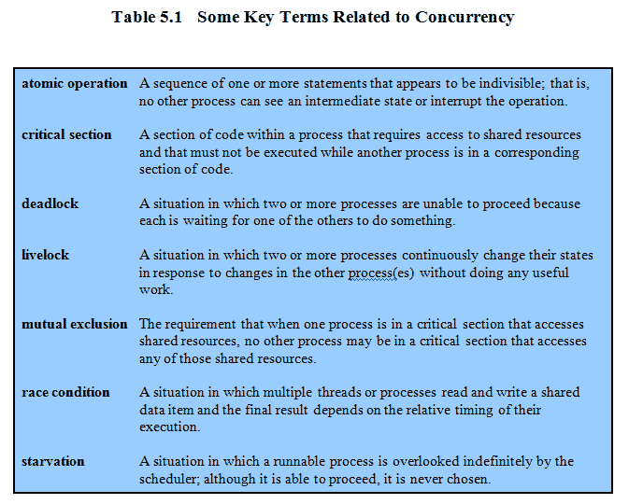
KEY TERMS

Slide 4
Live Lock
A thread often acts in response to the action of another
thread.
If the other thread's action is also a response to the
action of another thread, then live lock may result.
As with deadlock, livelocked threads are unable to make further progress.
However, the threads are not blocked — they are simply too busy responding to each other to resume work.
E.g. :- This is comparable to two people attempting to pass each other in a corridor:
A moves to his left to let B pass,
While B moves to his right to let A pass.
Seeing that they are still blocking each other,
A moves to his right, while B moves to his left.
They're still blocking each other, so..

Slide 5
A Simple Example
void echo()
{
chin = getchar();
chout = chin;
putchar(chout);
}
A program that will provide a character echo procedure;
input is obtained from a keyboard one keystroke at a time.
Each input character is stored in variable chin.
It is then transferred to variable chout
and finally sent to the display.
Any program can call this procedure repeatedly to accept user input and display it on the user’s screen.
Now consider that we have a single-processor multiprogramming system
The user can jump from one application to another, and each application uses the same keyboard for input and the same screen for output.
Notes:
A program that will provide a character echo procedure;
input is obtained from a keyboard one keystroke at a time.
Each input character is stored in variable chin.
It is then transferred to variable chout
and finally sent to the display.
Any program can call this procedure repeatedly to accept user input and display it on the user’s screen.
Now consider that we have a single-processor multiprogramming system supporting a single user.
The user can jump from one application to another, and each application uses the same keyboard for input and the same screen for output.
Each application needs to use the procedure echo,
So it makes sense for it to be a shared procedure that is loaded into a portion of memory global to all applications.
Thus, only a single copy of the echo procedure is used, saving space.

Slide 6
A Simple Example: On a Multiprocessor
Process P1 Process P2
. .
chin = getchar(); .
. chin = getchar();
chout = chin; chout = chin;
putchar(chout); .
. putchar(chout);
. .
The result is that the character input to P1 is lost before being displayed,
and the character input to P2 is displayed by both P1 and P2.
Notes:
The result is that the character input to P1 is lost before being displayed,
and the character input to P2 is displayed by both P1 and P2.

Slide 7
ROADMAP - Concurrency
Key terms
Principles of concurrency :
Requirement of mutual exclusion
Semaphores

Slide 8
SEMAPHORE
What operations can be performed on a semaphore?
Semaphore:
A semaphore is an integer value used for signalling among processes.
Only three operations may be performed on a semaphore, all of which are atomic:
1. Initialize:-
A semaphore may be initialized to a nonnegative integer value.
2.Decrement (semWait):- // To receive a signal
The semWait operation decrements the semaphore value.
If the value becomes negative, then the process executing the semWait is
blocked.
Otherwise, the process continues execution.
3. increment (semSignal):- // To transmit a signal
The semSignal operation increments the semaphore value.
If the resulting value is less than or equal to zero, then a process blocked
by a semWait operation, if any, is unblocked.

Slide 9
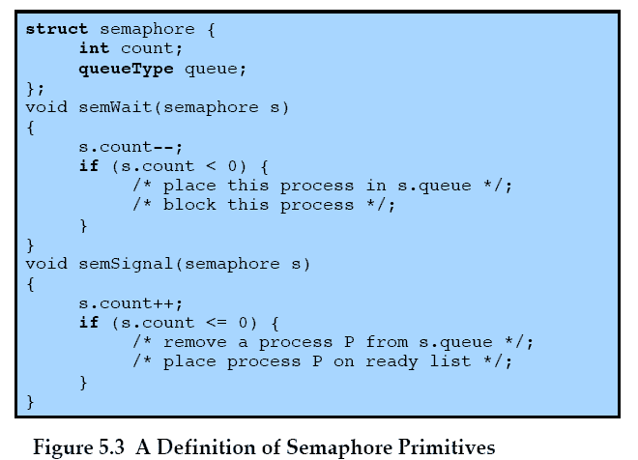
SEMAPHORE
Notes:
An example of a semaphore

Slide 10
Semaphore Example 1
semaphore s = 2;
P_{i} {
while(1) {
semWait(s);
/* CS */
semSignal(s);
/* remainder */
}
}
What happens?
When might this be desirable?

Slide 11
Semaphore Example 1
semaphore s = 2;
P_{i} {
while(1) {
semWait(s);
/* CS */
semSignal(s);
/* remainder */
}
}
What happens?
When might this be desirable?
×
×
×
s = 2
1
0
-1

Slide 12
Semaphore Example 1
semaphore s = 2;
P_{i} {
while(1) {
semWait(s);
/* CS */
semSignal(s);
/* remainder */
}
}
What happens?
Allows up to 2 processes to enter CS
When might this be desirable?
Need up to 2 processes inside CS
e.g., limit number of processes reading a var
Be careful not to violate mutual exclusion inside CS!

Slide 13
Semaphore Example 2
semaphore s = 0;
P_{i} {
while(1) {
semWait(s);
/* CS */
semSignal(s);
/* remainder */
}
}
What happens?
When might this be desirable?

Slide 14
Semaphore Example 2
semaphore s = 0;
P_{i} {
while(1) {
semWait(s);
/* CS */
semSignal(s);
/* remainder */
}
}
What happens?
When might this be desirable?
×
×
×
s = 0
-1
-2
-3

Slide 15
Semaphore Example 2
semaphore s = 0;
P_{i} {
while(1) {
semWait(s);
/* CS */
semSignal(s);
/* remainder */
}
}
What happens?
No one can enter CS! Ever!
When might this be desirable?
Never!

Slide 16
Binary Semaphore
A more restrictive semaphore which may only have the value of 0 or 1
A binary semaphore may be initialized to 0 or 1.
2. The semWaitB operation checks the semaphore value. If the value is zero, then
the Process executing the semWaitB is blocked. If the value is one, then the value
is Changed to zero and the process continues execution.
3. The semSignalB operation checks to see if any processes are blocked on this
semaphore (semaphore value equals zero).
If so, then a process blocked by a semWaitB operation is unblocked.
If no processes are blocked, then the value of the semaphore is set to one.
To contrast the two types of semaphores, the nonbinary semaphore is often
referred to as either a counting semaphore or a general semaphore.

Slide 17
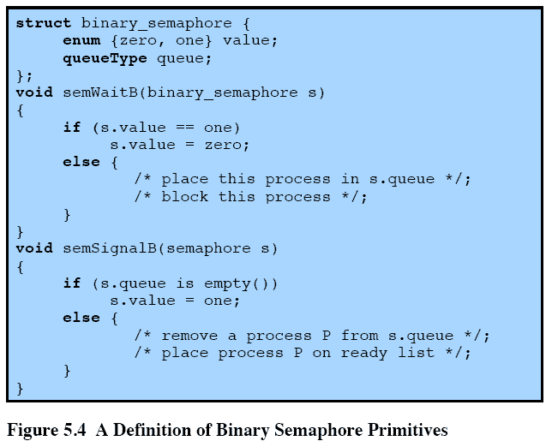
Binary Semaphore Primitives (locks & mutex)
Notes:
A more restrictive semaphore which may only have the value of 0 or 1
A similar concept related to the binary semaphore is the mutex.
A key difference between the two is that the process that locks the mutex (sets the value to zero) must be the one to unlock it (sets the value to 1).
In contrast, it is possible for one process to lock a binary semaphore and for another to unlock it.

Slide 18
Strong Semaphore Vs. Weak Semaphore
It is important to decide the order in which processes are removed from a blocked queue.
The fairest removal policy is first-in-first-out (FIFO):
The process that has been blocked the longest is released from the queue first; a semaphore follows this policy is called a strong semaphore.
A semaphore that does not specify the order in which processes are removed from the queue is a weak semaphore.
Strong semaphores guarantee freedom from starvation, while
Weak semaphores do not guarantee freedom from starvation.
Strong semaphores are more convenient because this is the form of semaphore typically provided by operating systems.
Weak semaphores are not convenient as strong semaphores.

Slide 19
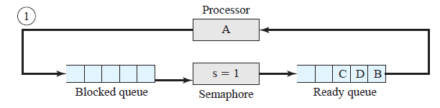
Example of Strong Semaphore Mechanism
Initially (1), A is running;
B, C, and D are ready;
The semaphore count is 1, indicating that one of D’s results is available.
That means up to 1 process can enter critical section.
When A issues a semWait instruction on semaphore s, the semaphore decrements
to 0, and A can continue to execute;
Subsequently it rejoins the ready queue.

Slide 20
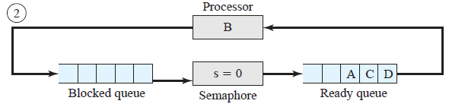
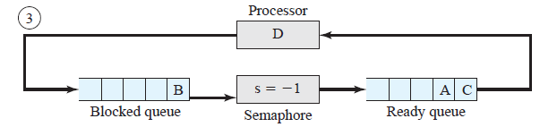
Then B runs, eventually issues a semWait instruction, and is blocked,
allowing D to run (3).

Slide 21
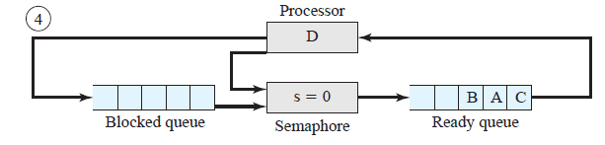
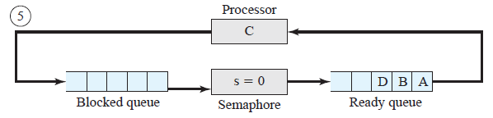
(4) When D completes a new result, it issues a semSignal instruction, which
allows B to move to the ready queue.
(5) D rejoins the ready queue and C begins to run but is blocked when it
issues a semWait instruction.

Slide 22
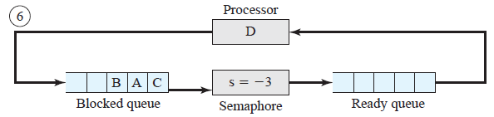
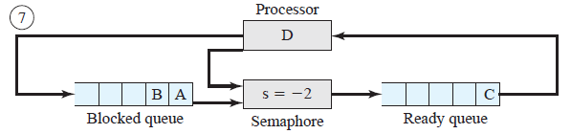
Similarly, A and B run and are blocked on the semaphore, allowing D to resume execution (6)
When D has a result, it issues a semSignal, which transfers C to the ready queue. Later cycles of D will release A and B from the Blocked state.

Slide 23
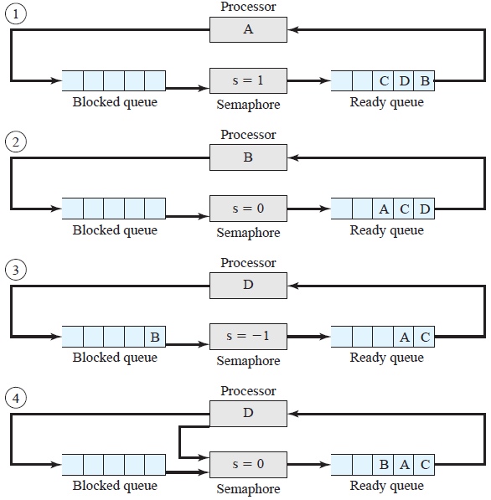
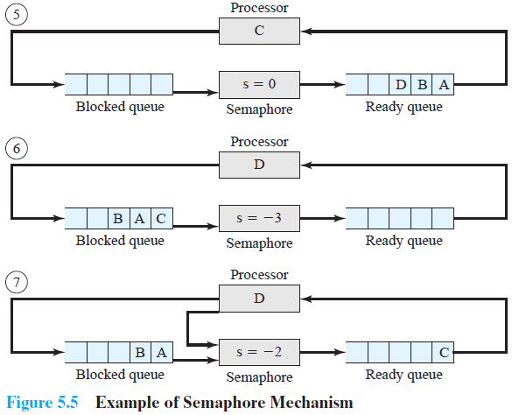

Slide 24
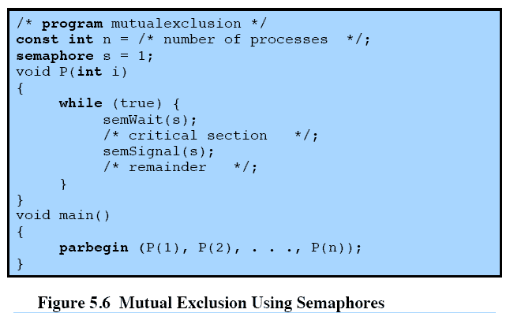
Mutual Exclusion Using Semaphore

Slide 25
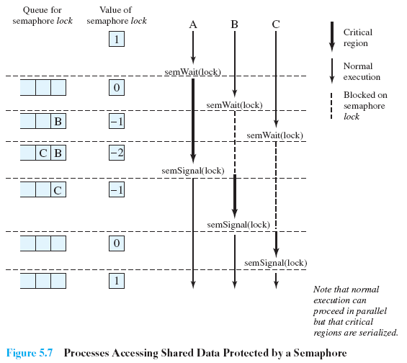
Processes Accessing Shared Data Protected by a Semaphore
Notes:
Figure 5.7, shows a possible sequence for three processes using the mutual exclusion discipline of Figure 5.6.
Three processes (A,B, C) access a shared resource protected by the semaphore lock.
Process-A executes semWait(lock);
because the semaphore has a value of 1 at the time of the semWait operation, A can immediately enter its critical section and the semaphore takes on the value 0.
While A is in its critical section, both B and C perform a semWait operation and are blocked pending the availability of the semaphore.
When A exits its critical section and performs semSignal(lock), B, which was the first process in the queue, can now enter its critical section.

Slide 26
ROADMAP - Deadlock
Principles of Deadlock
Deadlock Prevention
Deadlock Avoidance
Deadlock Detection
Dinning philosophers problem: Solution using semaphores

Slide 27
Deadlock
A set of processes is deadlocked when each process in the set is blocked awaiting an event that can only be triggered by another blocked process in the set
typically processes are waiting the freeing up of some requested resource.
Deadlock is permanent because none of the events is ever triggered.
Unlike other problems in concurrent process management, there is no efficient solution in the general case.

Slide 28

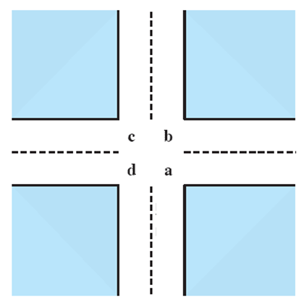
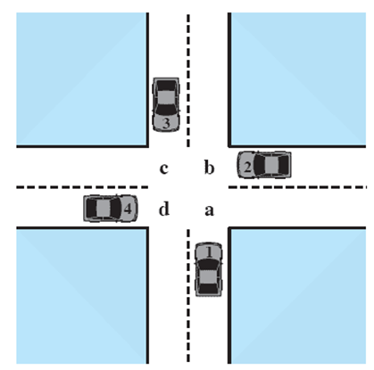



Potential Deadlock
I need quad C and D
I need quad B and C
I need quad A and B
I need quad D and A
Notes:
Animated Slide
Click 1 Cars approach intersection
Then Cars announce their resource needs
All deadlocks involve conflicting needs for resources by two or more processes. A common example is the traffic deadlock.
The typical rule of the road in the United States is that a car at a four-way stop should defer to a car immediately to its right.
This rule works if there are only two or three cars at the intersection.
If all four cars arrive at about the same time, each will refrain from entering the intersection, this causes a potential deadlock.
The deadlock is only potential, not actual, because the necessary resources are available for any of the cars to proceed.
If one car eventually does proceed, it can do so.

Slide 29

Potential Deadlock
All deadlocks involve conflicting needs for resources by two or more processes. A common example is the traffic deadlock.
The typical rule of the road in the United States is that a car at a four-way stop should defer to a car immediately to its right.
This rule works if there are only two or three cars at the intersection.
If all four cars arrive at about the same time, each will refrain from entering the intersection, this causes a potential deadlock.
The deadlock is only potential, not actual, because the necessary resources are available for any of the cars to proceed.
If one car eventually does proceed, it can do so.

Slide 30
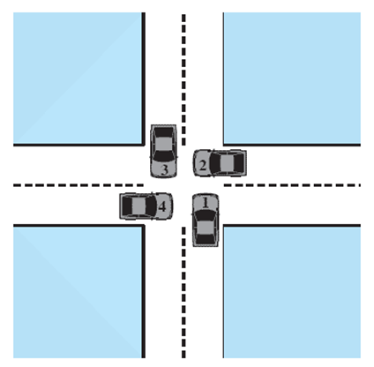
Actual Deadlock
HALT until D is free
HALT until C is free
HALT until B is free
HALT until A is free
Notes:
Animated Slide
Click 1 Cars move to deadlock
Then Cars announce their resource need
But if all four cars ignore the rules and proceed (cautiously) into the intersection at the same time, then each car seizes one resource (one quadrant) but cannot proceed because the required second resource has already been seized by another car.
This is an actual deadlock.

Slide 31
Actual Deadlock
But if all four cars ignore the rules and proceed (cautiously) into the intersection at the same time, then each car seizes one resource (one quadrant) but cannot proceed because the required second resource has already been seized by another car.
This is an actual deadlock.

Slide 32
Conditions for possible Deadlock
(1) Mutual exclusion:-
Only one process may use a resource at a time.
No process may access a resource unit that has been allocated to another process.
(2)Hold-and-wait:-
A process may hold allocated resources while awaiting assignment of other resources.
(3)No pre-emption:-
No resource can be forcibly removed form a process holding it.
In many ways these conditions are quite desirable.
For example, mutual exclusion is needed to ensure consistency of results and the integrity of a database.
Similarly, preemption should not be done arbitrarily.
For example, when data resources are involved, preemption must be supported by a rollback recovery mechanism.
All three must be present for deadlock to occur.
Notes:
All three must be present for deadlock to occur.

Slide 33
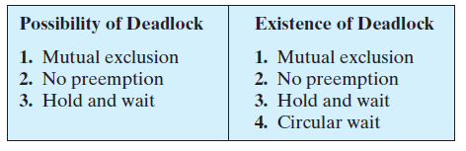
Actual Deadlock Requires …
All previous 3 conditions plus:
(4) Circular wait:-
A closed chain of processes exists, such that each process holds at least one resource needed by the next process in the chain.
This is actually a potential consequence of the first three.
Given that the first three conditions exist, a sequence of events may occur that lead to an unresolvable circular wait.
The unresolvable circular wait is in fact the definition of deadlock.
The circular wait listed as condition 4 is unresolvable because the first three conditions hold.
Thus, the four conditions, taken together, constitute necessary and sufficient conditions for deadlock.
Notes:
This is actually a potential consequence of the first three.
Given that the first three conditions exist, a sequence of events may occur that lead to an unresolvable circular wait.
The unresolvable circular wait is in fact the definition of deadlock.
The circular wait listed as condition 4 is unresolvable because the first three conditions hold.
Thus, the four conditions, taken together, constitute necessary and sufficient conditions for deadlock.

Slide 34
ROADMAP - Deadlock
Principles of Deadlock
Deadlock Prevention
Deadlock Avoidance
Deadlock Detection
Dinning philosophers problem: Solution using semaphores

Slide 35
Deadlock prevention Staregy
Deadlock prevention is strategy simply to design a system in such a way that the
possibility of deadlock is excluded.
We can view deadlock prevention methods as falling into two classes.
Indirect method of deadlock prevention is to prevent the occurrence of one of
the three necessary conditions listed previously (items 1 through 3).
Direct method of deadlock prevention is to prevent the occurrence of a circular
wait (item 4).
We now examine techniques related to each of the four conditions.
Deadlock prevention Conditions 1 & 2
(1) Mutual Exclusion:-
The first of the four listed conditions cannot be disallowed (in general).
If access to a resource requires mutual exclusion, then mutual exclusion must be supported by the OS.
Some resources, such as files, may allow multiple accesses for reads but only exclusive access for writes.
Even in this case, deadlock can occur if more than one process requires write permission.

Slide 36
Deadlock prevention Conditions 1 & 2
(2) Hold and Wait:-
Can be prevented by requiring that a process request all of its required resources at one time and blocking the process until all requests can be granted simultaneously.
This approach is inefficient in two ways.
1) a process may be held up for a long time waiting for all of its resource requests to be filled, when in fact it could have proceeded with only some of the resources.
resources allocated to a process may remain unused for a considerable period, during which time they are denied to other processes.
Another problem is that a process may not know in advance all of the resources that it will require.
There is also the practical problem created by the use of modular programming or a multithreaded structure for an application.
An application would need to be aware of all resources that will be requested at all levels or in all modules to make the simultaneous request.

Slide 37
Deadlock prevention Conditions 3 & 4
(3)No Preemption:-
can be prevented in several ways.
If a process holding certain resources is denied a further request, that process must release its original resources and, if necessary, request them again together with the additional resource.
If a process requests a resource that is currently held by another process, the OS may preempt the second process and require it to release its resources.
This latter scheme would prevent deadlock only if no two processes possessed the same priority.
This approach is practical only with resources whose state can be easily saved and restored later, as is the case with a processor.
(4)Circular Wait:-
Can be prevented by defining a linear ordering of resource types.
As with hold-and-wait prevention, circular-wait prevention may be inefficient, slowing down processes and denying resource access unnecessarily.

Slide 38
ROADMAP - Deadlock
Principles of Deadlock
Deadlock Prevention
Deadlock Avoidance
Deadlock Detection
Dinning philosophers problem: Solution using semaphores

Slide 39
Deadlock Avoidance
Deadlock avoidance allows the three necessary conditions
but makes judicious choices to assure that the deadlock point is never reached.
Avoidance allows more concurrency than prevention.
With deadlock avoidance, a decision is made dynamically whether the current resource allocation request will, if granted, potentially lead to a deadlock.
Deadlock avoidance requires knowledge of future process resource requests.
Two Approaches to Deadlock Avoidance:-
Process Initiation Denial
Do not start a process if its demands might lead to deadlock
Resource Allocation Denial
Do not grant an incremental resource request to a process if this allocation might lead to deadlock

Slide 40
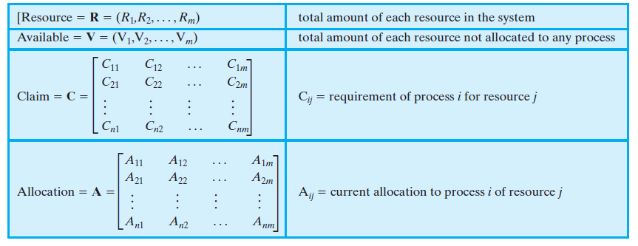
Process Initiation Denial
A process is only started if the maximum claim of all current processes plus those of the new process can be met.
This strategy is hardly optimal, because it assumes the worst:
that all processes will make their maximum claims togather.
Data Structures:-
Consider a system of n processes and m different types of resources. Let us define the following vectors and matrices:

Slide 41
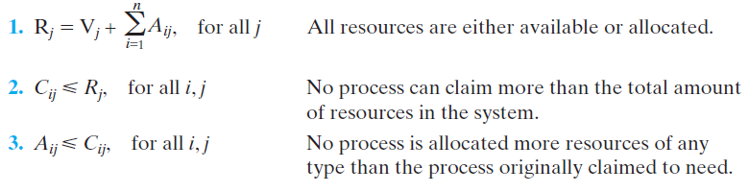

Process Initiation Denial
The matrix Claim gives the maximum requirement of each process for each resource,
with one row dedicated to each process.
This information must be declared in advance by a process for deadlock avoidance to
work.
The matrix Allocation gives the current allocation to each process.
The following relationships hold:
Start a new process Pn+1 only if
That is, a process is only started if the maximum claim of all current processes plus those of the new process can be met.

Slide 42
Resource Allocation Denial
A strategy of resource allocation denial is referred to as the banker’s algorithm.
Consider a system with fixed number of processes and a fixed number of resources.
At any time a process may have zero or more resources allocated to it.
State of the system is the current allocation of resources to process
Safe state is where there is at least one sequence of resource allocations to processes that does not result in deadlock.
i.e., all of the processes can be run to completion.
Unsafe state is a state that is not safe

Slide 43
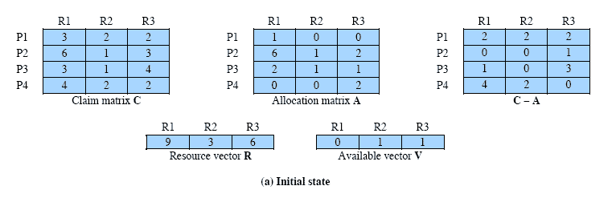
Determination of Safe State
A system consisting of four processes and three resources.
Allocations are made to processors
Is this a safe state?
Resources available after allocation
Amount of Existing Resources
This figure shows the state of a system consisting of four processes and three
resources.
Total amount of resources
R1 = 9 R2 = 3 R3 = 6
Notes:
Animation: Callouts explain resource parts of figure
This figure shows the state of a system consisting of four processes and three resources.
Total amount of resources
R1 = 9
R2 = 3
R3 = 6
In the current state allocations have been made to the four processes, leaving available
1 unit of R2
1 unit of R3
Is this a safe state?
To answer this question, we ask an intermediate question:
Can any of the four processes be run to completion with the resources available?
That is, can the difference between the maximum requirement and current allocation for any process be met with the available resources?

Slide 44
Determination of Safe State
In the current state allocations have been made to the four processes, leaving available 1 unit of R2 and 1 unit of R3
Is this a safe state?
To answer this question, we ask an intermediate question:
Can any of the four processes be run to completion with the resources available?
That is, can the difference between the maximum requirement and current allocation for any process be met with the available resources?
C_{ij} - A_{ij} ≤ V_{j}, for all j
This is not possible for P1,
which has only 1 unit of R1 and requires 2 more units of R1, 2 units of R2, and 2 units of R3.
If we assign one unit of R3 to process P2,
Then P2 has its maximum required resources allocated and can run to completion and return resources to ‘available’ pool.
The resulting state is shown in Figure 6.7b.

Slide 45
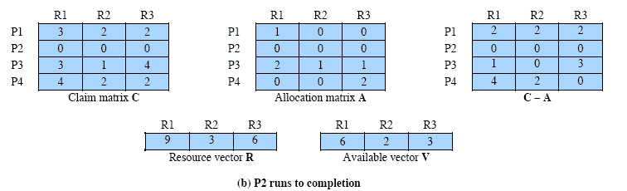
After P2 runs to completion
Can any of the remaining processes can be completed?
In this case, each of the remaining processes could be completed as shown on the next slides.
Note P2 is completed
Notes:
In this case, each of the remaining processes could be completed as shown on the next slides

Slide 46
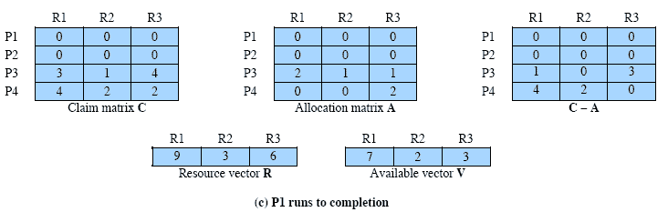
After P1 completes
Suppose we choose P1,
allocate the required resources,
complete P1,
and return all of P1’s resources to the available pool.
We are left in the state shown in Figure 6.7c on this slide
Notes:
Suppose we choose P1,
allocate the required resources,
complete P1,
and return all of P1’s resources to the available pool.
We are left in the state shown in Figure 6.7c on this slide

Slide 47
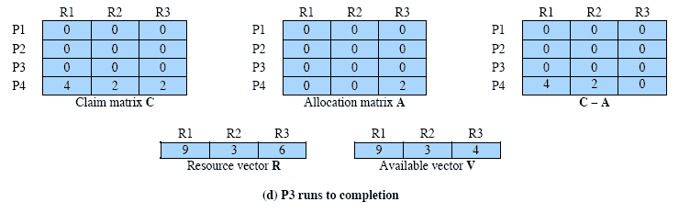
P3 Completes
P3 completes, resulting in the state of Figure 6.7d shown on this slide
Finally, we can complete P4. At this point, all of the processes have been run to completion.
Thus, the state defined by Figure 6.7a is a safe state.
Thus, the state defined originally is a safe state.
Notes:
P3 completes, resulting in the state of Figure 6.7d shown on this slide
Finally, we can complete P4. At this point, all of the processes have been run to completion.
Thus, the state defined by Figure 6.7a is a safe state.

Slide 48
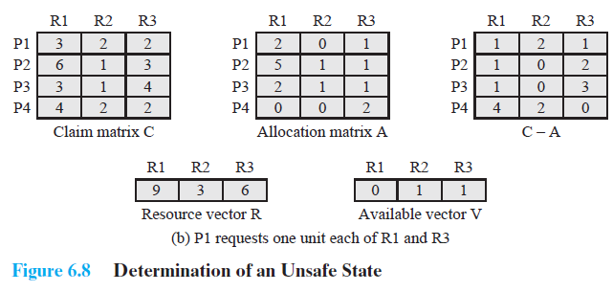
Determination of an Unsafe State
This is not a deadlocked state. It merely has the potential for deadlock.
It is possible, for example, that if P1 were run from this state it would
subsequently release one unit of R1 and one unit of R3 prior to
needing these resources again.
If that happened, the system would return to a safe state.
Thus, the deadlock avoidance strategy does not predict deadlock
with certainty; it merely anticipates the possibility of deadlock and
assures that there is never such a possibility.
This time Suppose that P1 makes the request for one additional unit each of R1 and R3.
Is this safe?

Slide 49
Deadlock Avoidance
This suggests the following deadlock avoidance strategy, which ensures that the system of processes and resources is always in a safe state.
When a process makes a request for a set of resources,
assume that the request is granted,
Update the system state accordingly,
Then determine if the result is a safe state.
If so, grant the request and,
if not, block the process until it is safe to grant the request.
Notes:
This suggests the following deadlock avoidance strategy,
which ensures that the system of processes and resources is always in a safe state.
When a process makes a request for a set of resources, assume that the request is granted, update
the system state accordingly, and then determine if the result is a safe state. If so,
grant the request and, if not, block the process until it is safe to grant the request.

Slide 50
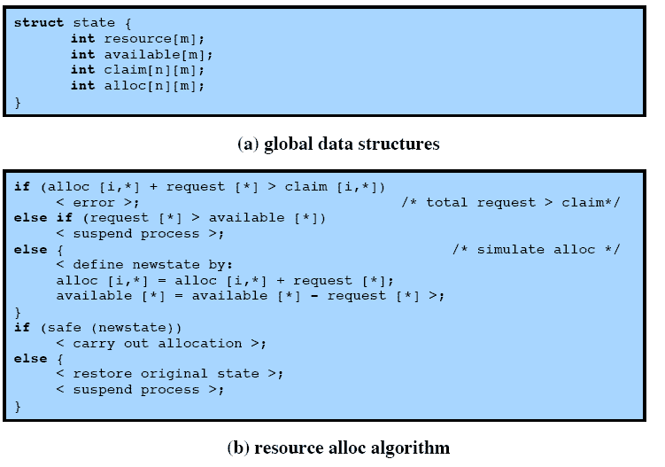
Deadlock Avoidance Logic
Notes:
This slide gives an abstract version of the deadlock avoidance logic.
The main algorithm is shown in part (b).
With the state of the system defined by the data structure state, request[*] is a vector defining the resources requested by process i.
First, a check is made to assure that the request does not exceed the original claim of the process.
If the request is valid, the next step is to determine if it is possible to fulfill the request (i.e., there are sufficient resources available).
If it is not possible, then the process is suspended.
If it is possible, the final step is to determine if it is safe to fulfill the request. To do this, the resources are tentatively assigned to process i to form newstate.

Slide 51
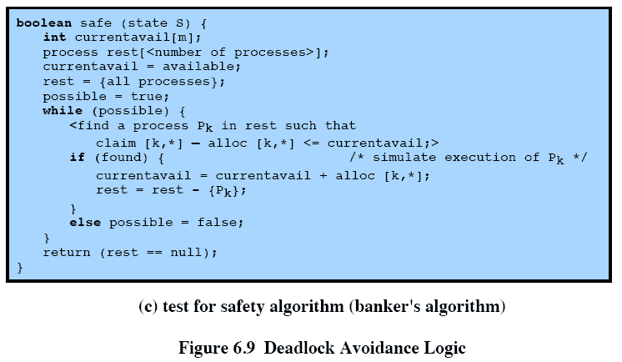
Deadlock Avoidance Logic
Notes:
Then a test for safety is made using the algorithm in Figure 6.9c.

Slide 52
Deadlock Avoidance Advantages
It is not necessary to preempt and rollback processes, as in deadlock detection,
It is less restrictive than deadlock prevention.
Deadlock Avoidance Restrictions
However, it does have a number of restrictions on its use
Maximum resource requirement must be stated in advance
Processes under consideration must be independent and with no synchronization requirements
There must be a fixed number of resources to allocate
No process may exit while holding resources
Notes:
Deadlock avoidance has the advantage that it is not necessary to preempt and
rollback processes, as in deadlock detection, and is less restrictive than deadlock
prevention.

Slide 53
ROADMAP - Deadlock
Principles of Deadlock
Deadlock Prevention
Deadlock Avoidance
Deadlock Detection
Dinning philosophers problem: Solution using semaphores

Slide 54
Deadlock Detection
Deadlock prevention strategies are very conservative;
limit access to resources and impose restrictions on processes.
Deadlock detection strategies do the opposite
Resource requests are granted whenever possible.
Periodically, the OS performs an algorithm that allows it to detect the circular wait condition
Deadlock Detection Algorithm
A check for deadlock can be made as frequently as each resource request.
Checking at each resource request has two advantages:
It leads to early detection,
The algorithm is relatively simple because it is based on incremental changes to
the state of the system.
On the other hand, such frequent checks consume considerable processor time.
Notes:
Deadlock checks can be made as frequently as each resource request or, less frequently, depending on how likely it is for a deadlock to occur.
Checking at each resource request has two advantages:
it leads to early detection,
the algorithm is relatively simple because it is based on incremental changes to the state of the system.
On the other hand, such frequent checks consume considerable processor time.

Slide 55
A Common Detection Algorithm
Use a Allocation matrix and Available vector as previous
Also use a request matrix Q
Where Qij indicates that an amount of resource j is requested by process I
First ‘un-mark’ all processes that are not deadlocked
Initially all processes are unmarked.
Steps for Detection Algorithm:-
Mark each process that has a row in the Allocation matrix of all zeros.
2. Initialize a temporary vector W to equal the Available vector.
3. Find an index i such that process i is currently unmarked and the ith row of Q is
less than or equal to W. That is, Qik <=Wk, for 1 <= k<= m. If no such row is found,
terminate the algorithm.
4. If such a row is found, mark process i and add the corresponding row of the
allocation matrix to W. That is, set Wk = Wk + Aik, for for 1 <= k<= m.
Return to step 3.
Notes:
A common algorithm for deadlock detection is one described in [COFF71].
The Allocation matrix and Available vector described in the previous section are used.
In addition, a request matrix Q is defined such that Qij represents the amount of resources of type j requested by process i.
The algorithm proceeds by marking processes that are not deadlocked. Initially, all processes are unmarked.

Slide 56
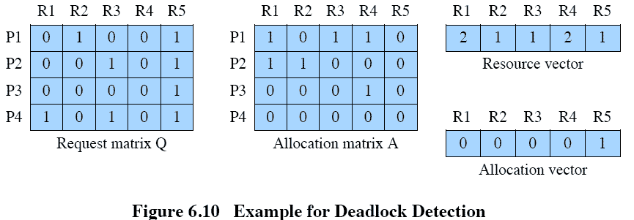
Deadlock Detection
Notes:
1. Mark P4, because P4 has no allocated resources.
2. Set W = (0 0 0 0 1).
3. The request of process P3 is less than or equal to W, so mark P3 and set W=W + (0 0 0 1 0) = (0 0 0 1 1).
4. No other unmarked process has a row in Q that is less than or equal to W.
Therefore, terminate the algorithm.
The algorithm concludes with P1 and P2 unmarked, indicating that these processes are deadlocked.

Slide 57
Recovery Strategies Once Deadlock Detected
Deadlock Detection
1. Mark P4, because P4 has no allocated resources.
2. Set W = (0 0 0 0 1).
3. The request of process P3 is less than or equal to W, so mark P3 and set W=W + (0 0 0 1 0) = (0 0 0 1 1).
4. No other unmarked process has a row in Q that is less than or equal to W.
Therefore, terminate the algorithm.
The algorithm concludes with P1 and P2 unmarked, indicating that these processes are deadlocked.
Abort all deadlocked processes
Back up each deadlocked process to some previously defined checkpoint, and restart all process
Risk or deadlock recurring
Successively abort deadlocked processes until deadlock no longer exists
Successively preempt resources until deadlock no longer exists

Slide 58
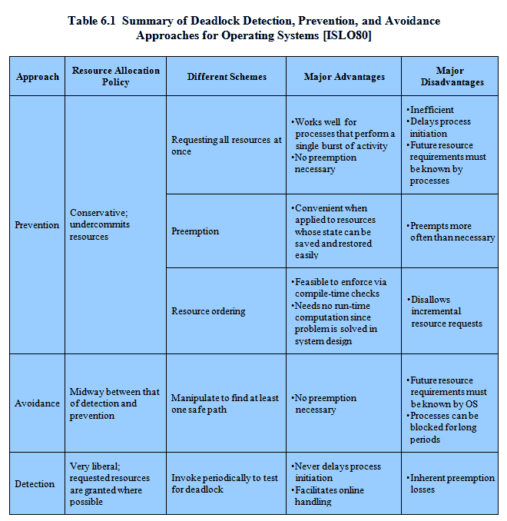
Advantages and Disadvantages
Notes:
There are strengths and weaknesses to all of the strategies for dealing with deadlock.
Rather than attempting to design an OS facility that employs only one of these strategies, it might be more efficient to use different strategies in different situations.

Slide 59
ROADMAP - Deadlock
Principles of Deadlock
Deadlock Prevention
Deadlock Avoidance
Deadlock Detection
Dinning philosophers problem: Solution using semaphores

Slide 60
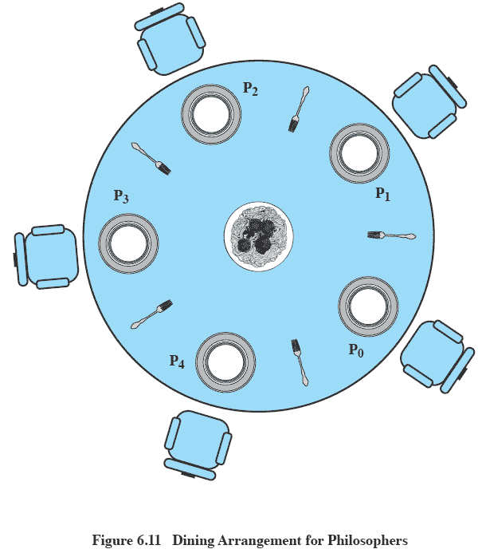
Dining Philosophers Problem: Scenario
Notes:
Five philosophers live in a house, where a table is laid for them.
The life of each philosopher consists principally of thinking and eating, and through years of thought, all of the philosophers had agreed that the only food that contributed to their thinking efforts was spaghetti.
Due to a lack of manual skill, each philosopher requires two forks to eat spaghetti.
A philosopher wishing to eat goes to his or her assigned place at the table and, using the two forks on either side of the plate, takes and eats some spaghetti.

Slide 61
The Problem
Dining Philosophers Problem: Scenario
Five philosophers live in a house, where a table is laid for them.
The life of each philosopher consists principally of thinking and eating, and through
years of thought, all of the philosophers had agreed that the only food that
contributed to their thinking efforts was spaghetti.
Due to a lack of manual skill, each philosopher requires two forks to eat spaghetti.
A philosopher wishing to eat goes to his or her assigned place at the table and, using
the two forks on either side of the plate, takes and eats some spaghetti.
Devise a ritual (algorithm) that will allow the philosophers to eat.
No two philosophers can use the same fork at the same time (mutual exclusion)
No philosopher must starve to death (avoid deadlock and starvation … literally!)

Slide 62
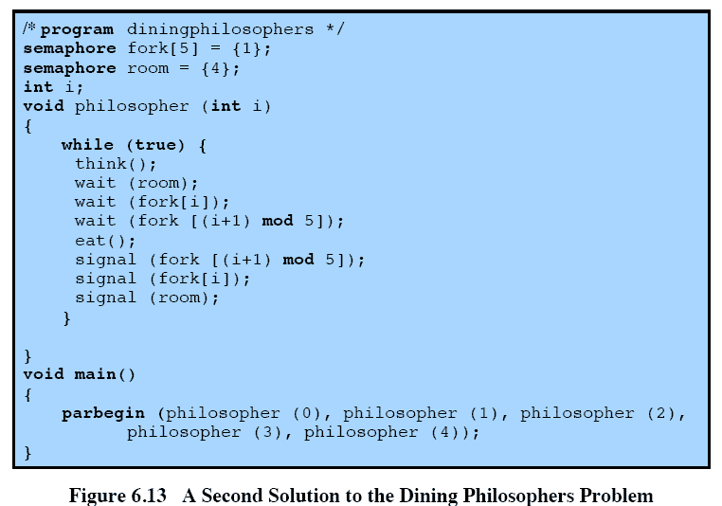
Avoiding deadlock
Notes:
We could consider adding an attendant who only allows four philosophers at a time into the dining room.
With at most four seated philosophers, at least one philosopher will have access to two forks.
This slide shows such a solution, again using semaphores. This solution is free of deadlock and starvation.

