Slide 1

Multidimensional Array
GAME 102
Parth Parmar
Lance Petryna

Slide 2
Definition of Multi-dimensional ARRAY
Multidimensional Array can be defined as “Array of Arrays”
Also known as ‘combination of multiple Arrays’
Multidimensional arrays can have two, three, four or more dimensions

Slide 3
Declaring An Array (syntax)
General Form of declaring N-Dimensional Array is as follows:
Data type _ name _ of _ Array [size1][size2]…[size N]
Inside “[ ]” we have to put sizes , which represents “The number of Elements”
For Example:
Int a [3][4]; // 2-D Array int a [3][4][6]; // 3-D Array
Note: Here, Size means the “Number Of Element”
Data Type
Name
Sizes

Slide 4
How To Initialize An Array?
There are two methods to initialize MultiDimensional Array:
Method 1: int x [2][3] = {1,2,3,4,5,6,}; // 2-D Array
We can visualise it: 0 1 2
0
1
In arrays first Index Always start with the 0 .
1 | 2 | 3
4 | 5 | 6

Slide 5
How To Initialize An Array?
Method 2: int x [2][3] = { {1,2,3} , {4,5,6,} }; // 2-D Array
We can visualise it: 0 1 2
0
1
We can conclude that, this 2D array creates a table/matrix form as output
In other words, data_ type_ name_ of_ array [x][y];
Row1
Row2
1 | 2 | 3
4 | 5 | 6
#rows
#columns

Slide 6
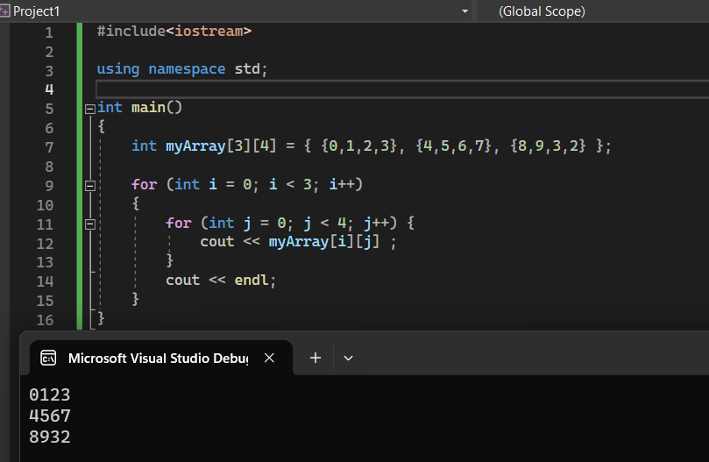
How set variables?
To set values in a multi-dimensional array is to use nested loops to iterate over each element and assign a value to it.
For example, consider a two-dimensional array of integers with dimensions 3x4:
int myArray[3][4] = { {0,1,2,3}, {4,5,6,7}, {8,9,3,2} };
Result

Slide 7
How To get values?
To get a value from a multi-dimensional array in C++, we need to specify the index for each dimension. For example, if we have a 2D array named myArray and we want to get the value at row 3, column 2, then we would use the following code:
int myArray[4][3] = { {1,2,3} {4,5,6} {7,8,9} {10,11,12} }
int value = myArray[2][1];
RESULT: 8
In this example, the first index specifies the row and the second index specifies the column. Note that array indices start at 0 in C++.
0 1 2
0
1
2
3
1 | 2 | 3
4 | 5 | 6
7 | 8 | 9
10 | 11 | 12

Slide 8
Size Calculation/Memory Allocation
The Size of Multi Dimensional Array can be Calculated By Multiplying the size of the all the dimensions.
For Example:
int a [10][20] = 10 * 20 = 200 = 200 * 4 = 800 bytes
Ex: size of int x [4][10][20] = 4*10*20 = 800*4 = 3200 bytes
Here, the number 4 stands for the size of data type
( size of the int=4 bytes)
Total number of Elements which array can contain

Slide 9
Number of dimensions in multidimensional arrays
The number of dimensions in multidimensional arrays can either be two-dimensional(2D) or three-dimensional(3D).
Two-dimensional arrays have two square brackets that represent rows and columns.
With three-dimensional arrays, its structure is a collection of two-dimensional arrays that could be visualized as multiple tables stacked on top of each other.
This type of array has three square brackets that represent the depth, number of rows, and number of columns within an array

Slide 10
Use cases for multidimensional arrays
They can be used to represent data tables and grids.
For Example, say we had thirty students and the grades for the ten assignments that they did in a course. It would be initialized like this:
Int students[30][10];
If we wanted to grab the grade of the tenth student's fifth assignment, It would be called for like this:
Int students[9][4];

Slide 11
USE CASES FOR MULTIDIMENSIONAL ARRAYS
With three-dimensional arrays, we could do something similar. For example, say we had thirty students and the ten assignments for each of the six courses they did. It would be initialized like this:
Int students[6][30][10];
To grab the fifteenth student's tenth grade from their second course, It would be called like this:
Int students[1][14][9];

Slide 12
PASSING Multidimensional arrays to functions
Passing a multidimensional array is similar to passing a regular array to a function.
The only difference is that it's important to specify the number of columns.
For Example, here is a two-dimensional array within a function:
Type functionName(int array[][2]);
If this is not specified, The compiler won't know what to do with the expression.

