Slide 1

COLLEGE INFORMATION
1
Master Of Computer Application
(MCA)
Academic Year 2024 - 2025

Slide 2
PROJECT INFORMATION
2
PHARMACY MANAGEMENT SYSTEM
PARTNERS
RUTIK PARMAR (92400584150)
SHYAM TANNA (92400584172)
MALAYA RANJAN MOHANTY (92400584195)
KAUSHAL MANVAR (92400584205)
INTERNAL GUIDE
RIPAL RANPARA MAM

Slide 3
SYNOPSIS
3
The Food Delivery App is designed to provide a convenient platform for customers to browse restaurant menus, place food orders, make payments, and track deliveries in real-time. The system connects three key stakeholders: customers, restaurants, and delivery personnel, ensuring smooth coordination and efficient food delivery.
Customers can register/login, browse available menus, add items to the cart, place orders, and track their status. Restaurants receive and manage orders, update menu details, and change order statuses. Delivery personnel are assigned orders, pick up food from restaurants, and deliver it to customers. An integrated payment module allows secure online transactions, ensuring seamless financial processing.
The admin panel manages users, restaurants, and delivery staff to maintain the overall system efficiently.

Slide 4
TECHNICAL DESCRIPTION
4
Hardware Requirements:
Processor:- Intel Core i3 or higher
Ram: Minimum 4 Gb
Hard-disk :- Minimum 500 Gb HDD or 128 Gb SSD
Software Requirements:
Operating System:- windows 10 or later
Programing Language: Android
Database:- Inbuilt Phone
Development Tools:- Android Studio

Slide 5
PROJECT DESCRIPTION
5
The Food Delivery App is a mobile-based application that enables customers to order food from nearby restaurants and have it delivered to their doorstep. The system provides a simple and user-friendly interface where customers can register, browse menus, add items to the cart, place orders, make payments, and track deliveries in real time.
Restaurants can receive and manage customer orders, update order status, and maintain menu details, while delivery personnel are assigned tasks to pick up and deliver orders efficiently. The application also includes a secure payment module for processing online transactions.
Additionally, an admin panel manages users, restaurants, and delivery staff, ensuring smooth system operations. The project demonstrates the practical implementation of software engineering concepts, including modular design, data flow, and interaction between multiple stakeholders.

Slide 6
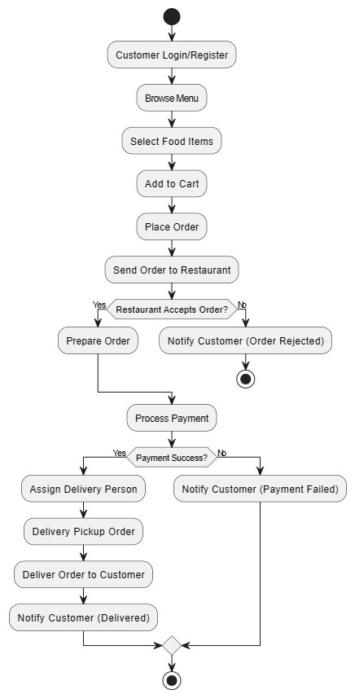
FLOW CHART
6

Slide 7
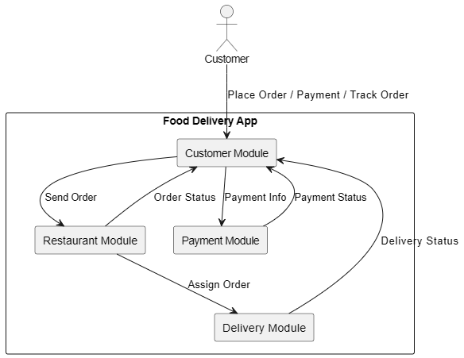
DATA FLOW DIAGRAM
7

Slide 8
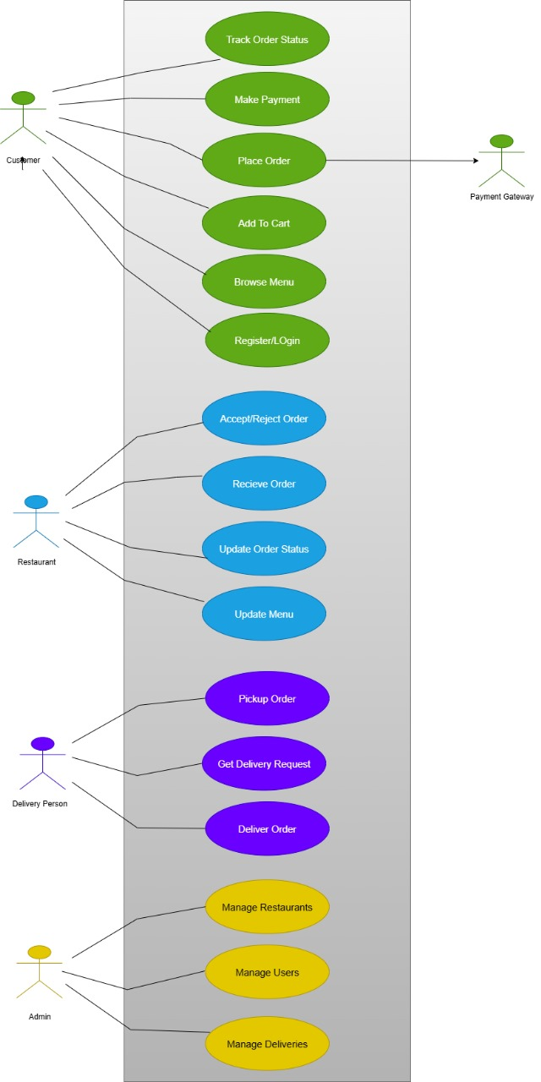
USE CASE DIAGRAM
8

Slide 9
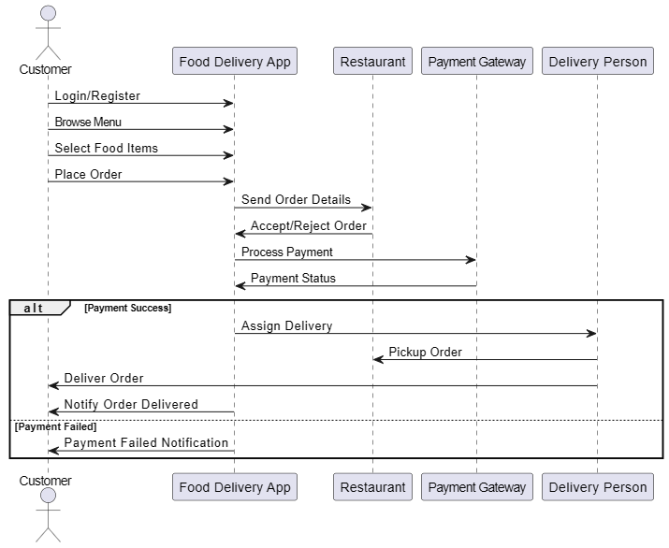
SEQUENTIAL DIAGRAM
9

Slide 10
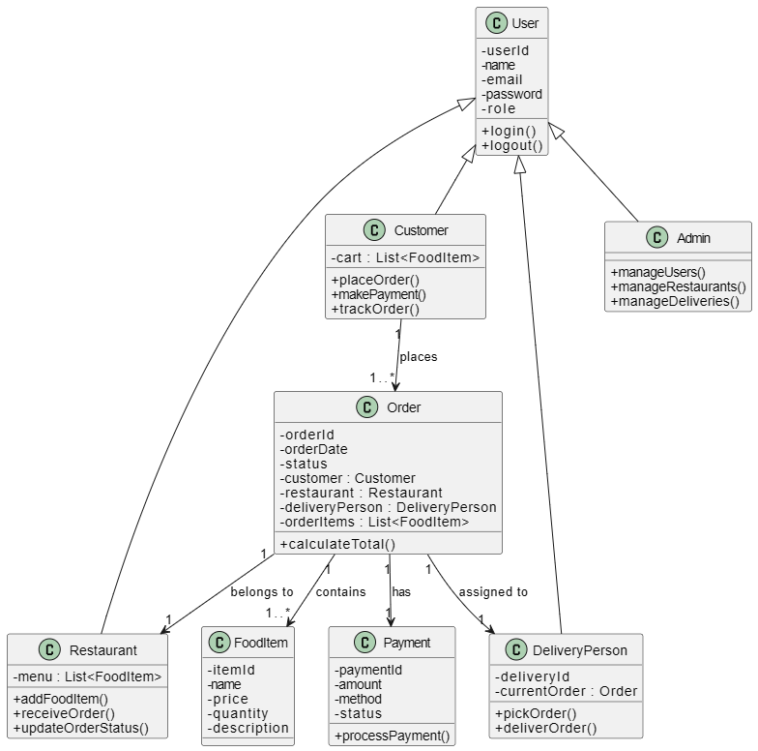
CLASS DIAGRAM
10

Slide 11
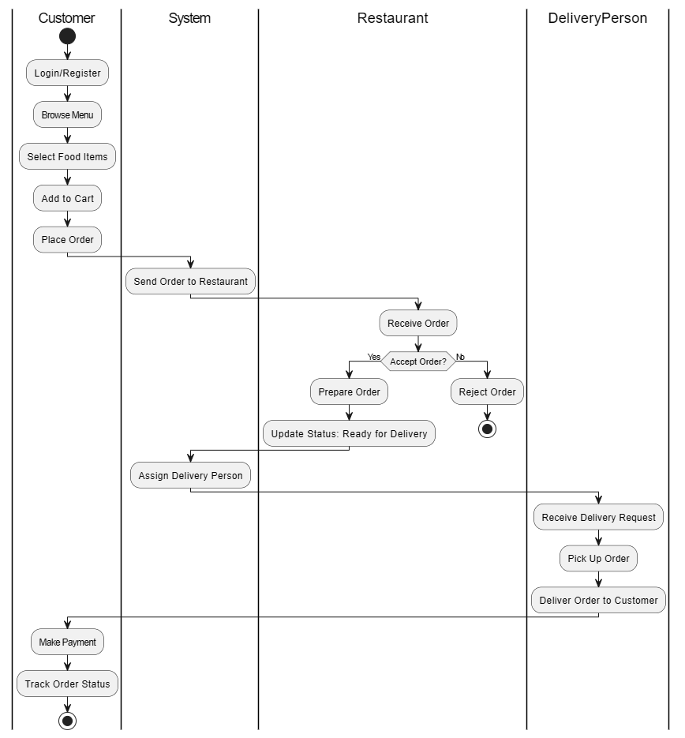
ACTIVITY DIAGRAM
11

Slide 12
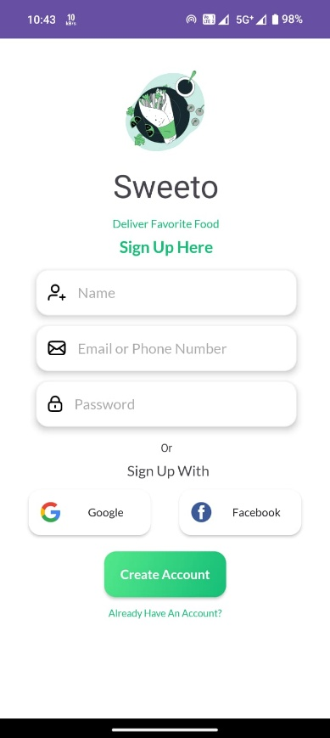
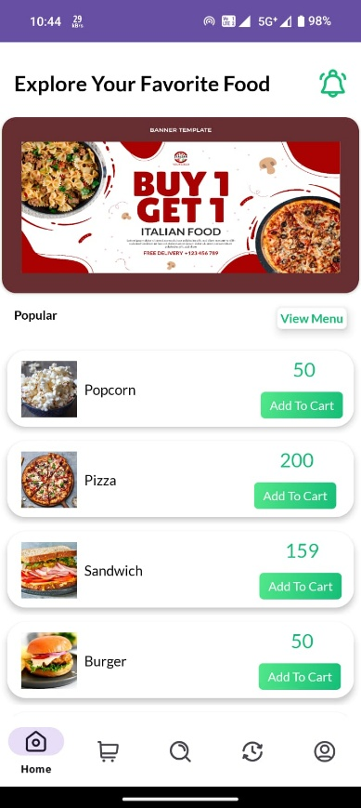
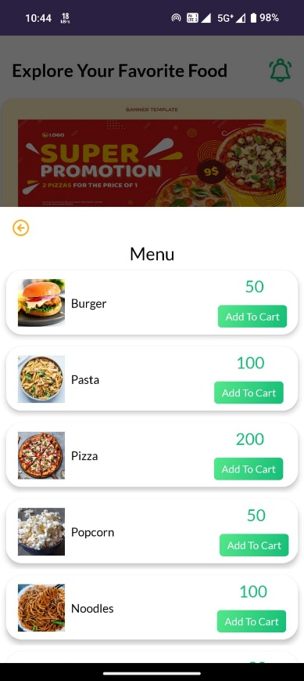
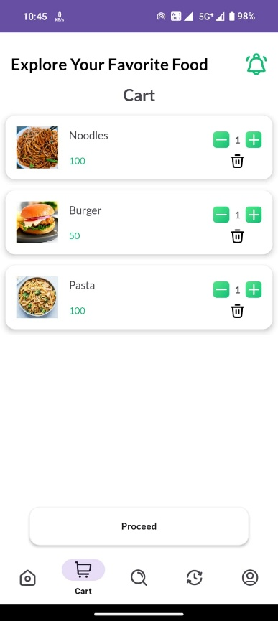
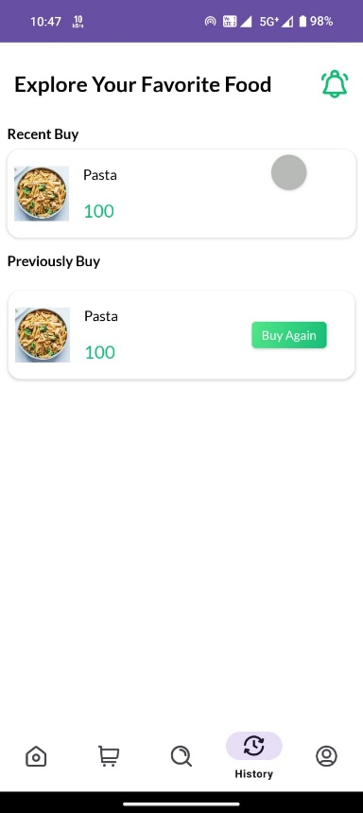
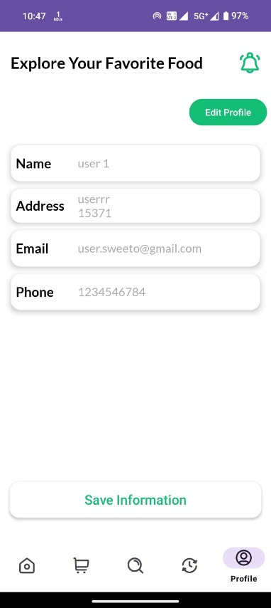
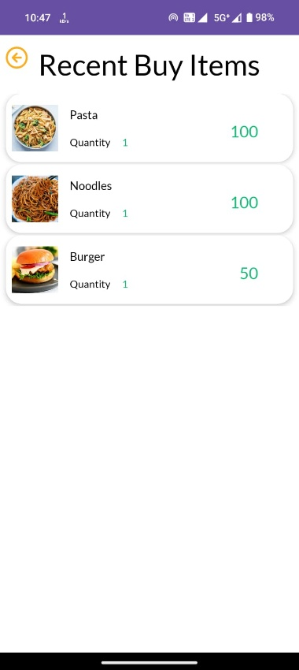
PROJECT DESIGN (USER SIDE)
12
Description :- We can Order Food, Add to Cart, Manage Cart.

Slide 13
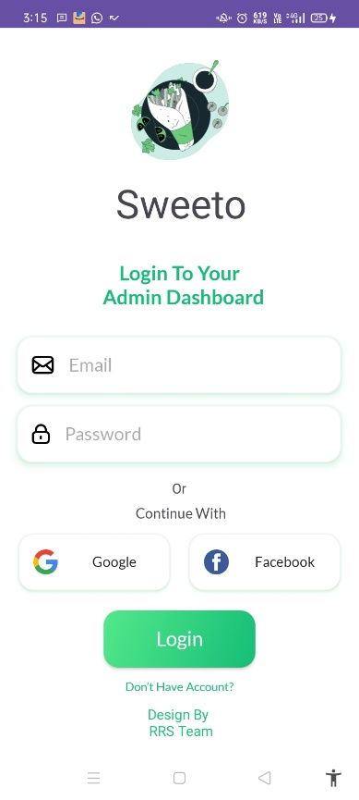
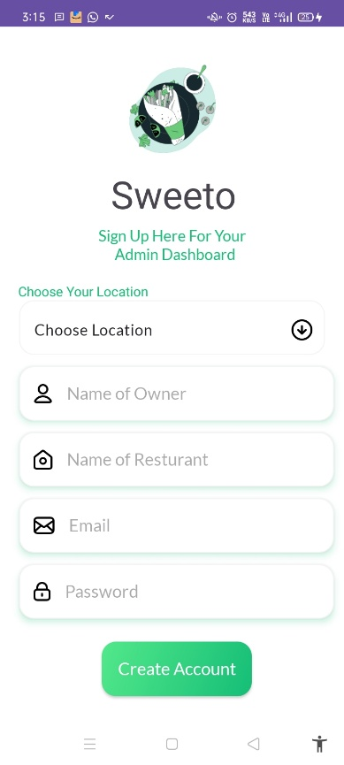
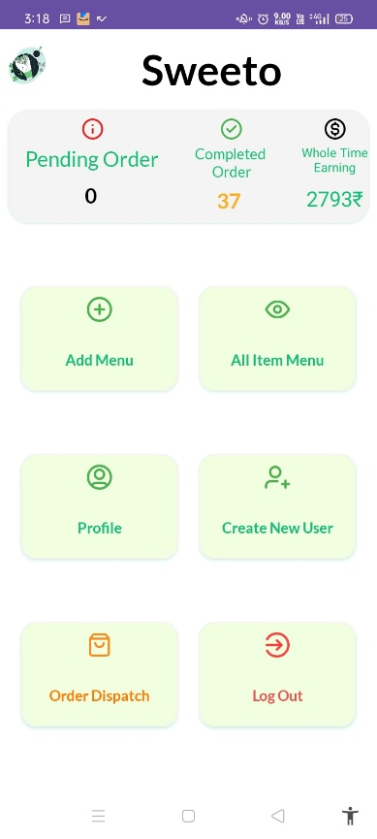
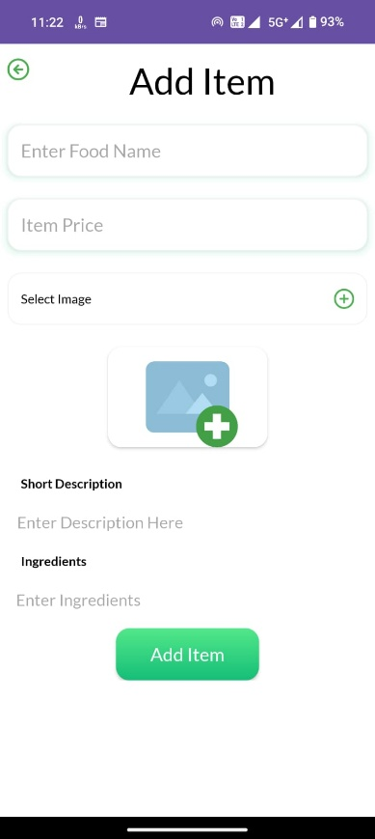
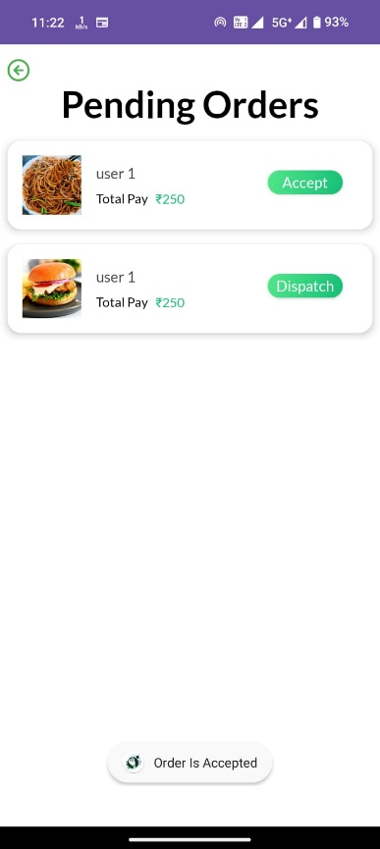
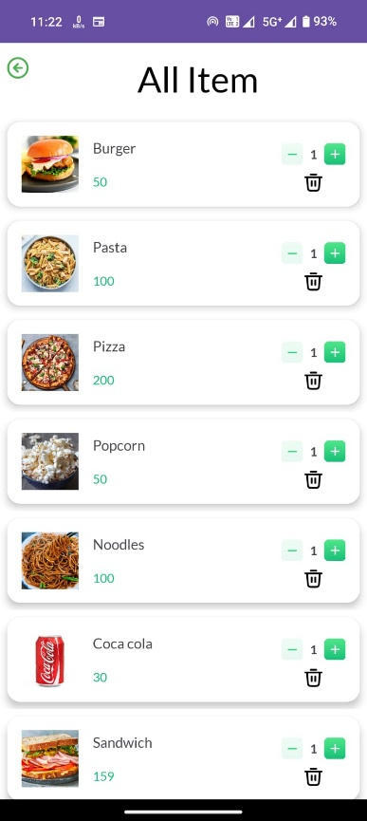
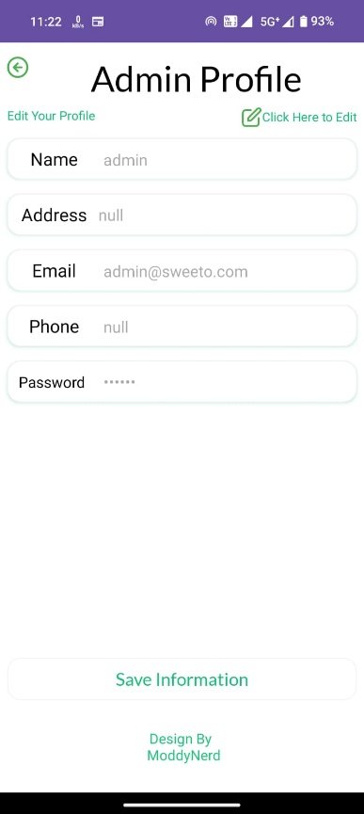
PROJECT DESIGN (ADMIN SIDE)
14
Description :- We can Add Item, Manage Orders, Add User, View Orders.

Slide 14
SYSTEM TESTING
15
1. Functional Testing
Ensures that each function of the software operates in accordance with the requirement like CRUD operations, search medicine and reset fields.
2. Integration Testing
Tests the interaction between different modules like the GUI, database, and backend logic.
3. Validation Testing
Checks whether user inputs are properly validated.
4. Performance Testing
Ensures the system responds quickly and can handle operations efficiently.
5. Usability Testing
Checks whether the application is easy to use for non-technical users.
6. Security Testing
Tests whether data is secure and unauthorized access is prevented.

Slide 15
CONCLUSION
16
The Food Delivery App successfully provides a digital platform that connects customers, restaurants, and delivery personnel in a seamless manner. It simplifies the process of food ordering by offering features like online ordering, secure payment, and real-time delivery tracking. Restaurants benefit from efficient order management, while customers enjoy convenience and transparency.
This project demonstrates how software engineering concepts can be applied to solve real-world problems by integrating user-friendly design, database management, and modular functionality. In conclusion, the Food Delivery App offers an effective, reliable, and scalable solution for modern food ordering and delivery services.

Slide 16
LEARNING DURING PROJECT WORK
17
Working on FOOD DELIVERY APP project. We learning like app development skills in learned how to design and build GUI based applications using Android.
Also we learned how to perform CRUD operations through SQL queries.
We enhanced analytical skill while troubleshooting bugs and logic errors

Slide 17
BIBLIOGRAPHY
18
Online references:
1. www.youtube.com
2. www.geeksforgeeks.org
3. Many Other Websites
Offline references:
Android Programming For Beginners
Android Programming : Pushing the limits

Slide 18
19
THANK YOU

